Slide 1
Executive Summary
Incident Overview: A phishing attack compromised a senior officer's email for 6 days.
Key Impacts:
- Data exfiltration (licenses, audits)
- Fake emails with malware
- Attempted privilege escalation
Top 3 Risks (DREAD):
- Information Disclosure (7.8)
- Elevation of Privilege (7.8)
- Spoofing (7.0)
Annualized Loss (Before Controls): $1.38M

Slide 2
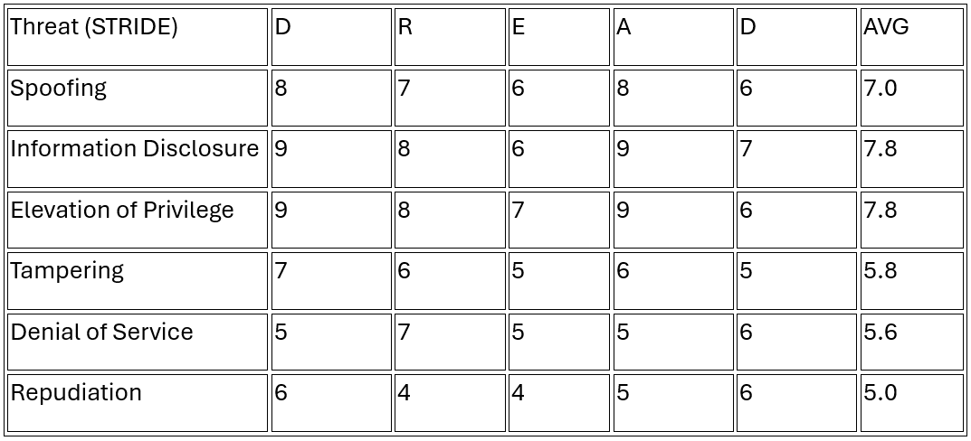
STRIDE/DREAD Threat Modelling

Slide 3
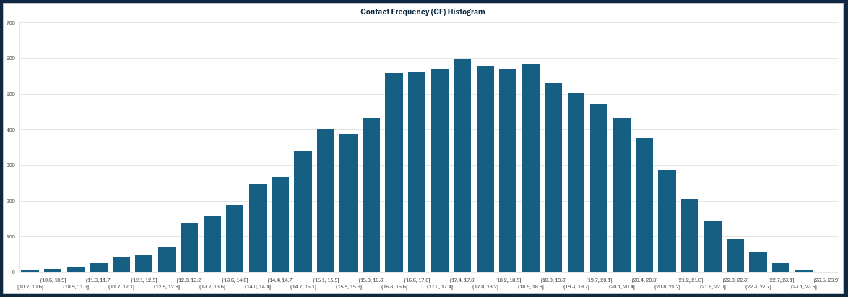
Contact Frequency (CF)
Consistent attacker contact confirms sustained targeting — not random.

Slide 4
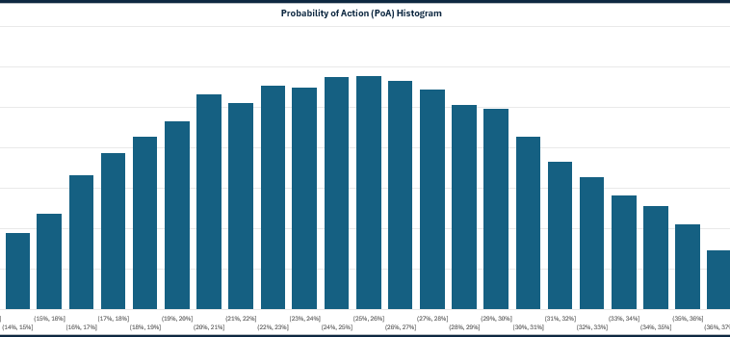
Probability of Action (PoA)
Even trained users still click: simulation shows PoA ~19%.
Explain PoA ≠ exploit success — it means user error window.
Notes:
“The attacker used real officer names and license references — this personalized lure increased PoA despite training.”

Slide 5
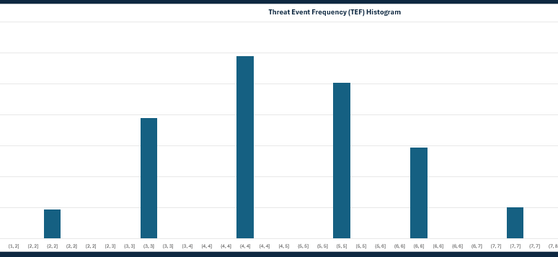
TEF & LEF Histogram
A threat event becomes a loss event when resistance fails — in this case, that happened fast due to low MFA usage and weak filters.
Notes:
Link TEF = CF × PoA → Show how those two variables fuel the actual threat events.
Clarify LEF = how often a loss occurs, not just contact.

Slide 6
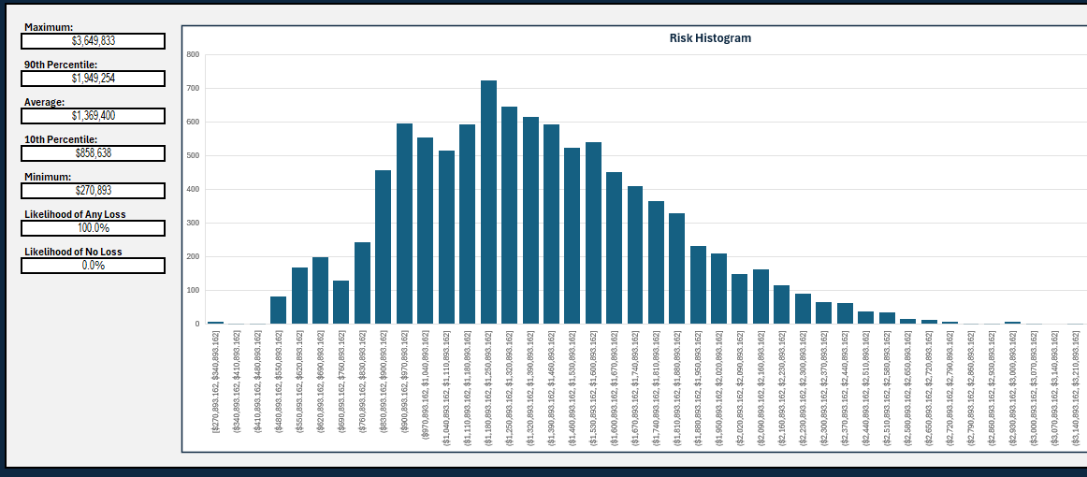
Loss Magnitude & Risk

Slide 7
Actionable Recommendations
Controls and Impact:
- Mandatory MFA: ↓ PoA, ↓ TEF
- Email System + SIEM: ↑ RS, ↓ LM
- Phishing Training: ↓ PoA
- Real-Time Alerting: ↓ SLEF, ↓ LM
- Incident Response Drills: ↓ PL
Estimated Cost: $190,000

Slide 8
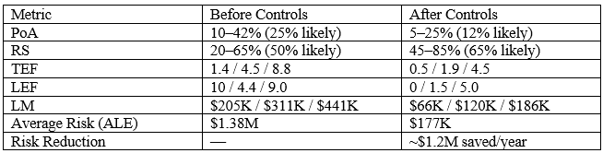
Risk Comparison (Before/After Controls)

Slide 9

FAIR Methodology – Strengths & Limitations
Strengths:
- Quantitative, risk-focused
- Monte Carlo modeling → realistic ranges
- Decision-support tool
Limitations:
- Time-intensive
- Needs subject matter estimates
- Relies on FAIR-U simulation assumptions

Slide 10
Any questions?

