Slide 1



Security
Prepared by: Farouq Hassan
Prepared for: Safaa Hrize

Slide 2
The potential impact of incorrect configuration of network security devices on IT security
Firewall: allow unauthorized access to the network and that maybe will lead to the data and the open ones can increase the number of the attacks and create security vulnerability
VPN: used un crypto VPN and opened that can expose sensitive data and make it easer for the attackers and steal the logins and sensitive information from their way

Slide 3
how implementing different techniques in network security can improve network security?
DMZ: it can control the traffic flow by placing the firewall between it and the internal network, and it can help to protect the company from the direct attacks
static IP: it can make it more difficult for the attackers to prob and scan the network without changing the IP which makes it harder for the attackers to target them.
NAT: it can improve security by not letting the attackers join the internal network and hide the IP in the system company from the public internet, and that make it more difficult for the attackers to target them

Slide 4
benefits of applying network monitoring system
Fix issues faster: it helps for solving problems faster and in easier way, and help to get the issues all in one time, from the performance of the devices and origin the problems
Identify security threats: it looks like what is the “normal” performance in the company, and that’s helps with the attacks and spot anything not usual or normal, that’s make you able to take a proactive approach after that or at the same time.
Justify equipment upgrade: its not enough for the most bosses to upgrade or to confirm on it without something physical, but with a historic insight with the performed of every equipment make more compelling.

Slide 5
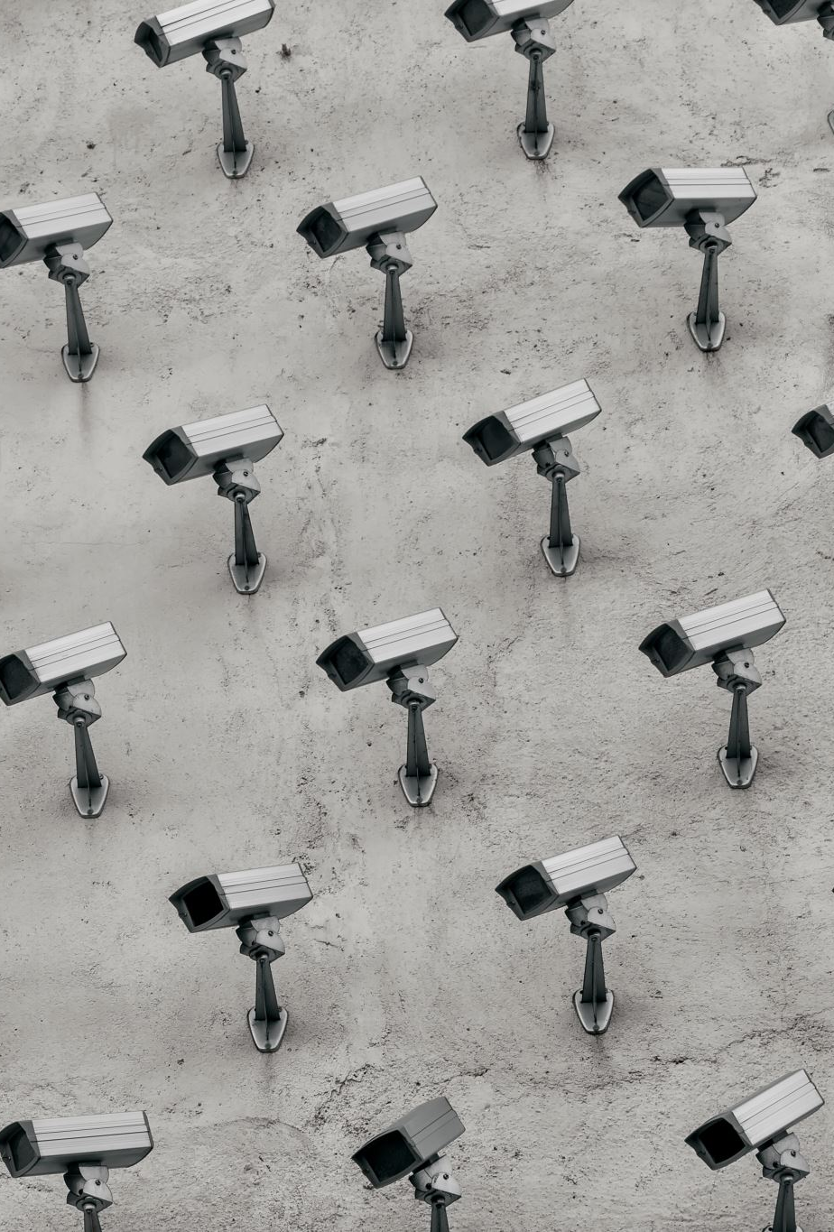
how can Warmaksan benefit from physical security measure ?
CCTV: to record the activity with a full facility and that’s help for surveillance on the company and on the physical ones and the employee’s safety, by know all who get in and leave Warmaksan.

Slide 6

how can Warmaksan benefit from virtual security measure?
VPN: Warmaksan can benefit from it by secure remote access by encrypt the data and information going out that’s help to protect against unauthorized access and allows the employees to access the network on it

Slide 7

Thank you for paying attention

