Slide 1

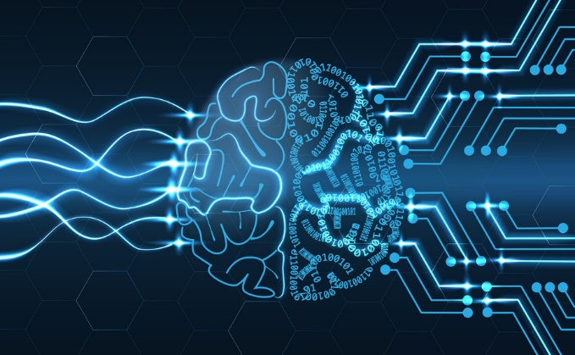
Breast cancer Diognostics
using Neural Network
Realised by :
- Benarous Ahmed Omar Farouq
Teacher :
Pedro João Soares Rodrigues
College year: 2018/2019

Slide 2
Presentation plan
I ) Introduction
II ) Used tools
III ) Implemantion
IV ) Conclusion

Slide 3
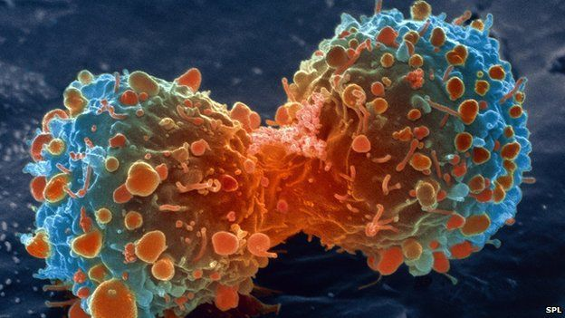
Introduction

Slide 4
What Is Cancer ?
* World Health Organization has cosidred Cancer as The worst deasease in humankind history
* It Has no Efficient Treatment
* Any Cell in our body can Randomly be a Cancer Cell
* So as an Alternative way is To Prevent this Transformation of cells (Prediction)

Slide 5
Artificial Intelligence
* AI Porbably its the greatest invention in the history
of humankind
Advantages
Disadvantages
*Create New jobs
* Job Losses : robots have already taken many jobs
on the assembly line
*Solve Gloval Warming
*Solve Diseases
* Devil Of IA Senario of AI Apocalypse
* Poverty
* Improve HelathCare
* Give us A better life

Slide 6
Used tools

Slide 7
Neural Network
* The First hear of neural network was in 1943 by
Warren McCulloch and Walter Pitts
* Artificial neural networks (ANN) is a computation
ML model
* The most Popular Machine Learning Model
* Types Neural Network : Perceptron , Deep Feed Forward Feed forward , Radial Basis Network’

Slide 8
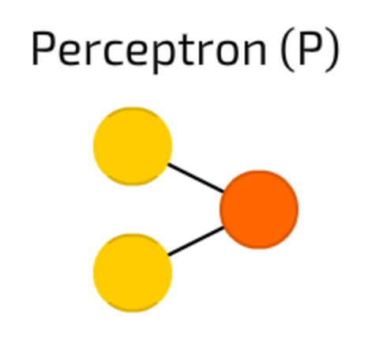
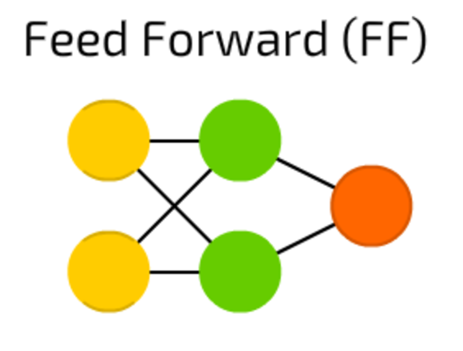
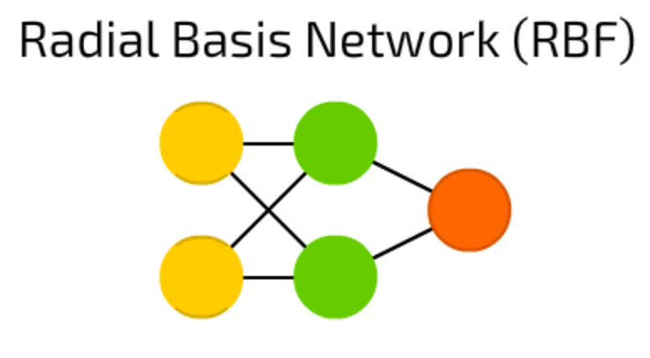
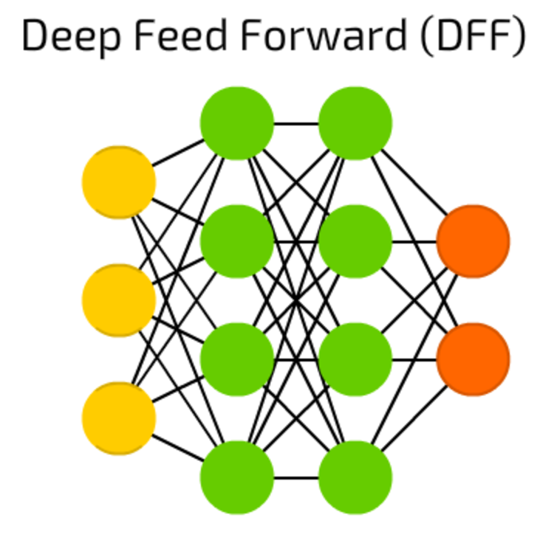
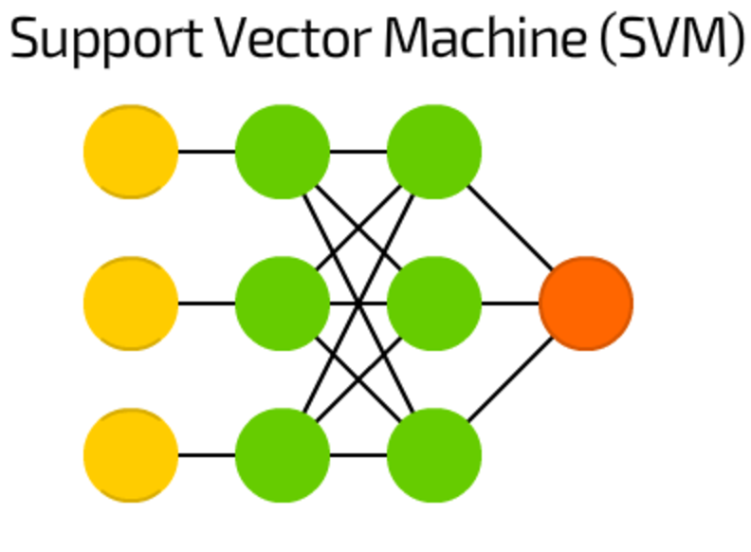
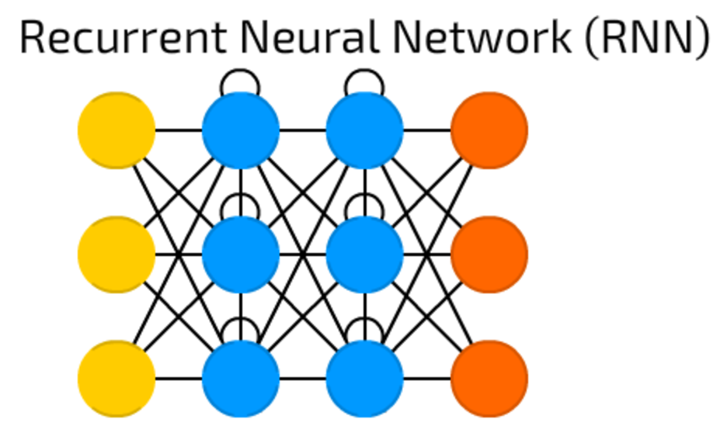

Slide 9
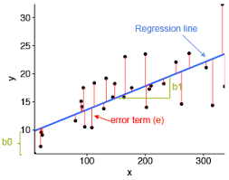
How Neural Network Woks ?
House Price
Area
Y = aX + b

Slide 10
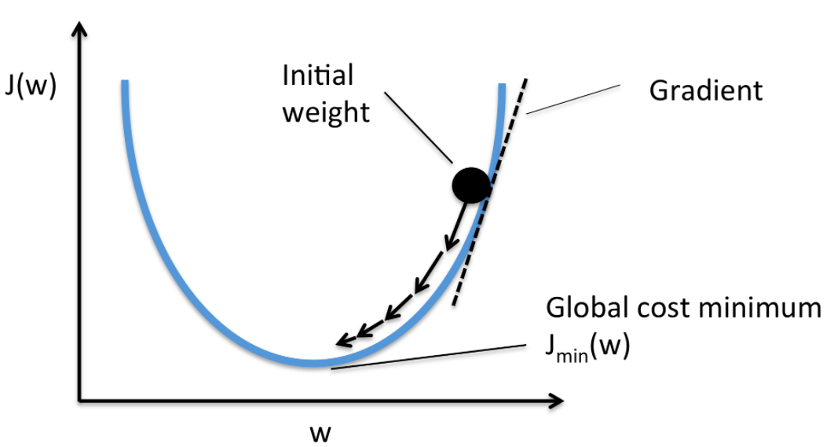
We Have To Calculate Cost Function
Y = a X + b

Slide 11
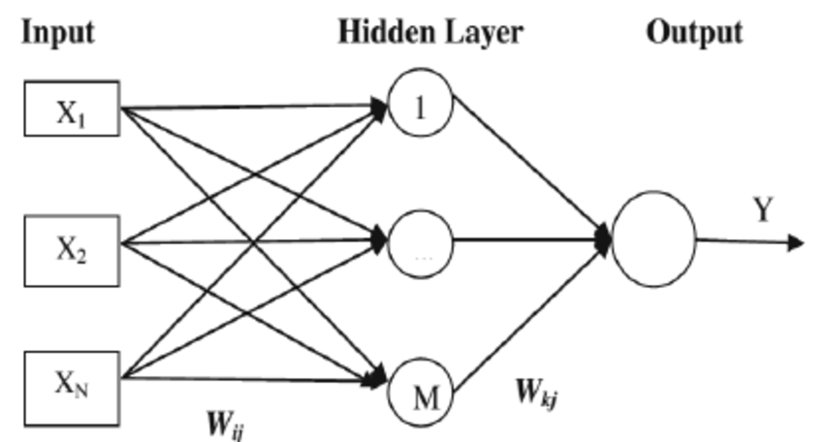

Slide 12
Implemantion

Slide 13
dimension
fractl
Sigmoid
1
symmetry
Sigmoid
Benign
OutPut
points
Sigmoid
Melignant
0
concave
Sigmoid
concavity
compactness
smoothness

Slide 14
Conclusion
Recommended Courses For Machine learning ?
Wich Programming Language Should I pick For ML ?
Latest Paper Of Artificial Intelligence :
residual network , Neural Differential Equations ,
DeepMind AlphaFold

Slide 15
Q & A

Slide 16
Thank you
For
Your Attention

