Slide 1
Neural correlates of certainty during movement time
The mouse can't tell us how sure it is, so we're asking its movements instead.
Farah Abulkhair · Larkum lab rotation
Notes:
Everyone here has had the experience of getting an answer right and KNOWING you got it right — versus getting it right but feeling like you basically flipped a coin. That feeling of certainty is metacognition, and in humans we just ask 'how sure were you?' The problem is our animals can't answer that. So this whole talk is a backdoor: the mouse tells us how sure it is whether it wants to or not — through how it moves.

Slide 2
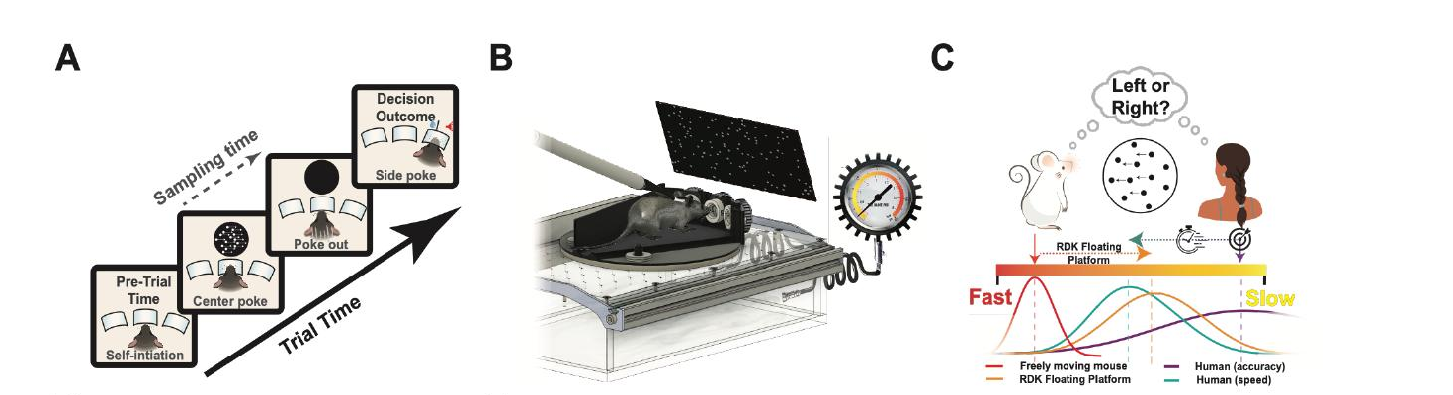
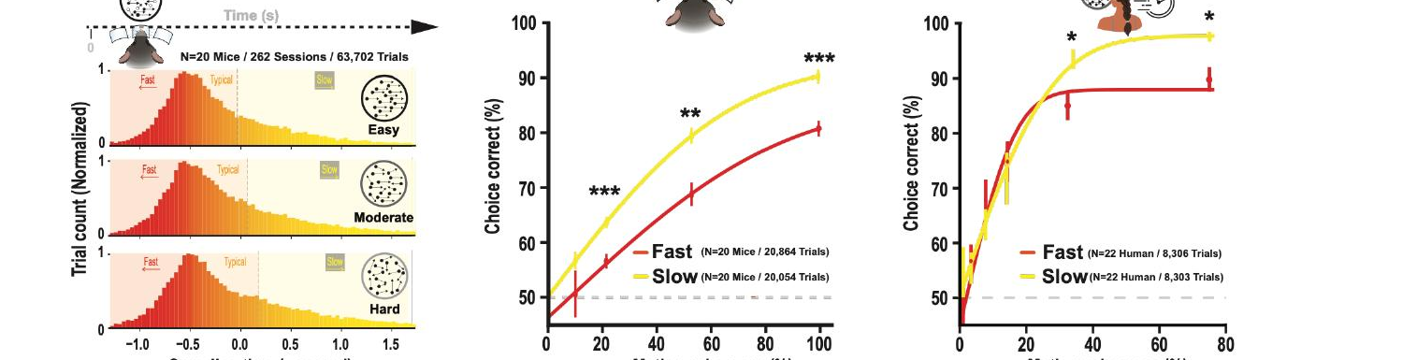
Fast & Slow: what sampling strategy do mice use?
INTRO
Figures adapted from Nashaat et al., Neuron — Fig 1
Free to choose when to commit, mice sample longer on hard trials — landing near the reward-optimal amount of evidence
1
Notes:
This project sits on top of the Fast & Slow paper. The task is a random-dot motion task: a cloud of dots drifts left or right, coherence sets the difficulty, and the mouse reports the direction (top row — the nose-poke floating platform). The twist is the mouse controls its own sampling time. The bottom row shows the strategy: sampling-time distributions run from fast to slow, and slow, more-deliberate sampling buys higher accuracy. The question the paper answered was whether that self-paced strategy is near-optimal — and it is: mice spend more time on hard trials, landing close to the reward-rate optimum. Hold onto that idea — time titrated against difficulty — because we do the same at the other end of the trial.

Slide 3
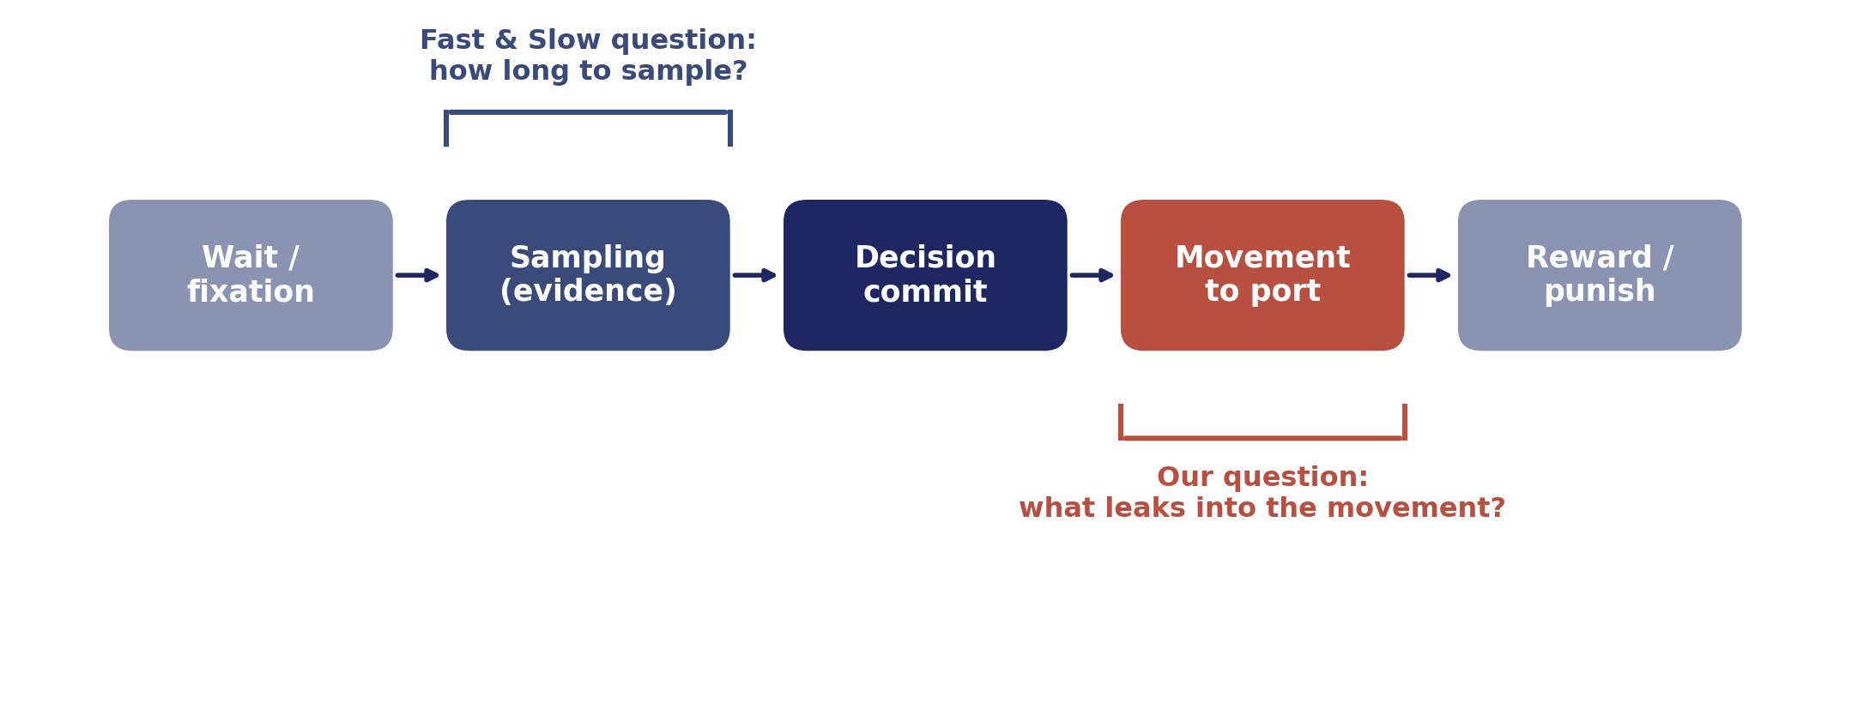
Same trial, a different question
INTRO
Fast & Slow studied evidence-gathering BEFORE the choice. We ask what the movement reveals AFTER it.
Same logic — time as a window into an internal state — moved from sampling to the movement
2
Notes:
Here's the shift. The Fast & Slow paper studied everything up to commitment — the evidence-gathering. Once the mouse commits and starts moving to the port, that was basically treated as 'the trial is over, it's just motor execution.' Our bet is that it's NOT just motor execution — the decision leaves a fingerprint on the movement. So we take the same logic — time as a readout of an internal state — and apply it to the movement instead of the sampling.

Slide 4
Can we use movement time as a proxy for the animal's confidence?
INTRO
METACOGNITION
METAMOTOR
You just answered a hard question. Before anyone tells you if you're right, you already have a hunch — 'nailed it' or 'total guess.' That private read on your own accuracy is metacognition.
That hunch changes your body. Sure → you commit fast and smooth. Unsure → you hesitate, drift, second-guess mid-reach. When confidence bends the movement, that's metamotor.
If the mouse's confidence bends its movement the same way, movement time becomes a window into certainty
3
Notes:
The question in one sentence — up on the slide. Two words. Metacognition is your private read on your own decision, before any feedback — 'I nailed that' or 'I'm guessing.' Metamotor is that read leaking into your body — the confident, smooth commit versus the hesitant, second-guessing reach. We're asking whether the mouse's run to the port carries that same signature. [MEME #1 optional: 'when you KNOW you know' vs 'when you're just guessing'.]

Slide 5
Humans reveal it in the hand
INTRO
▣ PASTE FIGURE Human reaching trajectories — non-CoM vs CoM PLOS Comput Biol (pcbi.1007149) · paste the two-panel screenshot
On a change-of-mind trial the hand starts toward the wrong target, then curves back — uncertainty made visible
4
Notes:
This has been shown in humans, and it makes the idea concrete. People report the decision by reaching to a target. On the left is a normal trial — a clean committed arc straight to the answer. On the right is a change-of-mind trial: the hand starts toward one option, then curves back and lands on the other. Nobody asked if they changed their mind — the hand said it. The movement leaks the decision process in real time.

Slide 6
Confidence leaves three signatures — our checklist
INTRO
▣ PASTE FIGURE Human CoM signatures (4 panels) less accurate · peaks at low coherence · grows with RT
1
DIFFICULTY more changes of mind on hard (low-coherence) trials
2
ACCURACY change-of-mind (unsure) trials are less accurate
3
HISTORY / TIME more changes of mind on slow, deliberative trials
Difficulty, accuracy, and timing each leave a mark — now we test movement time against the same three
5
Notes:
When you quantify the change-of-mind trials, three signatures fall out — this is our checklist for the rest of the talk. One, DIFFICULTY: changes of mind peak on hard, low-coherence trials. Two, ACCURACY: change-of-mind trials are less accurate — they happen when the person was unsure. Three, HISTORY / TIME: more of them on the slow, deliberative trials. Difficulty, accuracy, timing. Keep these three — every analysis slide tests movement time against one of them.

Slide 7
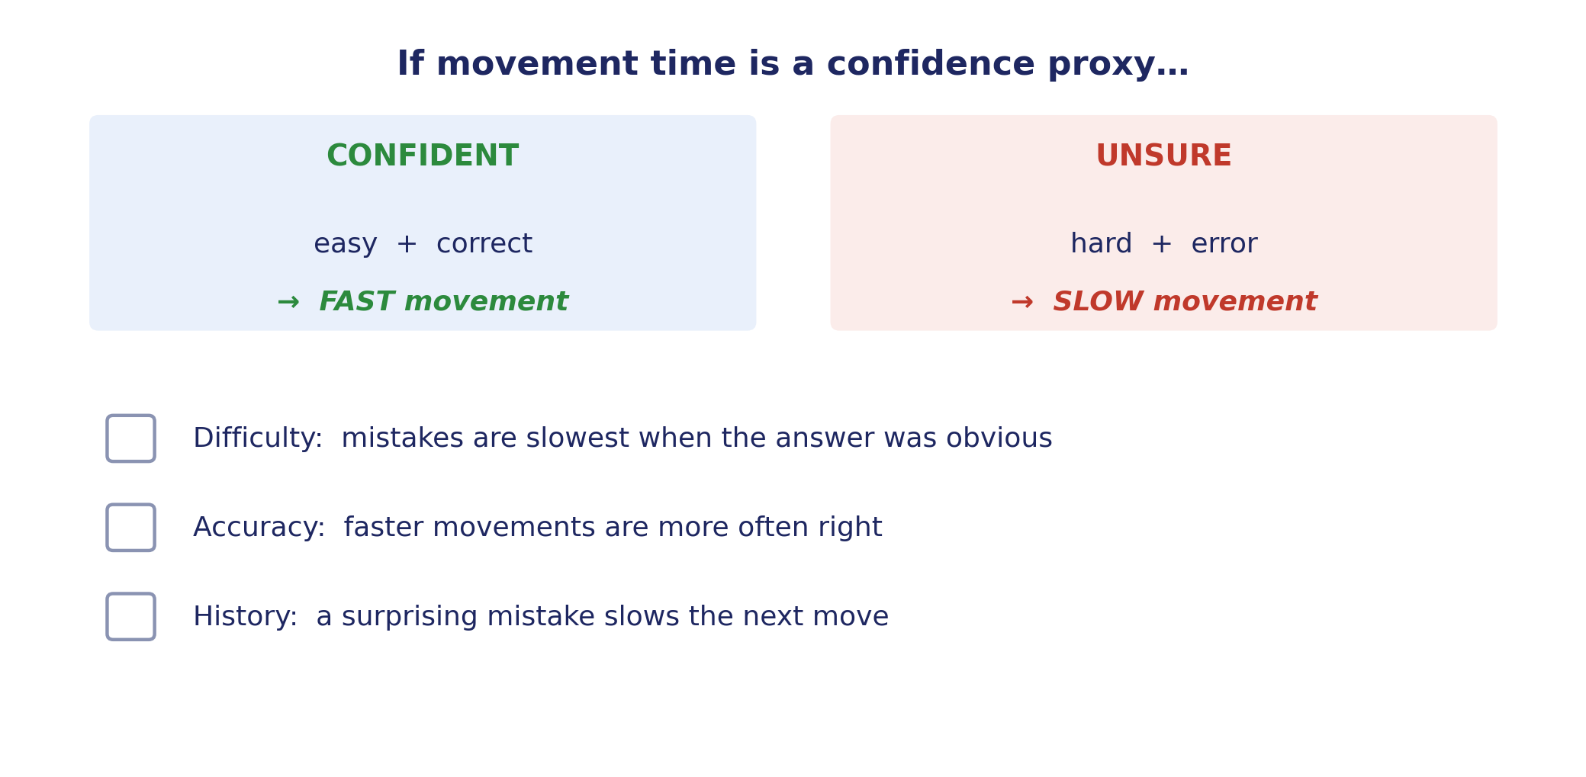
The prediction, before any data
INTRO
Each analysis slide tests one of these three — and if one fails, I'll say so
6
Notes:
Made explicit before I show data, so you can hold me to it. Confidence is high when the trial is easy and correct, low when hard or wrong — fast versus slow movement. So if movement time is a confidence proxy it should show the same three signatures we just saw in humans: DIFFICULTY, ACCURACY, HISTORY. Each analysis slide checks one box. If a box doesn't get checked, I'll tell you.

Slide 8
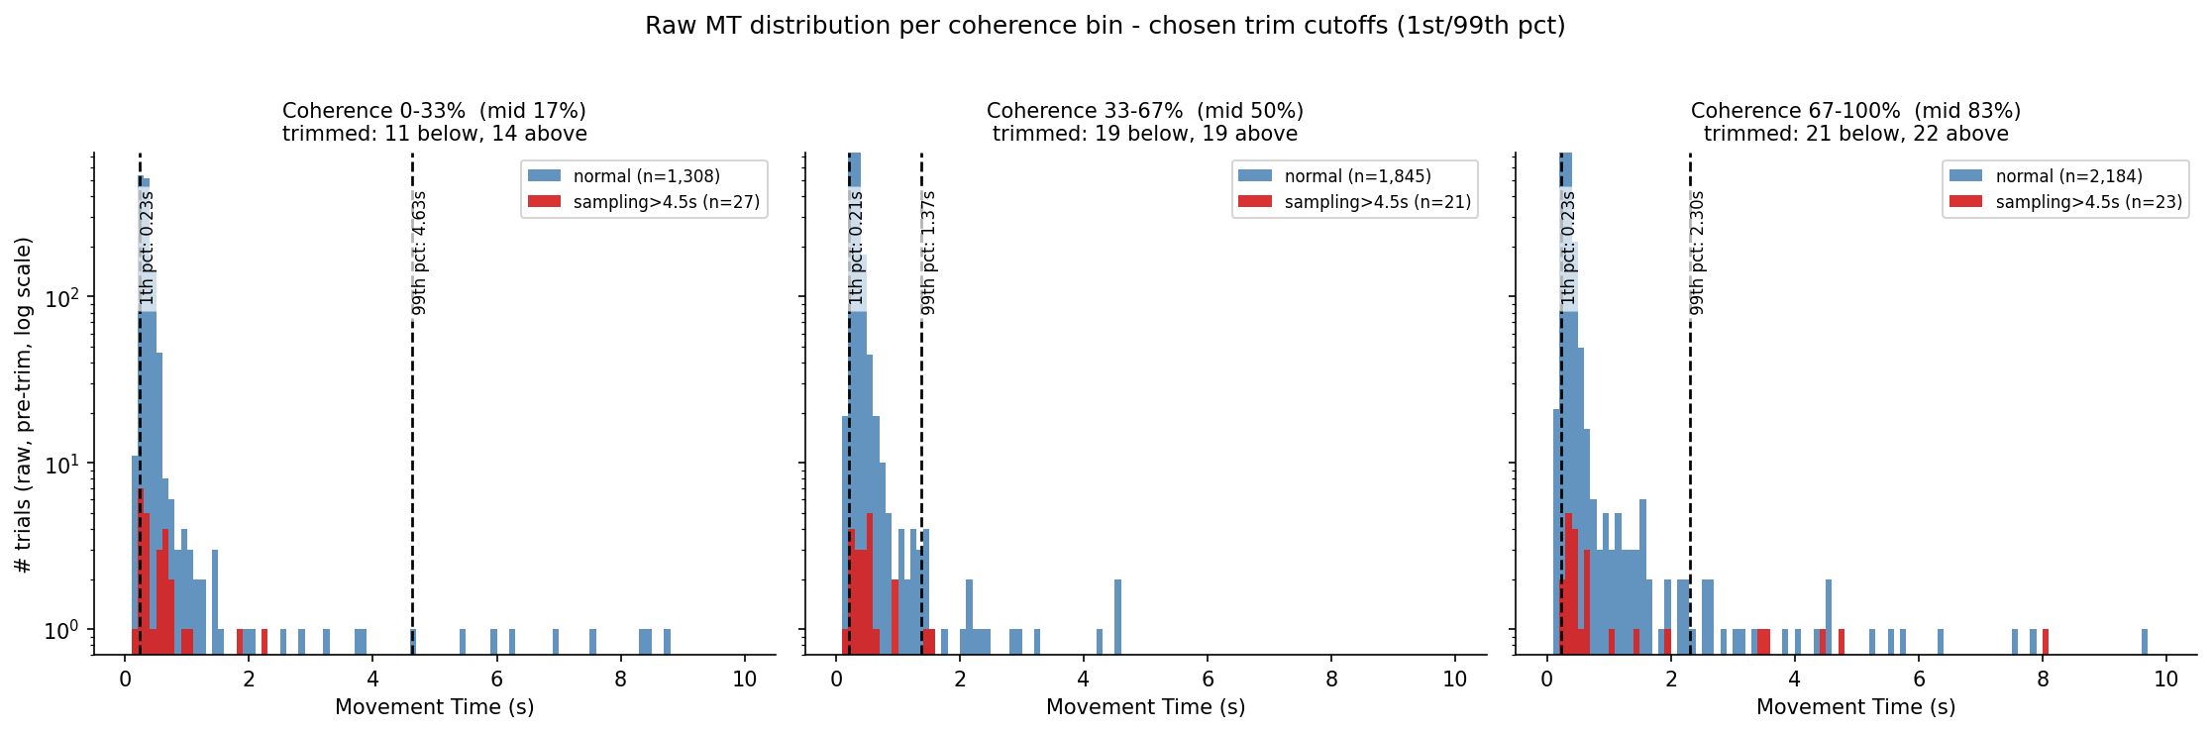
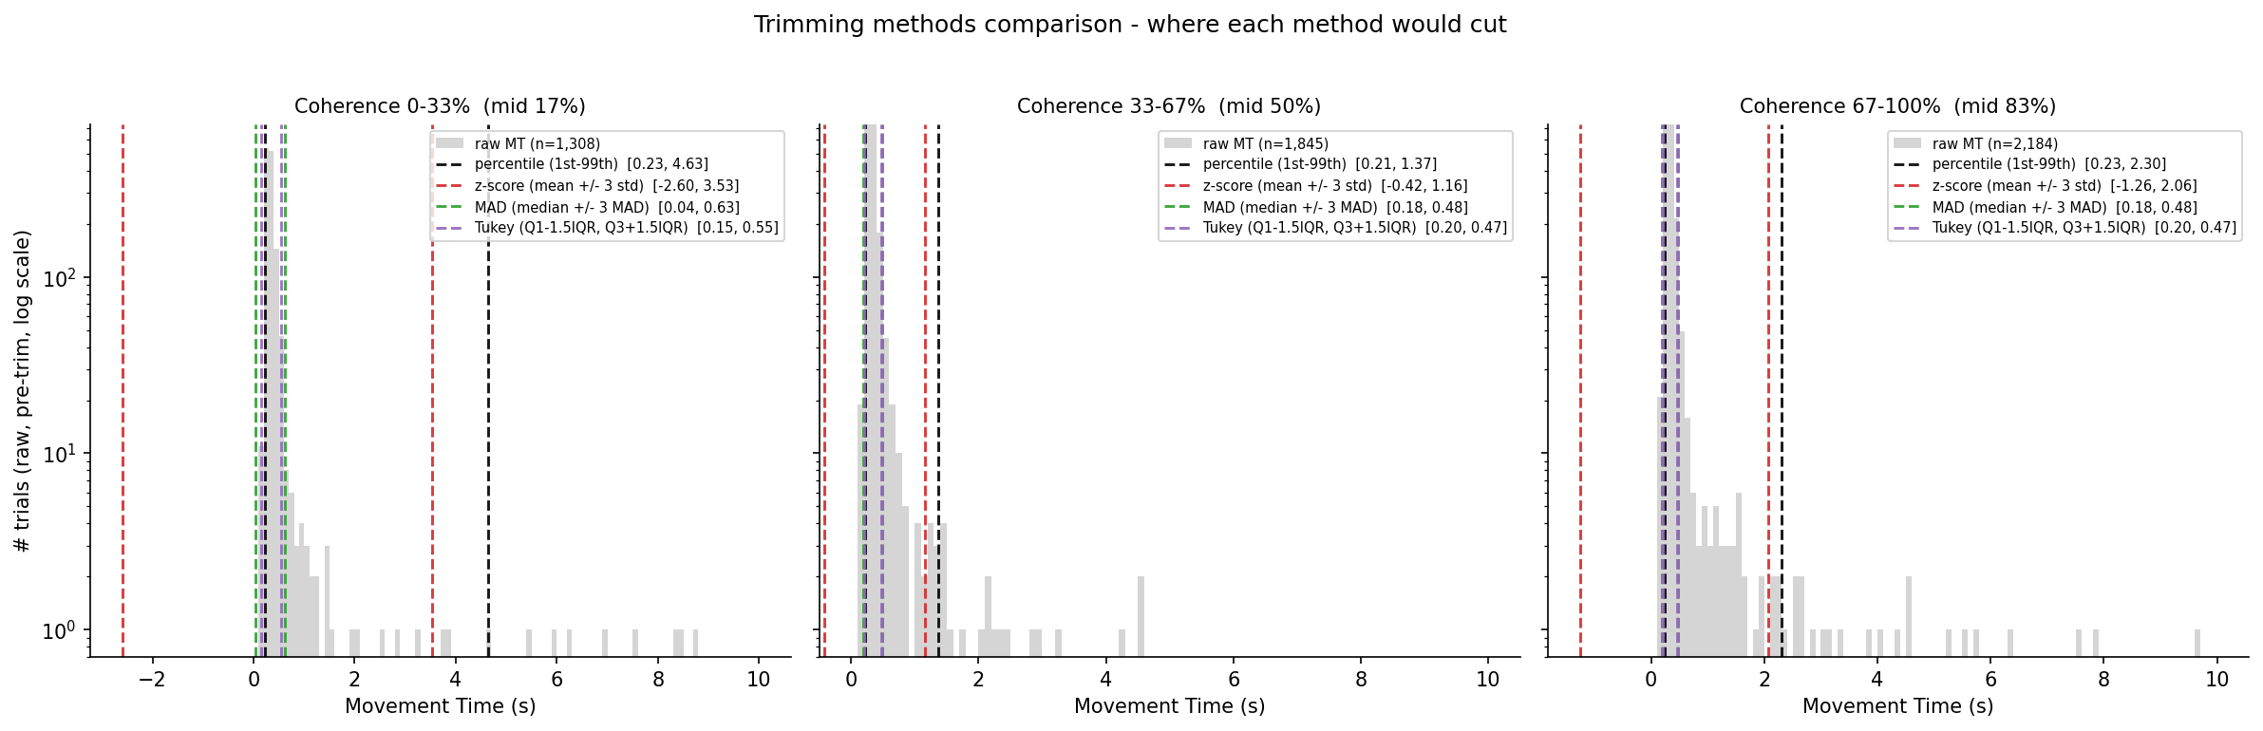
Defining & cleaning movement time
ANALYSIS · method
MT = the 'movement to lateral port' epoch, trimmed at 1st/99th percentile — the effects aren't outlier artifacts
7
Notes:
First, plumbing — the thing you'd ask me anyway. Movement time is the 'movement to lateral port' epoch: from leaving the centre to reaching the choice port. Raw distributions have long tails — trials where the animal disengaged, some 6–10 seconds; those aren't slow decisions, they're the animal stopping the task. So I trim at the 1st and 99th percentile within each difficulty bin, and (bottom) the result doesn't depend on which trimming rule I use. Colour code from here: green correct, red error, blue all.

Slide 9
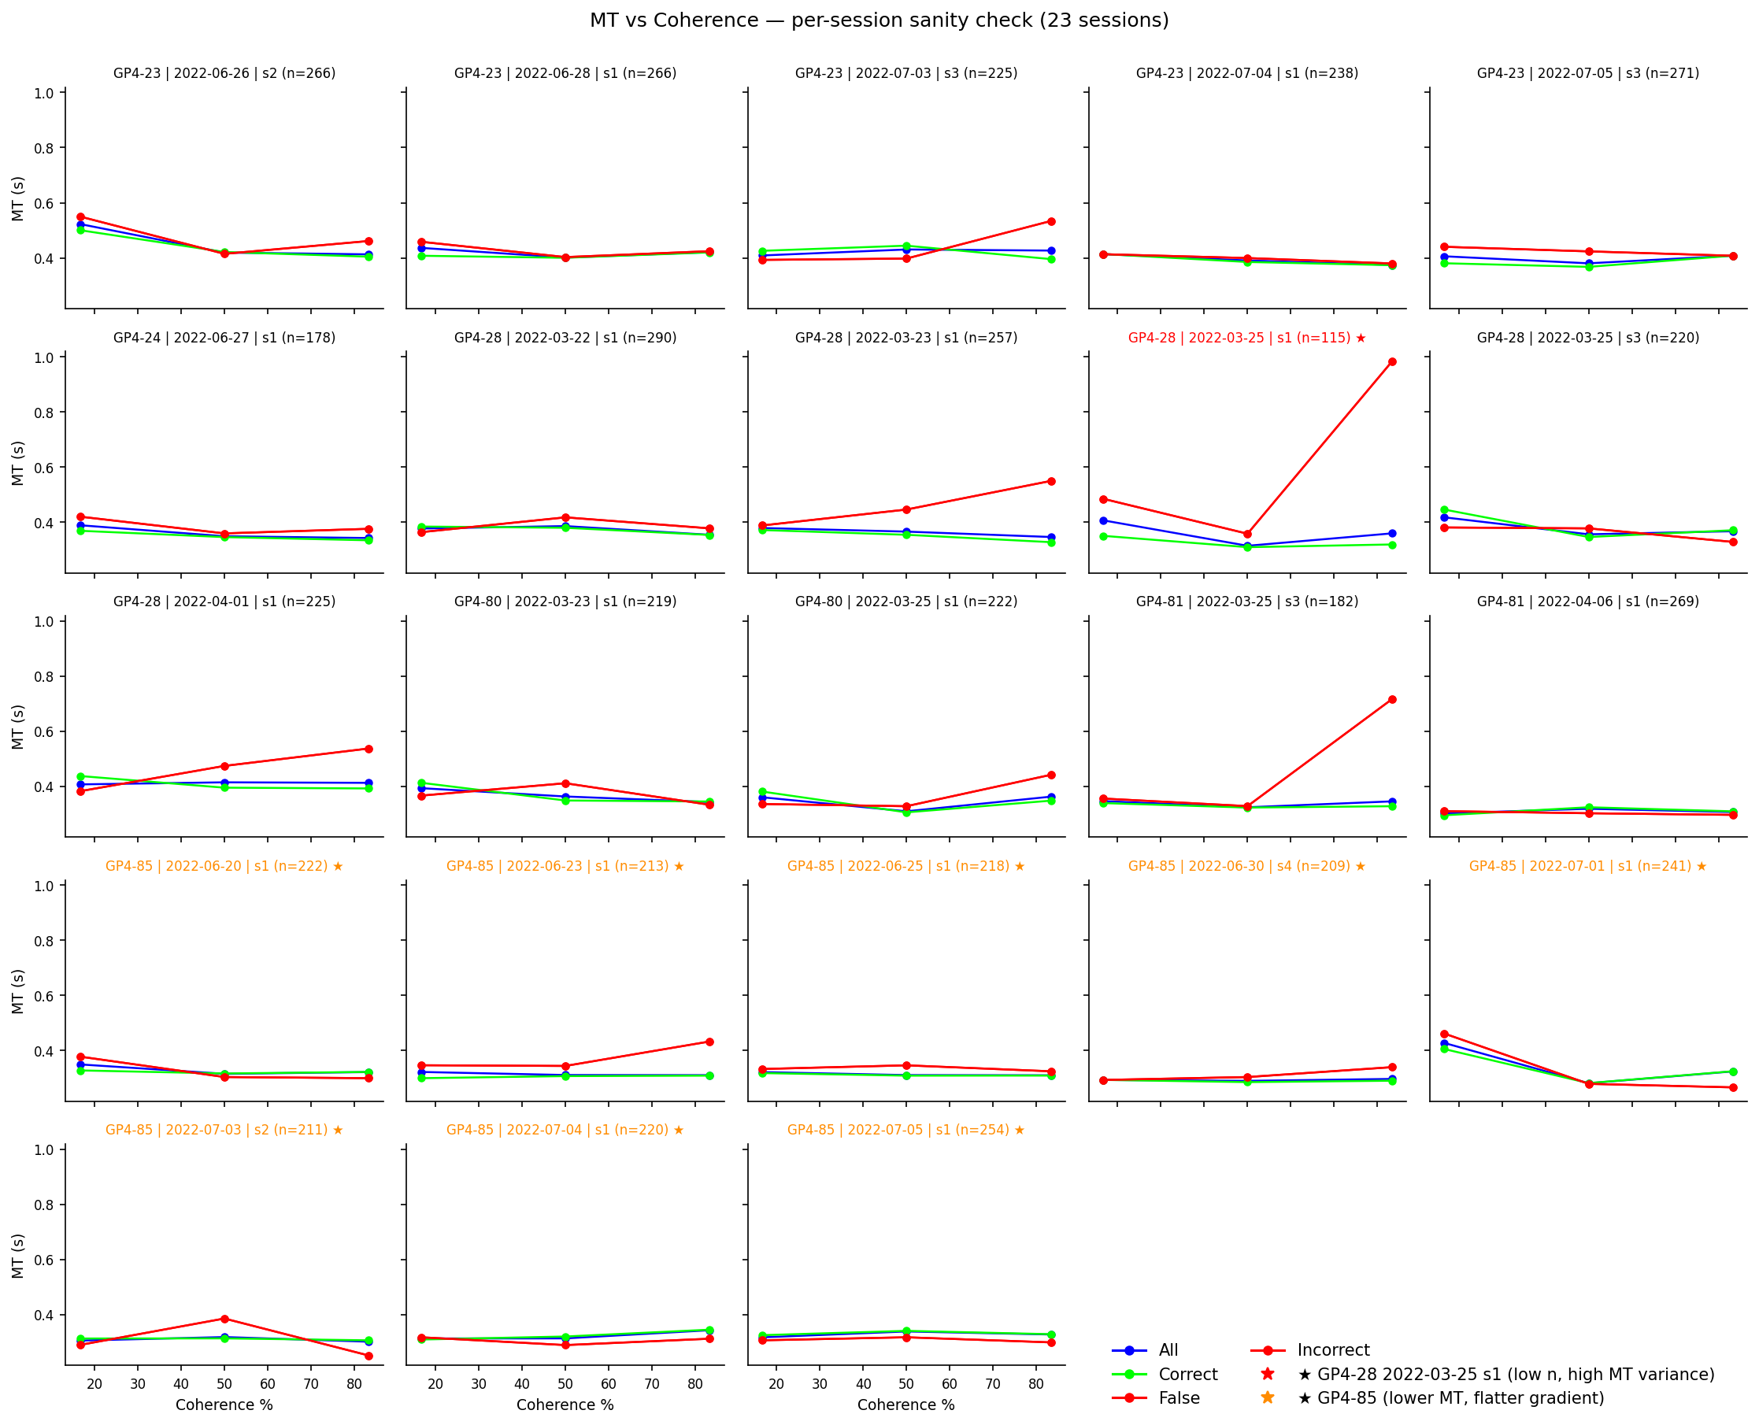
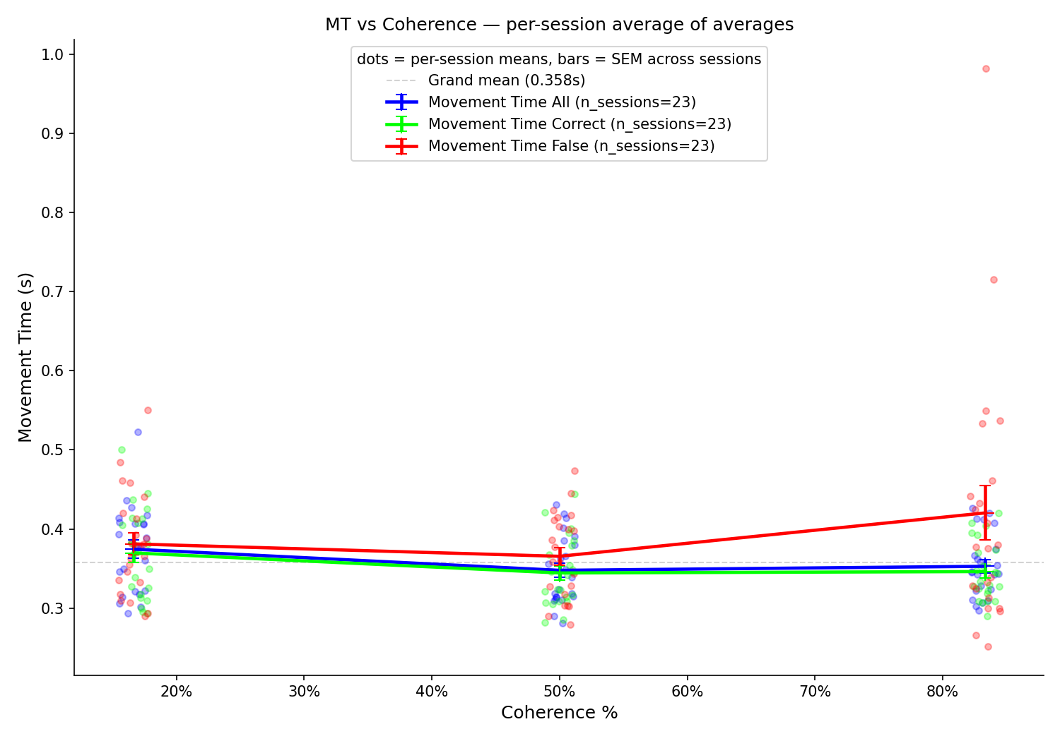
First a sanity check: is the effect there across sessions?
ANALYSIS · robustness
average across sessions (± SEM)
each of 23 sessions individually
Every session, and the 23-session average, show the same shape — errors slow down at high coherence
8
Notes:
Before I interpret anything, is the effect real and consistent? Left: all 23 sessions individually — in most of them the red error line peels upward at high coherence. Two are flagged: one low-trial high-variance session, and animal GP4-85 which is globally faster with a flatter gradient. Right: the average across sessions, with error bars across sessions, shows the same shape cleanly. So it's not one lucky animal — it's the population. Now let's read that shape as our first confidence signature.

Slide 10
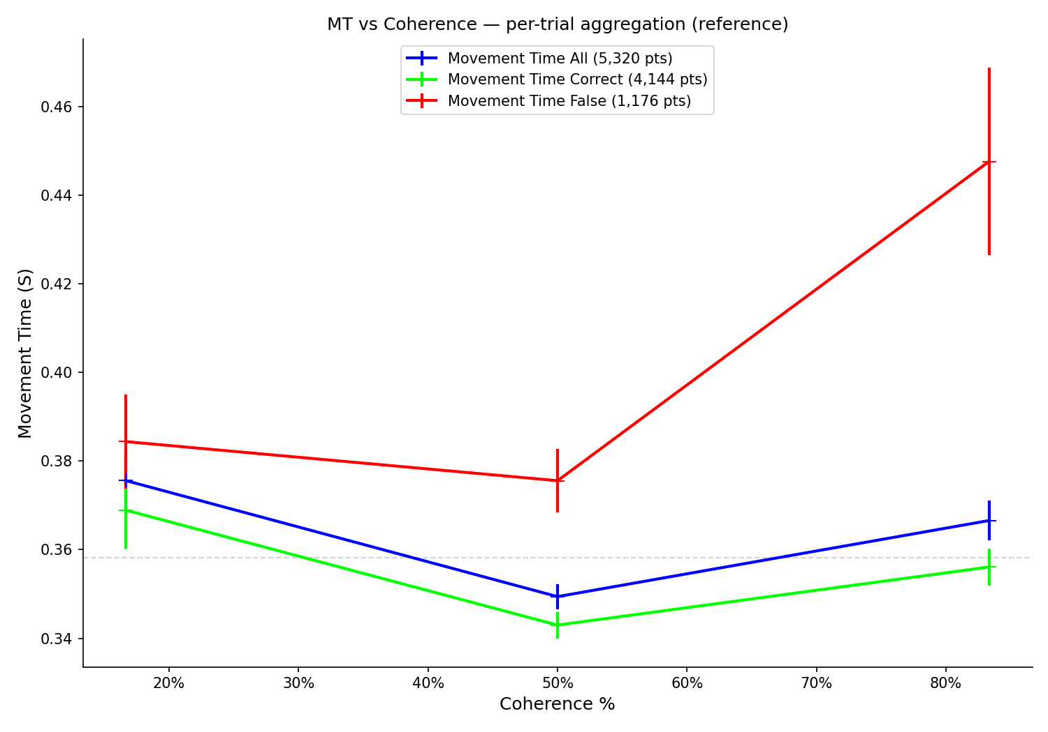
Signature 1 · Difficulty — mistakes are slowest when the answer was obvious
SIGNATURE 1/3
✓ An easy-trial error is exactly where you'd expect a change of mind — and the movement shows it
9
Notes:
Signature one, pooled over all trials for the cleanest view. X-axis coherence (difficulty, easy on the right); Y movement time. Green correct and blue all-trials are basically flat, even dipping as it gets easier. Now the red line, the errors: on easy trials, high coherence, errors are dramatically slower. An error on an easy trial is where the evidence screamed 'left' and the animal went right — exactly the trial you'd expect a wobble or change of mind — and the movement time balloons. That's the DIFFICULTY signature. Box one, checked.

Slide 11
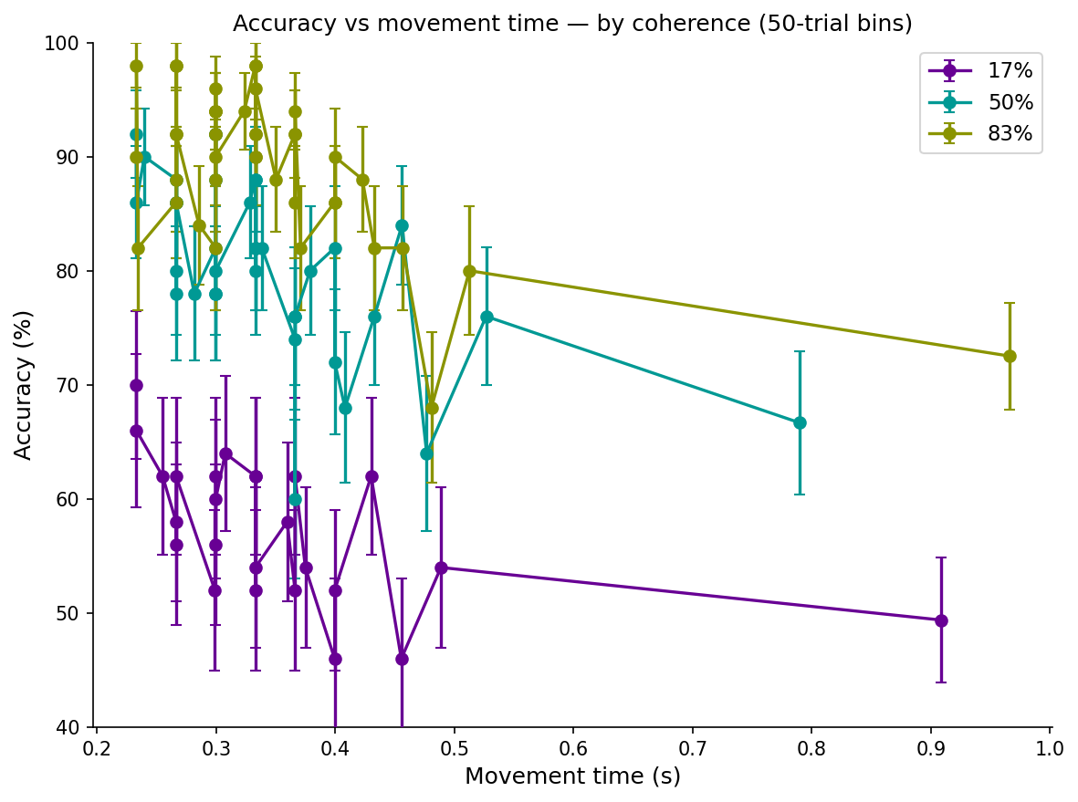
Signature 2 · Accuracy — faster movements are more often right
SIGNATURE 2/3
✓ True within every difficulty level — fast means sure means correct
10
Notes:
The one I'd frame if I had to pick a single slide. Here I bin trials by movement time and ask how accurate they are — three lines, three difficulties. Within EVERY difficulty level, faster movements are more accurate; the lines slope down as MT grows. So it's not just that easy trials are both fast and accurate — even holding difficulty fixed, when the animal moves fast it's more likely right. Exactly what 'movement time reads out confidence' predicts. Box two, checked.

Slide 12
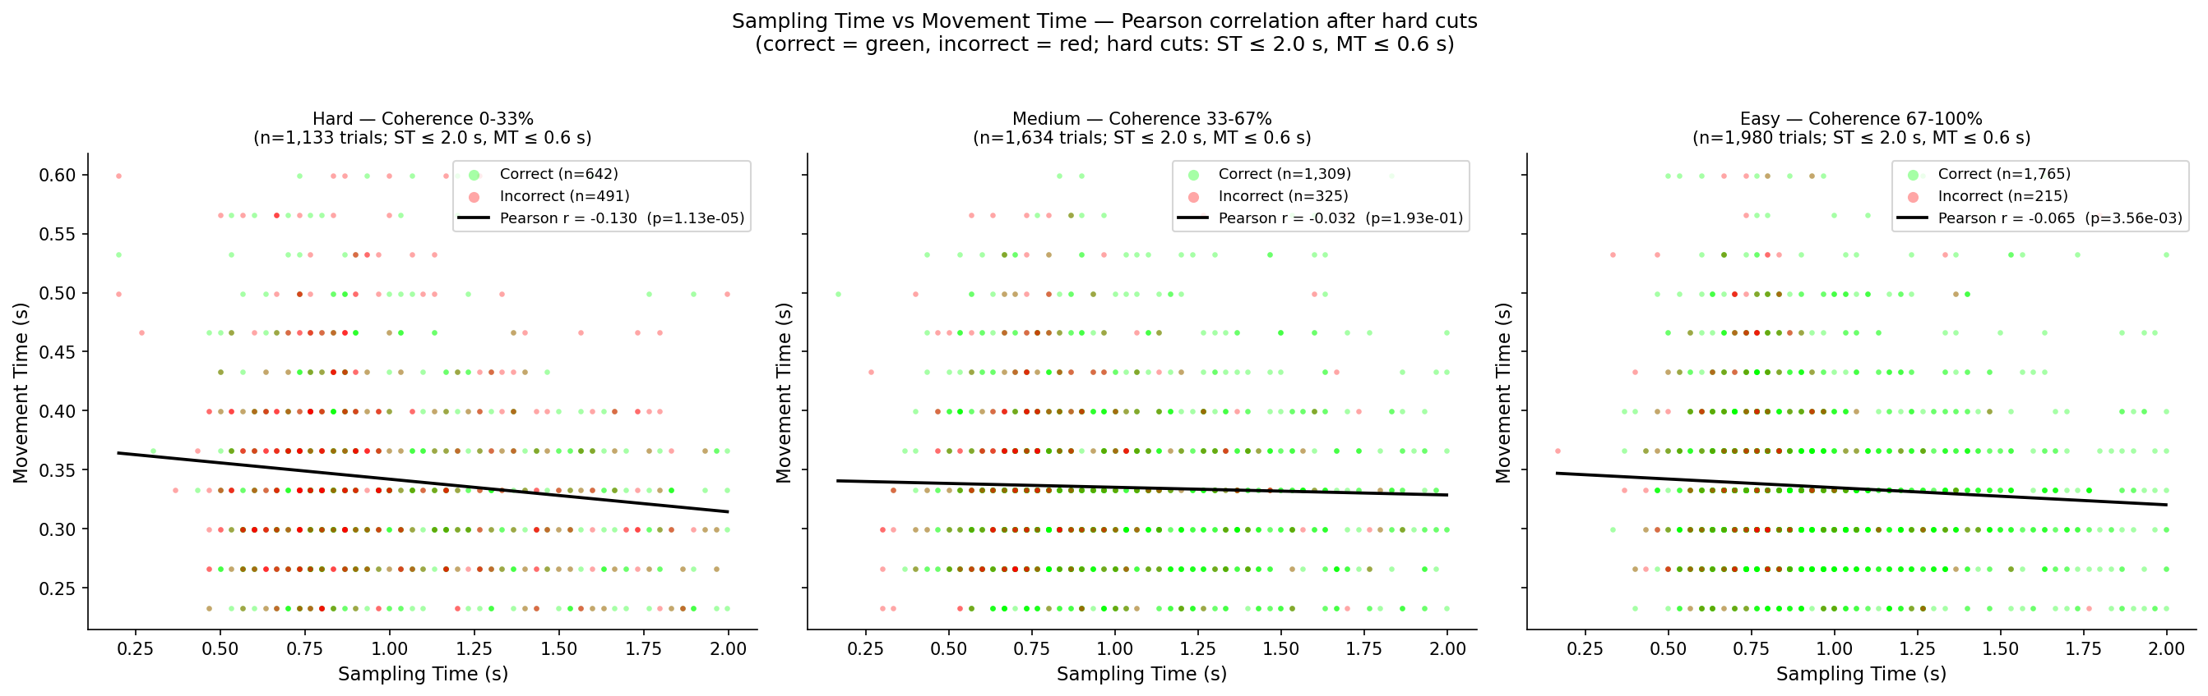
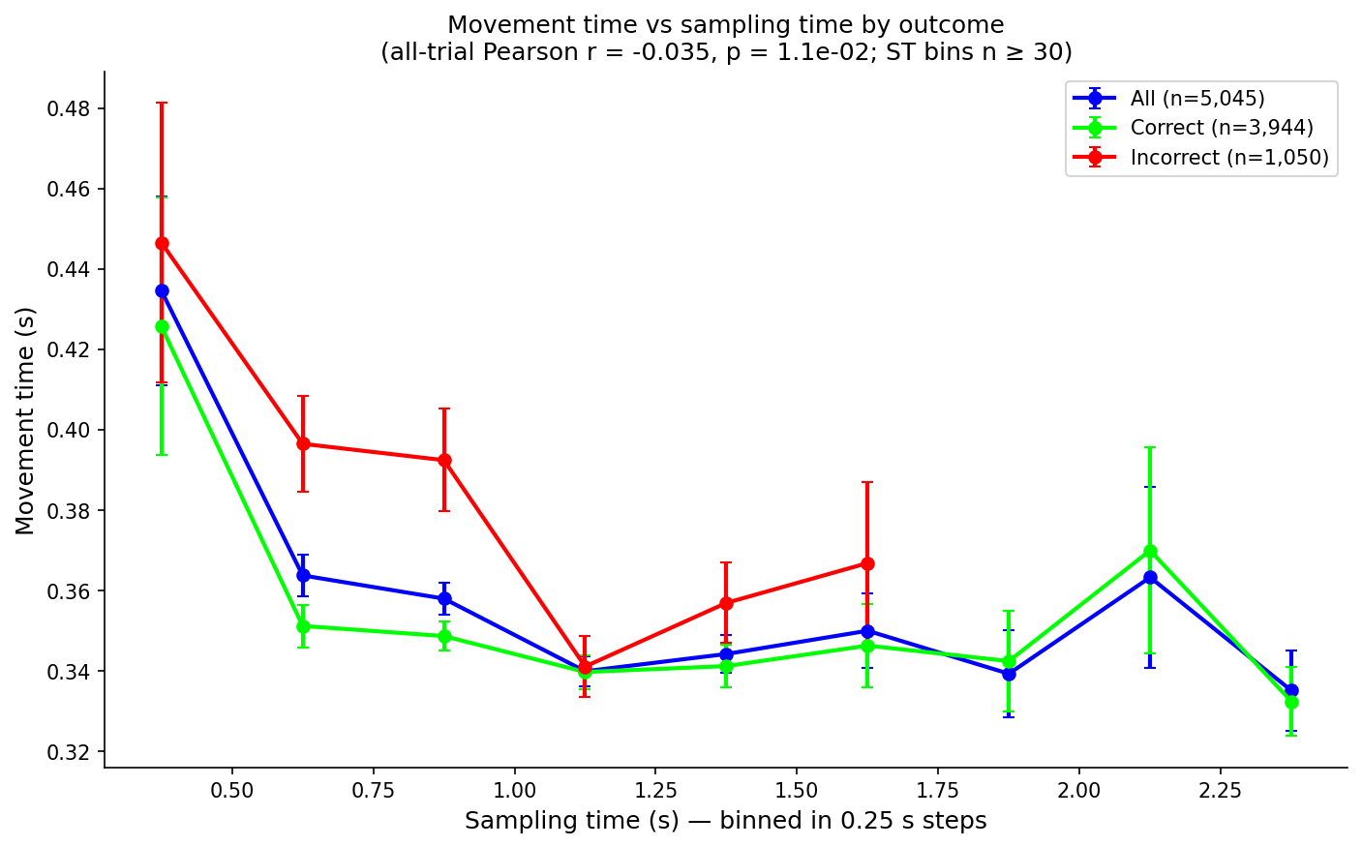
Is movement time just sampling time again?
ANALYSIS · confound
Weak, difficulty-specific coupling → movement time carries its own information (r≈−0.13 hard, ~0 easy)
11
Notes:
The obvious objection, hit head-on. The Fast & Slow paper showed sampling time tracks difficulty — so am I just re-measuring it? No. Left: trial-by-trial correlation between sampling and movement time is weak — significant on hard trials, r about −0.13, negligible on easy. Right, binned: a mild tendency for longer sampling to go with slightly faster movement, and errors (red) sit above correct (green) across the board. Two loosely coupled variables — movement time is not a copy of sampling time; it carries its own information. That's what makes it worth studying.

Slide 13
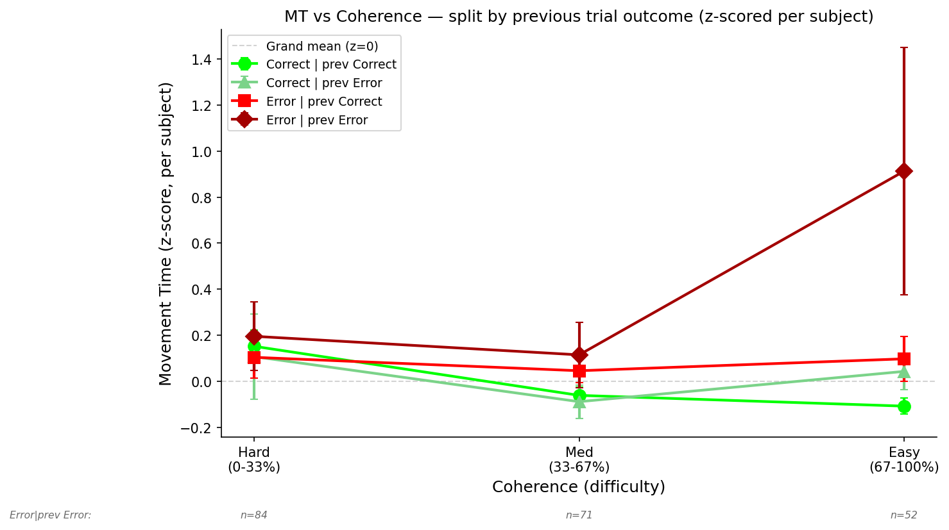
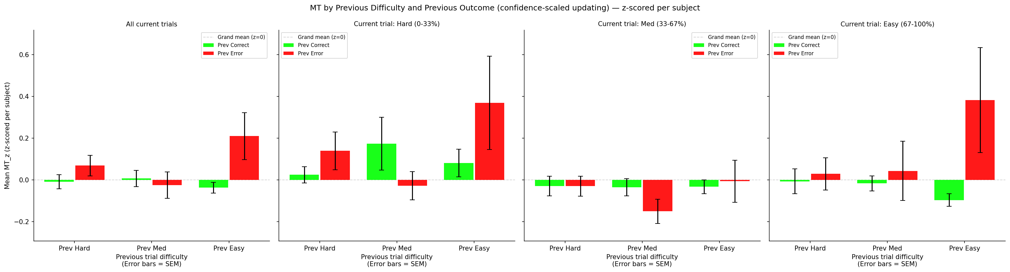
Signature 3 · History — a surprising mistake slows the next move
SIGNATURE 3/3
…broken down by previous difficulty
split by previous outcome
✓ Confidence-scaled updating: the more surprising the mistake, the bigger the next hesitation
12
Notes:
If movement time indexes a confidence state, it shouldn't reset every trial — it should carry over. Left: MT z-scored, split by whether the previous trial was correct or an error. Almost everything sits near zero except one condition that jumps up — an error following an error, on easy trials. Two errors in a row on trials that should've been easy is the animal's worst 'what am I doing' moment, and MT balloons. Right: broken down by the previous trial's difficulty — previous EASY errors slow you most, because an easy-trial error is the most surprising. Confidence-scaled updating. Box three, checked.

Slide 14
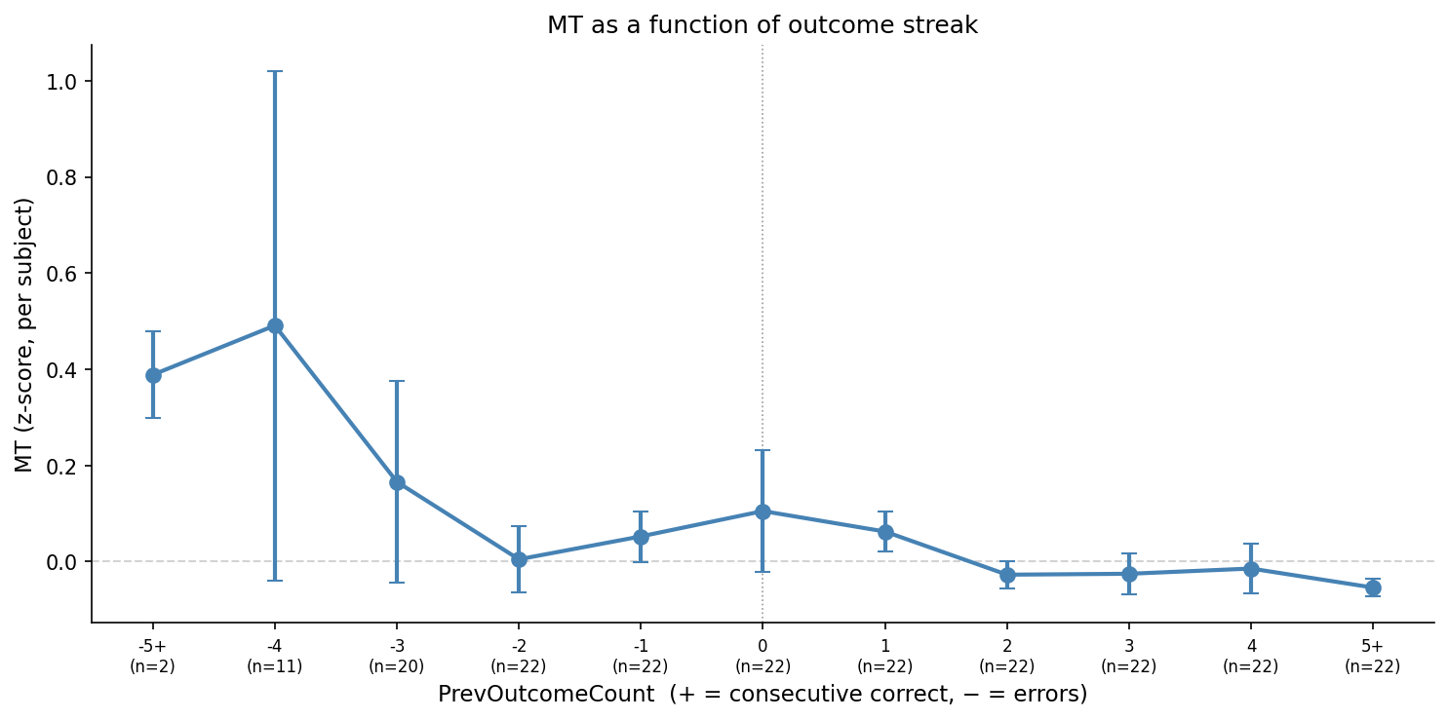
The hesitation builds over a losing streak
ANALYSIS · history
After several errors in a row the animal slows down — the low-confidence state accumulates
13
Notes:
One more history view. Movement time as a function of streak length — positive numbers are consecutive correct, negative are consecutive errors. When the animal is on a losing streak — minus three, four, five in a row — the movements slow right down; winning streaks are flat or slightly faster. So it's graded, not just the single previous trial: the low-confidence state accumulates the worse the run gets. (If asked about win-stay / lose-shift strategy: I tested it and movement time doesn't differ by strategy label — Kruskal–Wallis not significant — so it's the outcome history that matters, not the strategic label.)

Slide 15
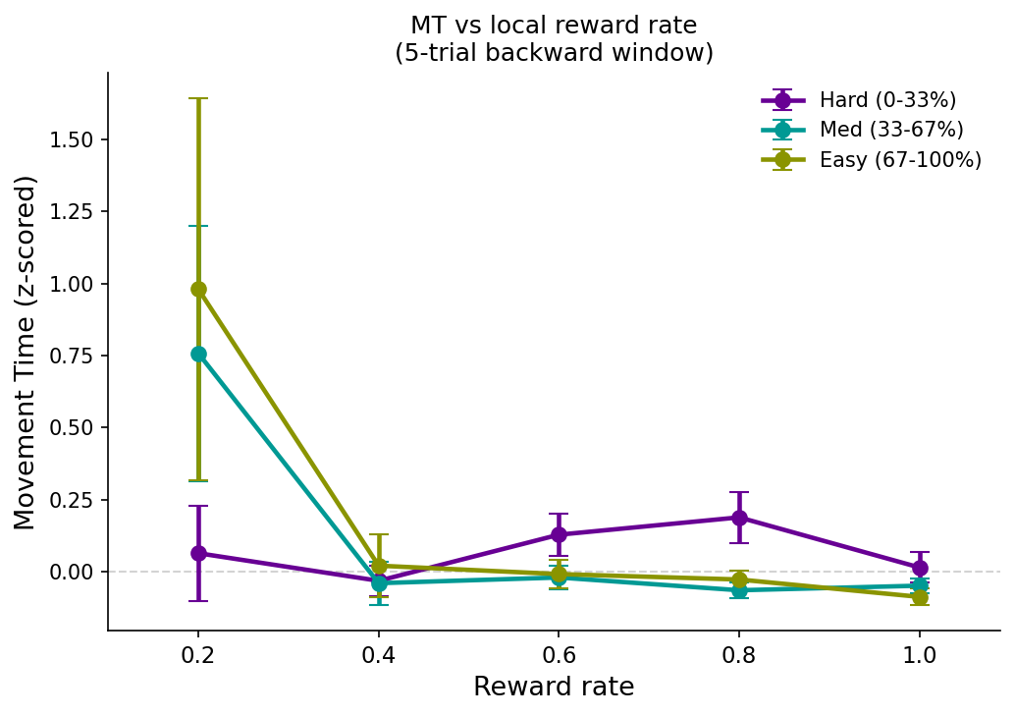
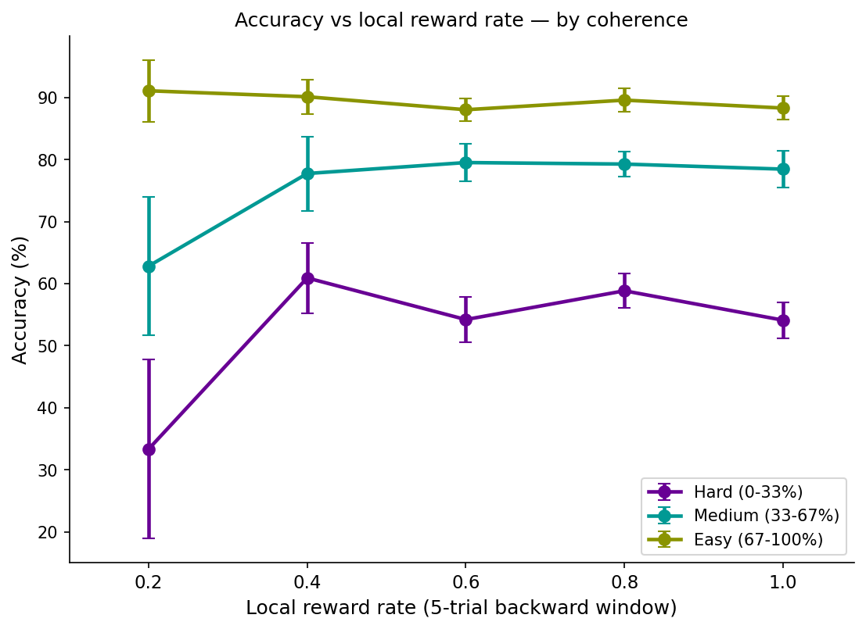
One thing to rule out: is the mouse just disengaged?
ANALYSIS · confound
recent reward low → slower
recent reward low → less accurate
⚠ Local reward rate = an engagement proxy: when it's low the mouse is slow AND wrong — separate this from confidence
14
Notes:
An honest caveat. I use local reward rate — how well the animal did in the last five trials — as a proxy for engagement. Left: when that reward rate is low, movement times shoot up, especially on medium and easy trials. Right: low reward rate also means lower accuracy. So there's a global engagement axis — sometimes the animal is just checked out, and then it's both slow and wrong. I flag it because it's a confound I have to regress out before I call a slow movement 'low confidence' rather than 'disengaged.' It doesn't erase the earlier effects — those hold within engaged blocks — but it's the asterisk.

Slide 16
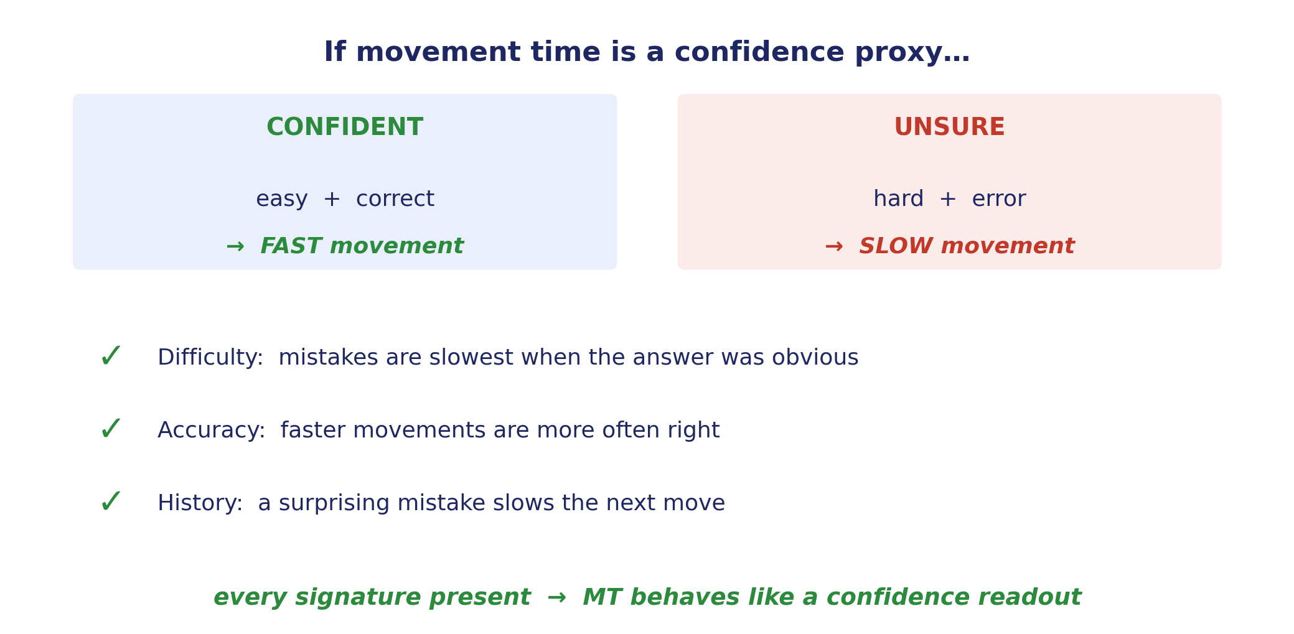
The checklist, all three confirmed
ANALYSIS · summary
✓ Movement time shows all three signatures — it behaves like a confidence readout
15
Notes:
Back to the checklist. DIFFICULTY: mistakes are slowest when the answer was obvious. ACCURACY: faster movements are more often right, even within a difficulty level. HISTORY: a surprising mistake slows the next move, scaled by how surprising it was. Caveats stay honest — engagement is a confound I control for — but all three confidence signatures are present. Movement time behaves like a confidence readout. So we now have a confidence signal to go looking for in the brain.

Slide 17
Next: where does this confidence signal live in the brain?
NEXT STEPS
If movement time is a behavioural readout of confidence, a neural signal should carry it. The plan:
Image 2-photon calcium activity in medial and lateral frontal cortex during the task
1
Align lock the neural traces to movement onset — the moment the animal commits and moves
2
Decode find neurons whose activity predicts movement time, and correct-vs-error, trial by trial
3
The bridge: from a behavioural proxy for confidence to its neural correlate
16
Notes:
Where does this go. We have two-photon calcium imaging from frontal cortex — medial and lateral fields — during the task. The plan is three steps: image the activity, align it to movement onset, and ask a simple decoding question — is there a population whose activity around the movement predicts movement time, and predicts correct versus error, trial by trial? If movement time is a confidence readout behaviourally, there should be a neural signal that carries it. That's the bridge from behavioural proxy to neural correlate of certainty.

Slide 18
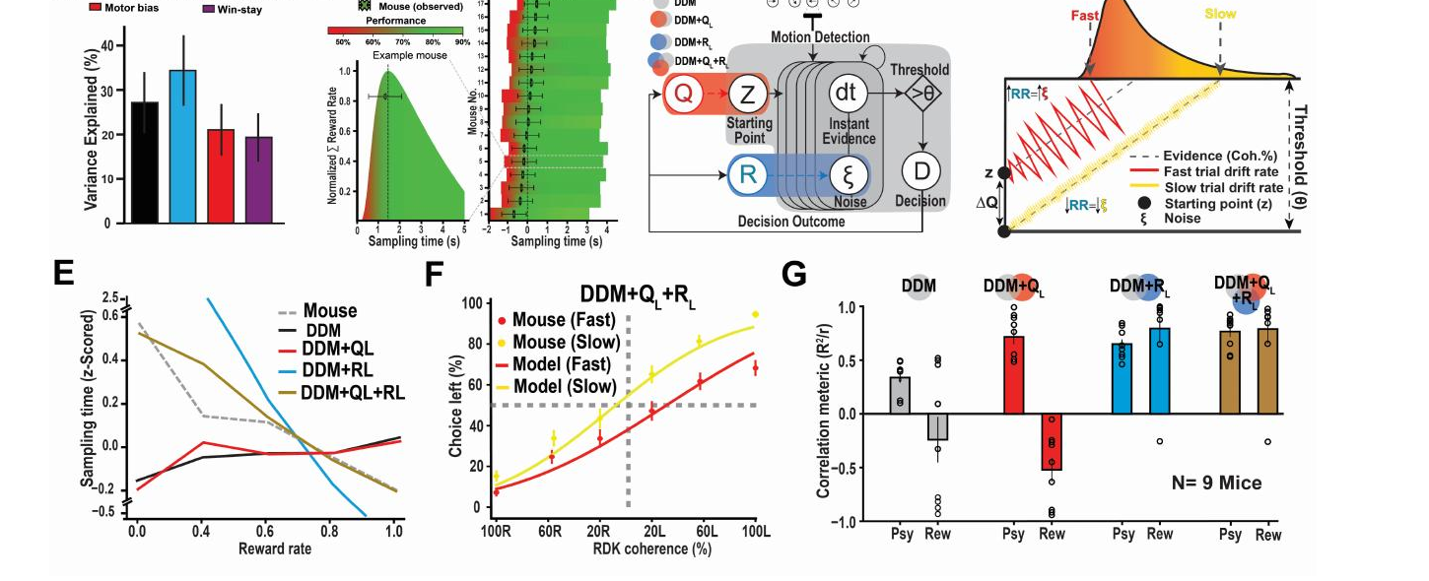
A ready-made model to build on
NEXT STEPS
The Fast & Slow model — drift-diffusion plus reinforcement / Q-learning — already predicts choices and sampling times. Next: add movement time as an output, and line the model's confidence up against the neural signal.
Figure adapted from Nashaat et al., Neuron — Fig 2 (DDM + RL / Q-learning)
Thank you · questions welcome
17
Notes:
Why I'm optimistic this is tractable: the Fast & Slow model — drift-diffusion wrapped in reinforcement and Q-learning — already predicts these animals' choices and sampling times well (that's the model schematic and the mouse-vs-model fits on the slide). It's a ready-made scaffold. The next step is to add movement time as an output of that same model — predict, trial by trial, not just what the animal chose but how fast it moved to say so — and tie that to the confidence term. Then line the model's confidence up against the neural signal from the previous slide. That's the roadmap for the rest of the rotation. Thanks — happy to take questions.

