Slide 1
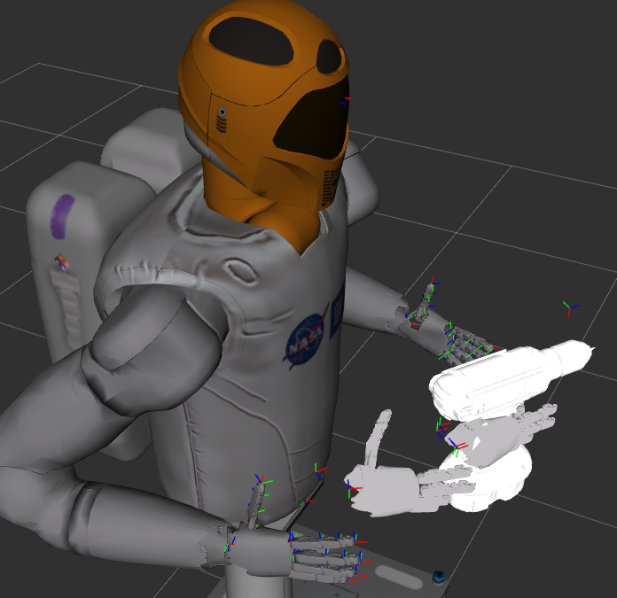
Object Model
Planned Grasp With AT

