Slide 1
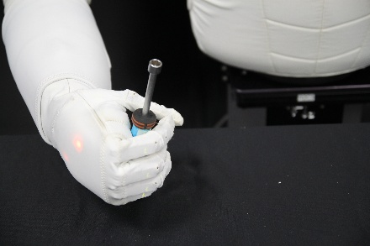
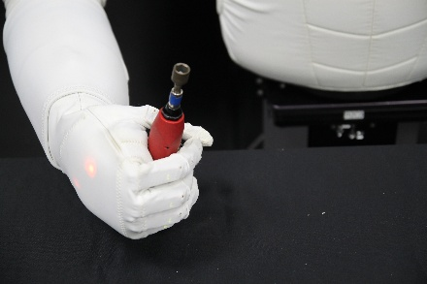
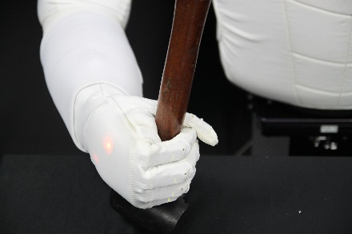
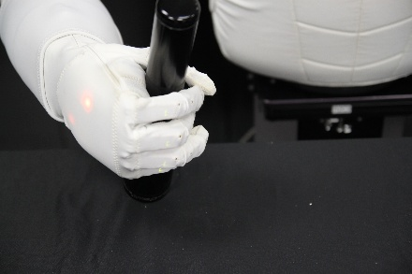
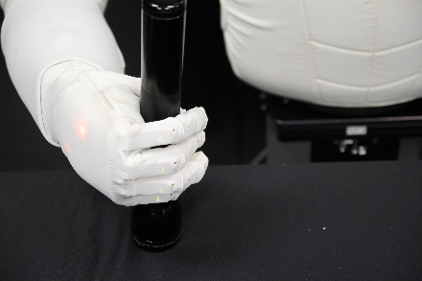


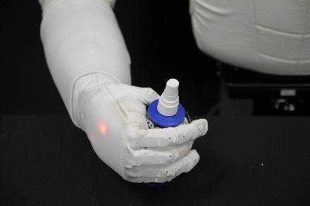
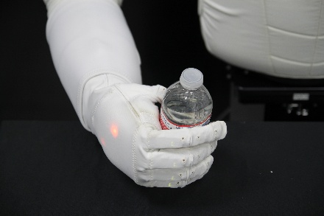
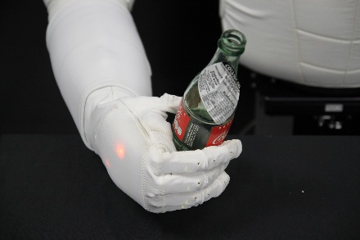
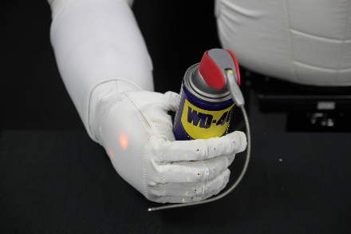
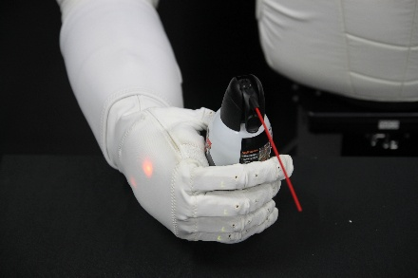
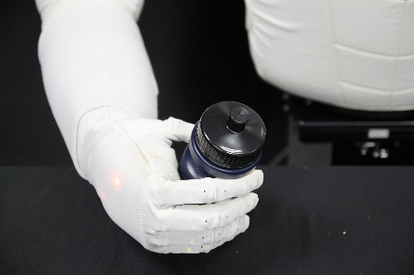
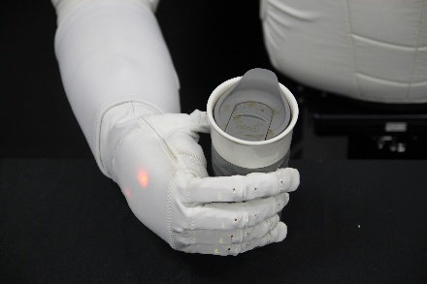
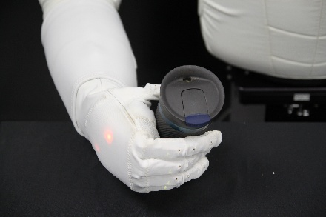
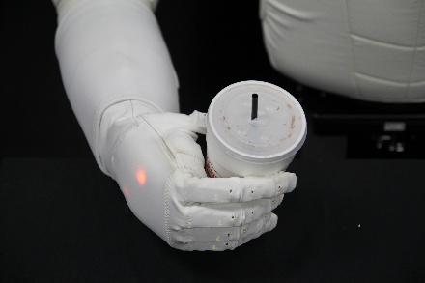
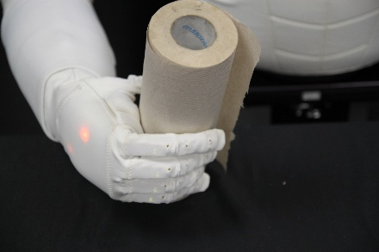
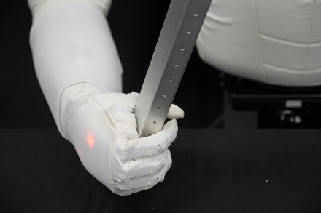
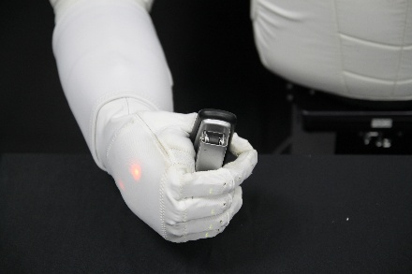
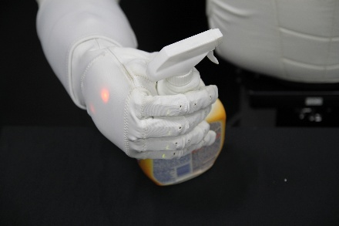
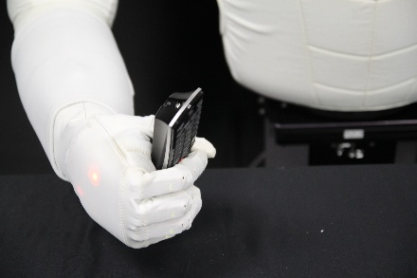
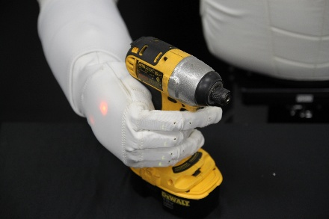
Screwdriver
D = 2.79 cm
Mass = 0.11 kg
Electric Screwdriver
D = 3.3 cm
Mass = 0.33 kg
Rubber Mallet
D = 3.3 cm
Mass = 0.37 kg
Flashlight
D = 6.35 cm
Mass = 0.57 kg
Large Flashlight
D = 6.35 cm
Mass = 1.02 kg
CYLINDERS
Small Spray Bottle
D = 5.08 cm
Mass = 0.16 kg
Plastic Water Bottle
D = 6.35 cm
Mass = 0.31 kg
Coke Bottle
D = 6.35 cm
Mass = 0.40 kg
Aerosol Can 1
D = 6.6 cm
Mass = 0.16 kg
Aerosol Can 2
D = 6.6 cm
Mass = 0.34 kg
Water Bottle
D = 7.4 cm
Mass = 0.05 kg
Ceramic Mug
D = 7.4 cm
Mass =0.32 kg
Metallic Coffee Cup
D = 7.4 cm
Mass = 0.34 kg
Styrofoam Cup
D = 7.9 cm
Mass = 0.005 kg
Paper Towel
D = 8.4 cm
Mass = 0.43 kg
COMPLEX
RECTANGLES
Aluminum Rod
2.5 x 5 cm
Mass = 0.33 kg
Stapler
D = 3.3 cm
Mass = 0.31 kg
Spray Bottle
D = 4.3 cm(handle)
Mass = 0.08 kg
Remote Control
5.08 x 2.79 cm
Mass = 0.16 kg
Dewalt Impact Driver
D = 4.32 cm (handle)
Mass = 1.54 kg

