Slide 1
How does app details contribute to user ratings?
By: Farros Mufid

Slide 2

About me
Name: Farros Mufid
Major
Bachelor of Electrical Engineering (Universitas Indonesia)
Bachelor of Engineering Honours Electrical (University of Sydney) (double degree)
Interest:
Tech
Hobby:
Music

Slide 3
Business Problem
Companies create bad apps (Rated below 4)
Companies cannot predict it is going to be a bad app or a good app before they launch it to the market
Highly rated apps usually comes from non quantitative measures
How it does one thing, innovation (disruptive or sustainable), how well it knows the audience, etc.

Slide 4
Solution (why we need machine learning?)
A machine learning algorithm to predict a successful app just by looking its app details (e.g. Size, genre, price, number of supported devices, etc.)
This research will also try to look at what makes an app successful based on app details from the existing market
Successful app is defined as an app that has user rating above 4 (inclusive)

Slide 5
About the dataset
Content:
appleStore.csv:
App details
appleStore_description.csv
App descriptions
Dimension:
7197 rows and 16 columns
The data was extracted from the iTunes Search API at the Apple Inc website by Ramanathan Perumal (2018). R and linux web scraping tools were used for this study.

Slide 6
STEPS
Read and Merge Dataset
EDA (Answer key questions)
Feature Engineering (Based on EDA)
Find Best Model (Logreg, decision tree, knn, random forest)
Hyperparameter Tuning (knn)

Slide 7
eda
Key Questions:
How does app details contribute to user ratings? What makes a good app?
Try to compare statistics for different groups!
What should a company do to boost user ratings by looking at app details?

Slide 8
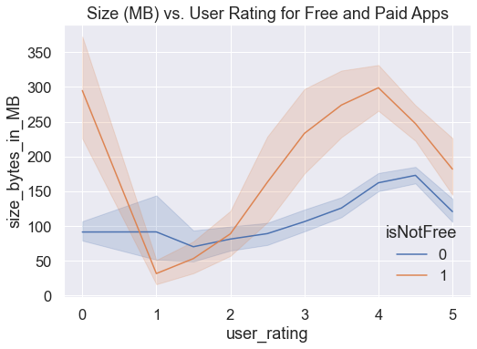
Apps size
Highest rated paid apps are between 175 MB - 300 MB in size. Highest rated free apps are between 100 MB - 175 MB in size.

Slide 9
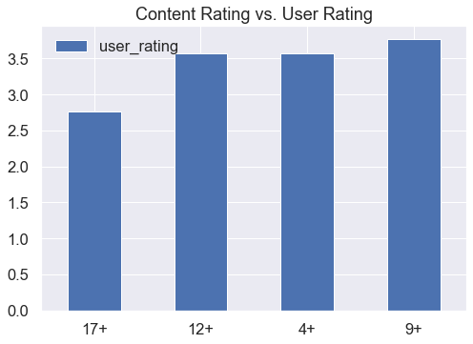
Content ratings
17+ content has an average lower user rating compared to the other content rating. 9+ content rating has the highest rating among all ages.

Slide 10
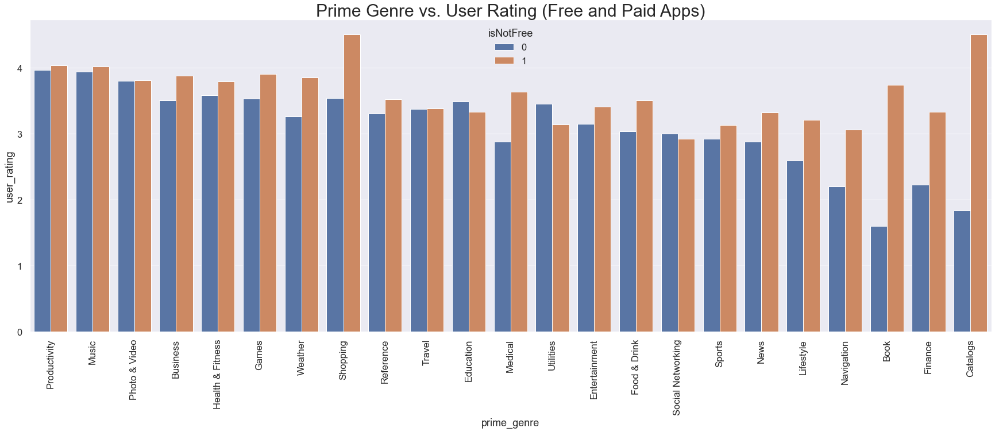
genre
In general apps have much higher ratings when they are paid.

Slide 11
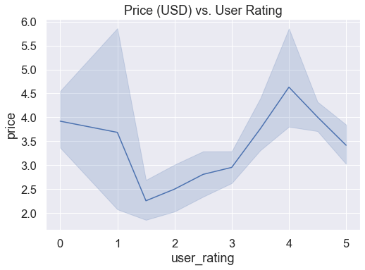
price
It can be seen that higher price can contribute to higher user rating. When the price is too high, user rating can be low.

Slide 12
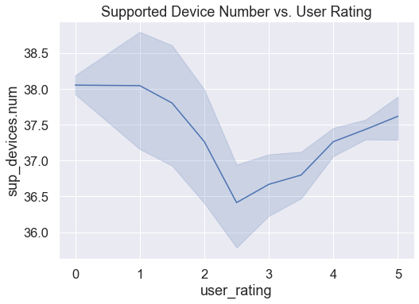
Supported devices
When supported device number is less than 37, user rating can dropped to somewhere above 2 and below 4.

Slide 13
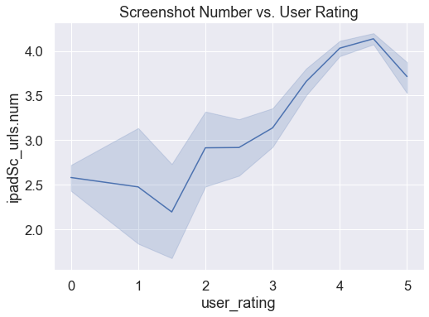
screenshots
It can be seen that higher screenshot number contribute to higher user ratings. Keeping 4 screenshots will make the app to have higher ratings.

Slide 14
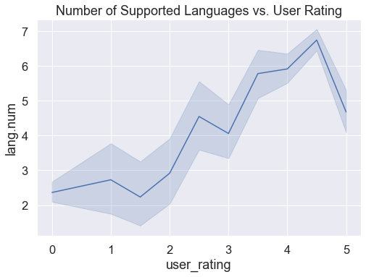
languages
It can be seen that in general, higher number of supported languages contribute to higher user ratings. Best apps (5 rated apps) usually have around 4 to 5 languages. Apps with 6-7 languages are more likely to be a good app.

Slide 15
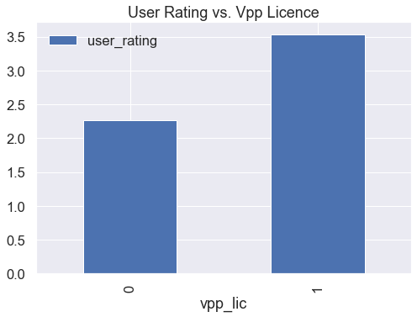
vpp
Apps with Vpp have higher user rating on average.

Slide 16
advice
Companies should keep free apps less than 175 MB and paid apps less than 300 MB.
Companies can avoid creating 17+ content to avoid lower ratings.
In general, paid apps always has better rating than free app.
Higher price usually contribute to higher user ratings, however, when price is too high, user ratings can be low.
Have at least 37 number of supported devices.
Have at least 4 screenshots of your app to be displayed.
Support at least 4-5 languages.
Having Vpp license is a good deal.

Slide 17
Metric evaluation
Precision
1: Good app (User rating >= 4)
0: Bad app
Metric evaluation used:
FP: Predict it is a going to be a good app but it turns out to be a bad app
FN: Predict it is going to be a bad app but it turns out to be a good app
Precision:
We want to minimize FP
Minimize to predict it is a good app but it turns out to be a bad app

Slide 18
preprocessing
MinMaxScaler() is used because only a maximum of 11% of the data are outliers, other scaler does not impact higher cross validation score as well
Features used
Numeric
Size in bytes, price, supported device number, screenshots number, language number
Categorical
isNotFree, Vpp License, Prime genre, Content rating
Features not used
App id, app name, currency type (USD), rating count total (for all version), rating count version (for current version), user rating ver (for current version), app description

Slide 19
Model selection
4 models are used, Logistic Regression, Decision Tree, Knn Classifier, and Random Forest
78% cross val score is achieved with Knn Classifier and MinMaxScaler() with nearmiss and smote sampler
However with balancing, the model will become bias
77% cross val score is achieved with Knn Classifier and MinMaxScaler() without sampler so our model will become lighter

Slide 20
Result (best model)
Achieved 75% precision score from using best machine learning model
Best model
Knn Classifier and MinMaxScaler()
Best params:
Leaf size: 5
N neighbors: 5
P: 1
Weights: Uniform
9 features are used to predict the model

Slide 21
conclusion
Although the algorithm is able to predict the success of a new app from its app details (quantitative standards) with 75% precision score, app details alone does not guarantee the app will have good quality.
Some qualities include (Non quantitative):
Does one thing well
Do not cram too many features into an app
Knows its audience
Research your audience and focus on meeting their specific needs
Polished app
Little details such as animations, sound effects, interactions

Slide 22
references
https://savvyapps.com/blog/what-makes-a-great-app#:~:text=What%20makes%20an%20app%20great,for%20creating%20a%20great%20app.

