Slide 1
WeatherFlow
Sougata Sarkar
Sougata Sarkar
Sougata Sarkar [24M0790]
Farhan Jawaid [24M0801]
Saba Mhabar [24M0811]

Slide 2
Problem statement:
In today's fast-paced world, individuals rely heavily on accurate and timely weather information to plan their daily activities.
Specifically, users often need to repeatedly search for weather information for the same cities, or nearby. There are number websites that provides weather information but our app provides weather information of your searched city without any complex details .
There is a need for a user-friendly website that not only provides real-time and accurate weather details but also allows users to save and easily revisit their searched cities for a more efficient and tailored experience.

Slide 3
Technology:
Front End
HTML Structures the content of the web pages, enabling the creation of a user-friendly interface.
CSS Styles the webpage, ensuring a visually appealing and responsive design.
JavaScript Provides interactivity and dynamic functionalities, such as real-time updates and responsive UI elements.

Slide 4
Back End
Python as a Programming Language
Flask a lightweight and flexible Python web framework, serves as the backbone of the application.
JavaScript to built and manage backend functionalities.
Database
SQLite database to have a backup of data searched and accessed

Slide 5
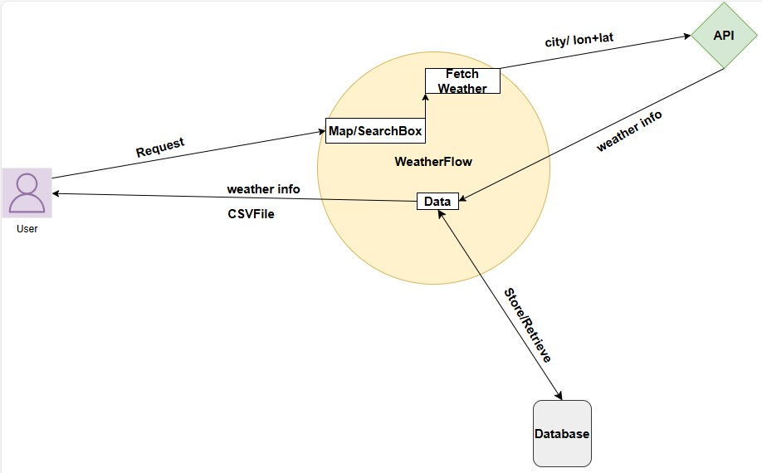
Architecture Diagram:

Slide 6
Architecture Details:
Website in built using Flask framework of python.
Leaflet.js is used to build interactive map in the website which is a popular open-source JavaScript library.
The data about specific location it’s temperature and other related information will be fetched from OpenWeatherMap API.
The plots are generated using Chart.js open source library by using data fetched from API and passing to it to generate line and bar graph.
The fetched data is stored into the database using SQLite.
HTML and CSS are used for markup and designing.

Slide 7
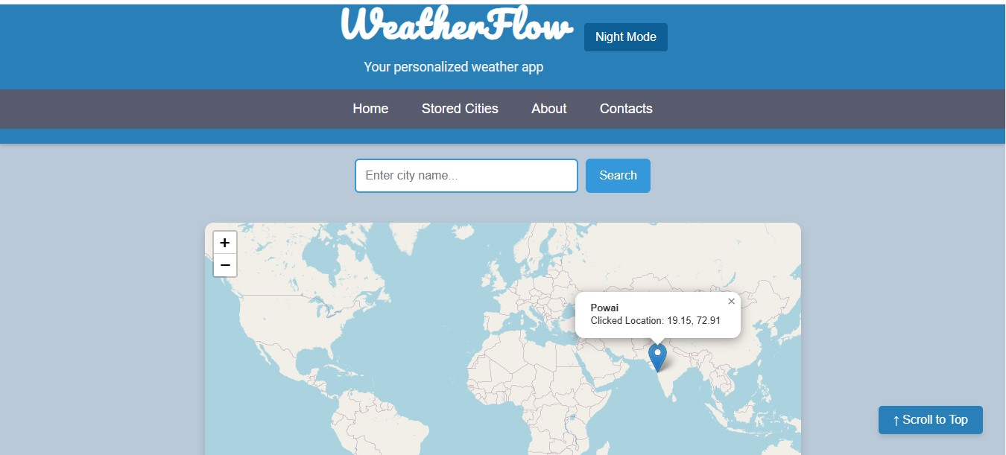
Home:

Slide 8
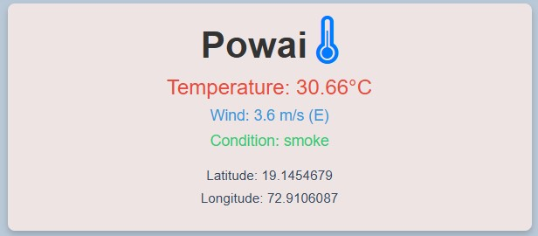
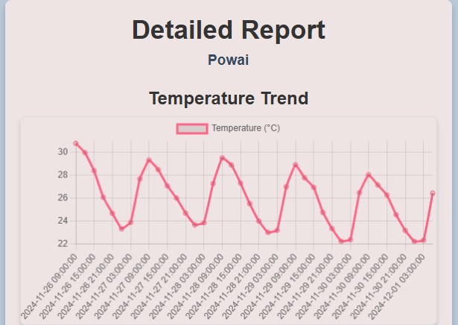
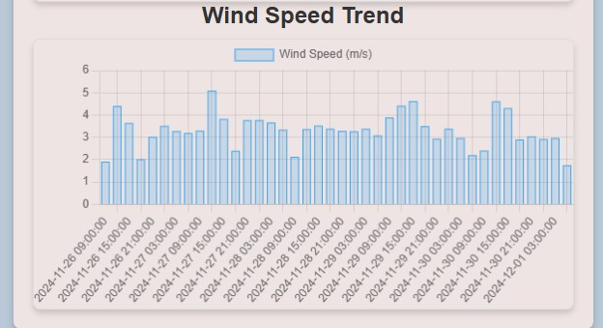
Results:

Slide 9
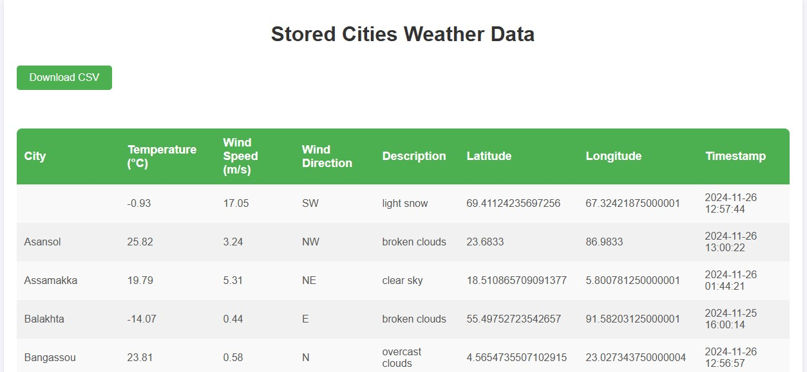
Database Table:

Slide 10
Result and Conclusion:
This Websites built on flask framework provides simple and accurate basic weather data.
It has most user friendly experience as it provides on point and required weather related information without much complex interface.
The data can be personalized and stored accordingly in database provided.
Further the data can we be downloaded from our site to use them for other (eg. ML related) works because they demand higher no. of datasets.

Slide 11
Future Scope:
The data stored in SQLite can be personalized according to the user requirement.
The data can be used further for analysis and getting useful outputs.
The database can be modified to retrieve data from database and use wherever necessary.
We can predict future data range for say temperature parameter using previously stored data by using it as input for some Machine learning model.

Slide 12
Contribution:
Frontend
HTML and CSS: Saba Mhabar
Designing of Website: Saba Mhabar
Backend
JavaScript: Sougata Sarkar
API Data fetching and Integration: Sougata Sarkar
Database
Database Creation: Farhan Jawaid
Integration of Database: Farhan Jawaid
Data Storage and Downloading in CSV Format: Farhan Jawaid
Overall Integration and Flask Application: By Group

Slide 13
Challenges:
To decide what API to be used to get live data as many API such as Google Maps, Bing Maps, MapBox requires paid subscription.
The presentation of all the features was bit confusing to finalize the way the data must be presented like graph, histogram, line plot, etc.
The database design and what components to add and in what format data should be accessed, means whether csv, excel, json, etc.
Maintaining code as the feature increases and keep it still readable was our constant effort. As HTML CSS and JavaScript bulk up even if single feature is added.

Slide 14
THANK YOU

