Slide 1
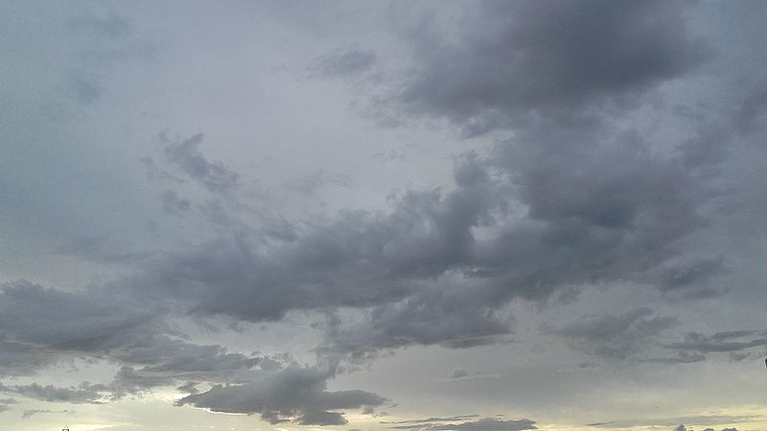
WeatherFlow A Comprehensive Weather Forecasting System Team Members: Farhan Jawaid, Sougata Sarkar, Saba Mhabar Course: Software Lab CS699 Date: 09/10/24

Slide 2

Overview
Objective: To create a weather dashboard that provides real-time weather information, graphical forecasts, and automated data logging etc…
Key Features:
Real-time weather updates
Graphical forecasts and trend analysis
Automated daily data logging
Weather alerts and notifications
Interactive map with weather locations

Slide 3

Project Scope
Phase 1: Build a simple web-based weather dashboard using OpenWeather API to fetch real-time data.
Phase 2: Implement graphical forecasts using Python libraries.
Phase 3: Automate periodic data fetching with shell scripts
Phase 4: Additional features like weather alerts, map integration, and visual comparisons of historical data.

Slide 4

Why Logging Data?
Historical Analysis: Collect and store weather data to analyze trends over time (e.g., temperature trends, rainfall).
API Optimization: Avoid excessive API calls by storing weather data at regular intervals, reducing dependence on live data.
Data Backup: In case of API failure or no internet, users can still access logged weather data.
Future Scope: Logged data can be used for machine learning models or enhanced forecasting.

Slide 5

Features
Real-time Weather Data: Fetch and display current weather details such as temperature, humidity, wind speed.
Graphical Forecasts: Visualize weather trends like temperature changes and precipitation for the upcoming days.
Automated Logging: Periodically fetch and store weather data to enable historical analysis and offline access.
Interactive Map: Users can click on locations to get weather info.
Weather Alerts: Send notifications or emails for certain weather conditions.

Slide 6

Proposed Tech Stack
Frontend: HTML, CSS, JavaScript for the dashboard’s user interface.
Backend: Python for API integration, data processing, and automating tasks.
Automation: Shell scripting to automate data fetching and logging.
APIs & Libraries:
OpenWeather API for fetching weather data.
Plotly/Matplotlib for visualizations.
SQLite/MySQL for data logging.
Leaflet.js for interactive maps.

Slide 7

Future Scope
Data Prediction: Use historical data to predict future weather trends.
Mobile App: Extend the project into a mobile-friendly version.
Advanced Notifications: Implement user-specific weather alerts for unusual conditions.

Slide 8
Thank you

