Slide 1
SOFTWARE TECHNOLOGY 1G 8995 CAPSTONE PROJECT PRESENTATION
INSERT PROJECT TITLE
STUDENT NAME/ID: Stephen Farrugia / u873301
TUTORIAL GROUP: Friday 12:30pm, on-line

Slide 2
Table of Contents
Introduction /
Problem Statement
Dataset Details
EDA (Exploratory Data Analysis) Outcomes
PDA (Predictive Data Analytics) Outcomes
Implementation and Deployment
Plan and Status Update
References

Slide 3
Introduction / Problem Statement
The Australian wine industry, is a major exporter and contributes tens of billions to the Australian economy
Wine quality is very subjective, however, Data sets exist which rate the quality of wines and contain information on the various chemical compounds within each of the wines
This analysis explores whether a Machine Learning algorithm can predict the wine quality based on the constituent chemicals

Slide 4
Dataset Details
Eleven chemical constituents and subjective wine quality for 1,599 red wines have been documented in the file at reference [2]
All factors are complete for each wine
The “quality” factor is an integer between 3 and 8 representing a score out of 10

Slide 5
Exploratory Data Analysis Outcomes
Started initially with Google Colab, however, found that with the free version I was not guaranteed processing time
Moved to Pycharm Community version which worked but was quite slow and I was unable to run segments of code
Reverted to Google Colab
Found that the graphing in Pycharm is more readily formatted than Google Colab so providing a mix of charts here from the two platforms
Notes:
Quality largely rated 5 or 6

Slide 6
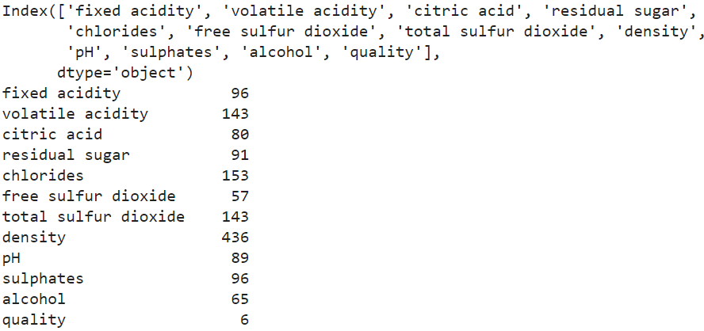
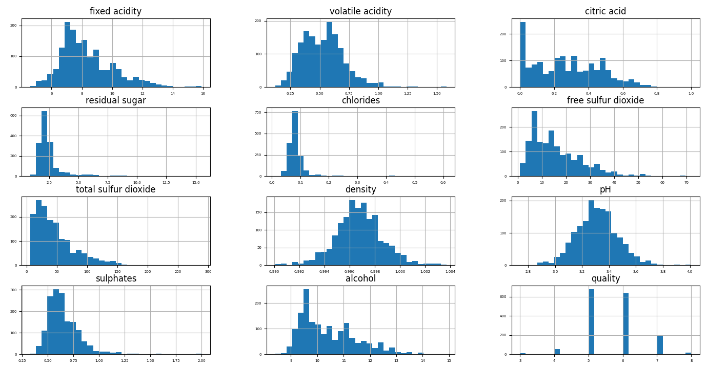
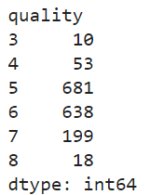
Exploratory Data Analysis Outcomes
Notes:
Quality largely rated 5 or 6

Slide 7
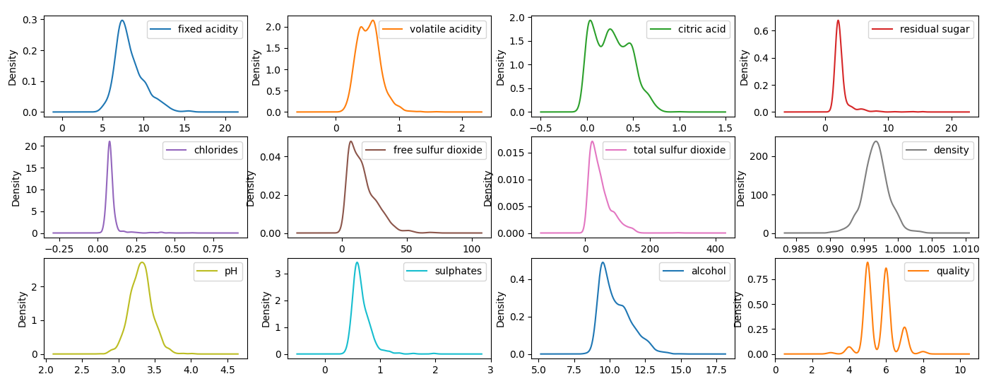
Exploratory Data Analysis Outcomes
Notes:
Significant number of outliers = particularly for residual sugar and chlorides

Slide 8
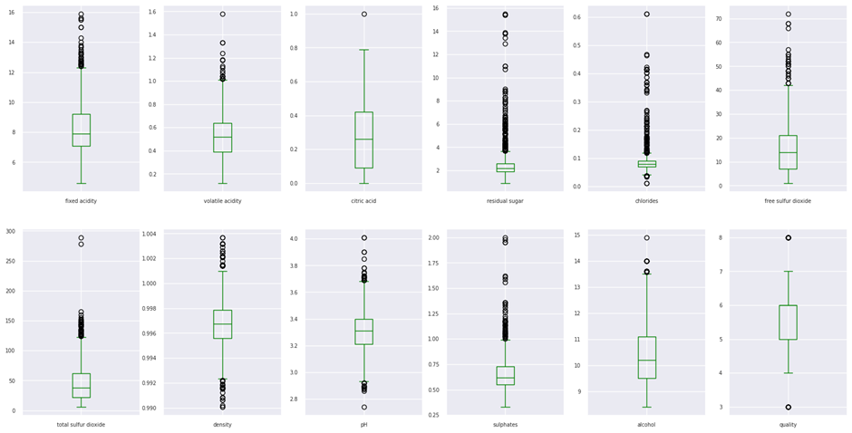
Exploratory Data Analysis Outcomes
Notes:
Significant number of outliers = particularly for residual sugar and chlorides

Slide 9
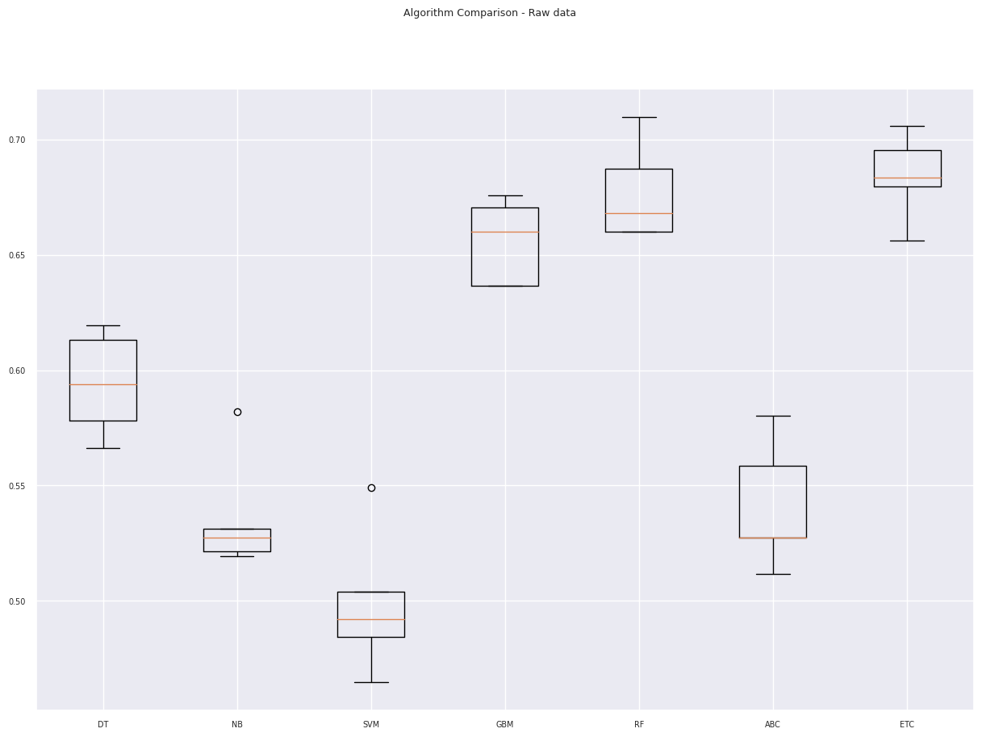
Predictive Data Analysis Outcomes
Split the data set – 80 / 20 – 80% for training and 20% for testing
Notes:
models.append(('DT', DecisionTreeClassifier()))
models.append(('NB', GaussianNB()))
models.append(('SVM', SVC()))
models.append(('GBM', GradientBoostingClassifier()))
models.append(('RF', RandomForestClassifier()))
models.append(('ABC', AdaBoostClassifier()))
models.append(('ETC', ExtraTreesClassifier()))

Slide 10
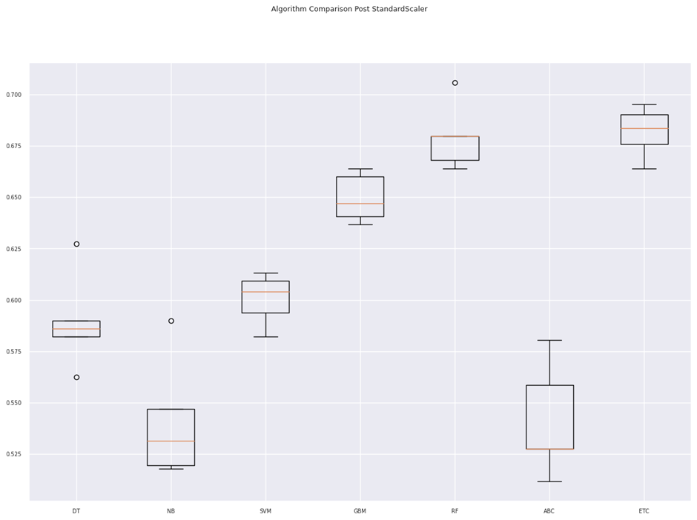
Predictive Data Analysis Outcomes
The StandardScaler was then used with mixed results – some improving and others getting worse

Slide 11
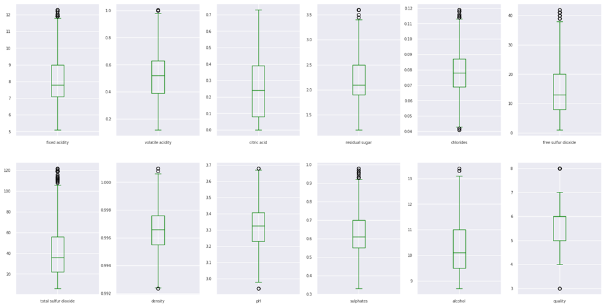
Predictive Data Analysis Outcomes
When the outliers were removed some models improved…

Slide 12
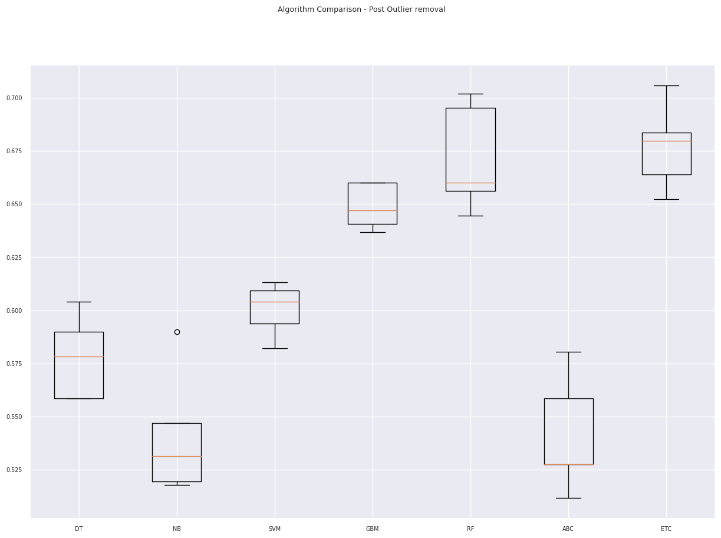
Predictive Data Analysis Outcomes
When the outliers were removed some models improved…

Slide 13
Predictive Data Analysis Outcomes
Decided on the use of the ExtraTreesClassifier model as that provided slightly better performance on average
This model was pickled (saved), reloaded and tested and then stored in a git-hub repository

Slide 14
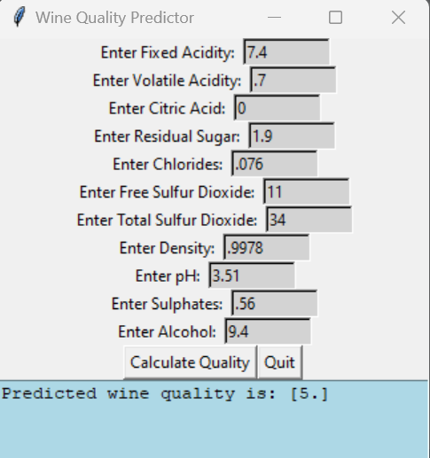
GUI Implementation
This was done using Pycharm and the model extracted from the predictive data analytics done using Google Colab

Slide 15
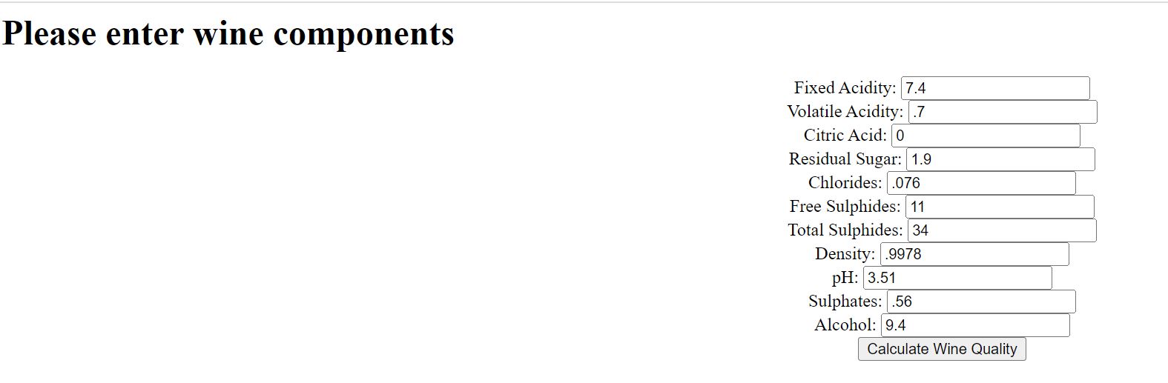
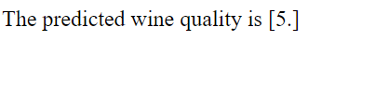
Web Implementation
This was done using Pycharm with a flask interface. Again using the model extracted from the predictive data analytics done using Google Colab

Slide 16
References
https://uclearn.canberra.edu.au/courses/13571/assignments/105232
P. Cortez, A. Cerdeira, F. Almeida, T. Matos and J. Reis. Modeling wine preferences by data mining from physicochemical properties. In Decision Support Systems, Elsevier, 47(4):547-553, 2009.
https://www.kaggle.com/datasets/uciml/red-wine-quality-cortez-et-al-2009
https://www.wineaustralia.com/market-insights/australian-wine-sector-at-a-glance
Google Colab platform - https://colab.research.google.com/
Pycharm Professional - https://www.jetbrains.com/pycharm/
Machine Learning with Python - https://colab.research.google.com/
https://www.geeksforgeeks.org/retrieving-html-from-data-using-flask/
https://www.tutorialspoint.com/How-to-center-text-in-HTML

