Slide 1



Information Systems
Department of Natural Sciences and Computer Technology
Ethnocount — Treasury & Money-Transfer Platform
Bachelor Paper
Farrukhsho Muzrabov | IT-2022 | Dr.sc.ing. prof. Jelena Caiko | 19 April 2026
Notes:
EN: 'My thesis studies atomic ledger and branch-scoped data isolation in a cross-platform group accounting application built with Flutter and Supabase.'

Slide 2


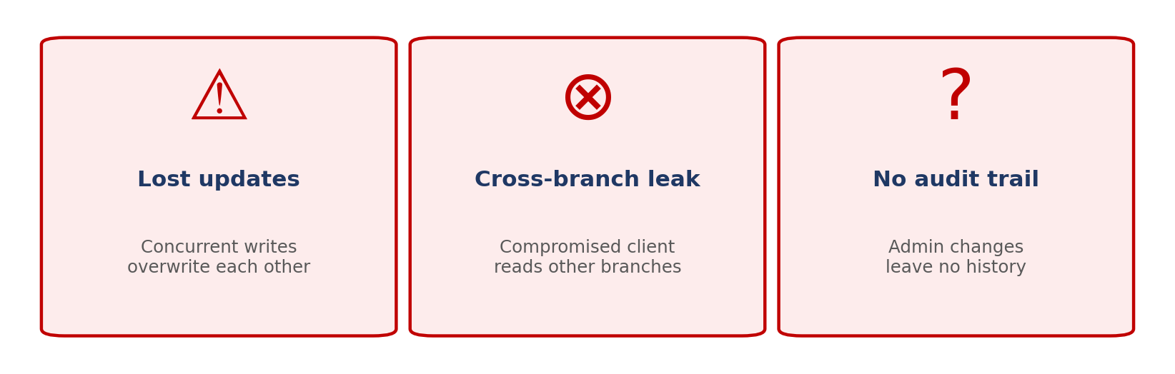
Research Problem
Small currency-exchange networks run several branches across cities and countries.
Branch staff, partners abroad and recurring clients all touch the same money daily —
and the spreadsheets they use today let three things go wrong:
ONE narrow research question: how to guarantee CORRECT, ISOLATED, AUDITABLE
multi-branch treasury transactions on a standard Postgres backend?
Notes:
RU: Узкая проблема — 3 беды при параллельных записях. Сужаю до одного вопроса: корректность + изоляция + аудит на обычном Postgres.

Slide 3
Aim, Hypothesis, Defended Theses
AIM
Make multi-branch treasury writes correct, isolated and auditable — without a custom server.
HYPOTHESIS
Postgres primitives — transactions, row locks, RLS, SECURITY DEFINER — are sufficient.
THREE DEFENDED THESES
1. Atomic SECURITY DEFINER RPCs eliminate race conditions in a double-entry ledger
and in the per-currency partner saldo update.
2. Row-Level Security keyed on assigned_branch_ids gives branch-level tenant
isolation that a malicious client cannot bypass.
3. A narrow admin API plus a Director-mediated approval workflow makes every
critical change traceable and reversible.
Notes:
RU: СЕРДЦЕ. Цель → гипотеза → 3 тезиса. Медленно. Ключи: atomic, isolation, auditable.

Slide 4
How others solve this — existing alternatives
Approach | Correctness | Isolation | Cost / Ops
A · Single-user trackers (CoinKeeper, Money Lover) | ✓ single user only | — not shared | low
B · Spreadsheets (Google Sheets, Excel) | ✗ last-write-wins | — no roles | low
C · Firebase Firestore + client writes | ✗ no cross-doc tx | ± per-row rules only | low
D · Custom backend (Node / Django + Postgres) | ✓ full control | ✓ full control | ✗ high (servers, CI)
THIS WORK — ETHNOCOUNT Flutter + Supabase + SECURITY DEFINER | ✓ atomic RPCs | ✓ RLS by branch | ✓ zero server code
Notes:
RU: 5 строк. Зелёная — наша. Дальше — более глубокий бенчмарк с Bitrix и 1С.

Slide 5
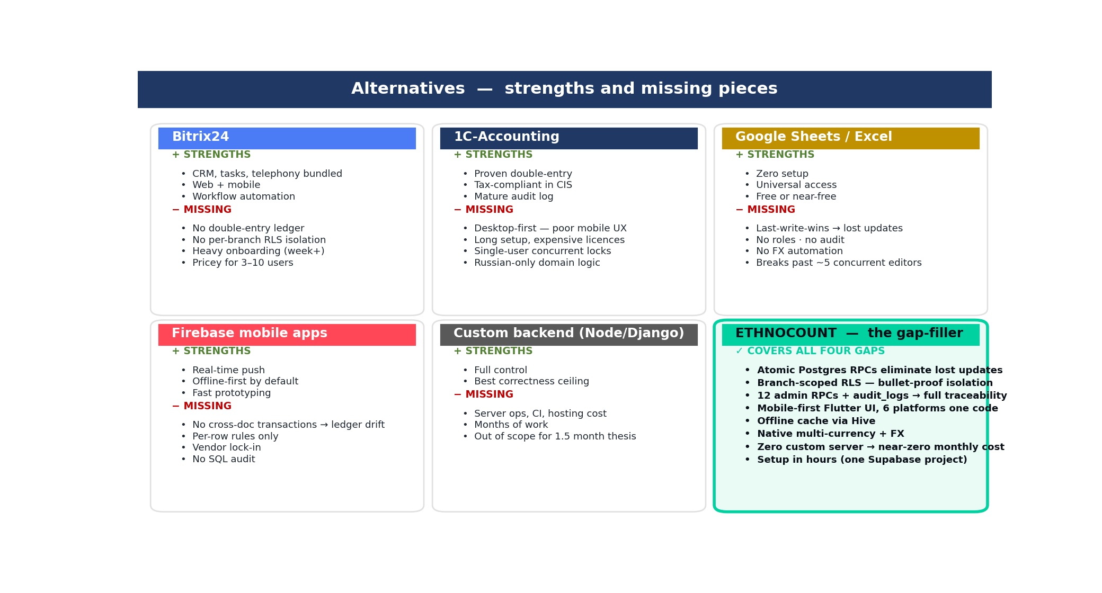
Notes:
RU: Те же 5 конкурентов, но карточками: что они делают хорошо, что отсутствует именно в нашем кейсе. Ethnocount — карточка справа-снизу — закрывает все дыры.

Slide 6
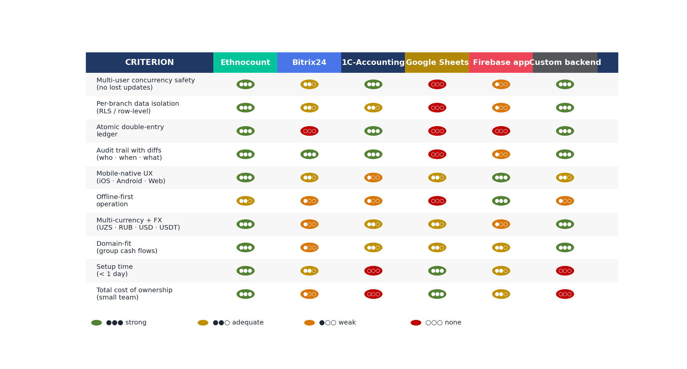
Competitive matrix — 10 criteria × 6 products
Notes:
RU: Глубокий benchmark — 10 критериев × 6 продуктов. Зелёные точки = strong. Ethnocount — единственный со strong на 7/10. Каждый конкурент силён в одном, но в нашем кейсе у всех есть критичная дыра.

Slide 7
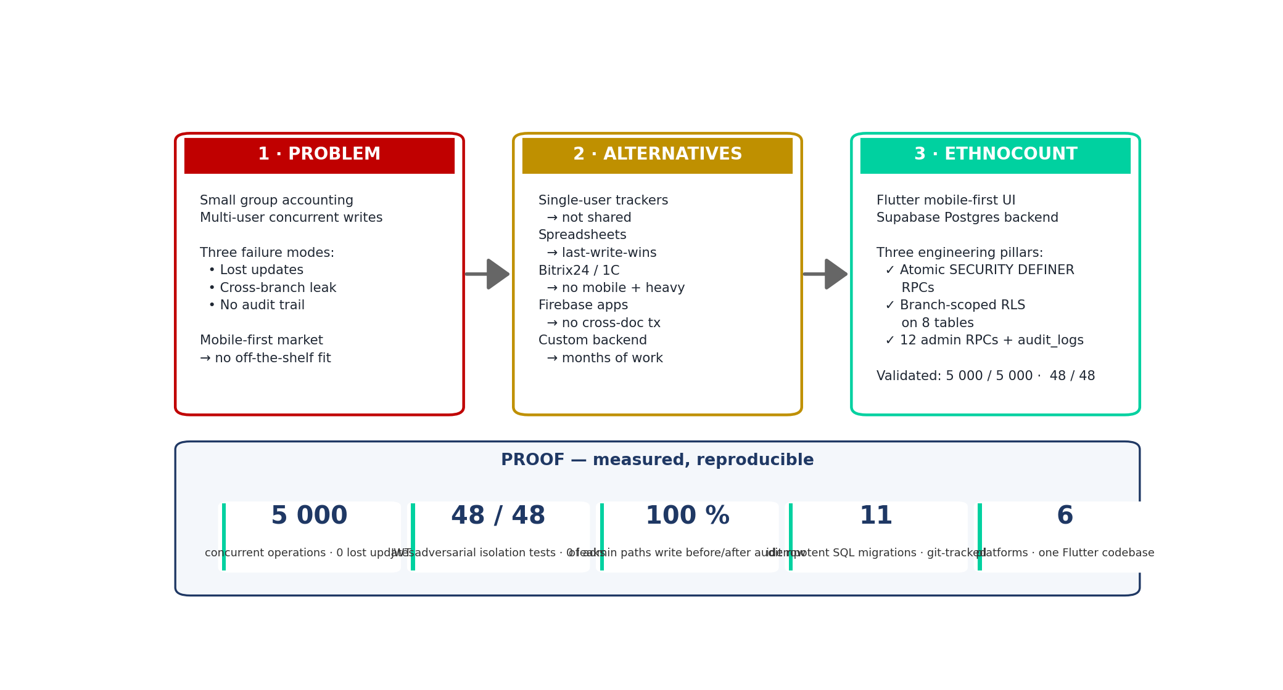
Solution flow — problem → alternatives → Ethnocount
Notes:
RU: Транзишн-слайд. Слева — проблема, в центре — почему альтернативы не подходят, справа — наше решение. Внизу — 5 цифр-доказательств.

Slide 8
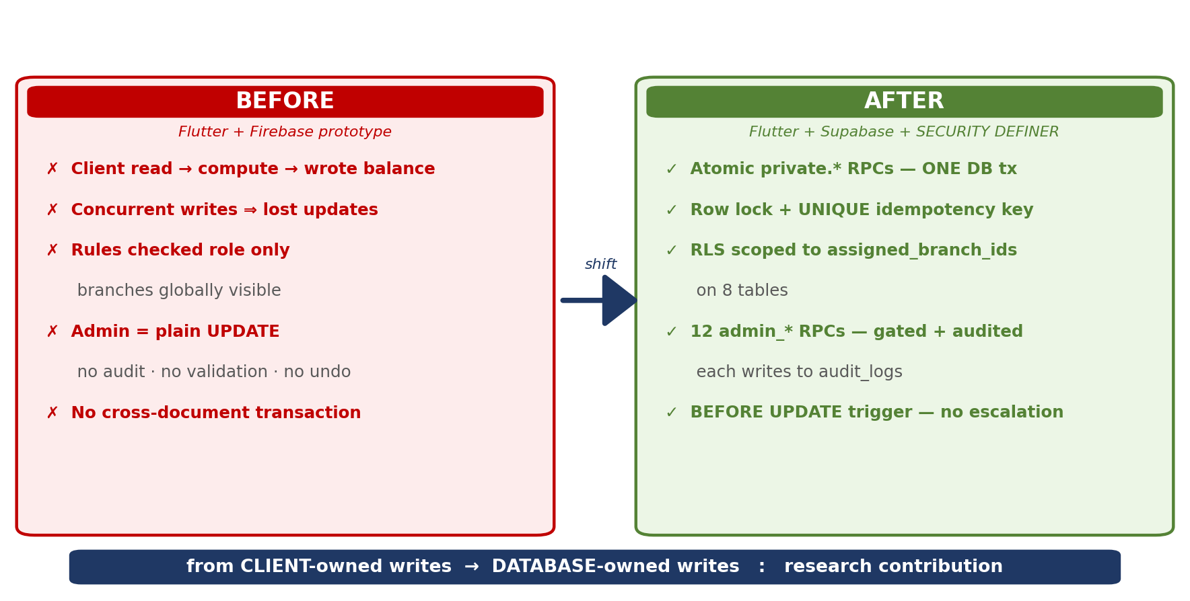
My approach — Modernization
Notes:
RU: САМЫЙ ВАЖНЫЙ слайд. 'The shift from client-owned writes to database-owned writes is the core contribution.'

Slide 9
Research methodology
1. LITERATURE & MARKET ANALYSIS
Review of competitor apps (Splitwise, Wave, QuickBooks, 1C, SAP/Kyriba)
plus Firebase Rules / Postgres RLS / stored-procedure documentation.
2. SYSTEM DESIGN (Clean Architecture)
data → domain → presentation; BLoC; get_it / injectable DI.
3. SOFTWARE ENGINEERING
Flutter 3 / Dart | Supabase (Postgres 16) | Hive read-side cache
GoRouter | freezed + json_serializable codegen.
4. ITERATIVE PROTOTYPING — GitHub, feature-driven, 66 numbered SQL migrations.
5. TESTING & EVALUATION
unit / widget / integration · concurrency stress · JWT impersonation
audit coverage · 2-week parallel-use trial with a real exchange operator.
Notes:
RU: 5 методов. 'Hypothesis is proven by concurrency stress tests and JWT impersonation tests.'

Slide 10
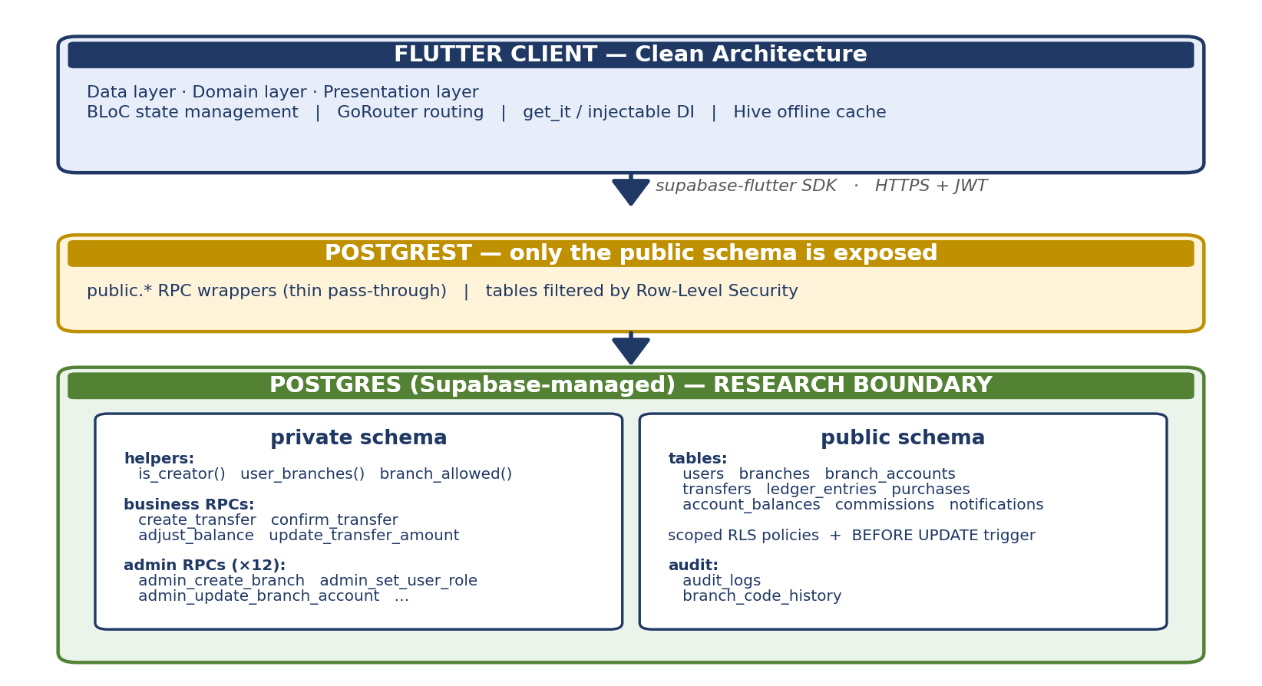
System architecture — where the research happens
Notes:
RU: Flutter → PostgREST → Postgres. Research живёт в БД, в схеме private. Клиент ничего не пишет напрямую.

Slide 11
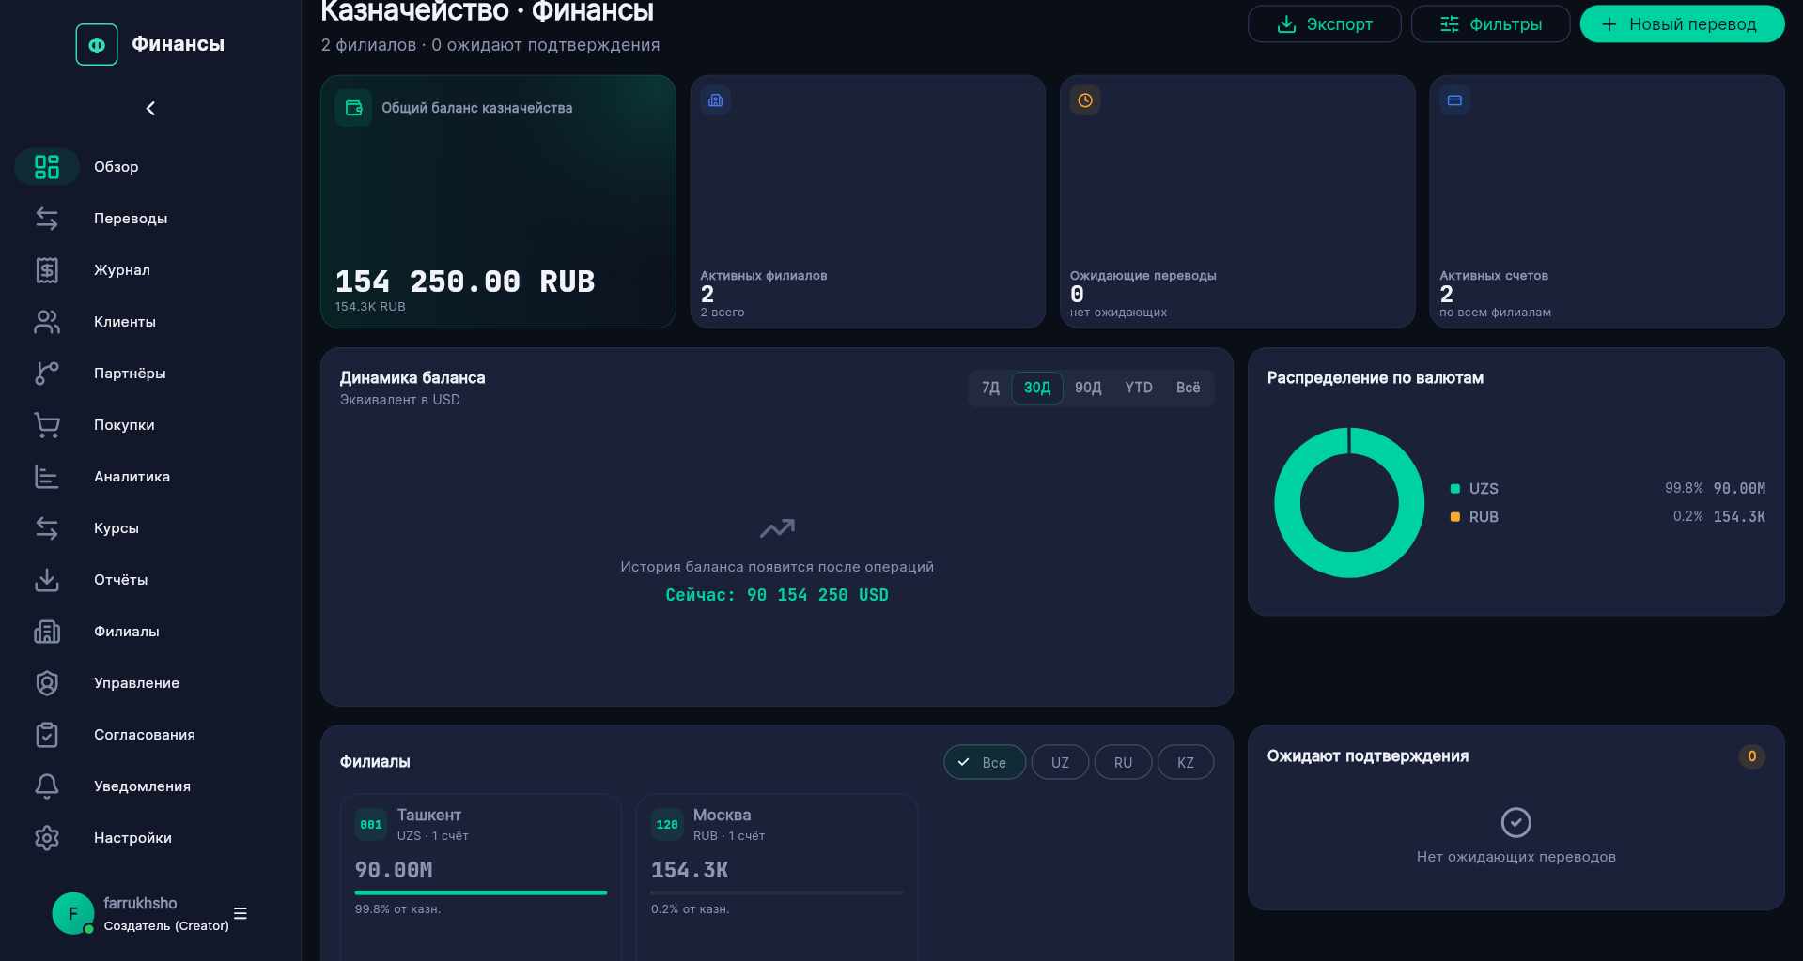
App in action — Dashboard (live UI, dark fintech theme)
Notes:
RU: ОТВЕТ НА ЗАМЕЧАНИЕ ПРЕ-ЗАЩИТЫ. Главный экран — hero balance, KPI tiles, live FX (Supabase Realtime), recent transfers, activity feed. Material 3 dark.

Slide 12
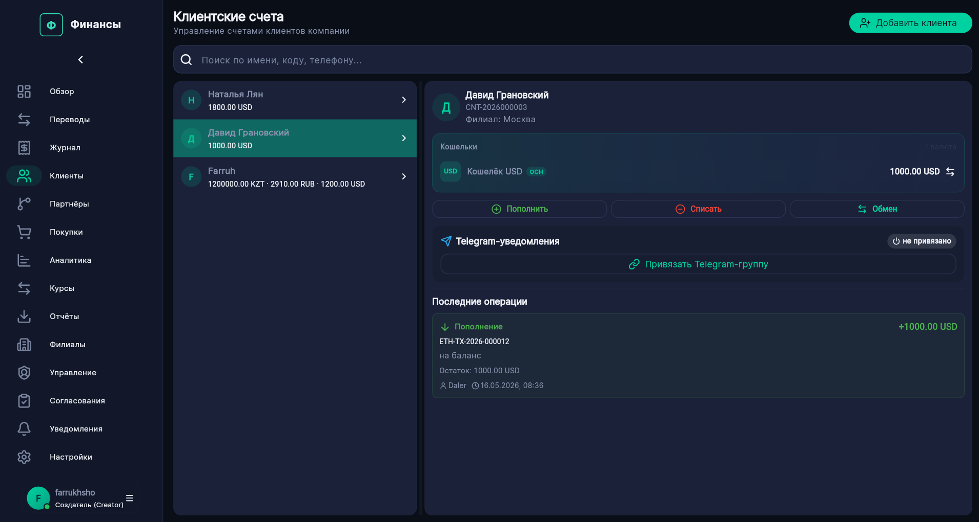
App in action — Partners (new feature, May 2026)
Left: partner master/detail with per-currency saldo (red = we owe · green = partner owes us).
Right: atomic partner-transfer dialog — debits the operator's till + moves partner saldo
in one DB transaction. Same architectural pattern, applied to a treasury feature.
Real partner-in-Moscow case — proves Theses 1 and 3 hold for cross-border settlement.
Notes:
RU: Фича последней недели. Кейс 'Тима в Москве'. Слева — partners со saldo per currency. Справа — partner-transfer dialog. ОДНОЙ транзакцией: debit + transfer + saldo.

Slide 13
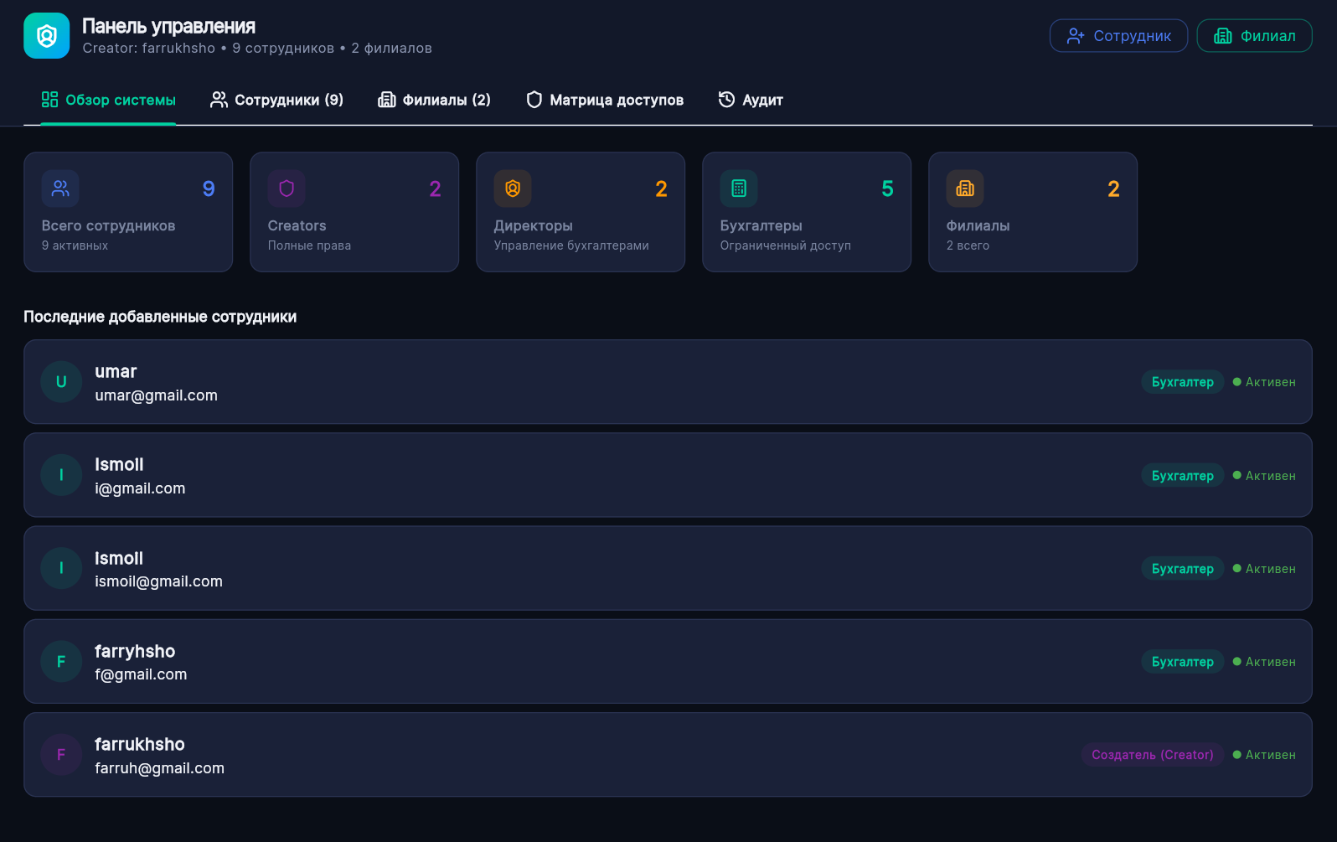
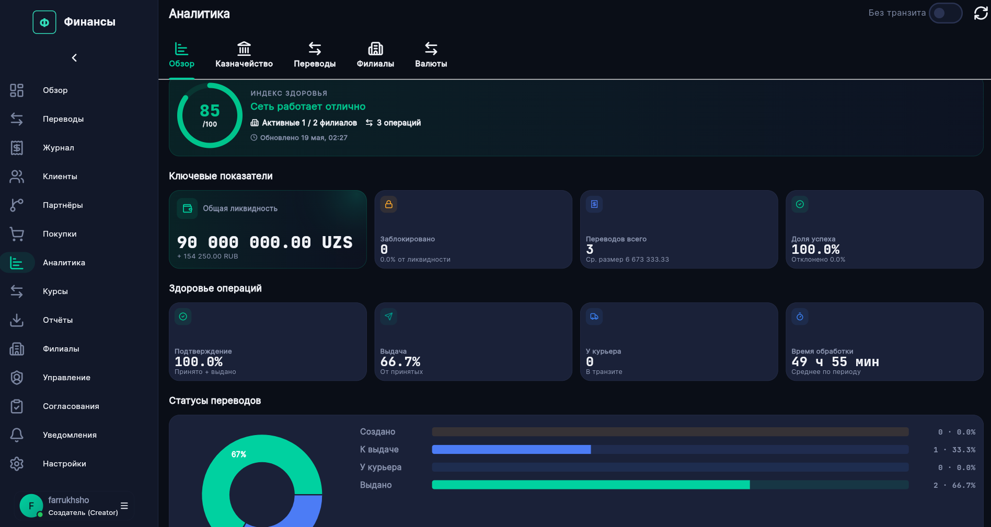
App in action — Approvals + Analytics
Left: director approve-workflow — every accountant amend/delete is gated and audited.
Right: analytics built on Postgres views — no separate analytics service.
These two screens together implement Thesis 3 (narrow audited admin surface) in production code.
Notes:
RU: Слева — director approve-workflow с audit_logs. Справа — analytics на Postgres views. Вместе реализуют Тезис 3.

Slide 14
Thesis 1 — Atomic ledger through SECURITY DEFINER RPCs
PROBLEM client-side read → compute → write loses updates.
SOLUTION every money movement is ONE database transaction:
• private.create_transfer debit source, lock row, record ledger
• private.confirm_transfer credit destination + commission row
• private.create_partner_transfer debit + transfer + partner saldo (NEW, May)
• private.adjust_balance single-row generic adjustment
• private.update_transfer_amount atomic amend with reversal
GUARANTEES FROM POSTGRES
• SELECT … FOR UPDATE on account_balances → no lost updates
• UNIQUE idempotency_key → duplicate-click safety
• SECURITY DEFINER → client cannot bypass the RPC
Notes:
RU: 'Instead of client doing read-compute-write, the database does everything in ONE transaction.' 3 гарантии Postgres: FOR UPDATE, UNIQUE, SECURITY DEFINER.

Slide 15
Thesis 2 — Branch-scoped RLS for tenant isolation
BEFORE users.assigned_branch_ids existed but RLS never read it.
Accountant A could SELECT data of Branch B — policy checked only role.
AFTER three helper functions:
• private.is_creator() → is the caller an active Creator?
• private.user_branches() → branches assigned to auth.uid()
• private.branch_allowed(id) → creator ∨ id ∈ user_branches()
Scoped RLS policies applied to 8 tables:
branches, branch_accounts, account_balances, transfers,
ledger_entries, purchases, commissions, notifications.
+ BEFORE UPDATE trigger users_guard_self_edit
accountants may change only display_name / phone / photo_url on their own row.
Notes:
RU: Раньше поле декоративное. Теперь 3 хелпера в политиках 8 таблиц + триггер.

Slide 16
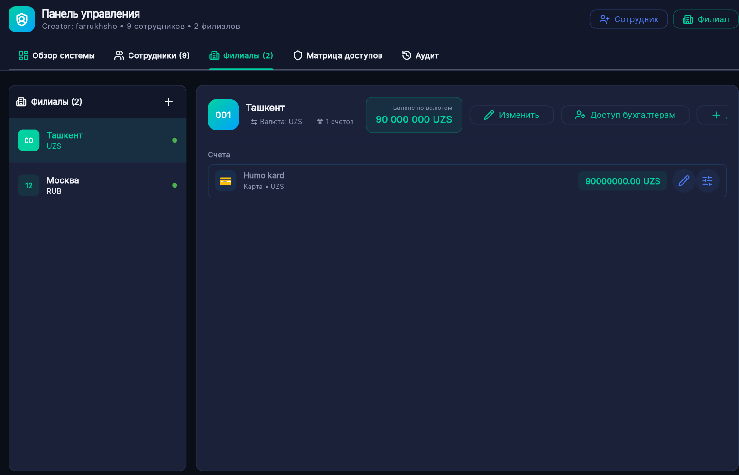
Thesis 3 — Narrow, audited admin surface
Notes:
RU: 12 admin RPC, все под is_creator, все пишут diff в audit_logs. Methodology — feature-driven, 11 миграций.

Slide 17
Conclusion
The narrow research question was answered with three validated theses:
1. Atomic SECURITY DEFINER RPCs eliminated race conditions — T1: 0 / 5 000 lost updates.
2. Branch-scoped RLS + self-edit trigger blocked adversarial access — T2: 48 / 48.
3. Narrow admin RPCs + Director approval workflow + audit_log made every critical change traceable — T3: 100 %.
Contribution to the field — novelty
A replicable pattern for plain-Postgres-only enforcement of a three-balance-domain treasury model
(own funds · per-currency partner saldo · client wallet), driven from a Flutter client without a custom server.
Demonstrated on a production-grade cross-platform treasury and money-transfer platform (Ethnocount).
Future work
Pending-partner-payout state · partial payouts · automatic FX-rate ingestion · ordered offline write queue · TLA⁺ verification of the RPC layer.
Thank you for your attention.
Questions are welcome.
Notes:
RU: 3 тезиса, 3 цифры, 1 вклад. Заучи contribution: 'a replicable pattern for using plain Postgres primitives from a Flutter client, without a custom server.'

