Slide 1
Mobile Attendance System
By Farrukh Jahangeer
2960928

Slide 2
Problem
Attendance are done manually on paper:
It is time consuming for lecturer and student during lecture
It has lots of paper work for administration
Risk of human error
Not hygienic because of pandemic issue

Slide 3

Solution
Make a mobile application to take attendance, lecturer should open attendance for a certain amount of time during the lecture to allow student to mark themselves as present.
The faculty and lecturer can access the attendance in real-time and does not need to check and count attendance from attendance sheet which saves their time.
It reduces the amount of paper resources needed.
Reduce the risk of Human error

Slide 4
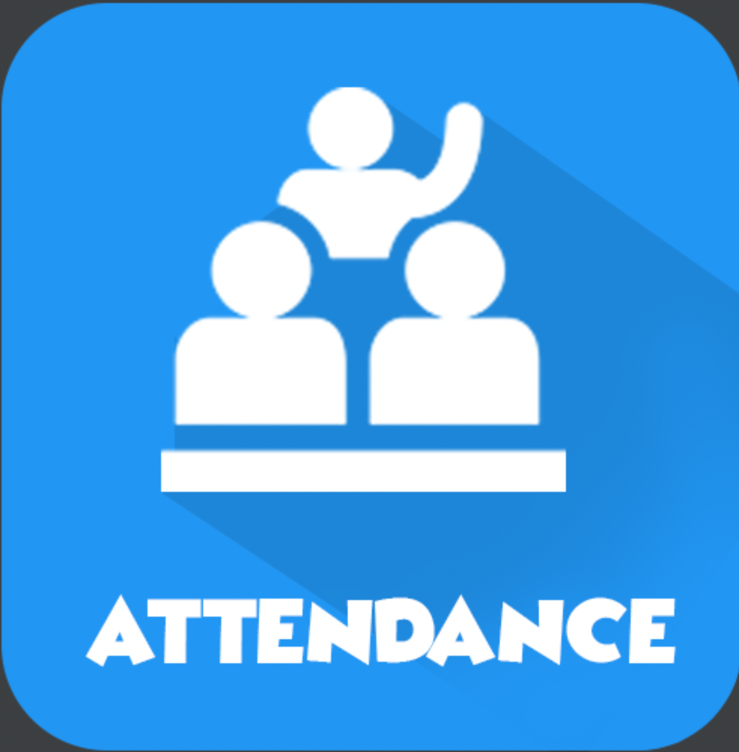
About Application
This application is a mobile attendance system that runs on android OS.
This application intends to make taking attendance easier for lecturers and administration.
The users for this application are:
Admin (Administration)
Lecturer
Student
The users’ login to use the application

Slide 5
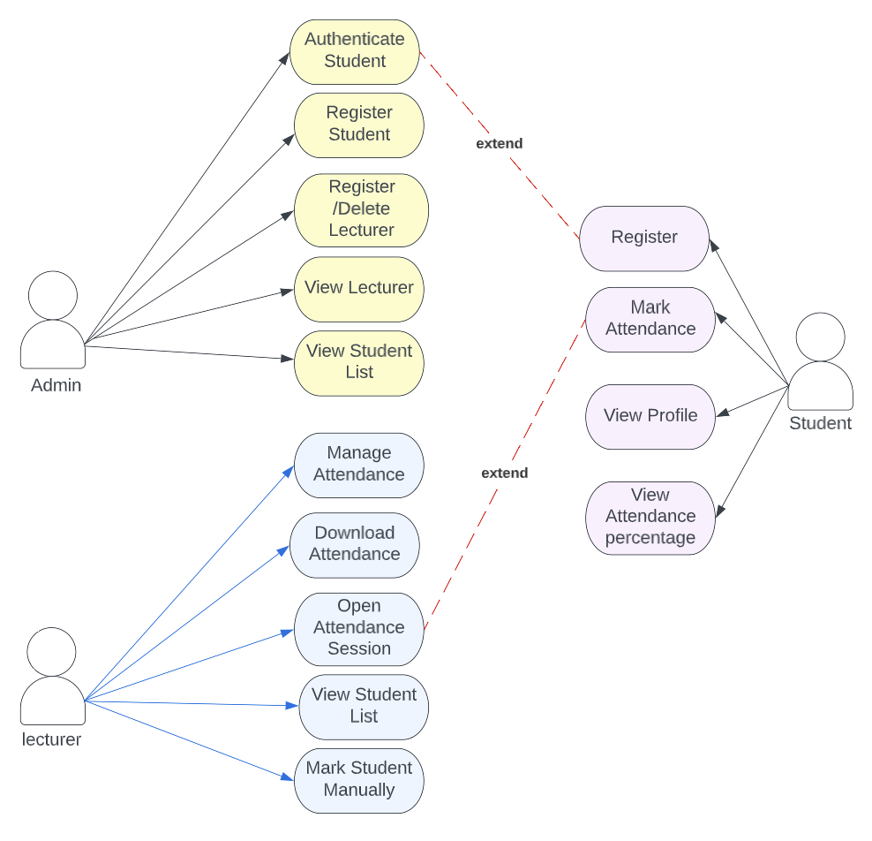

Slide 6

Technologies
The development tool used is the Android Studio
The application is developed in Kotlin language
The storage used is Firebase.

