Slide 1
Coding Temple
Flex Data Analytics Program
Capstone II Project
Prepared by: Farrukh Sultan

Slide 2
Presentation Overview
Recommendations
Exploratory Data Analysis
Dataset Introduction

Slide 3
Dataset Introduction

Slide 4
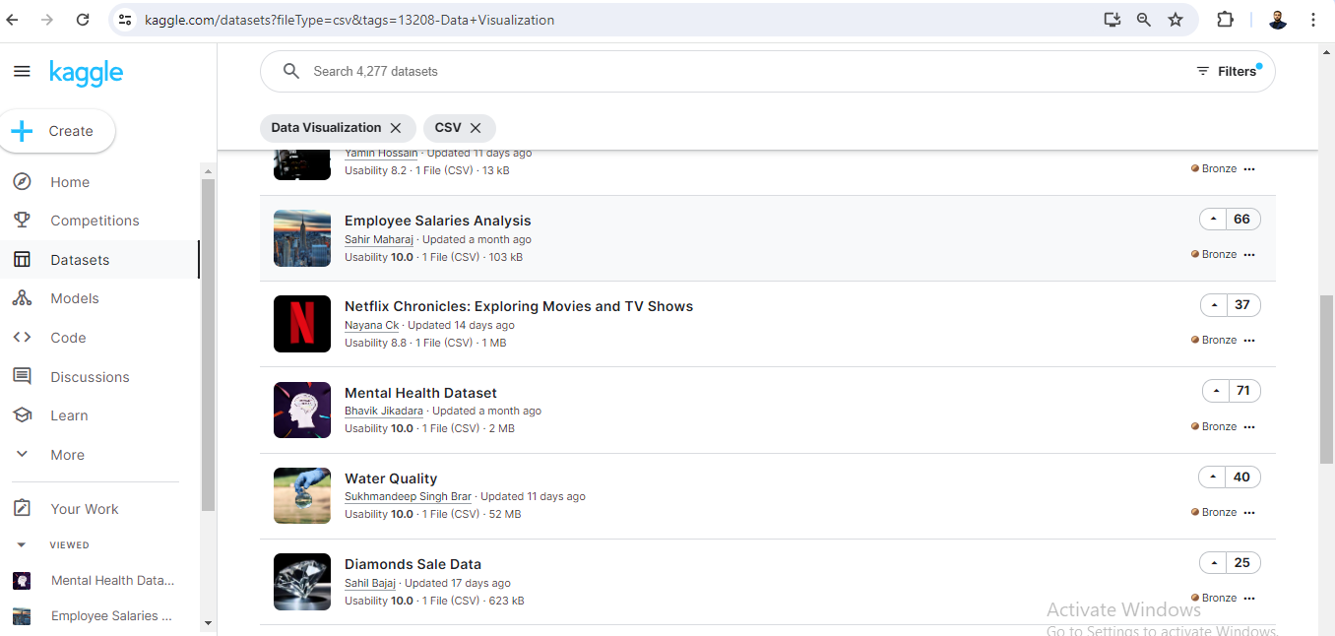

Slide 5

Dataset Description and Characteristics
Country
Gender
Occupation
Family history
Treatment sought
Days spent indoors
Stress levels
Changes in habits
Mood swings
Coping struggles
Work interest
Social weakness
Mental health interview participation

Slide 6

Exploring Mental Health: A Data-driven Analysis
Understanding Patterns and Trends in Mental Health Across Demographics
Data Analysis Tool:

Slide 7
Total number of individuals: 292,364
Total number of countries: 35
Period: 3 Years (Aug 2014 to Feb 2016)

Slide 8

Exploratory Data Analysis

Slide 9
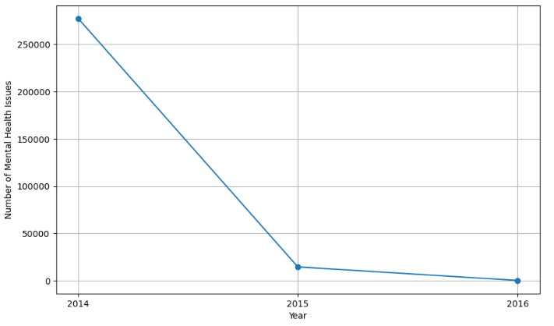
Temporal Trends in Mental Health Issues

Slide 10
Top 5 Countries with Highest Recorded Mental Issues
Country | Cases | %
United States | 171,308 | 59%
United Kingdom | 51,404 | 18%
Canada | 18,726 | 6%
Australia | 6,026 | 2%
Netherland | 5,894 | 2%
All others | 39,006 | 13%

Slide 11
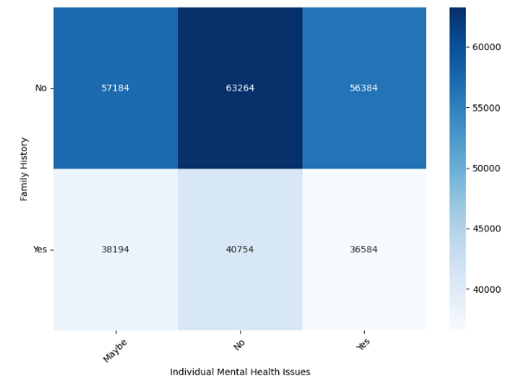
Relationship Between Family History and Individual Mental Health Issues

Slide 12
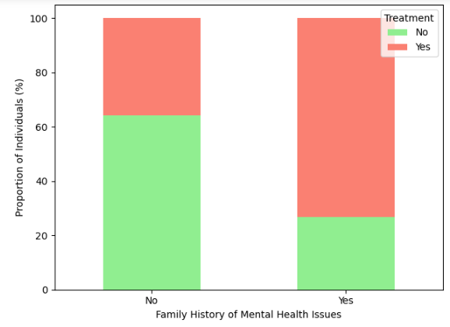
Proportion of Individuals Seeking Treatment by Family History

Slide 13
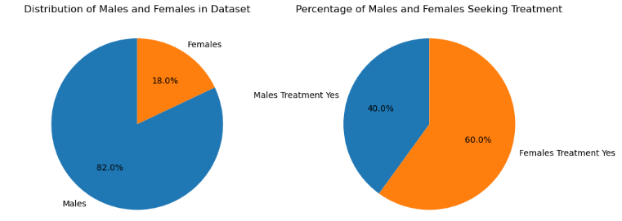
Proportion of Individuals Seeking Treatment by Gender

Slide 14
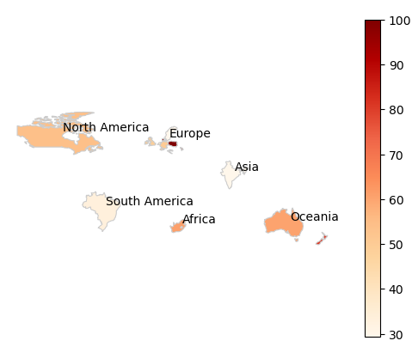
Prevalence of Mental Health Issues Treatment

Slide 15
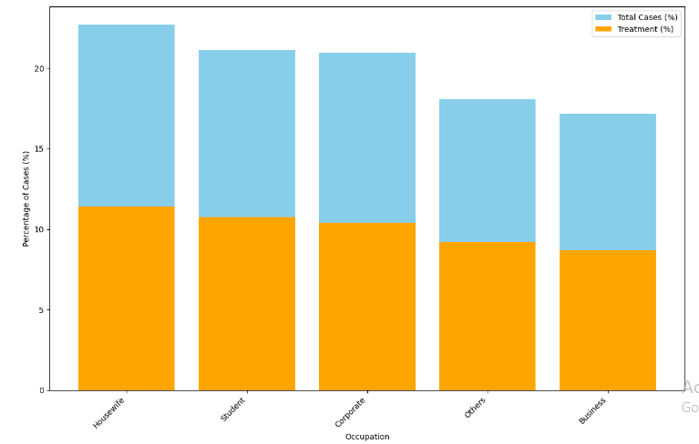
Total Cases Reported by Occupation (with Treatment)

Slide 16
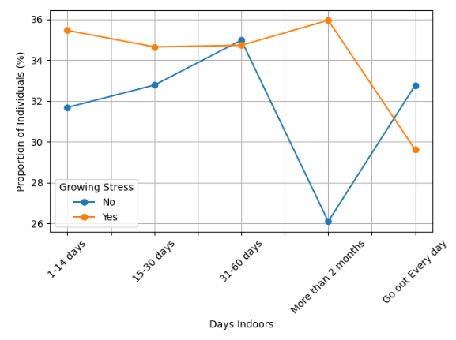
Relationship Between Days Indoors and Growing Stress

Slide 17
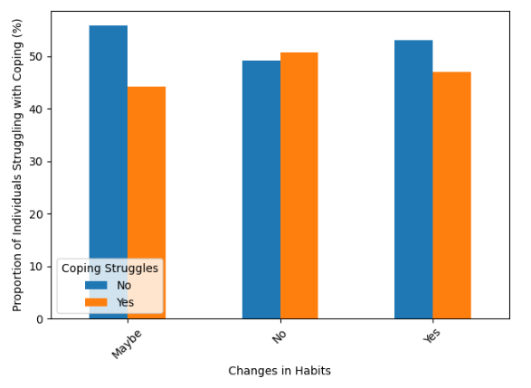
Coping Struggles with and without Changes in Habits

Slide 18
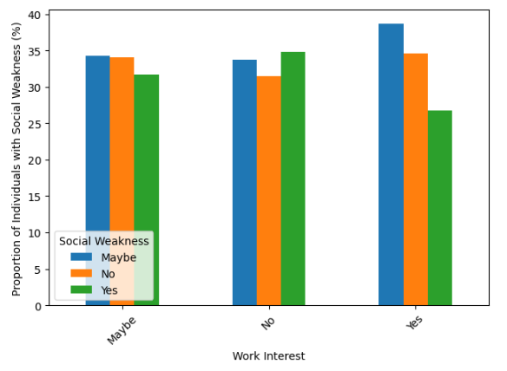
Relationship of Social Weakness Levels and Work Interest

Slide 19
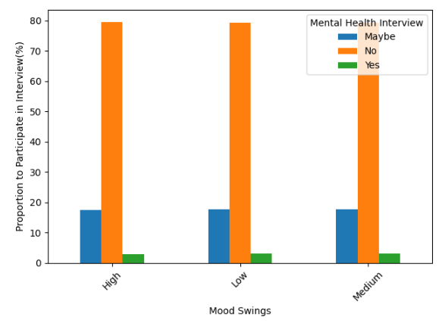
Participation in Mental Health Interview Based on Mood Swing Intensity

Slide 20
Recommendations

Slide 21
Improving Data Collection
Integrate Mental Health Services
Promote Workplace Wellness
Promoting Mental Health Literacy
Addressing Stigma
Expand Telehealth Services
Advocate for Policy Change
Invest in Innovation and Research
Recommendations

Slide 22
End of the presentation! Thank you! Farrukh Sultan Email: farrukh.sahi@gmail.com

