Slide 1


Impact on IFRS 15
Internal
Xin Fang
Product Owner
LoB Finance

Slide 2
Impact on IFRS
General Review of 5-Step Model of New IFRS 15
Comparison to existing guidance
Going through 3 examples with 5 steps
Other key comparison to existing contract
Summary View on 3 cases

Slide 3
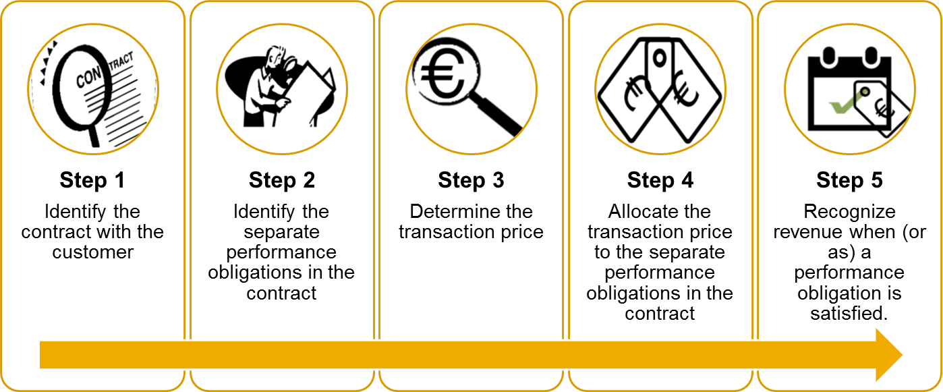
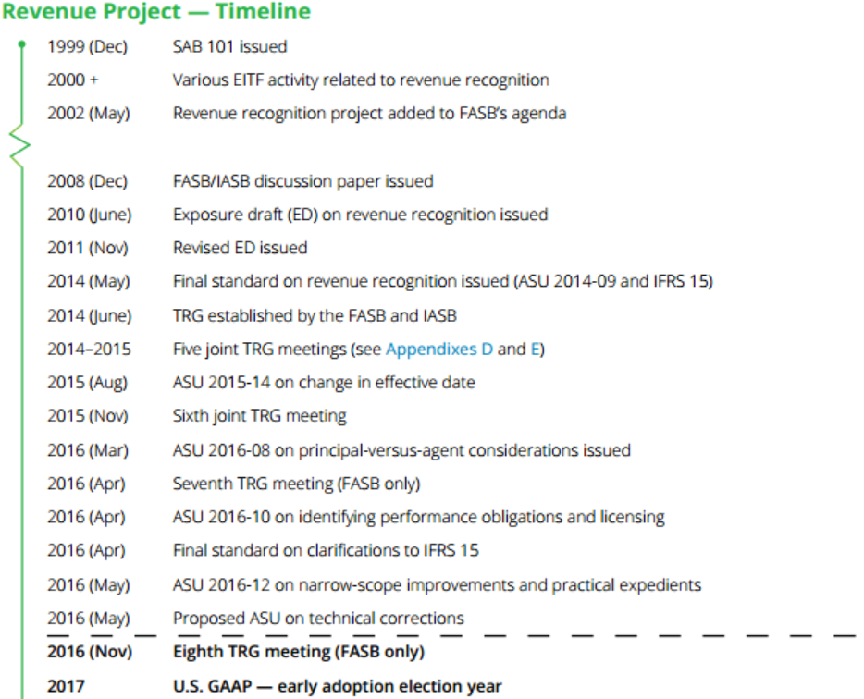
General Review of the Key Five Step Model
Key Concept:
Revenue recognition depicts transfer of promised goods or services to customer in amount that reflects consideration to which an entity expects to be titled.
Scope and Impact:
Contracts with customer of all industries
Removing existing industry-specific guidance
Merge construction contract into IFRS 15
Out of Scope:
Lease/Insurance Contract/Financial Instrument
Guarantees
Certain nonmonetary exchange.

Slide 4
Starting with Cases and Examples
Case #1: Software Industry
Enterprise Agreement: License and Software Assurance (Maintenance)
Case #2: Telco Industry
Device(Smartphone) and Service Contract
Case #3: Construction Industry
Construction with incentive fee and bonus
Contract Term
Total Contract Price | 3 million USD
Duration | 36 Months
License SSP | 1.8m USD
SA SSP | 1.2m USD
Billing | Amount
Billing per year (3 years) | 1 million per year
Total Billing | 3 million
Contract Term
Total Contract Price | 250 EUR
Duration | 24 Months
Device SSP | 100 EUR
Service SSP | 200 EUR
Can be renewal | Extend by 12 months
Billing | Amount
Cash upfront | 10 EUR
Billing per month (2 years) | 10 EUR per month
Total Billing | 250 EUR
Contract Term
Total Contract Price | 2.5 Million EUR
Incentive fee | +/- 10,000 EUR * day before/after deadline
Bonus | 0.1 Million EUR if KPI is met
Billing
Milestone Billing | Quarterly PoC based
Incentive fee + Bonus | At the end of contract
Notes:
Case 1: Microsoft
Case 2: VF: to mention month-to-month contract
Case 3: IE 21/para IE105
Case 1: Maintenance is also called PCS

Slide 5
Step 1: Identify the Contracts with a Customer
Existing Guidance
New Guidance
Generally consistent with existing practice
Contract is an agreement between parties that creates legally enforceable rights
Little guidance on contract modifications
Explicit guidance provided
Guidance on Portfolio Contract
 | Contract exists | Duration
Case #1 (Software) | Yes | 3 year
Case #2 (Telco) | Yes | 24 month
Case #3 (Construction) | Yes | Up to the end of the contract
Notes:
Telecom: Month-to-Month contract

Slide 6
Step 2: Identify the Performance Obligation
Existing Guidance
New Guidance
Performance obligations and Distinct replace deliverable and standalone value in assessing multiple element arrangements
Deliverables must have standalone value to be accounted for separately
 | Existing Guidance | New Guidance
Case #1 (Software) | Some entities account for 1 component/Some entities account for 2 components | 2 Performance Obligations: License Software Assurance
Case #2 (Telecom) | 2 components | 2 Performance Obligations Device Service
Case #3 (Construction) | 1 component | 1 Performance Obligation: Construction
Notes:
Software: development and PCS as single component under current IFRS
Current US-GAAP 605: If the VSOE is not available, it shall be recognized after the last element is delivered: specified upgrades: page 13 software products: page 13
Specified software upgrade
Unspecified software upgrade: not consistent

Slide 7
Step 3: Determine the Transaction Price
Existing Guidance
New Guidance
Entities must assess whether a significant financing component exists
Arrangement’s fee must be fixed or determinable for revenue to be recognized
Discounting of revenues required in limited circumstances
Variable consideration must be estimated subject to a constraint
 | Existing Guidance | New Guidance
Case #1 (Software) | 3 Million USD | 3 Million USD
Case #2 (Telecom) | 250 EUR | Transaction Price: 250 EUR Need to revise after step 4.
Case #3 (Construction) | 2.5 Million EUR at beginning 0.1 Million EUR at the end. | 2.6 Million USD ( + 0.1 Million USD Bonus ) Review the estimates regularly

Slide 8
Step 4: Allocate the Transaction Price to the Performance Obligation
Existing Guidance
New Guidance
Unified using Standalone Selling Price approach
Allocate transaction price to multiple deliverables based on relative selling price
Discounting of revenues required in limited circumstances
Entities must assess whether a significant financing component exists
Industry-specific method, heavily depending on cash/payment
May accelerate revenue recognition
Notes:
VSOE software specific
Vair value

Slide 9
Step 4: Allocate the Transaction Price to the Performance Obligation
Existing Guidance
New Guidance
Case #1:
 | VSOE | Allocated Price
License | 1.8M | 1.8M USD
Software Assurance | 1.2M | 1.2M USD
 | SSP | Allocated Price
License | 1.8M USD | 1.8M USD
Software Assurance | 1.2M USD | 1.2M USD
Case #2:
 |  | Allocated Price
Device | Limited to upfront fee | 10 EUR
Service | Periodic billing | 240 EUR
Financial component exists
 | SSP | Allocated Price
Device | 100 EUR | 73.53 EUR
Service | 240 EUR | 176.47 EUR (7.35 EUR/Month)
Device transaction price is based on NPV (interest rate 10%)
Revise Step 3: determine the transaction price
 | SSP | Allocated Price
Device | 100 EUR | 67.54 EUR
Service | 240 EUR | 176.47 EUR
Total Interest |  | 5.69 EUR
Notes:
Case 3 is omitted

Slide 10
Step 5: Recognize Revenue
Existing Guidance
New Guidance
Revenue recognized when or as control of good or service transfers to the customer
Recognition based on transfer of the risks and rewards of ownership
Criteria identified for assessing whether performance obligation is satisfied at a point in time or over time
 | Existing Guidance | New Guidance
Case #1 (Software) | License and Software Assurance are both recognized over time. | License: Recognized upfront 1.8 Software Assurance: Recognized overtime
Case #2 (Telecom) | Device: Recognized upfront Service: Recognized overtime | Device: Recognized upfront Service: Recognized overtime Interest revenue: Recognized overtime
Case #3 (Construction) | PoC based on 2.5 million 0.1 million recognized when KPI is reached | PoC based on 2.6 million

Slide 11
Case Summary

Slide 12
Case 1: Software Industry
Year 1 Year 2 Year 3

Slide 13
Case 2: Telecom Industry
Year 1 Year 2 Year 3

Slide 14
Case 3: Construction Industry

Slide 15
Other Changes(1) – Presentation – Receivable/Contract Asset
Due to “accelerated revenue”, recognition is in advance to billing(Account Receivable)
IFRS 15 reinforce the definition of Receivable: Unconditional right to the consideration. A right is unconditional only if the passage of time is required.
Conditional right to the consideration is ‘Contract Asset’.
Q: On Y1, 1 million is billed, 2.2 million revenue is recognized, how should the entity record the receivable?
A: On Y1: License and SA delivered to customer (2.2 Million), the entity should record a Receivable of 2.2 Million even though only 1 million is billed (1m Billed Receivable + 1.2 Unbilled Receivable)
 | Cash | Receivable | Contract Asset
Risk | Low | Medium | High
Timing to be recorded | Latest | Medium | Earliest

Slide 16
Other Changes(2) – Cost
Sales Commission of Telecom industry requires to be amortized
Cost has be adjusted to follow the ‘Matching-Principle’

Slide 17
Reference
IFRS: Revenue from Contracts with Customer, Illustrative Example, Basis for Conclusions
Deloitte: A Roadmap to Applying the New Revenue Recognition Standard 2016
Applying IFRS in Software and Cloud Services:
http://www.ey.com/Publication/vwLUAssets/Applying_IFRS_in_Software_and_Cloud_Services:_The_new_revenue_recognition_standard_-_software_and_cloud_services/$File/Applying%20IFRS-Tech(Software)-Rev-Jan2015.pdf
Applying IFRS in Telecommunications:
http://www.ey.com/Publication/vwLUAssets/Applying_IFRS_in_Telecommunications:_The_new_revenue_recognition_standard_-_telecommunications./$File/Applying-Telcos-Mar2015.pdf
Telcos – Implementing IFRS 15:
https://home.kpmg.com/xx/en/home/insights/2014/06/revenue-leaflet-telecommunication.html

Slide 18
Thank you
Contact information:
Xin Fang
I042117
xin.fang@sap.com

Slide 21
The Grid
Headline area
White space
Drawing area

