Slide 1


IFRS 15
Internal
Xin Fang

Slide 2
IFRS impact
General Review of 5-Step Model
Starting with 3 examples
Comparison to existing guidance
Going through 3 examples with 5 steps
Other key comparison to existing contract
Summary

Slide 3
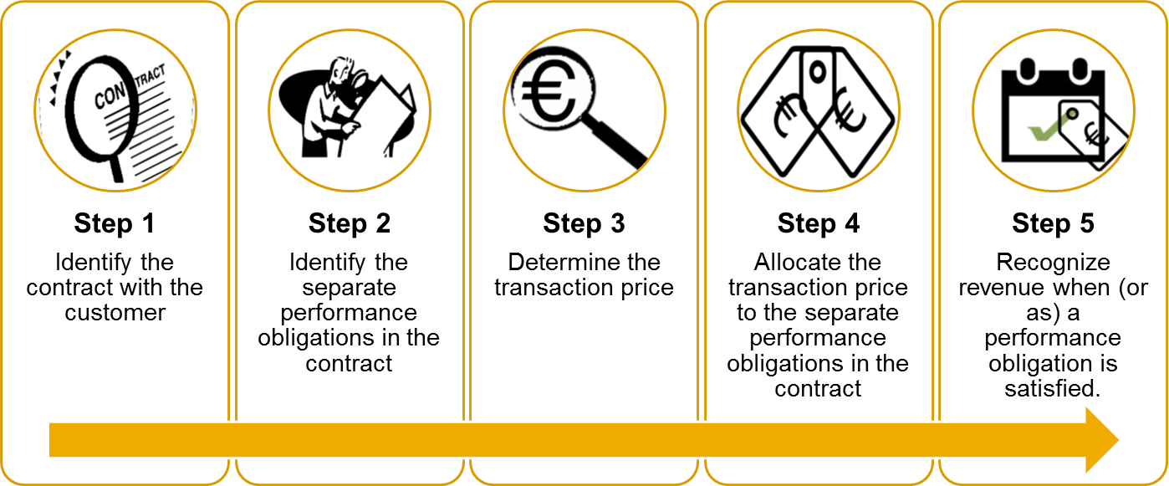
General Review of the Key Five Step Model
Key Concept:
Revenue recognition depicts transfer of control to customer in amount that reflects consideration to which an entity expects to be titled.
Scope and Impact:
Contracts with customer of all industries
Removing existing industry-specific guidance
Merge construction contract into IFRS 15
Out of Scope:
Lease/Insurance Contract/Financial instrument
Guarantees
Certain nonmonetary exchange.

Slide 4
Starting with Examples
Case #1: Software Industry
Enterprise Agreement: License and Software Assurance (Maintenance)
Case #2: Telco Industry
Device(Smartphone) and Service Contract
Case #3: Construction Industry
Construction with incentive fee and bonus
Contract Term
Total Contract Price | 3 million USD
Duration | 36 Months
License SSP | 1.8m USD
SA SSP | 1.2m USD
Billing | Amount
Billing per year (3 years) | 1 million per year
Total Billing | 3 million
Contract Term
Total Contract Price | 250 EUR
Duration | 24 Months
Device SSP | 100 EUR
Service SSP | 200 EUR
Can be renewal | Extend by 12 months
Billing | Amount
Cash upfront | 10 EUR
Billing per month (2 years) | 10 EUR per month
Total Billing | 250 EUR
Contract Term
Total Contract Price | 2.5 Million EUR
Incentive fee | +/- 10,000 EUR * day before/after deadline
Bonus | 0.1 Milllion EUR if KPI is met
Billing
Milestone Billing | Quarterly PoC based
Incentive fee + Bonus | At the end of contract
Notes:
Case 1: Microsoft
Case 2: VF: to mention month-to-month contract
Case 3: IE 21/para IE105

Slide 5
Step 1: Identify the contracts with a customer
Existing Guidance
New Guidance
Generally consistent with existing practice
Contract is an agreement between parties that creates legally enforceable rights
 | Contract exists | Duration
Case #1 (Software) | Yes | 2 year
Case #2 (Telco) | Yes | 24 month
Case #3 (Construction) | Yes | Up to the end of the contract
Notes:
Telecom: Month-to-Month contract

Slide 6
Step 2: Identify the performance obligation
Existing Guidance
New Guidance
Performance obligations and distinct replace deliverable and standalone value in assessing multiple element arrangements
Deliverables must have standalone value to be accounted for separately
 | Existing Guidance | New Guidance
Case #1 (Software) | 1 single component (can vary from entity policies) | 2 Performance Obligations: License Software Assurance
Case #2 (Telecom) | 1 single component | 2 Performance Obligations Device Service
Case #3 (Construction) | 1 component | 1 Performance Obligation: Construction

Slide 7
Step 3: Determine the transaction price
Existing Guidance
New Guidance
Entities must assess whether a significant financing component exists
Arrangement’s fee must be fixed or determinable for revenue to be recognized
Discounting of revenues required in limited circumstances
Variable consideration must be estimated subject to a constraint
 | Existing Guidance | New Guidance
Case #1 (Software) | 3 Million USD | 3 Million USD
Case #2 (Telecom) | 250 EUR | Transaction Price: 244.31 EUR Financial component: 5.69 EUR
Case #3 (Construction) | 2.5 Million EUR at beginning 0.1 Million EUR at the end. | 2.6 Million USD ( + 0.1 Million USD Bonus ) Review the estimates regularly

Slide 8
Step 4: Allocate the transaction price to the performance obligation
Existing Guidance
New Guidance
Generally consistent with existing practice, unified using standalone Selling Price approach
Allocate transaction price to multiple deliverables based on relative selling price, specific
Discounting of revenues required in limited circumstances
Entities must assess whether a significant financing component exists
Industry-specific method

Slide 9
Step 4: Allocate the transaction price to the performance obligation
Existing Guidance
New Guidance
Case #1:
 | VSOE | Allocated Price
License | 1.8M USD | 1.8M USD
Software Assurance | 1.2M USD | 1.2M USD
 | SSP | Allocated Price
License | 1.8M USD | 1.8M USD
Software Assurance | 1.2M USD | 1.2M USD
 |  | Allocated Price
Device | Limited to upfront fee | 10 EUR
Service | Periodic billing | 240 EUR
Financial component exists
Case #2:
 | SSP | Allocated Price
Device | 100 EUR | 73.53 EUR
Service | 240 EUR | 176.47 EUR
Device transaction price is based on NPV (interest rate 10%)
 | SSP | Allocated Price
Device | 100 EUR | 67.54 EUR
Service | 240 EUR | 176.47 EUR
Total Interest |  | 5.69 EUR
Notes:
VSOE:
Case 3 is omitted

Slide 10
Step 5: Recognize Revenue
Existing Guidance
New Guidance
Revenue recognized when or as control of good or service transfers to the customer
Recognition based on transfer of the risks and rewards of ownership
Criteria identified for assessing whether performance obligation is satisfied at a point in time or over time
 | Existing Guidance | New Guidance
Case #1 (Software) | License and Software Assurance are both recognized over time. | License: Recognized upfront 1.8 Software Assurance: Recognized overtime
Case #2 (Telecom) |  | Device: Recognized upfront Service: Recognized overtime Interest revenue: Recognized overtime
Case #3 (Construction) | PoC based on 2.5 million 0.1 million recognized when KPI is reached | PoC based on 2.5 million

Slide 11
Case 1: Software Industry
Year 1 Year 2 Year 3

Slide 12
Case 2: Telecom Industry
Year 1 Year 2 Year 3

Slide 13
Case 3: Construction Industry

Slide 14
Other Changes(1) – Presentation – Receivable/Contract Asset
Due to “accelerated revenue”, recognition is in advance to billing(Account Receivable)
IFRS 15 reinforce the definition of Receivable: Unconditional right to the consideration. A right is unconditional only if the passage of time is required.
Conditional right to the consideration is ‘Contract Asset’.
Q: On Y1, 1 million is billed, 2.2 million is recognized, how should the entity record the receivable?
A: On Y1: License and SA delivered to customer (2.2 Million), the entity should record a Receivable of 2.2 Million even though only 1 million is billed (1m billed receivable + 1.2 Unbilled)
 | Cash | Receivable | Contract Asset
Risk | Low | Medium | High
Timing to be recorded | Latest | Medium | Early

Slide 15
Other Changes(2) – Cost
Sales Commission of Telecom industry requires to be amortized
Cost has be adjusted to follow the ‘Matching-Principle’

Slide 16
Thank you
Contact information:
F name L name
Title
Address
Phone number
F name L name
Title
Address
Phone number

Slide 17
Reference
VSOE:
https://en.wikipedia.org/wiki/Vendor-specific_objective_evidence
Applying IFRS in Software and Cloud Services:
http://www.ey.com/Publication/vwLUAssets/Applying_IFRS_in_Software_and_Cloud_Services:_The_new_revenue_recognition_standard_-_software_and_cloud_services/$File/Applying%20IFRS-Tech(Software)-Rev-Jan2015.pdf
Applying IFRS in Telecommunications:
http://www.ey.com/Publication/vwLUAssets/Applying_IFRS_in_Telecommunications:_The_new_revenue_recognition_standard_-_telecommunications./$File/Applying-Telcos-Mar2015.pdf
KPMG
https://home.kpmg.com/xx/en/home/insights/2014/06/revenue-leaflet-telecommunication.html
http://www.revenuerecognition.com/industry/software

Slide 21
The Grid
Headline area
White space
Drawing area

