Slide 1
Random forest
Student Name: Farshad Moradi Shahrbabak

Slide 2
What is random forest?
Random forest is a supervised learning algorithm
classification problems
regression problems
It is one of the most flexible and easy to use algorithm. It creates decision trees on the given data samples, gets prediction from each tree and selects the best solution by means of voting

Slide 3
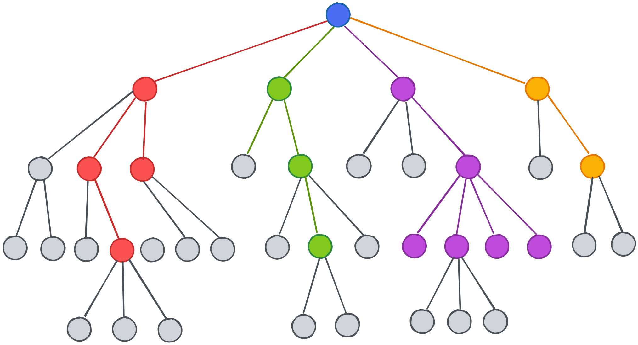
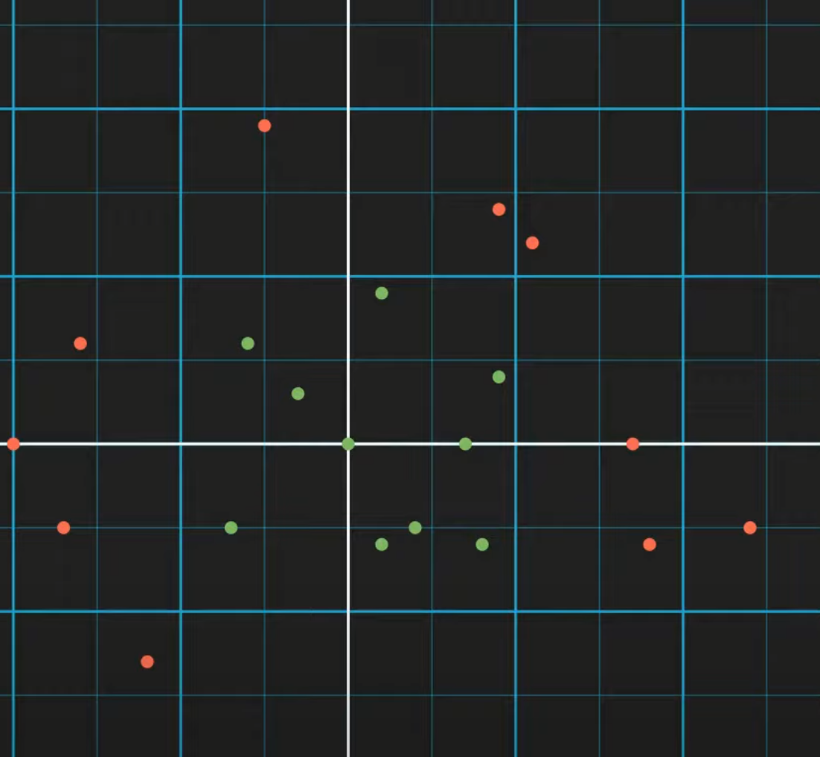
Decision trees
A decision tree is a flowchart-like tree structure where an internal node represents a feature(or attribute), the branch represents a decision rule, and each leaf node represents the outcome.
Decision trees are popular due to their simplicity and the fact that they can be visualized, which makes them easy to understand. However, they can be prone to overfitting, especially with very complex trees

Slide 4
Why should use the random forest instead decision tree?
Random forest is generally considered to be less prone to overfitting compared decision trees.
Random Forest
Less sensitive to training data.
Utilizes bootstrapping for stability.
Enhanced generalization capability compared to decision trees.
Decision Trees
Highly sensitive to training data
Prone to changing significantly with dataset variations
Difficulty in generalizing due to sensitivity

Slide 5
How random forest works
Bootstrap Aggregating (Bagging): Random Forest begins by creating multiple subsets from the original dataset, with replacement, known as bootstrap aggregating, or bagging. Each subset is used to train a separate decision tree.
Bootstrap + Aggregating Bagging
Feature Randomness: When building each tree, Random Forest introduces additional randomness. At each split, it selects a random subset of features, rather than considering all features. This ensures that the trees are diverse and reduces correlation among them.
Building Trees: Each tree is grown to the largest extent possible without pruning, leading to fully grown, deep trees.
Aggregation for Decision Making: For classification tasks, the mode of all the predictions from different trees is taken as the final prediction. For regression, the average prediction is considered.

Slide 6
Data set
Car Evaluation Database was derived from a simple hierarchical decision model. The model evaluates cars according to the following concept structure:
Buying : buying price (vhigh, high, med, low)
Maint : price of the maintenance (vhigh, high, med, low)
Doors : number of doors (2, 3, 4, 5, more)
Persons : capacity in terms of persons to carry (2, 4, more)
Lug_boot: the size of luggage boot (small, med, big)
Safety estimated safety of the car (low, med, high)
Class Values: unacc, acc, good, vgood
DEX, M. Bohanec, V. Rajkovic: Expert system for decision making. Sistemica 1(1), pp. 145-157, 1990
Link of dataset

Slide 7
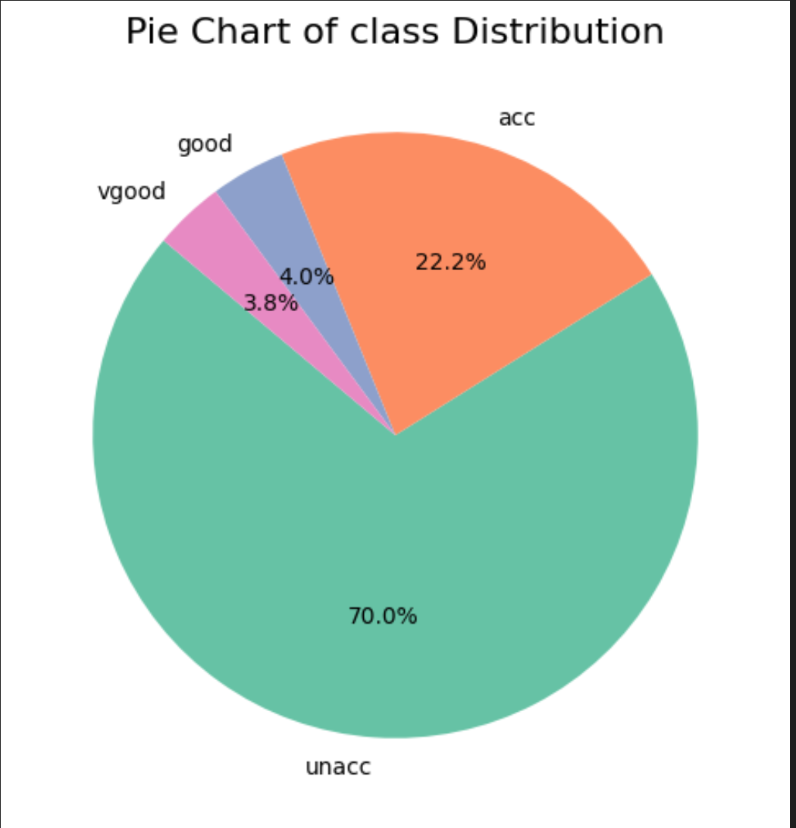
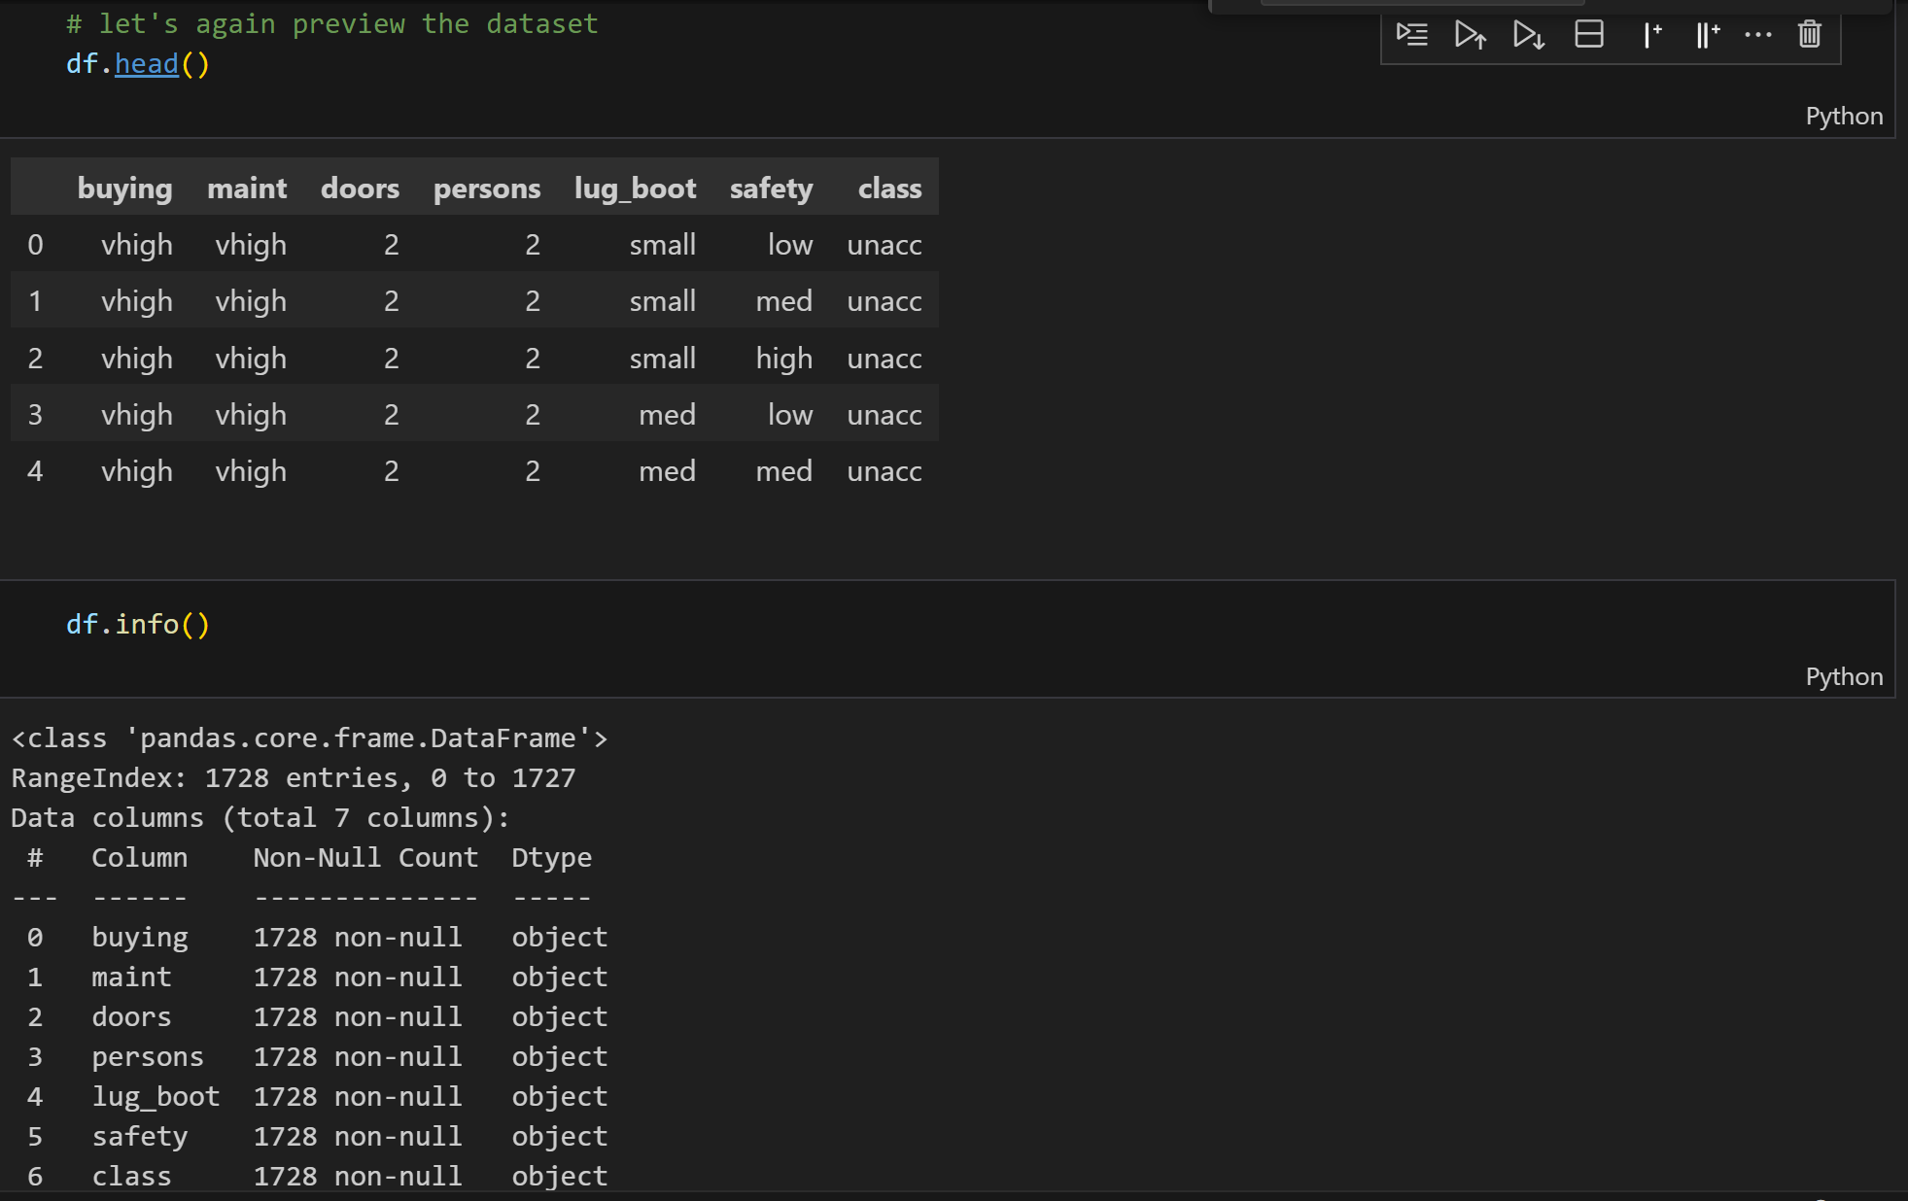
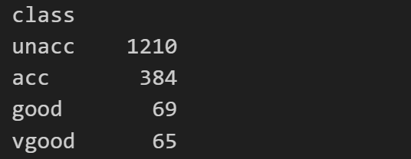
Characteristics

Slide 8
hyperparameter

Slide 9
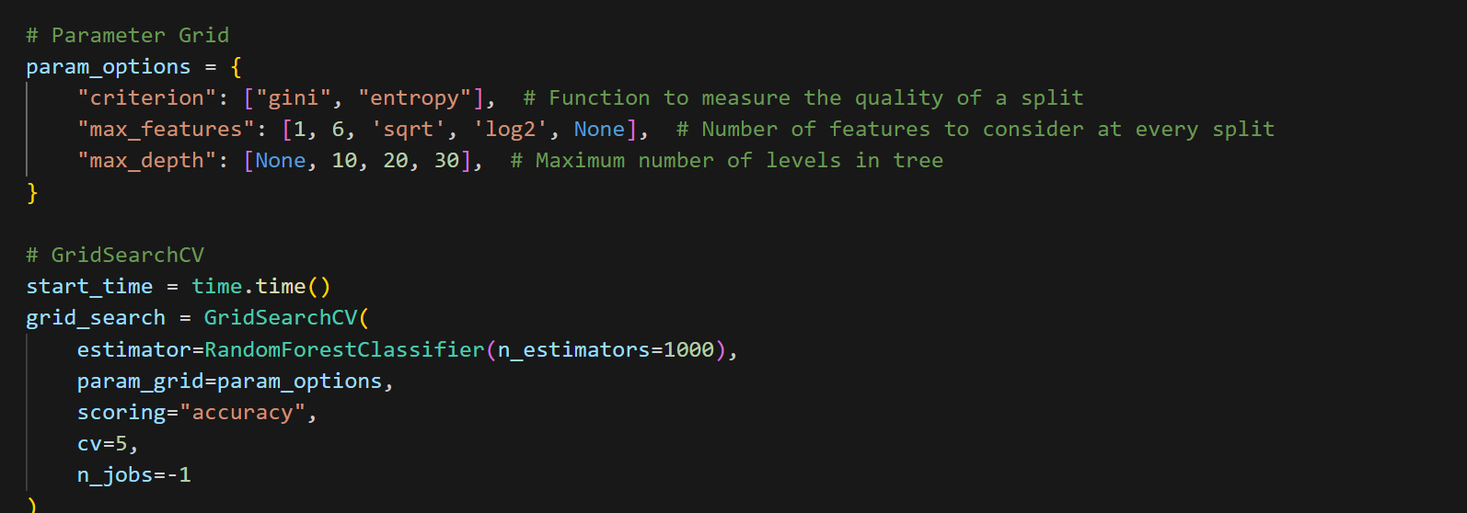
Using Grid Search to find the best parameters for our model

Slide 10
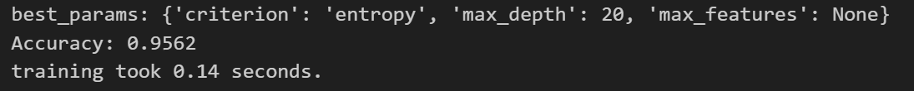
Increased accuracy with using custom hyperparameter

Slide 11
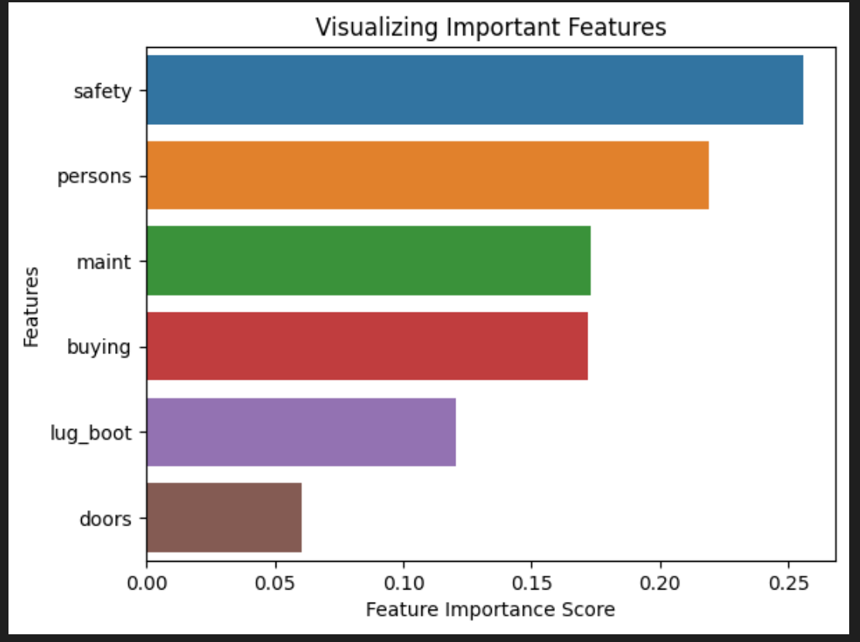
Feature importance

Slide 13
Summary
In this project, I build a Random Forest Classifier to predict the safety of the car. I build two models, one with 100 decision-trees and another one with 1000 decision-trees.
he model accuracy score with 100 decision-trees is 0.9247 but the same with 1000 decision-trees is 0.9457. So, as expected accuracy increases with number of decision-trees in the model.
I have used the Random Forest model to find only the important features, build the model using these features and see its effect on accuracy. The most important feature is safety and least important feature is doors.
I have removed the doors variable from the model, rebuild it and checked its accuracy. The accuracy of the model with doors variable removed is 0.9264. The accuracy of the model with all the variables taken into account is 0.9247. So, we can see that the model accuracy has been improved with doors variable removed from the model.
The second least important model is lug_boot. If I remove it from the model and rebuild the model, then the accuracy was found to be 0.8546. It is a significant drop in the accuracy. So, I will not drop it from the model.
Confusion matrix and classification report are another tool to visualize the model performance. They yield good performance.

