Slide 1
SOFTWARE DESIGN PRESENTATION
Raw Material Trading Platform
SRS / SDD / System Design Document
An industrial raw-material marketplace for metals and commodities — verified buyers and sellers, auctions, KYC, settlement, and dispute control.
BACKEND
FRONTEND
DATABASE
Prepared by · Reza
.NET Core 10 Web API
React.js
SQL Server
Version 0.01

Slide 2
RM
RAW MATERIAL TRADING PLATFORM
AGENDA
What we'll cover today
Three connected documents, one platform: scope, design and system architecture.
PART A
PART B
PART C
Project Scope and Requirements
Software Design Architecture
System Design Document
Problem statement, stakeholders, functional and non-functional requirements, domain model, sequence and state diagrams, technologies, project plan.
Modularization into subsystems, CRC cards, MVC design views, full sequence and state machines, database schema and updated technology stack.
Software design patterns, UI/UX design, deployment diagram, business rules, API endpoints and the consolidated project Gantt chart.
1
2
3
Agenda · Document map
02 / 73

Slide 3
RM
RAW MATERIAL TRADING PLATFORM
SNAPSHOT
The platform at a glance
What the system does, who uses it and how it is built.
USER ROLES
SUBSYSTEMS
FUNCTIONAL REQS
COMMISSION
5
12
40+
5‰
Buyer · Seller · Admin · Operator · Partner
From KYC to Analytics & AI
Across 7 capability areas
Split 40% seller · 60% buyer
END-TO-END TRANSACTION FLOW
Register & KYC
Create Order
Auction & Offers
Match
Commission
Settlement
Delivery
Grade & Review
TECHNOLOGY STACK
.NET Core 10
React.js
SQL Server
JWT + OTP
Entity Framework Core
Payment Gateway
SMS / KYC APIs
Project at a glance
03 / 73

Slide 4
RM
RAW MATERIAL TRADING PLATFORM
CONTEXT
Project Metadata
Core facts about the platform — scope, stack and ownership.
Field | Value
Project | Industrial raw-material marketplace and trading platform
Backend | .NET Core 10 Web API
Frontend | React.js
Database | SQL Server
Prepared By | Reza
Version | 0.01
Part A · Project Scope and Requirements
04 / 73

Slide 5
PROJECT · RAW MATERIAL TRADING PLATFORM
PART A
Project Scope and Requirements
Problem statement, stakeholders, requirements, domain model, diagrams, technologies and the project timeline.
01
Problem Statement
05
Entity Relationship Diagram
02
General Overview Modelling
06
System Sequence Diagrams
03
Functional & Non-Functional Requirements
07
Object State Machine Diagrams
04
Domain Class Diagram
08
Technologies & Project Plan
05 / 73

Slide 6
RM
RAW MATERIAL TRADING PLATFORM
1.1
Problem Domain & Business Need
Why an industrial raw-material trading platform is needed.
PROBLEM DOMAIN
BUSINESS NEED
A web-based industrial raw-material trading platform for metals and similar commodities. Verified buyers and sellers create buy and sell orders, submit offers, use auction-style matching, pay platform commissions and manage delivery, settlement, optional services and complaints when quality, quantity, delivery or payment problems occur.
Reduce trust problems in raw-material transactions involving high financial value, weight tolerance, quality claims, credit / LC payment terms and delivery delays. The platform adds KYC, seller and buyer grading, transaction logs, controlled messaging, operator supervision and digital workflows to make transactions transparent and safe.
Part A · 1. Problem Statement
06 / 73

Slide 7
RM
RAW MATERIAL TRADING PLATFORM
1.1.B
Platform Capabilities
End-to-end capabilities the platform delivers across the trade lifecycle.
Capability | Description
User registration and OTP | Individuals and companies register with mobile OTP and profile information.
KYC and role approval | Buyer and seller roles become active only after required verification and admin review.
Product catalogue & technical forms | Copper cathode, copper wire, zinc ingot, aluminium ingot, brass sheet, scrap copper and similar items have product-specific forms.
Buy and sell order management | Approved buyers and sellers can create time-limited orders 24 hours a day.
Auction and offer management | Open auction, dark auction, base-price options and price offers are supported.
Matching engine | Seller-initiated, buyer-initiated and automatic rule-based matching.
Commission and invoices | System commission invoices, proforma invoices, advance payment links and commission blocking rules.
Optional services | Inspection, transportation, insurance and warehousing service requests.
Complaint management | Quality, quantity, delivery, document, fraud and payment complaints with formal workflow.
Grading system | Buyer and seller grades from KYC, quality, delivery, financial, support and complaint metrics.
Analytics and AI | Free prices, paid analysis and AI-based price prediction using FX, global metal prices and demand.
Part A · 1. Problem Statement
07 / 73

Slide 8
RM
RAW MATERIAL TRADING PLATFORM
1.1.B
Business Benefits
How the platform translates capabilities into value for the market.
Benefit | Explanation
Trust and safety | KYC, grading and operator review reduce fake users and transaction fraud.
Pricing transparency | Users see selected market data, historical deals and auction activity based on access level.
Operational control | Order validity, matching windows, cancellation and penalty rules make the marketplace predictable.
Dispute reduction | Digital records, service partners, inspection reports and complaint workflows support evidence-based decisions.
Business growth | Premium analysis, paid access, golden user benefits and service commissions create revenue channels.
Part A · 1. Problem Statement
08 / 73

Slide 9
RM
RAW MATERIAL TRADING PLATFORM
1.2
Stakeholders & Roles
Each stakeholder's role in the marketplace ecosystem.
Stakeholder | Role in the System
Buyer | Registers, completes KYC, creates buy orders, submits offers, pays commission, confirms settlement and delivery, submits complaints, rates sellers.
Seller | Registers, completes KYC, creates sell orders, receives offers, matches transactions, issues proforma invoice, confirms delivery, responds to complaints.
Admin / Operator | Approves KYC, approves brands, monitors trading board, helps with matching, handles claims, updates grades, manages blocking and penalties.
Service Partner | Provides inspection, logistics, insurance or warehousing support after buyer request.
Payment Gateway / Bank | Processes commission payments, payment links, deposits and payment confirmations.
KYC Provider | Provides OCR, face match, national code, legal entity and bank account matching services.
SMS Provider | Sends OTP, alerts, matching notifications, payment reminders and complaint updates.
Developers and QA | Build, test, maintain and deploy the React front end, .NET Core backend and SQL Server database.
Part A · 1. Problem Statement
09 / 73

Slide 10
RM
RAW MATERIAL TRADING PLATFORM
1.3
Functional Subsystems
Twelve cooperating subsystems form the complete platform.
Subsystem | Main Responsibilities
Login and Registration | Account creation, OTP verification, login, logout, password reset, user profile.
KYC and Role Approval | Document upload, identity validation, legal entity verification, bank account matching, buyer/seller approval.
Product Catalogue | Product categories, brands, technical fields, packaging standards and product-specific order forms.
Trading Board | Display active buy/sell orders, order validity, quantity, conditions and status.
Offer and Auction | Open auction, dark auction, base price, credit/LC/presale visibility rules and offer history.
Matching Engine | Manual match, auto-match, partial match, remaining quantity, cancellation and expiry rules.
Payment and Commission | Commission calculation, invoices, advance payment, payment link, blocking on unpaid commission.
Delivery and Settlement | Settlement confirmation, delivery weight, bill of lading, delivery delay handling, final invoice.
Complaint / Claim | Complaint form, evidence collection, operator assignment, service partner reports, resolution, penalties.
Grading and Risk | Buyer/seller scoring, golden user status, restriction logic, fraud flags, periodic review.
Analytics and AI | Price dashboards, analysis sales, AI price prediction and customer behaviour analytics.
Admin Dashboard | Approval queues, monitoring, reports, penalties, user management, platform settings.
Part A · 1. Problem Statement
10 / 73

Slide 11
RM
RAW MATERIAL TRADING PLATFORM
1.4
Who reads this SRS?
Five audiences use the same document for different decisions.
DEVELOPERS
PROJECT MANAGERS
■ .NET Core 10 backend APIs and matching services
■ React pages, components and routing
■ SQL Server schema and migrations
■ External integrations (KYC, SMS, payments)
■ Define scope and acceptance criteria
■ Plan timeline and dependencies
■ Track milestones and deliverables
BUSINESS / CLIENT REPS
QA & LEGAL / OPS
■ Validate that requirements match the marketplace process
■ Confirm commission, KYC and matching rules
■ Sign off on acceptance criteria
■ Write acceptance and integration tests
■ Review platform rules, disclaimers and penalties
■ Verify complaint workflows and audit trails
Part A · 1.4 Intended Users of the SRS
11 / 73

Slide 12
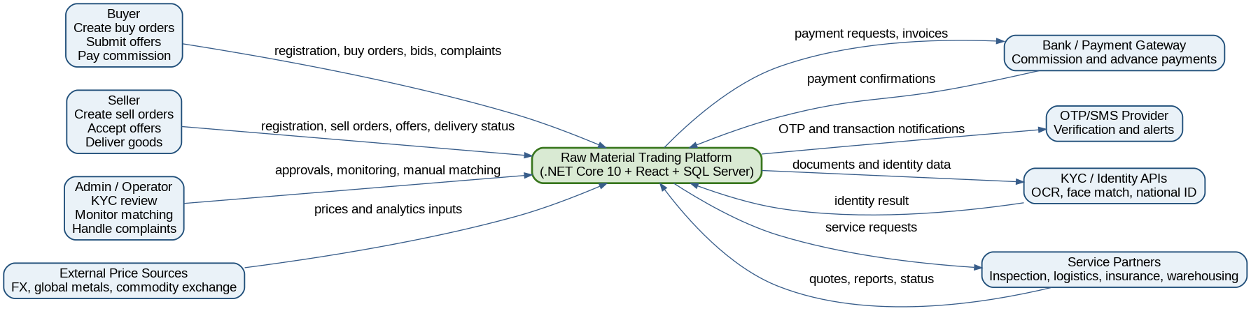
RM
RAW MATERIAL TRADING PLATFORM
2.1
Context Flow Diagram (CFD)
External actors and data flows around the marketplace.
KEY POINTS
› Buyers, sellers, admins, KYC and SMS providers, payment gateways and service partners surround the system.
› Each external actor exchanges only the data it needs — KYC docs, OTPs, payments, inspection reports.
› Audit trail captures every cross-boundary message for traceability.
Figure 1 — Context Flow Diagram for the Raw Material Trading Platform.
Part A · 2. General Overview Modelling
12 / 73

Slide 13
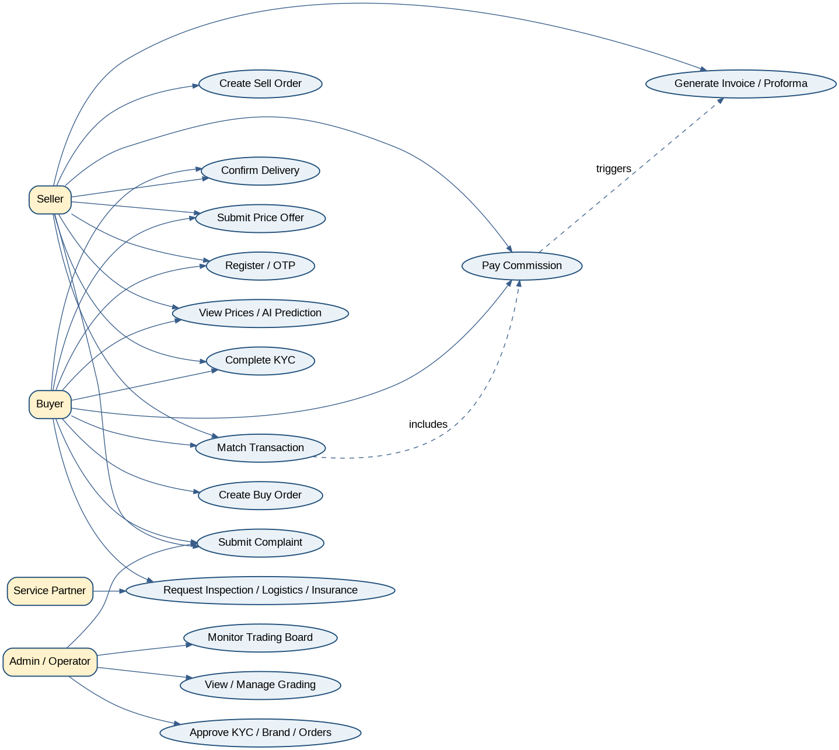
RM
RAW MATERIAL TRADING PLATFORM
2.2
Use Case Diagram
Main use cases for the four primary platform users.
KEY POINTS
› Buyers register, complete KYC, post buy orders and submit offers.
› Sellers create sell orders, match offers and confirm delivery.
› Admins approve KYC, brands and complaints; operators monitor the trading board.
› Use cases are bound by role — an unverified user cannot trade.
Figure 2 — Main use cases for buyers, sellers, admins and operators.
Part A · 2. General Overview Modelling
13 / 73

Slide 14
RM
RAW MATERIAL TRADING PLATFORM
3.1
Non-Functional Requirements
Quality attributes the platform must satisfy.
NFR# | Name | Description
NFR001 | Performance | Trading board and order pages load within 3 seconds under normal traffic. Matching completes in near real time.
NFR002 | Security | All APIs require HTTPS, JWT authentication, RBAC, server-side validation and secure storage of sensitive data.
NFR003 | Confidentiality | KYC documents, bank details, identity data and transaction details are accessible only to authorised users.
NFR004 | Availability | Platform is available 24/7 for order submission while matching windows can be business-rule limited.
NFR005 | Scalability | Architecture supports increasing users, products, orders and notifications using scalable .NET services and SQL indexing.
NFR006 | Auditability | KYC approvals, offer submission, matching, payments, penalties and complaint decisions are logged.
NFR007 | Maintainability | Layered architecture, DTOs, services, repositories, dependency injection and unit tests.
NFR008 | Usability | React pages are responsive, clear and simple for buyers, sellers, admins and operators.
NFR009 | Interoperability | Integrates with SMS, KYC APIs, payment gateways, analysis APIs and future CRM systems.
NFR010 | Compliance | Disclaimers, risk statements, prohibited chat content and avoid conflict with commodity exchange obligations.
Part A · 3. Requirements
14 / 73

Slide 15
RM
RAW MATERIAL TRADING PLATFORM
3.2.1
Login, Registration & KYC — FRs
Functional requirements for user onboarding and identity verification.
FR# | Goal Use Case | Role Players | Description
FR-KYC-01 | Create Individual Account | Visitor, System | Register with name, family name, national code, mobile, optional email, address and postal code.
FR-KYC-02 | Create Company Account | Visitor, System | Legal entity registers with company name, national ID, phones, address, activity type and warehouse postal code.
FR-KYC-03 | Send and Verify OTP | System, SMS Provider | Send SMS OTP and validate the user mobile number before account activation.
FR-KYC-04 | Complete KYC | Buyer/Seller, System | Collect national card, selfie, company documents, representative authorisation and bank account details.
FR-KYC-05 | Approve Buyer/Seller Role | Admin, System | Admin approves buyer role, seller role or both. Seller approval may need operator contact and contract review.
FR-KYC-06 | Bank Account Verification | System, KYC Provider | Verify that bank card or IBAN owner name matches the verified user or company identity.
FR-KYC-07 | KYC Status Tracking | User, System | Show statuses: pending, needs correction, rejected, approved. Provide reason when rejected or correction needed.
Part A · 3.2 Functional Requirements
15 / 73

Slide 16
RM
RAW MATERIAL TRADING PLATFORM
3.2.1
User Stories — Registration & KYC
Three user-facing journeys that drive the KYC subsystem.
USER STORY 1
USER STORY 2
USER STORY 3
“As a visitor, I want to register using my mobile number so I can enter the platform securely.”
“As a seller, I want to complete seller KYC so I can publish sell orders.”
“As an admin, I want a clear KYC review queue so approvals are fast.”
ACCEPTANCE CRITERIA
ACCEPTANCE CRITERIA
ACCEPTANCE CRITERIA
■ Registration form accepts required fields.
■ OTP is sent to mobile number.
■ Account is created only after OTP verification.
■ Seller role shows pending until admin approval.
■ System stores uploaded documents.
■ Admin can approve, reject or request correction.
■ Queue shows pending KYCs sorted by submission date.
■ Admin can approve, reject or request correction.
■ User receives status update via SMS / platform.
Part A · 3.2 Functional Requirements
16 / 73

Slide 17
RM
RAW MATERIAL TRADING PLATFORM
3.2.2
Trading & Order — FRs
Functional requirements for buy and sell order management.
FR# | Goal Use Case | Role Players | Description
FR-TRD-01 | Create Sell Order | Seller, System | Approved sellers create sell orders 24/7 with product, brand, quantity, packaging, technical specs, terms and validity.
FR-TRD-02 | Create Buy Order | Buyer, System | Approved buyers create buy orders with product, quantity, payment & delivery terms, base target price and validity.
FR-TRD-03 | Product-Specific Forms | System | Open a product-specific technical and commercial form based on selected product category.
FR-TRD-04 | Brand Approval | Seller, Admin | Sellers can request a new brand; the order remains pending until admin approval.
FR-TRD-05 | Trading Board Display | System | Publish valid orders to the trading board after checks and notify users by access level.
FR-TRD-06 | Order Edit / Cancel Rules | Seller/Buyer, System | Allow edits or cancellation based on role, golden grade, matching window and order state.
Part A · 3.2 Functional Requirements
17 / 73

Slide 18
RM
RAW MATERIAL TRADING PLATFORM
3.2.3
Offer, Auction & Matching — FRs
Functional requirements for offers, auctions and the matching engine.
FR# | Goal Use Case | Role Players | Description
FR-MAT-01 | Submit Price Offer | Buyer/Seller, System | Submit price, quantity, validity, requested quality guarantee and special purchase/sale conditions.
FR-MAT-02 | Open Auction Visibility | System | Golden or paid users can view competing prices in open auctions based on access policy.
FR-MAT-03 | Dark Auction | System | Hidden bids — users cannot see other offers.
FR-MAT-04 | Manual Match | Buyer/Seller, System | Seller or buyer can manually match a suitable offer before validity ends.
FR-MAT-05 | Automatic Match | System | At expiry, match automatically if offer meets base-price rule; earliest qualifying offer wins on ties.
FR-MAT-06 | Partial Match | System | Allow partial quantity matching above minimum quantity and show remaining quantity on the board.
FR-MAT-07 | Cancellation Penalty | System | Apply guarantee, penalty, loss recovery, grade reduction or trading ban based on rules.
Part A · 3.2 Functional Requirements
18 / 73

Slide 19
RM
RAW MATERIAL TRADING PLATFORM
3.2.4
Payment, Commission & Settlement — FRs
Financial workflows after a successful match.
FR# | Goal Use Case | Role Players | Description
FR-PAY-01 | Calculate Commission | System | Total platform commission is 5 per thousand, split 40% seller / 60% buyer unless policy changes.
FR-PAY-02 | Issue Commission Invoice | System | Generate system commission invoice and send it to both sides after matching.
FR-PAY-03 | Payment Link | Payment Gateway, System | Provide payment links for commission and advance payment where required.
FR-PAY-04 | Block on Unpaid Commission | System | Block or restrict accounts when commission is not paid based on policy.
FR-PAY-05 | Issue Proforma | Seller, System | After commission payment, seller issues system proforma with terms, account number and validity.
FR-PAY-06 | Settlement Confirmation | Buyer/Seller, System | Buyer confirms payment or credit/LC completion; seller confirms settlement as required.
Part A · 3.2 Functional Requirements
19 / 73

Slide 20
RM
RAW MATERIAL TRADING PLATFORM
3.2.5
Delivery & Optional Services — FRs
Inspection, transportation, insurance, warehousing and delivery confirmation.
FR# | Goal Use Case | Role Players | Description
FR-SRV-01 | Request Inspection | Buyer, System | Request quality guarantee or inspection at origin/destination with parameters and service cost.
FR-SRV-02 | Request Transportation | Buyer, System | Request a logistics quote, pay cost and receive vehicle and driver details.
FR-SRV-03 | Request Insurance | Buyer, System | Request insurance type, estimated cargo value, pay premium and receive policy document.
FR-SRV-04 | Request Warehousing | Buyer, System | Request warehouse service, receive cost, pay fee and receive warehouse address.
FR-SRV-05 | Delivery Confirmation | Seller/Buyer, System | Seller records exact weight and delivery status; system may require bill of lading or buyer confirmation.
Part A · 3.2 Functional Requirements
20 / 73

Slide 21
RM
RAW MATERIAL TRADING PLATFORM
3.2.6
Complaint, Claim & Grading — FRs
Disputes, evidence, SLAs and the buyer/seller grading system.
FR# | Goal Use Case | Role Players | Description
FR-CLM-01 | Submit Complaint | Buyer/Seller, System | Submit complaints for quality, quantity, delivery, payment, document, fraud or service issues.
FR-CLM-02 | 1-Hour Response SLA | Operator, System | Workflow creates an operator task and requires first response within one hour where applicable.
FR-CLM-03 | Evidence Collection | System | Upload documents, photos, invoices, inspection reports, weighbridge tickets and messages.
FR-CLM-04 | Complaint Tracking | User, System | Show each complaint stage in the platform until closed.
FR-CLM-05 | Grade Impact | System | Confirmed complaints and violations affect buyer/seller grade.
FR-GRD-01 | Seller Grading | System | Score sellers by KYC, quality, price, delivery, support, financial stability, history and ethics.
FR-GRD-02 | Buyer Grading | System | Score buyers by financial credit, timely payment, conduct, purchase potential, documentation and communication.
Part A · 3.2 Functional Requirements
21 / 73

Slide 22
RM
RAW MATERIAL TRADING PLATFORM
3.2.7
Website, Analytics & AI — FRs
Free content, paid analysis, AI price prediction and post-trade surveys.
FR# | Goal Use Case | Role Players | Description
FR-WEB-01 | Free Website Content | System | Weekly transaction quantities, FX price, global metal prices, exchange prices, ads, normal analysis and trading time.
FR-WEB-02 | Paid Analysis | System | Sell analysis, customer behaviour analytics, historical prices and AI price prediction to non-golden users.
FR-WEB-03 | AI Price Prediction | System | Predict prices using dollar rate, global metal prices, previous week trades, demand and market data.
FR-WEB-04 | Survey Link | System | Send survey links after matched and unmatched transactions for platform quality and user evaluation.
Part A · 3.2 Functional Requirements
22 / 73

Slide 23
RM
RAW MATERIAL TRADING PLATFORM
4.1
Domain Class List
Nine groups, ~30 classes that model the marketplace.
#01
USERS & IDENTITY
#02
KYC & ACCOUNTS
#03
CATALOGUE
User · Buyer · Seller · Admin · Operator
KYCRecord · UploadedDocument · BankAccount
Product · ProductCategory · Brand · ProductSpecification · PackagingStandard
#04
TRADING
#05
FINANCIAL
#06
DISPUTES
Order · BuyOrder · SellOrder · Offer · Auction · MatchingRule
Transaction · Invoice · Payment · Commission · Settlement · Delivery
Complaint · Evidence · ComplaintResolution · Penalty
#07
GRADING
#08
SERVICES
#09
OPS & AUDIT
GradeScore · SellerGradeMetric · BuyerGradeMetric
ServiceRequest · InspectionRequest · LogisticsRequest · InsuranceRequest · WarehouseRequest
Notification · SmsMessage · AuditLog · SurveyResponse
Part A · 4. Domain Class Diagram
23 / 73

Slide 24
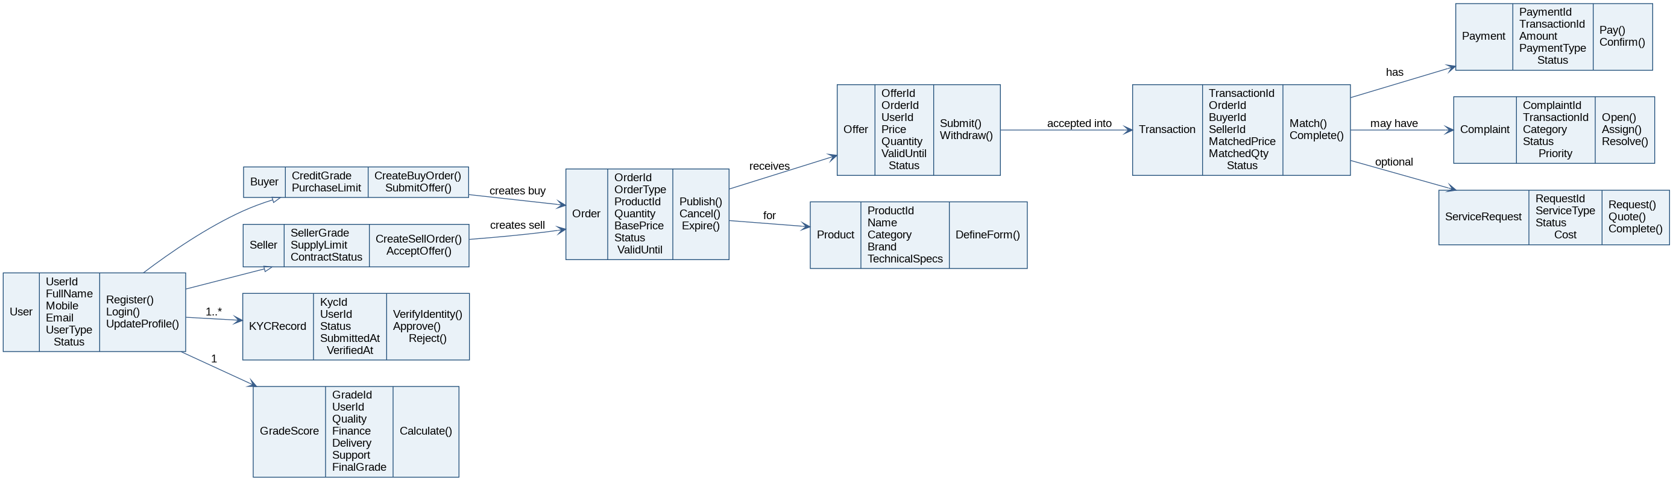
RM
RAW MATERIAL TRADING PLATFORM
4.2
Domain Class Diagram
Class relationships across the marketplace domain.
Figure 3 — Domain class diagram for the Raw Material Trading Platform.
Part A · 4. Domain Class Diagram
24 / 73

Slide 25
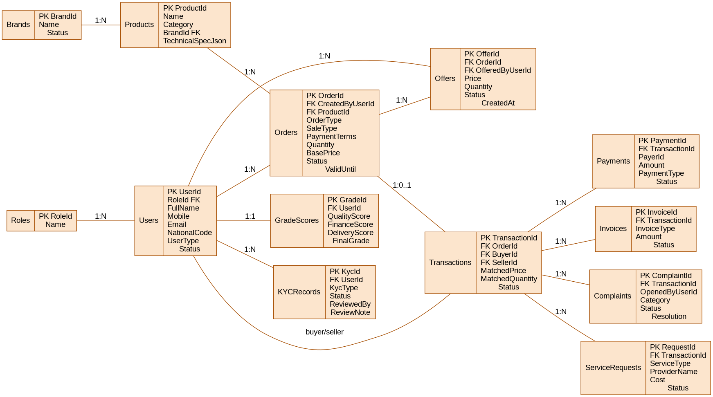
RM
RAW MATERIAL TRADING PLATFORM
5.1
Entity Relationship Diagram
SQL Server schema with relational foreign keys and audit tables.
Figure 4 — Entity relationship diagram (SQL Server).
Part A · 5. Entity Relationship Diagram
25 / 73

Slide 26
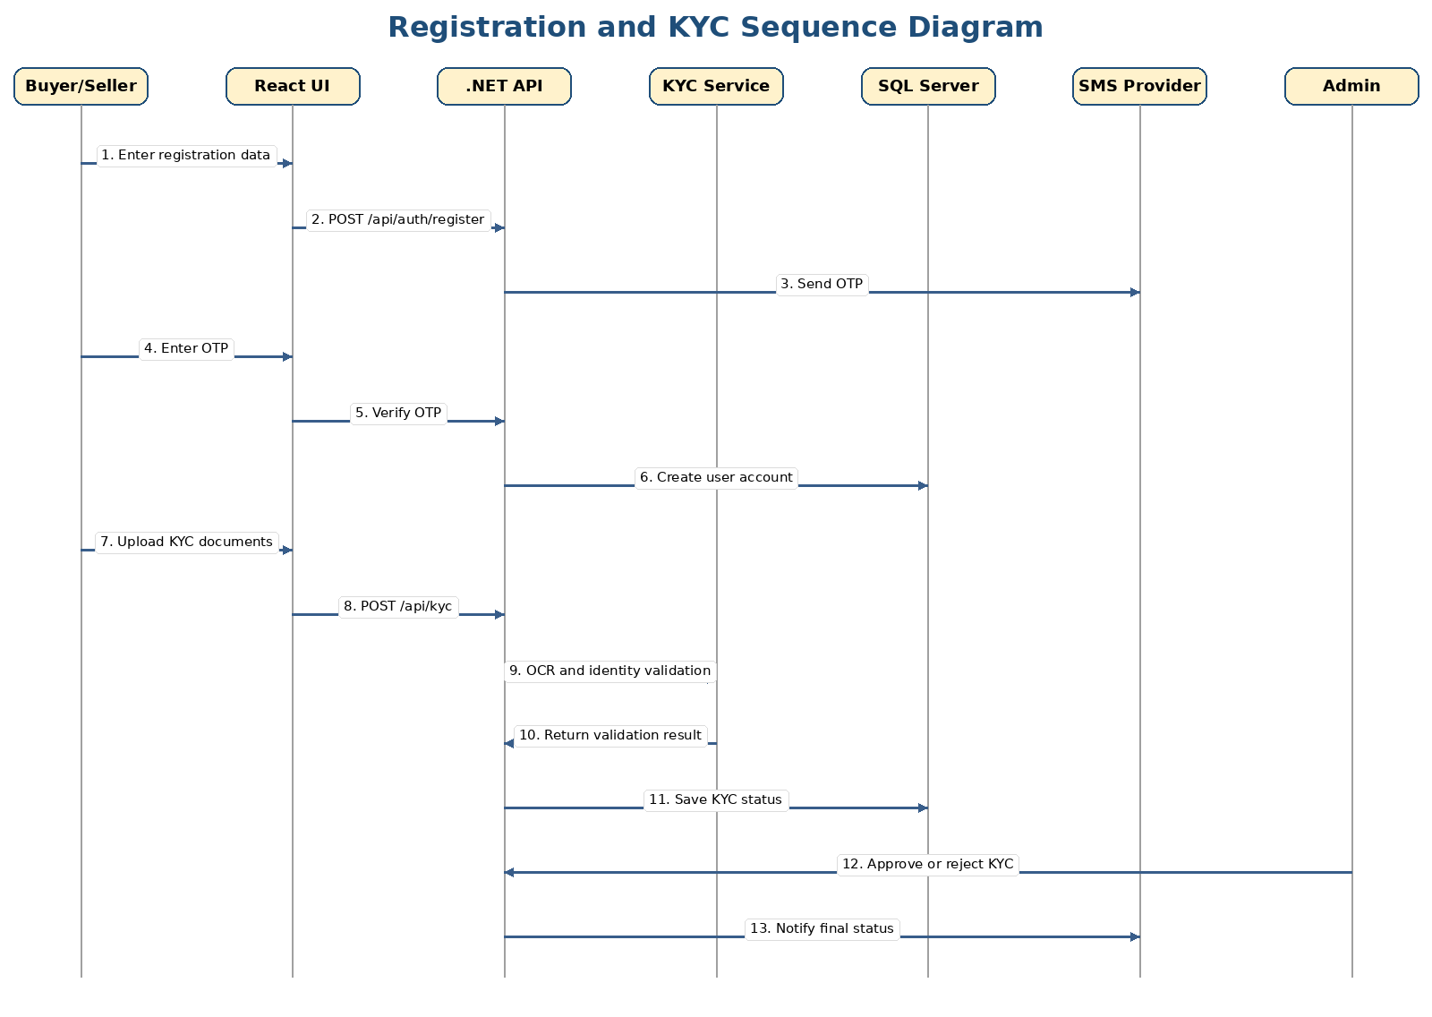
RM
RAW MATERIAL TRADING PLATFORM
6.1
Registration & KYC — Sequence
Visitor → System → SMS Provider → Admin handshake.
KEY POINTS
› Visitor submits registration data; system creates a pending account.
› OTP is sent through the SMS provider and verified inside a short window.
› KYC documents are uploaded and queued for admin review.
› Admin approves, rejects or requests correction; the user is notified.
Figure 5 — Registration and KYC sequence.
Part A · 6. System Sequence Diagrams
26 / 73

Slide 27
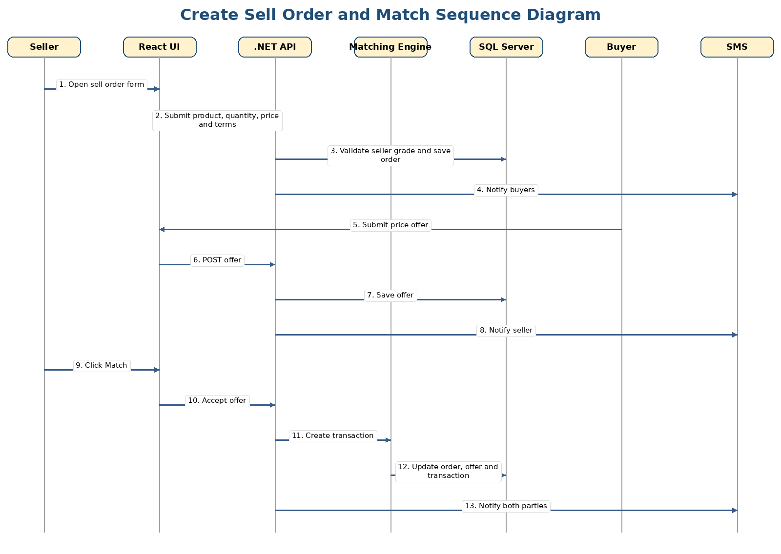
RM
RAW MATERIAL TRADING PLATFORM
6.2
Sell Order & Matching — Sequence
From sell order creation to a successful match.
KEY POINTS
› Approved seller creates a sell order with technical specs and validity.
› Buyers submit offers; the trading board reflects state in real time.
› Match can be manual (seller picks the offer) or automatic at expiry.
› Both parties are notified by SMS / platform notification.
Figure 6 — Create sell order and matching sequence.
Part A · 6. System Sequence Diagrams
27 / 73

Slide 28
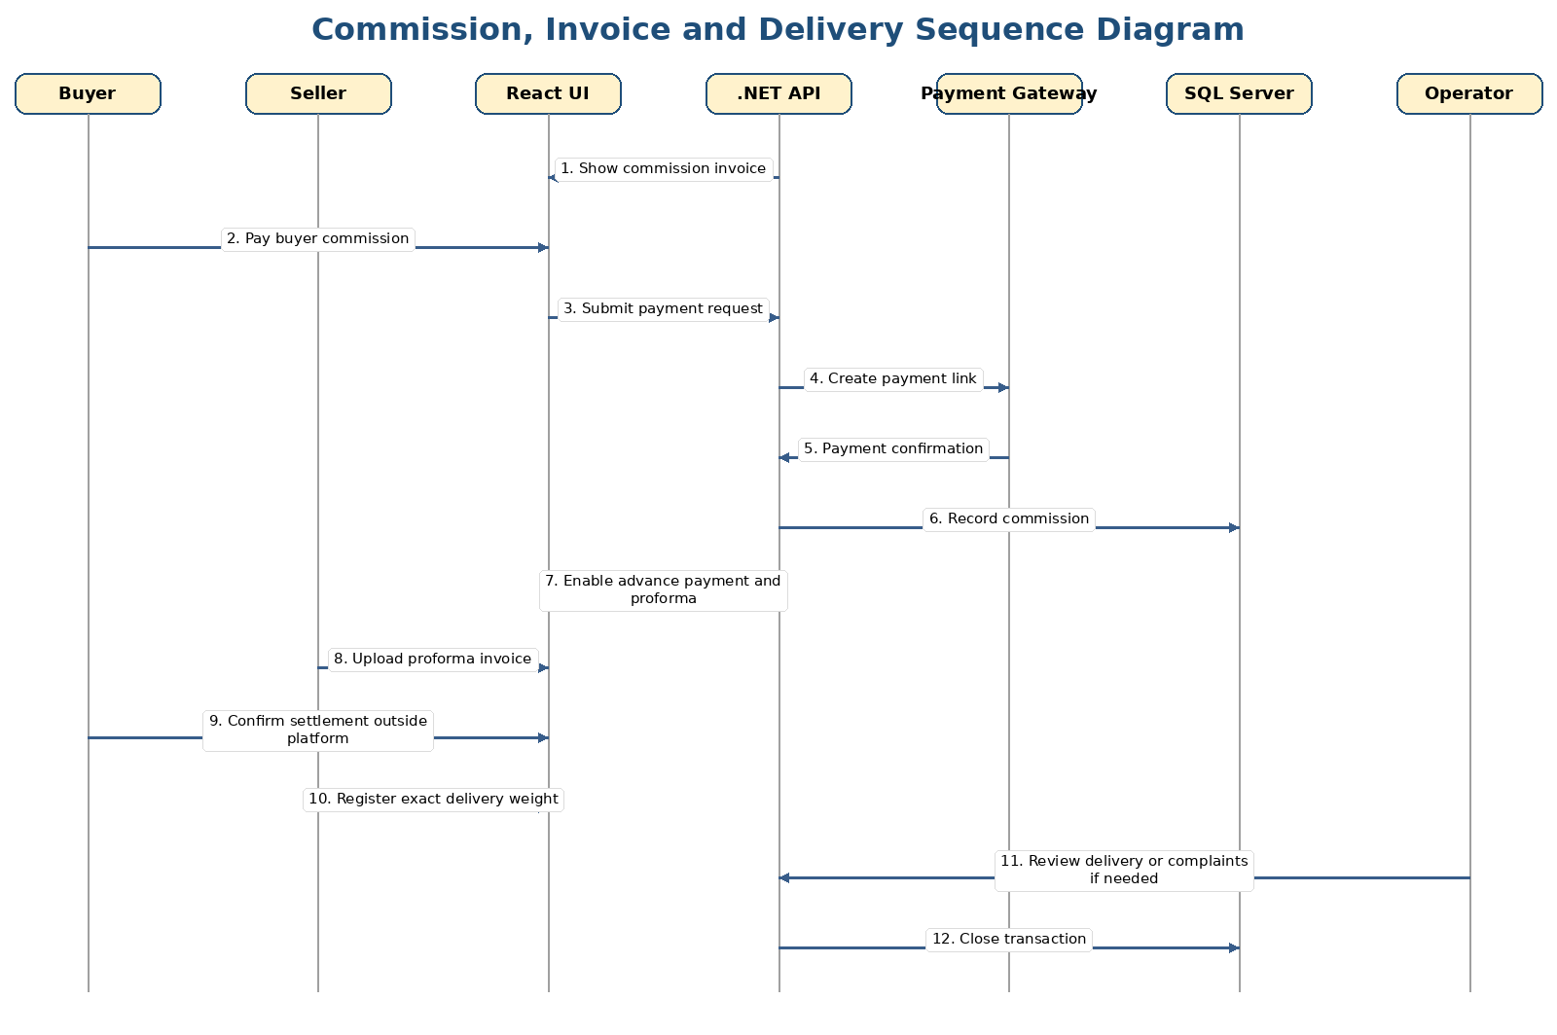
RM
RAW MATERIAL TRADING PLATFORM
6.3
Commission, Invoice & Delivery — Sequence
Financial workflow after a match — commission, proforma, settlement.
KEY POINTS
› Platform issues a commission invoice to both sides.
› Payment gateway processes commission; unpaid commission can block accounts.
› Seller issues system proforma invoice and confirms settlement.
› Delivery weight and bill of lading close the transaction.
Figure 7 — Commission, invoice and delivery sequence.
Part A · 6. System Sequence Diagrams
28 / 73

Slide 29
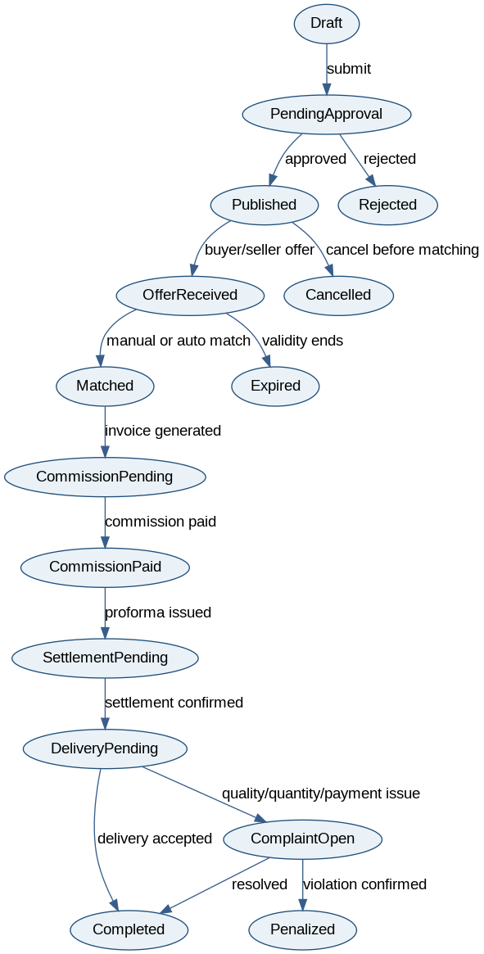
RM
RAW MATERIAL TRADING PLATFORM
7.1
Order / Transaction State Machine
Lifecycle of an order from draft to completed.
KEY POINTS
› Draft → Approval → Published on the trading board.
› Offer received → Matched → Commission pending → Delivery pending.
› Complaint open → resolved or penalised; otherwise Completed.
› Each transition is captured in the AuditLog table.
Figure 8 — Order / transaction state machine.
Part A · 7. Object State Machine Diagrams
29 / 73

Slide 30
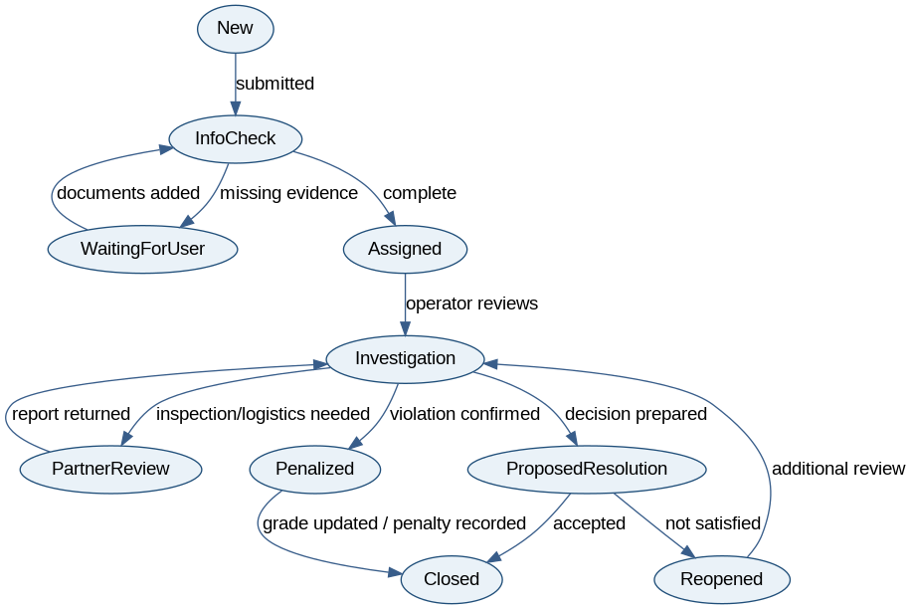
RM
RAW MATERIAL TRADING PLATFORM
7.2
Complaint State Machine
Lifecycle of a complaint with SLA, evidence and penalty states.
KEY POINTS
› Submitted → Operator assigned within 1 hour SLA.
› Evidence collected from buyer, seller, partners and inspection reports.
› Resolved, reopened or escalated to penalty / grade reduction.
› Confirmed complaints update buyer / seller grade automatically.
Figure 9 — Complaint state machine.
Part A · 7. Object State Machine Diagrams
30 / 73

Slide 31
RM
RAW MATERIAL TRADING PLATFORM
8
Technology Stack
Layered architecture from React on the client to SQL Server on the data side.
Layer | Technology | Purpose
Client side | React.js, HTML, CSS, JavaScript / TypeScript | Responsive buyer, seller and admin portals plus the trading board.
Backend | ASP.NET Core 10 Web API | REST APIs, controllers, authentication, matching services, business rules.
Database | SQL Server | Relational transaction storage, reporting, audit logs, KYC metadata.
Authentication | JWT, refresh tokens, OTP SMS | Secure login and role-based access.
External Integrations | SMS, payment gateway, KYC APIs, market data APIs | Verification, notifications, payments and price feeds.
AI / Analytics | Python or .NET ML service in later phase | Price prediction, behaviour analytics and fraud signals.
DevOps | GitHub, CI/CD, Docker (optional) | Version control, automated builds and deployment.
Part A · 8. Technologies
31 / 73

Slide 32
RM
RAW MATERIAL TRADING PLATFORM
9
Project Plan — Part A (Weeks 1–8)
Initial 8-week plan covering requirements, design and core development.
Task | W1 | W2 | W3 | W4 | W5 | W6 | W7 | W8
Requirements & client review | X | X
SRS Part A diagrams & use cases |  | X | X
Architecture & database design |  |  | X | X
Backend API setup |  |  |  | X | X
React UI setup |  |  |  | X | X
Trading & matching workflows |  |  |  |  | X | X
Payment, complaints, grading |  |  |  |  |  | X | X
Testing, final report, presentation |  |  |  |  |  |  | X | X
Part A · 9. Project Management
32 / 73

Slide 33
PROJECT · RAW MATERIAL TRADING PLATFORM
PART B
Software Design Architecture
From requirements to a modular design — context diagrams, subsystems, CRC cards, MVC views and the database schema.
01
Requirements Edits to Part A
05
Full Sequence Diagrams
02
Overview Model — CFD & ACD
06
State Machine Diagrams
03
Modularization (4 subsystems)
07
Data Layer & Schema
04
MVC Framework & Detailed Design
08
Updated Gantt Chart
33 / 73

Slide 34
RM
RAW MATERIAL TRADING PLATFORM
1
Requirements Edits to Part A
Refinements applied after the initial review of Part A.
Area | Correction / Refinement
Class list | Added service requests, grade scores, notifications, audit logs, product specification, commission, settlement and complaint evidence classes.
Domain diagram | Separated core marketplace concepts: User, Order, Offer, Transaction, Payment, Complaint, GradeScore and ServiceRequest.
ERD | Updated database model for SQL Server with relational foreign keys and transaction-safe entities.
Technology stack | Updated stack from sample to React frontend, .NET Core 10 backend and SQL Server database.
Business rules | Added matching windows, role approval, golden-user access, commission split, penalties and partial match rules.
Part B · 1. Requirements Edits to Part A
34 / 73

Slide 35
RM
RAW MATERIAL TRADING PLATFORM
2.1
Intended users of the SDD
Five audiences each find specific design artefacts in this document.
DEVELOPERS
PROJECT MANAGERS
■ Design classes, controllers, services and entities
■ Sequence flows for the main subsystems
■ Database schema and migrations
■ Modular scope and dependencies
■ Milestones aligned with the Gantt chart
■ Risk and effort visibility per subsystem
QA TESTERS
ADMIN / OPS / CLIENT REPS
■ Testable flows and state transitions
■ Acceptance criteria per FR
■ Sequence diagrams as a basis for integration tests
■ Transaction monitoring and complaint handling
■ Confirmation that the design supports the business workflow
■ Operational dashboards and reports
Part B · 2.1 Intended Users of the SDD
35 / 73

Slide 36
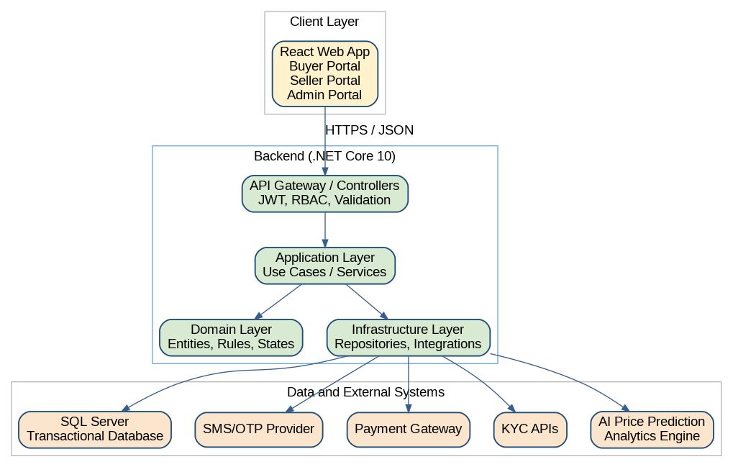
RM
RAW MATERIAL TRADING PLATFORM
2.2.1
Updated Context Flow Diagram
Context flow with audit and notifications boundaries clarified.
Figure 10 — Updated context flow diagram.
Part B · 2. Overview Model
36 / 73

Slide 37
RM
RAW MATERIAL TRADING PLATFORM
2.2.2
Architectural Context Diagram (ACD)
How the platform sits between users, gateways and external services.
KEY POINTS
› React clients hit the .NET Core API behind a JWT-secured gateway.
› Adapters isolate the system from SMS, KYC and payment providers.
› SQL Server holds transactions; analytics flows to a future ML service.
› Audit log records every cross-boundary call.
Figure 11 — Architectural Context Diagram (ACD).
Part B · 2. Overview Model
37 / 73

Slide 38
RM
RAW MATERIAL TRADING PLATFORM
3
Four design subsystems
The detailed design groups the platform into four cooperating subsystems.
3.1
3.2
3.3
3.4
Login, Registration & KYC
Trading & Matching
Payment, Commission & Invoice
Complaint & Grading
Login & registration screens, OTP service, KYC upload and review interfaces. Manages User, KYCRecord, BankAccount and Admin actors.
Trading board, sell / buy order forms, offer form and matching service. Operates Order, Offer, Transaction and Notification.
Commission invoice view, payment links, payment confirmation webhook, proforma invoice and settlement status.
Complaint form, dashboard, evidence upload, grade calculator and penalty rules.
Part B · 3. Modularization
38 / 73

Slide 39
RM
RAW MATERIAL TRADING PLATFORM
3.1
CRC Cards — Login, Registration & KYC
Class · Responsibility · Collaborators for the KYC subsystem.
Class | Responsibility | Collaborators
User | Stores registered individual / company information | KYCRecord, BankAccount, Role
KYCRecord | Tracks identity documents, validation result and approval status | User, Admin, KYC Provider
AuthController | Receives login, register, OTP and password requests | AuthService, UserRepository
KycController | Receives KYC upload and review requests | KycService, DocumentStorage, Admin
Part B · 3.1 Login, Registration & KYC
39 / 73

Slide 40
RM
RAW MATERIAL TRADING PLATFORM
3.1
MVC / Design View — Login & KYC
Models, views and controllers for the KYC subsystem.
Figure 12 — MVC / design view for the KYC subsystem.
Part B · 3.1 Login, Registration & KYC
40 / 73

Slide 41
RM
RAW MATERIAL TRADING PLATFORM
3.2
CRC Cards — Trading & Matching
Class · Responsibility · Collaborators for trading.
Class | Responsibility | Collaborators
Order | Stores buy or sell demand with product, quantity, price and terms | Product, Offer, Transaction
Offer | Stores buyer/seller submitted price and quantity | Order, User
MatchingService | Applies manual match, auto-match, partial match and expiry rules | Order, Offer, Transaction
TradingController | Exposes order, offer, board and match APIs | TradingService, MatchingService
Part B · 3.2 Trading & Matching
41 / 73

Slide 42
RM
RAW MATERIAL TRADING PLATFORM
3.2
MVC / Design View — Trading & Matching
Models, views and controllers for the trading subsystem.
Figure 13 — MVC / design view for trading.
Part B · 3.2 Trading & Matching
42 / 73

Slide 43
RM
RAW MATERIAL TRADING PLATFORM
3.3
CRC Cards — Payment, Commission & Invoice
Class · Responsibility · Collaborators for the financial subsystem.
Class | Responsibility | Collaborators
CommissionService | Calculates platform fee and payer split | Transaction, Payment
Payment | Tracks payment type, amount, status and gateway reference | Transaction, User
Invoice | Stores commission invoice and proforma invoice data | Transaction, Payment
PaymentGatewayAdapter | Converts platform payment calls into gateway-specific API calls | Payment Gateway
Part B · 3.3 Payment, Commission & Invoice
43 / 73

Slide 44
RM
RAW MATERIAL TRADING PLATFORM
3.3
MVC / Design View — Payment & Invoice
Models, views and controllers for the payment subsystem.
Figure 14 — MVC / design view for payment & invoice.
Part B · 3.3 Payment, Commission & Invoice
44 / 73

Slide 45
RM
RAW MATERIAL TRADING PLATFORM
3.4
CRC Cards — Complaint & Grading
Class · Responsibility · Collaborators for disputes.
Class | Responsibility | Collaborators
Complaint | Tracks category, evidence, status, assignment and resolution | Transaction, User, Evidence
GradeScore | Stores buyer/seller scoring dimensions and final grade | User, Complaint, Transaction
ComplaintService | Manages complaint workflow and first-response SLA | Complaint, Operator, Partner
GradeService | Calculates manual and automatic grade scores | GradeScore, Transaction, Complaint
Part B · 3.4 Complaint & Grading
45 / 73

Slide 46
RM
RAW MATERIAL TRADING PLATFORM
3.4
Design View — Complaint State & Grade
Complaint state and grade design view.
Figure 15 — Complaint state and grade design view.
Part B · 3.4 Complaint & Grading
46 / 73

Slide 47
RM
RAW MATERIAL TRADING PLATFORM
4
MVC Framework
Same MVC pattern applied consistently across the three core subsystems.
MODEL
VIEW
CONTROLLER
Domain entities, services and repositories. Pure business rules — Order, Offer, Matching, Commission, Complaint.
React pages and components — login, KYC, trading board, complaint panel, admin dashboard, analytics page.
ASP.NET Core 10 controllers — receive requests, validate authorisation, call services and return DTOs.
Each subsystem is documented as an MVC view in the next slides — Login & KYC · Trading & Matching · Payment & Commission.
Part B · 4. MVC Framework
47 / 73

Slide 48
RM
RAW MATERIAL TRADING PLATFORM
4.1.1
Login & KYC Subsystem — MVC
Detailed MVC view for KYC.
Figure 16 — Login & KYC subsystem MVC.
Part B · 4.1 MVC Pattern Diagrams
48 / 73

Slide 49
RM
RAW MATERIAL TRADING PLATFORM
4.1.2
Trading & Matching Subsystem — MVC
Detailed MVC view for trading and matching.
Figure 17 — Trading & matching subsystem MVC.
Part B · 4.1 MVC Pattern Diagrams
49 / 73

Slide 50
RM
RAW MATERIAL TRADING PLATFORM
4.1.3
Payment & Commission Subsystem — MVC
Detailed MVC view for payment and commission.
Figure 18 — Payment & commission subsystem MVC.
Part B · 4.1 MVC Pattern Diagrams
50 / 73

Slide 51
RM
RAW MATERIAL TRADING PLATFORM
4.2.1
Full KYC Approval Sequence
End-to-end sequence diagram for KYC approval.
KEY POINTS
› Visitor signs up; OTP verifies the mobile.
› KYC documents stored with metadata in KYCRecords table.
› Admin reviews, requests correction, rejects or approves.
› Bank account is verified via the KYC provider.
Figure 19 — Full KYC approval sequence.
Part B · 4.2 Full Sequence Diagrams
51 / 73

Slide 52
RM
RAW MATERIAL TRADING PLATFORM
4.2.2
Full Trading Match Sequence
End-to-end sequence diagram from order to match.
KEY POINTS
› Order published only after validation and brand approval.
› Buyers submit offers — open or dark auction visibility applies.
› Match strategy chosen by order type (manual / auto / partial).
› Notification fan-out informs both sides immediately.
Figure 20 — Full trading match sequence.
Part B · 4.2 Full Sequence Diagrams
52 / 73

Slide 53
RM
RAW MATERIAL TRADING PLATFORM
4.2.3
Full Payment & Delivery Sequence
End-to-end sequence diagram for the financial workflow.
KEY POINTS
› Commission invoice issued automatically after match.
› Payment gateway adapter abstracts gateway-specific calls.
› Proforma issued by seller after commission settled.
› Delivery weight and bill of lading close the transaction.
Figure 21 — Full payment & delivery sequence.
Part B · 4.2 Full Sequence Diagrams
53 / 73

Slide 54
RM
RAW MATERIAL TRADING PLATFORM
4.3.1
Order & Transaction State Machine
Detailed lifecycle of orders and transactions.
Figure 22 — Order & transaction state machine.
Part B · 4.3 State Machine Diagrams
54 / 73

Slide 55
RM
RAW MATERIAL TRADING PLATFORM
4.3.2
Complaint State Machine
Detailed lifecycle of a complaint, evidence and resolution.
Figure 23 — Complaint state machine.
Part B · 4.3 State Machine Diagrams
55 / 73

Slide 56
RM
RAW MATERIAL TRADING PLATFORM
5.1
Database Schema
Core SQL Server tables and key columns.
Table | Important Columns | Notes
Users | UserId, RoleId, FullName, Mobile, Email, NationalCode, UserType, Status | Main identity table for individuals and companies.
KYCRecords | KycId, UserId, KycType, Status, ReviewedBy, ReviewNote | Tracks KYC workflow and review result.
Products | ProductId, CategoryId, BrandId, TechnicalSpecJson | Supports product-specific forms and technical data.
Orders | OrderId, CreatedByUserId, ProductId, OrderType, Quantity, BasePrice, ValidUntil, Status | Core buy/sell order record.
Offers | OfferId, OrderId, OfferedByUserId, Price, Quantity, Status | Submitted bids and offers.
Transactions | TransactionId, OrderId, BuyerId, SellerId, MatchedPrice, MatchedQuantity, Status | Created after a match.
Payments | PaymentId, TransactionId, PayerId, Amount, PaymentType, Status | Commission and advance payments.
Complaints | ComplaintId, TransactionId, OpenedByUserId, Category, Status, Resolution | Claim workflow.
GradeScores | GradeId, UserId, QualityScore, FinanceScore, DeliveryScore, FinalGrade | Buyer and seller grade model.
AuditLogs | AuditLogId, UserId, Action, EntityName, EntityId, CreatedAt | Traceability and security.
Part B · 5. Data Layer
56 / 73

Slide 57
RM
RAW MATERIAL TRADING PLATFORM
5.1
Database Schema ERD
Tables, keys and relationships for the SQL Server schema.
Figure 24 — Database schema ERD.
Part B · 5. Data Layer
57 / 73

Slide 58
RM
RAW MATERIAL TRADING PLATFORM
5.2
Updated Technology List
Mapping from the original sample stack to the project's technology choices.
Original Sample Area | Updated Technology for This Project
Client side | React.js, TypeScript optional, HTML, CSS, responsive components.
Business logic | ASP.NET Core 10 Web API, C#, dependency injection, layered architecture.
Data side | SQL Server, Entity Framework Core, migrations, indexed relational tables.
Security | JWT, refresh token, OTP, RBAC, audit logging, secure file storage.
Integrations | Payment gateway adapter, SMS provider, KYC API adapter, market data API adapter.
Part B · 5. Data Layer
58 / 73

Slide 59
RM
RAW MATERIAL TRADING PLATFORM
6
Project Plan — Part B (Weeks 3–8)
Software design tasks layered on top of the Part A plan.
Part B Task | W3 | W4 | W5 | W6 | W7 | W8
Update Part A requirements |  | X
Create architecture context diagram |  | X
Design modules & CRC cards |  | X | X
Design MVC diagrams |  |  | X
Create full sequence / state diagrams |  |  | X | X
Design database schema |  |  | X | X
Review and correction |  |  |  | X | X
Part B · 6. Gantt Chart Update
59 / 73

Slide 60
PROJECT · RAW MATERIAL TRADING PLATFORM
PART C
System Design Document
Patterns, UI/UX, deployment, business rules and APIs that complete the system design view.
01
Corrections to Part B
05
Updated Gantt Chart
02
Software Design Patterns
06
Business Rules (Appendix)
03
UI / UX Design
07
API Endpoints (Appendix)
04
High-Level Component / Deployment
60 / 73

Slide 61
RM
RAW MATERIAL TRADING PLATFORM
1
Corrections to Part B
Adjustments applied after the second design review.
Correction | Description
MVC controllers | Controllers only receive requests, validate authorisation, call application services and return DTOs. Business rules stay in services / domain.
Payment module | Added adapter boundary so payment gateway can change without changing domain logic.
Order state | Added explicit states: draft, approval, published, offer received, matched, commission pending, delivery pending, complaint open, completed and penalised.
Complaint flow | Added evidence collection, partner review, SLA response, reopen and penalty states.
Data layer | Added audit logs, service requests and grade score tables for operational traceability.
Part C · 1. Corrections to Part B
61 / 73

Slide 62
RM
RAW MATERIAL TRADING PLATFORM
2
Four design patterns drive the architecture
Each pattern solves a specific maintainability or extensibility problem.
STATE
ADAPTER
REPOSITORY
STRATEGY
Order & complaint lifecycles
External service boundaries
Data access abstraction
Auction & matching rules
Replaces nested if/else with explicit state objects for clear, safe transitions.
Wraps SMS, KYC, payment and market-data providers behind common interfaces.
Hides Entity Framework details; improves testability and separation of concerns.
Selects matching strategy by order type — open, dark, base price, partial, golden.
Part C · 2. Software Design Patterns
62 / 73

Slide 63
RM
RAW MATERIAL TRADING PLATFORM
2.1
State Pattern
Pattern context, problem, solution and trade-offs.
Aspect | Description
Problem | Order and complaint lifecycles contain many states and transitions. If implemented with nested if/else, code becomes difficult to maintain.
Solution | Create separate state logic for order and complaint statuses. The service changes allowed actions based on current state.
Benefits | Clear lifecycle rules, easier testing, safer transitions.
Consequences | More classes and mappings are required.
PATTERN
State
Lifecycle made explicit
Part C · 2. State Pattern
63 / 73

Slide 64
RM
RAW MATERIAL TRADING PLATFORM
2.2
Adapter Pattern
Pattern context, problem, solution and trade-offs.
Aspect | Description
Problem | Payment gateways, SMS providers, KYC APIs and market-data APIs may have different interfaces; direct dependency makes future changes expensive.
Solution | Create adapters such as IPaymentGatewayAdapter, ISmsProviderAdapter, IKycProviderAdapter and IMarketDataAdapter.
Benefits | External services can be replaced with minimal business-logic changes.
Consequences | Adds an extra abstraction layer.
PATTERN
Adapter
Decouples external services
Part C · 2. Adapter Pattern
64 / 73

Slide 65
RM
RAW MATERIAL TRADING PLATFORM
2.3
Repository Pattern
Pattern context, problem, solution and trade-offs.
Aspect | Description
Problem | The application should not depend directly on Entity Framework queries everywhere.
Solution | Create repositories or query services for Users, Orders, Offers, Transactions, Payments, Complaints and Grades.
Benefits | Improves testability and separates persistence concerns.
Consequences | Can be unnecessary for very simple CRUD if overused.
PATTERN
Repository
Hides persistence
Part C · 2. Repository Pattern
65 / 73

Slide 66
RM
RAW MATERIAL TRADING PLATFORM
2.4
Strategy Pattern
Pattern context, problem, solution and trade-offs.
Aspect | Description
Problem | Different auction types and matching rules are required: open auction, dark auction, base price, no-base-price, partial match and golden-user rules.
Solution | Create matching strategies implementing a common interface and select the correct strategy based on order type.
Benefits | New auction rules can be added without changing the whole matching engine.
Consequences | Requires careful selection and configuration of strategies.
PATTERN
Strategy
Pluggable algorithms
Part C · 2. Strategy Pattern
66 / 73

Slide 67
RM
RAW MATERIAL TRADING PLATFORM
3
UI / UX Screen Design
Nine core screens map directly to the marketplace workflow.
Screen | Main Elements | Purpose
Login & Registration | Login form, register form, OTP input, password reset | Secure account entry and first registration.
KYC Upload | Identity / company fields, document upload, bank account, status tracker | Complete verification before trading.
Buyer Dashboard | Trading board, buy orders, offers, price analysis, service requests | Buyer workflow control.
Seller Dashboard | Sell order form, product technical form, offers received, match button | Seller workflow control.
Trading Board | Filters, product list, quantity, price range, auction type, validity countdown | Central market view.
Commission / Invoice | Commission invoice, payment link, proforma, payment status | Financial workflow after match.
Complaint Panel | Complaint category, evidence upload, status timeline, operator messages | Dispute handling and transparency.
Admin Dashboard | KYC queue, brand approval, order monitoring, complaint queue, user grades | Operational control.
Analytics Page | Free prices, paid analysis, AI prediction, historical prices | Inform users and create premium revenue.
Part C · 3. UI / UX Design
67 / 73

Slide 68
RM
RAW MATERIAL TRADING PLATFORM
3.1
UI / UX Wireframe Principles
Design decisions that keep complex workflows simple for traders.
1
Login and registration use mobile number, OTP verification and clear user-type selection.
2
KYC pages show progress steps: basic profile, documents, bank account, submitted, under review, approved or rejected.
3
Trading board shows status labels, validity countdown, product filters and role-based action buttons.
4
Order forms are dynamic: selecting a product opens the correct technical and commercial fields.
5
Complaint panel uses a timeline view to reduce support calls and increase trust.
Part C · 3. UI / UX Design
68 / 73

Slide 69
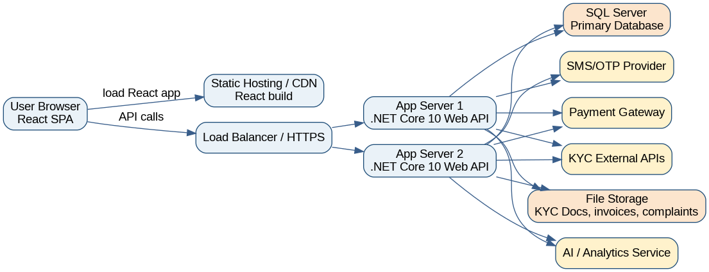
RM
RAW MATERIAL TRADING PLATFORM
4.1
High-Level Component / Deployment Diagram
How the platform is deployed across client, server, data and integration tiers.
KEY POINTS
› React SPA served from CDN; talks to ASP.NET Core API over HTTPS.
› Azure / on-prem SQL Server hosts relational data with daily backups.
› Adapters route to SMS, KYC and payment providers — replaceable.
› Optional ML service for AI price prediction in a later phase.
Figure 25 — High-level component / deployment diagram.
Part C · 4. Deployment
69 / 73

Slide 70
RM
RAW MATERIAL TRADING PLATFORM
5
Project Plan — Part C (Weeks 6–10)
Final tasks for patterns, UI/UX, deployment and submission.
Part C Task | W6 | W7 | W8 | W9 | W10
Design pattern documentation | X | X
UI/UX screen descriptions |  | X | X
Deployment diagram |  | X | X
Database correction & final review |  |  | X | X
Final formatting and submission |  |  |  | X | X
Part C · 5. Gantt Chart Update
70 / 73

Slide 71
RM
RAW MATERIAL TRADING PLATFORM
APPENDIX A
Important Business Rules
Marketplace policies that govern matching, cancellation, commission and disputes.
Rule Area | Business Rule
Matching window | Matching operates during defined business hours such as 9:00–17:00. Orders may be submitted 24/7.
Seller cancellation | Seller cannot cancel during matching window except based on configured grade and penalty rules.
Golden users | Golden buyers / sellers have extra visibility and flexibility; non-golden users may pay for premium access.
Presale | Presale may require buyer grade 1 or additional guarantee and has delivery time and tonnage limits.
Credit sale | Credit / LC sales are visible or available only to qualified or golden buyers.
Commission | Default commission is 5 per thousand, split 40% seller and 60% buyer.
Unpaid commission | Unpaid commission can block or restrict the user account.
Partial match | If accepted quantity is less than total but above minimum, remaining quantity is shown or cancelled by rules.
Tolerance | Weight tolerance must be clearly defined. Higher disagreement triggers third-party weighing and complaint process.
Disintermediation | Users attempting behind-the-scenes transactions outside the platform can be blocked or penalised.
Chat restrictions | Chat blocks phone numbers and prohibited contact-sharing content.
Disclaimer | Platform is not responsible for quality, storage, insurance or logistics unless a specific service contract is active.
Appendix A · Business Rules
71 / 73

Slide 72
RM
RAW MATERIAL TRADING PLATFORM
APPENDIX B
Suggested API Endpoints
Reference list of REST endpoints exposed by the .NET Core 10 backend.
Area | Endpoint | Description
Auth | POST /api/auth/register | Create account and send OTP.
Auth | POST /api/auth/login | Login and return JWT.
KYC | POST /api/kyc | Submit KYC profile and documents.
Admin | PUT /api/admin/kyc/{id}/approve | Approve or reject KYC.
Orders | POST /api/orders/sell | Create sell order.
Orders | POST /api/orders/buy | Create buy order.
Trading | GET /api/trading-board | List visible orders based on role / access.
Offers | POST /api/orders/{id}/offers | Submit offer.
Matching | POST /api/orders/{id}/match/{offerId} | Manually match an offer.
Payments | POST /api/payments/commission | Create commission payment.
Complaints | POST /api/complaints | Open complaint.
Grades | GET /api/grades/{userId} | View user grade based on access rules.
Analytics | GET /api/analytics/price-prediction | Return AI price prediction for selected product.
Appendix B · API Endpoints
72 / 73

Slide 73
PROJECT · RAW MATERIAL TRADING PLATFORM
WRAP UP
Thank you.
A trustworthy, transparent and digitally controlled marketplace for industrial raw materials.
Questions and discussion welcome.
.NET Core 10 · React.js · SQL Server · JWT + OTP · EF Core · Adapter-based integrations
Prepared by Reza · Version 0.01
73 / 73

