Slide 1
COMP 262 — Natural Language Processing & Recommender Systems
Phase #1: Sentiment Analysis Lexicon-Based Approach
Amazon Product Reviews — Industrial & Scientific Category
Group #4
Mahyar Eslami • Mauli Gandhi • Rouhollah Kamali Jose Pieruccini Arias • Arbina Shemael
Professor: Sajid Hussain • Winter 2026

Slide 2
Agenda
Step 1
Dataset Data Exploration
Counts, distributions, outliers, duplicates, word cloud
Step 2
Text Pre-processing
Labelling, column selection, outlier detection, basic cleaning
Step 3
Lexicon Package Study
VADER vs TextBlob vs SentiWordNet — comparison & selection
Step 4
Per-Lexicon Preprocessing
Minimal (VADER) vs light cleaning (TextBlob)
Step 5
Random Sampling
Stratified selection of 1,000 reviews
Step 6
Model Building
VADER & TextBlob sentiment models
Step 7
Validation & Comparison
Accuracy, Precision, Recall, F1, confusion matrices

Slide 3
Step 1 — Dataset Overview
Amazon Industrial & Scientific Reviews (Ni et al., 2019)
77,071
5,334
11,041
4.52
44.2
12
Total Reviews
Unique Products
Unique Users
Avg Rating ★
Avg Word Count
Columns
Rating Distribution
Key Insights
• Dataset is heavily skewed — 72.85% five-star ratings
• Median review length: 18 words (many are very short)
• 25,507 duplicate review texts detected
• 97.8% of image fields are missing
• 87.5% of vote fields are missing
Rating | Count | Percentage
★★★★★ (5) | 56,150 | 72.85%
★★★★ (4) | 12,061 | 15.65%
★★★ (3) | 4,442 | 5.76%
★★ (2) | 1,936 | 2.51%
★ (1) | 2,482 | 3.22%

Slide 4
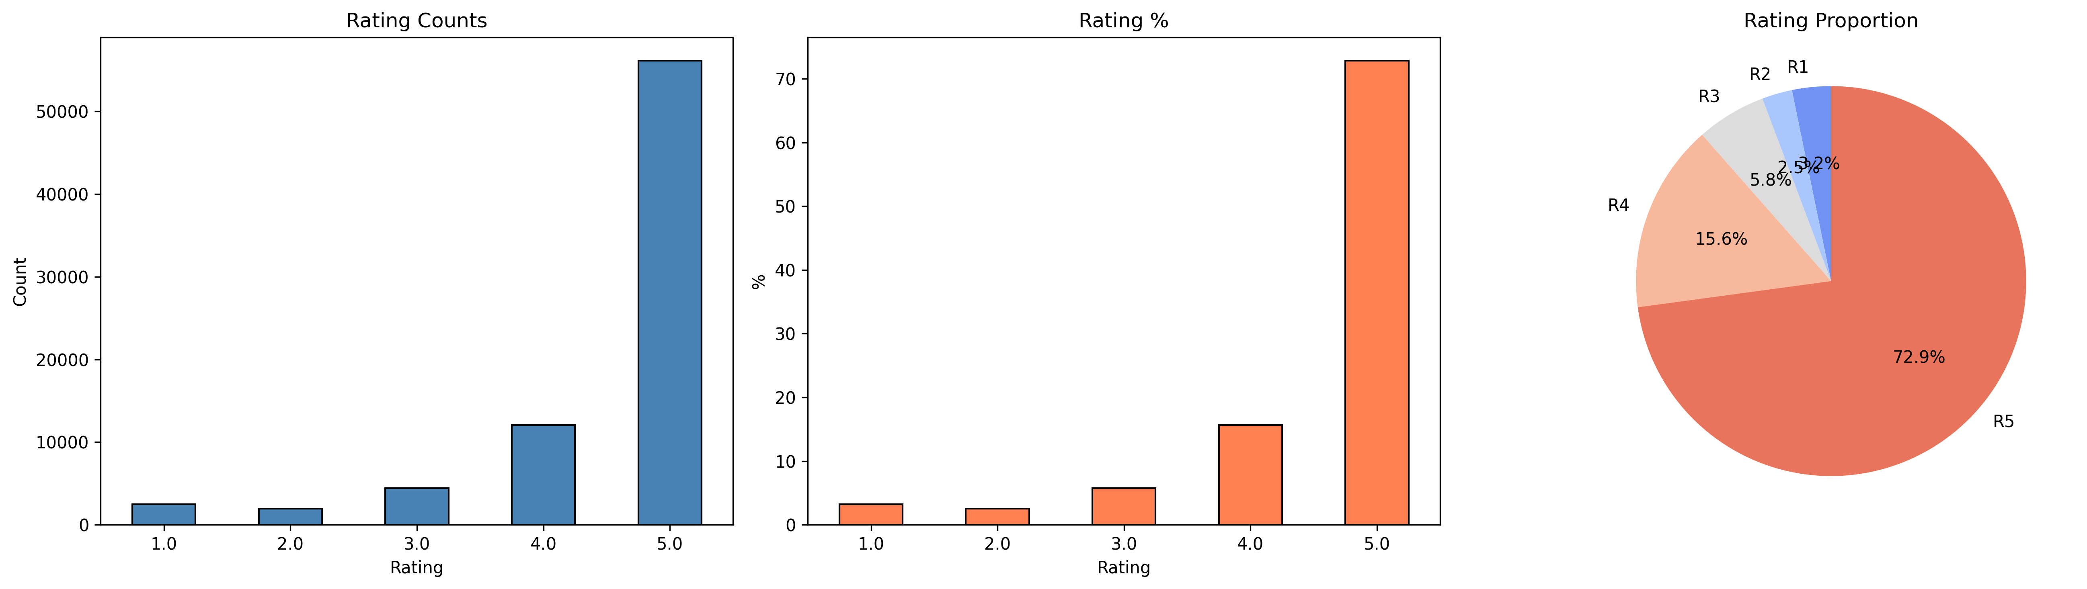
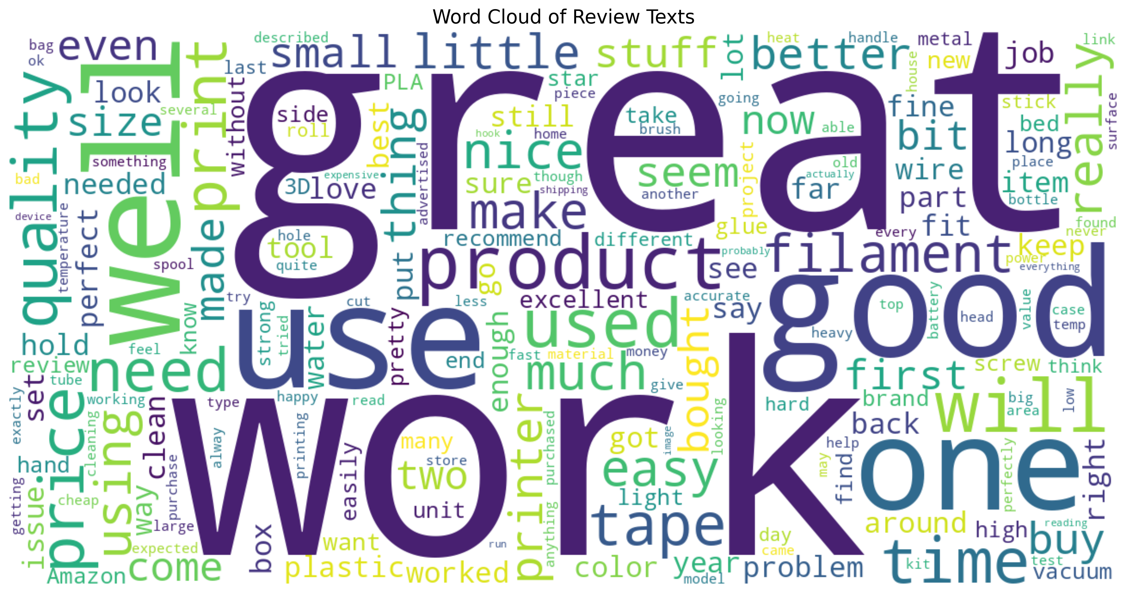
Step 1 — Exploration Visuals
Rating Distribution
Word Cloud of Review Text

Slide 5
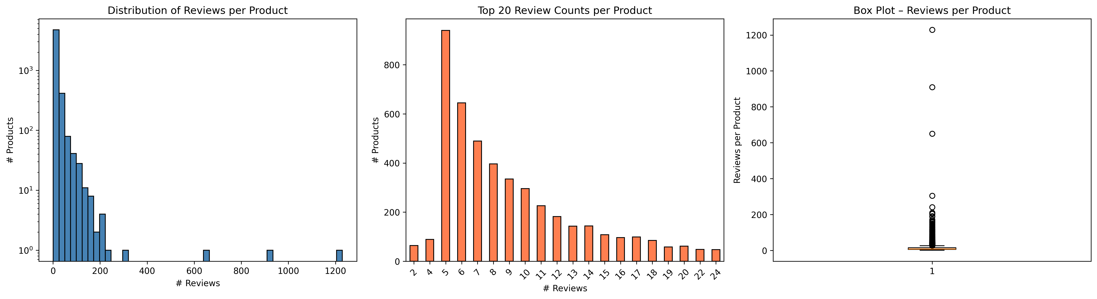
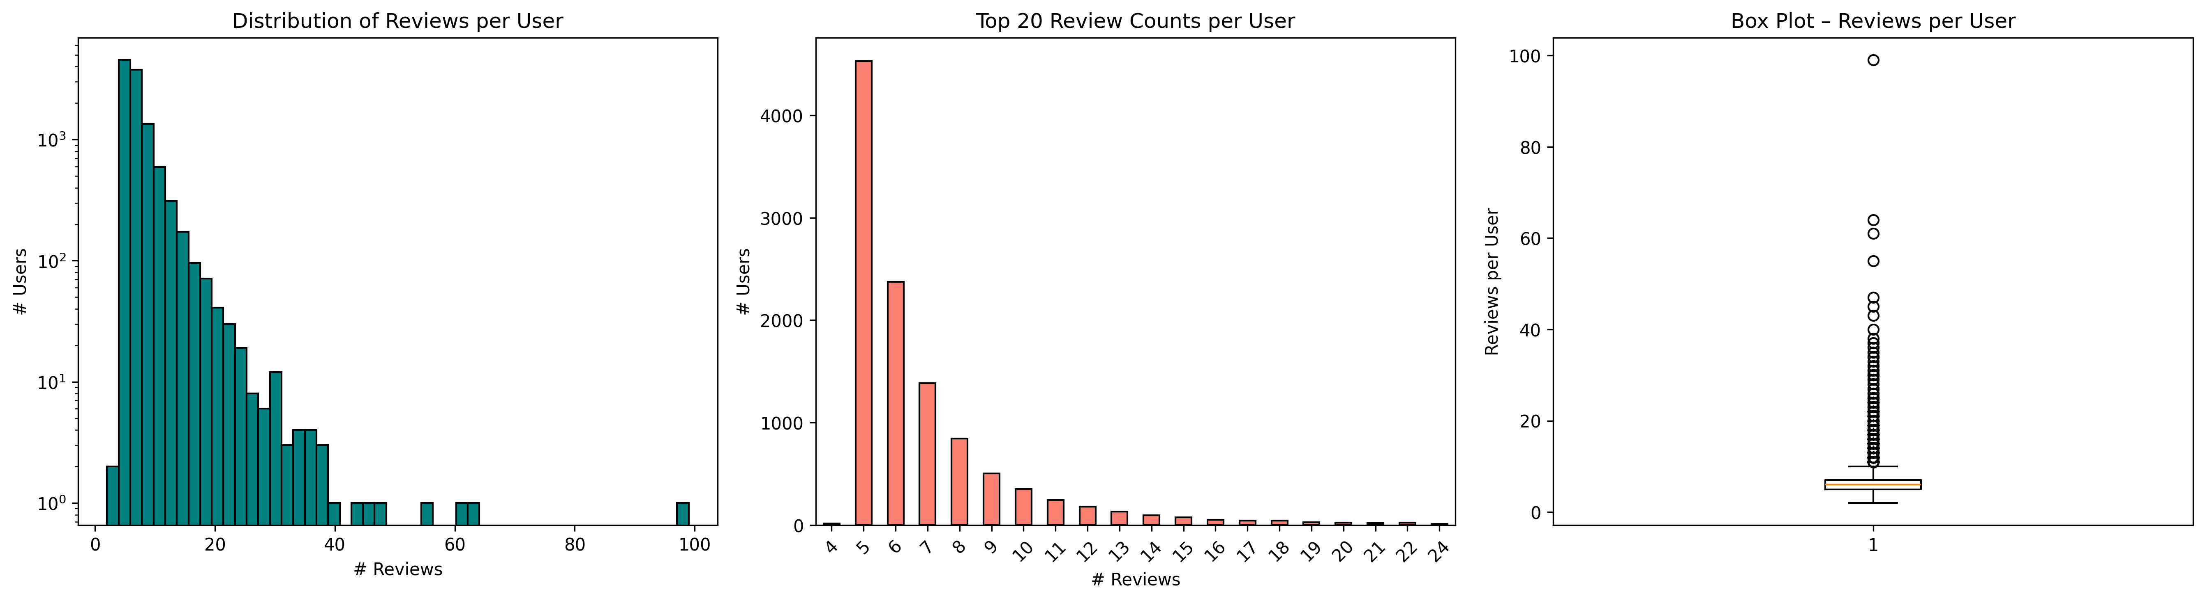
Step 1 — Distribution Analysis
Reviews per Product
Reviews per User

Slide 6
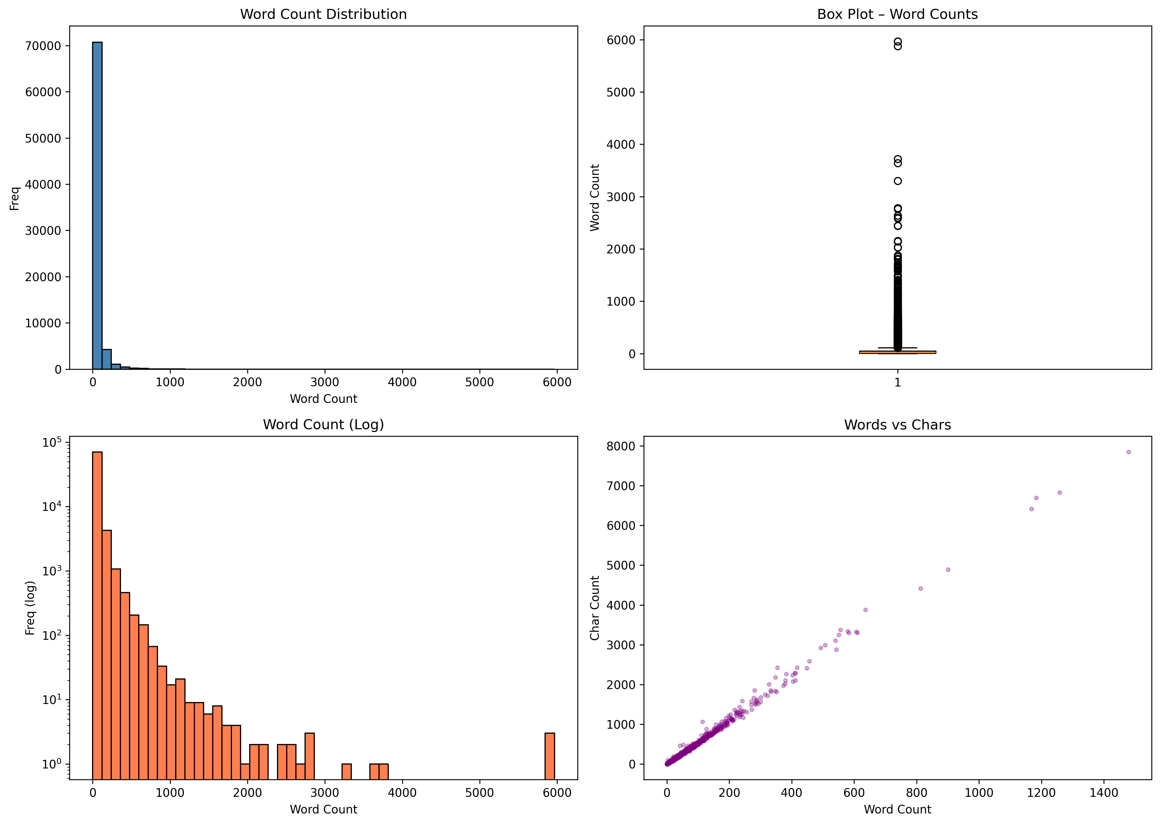
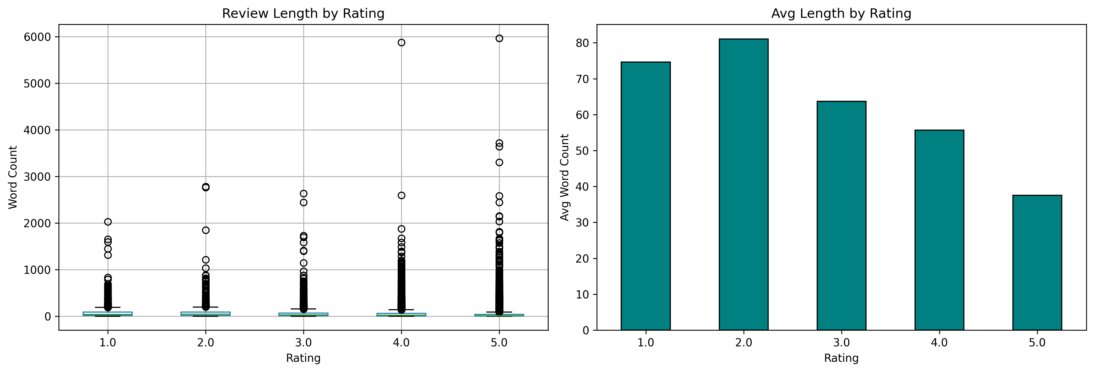
Step 1 — Review Length & Rating Correlation
Review Length Analysis
Rating vs. Review Length

Slide 7
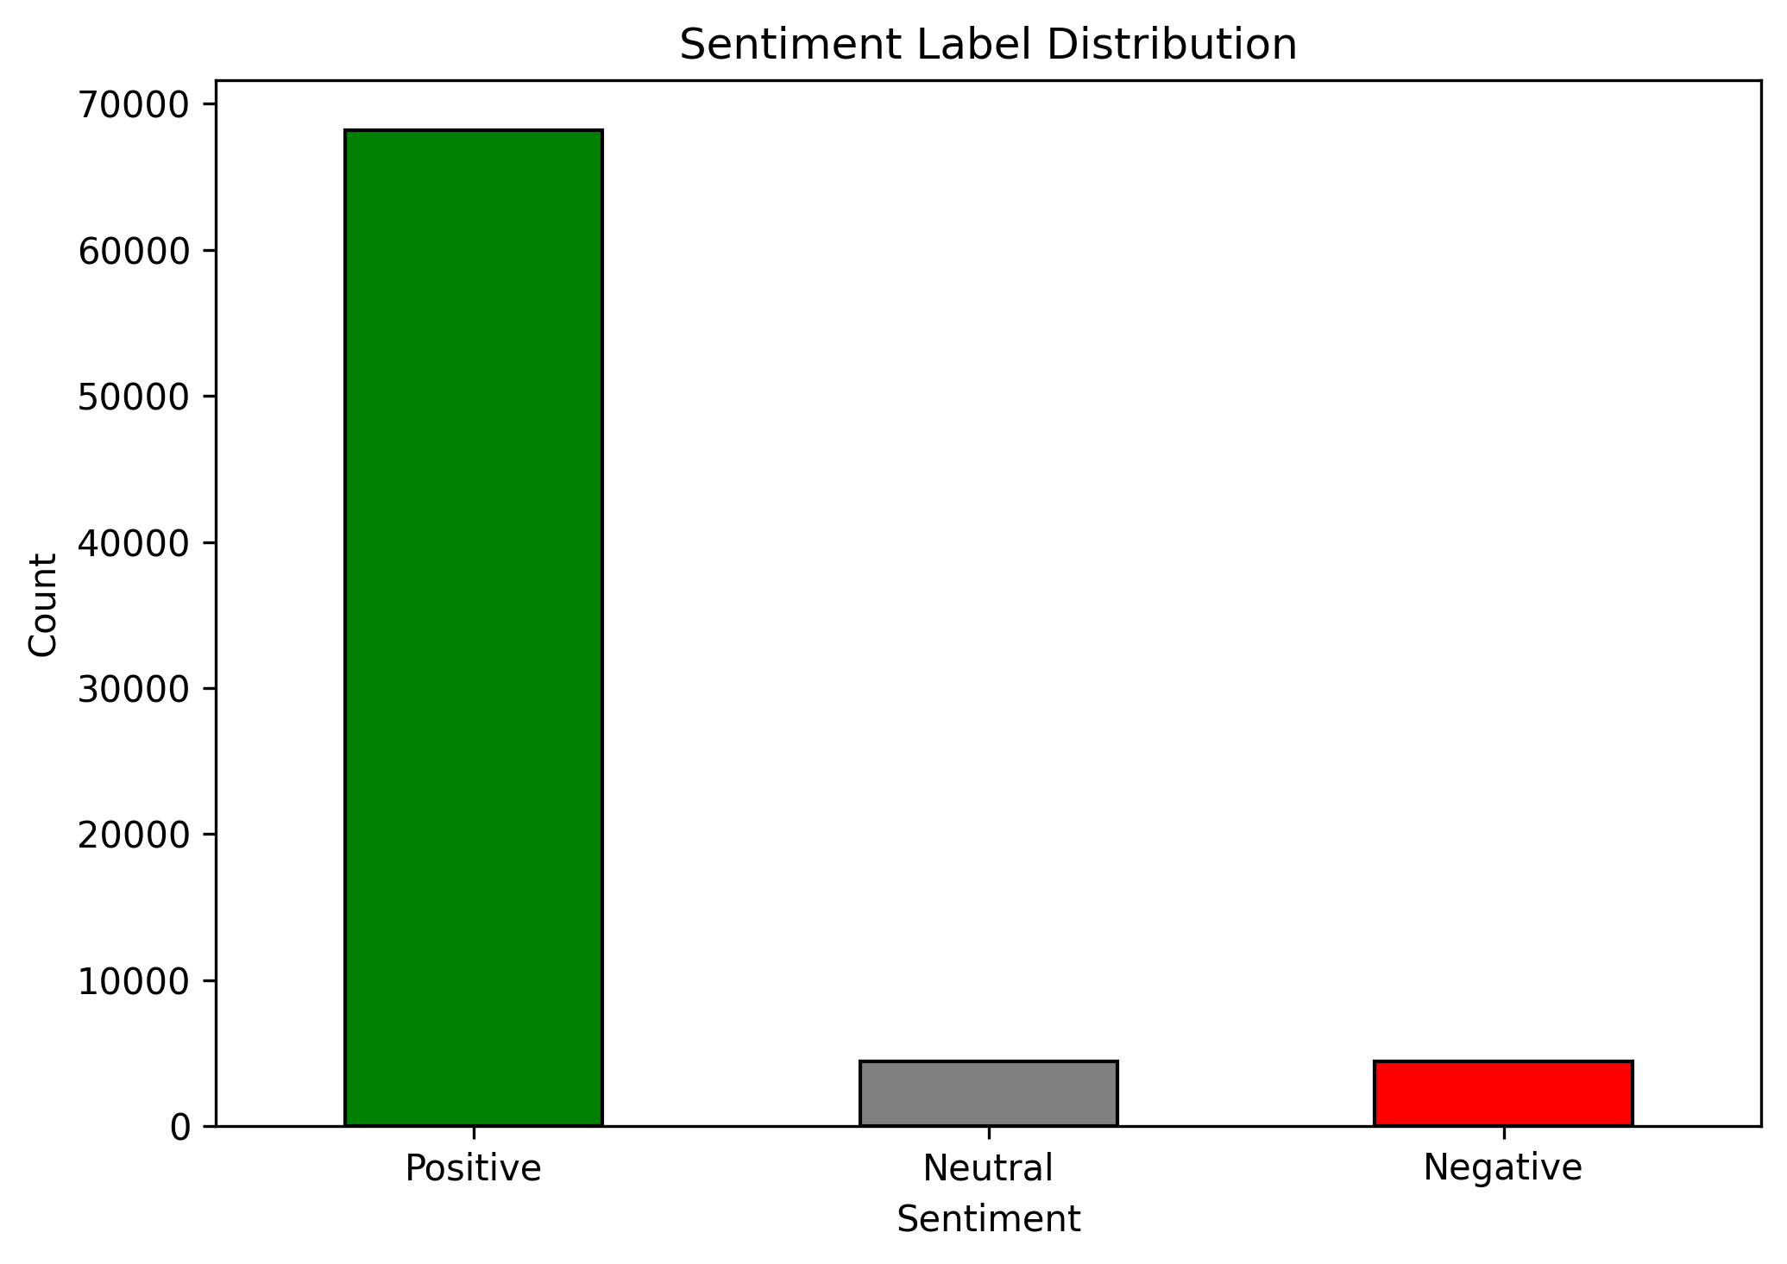
Step 2 — Text Pre-processing
Sentiment Labelling
★★★★–★★★★★ (4-5) → Positive
★★★ (3) → Neutral
★–★★ (1-2) → Negative
Column Selection (with justification)
• reviewText — primary input for sentiment
• overall — star rating for ground-truth labels
• summary — reinforces/contradicts body text
• asin — product ID for per-product tracking
• reviewerID — user ID for per-user tracking
Outlier Detection (IQR Method)
• review_length outliers: 7,330 (9.51%)
• word_count outliers: 7,330 (9.51%)
• Outliers flagged, not removed — lexicons
handle variable-length text well
Basic Text Cleaning
• Remove null / NaN entries
• Strip residual HTML tags
• Remove URLs
• Normalise whitespace
• Created 'full_text' = summary + reviewText

Slide 8
Step 3 — Lexicon Package Study
Comparing VADER, TextBlob, and SentiWordNet
VADER
TextBlob
SentiWordNet
✓ Designed for informal / social text
✓ Handles CAPS, punctuation (!!!)
✓ Degree modifiers & negation
✓ Fastest execution (0.001s)
✓ Compound score aggregation
✗ Rule-based — not trainable
✗ Weaker on formal text
✓ Simple API (polarity + subjectivity)
✓ Good general-purpose analyser
✓ Subjectivity score is useful
✓ Built on Pattern library
✗ No capitalisation handling
✗ Less nuanced for reviews
✓ Based on WordNet semantics
✓ Separate pos / neg / obj scores
✓ Word-level inspection
✗ Heavy preprocessing required
✗ Slowest (0.013s — 13× VADER)
✗ No negation handling
✗ First-synset heuristic errors
Agreement: VADER–TextBlob 75% | VADER–SentiWordNet 45% | TextBlob–SentiWordNet 40%
★ Selected: VADER & TextBlob ✗ Rejected: SentiWordNet

Slide 9
Step 4 — Per-Lexicon Text Preprocessing
Why minimal preprocessing preserves sentiment signals
VADER — Minimal Preprocessing
TextBlob — Light Cleaning
• Preserve CAPITALISATION → emphasis signal
• Preserve punctuation (!!!) → intensity signal
• Preserve degree modifiers (very, extremely)
• Keep negation words (not, never)
• Only: strip leading/trailing whitespace
NOT applied:
✗ Lowercasing ✗ Stop-word removal
✗ Stemming ✗ Lemmatisation
• Remove residual HTML tags
• Normalise whitespace
• TextBlob handles case-folding internally
• Keep original word forms for lookup
NOT applied:
✗ Stop-word removal (removes context)
✗ Stemming (changes dictionary forms)
✗ Lemmatisation
Justification: Heavy preprocessing (stop-word removal, stemming) would strip the linguistic cues that both lexicon tools rely on for accurate sentiment scoring.

Slide 10
Steps 5–6 — Sampling & Model Building
Stratified sample of 1,000 reviews → two lexicon-based models
Stratified Random Sampling (Step 5)
• Sample size: 1,000 reviews
• Stratified by sentiment_label to preserve
class distribution from the full dataset
• Random seed = 42 for reproducibility
Sample Class Distribution:
Positive: ~810 reviews (81%)
Neutral: ~58 reviews (5.8%)
Negative: ~57 reviews (5.7%)
(mirrors full-dataset skew)
Model Building (Step 6)
Model 1: VADER
• Input: full_text (summary + reviewText)
• Output: compound score → label
• Thresholds: ≥0.05 Pos, ≤-0.05 Neg
Model 2: TextBlob
• Input: lightly cleaned full_text
• Output: polarity score → label
• Thresholds: >0.1 Pos, <-0.1 Neg
Both use full_text = summary + reviewText
for richer sentiment signal.

Slide 11
Step 7 — Model Comparison Results
Metric | VADER | TextBlob | Difference
Accuracy | 0.7930 | 0.7350 | +0.0580
Precision (macro) | 0.4575 | 0.4656 | −0.0081
Recall (macro) | 0.5143 | 0.4559 | +0.0584
F1-Score (macro) | 0.4748 | 0.4332 | +0.0416
Precision (weighted) | 0.8570 | 0.8550 | +0.0020
Recall (weighted) | 0.7930 | 0.7350 | +0.0580
F1-Score (weighted) | 0.8212 | 0.7854 | +0.0358
VADER outperforms TextBlob on 6 of 7 metrics — TextBlob leads only on Precision (macro)
Agreement between models: 792 / 1,000 predictions (79.2%)

Slide 12
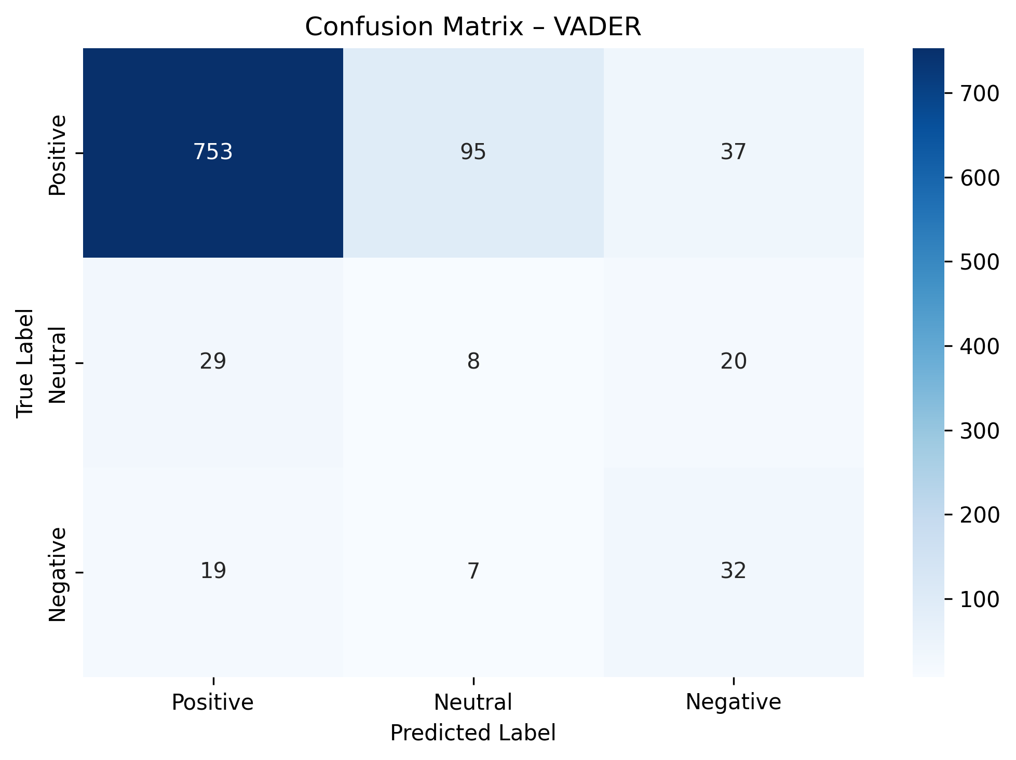
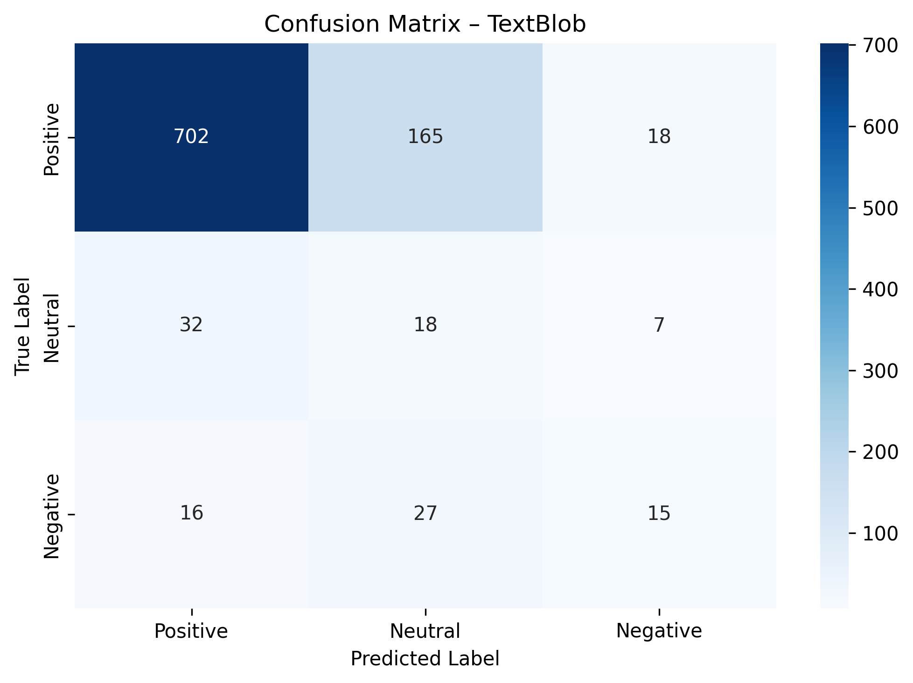
Step 7 — Confusion Matrices
VADER — 207 misclassifications (20.7%)
TextBlob — 265 misclassifications (26.5%)

Slide 13
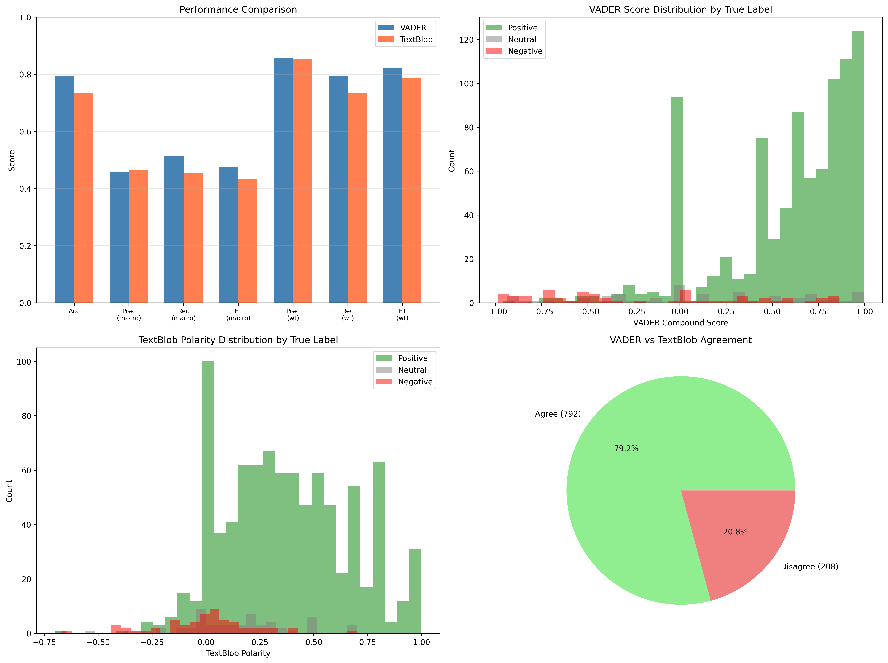
Step 7 — Performance Visualisation

Slide 14
Step 7 — Error Analysis
Understanding why lexicon models fail
VADER Misclassifications: 207 / 1,000 (20.7%)
Positive → Neutral: 95 (most common)
Positive → Negative: 37
Neutral → Positive: 29
Neutral → Negative: 20
Negative → Positive: 19
Negative → Neutral: 7
TextBlob Misclassifications: 265 / 1,000 (26.5%)
Positive → Neutral: 165 (most common)
Neutral → Positive: 32
Negative → Neutral: 27
Positive → Negative: 18
Negative → Positive: 16
Neutral → Negative: 7
Common Failure Patterns:
• Sarcasm / irony — lexicons take words at face value
• Mixed sentiment — "Great product but shipping was awful"
• Short / vague reviews — too little text for reliable scoring
• Neutral class is hardest — overlaps with weak positive/negative signals

Slide 15
Conclusion & Key Findings
VADER outperforms TextBlob across most metrics
• Macro F1: VADER 0.4748 vs TextBlob 0.4332 (+4.2%)
• Weighted F1: VADER 0.8212 vs TextBlob 0.7854 (+3.6%)
• Accuracy: VADER 79.3% vs TextBlob 73.5% (+5.8%)
VADER excels with informal, short reviews with capitalization
and punctuation emphasis — ideal for product reviews.
TextBlob is more conservative, frequently classifying
reviews as Neutral — leading to higher Positive → Neutral errors.
Both models struggle with the Neutral class, sarcasm,
and mixed-sentiment reviews.
Amazon review data is heavily skewed (72.85% five-star),
making macro F1 the most informative metric for evaluating
performance on minority classes (Neutral & Negative).
Best Model
VADER
Macro F1: 0.4748
Accuracy: 79.3%
Next: Phase #2
Supervised ML models
trained on labelled data
for improved performance

Slide 16
Project Architecture & Tools
Project Pipeline
main.py → orchestrates all 7 steps
data_exploration.py → Step 1
preprocessing.py → Step 2
lexicon_analysis.py → Step 3
sentiment_analysis.py → Steps 4–7
Libraries & Tools
• pandas, numpy — data manipulation
• matplotlib, seaborn — visualisation
• vaderSentiment — VADER lexicon
• textblob — TextBlob lexicon
• nltk (SentiWordNet) — comparison only
• scikit-learn — evaluation metrics
• wordcloud — text visualisation
Generated Outputs: 16 files — reports (.txt), tables (.csv), visualisations (.png), preprocessed data (.csv)
Dataset: Ni, J., Li, J., & McAuley, J. (2019). Justifying recommendations using distantly-labeled reviews and fine-grained aspects. EMNLP-IJCNLP 2019.

Slide 17
Thank You
Phase #1: Sentiment Analysis — Lexicon-Based Approach
Group #4 — Industrial & Scientific Dataset

