Slide 1
Natural Language & Recommender Systems

Slide 2
Phase 1
Phase 2
LLM
Conclusions
COMP 262 • Group 4
Project Overview
PHASE 1
PHASE 2
Lexicon-Based Sentiment Analysis
ML, Recommender & LLM
📊
Dataset Exploration
🤖
ML Models
1.7M Amazon reviews
Logistic Regression & SVM
⚙️
Pre-processing
⚖️
Cross-Comparison
Feature selection & cleaning
Lexicon vs ML models
🔤
VADER & TextBlob
⭐
Recommender System
Lexicon-based models
Sentiment-enhanced CF
📈
Evaluation
📝
LLM Summarization
Confusion matrices & F1
DistilBART review summaries
🔧
Fine Tuning
💬
CS Response Gen
Thresholds & sampling
Flan-T5 auto-responses

Slide 3
01
Phase 1: Lexicon-Based Sentiment Analysis
Amazon Industrial & Scientific Reviews • VADER • TextBlob

Slide 4
Phase 1
Phase 2
LLM
Conclusions
COMP 262 • Group 4
Dataset Exploration
1.76M
165,764
1.25M
4.29
Total Reviews
Products
Unique Users
Avg Rating
⭐ Rating Distribution (Heavily Imbalanced)
📦 Reviews Per Product
Avg 10.61 reviews/product • Median: 2
78,651 products with only 1 review
Most reviewed item: 14,331 reviews
5 stars
67.9%
4 stars
13.7%
3 stars
6.3%
⚠️ Data Quality
2 stars
4.1%
78% users wrote only 1 review
Images missing: 98% • Votes: 88%
377,093 duplicate texts • 87,081 full duplicates
ReviewText & Summary: <1% missing ✓
1 star
8.0%

Slide 5
Phase 1
Phase 2
LLM
Conclusions
COMP 262 • Group 4
Dataset Pre-processing
Processing Pipeline
1
Feature Selection
2
Label Mapping
3
Outlier Decision
4
Feature Engineering
Kept: reviewText, summary, overall, asin, reviewerID
4-5★ → Positive 3★ → Neutral 1-2★ → Negative
Kept <10% outliers — lexicons handle long text
Created 'full_text' = summary + reviewText
Model-Specific Pre-processing
🔵 VADER — Minimal Preprocessing
🟠 TextBlob — Light Cleaning
✓ Preserved capitalization (intensity signal)
✓ Kept punctuation (!!!) as emphasis
✓ Retained degree modifiers ('very', 'extremely')
✓ HTML tag removal
✓ Whitespace normalization
✓ Internal tokenization handled

Slide 6
Phase 1
Phase 2
LLM
Conclusions
COMP 262 • Group 4
Lexicon Models: VADER vs TextBlob
V
VADER
T
TextBlob
Valence Aware Dictionary & Sentiment Reasoner
Pattern-Based Polarity Analysis
How it works:
• Rule-based analyzer for informal text
• Sentiment lexicon with polarity strengths
• Adjusts for caps, punctuation, modifiers
• Detects negations
Outputs:
• Positive, Neutral, Negative proportions
• Compound score ∈ [-1, +1]
Thresholds:
• compound ≥ 0.05 → Positive
• compound ≤ -0.05 → Negative
• otherwise → Neutral
How it works:
• Polarity from underlying lexicon
• Polarity range [-1, +1]
• Subjectivity score (not used here)
• Stable baseline model
Limitations:
• Doesn't handle caps/punctuation emphasis
• More conservative on Neutral
Thresholds:
• polarity > 0.1 → Positive
• polarity < -0.1 → Negative
• otherwise → Neutral

Slide 7
Phase 1
Phase 2
LLM
Conclusions
COMP 262 • Group 4
Fine Tuning Strategy
⚡
Threshold Tuning
📊
Stratified Sampling
🔧
Preprocessing Per Model
VADER: compound at ±0.05
TextBlob: polarity at ±0.1
Balances sensitivity — avoids
forcing weak sentiment into
Positive or Negative classes
1,000 reviews for evaluation
Mirrors class distribution
Ensures minority classes are
fairly represented in testing
Reproducible & meaningful
VADER: minimal (keep cues)
TextBlob: light cleaning
Heavy preprocessing avoided —
lexicons rely on surface cues
that aggressive cleaning removes
ℹ️ No hyperparameter search or model fitting — lexicon models have no trainable weights. Fine tuning is limited to thresholds, sampling methods, and preprocessing choices.
Ground Truth Label Mapping
★★★★★ ★★★★
→
Positive
★★★
→
Neutral
★★ ★
→
Negative

Slide 8
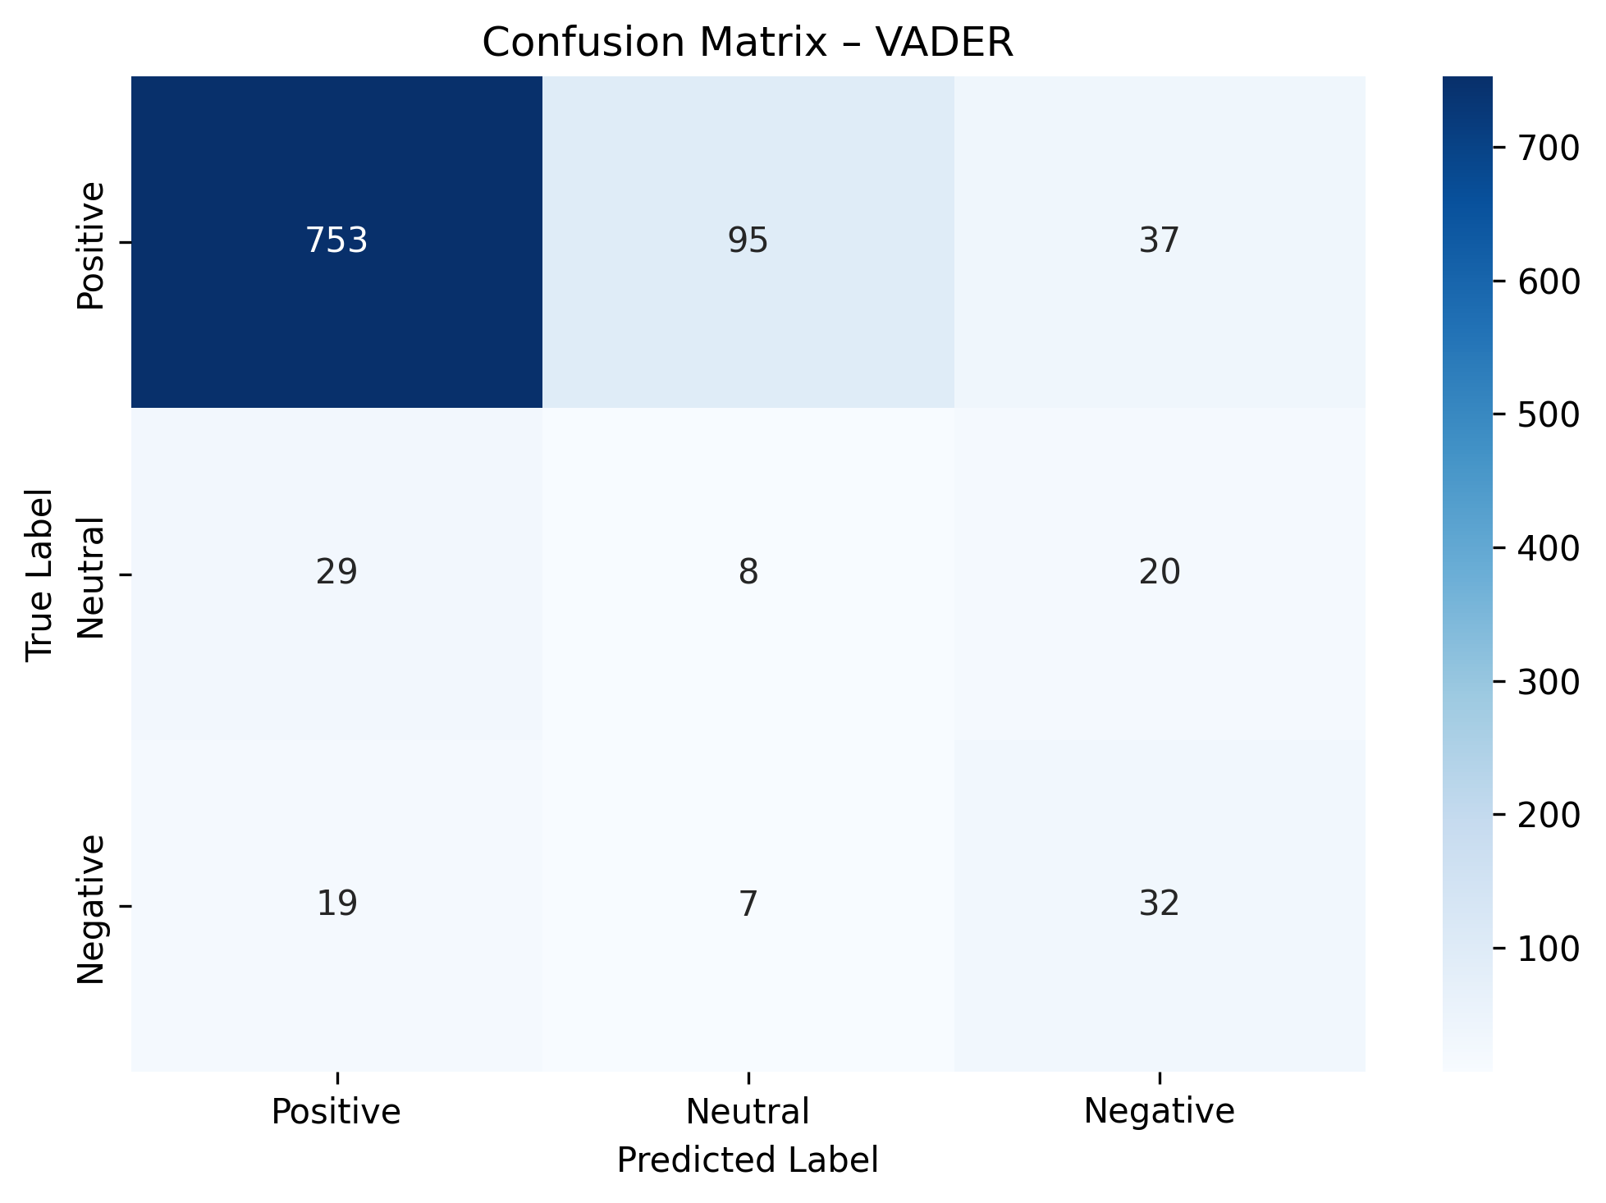
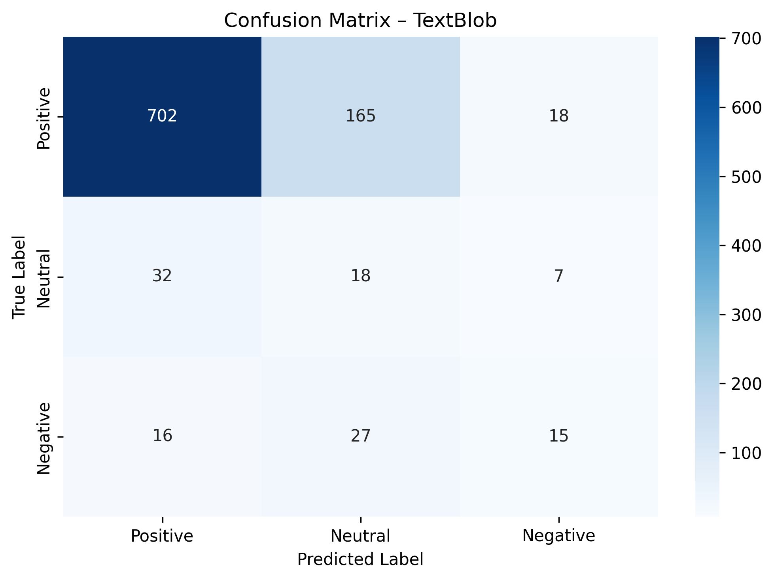
Phase 1
Phase 2
LLM
Conclusions
COMP 262 • Group 4
Confusion Matrices
VADER
TextBlob
💡 VADER is stronger on the Positive class; both struggle with Neutral near threshold boundaries

Slide 9
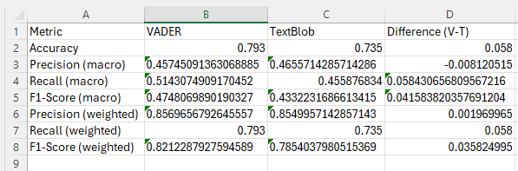
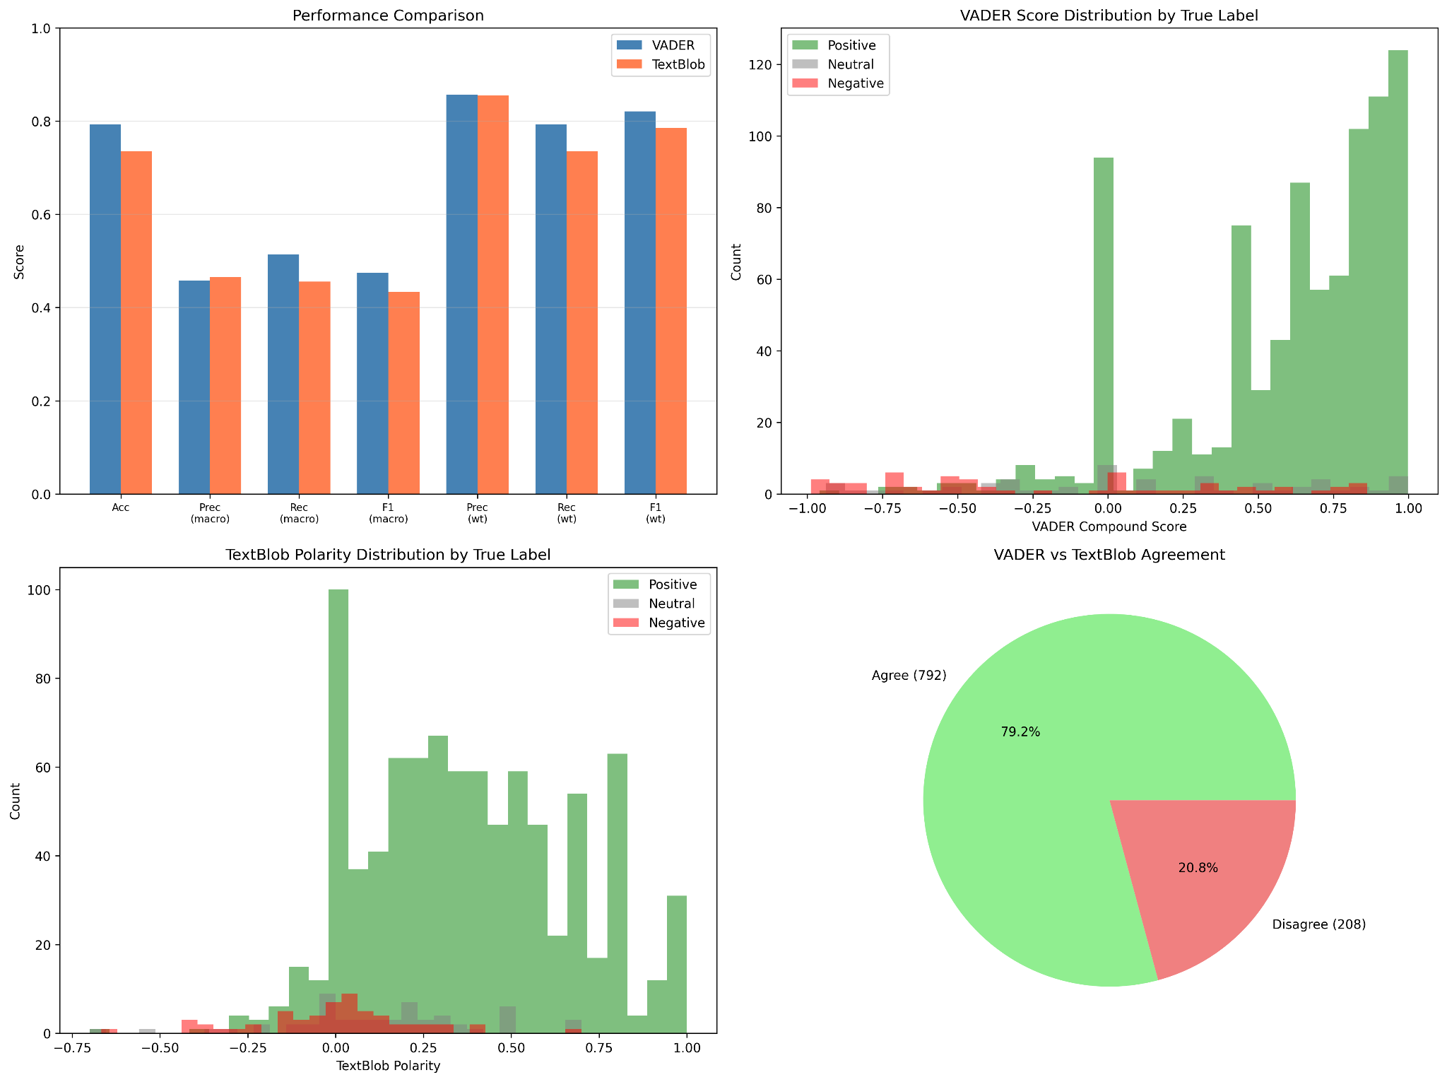
Phase 1
Phase 2
LLM
Conclusions
COMP 262 • Group 4
Performance Comparison & Distributions
📋 Metrics Comparison
📊 Score Distributions & Agreement
Key Findings
✓ VADER outperforms TextBlob on Macro F1
✓ Macro F1 = primary metric (treats each class equally)
✓ ~80% agreement between models
✓ Differences mainly on Neutral boundaries

Slide 10
Phase 1
Phase 2
LLM
Conclusions
COMP 262 • Group 4
Error Analysis & Phase 1 Conclusion
⚠️ Common Misclassification Patterns
✅ Phase 1 Conclusions
TextBlob: 26.5% misclassified
VADER wins on Macro F1
VADER: 20.7% misclassified
Better handling of minority classes Stronger at informal cues & emphasis
🎭
Sarcasm / Irony
Both have limitations
"great… not"
Struggle with ambiguous/neutral reviews Cannot learn domain-specific sentiment
⚖️
Mixed Sentiment
"good product but terrible shipping"
❓
Short / Vague
Next: Supervised ML
"ok", "fine"
Phase 2 improves results with labeled training data & ML classifiers
🔄
Weak Signals
Neutral with weak positive/negative words

Slide 11
02
Phase 2: Machine Learning, Recommender & LLM
Logistic Regression • SVM • Collaborative Filtering • Hugging Face

Slide 12
Phase 1
Phase 2
LLM
Conclusions
COMP 262 • Group 4
Phase 2: Dataset & Text Representation
📂 Dataset Subset
⚙️ ML Pre-processing Steps
2,000+ reviews from Industrial & Scientific
Same imbalanced distribution as Phase 1
Predominantly 4-5 star reviews
Stratified splits & macro metrics essential
Lowercase
Remove punctuation
Remove HTML
Tokenize
TF-IDF
→
→
→
→
+ Combined summary & reviewText
TF-IDF: Text Representation Method
📊
Sparse Text
🔍
Domain Terms
⚡
Linear Models
🚀
Scalable
Performs well on high-dimensional text
Captures vocabulary like 'defect', 'broke'
Efficient with Logistic Regression & SVM
Computationally efficient for large datasets

Slide 13
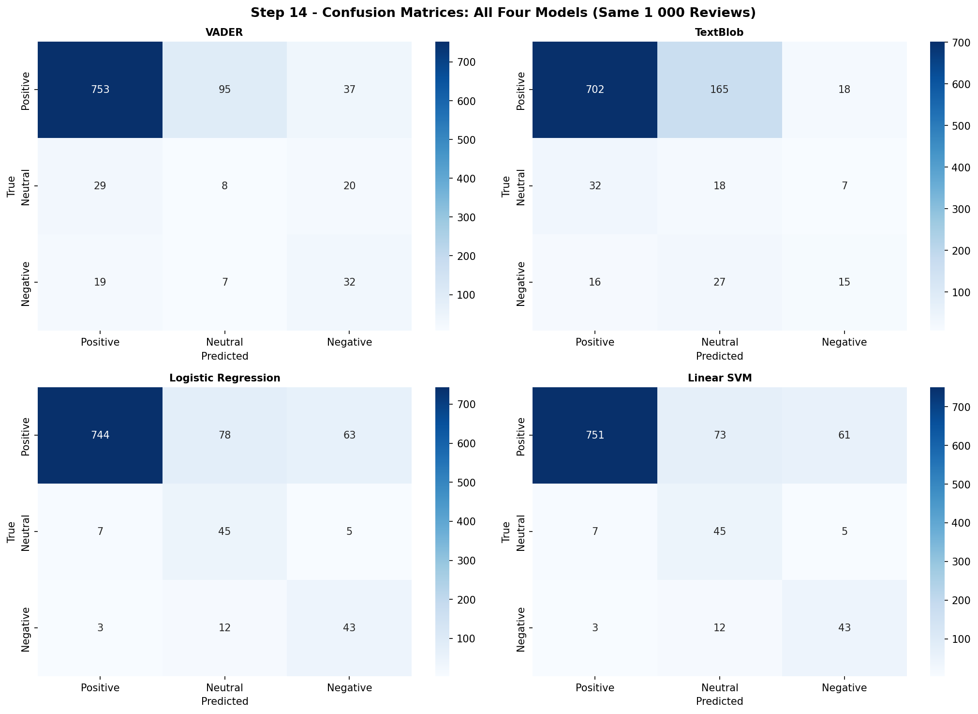
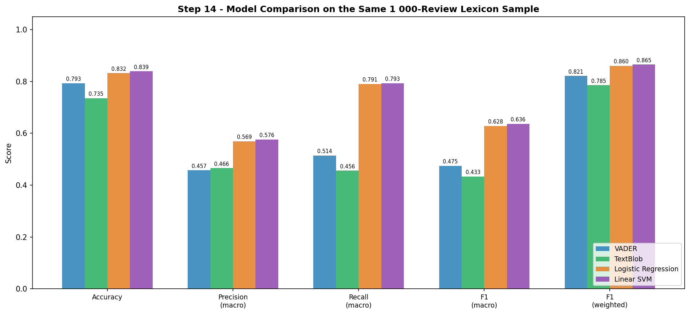
Phase 1
Phase 2
LLM
Conclusions
COMP 262 • Group 4
Machine Learning Models & Results
Logistic Regression
Linear SVM
⚙️ Training Configuration
Linear classifier that models class probability boundaries
Maximum margin classifier for high-dimensional text
70/30 stratified train/test split • Grid Search tuning • Limited TF-IDF vocab size
📈 Results
📊 Comparison

Slide 14
Phase 1
Phase 2
LLM
Conclusions
COMP 262 • Group 4
Cross-Model Comparison: All 4 Models
All models tested on same 1,000 stratified sample for fair comparison
ML models outperform lexicon models across all metrics
Lexicons struggle with mixed sentiment & domain terms • ML learns patterns like 'broke', 'defect', 'return'
1
Linear SVM
Best Macro F1 overall
2
Logistic Regression
Ideal production model
3
VADER
Close second
Strong across all metrics
Best lexicon model
4
TextBlob
Good at informal cues
Conservative baseline
Over-predicts Neutral

Slide 15

Phase 1
Phase 2
LLM
Conclusions
COMP 262 • Group 4
Sentiment-Enhanced Collaborative Filtering
Enhancement Architecture
Review Text
→
VADER Analysis
→
Sentiment Score
→
Blend Formula
→
Enhanced Rating
📐 Formulas
📈 Results
sentiment_score
= (VADER_compound + 1) / 2
MAE Improvement
▼ 6.7%
normalized_star
= (rating − 1) / 4
RMSE Change
▲ 24.9%
enhanced_rating
= 0.6 × norm_star + 0.4 × sent_score
Sentiment minimizes noise in sparse
rating matrices → more accurate &
stable recommendations
Especially helpful for controversial products

Slide 16
03
LLM-Powered NLP Tasks
Review Summarization • Customer Service Response Generation

Slide 17
Phase 1
Phase 2
LLM
Conclusions
COMP 262 • Group 4
Review Summarization with LLM
🤗 sshleifer/distilbart-cnn-12-6
Pipeline:
Select 10 reviews >100 words
Feed to DistilBART model
Generate abstractive summary
~50 word condensed output
→
→
→
Example 1
Observations
Original (~120 words):
✓
Captures main sentiment & key aspects
"As another reviewer mentioned I don't think there is any difference in which Goop you buy… The only reason I dropped off a star is that it often hardens after a tube is opened…"
✓
Coherent, preserves essential meaning
✓
Significantly reduces text length
Generated Summary (38 words):
△
Minor details sometimes omitted
"The only reason I dropped off a star is that it often hardens after a tube is opened even though the cap is on tight. Other than that, the product itself is 5-stars all the way."
△
Occasionally shorter than 50-word target
△
Focuses on dominant sentiment
💡 Abstractive summarization generates new sentences — more natural & readable than extractive methods

Slide 18
Phase 1
Phase 2
LLM
Conclusions
COMP 262 • Group 4
Automatic Customer Service Response
🤗 google/flan-t5-large (instruction-tuned)
Customer Review
Extract Complaint
Design Prompt
Generate Response
Sample Result
📩 Customer Review:
"I've found all kinds of uses for this product… however when removing it, the adhesive pulled paint off the wall…"
🔍 Extracted Complaint:
"The adhesive pulled paint off walls and is not wall-friendly like other products."
💬 Generated Response:
"Dear Customer, thank you for taking the time to share your experience… We sincerely apologize for the issue you described… Please contact our support team and we will assist you further."
✓ Coherent • Polite • Well-structured • Acknowledges concerns
△ Generic responses • No business context • Not always actionable
Strengths
Limitations

Slide 19
Phase 1
Phase 2
LLM
Conclusions
COMP 262 • Group 4
Conclusions & Future Work
1
Phase 1: Lexicon
2
Phase 2: ML
3
LLM Tasks
✓ VADER outperforms TextBlob
(higher Macro F1)
✓ Good baseline without training
△ Struggles with Neutral reviews
△ Cannot learn domain sentiment
✓ Linear SVM = best model
✓ ML beats lexicon on all metrics
✓ Sentiment CF improves MAE 6.7%
△ Neutral class remains hardest
✓ Effective summarization
✓ Coherent CS responses
✓ Extends beyond classification
△ Pre-trained, not fine-tuned
△ Can lack domain specificity
🚀 Future Improvements
🔬
Fine-tune LLMs on domain-specific datasets
🔗
Integrate retrieval-based systems for precise responses
🧠
Explore deep learning (BERT, transformers) for classification
⚡
Strong potential for real-world integration of all approaches

