Slide 1
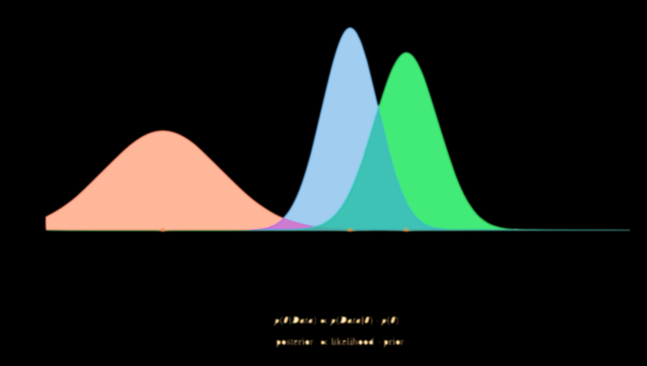
ML
APM
This Photo by Unknown Author is licensed under CC BY-SA

