Slide 1
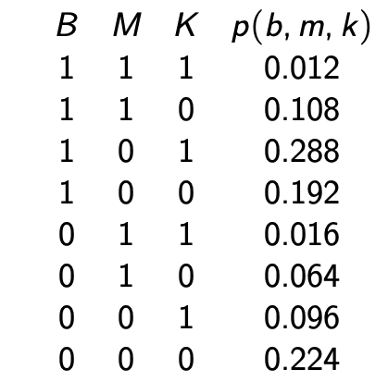
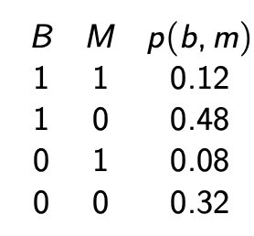
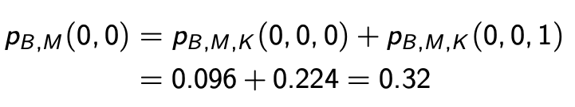

Slide 3
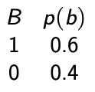
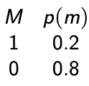

Slide 4
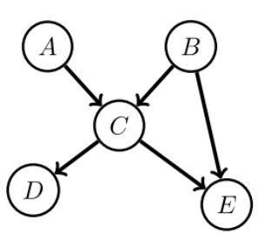

Slide 5
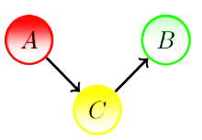
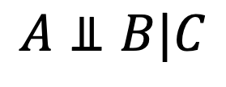
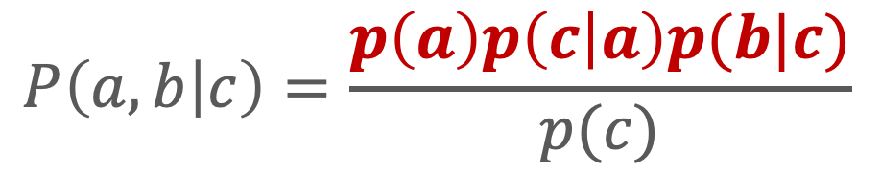
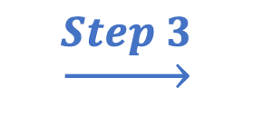
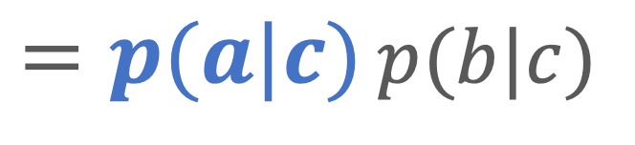
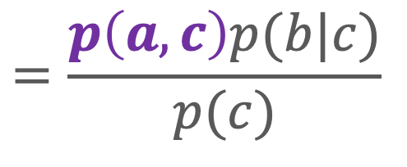
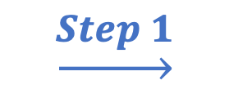
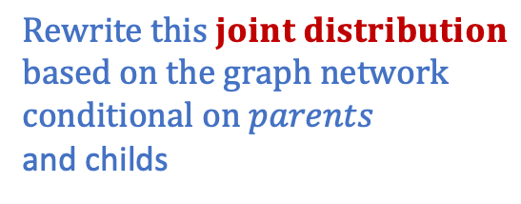



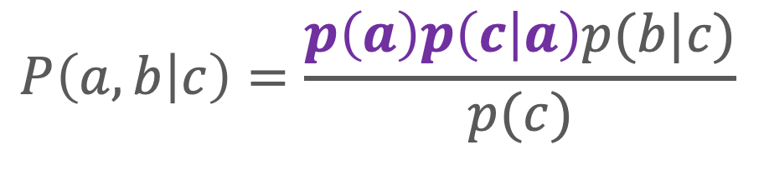

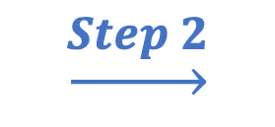
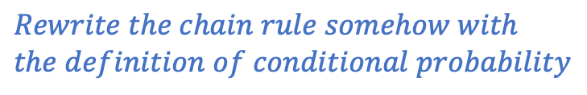
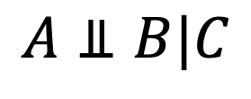

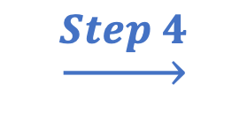



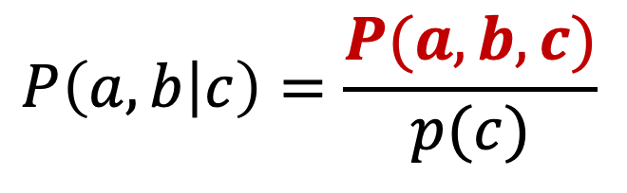
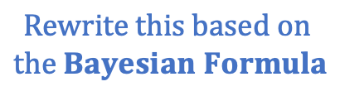



$$\underset{→}{Step 1}$$
$$P\left(a,b | c\right)=\frac{P(a,b,c)}{p(c)}$$
$$A⫫B|C$$
$$≡$$
$$Rewrite this based on$$
$$the Bayesian Formula$$
$$A⫫B|C$$
(No need to look at graph at this step)
$$Ture or False$$
$$\underset{→}{Step 2}$$
$$Rewrite this joint distribution$$
$$based on the graph network$$
$conditional on parents$ and childs
$$p\left(a\right)$$
$$p\left(b|c\right)$$
$$p\left(a|c\right)$$
$$P\left(a,b,c\right)=p\left(a\right)p\left(c | a\right)p(b|c)$$
$$P\left(a,b | c\right)=\frac{p\left(a\right)p\left(c | a\right)p(b|c)}{p(c)}$$
$$\underset{→}{Step 3}$$
$$Find a chain rule expansion$$
$$P\left(a,b | c\right)=\frac{p\left(a\right)p\left(c | a\right)p(b|c)}{p(c)}$$
$$=$$
$$=\frac{p\left(a,c\right)p(b|c)}{p(c)}$$
$$\underset{→}{Step 4}$$
$$Rewrite the chain rule somehow with$$
$$the definition of conditional probability$$
$=\frac{p\left(a,c\right)}{p(c)}$ $p(b|c)$
$$=$$
$$Ture$$
$=p(a|c)$ $p(b|c)$

