Slide 1

Grocery Store Management
By- Shaik Mohammed Farhan

Slide 2
About me
Background:-
I have completed my B. Tech in Artificial Intelligence And Machine Learning.
My academic focus has been on programming, databases, and applied machine learning concepts.
Why I Want to Learn Data Science:-
I want to learn Data Science because it bridges programming, analytics, and decision-making abilities.
I’m passionate about using data to uncover insights, build predictive models, and create intelligent solutions that can automate tasks or improve business outcomes.
Work Experience:-
Currently, I’m a fresher, but I have hands-on experience through multiple Python and SQL projects, including:
- Exploratory Data Analysis (EDA)
- Power BI Dashboard Creation
- AI Agent Development
LinkedIn & GitHub Profiles:-
LinkedIn:shaikmohammedfarhan
GitHub: https://github.com/faru-code-19

Slide 3
Agenda
Objective of the Project
ER Diagram and schema explanation
Key analysis questions (use cases)
SQL query results with screenshots or summaries
Final business insights and recommendations
Conclusion (Key finding overall)
Q&A Slide
Your Experience/Challenges working on SQL – Data Analysis Project.

Slide 4
Objective of the Project
The main goals of this SQL project are:
To design and implement a relational database for a grocery store.
To retrieve and manipulate data using SQL queries.
To perform data analysis for business insights such as top customers, best-selling products, and revenue trends.

Slide 5
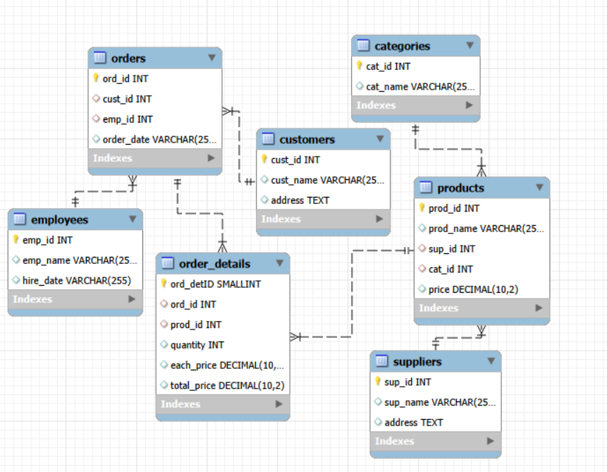
ER Diagram and schema explanation

Slide 6
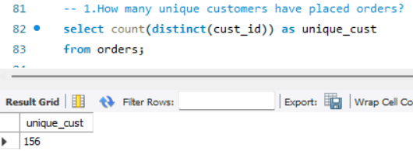
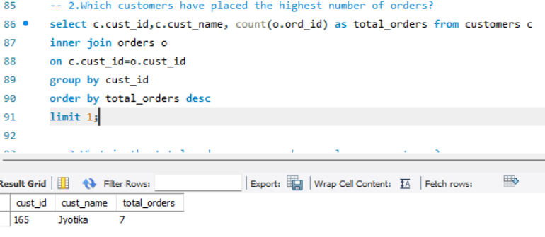
Key analysis questions (use cases)
1️. Customer Insights

Slide 7
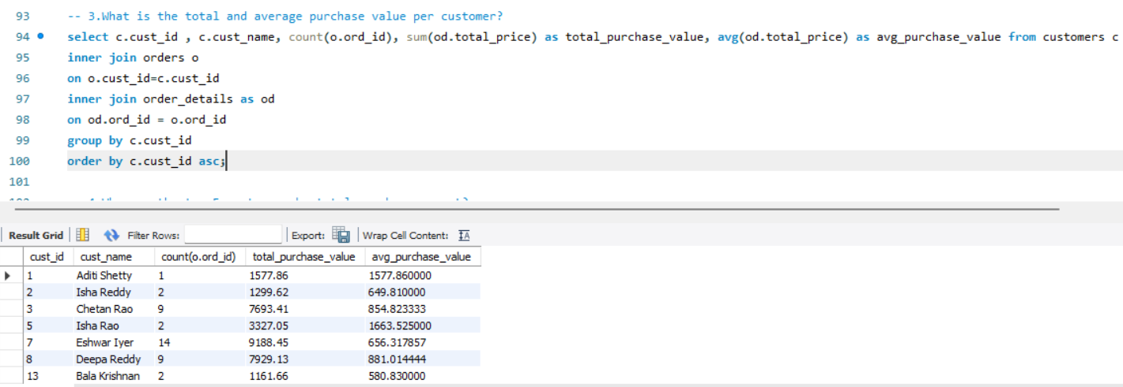
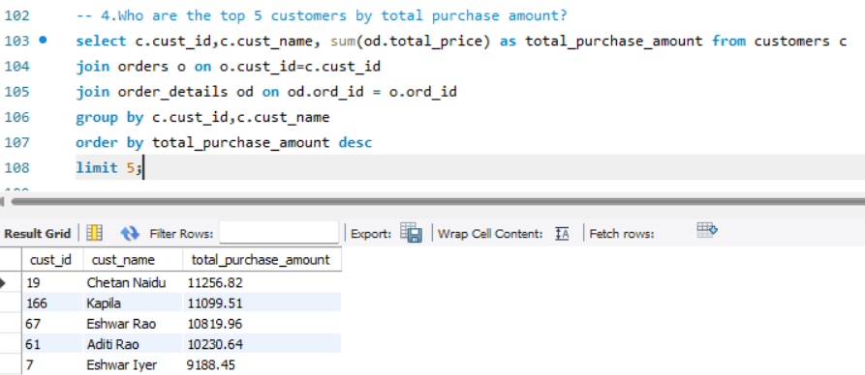

Slide 8
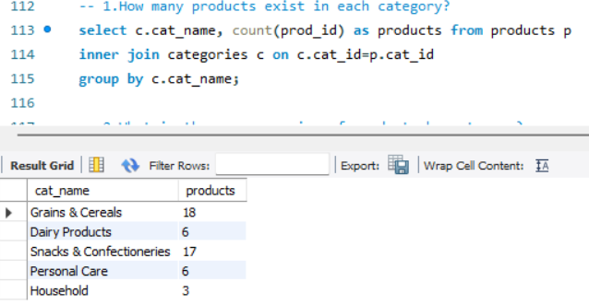
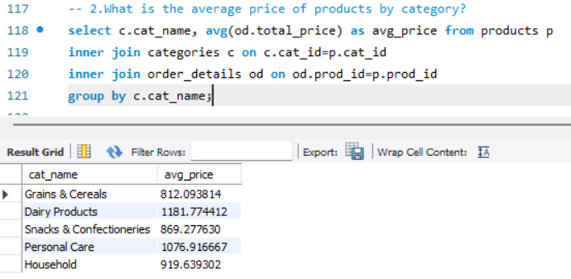
2. Product Performance

Slide 9
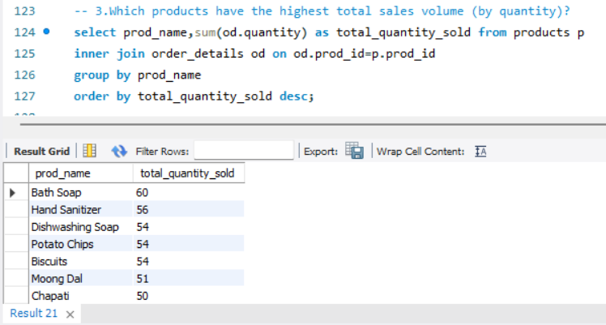
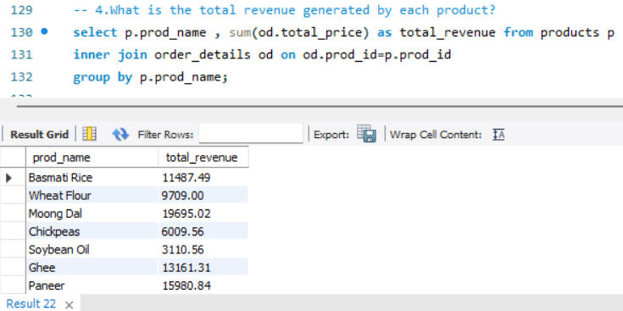

Slide 10
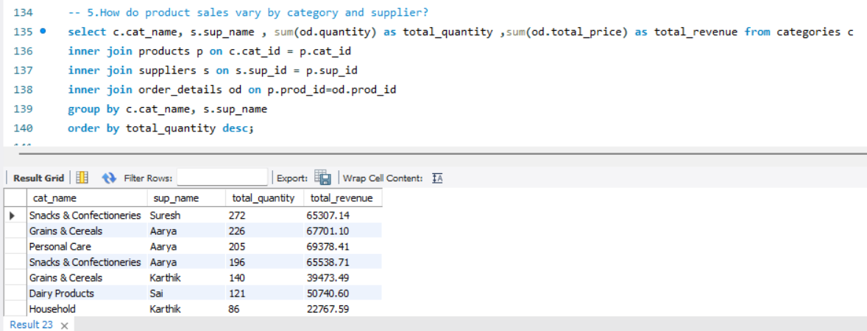

Slide 11
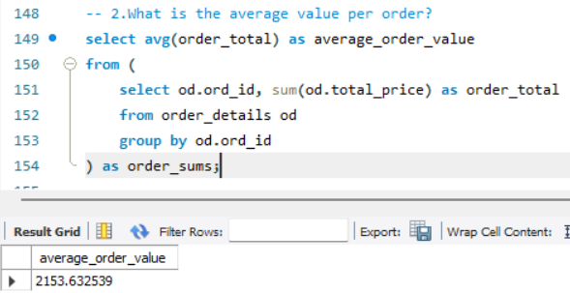
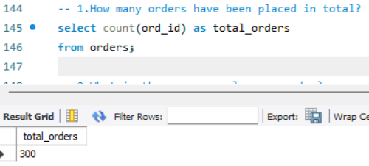
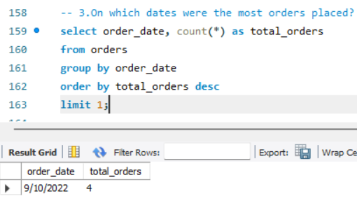
3. Sales and Order Trends

Slide 12
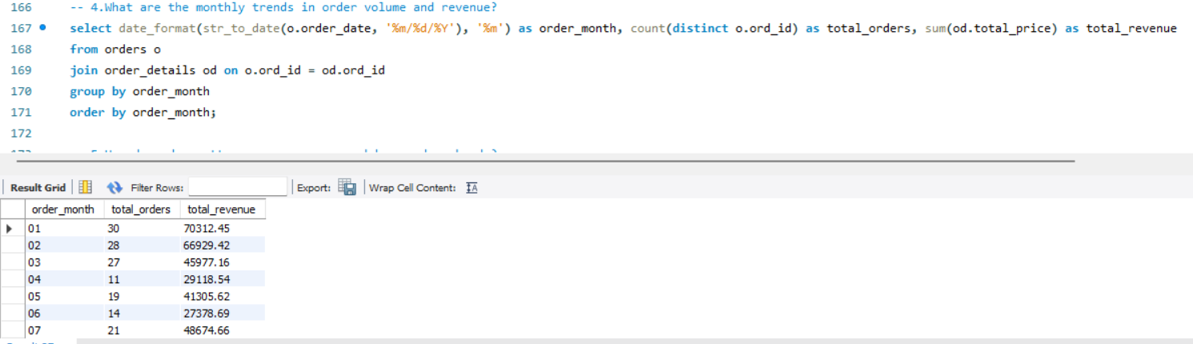
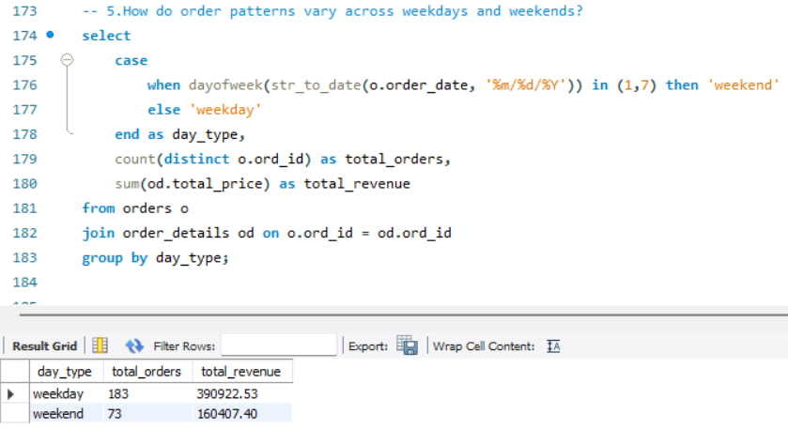

Slide 13
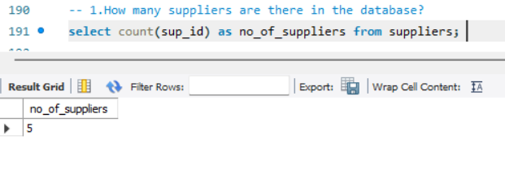
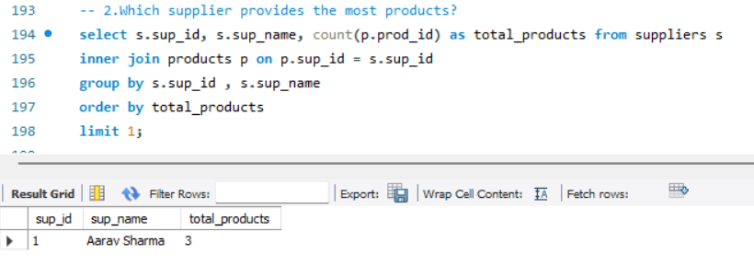
4️. Supplier Contribution

Slide 14
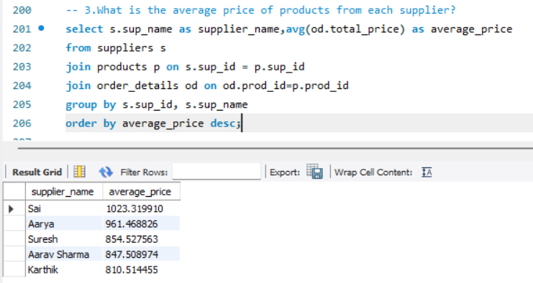
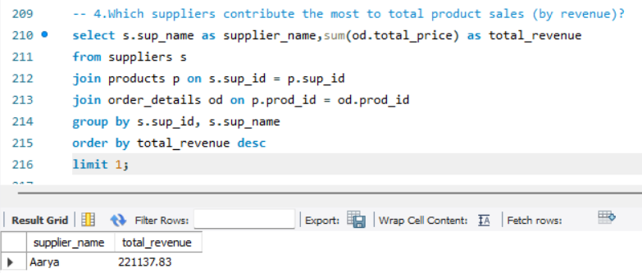

Slide 15
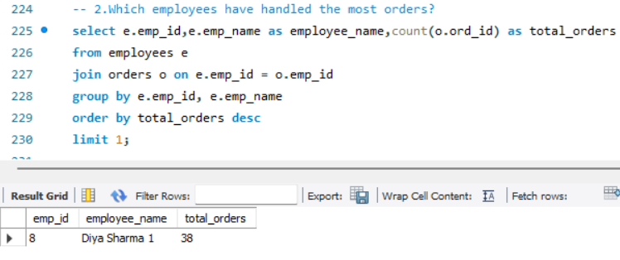
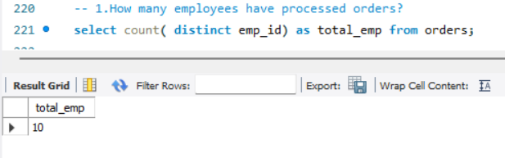
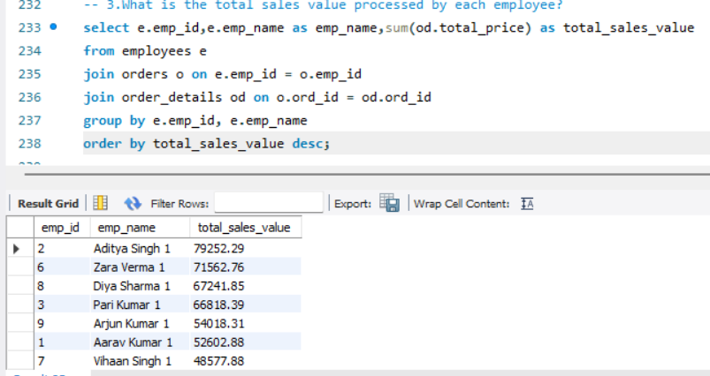
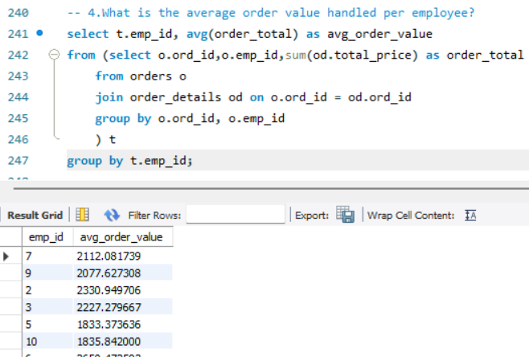
5.Employee Performance

Slide 16
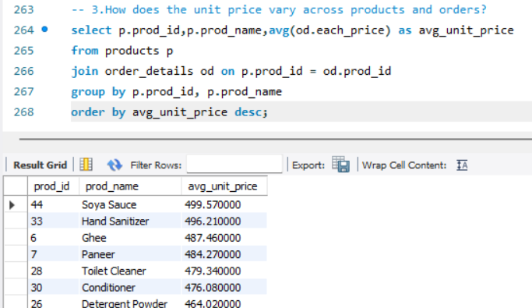
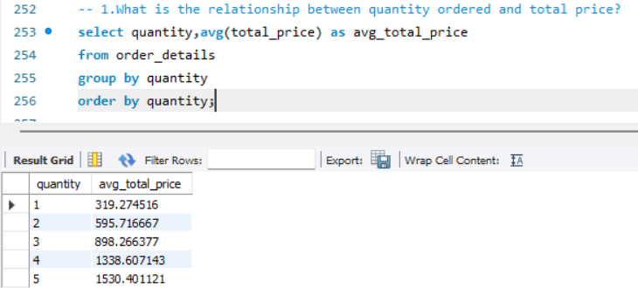
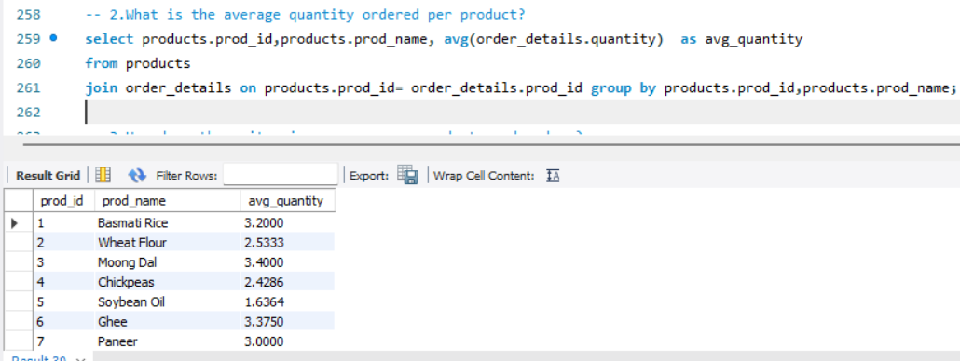
6️. Order Details

Slide 17
Final business insights and recommendations
Key insights:
Grains & Cereals along with Snacks have the highest product variety, indicating strong demand and broader assortment needs.
Dairy Products and Personal Care have the highest average prices, contributing more per sale despite fewer products.
Analysis shows that weekdays have generated more revenue than weekends.
The Average amount a customer should have for buying a product is 500 rupees.

Slide 18
Business recommendations
Focus on weekday operations, as revenue is higher compared to weekends.
Improve supplier planning by analyzing purchase frequency and demand patterns.
Monitor product-wise profitability to prioritize high-margin items.
Enhance customer satisfaction by ensuring product availability for high-demand items.

Slide 19
Conclusion
The Grocery Store Management system successfully demonstrates how SQL can efficiently handle and analyze large grocery datasets, including products, sales.
This supports better decision-making and transparency, making it an effective solution for Grocery Management.
It reduces manual effort, improves data accuracy

Slide 20

THANK YOU

