Slide 1
Parallel Multi-Start Optimization
Faruk Kaplan 06/10/24

Slide 2
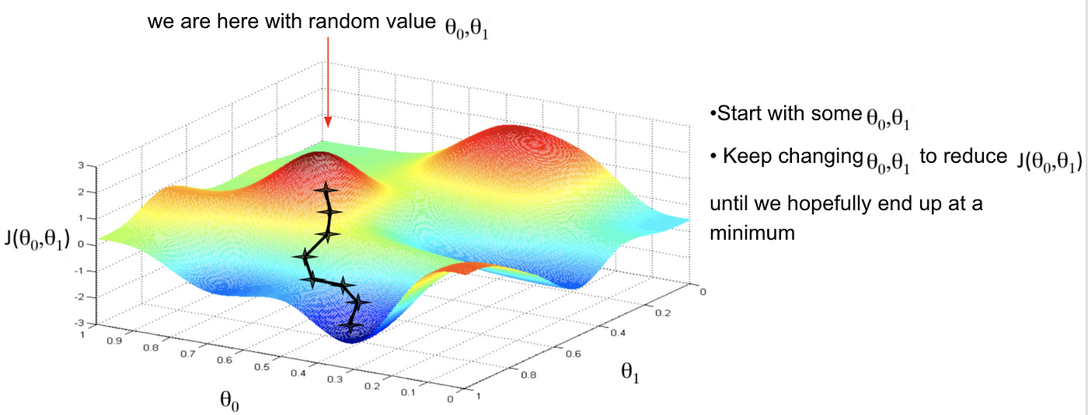
Introduction
In neural networks, we have a cost function that needs to be minimised

Slide 3
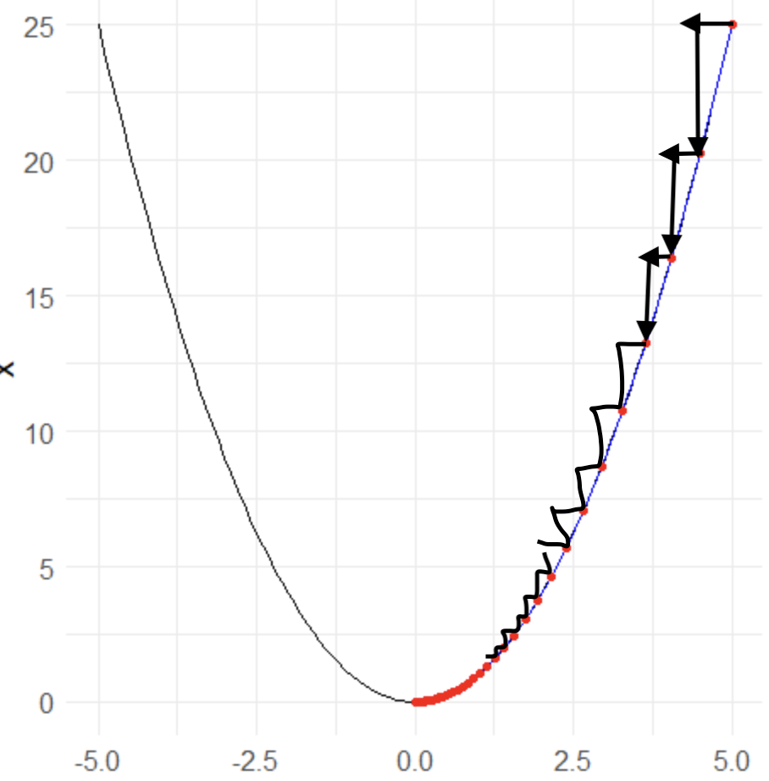
Explanation
Minimization means that finding the lowest point of the function, this procedure implemented by some algorithms - Gradient descent, momentum, Nesterov Accelerated Gradient etc.

Slide 4
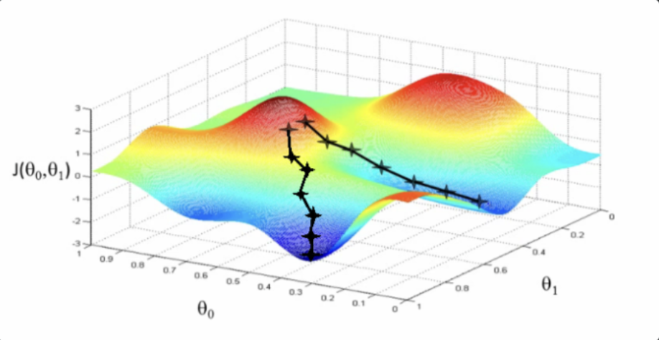
Problem
But we have a problem in here:
When we try to minimize our cost function, we might stuck on local minima, and there is no way we can know whether we are on local or global minima

Slide 5
Problem - Continue
Depend on our starting point, we might end up with different local minimas, or global minima

Slide 6
Solution
Our solution works like this:
We will optimize the same cost function starting with several different points
Since optimizing the cost function needs computational power, we will parallelise this process

Slide 7
Tools
C, Python as programming languages
CUDA, MPI, OpenMP as libraries

Slide 8
TT
Thanks

