Slide 1
NoSQL and Relational in the Modern Data Architecture

Slide 2
Agenda
Introduction to Azure Data Services
Hadoop
Column Families
Document Stores
Streaming

Slide 3


Microsoft Azure Data Services
Visualize + decide
Applications
Reports
Dashboards
Natural Language
Mobile
Transform
+ analyze
Transform + analyze
Visualize
+ decide
Orchestration
Information management
Complex Event Processing
Query
Prediction
Data
Capture + manage
Capture + manage
Relational
Non-relational
Search
Streaming
Internal & external
{ }
✓
Notes:
Presenter guidance:
Share how we think about the data platform in the cloud. Today, we’ll specifically talk about SQL in a VM (briefly), SQL DB, DocumentDB, HBase on HDInsight, and Tables/Blobs. There are lots of other adjacent services such as Redis Cache, Event Hubs, HDInsight, Azure ML, Data Factory, Stream Analytics that will not be addressed in this deck.
Slide talk track:
The top row is Power BI – you’re making decisions based on data
The middle row is ML, Stream Analytics, HDInsight, and Data Factory – processing and making sense of the data
The bottom row is where you ingest and store data -
With Azure, organizations have access to a whole range of services that allow them to use the right tool for the right job when developing applications.
In the cloud, organizations can collect and manage data in the form in which it’s born and store it in the form that best suits an application’s needs.

Slide 4
The And of Data Persistence
Polyglot persistence
Not a new concept
EAV
XML
Architecture paradigm: OLAP/DW and OLTP
Optimized for data
Optimized for workload

Slide 5
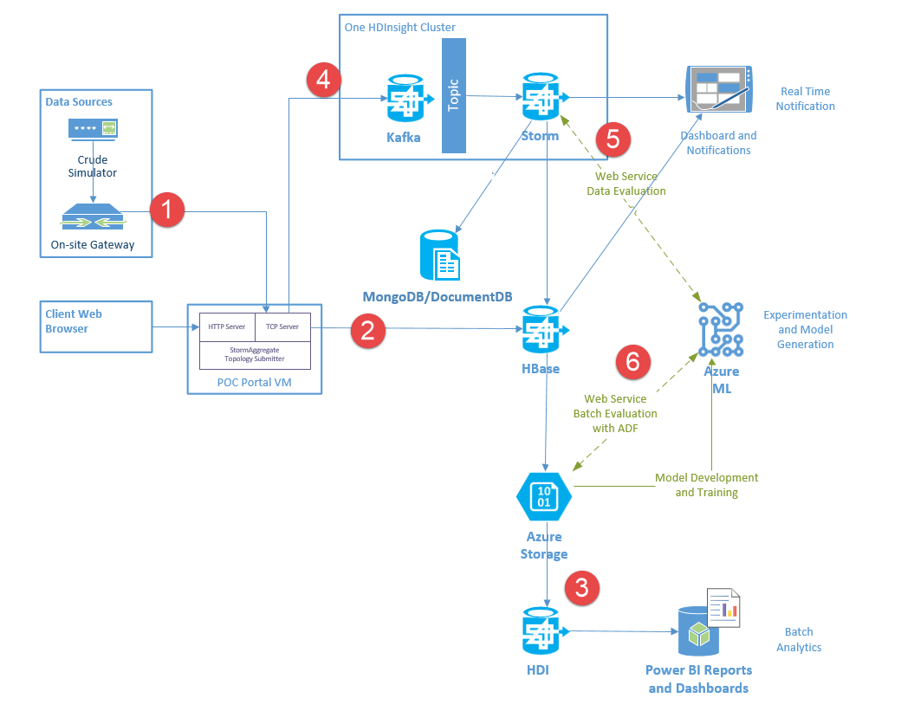

Slide 6

Kinect Telemetry Retail Application
Price Check
Key-Value
Product Catalog
Document Store
Sensor Data
Column Family
Reporting/Analysis
Hadoop Batch Processing
{ }

Slide 7
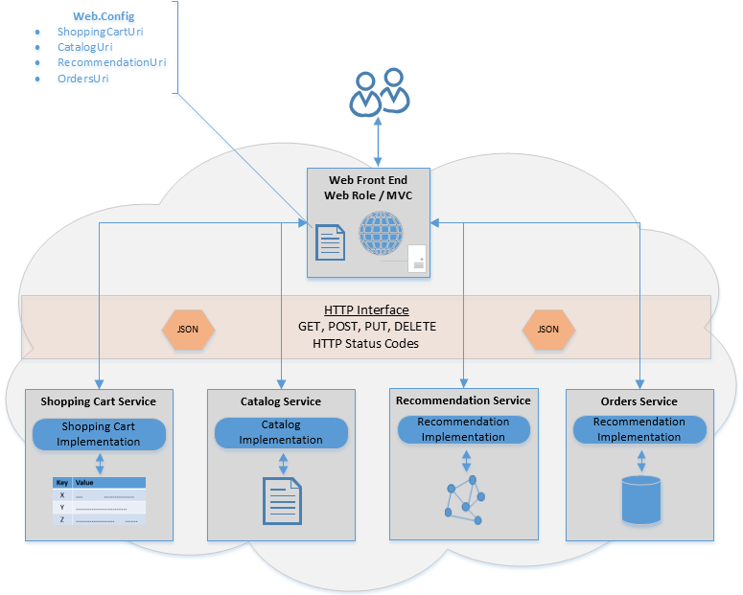
Polyglot Persistence Pattern
Cloud Ninja Polyglot Persistence Sample Application

Slide 8
Data-Intensive Applications in the Cloud Computing World

Slide 9




Event producers
Collection
Event Queuing System
Transformation
Long-term storage
Presentation and action
Apache Storm on HDInsight
Kafka /
RabbitMQ /
ActiveMQ
HBase
Web/thick client dashboards
Applications
HDFS
Azure DBs
Event Hubs
Azure Stream Analytics
Search and query
Cloud gateways (web APIs)
Stream processing
Devices
Azure storage
Live Dashboards
Data analytics (Excel)
Sensors
Field gateways
Storage adapters
Web and Social
Devices to take action
Notes:
Hadoop suits multiple data platform needs in a variety of workloads. In a canonical IoT scenario you will find Hadoop supporting streaming, realtime, and batch oriented workloads. Microsoft Azure will support all these workloads from a 1st party (Microsoft developed) service, as well as 3rd party (Partner developed) solutions.

Slide 11
Terminology Time
ACID
Cloud
CAP
BASE
SCHEMA
POLYGLOT
Consistency

Slide 12
Distributed Systems and the CAP Theorem
Consistency
Relational, Un-partitioned
Availability
Big Table-like:
HBase, MongoDB
Dynamo-like:
Cassandra, CouchDB
Eric Brewer’s CAP Theorem and even better
CAP Twelve Years Later
and even better yet
Myth: Eric Brewer On Why Banks Are BASE Not ACID - Availability Is Revenue
Partition Tolerant
Notes:
Drop Partition Tolerance
Put it on one machine and you are fine…. Except this imposes scale limitations.
Drop Availability
Just wait for the data to be consistent on all nodes in the cluster. No services may access nodes in the cluster until it is consistent.
Drop Consistency
Wait for things to be eventually consistent. Can you get “close enough” or feed stale data? Hm…

Slide 13
BASE - ACID
BASE
ACID
Basically Available
Soft State
Eventually Consistent
Atomic
Consistent
Isolated
Durable
Notes:
Atomic: Everything in a transaction succeeds or the entire transaction is rolled back.
Consistent: A transaction cannot leave the database in an inconsistent state.
Isolated: Transactions cannot interfere with each other.
Durable: Completed transactions persist, even when servers restart etc.

Slide 14
__aaS - Services
PaaS
IaaS
SaaS
Platform
Infrastructure
Service

Slide 15
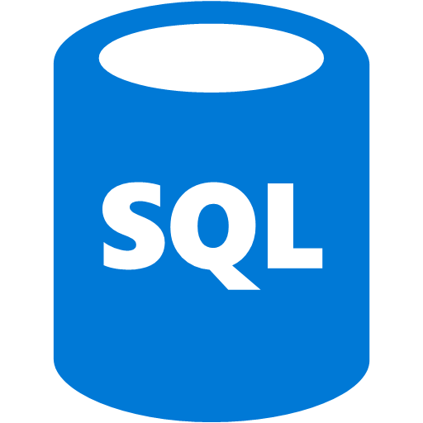




Azure Data Services
SQL Database
DocumentDB
HBase
Hadoop Batch
fully featured RDBMS
rich query
transactional processing
managed as a service
elastic scale
schema-free data model
internet accessible http/rest
arbitrary data formats
Streaming and Search
Notes:
Presenter guidance:
Introduce the family portrait.
Slide talk track:
This is how we think about the core differences across the data services for capturing and managing data
On the left, you have more database imposed structure on the left and this loosens as you move to the right, ending in blobs which is just large containers of binary data.

Slide 16

Agenda
Introduction to Azure Data Services
Hadoop
Column Families
Document Stores
Streaming

Slide 17
HOL1 Explore the Portal(s)

