Slide 1
Report Inspection
An NLP Study for public transportation reports

Slide 2
The Problem - I
Public bus users face problems
Some of them report to Beyaz Masa of IBB
There is a board of discipline to determine punishments
They label for each:
Muspet (No punishment)
Menfi (Punishment)
Uyari (Warning)

Slide 3
The Problem - II
There are tens of thousands of reports per year
Most of them are Muspet
Hard to evaluate all of them for humans
Pre-elimination is required for efficiency

Slide 4
The aim
Process all reports by NLP techniques to eliminate “Muspet” ones.
Reduce the number of reports for board of discipline

Slide 5
Data Exploration - I (Top words)
Araç | 27276
Sefer | 26807
Zayi | 24114
Ve | 22017
Saati | 19520
yapilmasini | 14548
gereği | 12979
raporu | 12556
etkilenmiştir | 12500
saat | 12435
Top Word Frequencies:

Slide 6
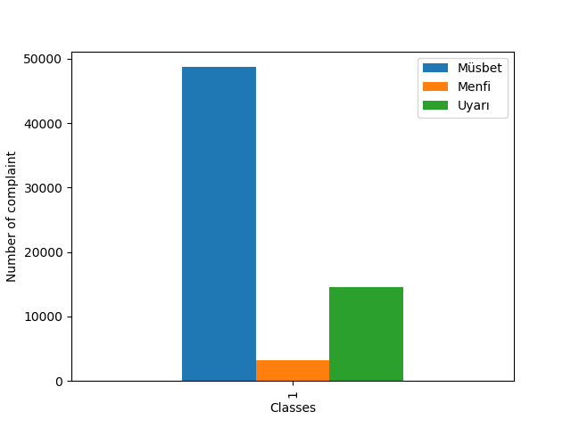
Data Exploration - II (Label Distribution)

Slide 7
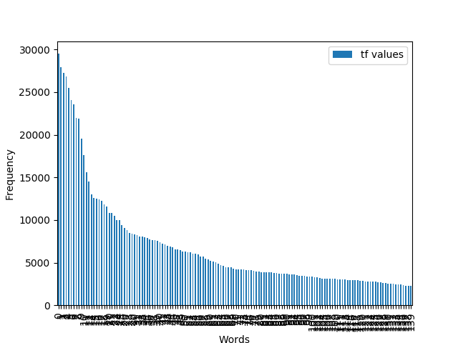
Data Exploration - III (Word frequencies)

Slide 8
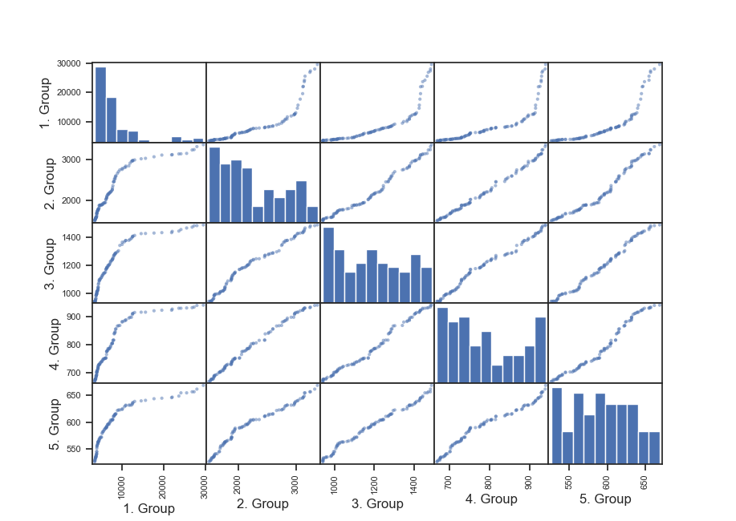
Data Exploration - IV (Scatter Plot Matrix)

Slide 9
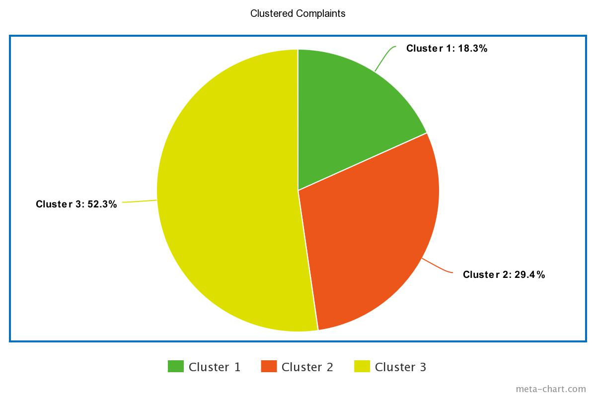
Clustering by k-means
Müspet: 200
Menfi: 9
Uyarı: 2
Müspet: 1779
Menfi: 593
Uyarı: 550
Müspet: 914
Menfi: 83
Uyarı: 8

Slide 10
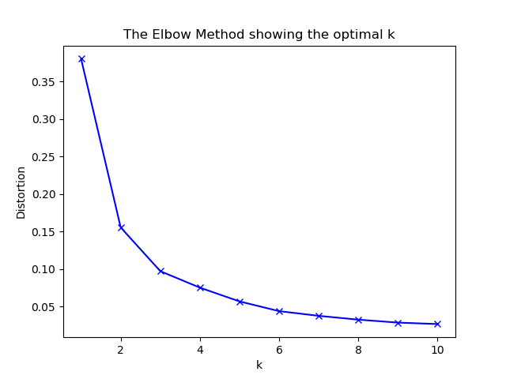
Optimal K - The Elbow Method

Slide 11
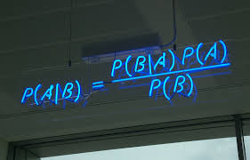
Predicting by Naive Bayes Algorithm
Data Length: 4138 (complaints)
Train Part: %80 Test Part: %20
Accuracy: %18.7
Menfi Müspet Uyarı
f1 score 0.2851 0.0663 0.0176

Slide 12
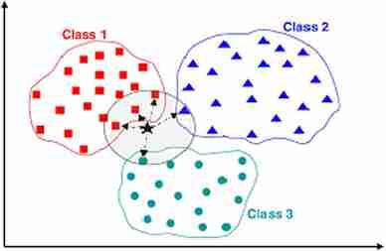
Predicting by K-Nearest-Neighbor Algorithm
Data Length: 4138 (complaints)
Train Part: %80 Test Part: %20
Accuracy: %70.41
Menfi Müspet Uyarı
f1 score: 0.1307 0.8238 0

Slide 13
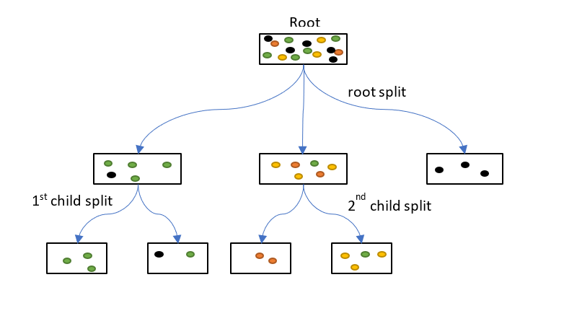
Predicting by Decision Tree Algorithm
Data Length: 4138 (complaints)
Train Part: %80 Test Part: %20
Accuracy: %69.92
Menfi Müspet Uyarı
f1 score: 0.0283 0.8225 0

Slide 14
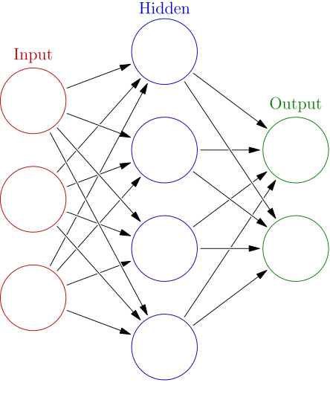
Predicting by Neural network algorithm
Data Length: 2624 (complaints)
Train Part: %80 Test Part: %20
Accuracy: %79.8

