Slide 1

LIFE EXPECTANCY
Statistical Analysis on factors influencing Life Expectancy
Group 5

Slide 2
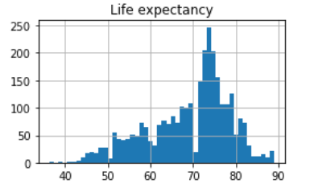
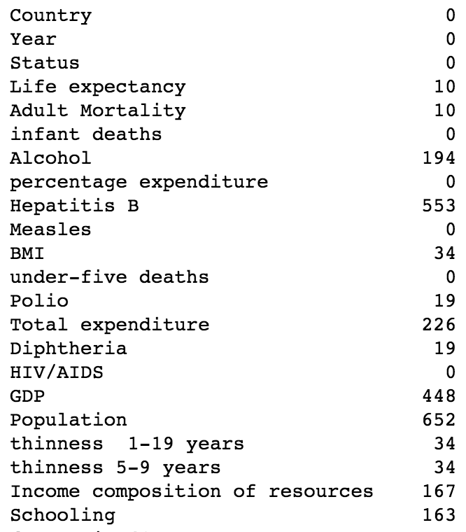
Dataset
Kaggle
2938 rows, 22 columns
Columns & Missing Values

Slide 3
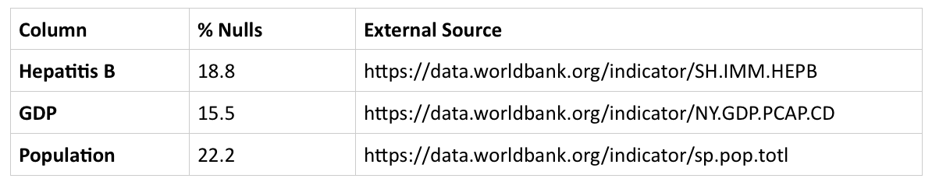
Data Cleaning
Dropping 10 countries
Cook Islands, Dominica, Marshall Islands, Monaco, Nauru, Niue, Palau, Saint Kitts and Nevis, San Marino, Tuvalu
Only had 1 year of data and missing values for life expectancy & adult mortality
2. Filling missing values with external data sources
3. Filling missing values from external data sources using mean
Hepatitis B for Algeria was missing values for years 2000 - 2003, the values were filled with the mean from other years
Hepatitis B for Denmark, Finland, Hungary, Iceland, Japan, Norway, Slovenia, and UK filled using values from Norway

Slide 4
Data Cleaning Cont.
4. Interpolating
- Polio, Diphtheria, Total Expenditure, Income composition of resources, schooling, thinness 1-19 years, thinness 5-9 years, schooling
Used ‘linear’ method to ignore the index & treat values as equally spaced
Used ‘forward direction’ to interpolate
5. Unlikely BMI
>200 countries reported a BMI less than 10
Replaced these BMI values with the average BMI from the country (excluding BMI < 10)

Slide 5
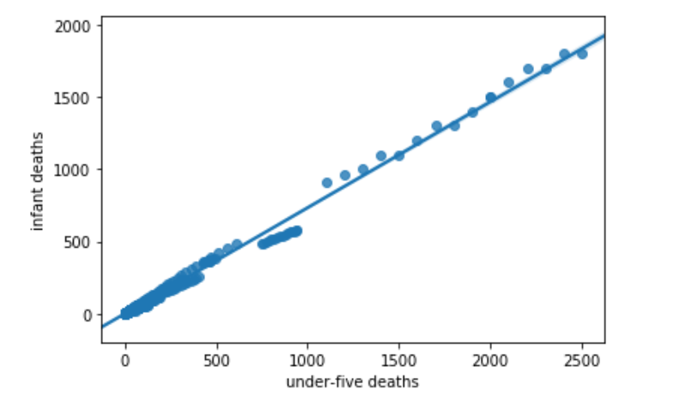
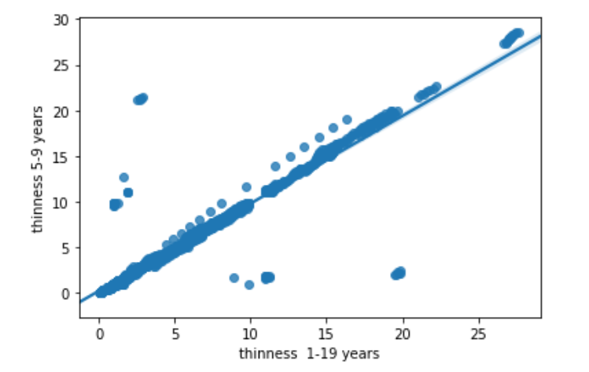
Collinearity & Feature Engineering
Variables that have > 0.6 correlation with Life Expectancy:
- Adult Mortality
- Income composition of resources
- Schooling
Variables that seem to be highly correlated with each other:
- under-five deaths & infant deaths - these attributes could be merged into an engineered attribute pct_infantDeaths
- thinness 1-19 year & thinness 5-9 years - these attributes could be merged into an engineered attribute pct_thinness
Income composition of resources & Schooling
- GDP & percentage expenditure
- Hepatitis B, Polio, Diphtheria combined to make Immunization

Slide 6
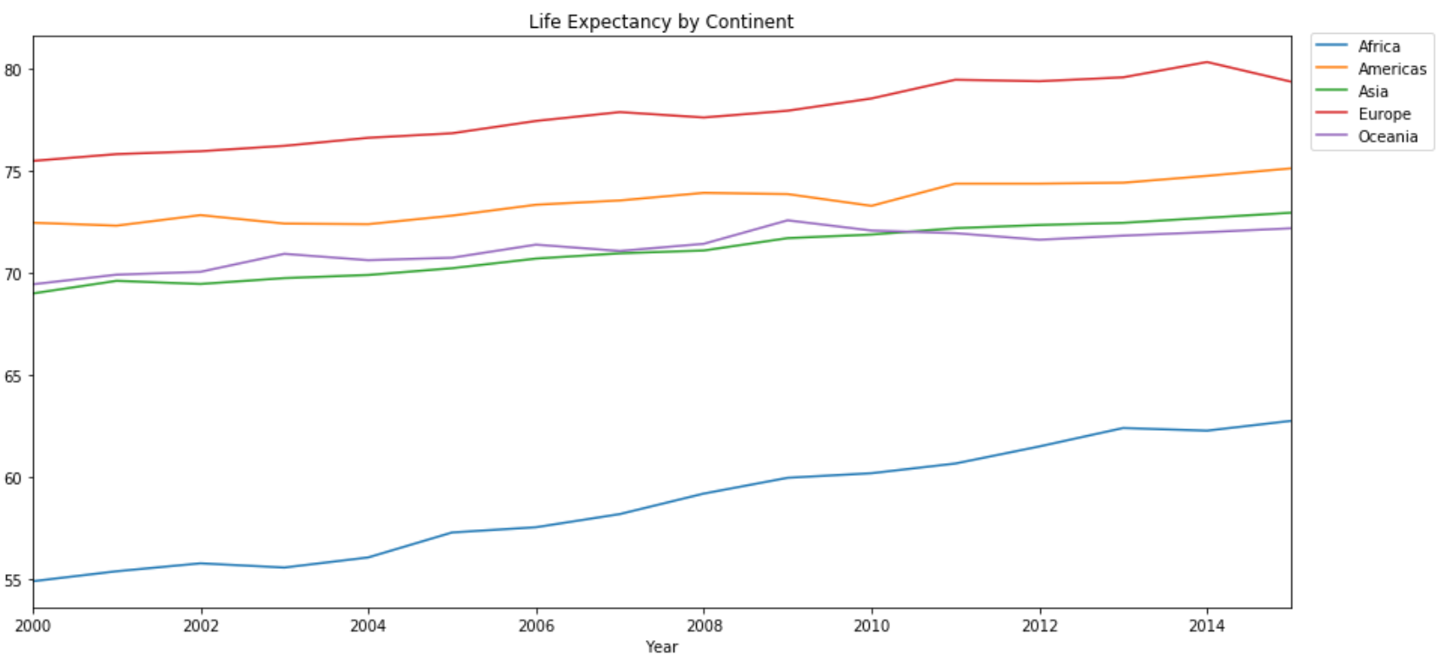
Adding Continent Data

Slide 7
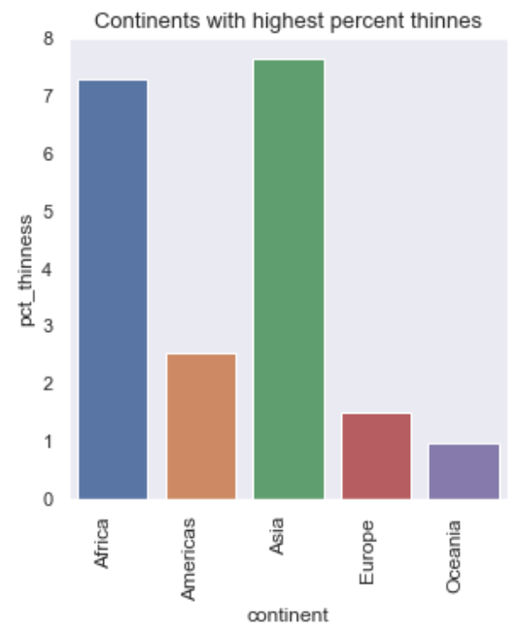
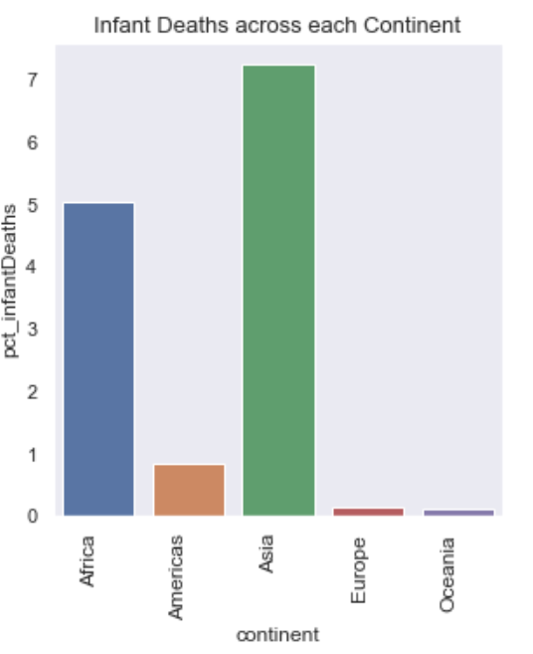
Exploring the Data in depth Kids thinness & Infant Deaths by continents

Slide 8
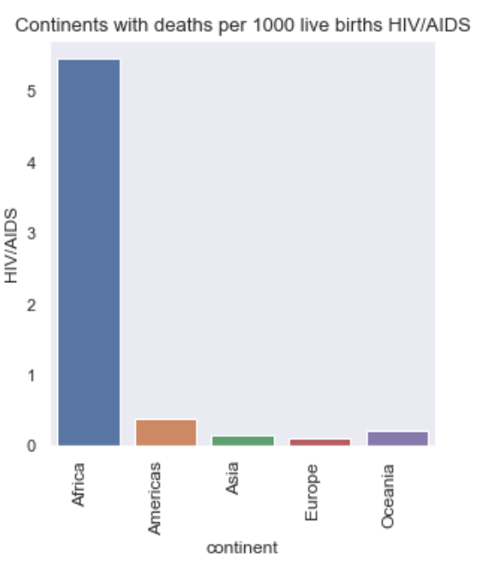
Exploring the Data in depth HIV/AIDS variable by continents

Slide 9
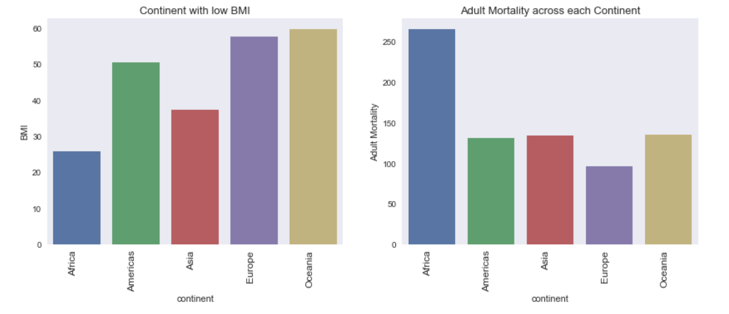
Exploring the Data in depth BMI variable by continents

Slide 10
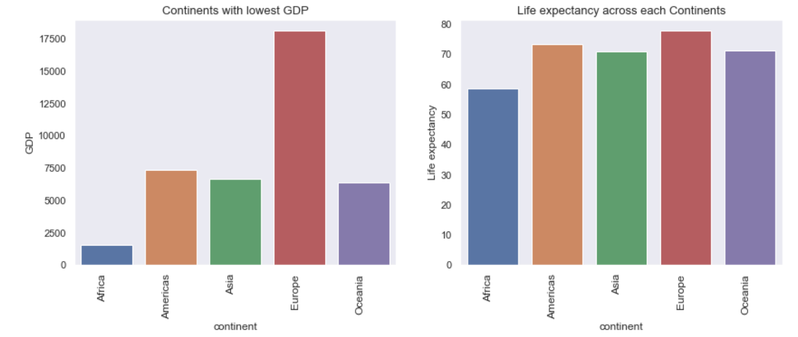
Exploring the Data in depth GDP variable by continents

Slide 11
Predictive Analytics
The Objective of analysis is to create a model based on data provided by the World Health Organization (WHO) to evaluate the life expectancy for different countries in years.
Two algorithms were used for building valid predictive models
Linear Regression
Random Forest Regression
Notes:
Random forest algorithm does is that it creates multiple decision trees and merges them together to obtain a more stable and accurate prediction. In general, the more trees in the forest, the more robust would be the prediction and thus higher accuracy. Random forest regression will handle the missing values and maintain the accuracy of a large proportion of data.

Slide 12
Linear Regression with all features
OLS Regression Results
Dep. Variable: | Life expectancy | R-squared: | 0.997
Model: | OLS | Adj. R-squared: | 0.997
Method: | Least Squares | F-statistic: | 3.507e+04
Date: | Thu, 05 Dec 2019 | Prob (F-statistic): | 0.00
Time: | 22:39:20 | Log-Likelihood: | -5419.8
No. Observations: | 1971 | AIC: | 1.088e+04
Df Residuals: | 1952 | BIC: | 1.098e+04
Df Model: | 19
Covariance Type: | nonrobust
Prob(Omnibus): | 0.000 | Jarque-Bera (JB): | 85.201
Skew: | -0.015 | Prob(JB): | 3.15e-19
Kurtosis: | 4.018 | Cond. No. | 4.61e+08
Notes:
Kurtosis is used to measure the data in relation to normal distribution. The +ve krutosis >3 refer to distribution is more peaked than normal distribution. Extreme values in data points and outliers are less.

Slide 13
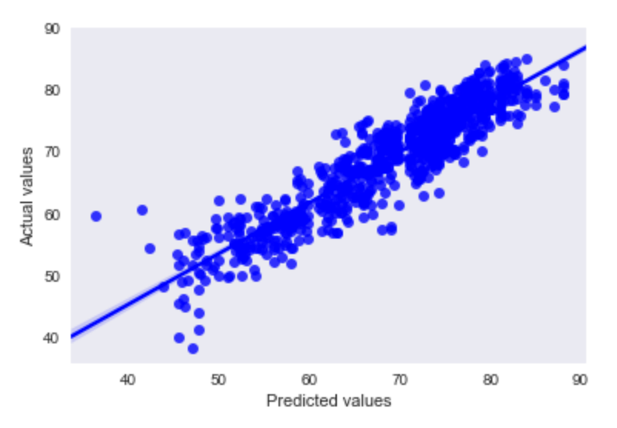
Regression Plot
The R² value is 0.997, which is very close to 1.
The Kurtosis value is 4.018, which is higher than expected.
These results also shows that there is still some multicollinearity.

Slide 14
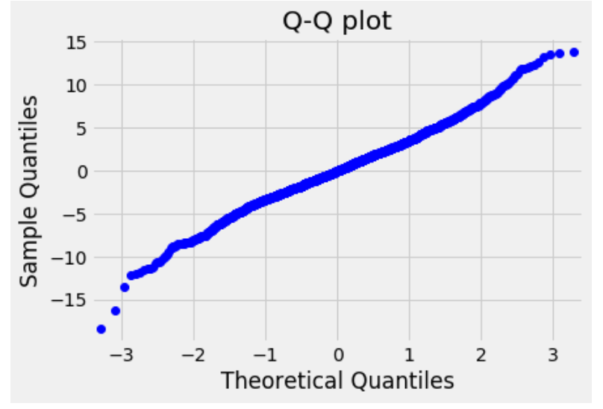
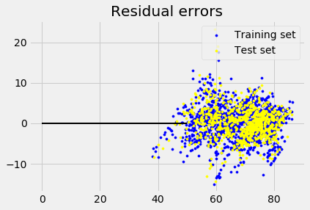
Cross Validation of Predictive Model
Quantile plot
Residual Errors
Notes:
Q-Q Plot is to check the normal distribution of lot . It does random sampling it self based on regression and it form the linear relationship shows the data is normally distributed. Its correlation between Theoretical Quantile and Sample quantile

Slide 15
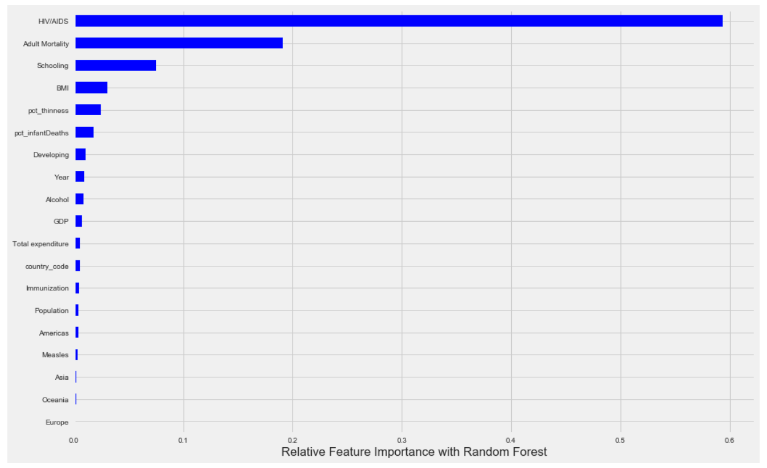
Random Forest Regression
The Accuracy of Model is : 98.19%
R-square : 0.947
Mean cross validation score: 0.88
Features influencing Life Expectancy:
HIV/AID
Adult Mortality
Adult Schooling
Notes:
Influential Features:
HIV/AID,
Adult Mortality
and adult Schooling have a high influence on the life expectancy as compared to the other features.
The accuracy = number of correct prediction and also depends on the quality and quantity of data.
The countries should improve life expectancy, by decreasing and eleminating the HIV/AIDS and paying more attanetion towards adult education and infant care.

Slide 16
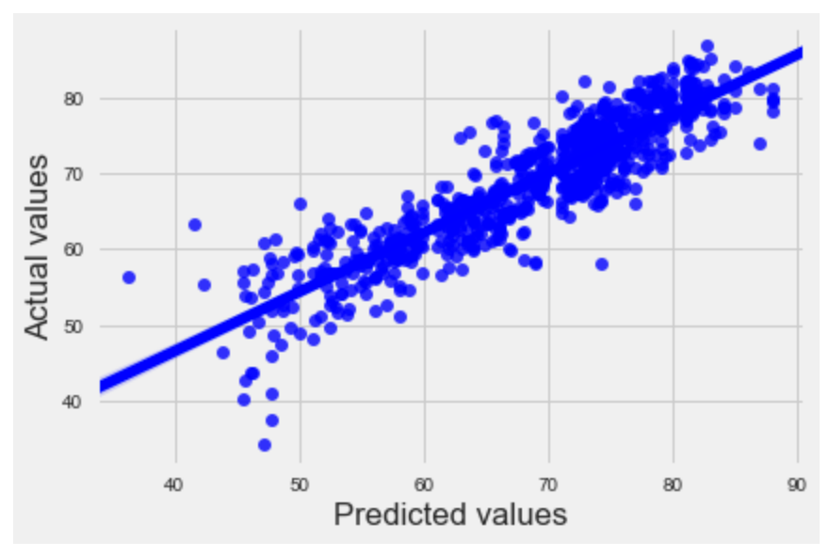
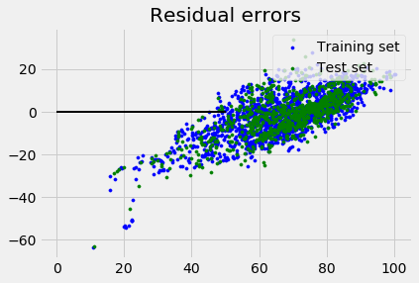
Regression Model with Important Features
OLS Regression Results
Dep. Variable: | Life expectancy | R-squared: | 0.979
Model: | OLS | Adj. R-squared: | 0.979
Method: | Least Squares | F-statistic: | 1.015e+04
Date: | Thu, 05 Dec 2019 | Prob (F-statistic): | 0.00
Time: | 22:39:20 | Log-Likelihood: | -7364.9
No. Observations: | 1971 | AIC: | 1.475e+04
Df Residuals: | 1952 | BIC: | 1.480e+04
Df Model: | 6
Covariance Type: | nonrobust
Regression Plot
Prob(Omnibus): | 0.000 | Jarque-Bera (JB): | 1140.355
Skew: | 0.944 | Prob(JB): | 2.27e-248
Kurtosis: | 6.212 | Cond. No. | 2.07e+07
Notes:
R-Square, is the square of correlation and always between -1 and 1. R-squared = 0.979 means close to 1 which means, X is effecting response variable.

Slide 17
Conclusion
Data Cleansing: missing values filled out using:
External Data Sources, interpolation method and mean values
Exploring the data: adding new variable, feature engineering
Check on multicollinearity, removing some variables
Spliting the data to Test and Train, check the most important variables
Building predictive model using two algorithms:
Linear Regression, Random Forest Regression
Cross Validation of the Predictive models

Slide 18
QUESTIONS???

Slide 19
Thank you!!!

