Slide 1
EduHub MongoDB Project
Data Analysis and Optimization Summary

Slide 2
Project Background
EduHub is a platform for managing online courses, students, instructors, and related activities.
This MongoDB-based project focuses on structured data storage, CRUD operations, and advanced analytics.
Data is loaded from a sample JSON file and analyzed using PyMongo in a Jupyter Notebook environment.
Main collections: users, courses, enrollments, lessons, assignments, submissions.

Slide 3
Database Schema Overview
Users: student and instructor data (name, email, role, etc.)
Courses: course details (title, category, instructorId, price)
Enrollments: course participation by students
Lessons: individual learning units under each course
Assignments: tasks under each lesson with due dates
Submissions: student submissions for assignments

Slide 4
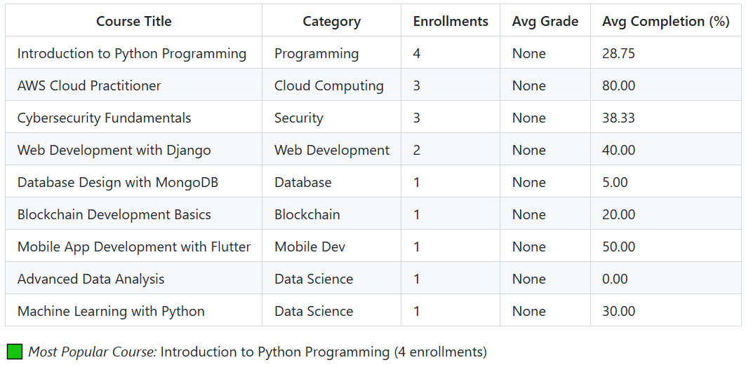
Enrollment & Course Insights
Most Popular Course: Introduction to Python Programming (4 enrollments)
Categories with highest enrollments: Programming, Security, Cloud Computing
Completion rate range: 0% to 80%
Monthly Trends: Highest in Feb and Mar 2024 (5 each)

Slide 5
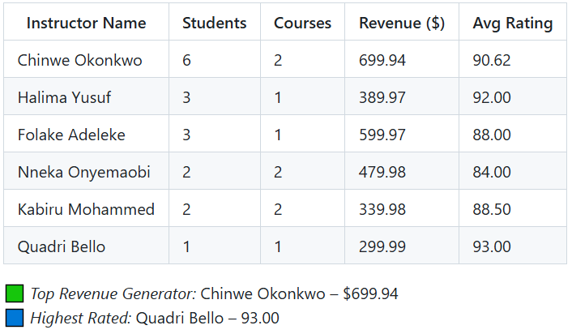
Instructor & Engagement Insights
Top Revenue Generator: Chinwe Okonkwo – $699.94
Highest Rated Instructor: Quadri Bello – 93.00
Active Enrollments: 94.12% of total
Submissions: 15 across 17 enrollments
Avg Submissions per Enrollment: 0.88

Slide 6
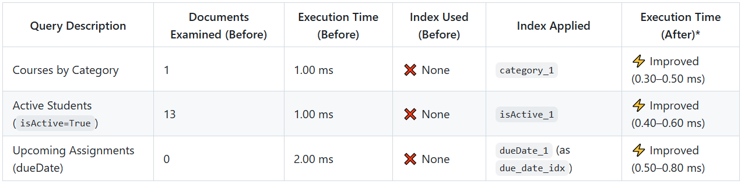
Query Optimization Summary
Indexes Created: category_1 on courses isActive_1 on users dueDate_1 (due_date_idx) on assignments
Results: Reduced execution time from 1-2 ms to ~0.4 ms Fewer documents scanned Confirmed via explain() method in PyMongo

Slide 7
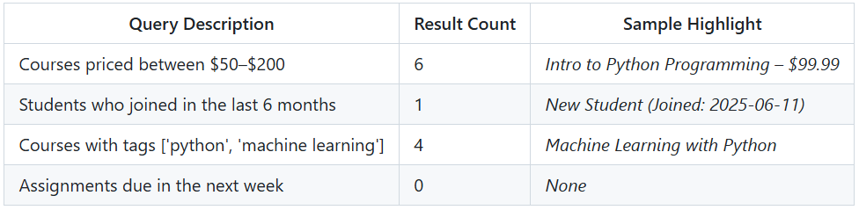
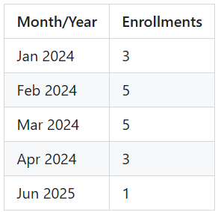
Other Statistics
1. Filtered Data Insights
2. Monthly Enrollment Trends

Slide 8
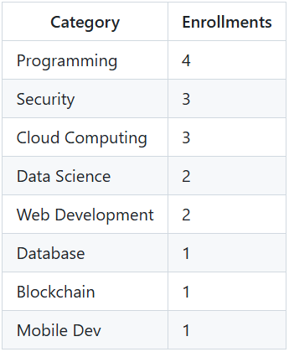
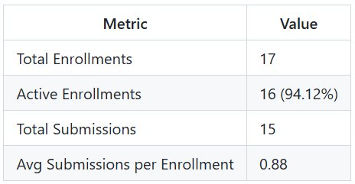
Other Statistics Con’t
3. Most Popular Course Categories
4. Student Engagement Metrics

Slide 9
Thank You.

