Slide 1

CS 478 - Computational Geometry
Implementation of Two Delaunay Triangulation Algorithms and Comparing Their Performances
Group Members
Ahmet Faruk Ulutaş - 21803717
Mustafa Azyoksul - 21501426

Slide 2
Project Overview
In this project, two different Delaunay Triangulation algorithm for triangulating a set of points in a two-dimensional plane is implemented.
Randomized incremental algorithm
Divide-and-conquer algorithm

Slide 3
Randomized Incremental Algorithm
The incremental DT algorithm starts with a triangle large enough to contain all of the points in the input. Points are added into the triangulation one by one, maintaining the invariant that the triangulation is Delaunay [1].

Slide 4
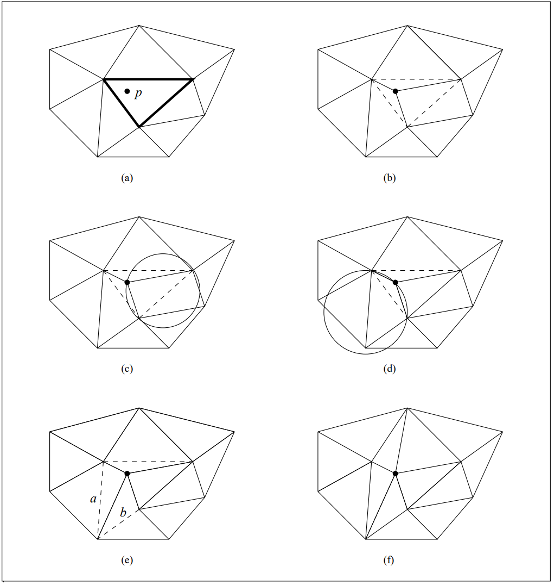
Analysis of Randomized Incremental Algorithm
Algorithm
Find a triangle that contains the entire point set.
Select a new point P (1a)
Find the triangle in the current triangulation that contains P (1a)
Connect P to the vertices of this triangle (1b)
Add old edges of the triangle into a candidate list (1b)
Repeat until the candidate list is empty
Draw the circumcircle of the triangle formed by the candidate edge and P (1c)
If no point is in the circumcircle (1c)
Continue loop
If there is a point Q inside the circumcircle (1d)
Swap the candidate edge with the edge [PQ] (1e)
Add edges from the ends of candidate edge to Q to candidate list (1e)
End (1f)
In the worst case the insertion of a point can require O(n) edges to be flipped.
Locating the containing triangle can be done in an optimal O(log n) time
Thus, O(n log(n) ) time and O(n) storage [2].

Slide 5
Divide and Conquer Algorithm
In the divide and conquer algorithm, a recursive line is drawn to divide the vertices into two sets. The Delaunay triangulation is then calculated for each dividing cluster and the clusters are joined along the dividing line.

Slide 6
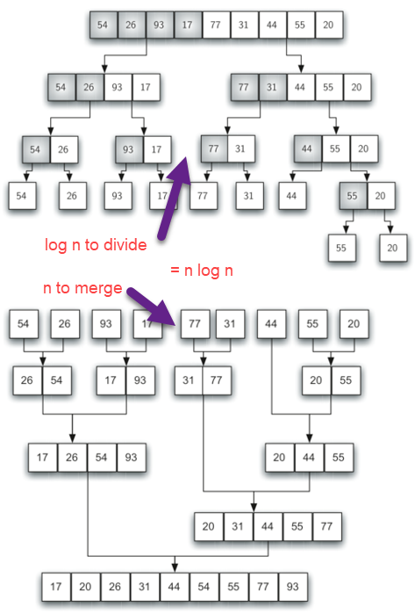
Analysis of Divide and Conquer Algorithm
Algorithm
Put all of the points into order of increasing x-coordinates. If two points have the same x-coordinate, one with lower y-coordinate comes first.
Divide the set into subsets by halving the set of points recursively until each group has at most 3 points.
Trivially triangulate the subsets of at most 3 points.
Run the recursive stack back and merge the subsets in each step.
Division process O(log(n)),
Merge process O(n),
Thus, O(n log(n)) [3].

Slide 7
Performance
Randomized Incremental Algorithm Performance:
# of Points Seconds
100 0.039
1.000 2.999
10.000 343.191
100.000 (apprx. 18 hours)
1.000.000 (apprx. 145 days)
Divide and Conquer Algorithm Performance:
# of Points Seconds
100 0.012
1.000 0.118
10.000 2.002
100.000 24.324
1.000.000 289.074

Slide 8
Application

Slide 9
References
[1] Cignoni, Paolo & Montani, Claudio & Scopigno, Roberto. (1998). DeWall: A fast divide and conquer Delaunay triangulation algorithm in E d. Computer-Aided Design. 30. 333-341. 10.1016/S0010-4485(97)00082-1.
[2] Lischinski, Dani. “Incremental Delaunay Triangulation” Graphics Gems IV. Paul S. Heckbert (Ed.). Academic Press Prof., Inc., San Diego, CA, USA. 1994. Page 47-59. http://www.karlchenofhell.org/cppswp/lischinski.pdf doi: https://dl.acm.org/citation.cfm?id=180900
[3] S. Peterson, “Computing Constrained Delaunay Triangulations,” COMPUTING CONSTRAINED DELAUNAY TRIANGULATIONS IN THE PLANE. [Online]. Available: http://www.geom.uiuc.edu/~samuelp/del_project.html#:~:text=The%20divide%20and%20conquer%20algorithm,by%20their%20y%2Dcoordinates). [Accessed: 22-Mar-2022].

