Slide 1

Managing Information System

Slide 2
‘Fantasy ‘an interesting website in which people add pictures, videos. At the end of the month on the basis of votes best one wins the price
There are two section
Pictures
Videos
Every posted thing on a website cost 1$ and at the end of the month winner gets 10$ price. On the basis of people votes there winners decided at the end. One from best pictures, and one from videos.

Slide 3
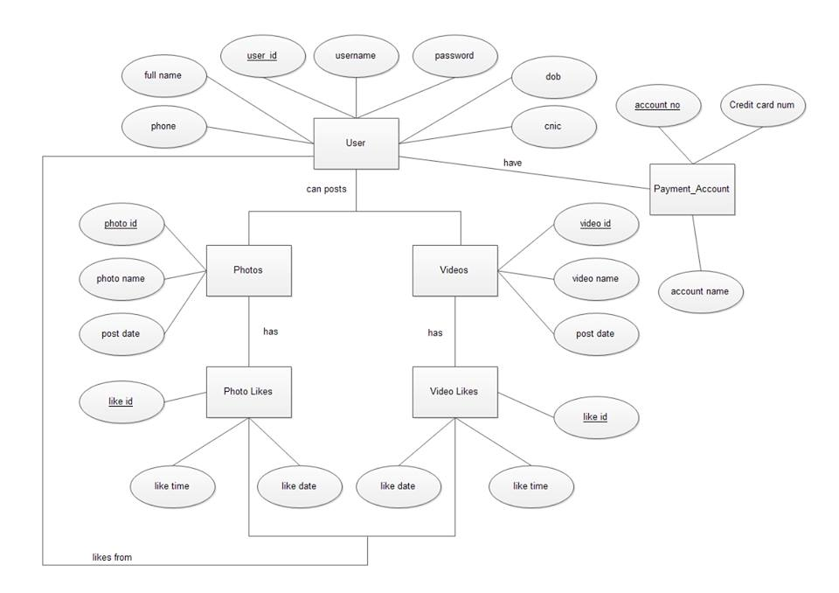
ER DIAGRAM

Slide 4
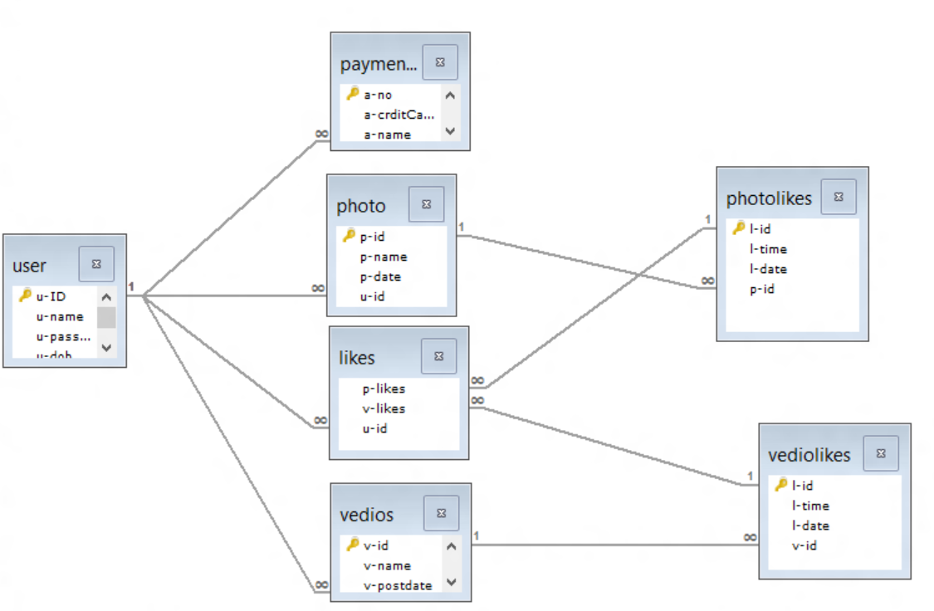
RELATION SCHEMA

Slide 5
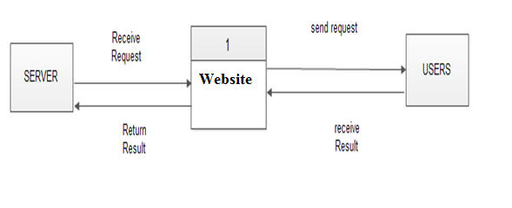
DATA FLOW DIAGRAM 0 –Level

Slide 6
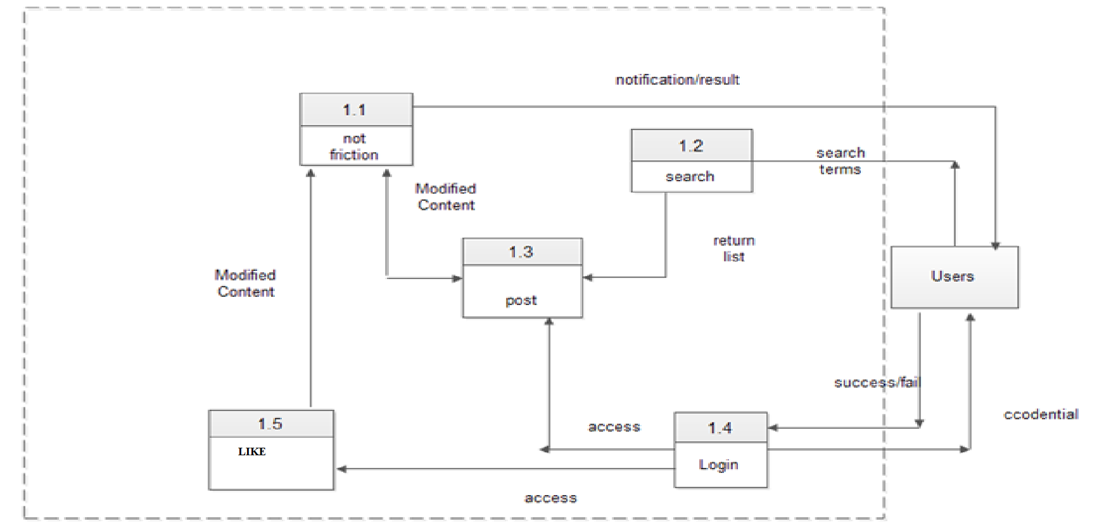
DATA FLOW DIAGRAM 1 –Level

Slide 7
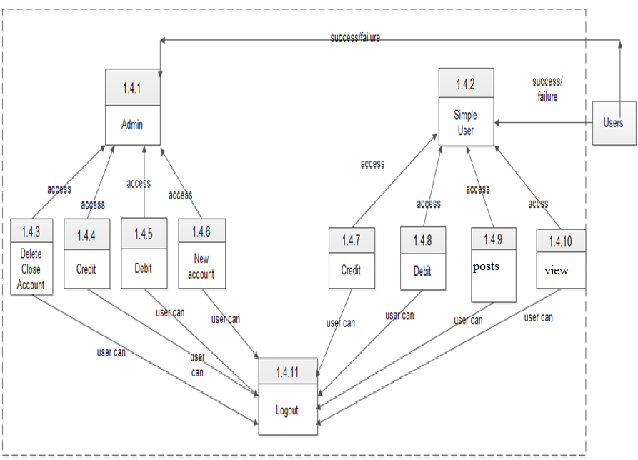
DATA FLOW DIAGRAM 2 –Level

Slide 8


Slide 9
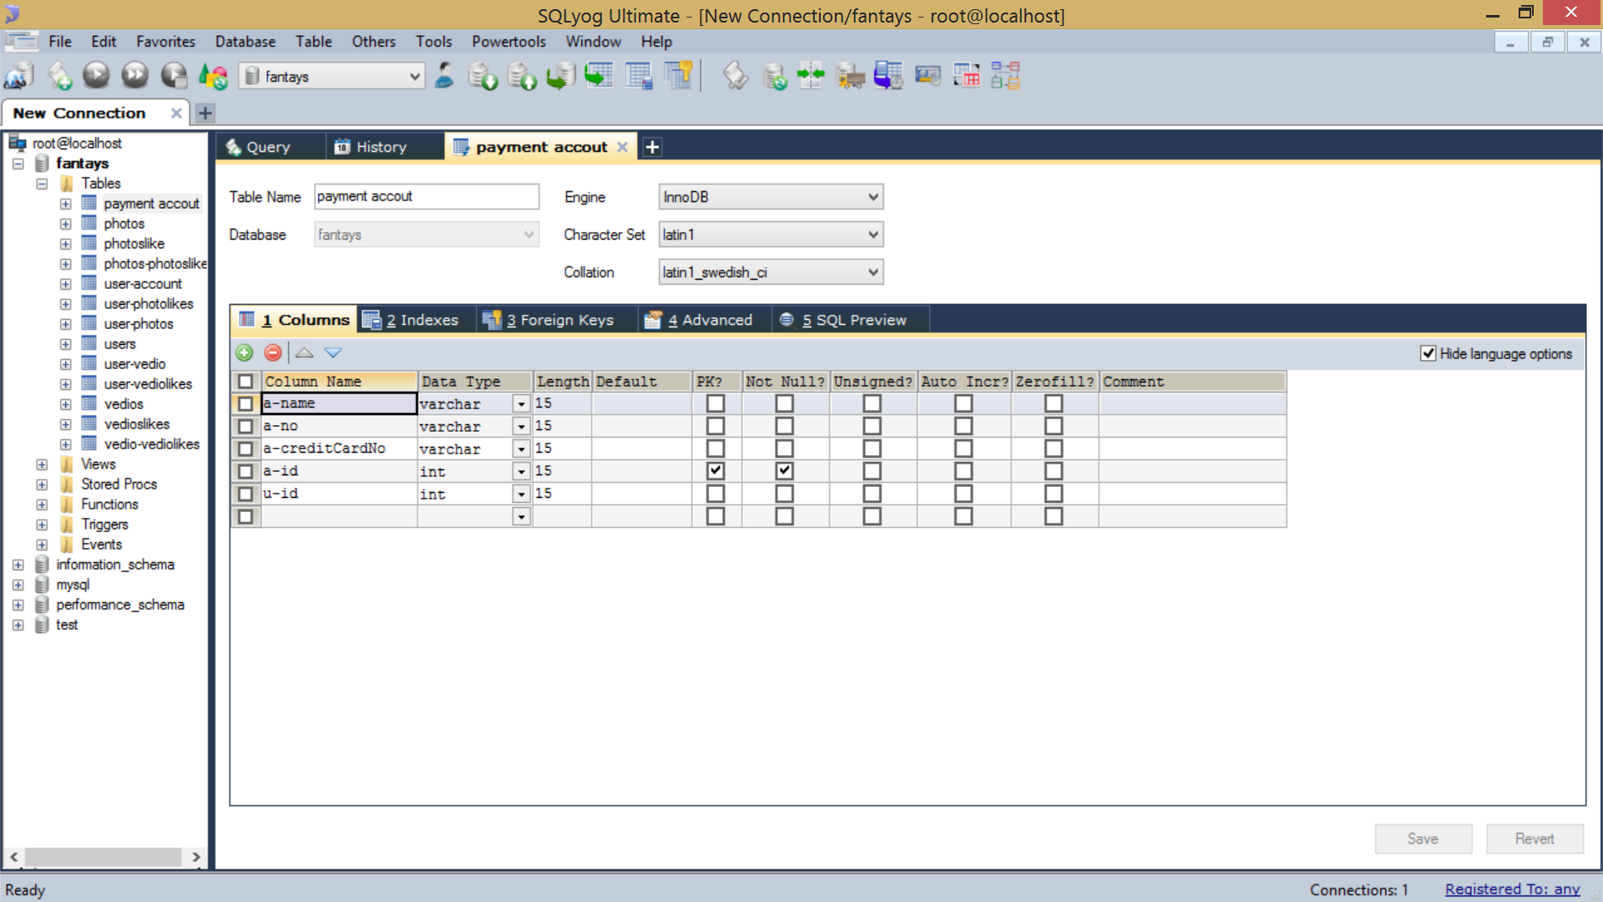

Slide 10
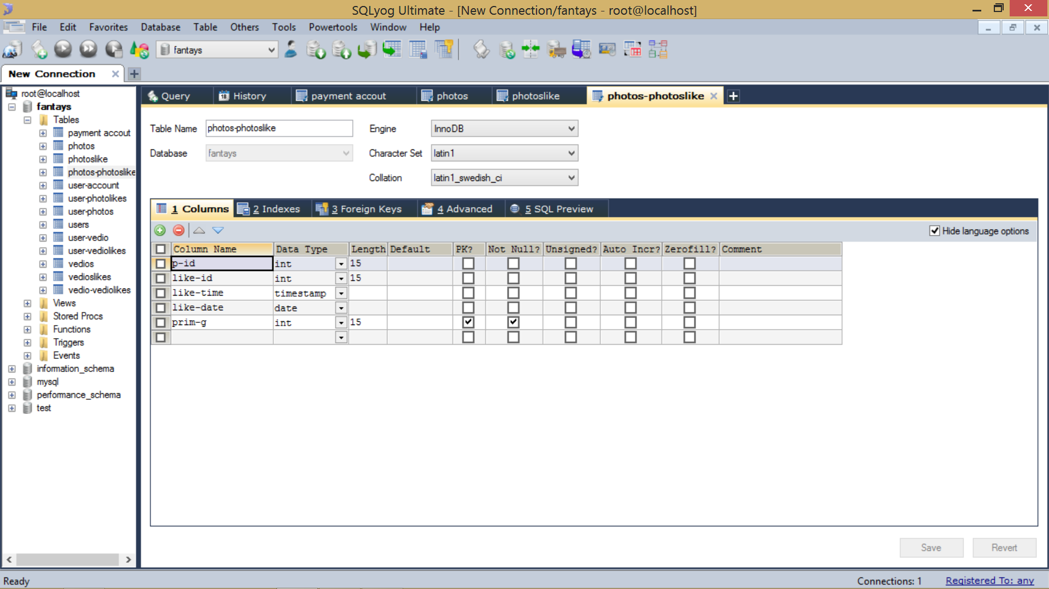

Slide 11
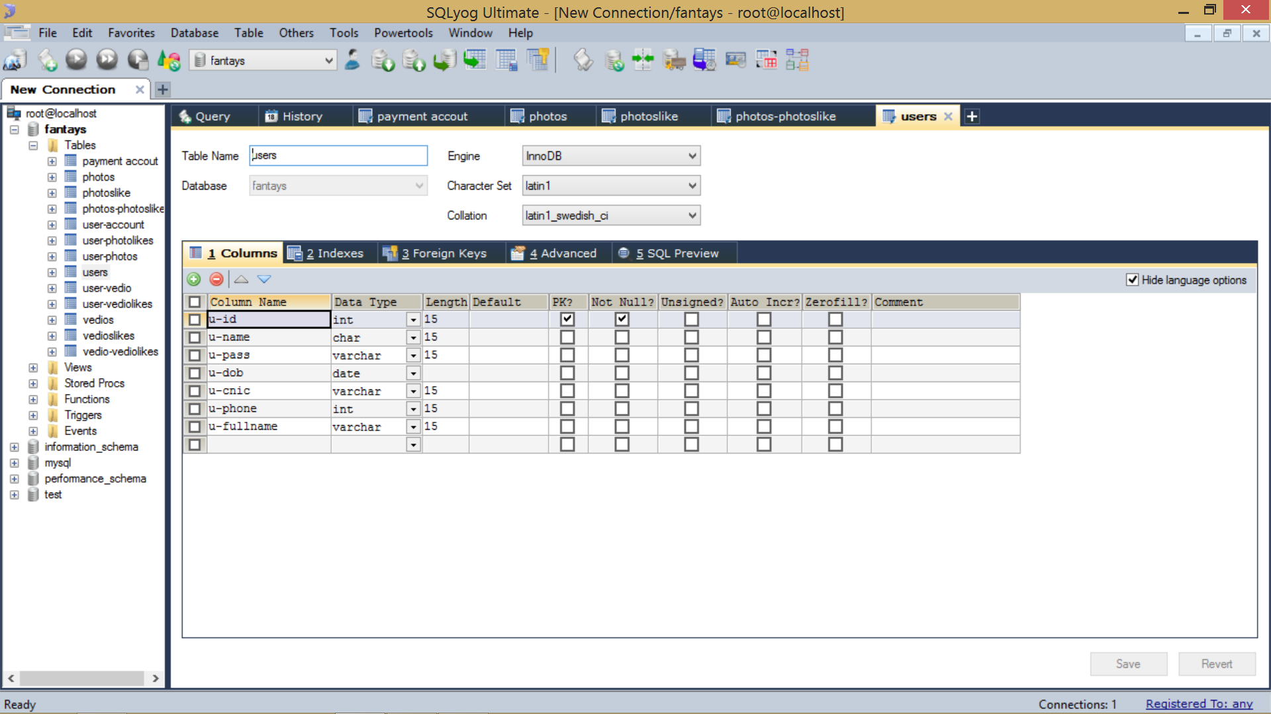

Slide 12
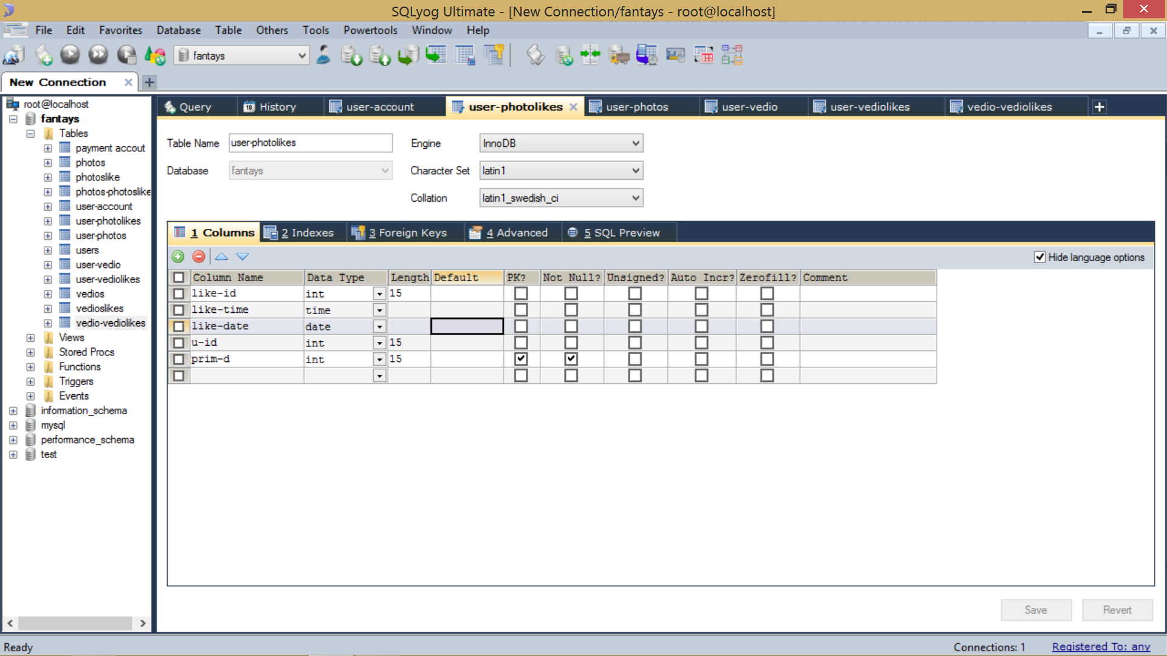

Slide 13
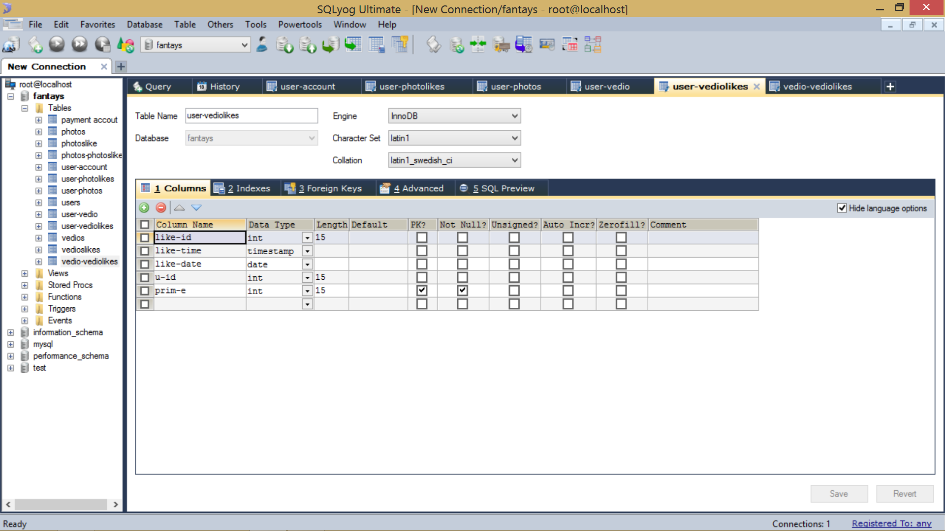

Slide 14
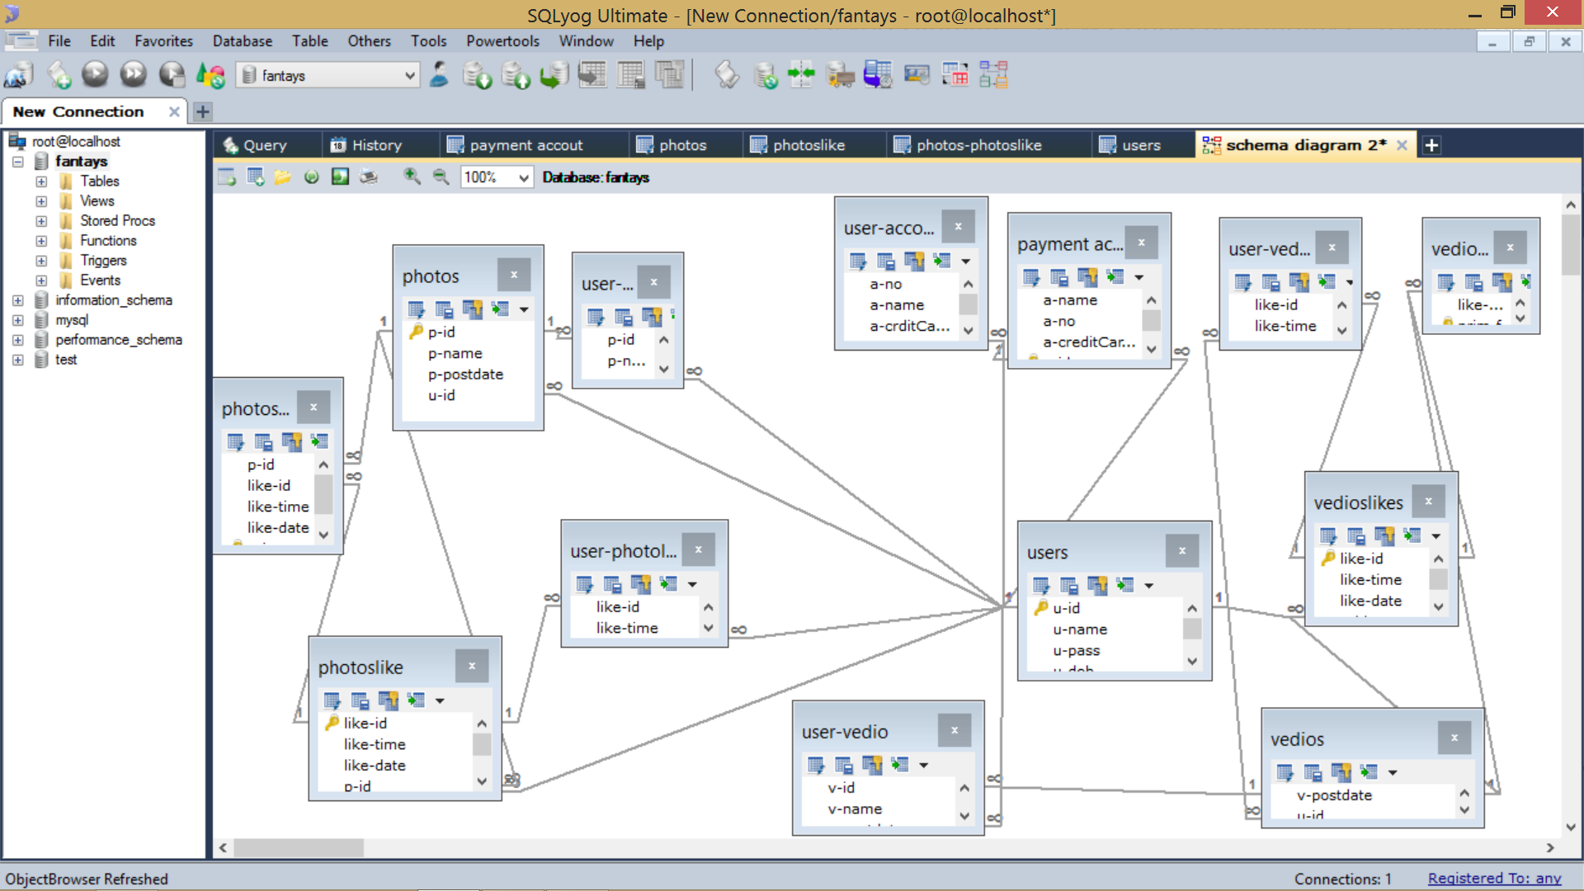

Slide 15
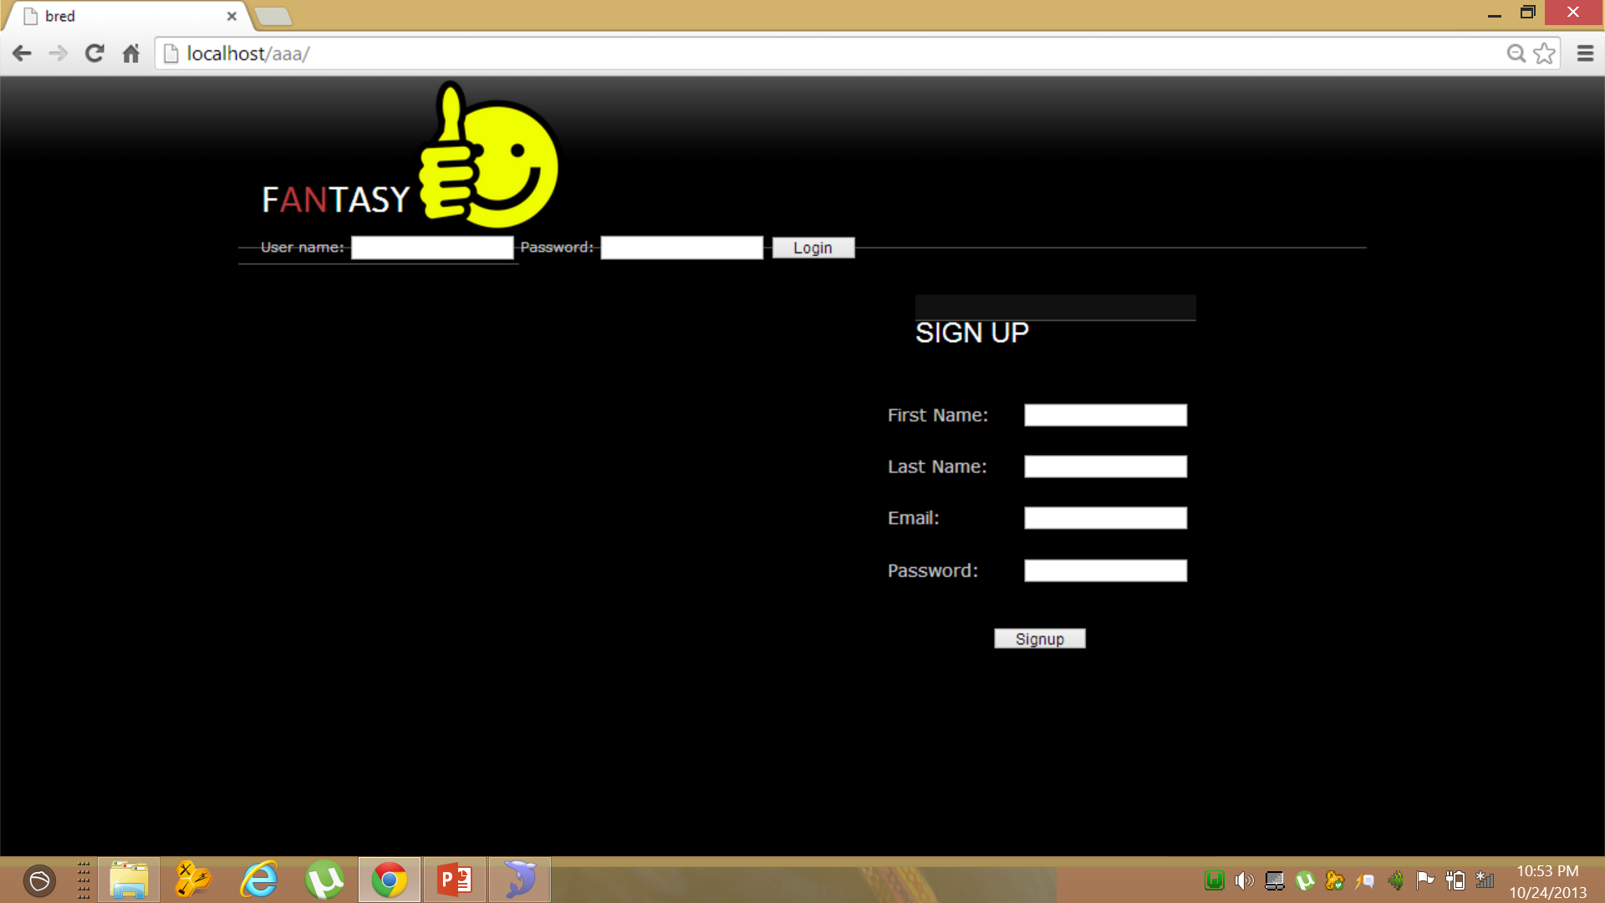

Slide 16
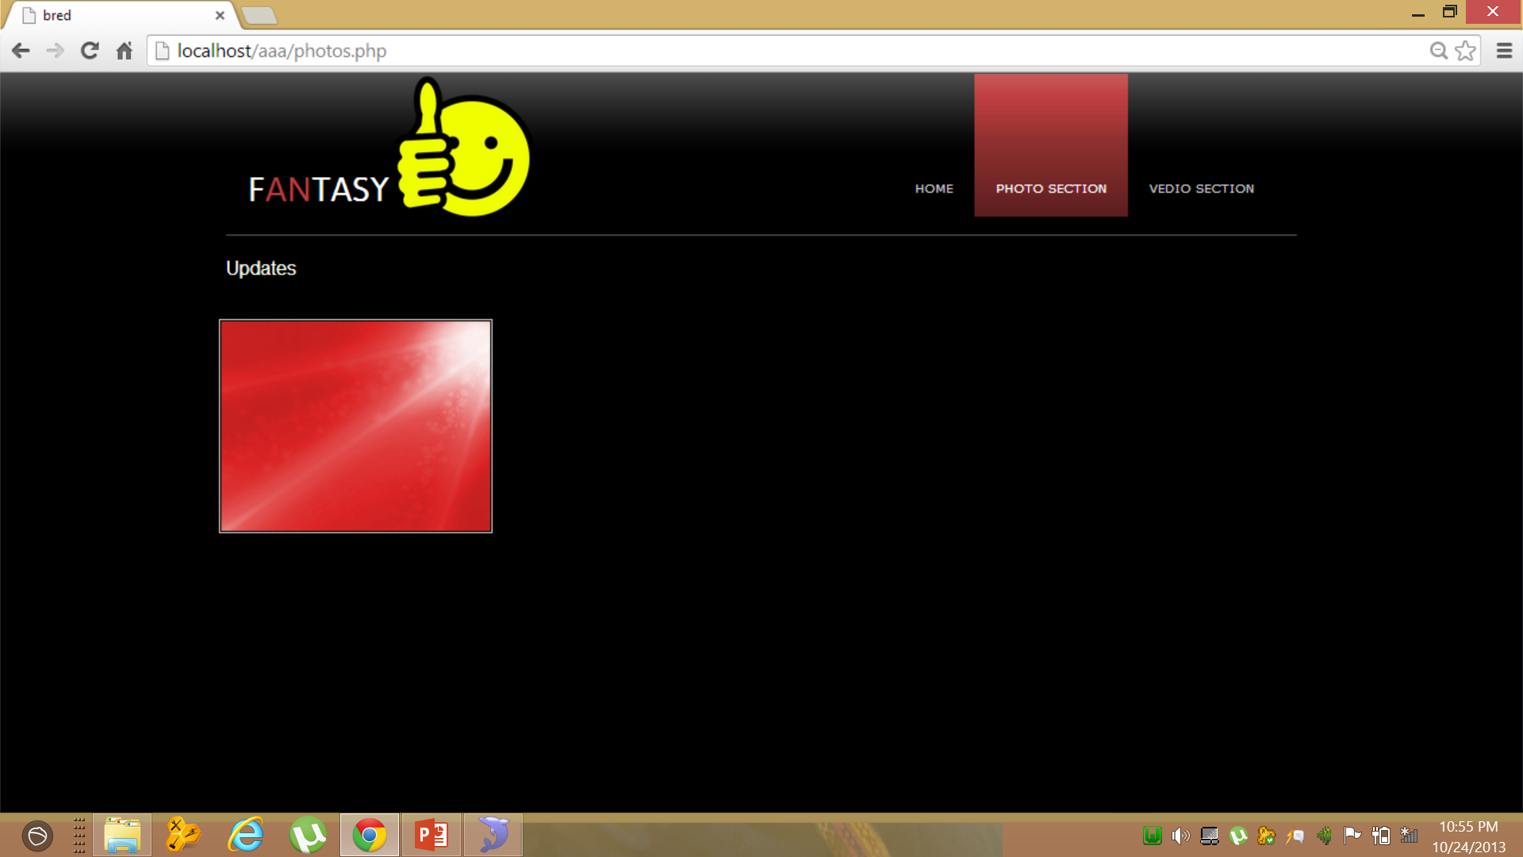

Slide 17
