Slide 1
New York Stock Exchange
Data Analysis

Slide 2
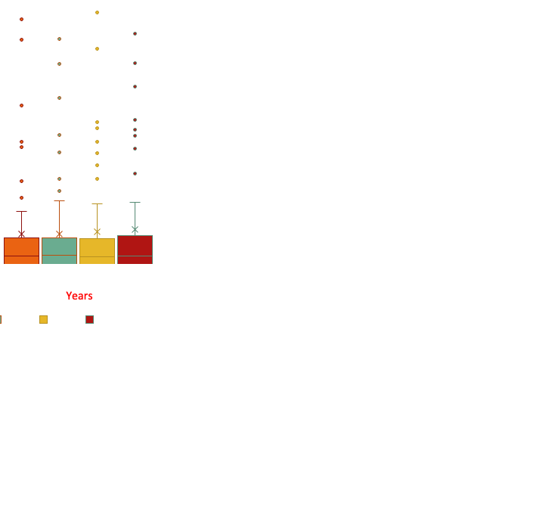
How Health Care R&D spendings have changed over 4 years?
The Box and Whisker Plot with outliers is representing the distribution of year over year spend on R&D in the health care sector.
The mean number of spend over 4 years has a slight increase from 995 to 1159 million dollars.
There is a clear distinction between some companies spending way more than average spend in the health care sector on R&D. This can be seen from the outliers and right skewness of box plot and an elevated range of approximately 8 billion.

Slide 3
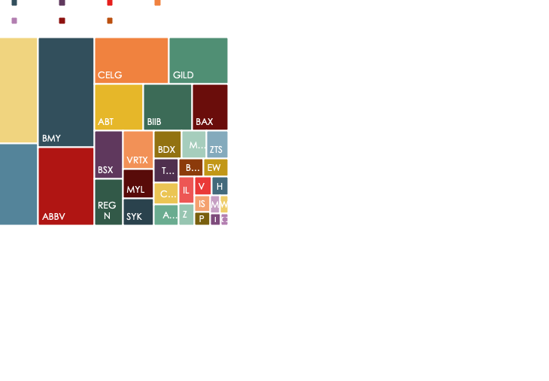
How Health Care R&D spendings have changed over 4 years?
5 of the 48 companies form the bulk spending of 70% of the health care sector on R&D.
This is in range from 4 to 8 billion per year. This is quite elevated from the average of the sector at around 1 billion per year.
14 out of 48 companies have no spending on R&D. This is approximately 30% of the health sector as seen on the next graph.
The standard deviation of 1.9 billion is double of mean representing reasonably large variations in spend across companies considering outliers.

Slide 4
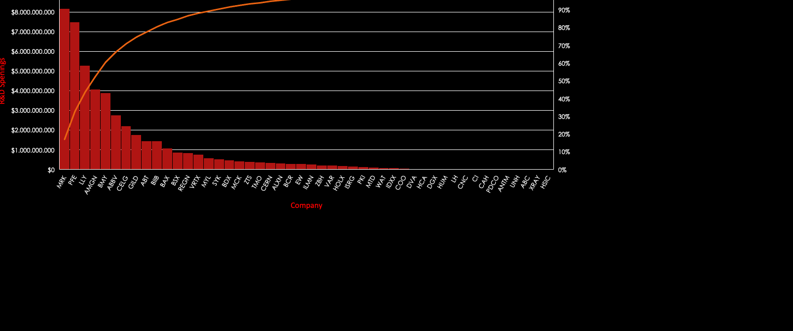
How Health Care R&D spendings have changed over 4 years?

Slide 5
THANK YOU

