Slide 1

Market for Startups
and Venture Capitalists
Farzad Pourbabaee
Rachel Hu
Shubei Wang
Chris Gagne

Slide 2
Variable description
Y variable: binary outcome of the startup (1 for success, 0 for failure)
  Success: IPO, merger, LBO (N=4625, 72%)
  Failure: Bankruptcy (chapter 7 and 11), defunct (N=1736, 28%)
X variables: set of features for every startup over its entire life-cycle
  Industry: SIC code, VE code and NAICS code
  Location: state
  Founding year
  Business duration
  Total funds raised
  Number of financing rounds
  Percentage of funding per round (in a CDF fashion)

Slide 3
Variable description
X variables continued:
  Identity of investors in each round
  Reputation score of VC investors: proxied by net amount that every VC invested by in the market.
  Time gaps between rounds of financing (in a CDF format)

Slide 4
Snapshot of a company
Internap Corporation
Headquarters' address: One Ravinia Drive, Atlanta, Georgia 30346 United States.
Phone and Fax number and website address: 4043029700, 4044750520, www.internap.com
SIC code: Prepackaged Software (7372)
Number of employees: 430
Last available sales figure: $244.63 Million (2011)
Company founded date: 01/01/1996
Company status: went public
Legal counsel: Cooley Godward LLP
Banking relationships: Silicon Valley Bank
Accountant: PricewaterhouseCoopers
Ticker: INAP
IPO- date: 09/29/1999
IPO Book manager: Morgan Stanley Dean Witter

Slide 5
Key Financials of INAP
Total assets: 356.71 (2011), 293.14 (2010), 267.50 (2010), 330.08 (2008)
Total shareholders equity: 192.17 (2011), 188.61 (2010), 184.40 (2009), 248.20 (2008)
Net sales and revenues: 244.63 (2011), 244.16 (2010), 256.26 (2009), 253.99 (2008)
Investment rounds:
  First round 1996: early stage and made by Robert J. Lunday, Jr. in total of $0.68 Million.
  Second round 1997: expansion stage made by eight VCs and LPs in total of $7.72 Million.
  Third round 1999: again made by eight investors in total of $32.0 Million.
  Final stage 2001: twelve investors, through a combination of VC firms and individuals participated in this round and put in $101.0 Million.
Top competitors: AT&T corp, Cable & Wireless PLC, MCI
List of company's products
Officers' names and their titles
Directors' name and their titles

Slide 6
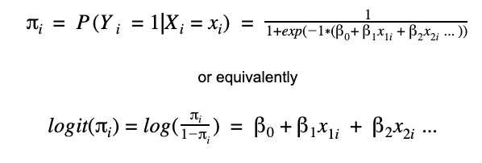
Which startup features correlate with success?
Logistic Regression
We can interpret the beta coefficients as the linear contribution of a predictor to the log-odds.
Predictors were scaled, fit using MLE, confidence intervals obtained via bootstrapping.

Slide 7
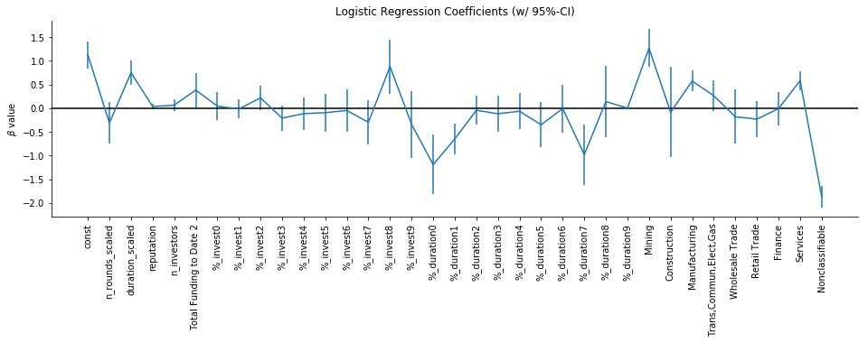
Which startup features correlate with success?

Slide 8
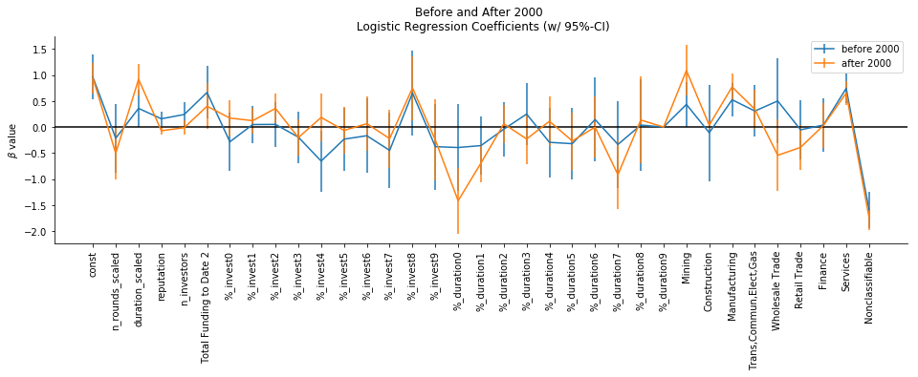
Is effect of duration / total funding consistent before and after the “dot com bubble”?

Slide 9

Which startup features predict success?
Restricted dataset to startups whose status was not yet determined by year 2 (or year 4)
Use features before year 2 (or year 4) to predict success after year 2 (or year 4)
  Number of rounds before year 2 (or year 4)
  Investment amount in year 0 and year 1 (and year 2 and year 3)
  Sector (Manufacturing, Services, Unclassified)
Used logistic regression as baseline model

Slide 10
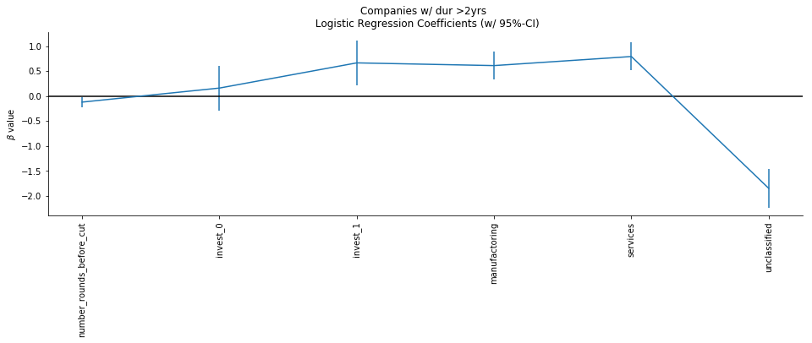
Which startup features predict success after 2 yrs?

Slide 11
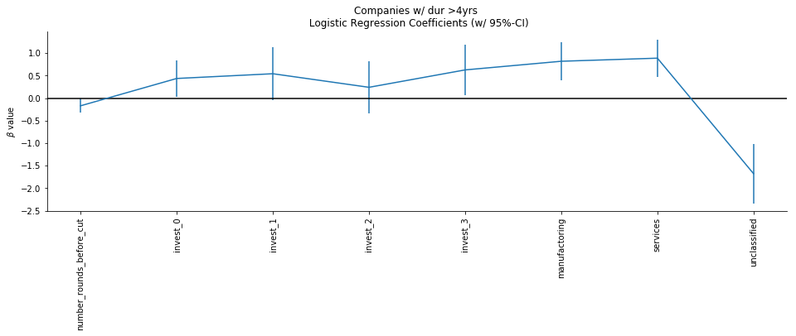
Which startup features predict success after 4 years?

Slide 12
Which startup features predict success?
Take home:
Fewer early rounds of investment and more funding in those rounds is predictive of future success.

Slide 13
Machine learning methods
Can we improve the model performance by using ML methods?
(Original Parameter Settings)
K-Neighbors(n_neighbors=5, p=2=euclidean distance)
Support Vector Machine(kernel=’rbf’, C=1)
Random Forest (n_estimator=10, criterion=’entropy’)
XGBoost (n_estimator=10, max_depth=3)
Notes:
Random Forest
https://scikit-learn.org/stable/modules/generated/sklearn.ensemble.RandomForestClassifier.html
KNN
https://scikit-learn.org/stable/modules/generated/sklearn.neighbors.KNeighborsClassifier.html
SVM
https://scikit-learn.org/stable/modules/generated/sklearn.svm.SVC.html
XGBoost
https://xgboost.readthedocs.io/en/latest/python/python_api.html
max_depth (int) – Maximum tree depth for base learners.
learning_rate (float) – Boosting learning rate (xgb’s “eta”)
n_estimators (int) – Number of trees to fit.

Slide 14
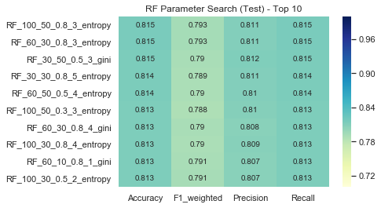
Random forest - fine tuning
Grid Search:
N_esitmator : [5,8,10,30,60,100]
Max_depth : [3,5,8,10,30,50]
Max_feature : [0.3,0.5,0.8]
Min_samples_leaf : [1,2,3,4,5]
Criterion : ["gini", "entropy"]
RandomForestClassifier(n_estimators=60, criterion=“entropy”, max_features = 0.8, min_samples_leaf=3, max_depth = 30)

Slide 15
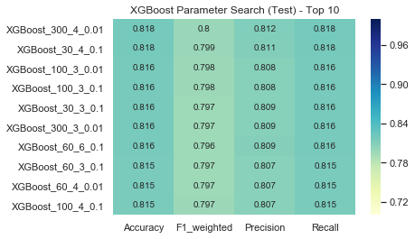
XGBoost - fine tuning
Grid Search:
N_esitmator: [30,60,100,300]
Max_depth:[3,4,5,6,8,10]
Learning_rate:[0.01,0.1]
XGBClassifier(n_estimators=30, max_depth=4, learning_rate=0.1)

Slide 16
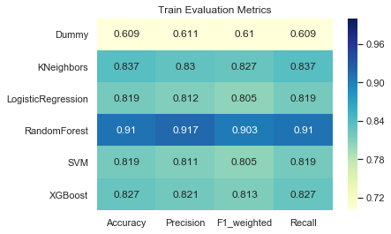
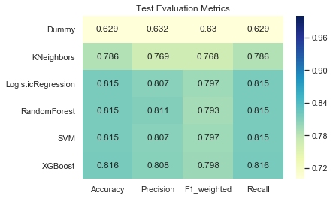
Model comparison
Logistic Regression, Random Forest and XGBoost all work well.

Slide 17
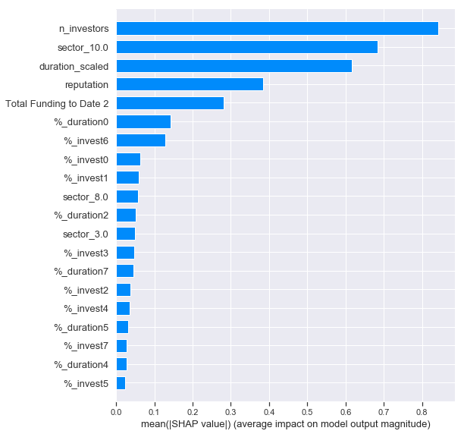
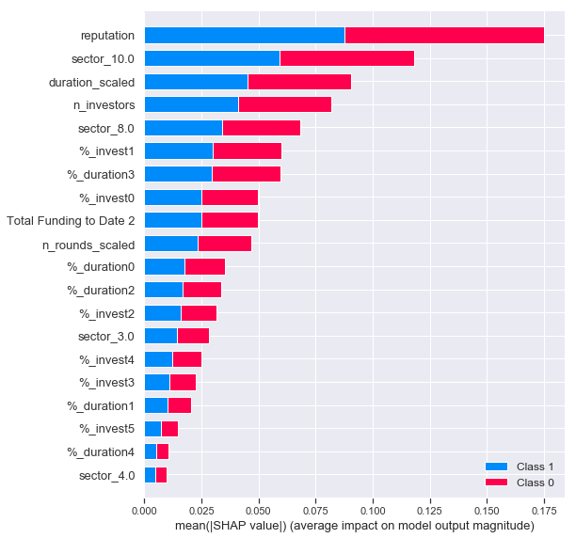
Feature importance comparison
XGBoost
Random Forest
For both models, the following features are highly critical:
“N_investors”
“Sector_10”
“Duration_scaled”
“reputation”
Notes:
SHAP (SHapley Additive exPlanations ) is proposed to NIPS in 2017.
improved computational performance and/or better consistency with human intuition than previous approaches.
notable because several recent methods in the class lack the proposed desirable properties,
It unifies six existing methods,
assigns each feature an importance value for a particular prediction.
LIME method interprets individual model predictions based on locally approximating the model around a given prediction

Slide 18
Feature importance comparison
Duration
Total funding
Mining, Manufacturing, Services, Nonclassifiable
The duration of the first two rounds
Logistic regression
ML methods
Duration
Total funding
Manufacturing, Services, Nonclassifiable
Reputation
Number of investors

Slide 19
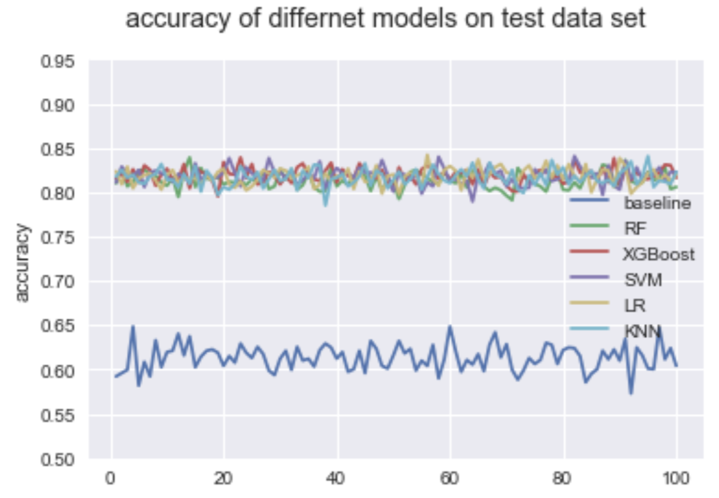
Robustness assessment
We did 100 trials on different test datasets to assess the robustness for each method.

Slide 20
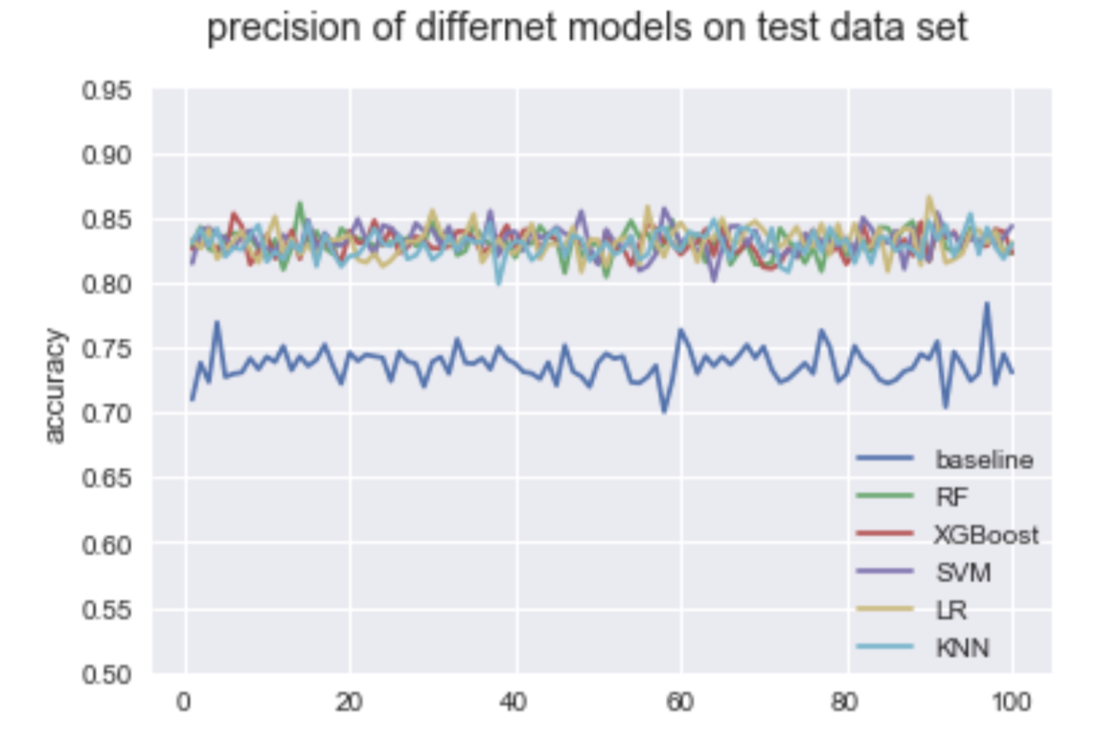
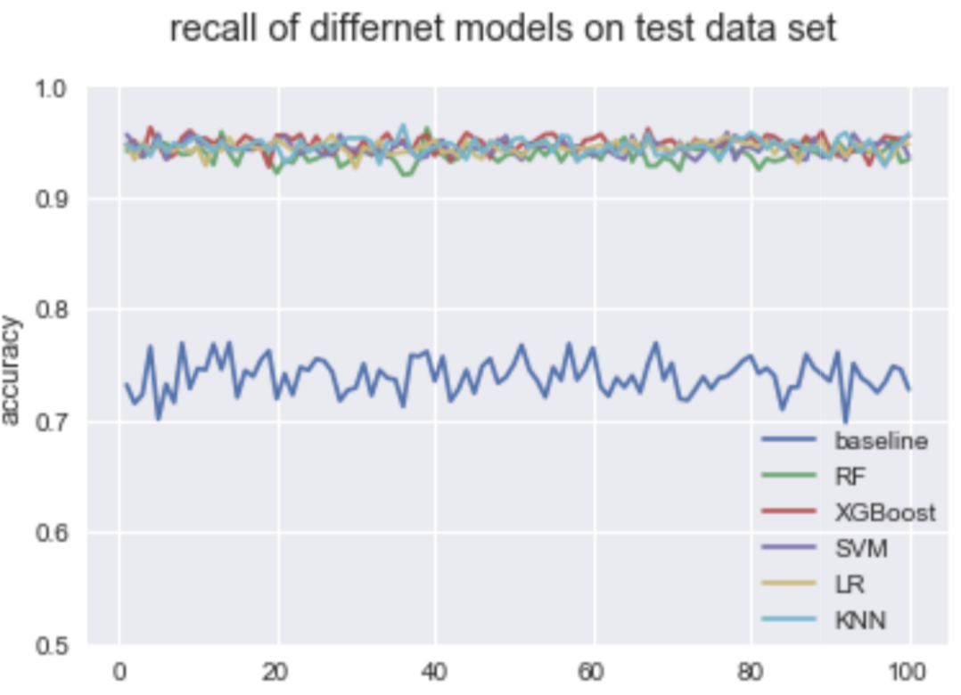
Robustness assessment
Overall, all the models are quite robust for different train/test split data

Slide 21
Sector analysis & modeling
From previous analysis, 4 sectors: Mining, Service, Manufacturing and Nonclassifiable are highly correlated with the outcome.
Different sectors may have different factor importance.
We explored further within sectors:
Mining: 15 samples ( 93.33% succeed)
Service: 3122 samples (83.76% succeed)
Manufacturing: 1757 samples (85.54% succeed)

Slide 22
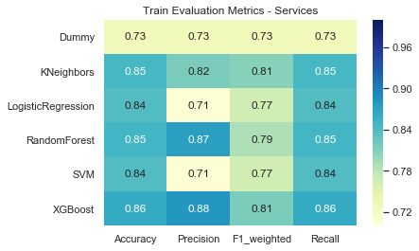
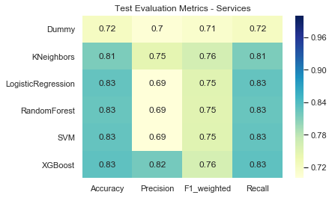
Model Comparison (Service)
XGBoost outperforms other models in Service sector.

Slide 23
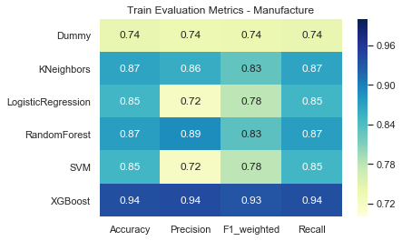
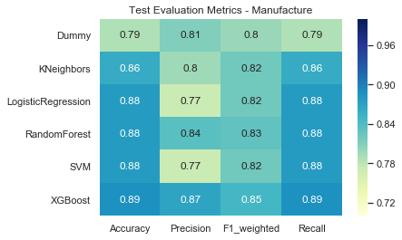
Model Comparison (Manufacturing)
XGBoost outperforms other models in Manufacturing sector.

Slide 24
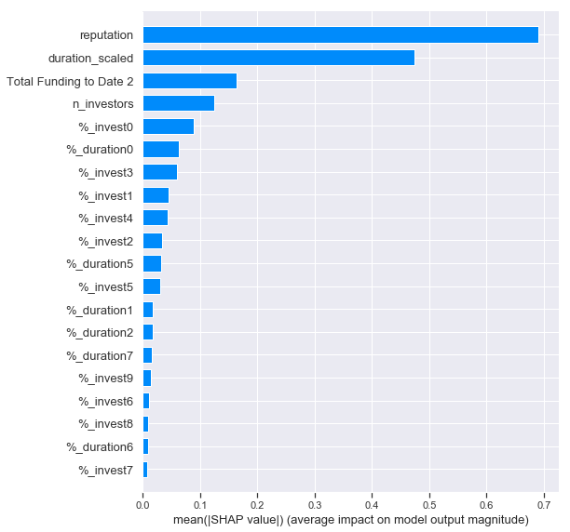
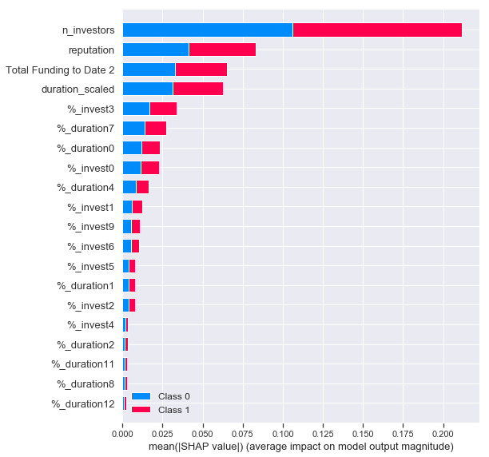
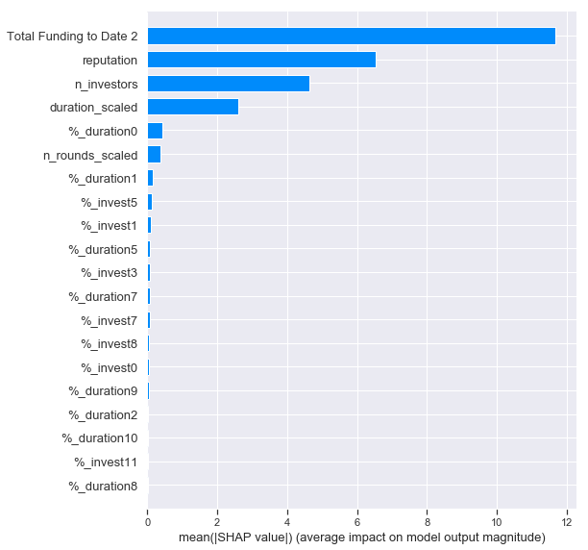
Feature importance (Services)
XGBoost
Random Forest
Logistic Regression
XGBoost
Random Forest
Logistic Regression
For all of the three models, the following features are highly critical:
“N_investors”, ”duration”,”reputation”, “total funding”

Slide 25
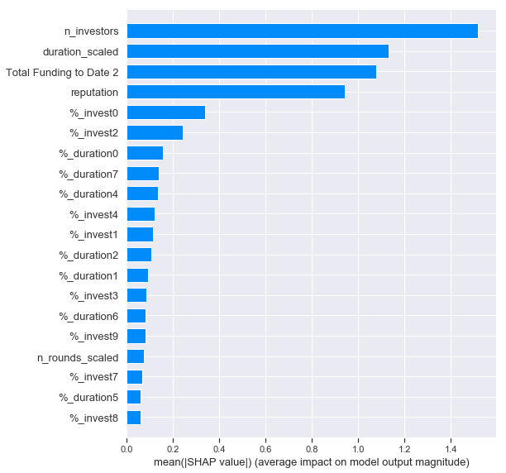
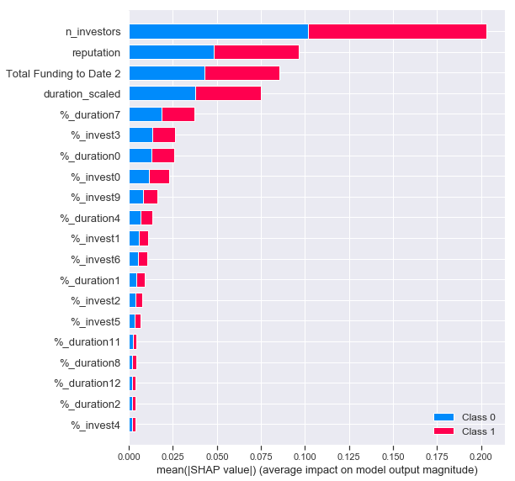
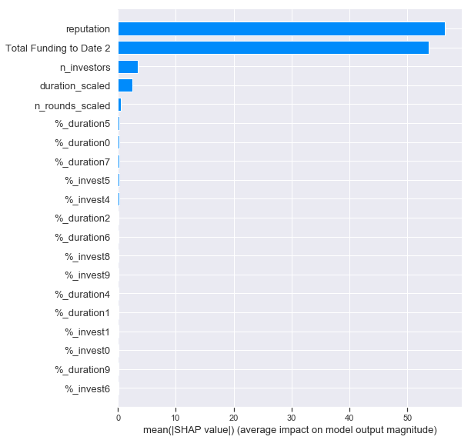
Feature importance (Manufacturing)
XGBoost
Random Forest
Logistic Regression
XGBoost
Random Forest
Logistic Regression
For all of the three models, the following features are highly critical:
“N_investors”, ”duration”,”reputation”, “total funding”

Slide 26
Feature importance comparison
Reputation
Total funding
Number of investors
Duration
Services
Manufacturing
Number of investors
Reputation
Total funding
Duration
Want success? Get more funding and prestigious investors!

Slide 27
Appendix

Slide 28
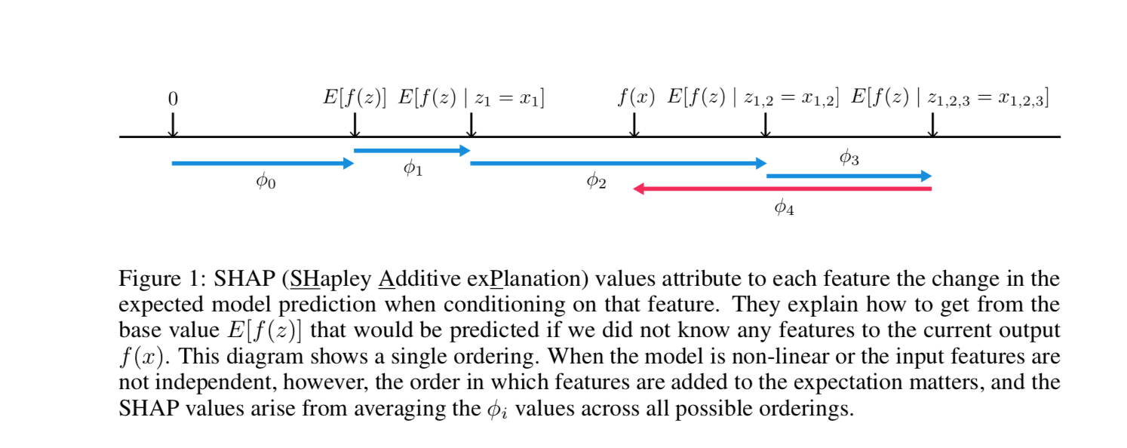
SHAP
Notes:
model is non-linear or the input features are not independent
summing the effects of all feature attributions approximates the output f(x) of the original model.

Slide 29
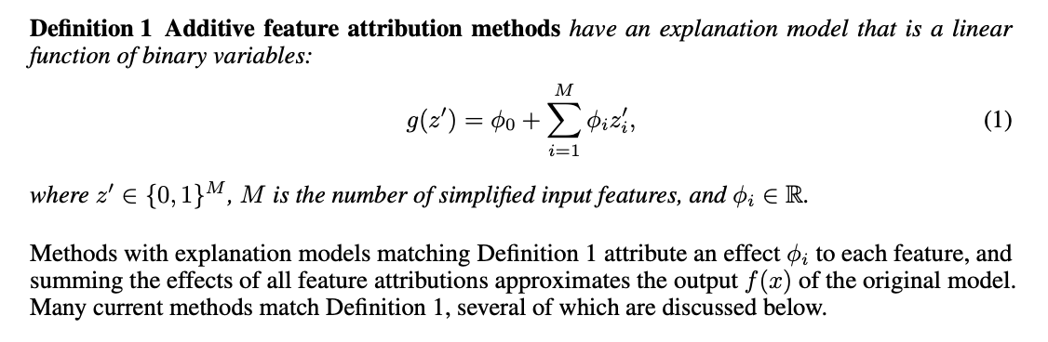
SHAP
Notes:
summing the effects of all feature attributions approximates the output f(x) of the original model.

Slide 30
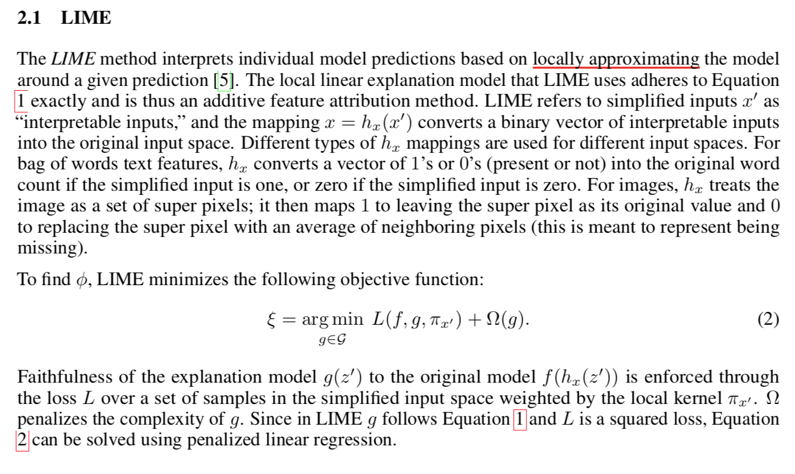

Slide 31
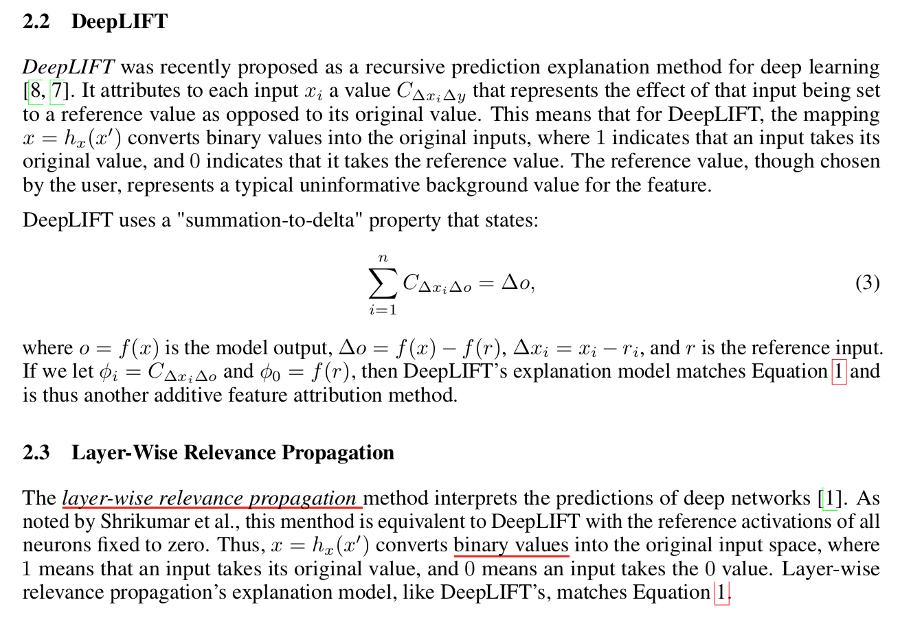

Slide 32
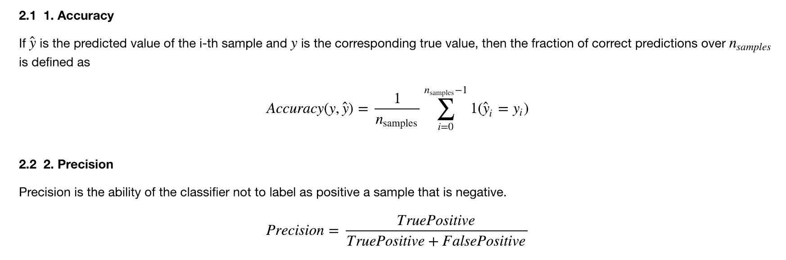
Model Evaluation Metrics
Notes:
We also applied several machine learning methods including random forest, decision tree and etc. to see which model has the best performance. We used 4 kinds of metrics to evaluate our models. The first one is accuracy, which is the fraction of correct predictions. The second is precision, it’s the fraction of true positives in all positive predictions.

Slide 33
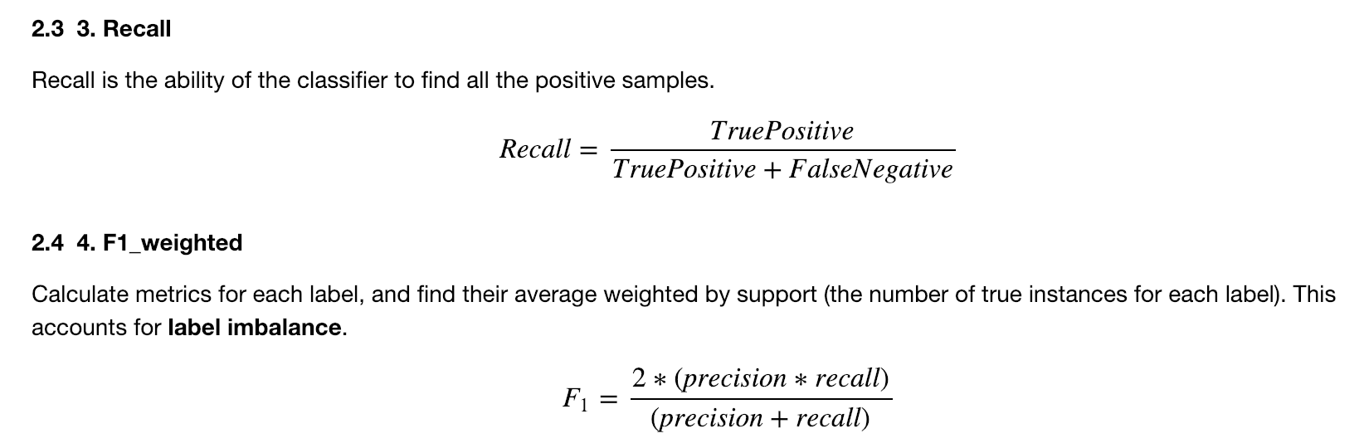
Model Evaluation Metrics
Notes:
We also use recall and F1 weighted to measure the accuracy of our models. Recall measures the ability of a model to find the positive samples and F1 weighted is a harmonic average of the precision and recall.

Slide 34
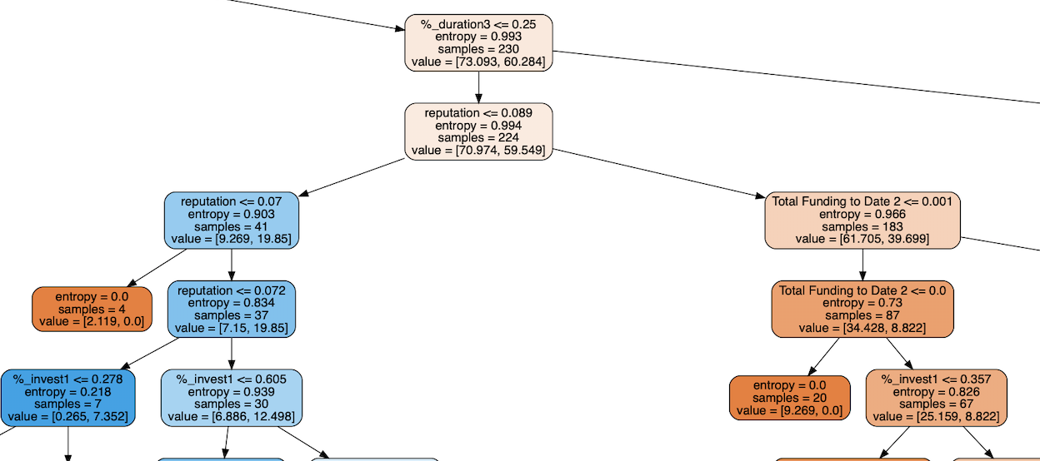
Random Forest Tree Split partial example

Slide 35
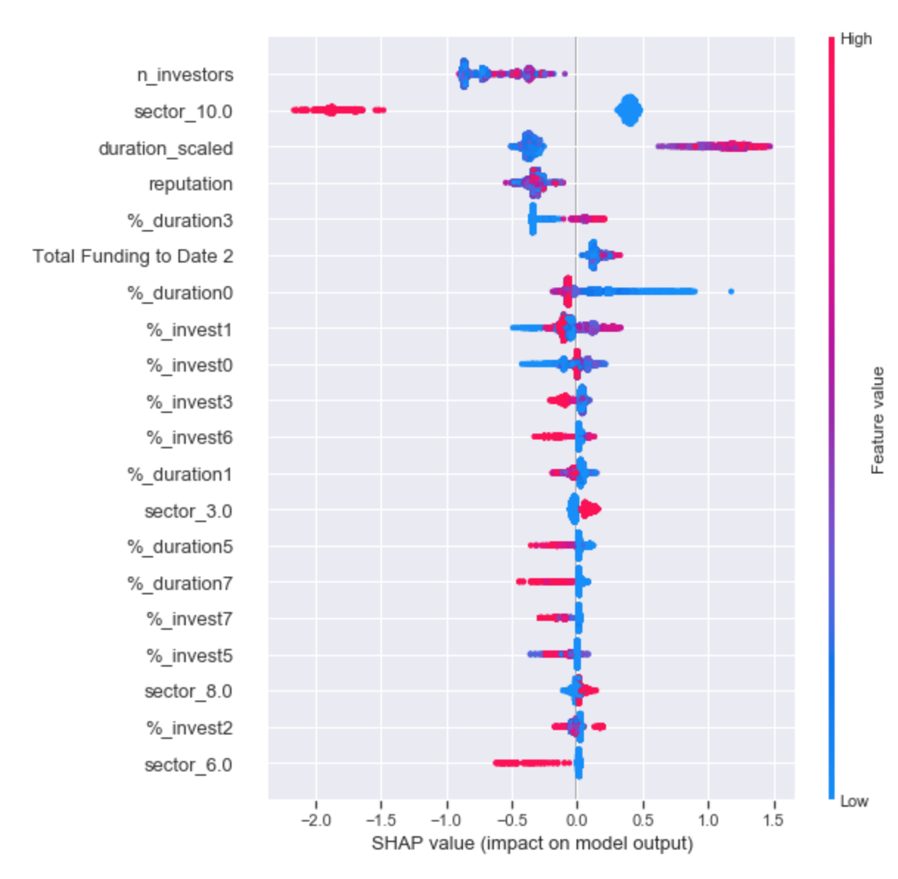
To get an overview of which features are most important for a model we can plot the SHAP values of every feature for every sample.
The color represents the feature value (red high, blue low). This reveals for example that a high sector_10 value (in a binary case is 1) lowers the predicted value of success.
XGBoost Intrepretation
Notes:
The plot sorts features by the sum of SHAP value magnitudes over all samples, and uses SHAP values to show the distribution of the impacts each feature has on the model output.

Slide 36
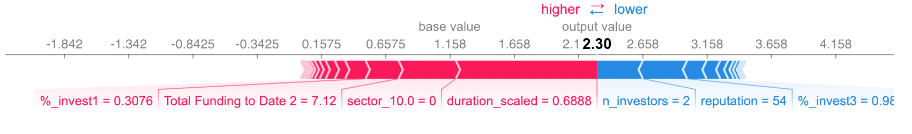
XGBoost
one sample interpretation
The above explanation shows features each contributing to push the model output from the base value (the average model output over the training dataset we passed) to the model output. Features pushing the prediction higher are shown in red, those pushing the prediction lower are in blue (these force plots are introduced in our Nature BME paper).

Slide 37
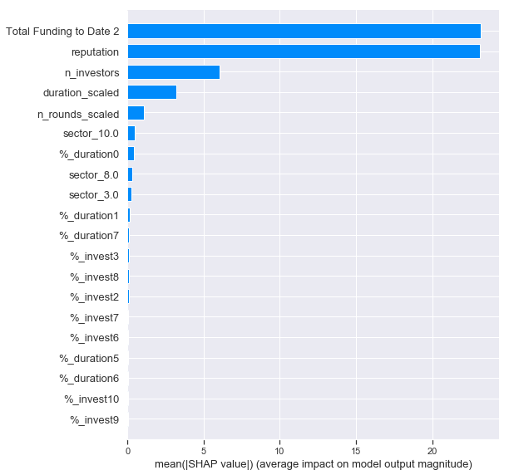
Feature importance comparison
For all of the three models, the following features are highly critical:
“N_investors”, “sector_10”,”duration_scaled”,”reputation”
XGBoost
Random Forest
Logistic Regression

