Slide 1
WAVENET
© Templateswise.com
PowerPoint template

Slide 2
What is WaveNet?
A deep generative model of raw audio waveforms.
Able to generate speech which mimics any human voice and which sounds more natural than the best existing Text-to-Speech systems.
Reducing the gap with human performance by over 50%.
*https://deepmind.com/blog/article/wavenet-generative-model-raw-audio
Notes:
This post presents WaveNet, a deep generative model of raw audio waveforms. We show that WaveNets are able to generate speech which mimics any human voice and which sounds more natural than the best existing Text-to-Speech systems, reducing the gap with human performance by over 50%. WaveNet is a powerful new predictive technique that uses multiple Deep Learning (DL) strategies from Computer Vision (CV) and Audio Signal Processing models and applies them to longitudinal (time-series) data. It was created by researchers at London-based artificial intelligence firm DeepMind, and currently powers Google Assistant voices.

Slide 3
Why WaveNet is better?
Directly models the raw waveform of the audio signal one sample at a time.
Yields more natural-sounding speech, using raw waveforms.
WaveNet can model any kind of audio, including music.
*https://deepmind.com/blog/article/wavenet-generative-model-raw-audio

Slide 4
How WaveNet works ?
Input sequences are real waveforms recorded from human speakers.
Sample the network to generate synthetic utterances.
At each step during sampling a value is drawn from the probability distribution computed by the network.
This value is then fed back into the input and a new prediction for the next step is made.
Building up samples one step at a time like this is computationally expensive, but it has been found that it is essential for generating complex, realistic-sounding audio.
Notes:
At training time, the input sequences are real waveforms recorded from human speakers. After training, we can sample the network to generate synthetic utterances. At each step during sampling a value is drawn from the probability distribution computed by the network. This value is then fed back into the input and a new prediction for the next step is made. Building up samples one step at a time like this is computationally expensive, but we have found it essential for generating complex, realistic-sounding audio.

Slide 5
Layers of WaveNet
Inspired from PixelRNN and PixelCNN models, published earlier.
Showed that it was possible to generate complex natural images not only one pixel at a time, but one colour-channel at a time, requiring thousands of predictions per image.
Two-dimensional PixelNets to a one-dimensional WaveNet.
Notes:
The above animation shows how a WaveNet is structured. It is a fully convolutional neural network, where the convolutional layers have various dilation factors that allow its receptive field to grow exponentially with depth and cover thousands of timesteps.

Slide 6
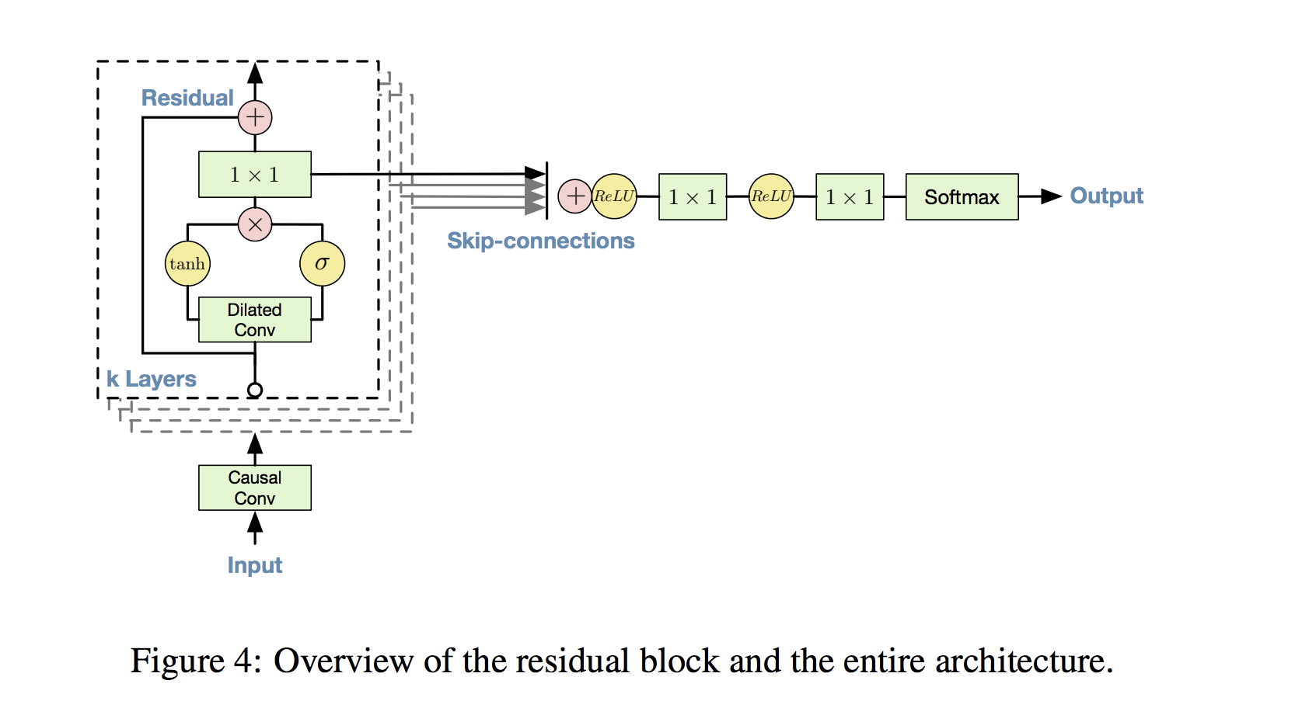
Architecture
https://towardsdatascience.com/how-wavenet-works-12e2420ef386
Notes:
What we see above is a Gated Activation. Similar to gates in LSTM or GRUs, the tanh branch is an activation filter, or modifier of the dilated convolution that happened just below. It’s the “squashing function” we’ve seen in CNNs before. The sigmoid branch serves essentially as a binary gate, and is able to cancel everything up to it; it learns which data is important, going back an arbitrary number of periods into the past.
Also note the grey arrows pointing right: these are Skip Connections. They allow a complete bypass of convolution layers, and give raw data the ability to influence the formulation of predictions — again — to an arbitrary number of periods into the future. Don’t worry, these are hyper-parameters that you can validate on slices of your data. Optimal values depend on the structure and complexity of the sequence you learn.
Remember, in fully-connected NNs, a neuron takes inputs from all neurons in the previous layer: early layers establish later ones via a hierarchy of intermediate computations. This allows NNs to build complex interactions of raw inputs/signals.
But… what if raw inputs are directly useful for prediction, and we want them to directly influence the output? In detail, skip connections allow outputs of any layer to bypass multiple future layers and skip influence dilution! Keras allows us to store the tensor output of each convolutional block — in addition to passing it through further layers — with skips.append(). Note how for each block in the stack above, the output from the gated activations joins the set of skip connections.

Slide 7
References
https://towardsdatascience.com/how-wavenet-works-12e2420ef386
https://deepmind.com/blog/article/wavenet-generative-model-raw-audio
https://towardsdatascience.com/wavenet-google-assistants-voice-synthesizer-a168e9af13b1

