Slide 1
NGO MANAGEMENT SYSTEM (NMS)
Team DeadInside
Siana Rizwan (180042105)
Farzana Tabassum (180042119)
Sabrina Islam (180042122)
Repo link: https://github.com/SianaRizwan/NGO-Management-System

Slide 2
MOTIVATION
Most of the time information regarding the operations of an NGO, are stored across multiple locations digitally or physically creating a messy management system.
By automating all the tasks, we remove the need of having people doing the functions of NGO manually.
2

Slide 3
OBJECTIVES
NGO management system is intended as a tool for simplifying the task of management of an NGO.
It will automate the functioning of an NGO.
Removing the need of having people doing the functions of NGO manually.
Reduction in human labor and time management
Easy to manage history and records
3

Slide 4
CONTRIBUTION
Database design : Farzana Tabassum
UI design, Dashboard : Siana Rizwan, Sabrina Islam
Authentication, Personnel information : Farzana Tabassum, Siana Rizwan
Supply details, Accounts : Siana Rizwan, Sabrina Islam
Events : Sabrina Islam, Farzana Tabassum
4

Slide 5
Programming Language And Tools
Programming Language:
Frontend – JavaFx, Java
Backend – SQL
Tools or Platform:
IntelliJ
Oracle 18c

Slide 6
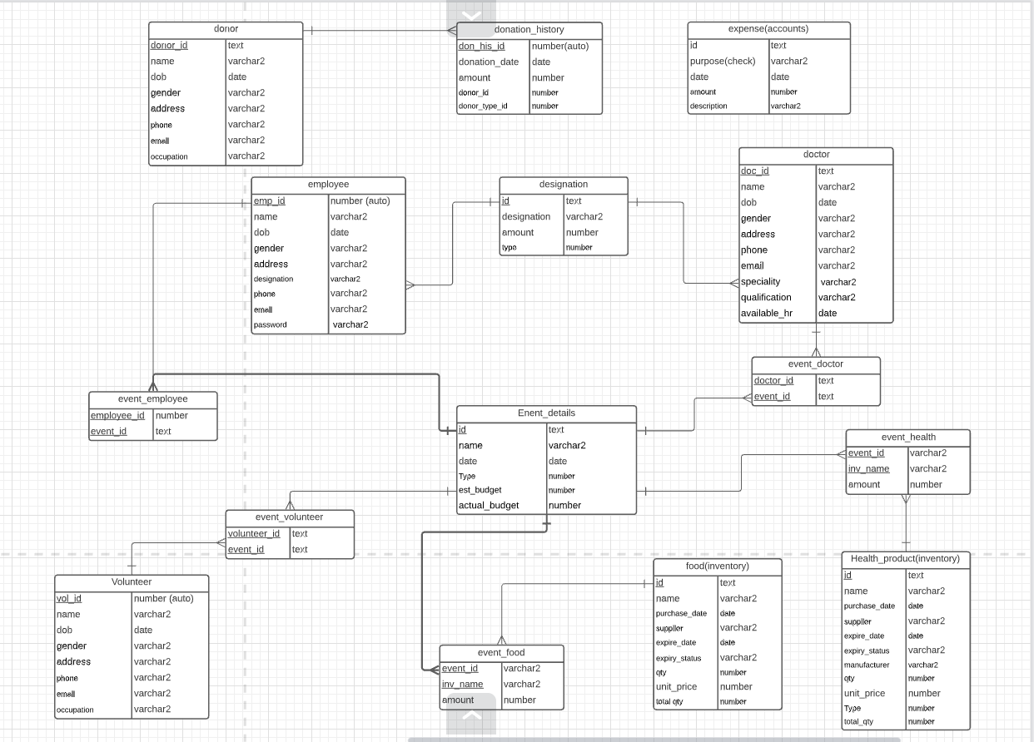
ER-Diagram

Slide 7
Timeline:

Slide 8
Thank You
The floor is open for Q/A

