Slide 1
Lab - Continuous Integration with Jenkins
In this lab you will work with Jenkins which is a Continuous Integration (CI) tool.
The project supplied is written in Java, but Jenkins' CI pipeline can work for any buildable software.
Objectives
To get Jenkins up and running using Docker
To explore the options Jenkins gives us for connecting to other services
To explore the Jenkins dashboard
Prerequisites
Docker desktop is installed
Git CLI
You have a GitHub account

Slide 2




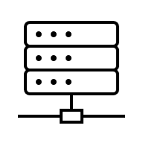
Objective of this exercise
Write code Make changes
Check the code in
Detects the change Raises a build event
Build and runs tests Deploy the code
Report result to GitHub
In this lab, you will
Deploy a Maven app from GitHub to Jenkins
Build and test the app using Jenkins
Make changes to your code and deploy the changes to GitHub
Set up Jenkins to detect the change in code and rebuild the app
Production

Slide 3
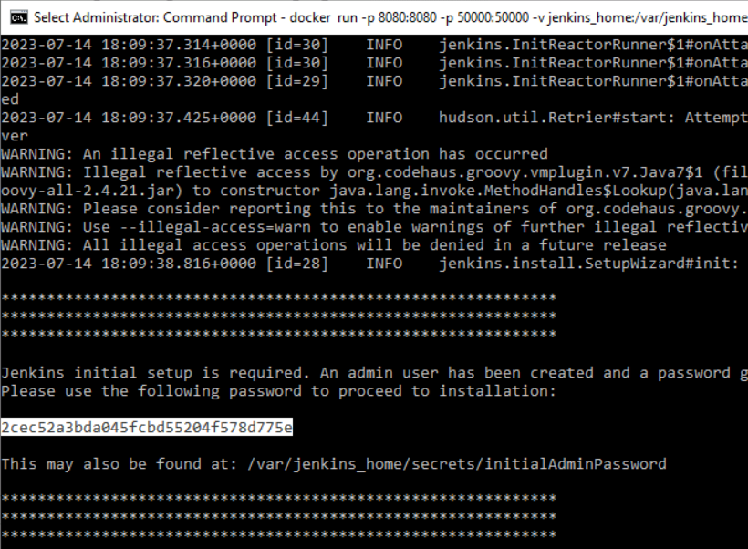

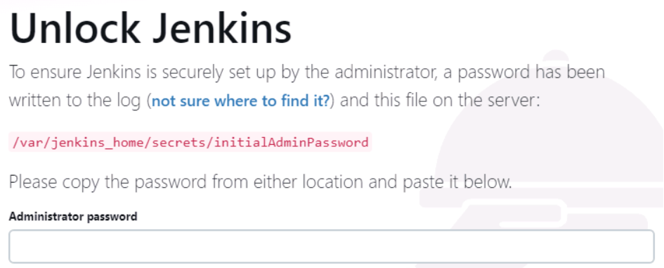
Run Jenkins using Docker
In a terminal window, type
docker run -p 8080:8080 -p 50000:50000 -v jenkins_home:/var/jenkins_home jenkins/jenkins:lts
Run Jenkins in a browser
paste
copy

Slide 4
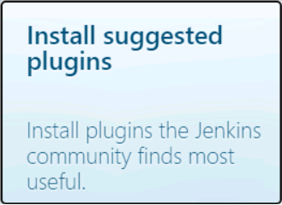
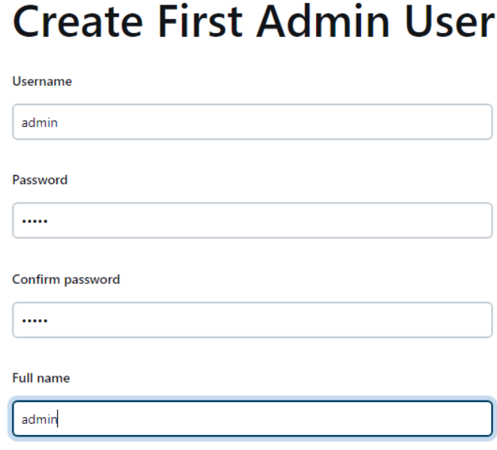

Accept or change the port

Slide 5

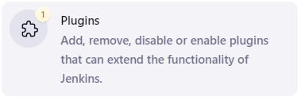

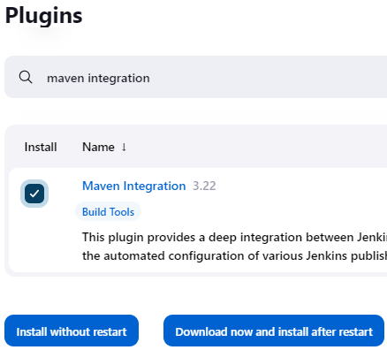

Stop and start Jenkins in Docker desktop
Click

Slide 6
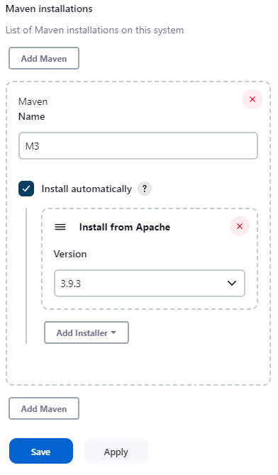

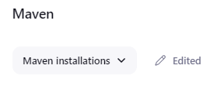
Type
Scroll down until you find the Maven section
Click

Slide 7

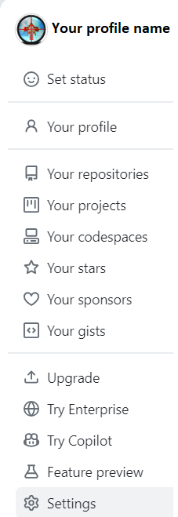


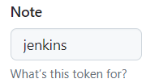
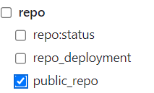


Generate a secret key to grant Jenkins access to GitHub
Click
<> Developer settings
Select Tokens (classic)
Select (classic)
Copy the secret key to notepad

Slide 8
Create a repository for your code
Copy the calculator-jenkins folder from the Jenkins folder to C:\calculator-Jenkins
Open a terminal window, and navigate to C:\calculator-Jenkins cd c:\calculator-jenkins
Initialise the folder as a new Git repo: git init
Add all of the files: git add .
Commit the files: git commit -m "Initial commit"
Create a new repository in GitHub and call it calculator-Jenkins
Type git branch -M main (in the terminal window)
git remote add origin https://github.com/..../calculator-jenkins.git
git push -u origin main
Copy the address

Slide 9

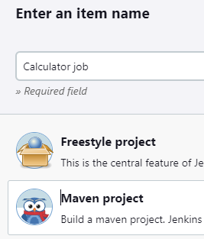
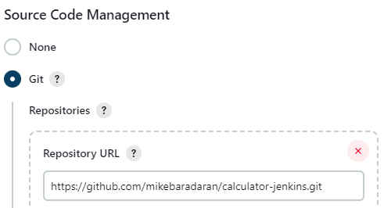

Create a new Jenkins job
On the screen below
Type
Select
Continue on the next slide…
Click

Slide 10
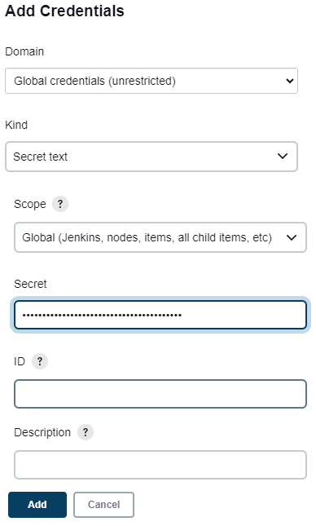
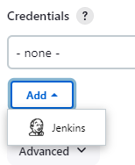
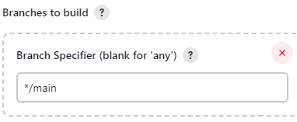

Click the arrow
Select
Then Click
Personal access token from GitHub

Slide 11

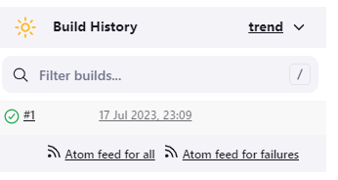
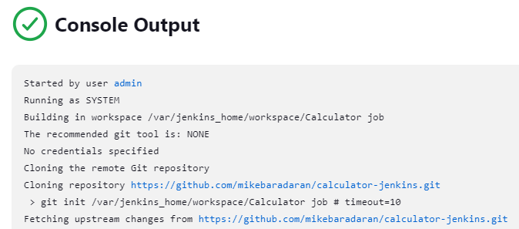
Click to see log

Slide 12


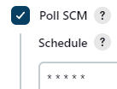
Configure Jenkins’ Build Triggers
In the Calculator job window, select
Click on
Check the Poll SCM (Source Control Management) box Enter * * * * * into the Schedule to build every minute every time a commit is made to this repo
Let's test this on the next page

Slide 13

Run the Trigger (Terminal window)
In the C:\ drive /src/test/java/com/agile/calculator/CalculatorTest.java
Change the value of expected on line 17 to 42 (makes the test fail)
Save the file
Add and commit this file to the repo git add . git commit –m "change test result" git push
Wait for a minute (resist the urge to press the Build now button!)
This time the build fails, and the log indicates the reason for this failure

