Slide 1
CSC420: Final Project
Fall 2019
Farzan Haq and Usama Zaki

Slide 2
Presentation Agenda
Problem Definition
Comparisons
The problem we are solving
Outcomes from different methods
Method
Course Coverage
How we are solving the problem
How the project covers topics from the course
Results
Contributions
Examples and overall trends.
The role of each group member

Slide 3
1
Problem Definition

Slide 4
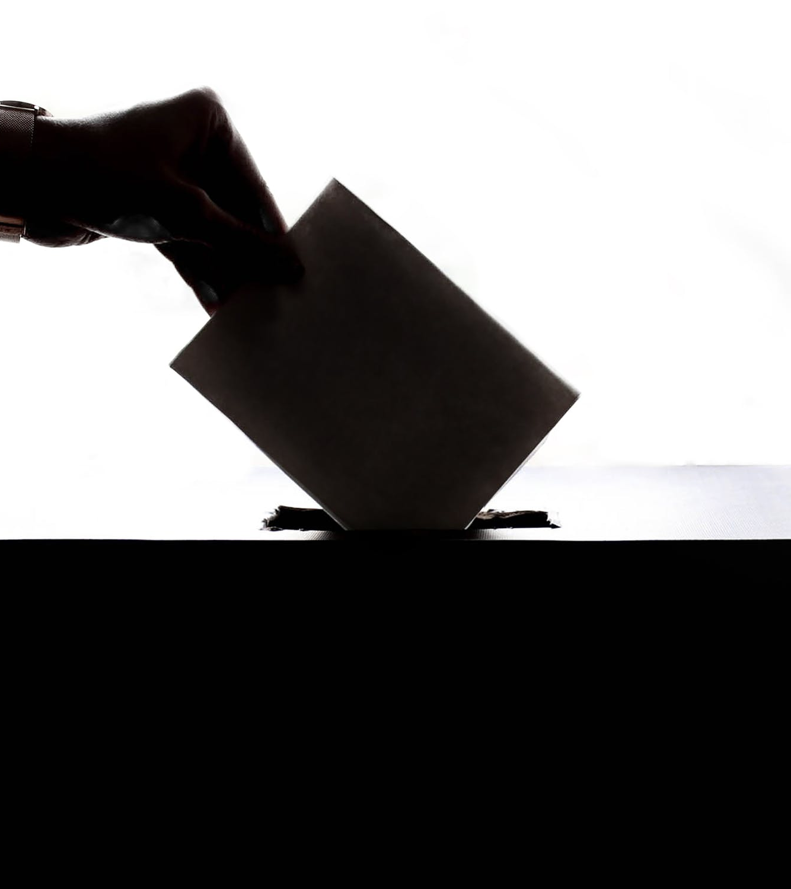
Problem Definition
01
Who
Voters, candidates and election commissions.
02
What
Electoral ballot detection software
03
Why
Make the electoral system more reliable, adaptable and efficient
04
When
During the election period

Slide 5
2
Method

Slide 6
How We Are Solving the Problem
Data Generation and
Image Segmentation
Template Matching and
Text Recognition
Data Augmentation and
Neural Networks
Manually generate data for the neural network using the sample ballot and photo editing software to simulate user votes
Segment the ballot into individual candidates and votes using edge detection and image convolution techniques
Extract name of each segmented candidate using template matching with templates manually from the sample ballot
Perform template matching using normalized cross correlation
Expand dataset by flipping, adding noise and adding blur to images in the base dataset to increase the diversity of data available for training our neural network
Use pretrained network (VGG16) to perform transfer learning
Extend network to classify valid or invalid votes

Slide 7
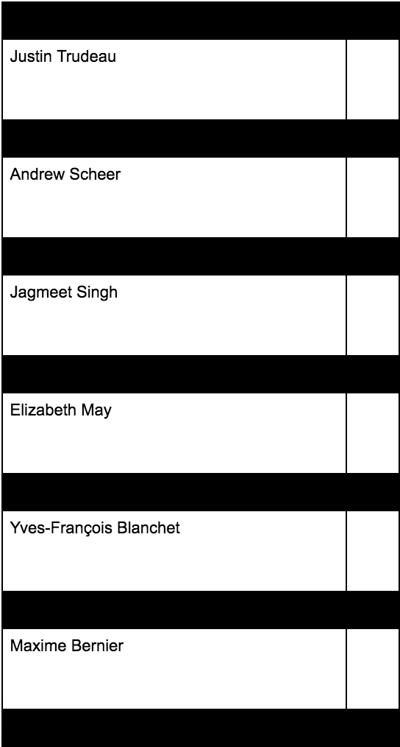
Sample ballot template designed
for the purposes of this task

Slide 8
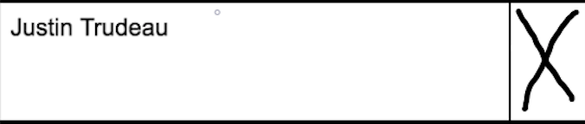
Data Generation and Image Segmentation
Candidate with vote:
Segment the ballot into individual rows (one per candidate). The row contains the candidate and their corresponding vote.
Segment the row into two parts: the candidate section and the vote section.
Candidate section is used for text recognition and the vote section is passed into the neural network which classifies it as valid or invalid.
Candidate section:
Vote section:

Slide 9
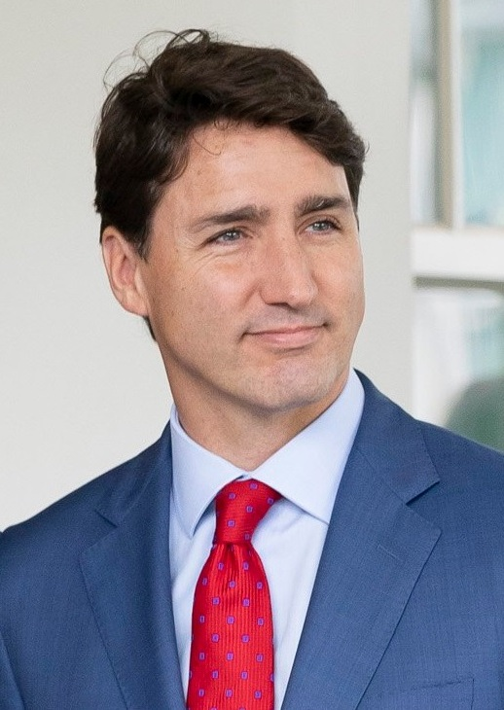

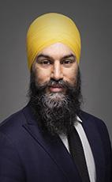
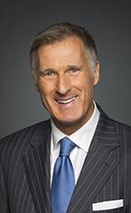

Template Matching and Text Recognition
Justin Trudeau
Andrew Scheer
Jagmeet Singh
Maxime Bernier
Elizabeth May
Use custom candidate name templates in our template matching algorithm
The algorithm slides the template over the image, assigns scores using normalized cross correlation and reports the highest score
The template with the highest score represents the candidate in the corresponding candidate section

Slide 10




Data Augmentation
Valid votes are represented by distinct crosses (‘X’) and must fall within the designated boundaries.
Valid votes were augmented to enlarge the data set for training purposes (eg. blur)
Invalid votes do not conform the criteria of valid votes (eg. checkmarks, initials, numbers).
Invalid votes were augmented to enlarge the data set for training purposes (eg. flip)

Slide 11
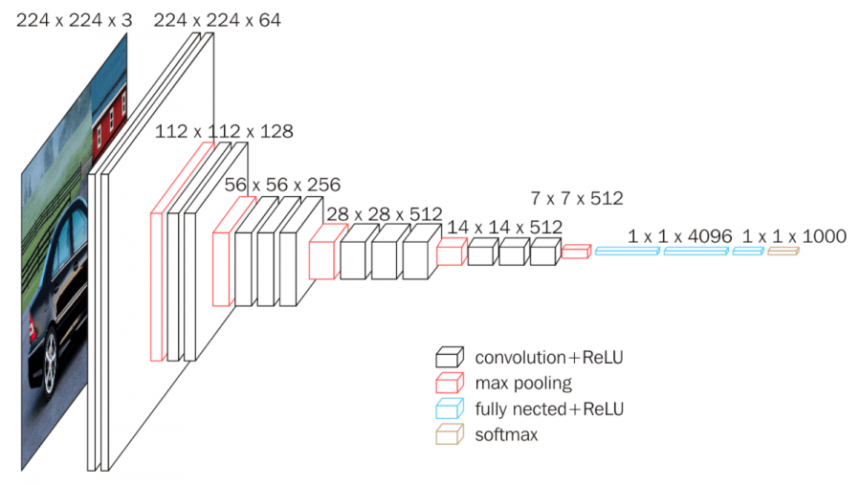
Neural Network
VGG16
The pretrained network we used for transfer learning
Convolutional Neural Network
Classifies images

Slide 12
Neural Network
model.compile()
model.add(layers.Dense())
optimizer='adam’
loss='binary_crossentropy’
metrics=['acc']
Sigmoid layer
1, activation='sigmoid'
model.add(layers.Dense())
model = models.Sequential()
Classification layer
1024, activation='relu'
Take features received from the VGG16 network
Apply a dense layer as classification layer
Use sigmoid to make prediction between 0 and 1
inputs=model.inputs
outputs=model.layers[-1].output
model = VGG16()
model = model.layers.pop()
Extract features from the image
Load external model for transfer learning and remove its last classification layer

Slide 13
3
Results

Slide 14

Demo
The following live demonstration will consist of a voting simulation, in which 5 votes are casted for 6 candidates. The winner of the election will be displayed at the end.

Slide 15
4
Comparisons

Slide 16
Comparisons
Method 1
Method 2
Method 3
Best
2nd best
3rd best
Point 1
Point 1
Point 1
Point 2
Point 2
Point 2
Point 3
Point 3
Point 3
Point 4
Point 4
Point 4
At qui zril phaedrum vituperatoribus, clita scriptorem id mea. Adhuc laudem soluta vix in, usu in prodesset philosophia. In oblique dolorem mei. Est commodo ullamcorper ne, idque decore utroque per ex, at nam illum summo doctus.

Slide 17
Comparisons
98%
80%
43%
Method 1
Method 2
Method 3
Accusamus torquatos eos ne, ex eum vero zril, qui atqui homero ea. Et iusto ponderum vim.
Pro dicunt albucius eligendi an, has volumus omittam contentiones at. Facilis dissentias et per.
Nec summo discere no, cum quod graeco ei. Has debitis tibique periculis ne, vix sensibus referrentur no.

Slide 18
5
Course Coverage

Slide 19
Course Coverage
Linear Filtering
Topic #1
Convolution (Gaussian filter, Sobel filter)
Normalized cross correlation for template matching
Topic #2
Edges
Edge detection for image segmentation
Deep Learning
Topic #3
Data augmentation
Neural networks
Transfer learning

Slide 20
6
Contributions

Slide 21


Contributions
Farzan Haq
Data generation
Image segmentation (via edge detection)
Neural network (data augmentation, initialization, debugging)
Usama Zaki
Data generation
Text recognition (via template matching)
Neural network (transfer learning, hyperparameter tuning, debugging)

Slide 22
Thank you!

