Slide 1
Water storage change across Thailand
Climate reconstruction and the limits of human attribution
Farzeen Khan
MS in Water Engineering and Management
Asian Institute of Technology
Advisor: Dr. Natthachet Tangdamrongsub
Notes:
Source: verified Thailand extended study, report and basin/forcing appendix.
Main research presentation.

Slide 2
Research focus
How are total and groundwater storage changing across Thailand’s 22 principal basins?
How much of the observed change can the climate baseline explain?
How strongly do independent observations support the remaining residual?
Introduction
2 / 35
Notes:
Source: verified Thailand extended study, report and basin/forcing appendix.
Main research presentation.

Slide 3
Research objectives
Objective | Output
1 Storage change | Monthly TWSA/GWSA, Sen slopes and Mann–Kendall tests
2 Climate and residual | Climate reconstruction, GLDAS benchmark and observation checks
3 Decision support | Interactive basin app, input data and reproducible code
Introduction
3 / 35
Notes:
Source: verified Thailand extended study, report and basin/forcing appendix.
Main research presentation.

Slide 4
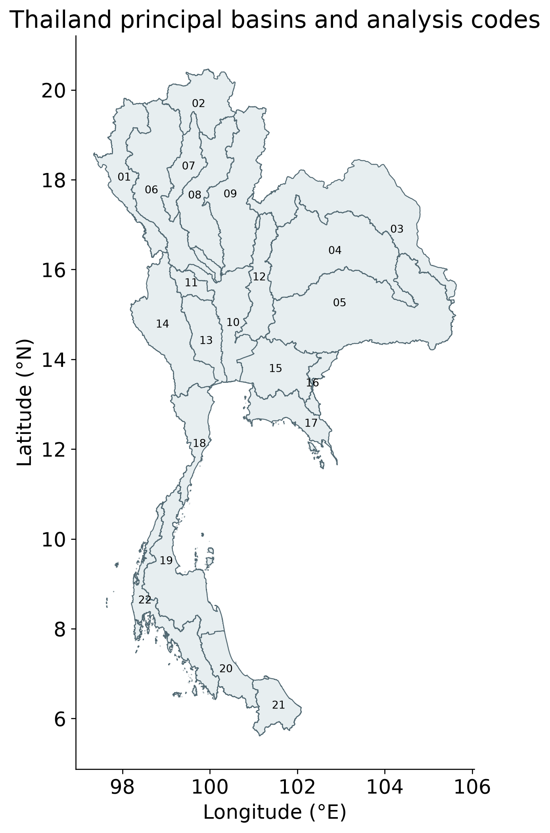
Thailand’s 22 principal basins
Official ONWR reporting framework
GRACE information extends across basin boundaries
All basin tables retain coverage and uncertainty
ONWR principal-basin geometry. Reporting units do not imply independent GRACE observations.
Study design
4 / 35
Notes:
ONWR principal-basin geometry. Reporting units do not imply independent GRACE observations.
Source: verified Thailand extended study, report and basin/forcing appendix.
Main research presentation.

Slide 5
Data and scientific roles
Record | Role
CSR RL06.3 GRACE/GRACE-FO | Observed total storage
GLDAS Noah and G3P | Non-groundwater storage compartments
Paired WaterGAP simulations | Naturalized and historical-human baselines
Native P/PET and CHIRPS | Weather reconstruction and rainfall sensitivity
Thai wells and MSEA-Res | Groundwater and reservoir consistency evidence
Primary TWSA: April 2002–September 2024. Derived GWSA: April 2002–September 2023.
Study design
5 / 35
Notes:
Primary TWSA: April 2002–September 2024. Derived GWSA: April 2002–September 2023.
Source: verified Thailand extended study, report and basin/forcing appendix.
Main research presentation.

Slide 6
Analysis workflow
Harmonize monthly units, dates, area weights and the 2004–2009 reference
Calculate GWSA and estimate storage trends
Reconstruct naturalized storage using weather and climate memory
Calculate the residual, examine uncertainty and compare independent observations
Methodology
6 / 35
Notes:
Source: verified Thailand extended study, report and basin/forcing appendix.
Main research presentation.

Slide 7
Groundwater storage balance
GWSA = TWSA − SMSA − SWSA − CWSA − SWEA
Subtract soil, surface, canopy and snow storage anomalies
Use common valid cells and a common reference period
Groundwater uncertainty includes every subtracted compartment
Storage anomalies use mm of equivalent water depth. Snow is small in Thailand but retained consistently.
Methodology
7 / 35
Notes:
Storage anomalies use mm of equivalent water depth. Snow is small in Thailand but retained consistently.
Source: verified Thailand extended study, report and basin/forcing appendix.
Main research presentation.

Slide 8
Naturalized and historical simulations
Symbol | Meaning
O | Observed or compartment-derived storage
C | Naturalized WaterGAP baseline
A | Historical WaterGAP with represented human activities
Paired simulations share model structure and forcing. The naturalized baseline remains a model experiment.
Methodology
8 / 35
Notes:
Paired simulations share model structure and forcing. The naturalized baseline remains a model experiment.
Source: verified Thailand extended study, report and basin/forcing appendix.
Main research presentation.

Slide 9
Residual accounting
R = O − C = (A − C) + (O − A) = H + E
H describes the human effect represented by the paired model
E retains the observation–historical-model discrepancy
The primary residual uses the published naturalized baseline
The statistical emulator reconstructs C from weather. Its prediction does not replace C in the primary residual.
Methodology
9 / 35
Notes:
The statistical emulator reconstructs C from weather. Its prediction does not replace C in the primary residual.
Source: verified Thailand extended study, report and basin/forcing appendix.
Main research presentation.

Slide 10
Chronological model evaluation
Period | Years | Use
Warm-up | 1981–1990 | Initialize climate memory
Training | 1991–2009 | Fit transformations and tune models
Validation | 2010–2015 | Freeze model selection
Test | 2016–2023 | Evaluate unseen years
Ridge, Elastic Net, splines and Random Forest. Predictors exclude GRACE and groundwater observations.
Methodology
10 / 35
Notes:
Ridge, Elastic Net, splines and Random Forest. Predictors exclude GRACE and groundwater observations.
Source: verified Thailand extended study, report and basin/forcing appendix.
Main research presentation.

Slide 11
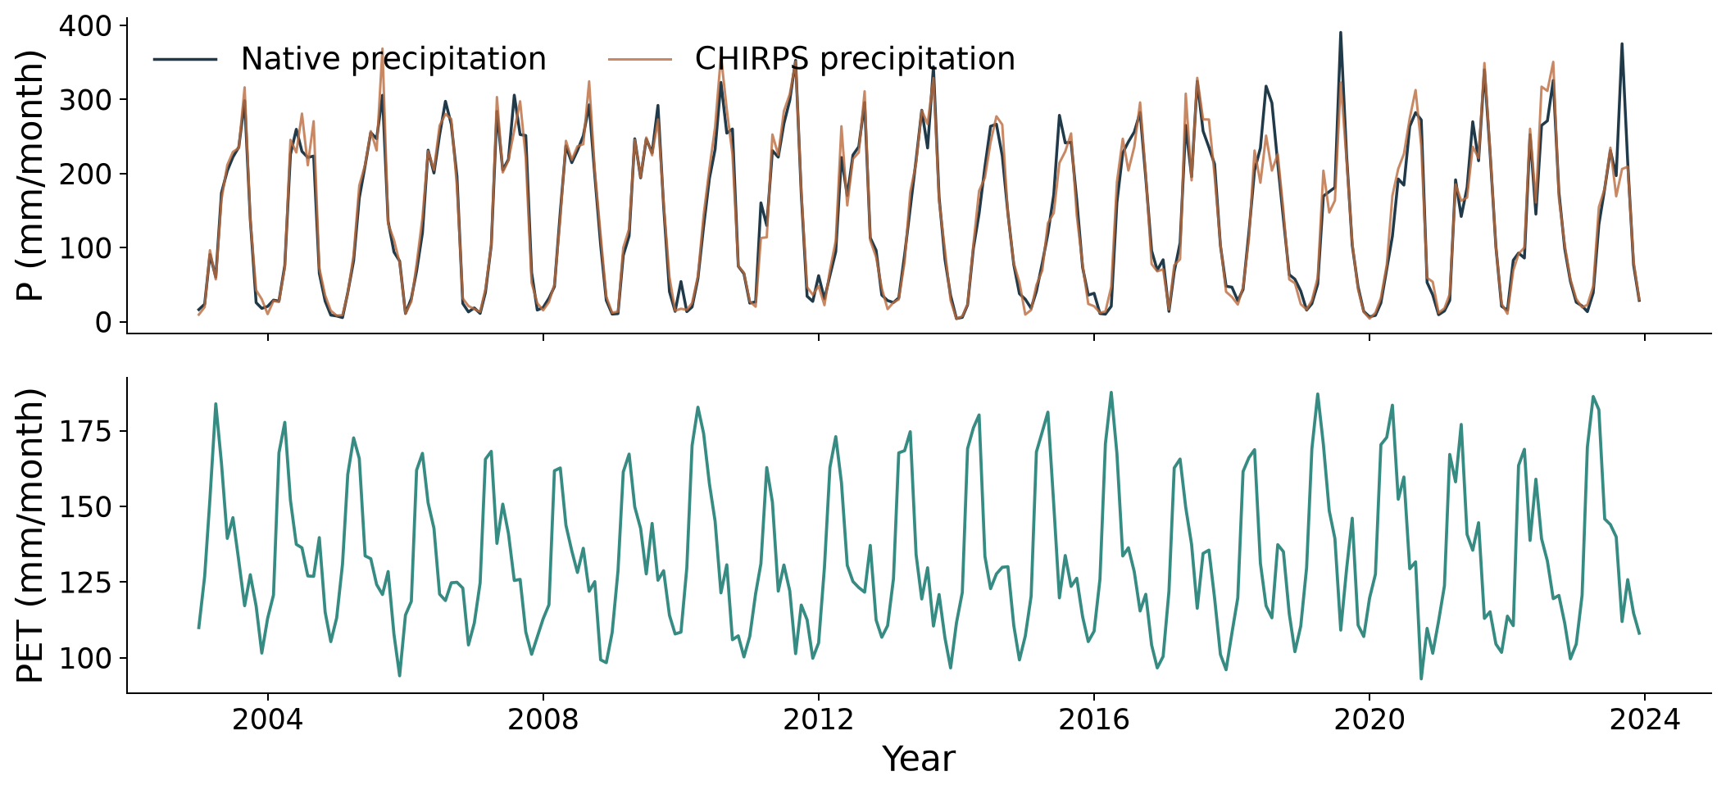
Precipitation and potential ET
National monthly values, 2003–2023. Native P/PET drive reconstruction. CHIRPS supplies the rainfall replacement test.
Climate forcing
11 / 35
Notes:
National monthly values, 2003–2023. Native P/PET drive reconstruction. CHIRPS supplies the rainfall replacement test.
Source: verified Thailand extended study, report and basin/forcing appendix.
Main research presentation.

Slide 12
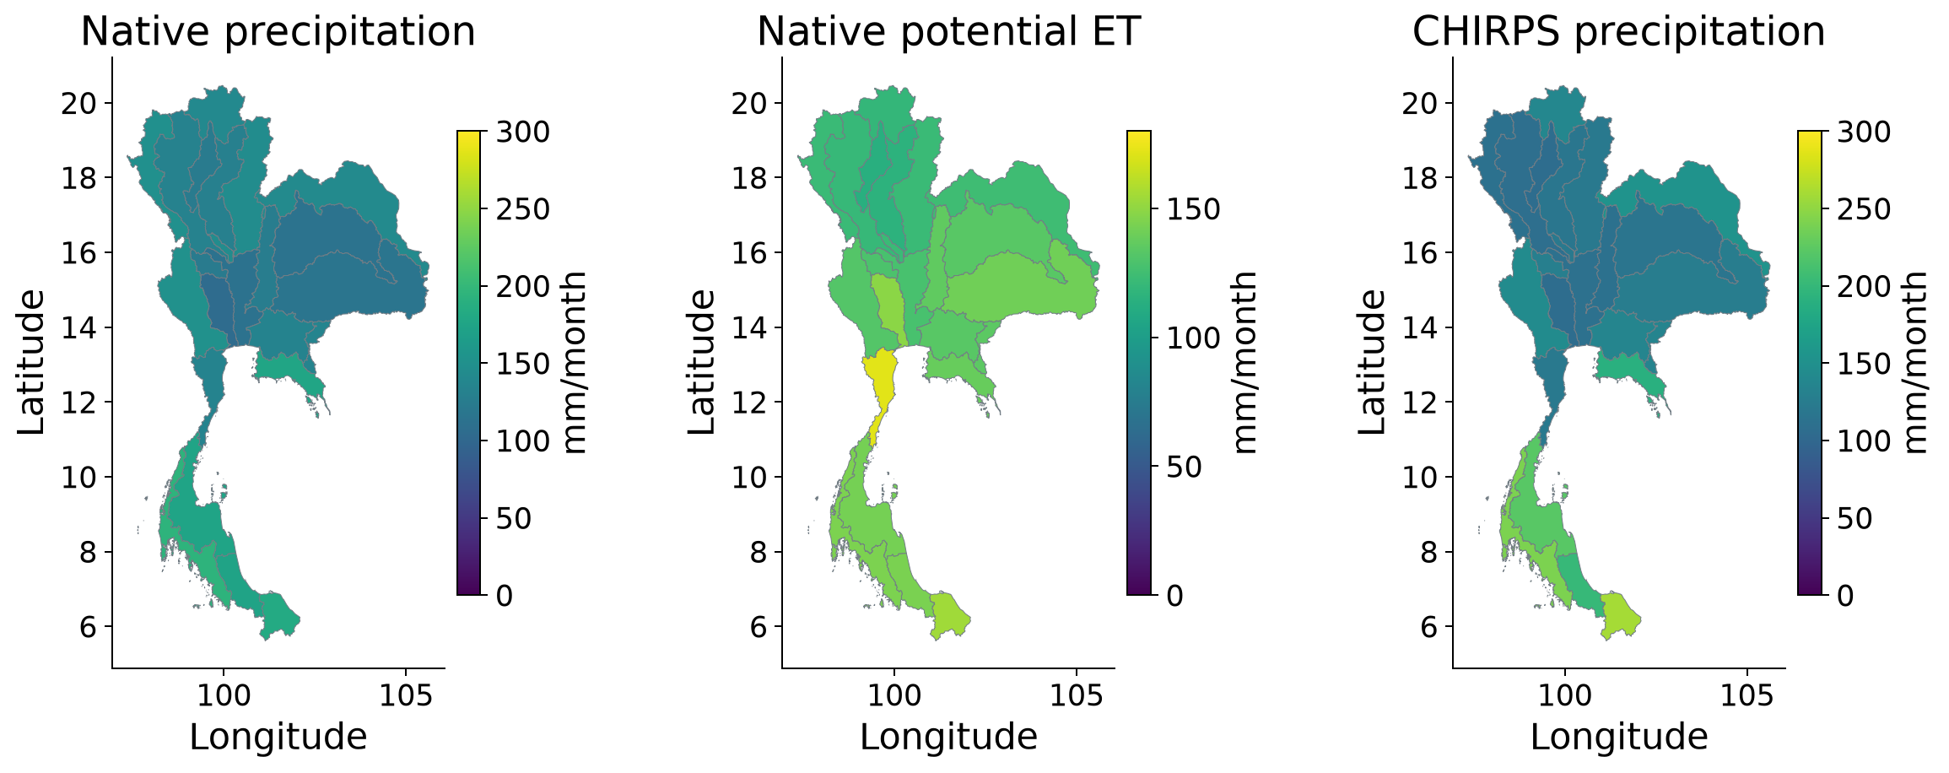
Spatial distribution of the meteorological inputs
Available-month basin means, 2003–2023. Values are mm/month, not annual totals. Each map uses its labelled scale.
Climate forcing
12 / 35
Notes:
Available-month basin means, 2003–2023. Values are mm/month, not annual totals. Each map uses its labelled scale.
Source: verified Thailand extended study, report and basin/forcing appendix.
Main research presentation.

Slide 13
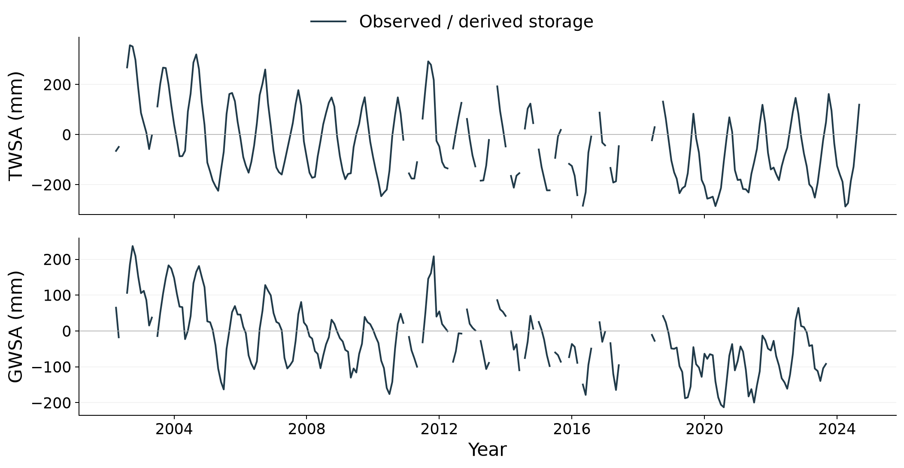
Observed storage through time
National CSR TWSA and compartment-derived GWSA. Missing months remain gaps. Groundwater ends earlier because of compartment availability.
Objective 1
13 / 35
Notes:
National CSR TWSA and compartment-derived GWSA. Missing months remain gaps. Groundwater ends earlier because of compartment availability.
Source: verified Thailand extended study, report and basin/forcing appendix.
Main research presentation.

Slide 14
National storage decline
Storage | Sen slope (mm/year) | Conditional 95% interval
Total storage | −7.51 | −9.79 to −5.68
Groundwater storage | −6.84 | −8.77 to −5.11
237 TWSA months through September 2024; 225 GWSA months through September 2023. Full-record seasonal Sen slopes.
Objective 1
14 / 35
Notes:
237 TWSA months through September 2024; 225 GWSA months through September 2023. Full-record seasonal Sen slopes.
Source: verified Thailand extended study, report and basin/forcing appendix.
Main research presentation.

Slide 15
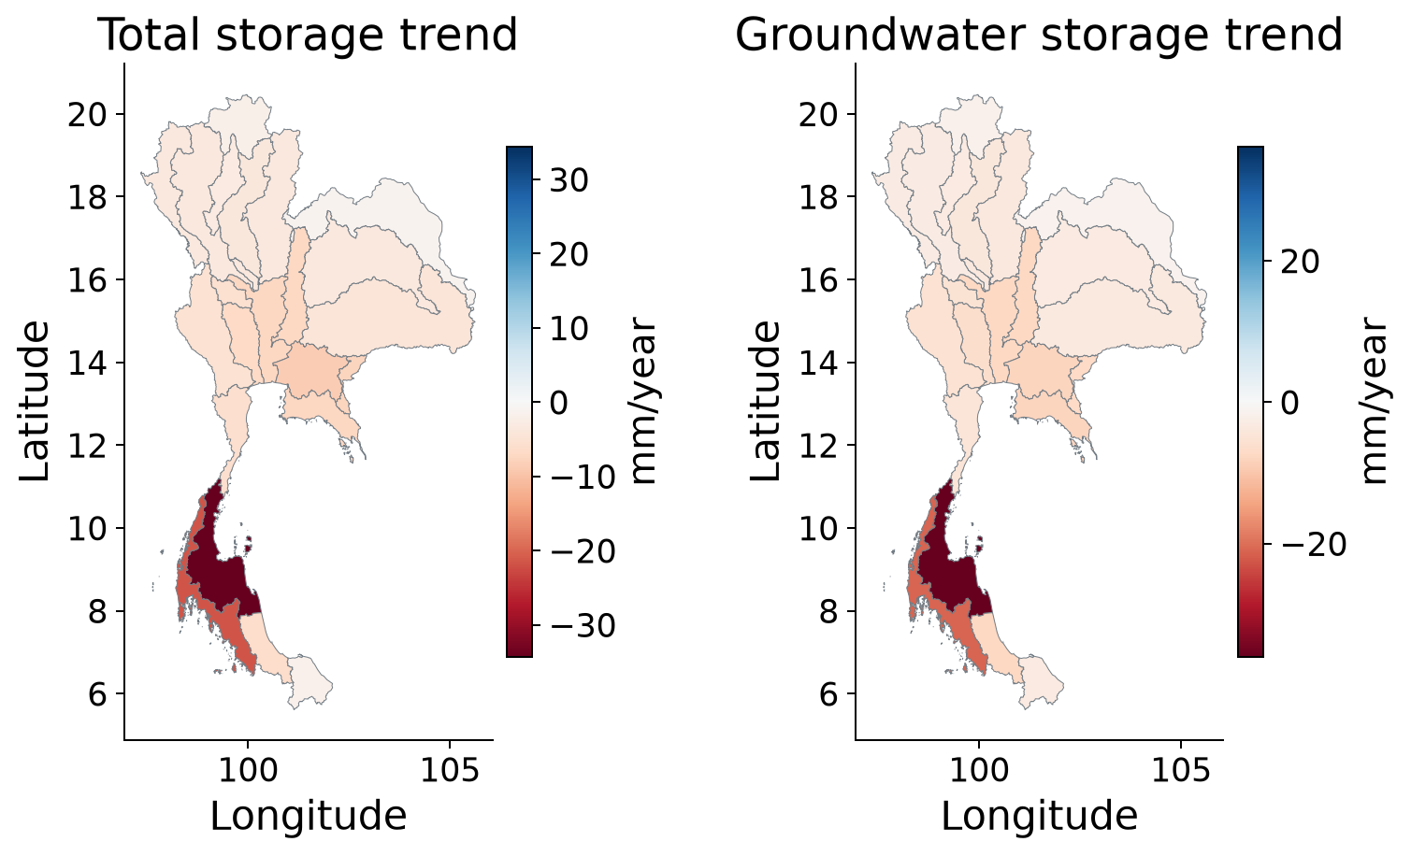
Storage trend patterns across basins
Seasonal Sen slopes. Negative values indicate decline. All basins retain the CSR small-area caution.
Objective 1
15 / 35
Notes:
Seasonal Sen slopes. Negative values indicate decline. All basins retain the CSR small-area caution.
Source: verified Thailand extended study, report and basin/forcing appendix.
Main research presentation.

Slide 16
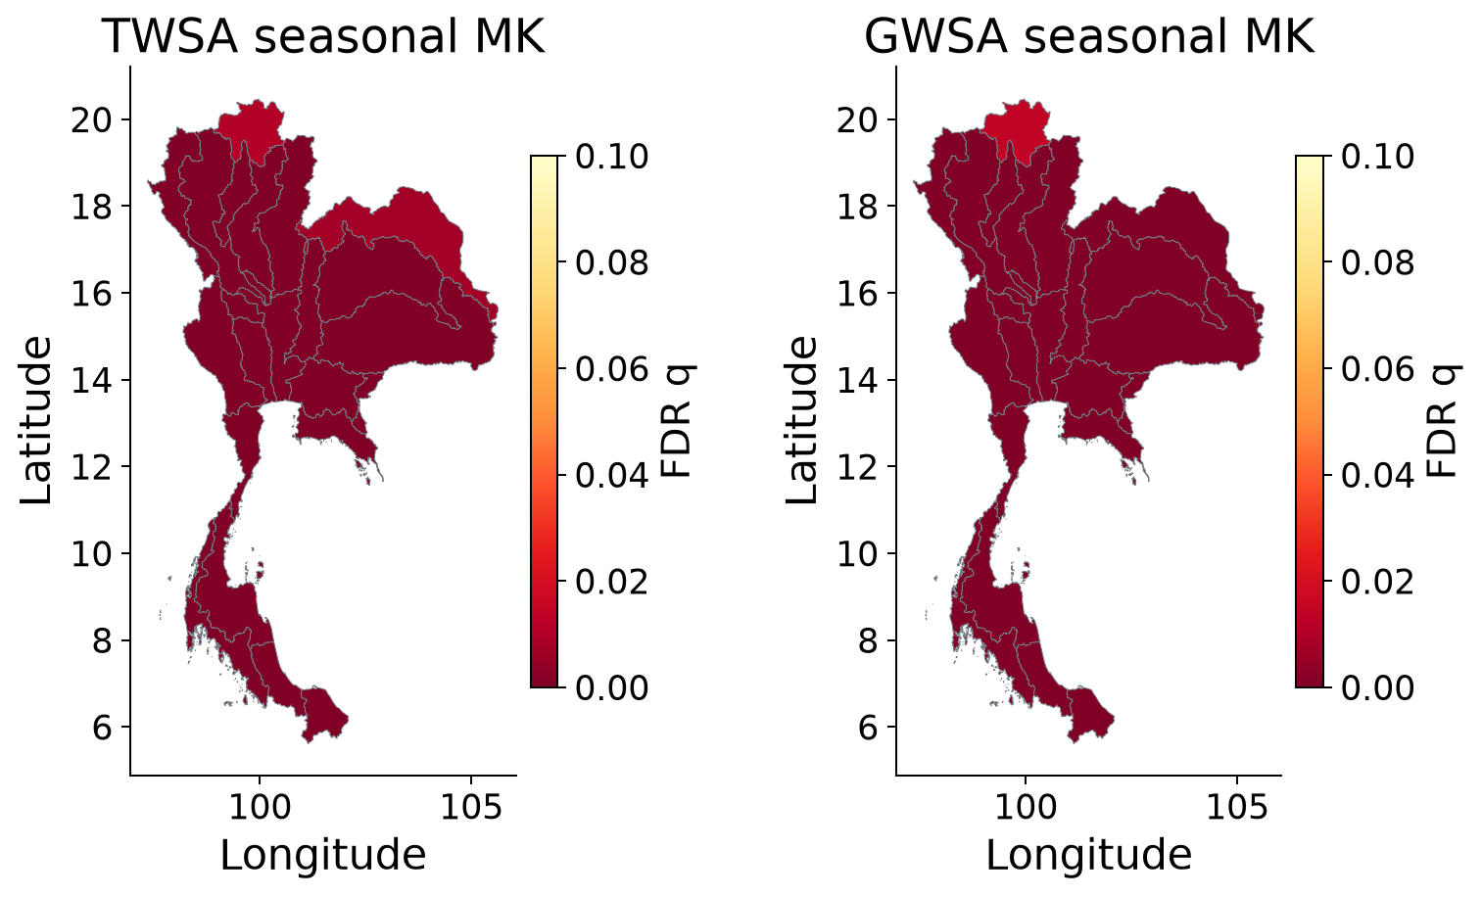
Statistical evidence for basin trends
Seasonal Mann–Kendall with basin FDR. Colours saturate at q = 0.10. This test does not remove serial dependence or product uncertainty.
Objective 1
16 / 35
Notes:
Seasonal Mann–Kendall with basin FDR. Colours saturate at q = 0.10. This test does not remove serial dependence or product uncertainty.
Source: verified Thailand extended study, report and basin/forcing appendix.
Main research presentation.

Slide 17
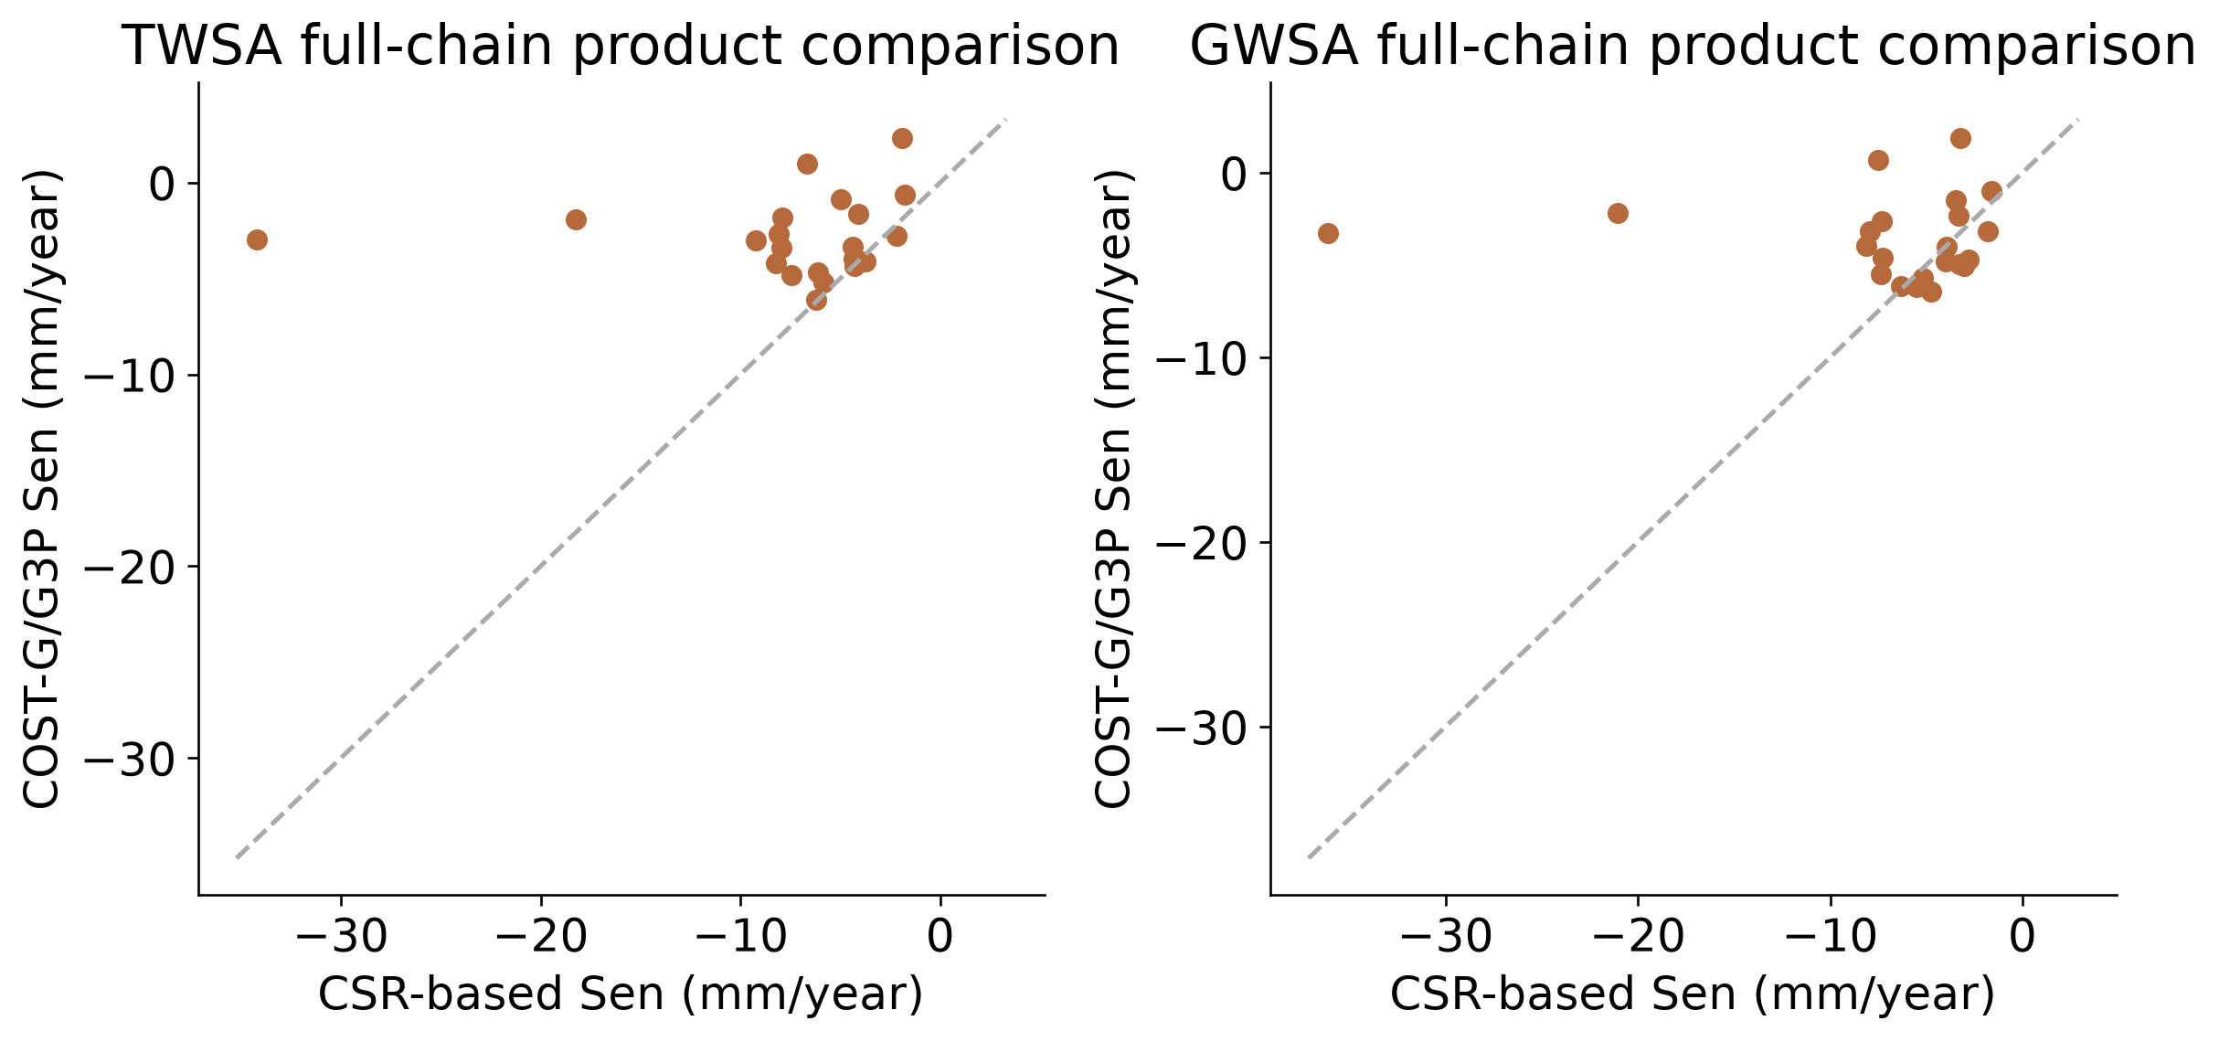
Basin ranking depends on the processing chain
Common-date rank correlations: TWSA 0.138 and GWSA 0.027. Groundwater chains also differ in compartment processing.
Objective 1
17 / 35
Notes:
Common-date rank correlations: TWSA 0.138 and GWSA 0.027. Groundwater chains also differ in compartment processing.
Source: verified Thailand extended study, report and basin/forcing appendix.
Main research presentation.

Slide 18
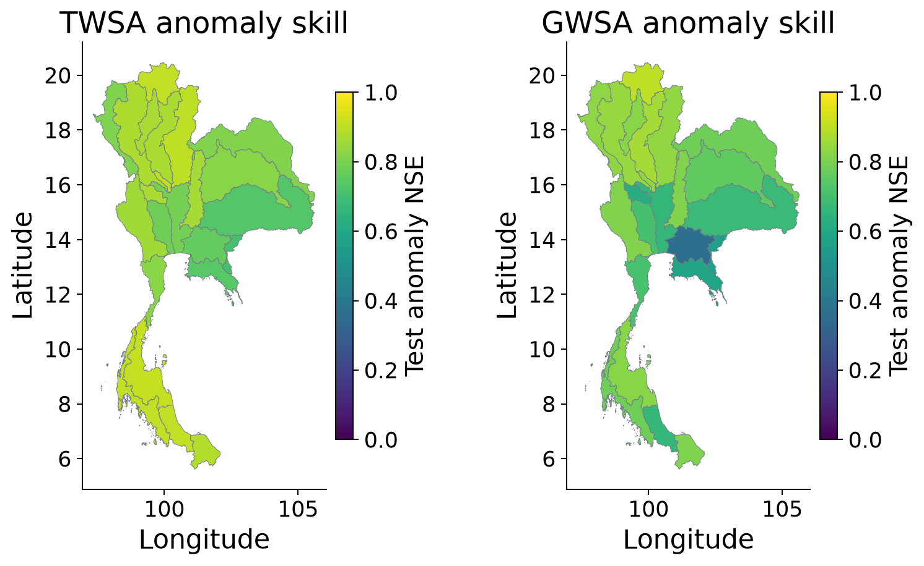
Climate reconstruction performance
Ensemble test anomaly NSE against naturalized WaterGAP, 2016–2023. High scores verify reconstruction of the parent model.
Objective 2
18 / 35
Notes:
Ensemble test anomaly NSE against naturalized WaterGAP, 2016–2023. High scores verify reconstruction of the parent model.
Source: verified Thailand extended study, report and basin/forcing appendix.
Main research presentation.

Slide 19
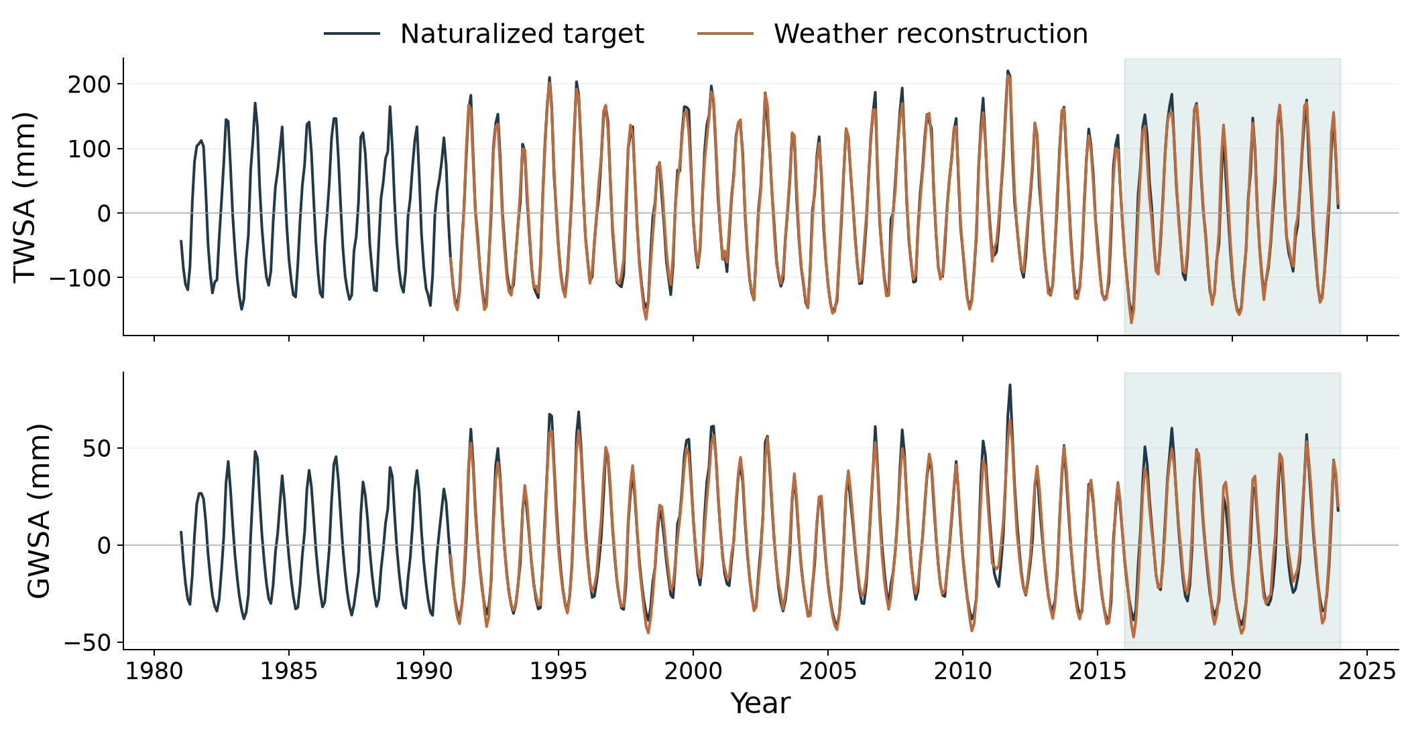
Naturalized storage and weather reconstruction
National series. Training: 1991–2009; validation: 2010–2015; test: 2016–2023. Parent-model agreement is distinct from observational validation.
Objective 2
19 / 35
Notes:
National series. Training: 1991–2009; validation: 2010–2015; test: 2016–2023. Parent-model agreement is distinct from observational validation.
Source: verified Thailand extended study, report and basin/forcing appendix.
Main research presentation.

Slide 20
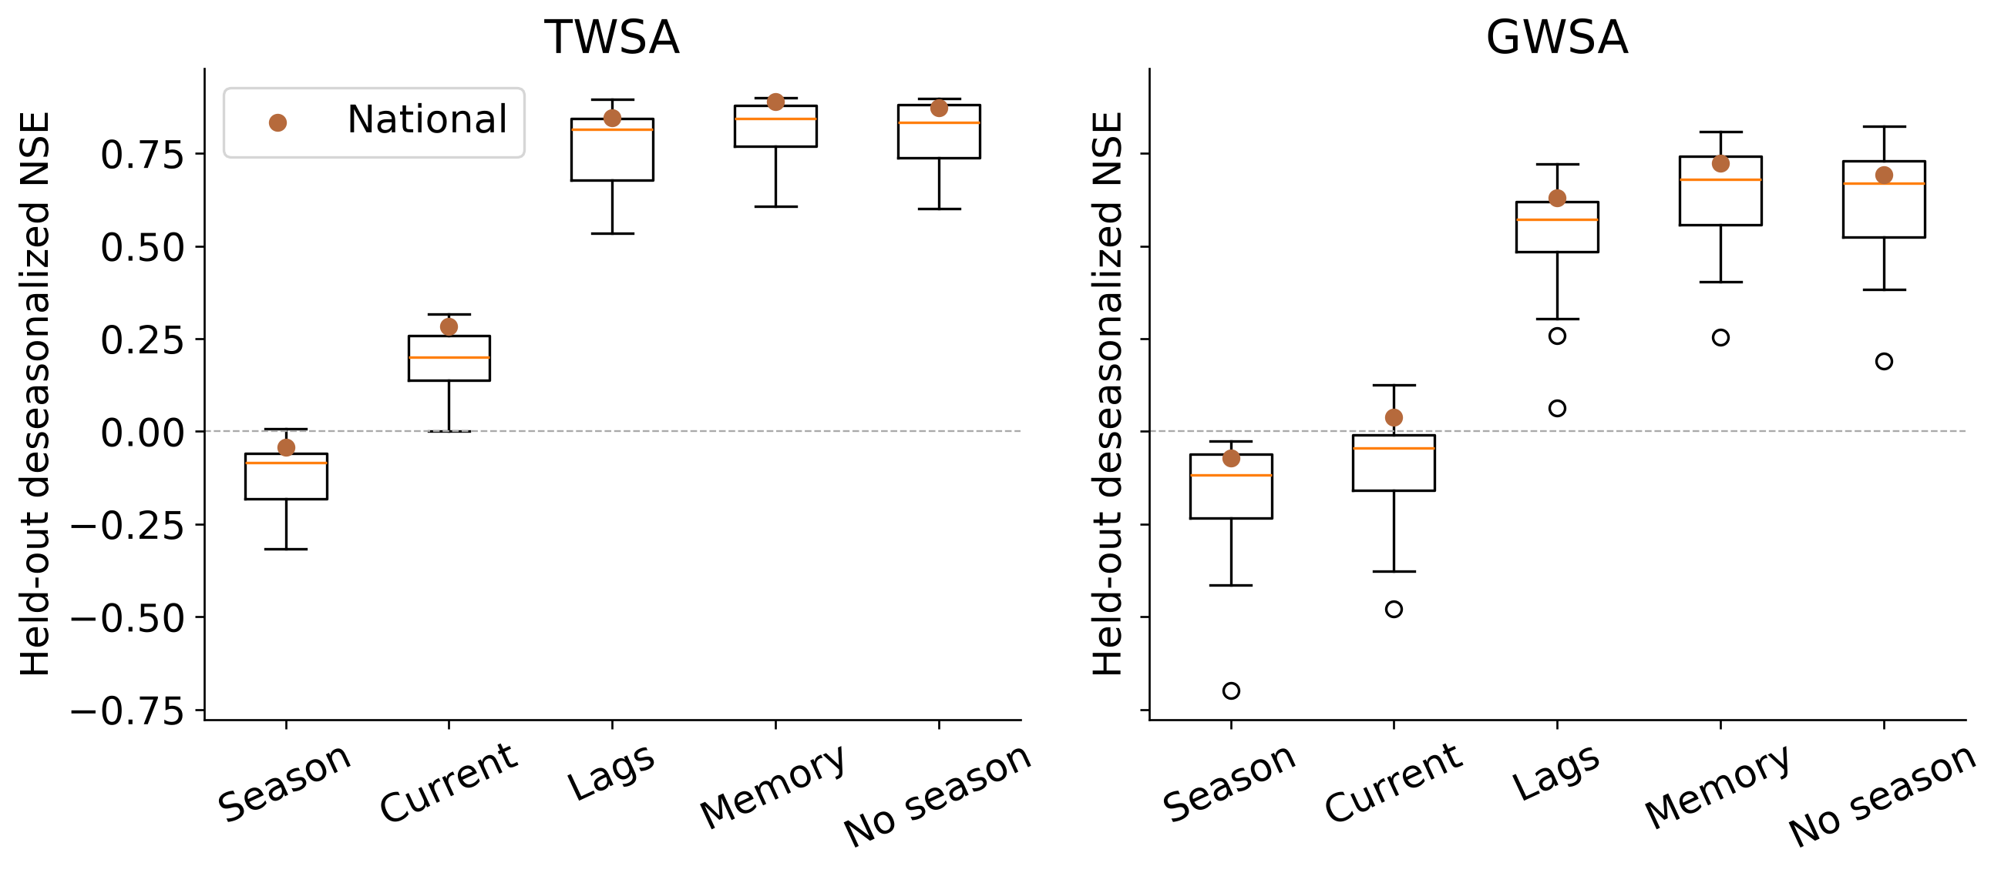
Climate memory improves reconstruction
Controlled Ridge experiment. National test anomaly NSE: current weather / memory = 0.283 / 0.890 for TWSA and 0.039 / 0.723 for GWSA.
Objective 2
20 / 35
Notes:
Controlled Ridge experiment. National test anomaly NSE: current weather / memory = 0.283 / 0.890 for TWSA and 0.039 / 0.723 for GWSA.
Source: verified Thailand extended study, report and basin/forcing appendix.
Main research presentation.

Slide 21
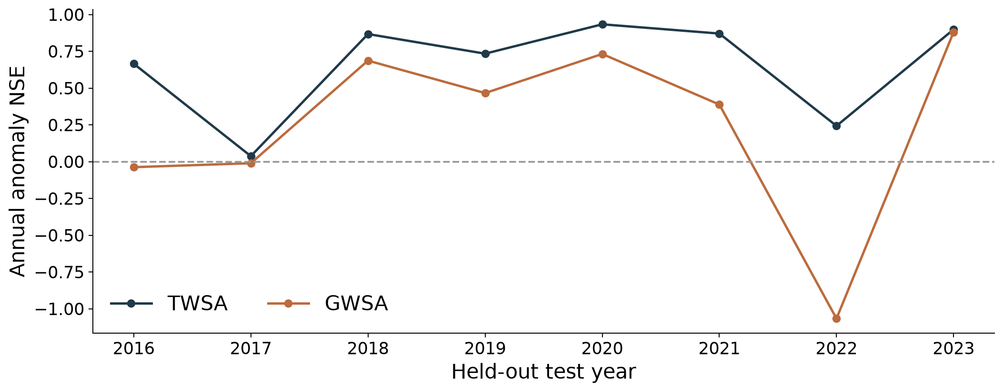
Performance varies between test years
2022 national anomaly NSE: TWSA 0.234; GWSA −1.067. Negative NSE indicates performance below the mean benchmark.
Objective 2
21 / 35
Notes:
2022 national anomaly NSE: TWSA 0.234; GWSA −1.067. Negative NSE indicates performance below the mean benchmark.
Source: verified Thailand extended study, report and basin/forcing appendix.
Main research presentation.

Slide 22
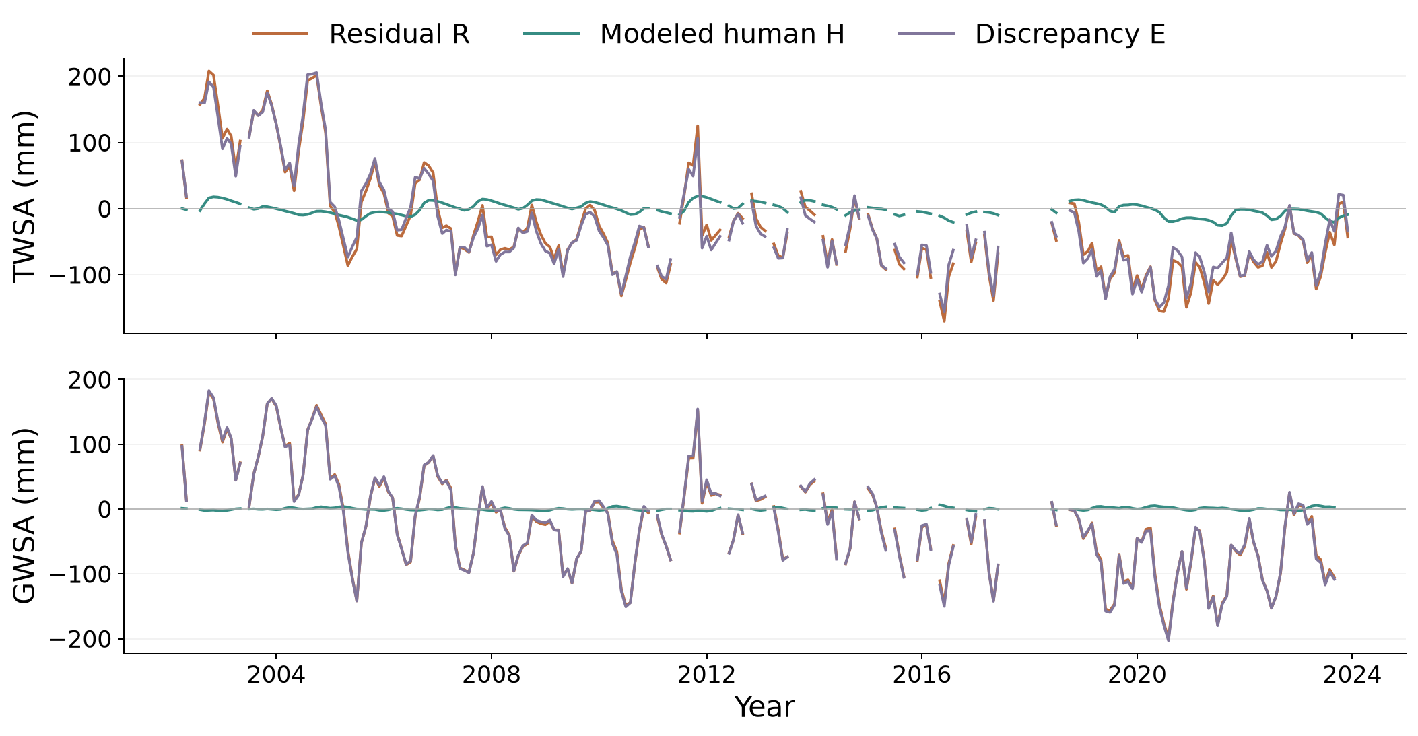
Residual and modeled human effects differ
R = H + E on common observed months. The remaining discrepancy includes unresolved model and observation errors.
Objective 2
22 / 35
Notes:
R = H + E on common observed months. The remaining discrepancy includes unresolved model and observation errors.
Source: verified Thailand extended study, report and basin/forcing appendix.
Main research presentation.

Slide 23
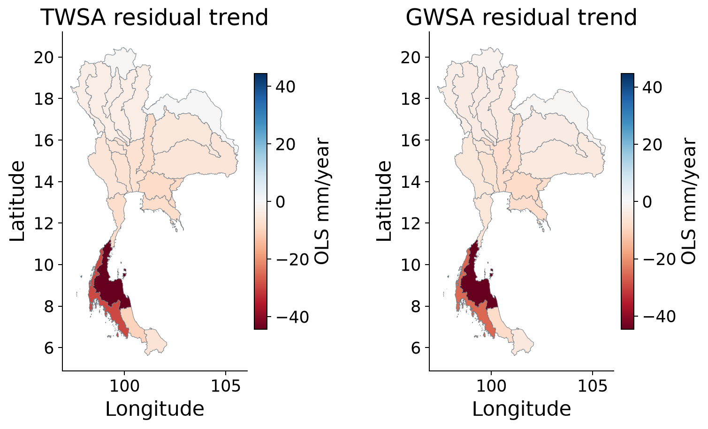
Spatial residual trends
Calendar-month fixed-effect OLS slopes on matched support. These slopes describe residual change and do not measure pumping.
Objective 2
23 / 35
Notes:
Calendar-month fixed-effect OLS slopes on matched support. These slopes describe residual change and do not measure pumping.
Source: verified Thailand extended study, report and basin/forcing appendix.
Main research presentation.

Slide 24
Additive national trend partition
Component | TWSA | GWSA
Observed O | -8.36 | -7.28
Naturalized C | -0.54 | -0.21
Modeled human H | -0.49 | 0.06
Residual R | -7.81 | -7.07
Discrepancy E | -7.32 | -7.13
OLS slopes, mm/year, using the same months. R = H + E. Seasonal Sen slopes are reported separately because their medians are not additive.
Objective 2
24 / 35
Notes:
OLS slopes, mm/year, using the same months. R = H + E. Seasonal Sen slopes are reported separately because their medians are not additive.
Source: verified Thailand extended study, report and basin/forcing appendix.
Main research presentation.

Slide 25
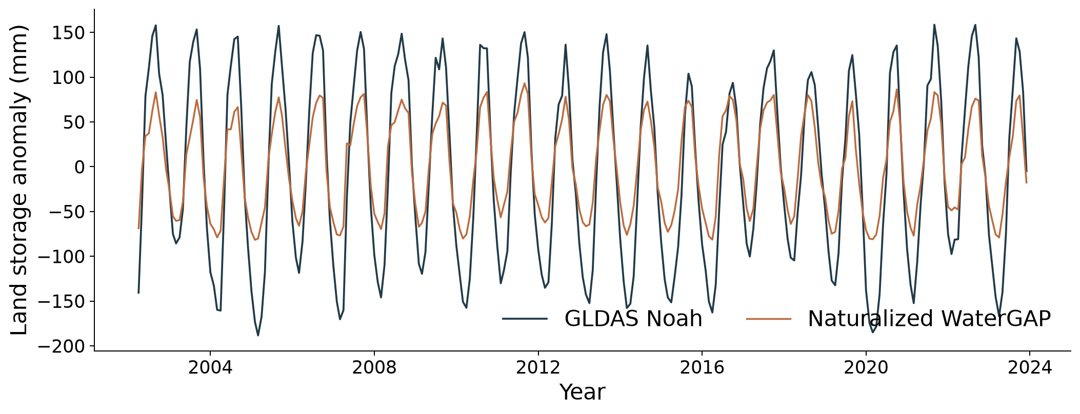
GLDAS comparison on matching compartments
Soil + canopy + snow only. National r = 0.969, NSE = 0.738, RMSE = 52.49 mm across 261 months. Groundwater and surface water are excluded.
Evaluation
25 / 35
Notes:
Soil + canopy + snow only. National r = 0.969, NSE = 0.738, RMSE = 52.49 mm across 261 months. Groundwater and surface water are excluded.
Source: verified Thailand extended study, report and basin/forcing appendix.
Main research presentation.

Slide 26
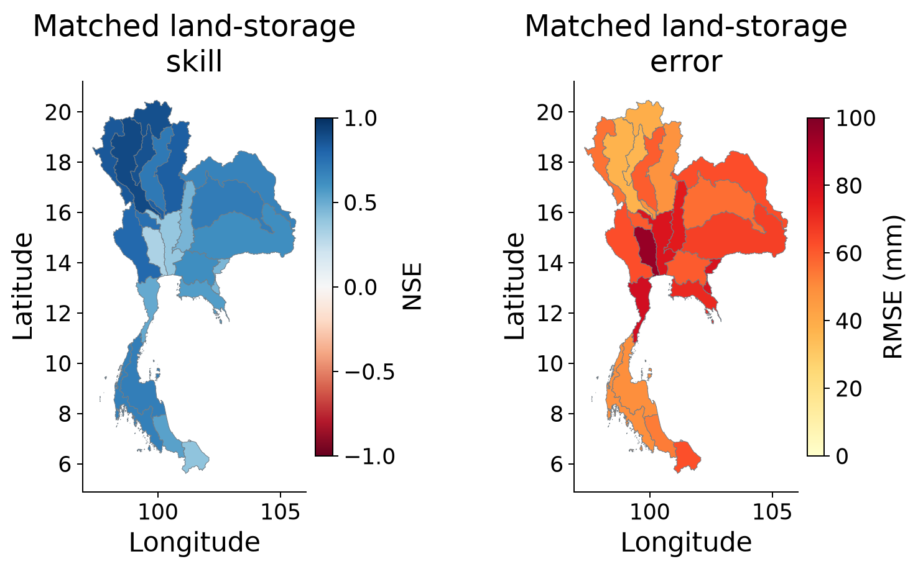
GLDAS agreement varies among basins
Matched land-storage benchmark. NSE colours saturate below −1 and RMSE above 100 mm. GLDAS also contributes to the groundwater subtraction.
Evaluation
26 / 35
Notes:
Matched land-storage benchmark. NSE colours saturate below −1 and RMSE above 100 mm. GLDAS also contributes to the groundwater subtraction.
Source: verified Thailand extended study, report and basin/forcing appendix.
Main research presentation.

Slide 27
Groundwater level and storage use different units
Observation | What the comparison establishes
Groundwater head or depth (m) | Local aquifer response and direction
Regional storage anomaly (mm) | Water-mass change over a basin
Paired annual correlation | Agreement in timing on observed years
A head-to-storage conversion requires aquifer storage coefficients and representative areas. Those inputs are unavailable here.
Evaluation
27 / 35
Notes:
A head-to-storage conversion requires aquifer storage coefficients and representative areas. Those inputs are unavailable here.
Source: verified Thailand extended study, report and basin/forcing appendix.
Main research presentation.

Slide 28
Well selection changes residual agreement
Station panel | TWS r | GWS r | GWS years
Longest overlap | 0.127 | 0.037 | 17
Fixed eligibility / wider history | 0.657 | 0.511 | 17
Common period | 0.325 | 0.029 | 8
Strictly balanced | 0.305 | ≈0.000 | 8
511 wells provide 5,484 aggregates. Co-located wells are grouped. The common-period panels cover eight usable storage years within 2013–2022.
Evaluation
28 / 35
Notes:
511 wells provide 5,484 aggregates. Co-located wells are grouped. The common-period panels cover eight usable storage years within 2013–2022.
Source: verified Thailand extended study, report and basin/forcing appendix.
Main research presentation.

Slide 29
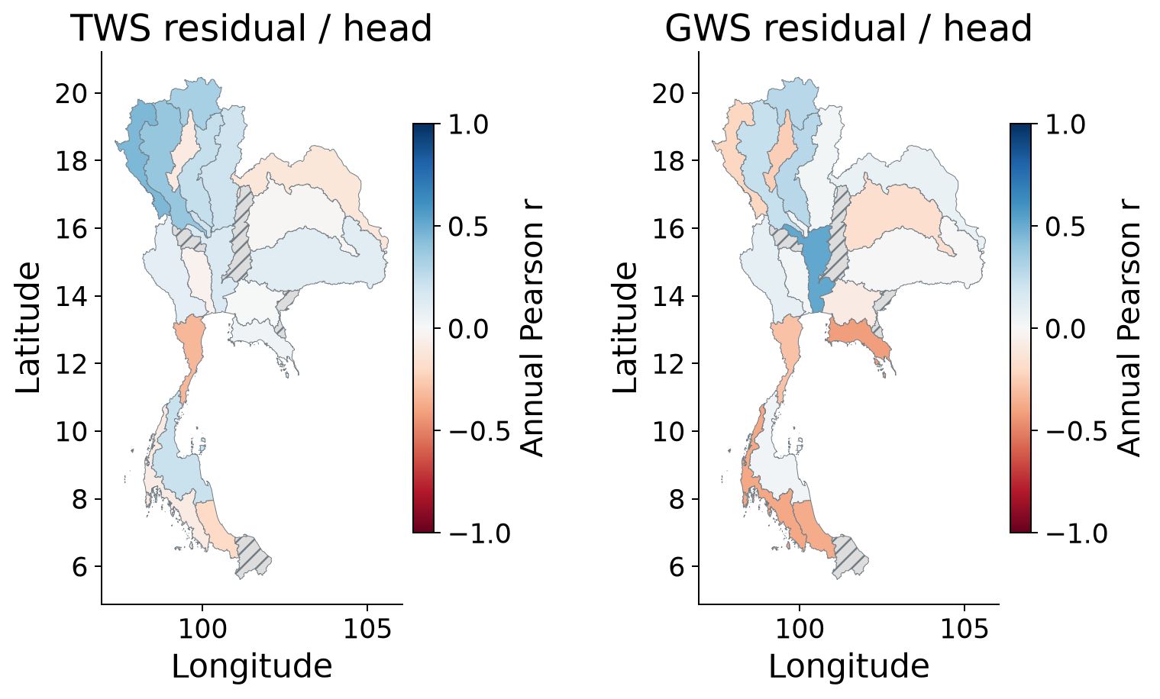
Spatial groundwater consistency
Residual–head correlations on available annual pairs. Grey hatching marks insufficient evidence. These comparisons cannot validate a human-only total.
Evaluation
29 / 35
Notes:
Residual–head correlations on available annual pairs. Grey hatching marks insufficient evidence. These comparisons cannot validate a human-only total.
Source: verified Thailand extended study, report and basin/forcing appendix.
Main research presentation.

Slide 30
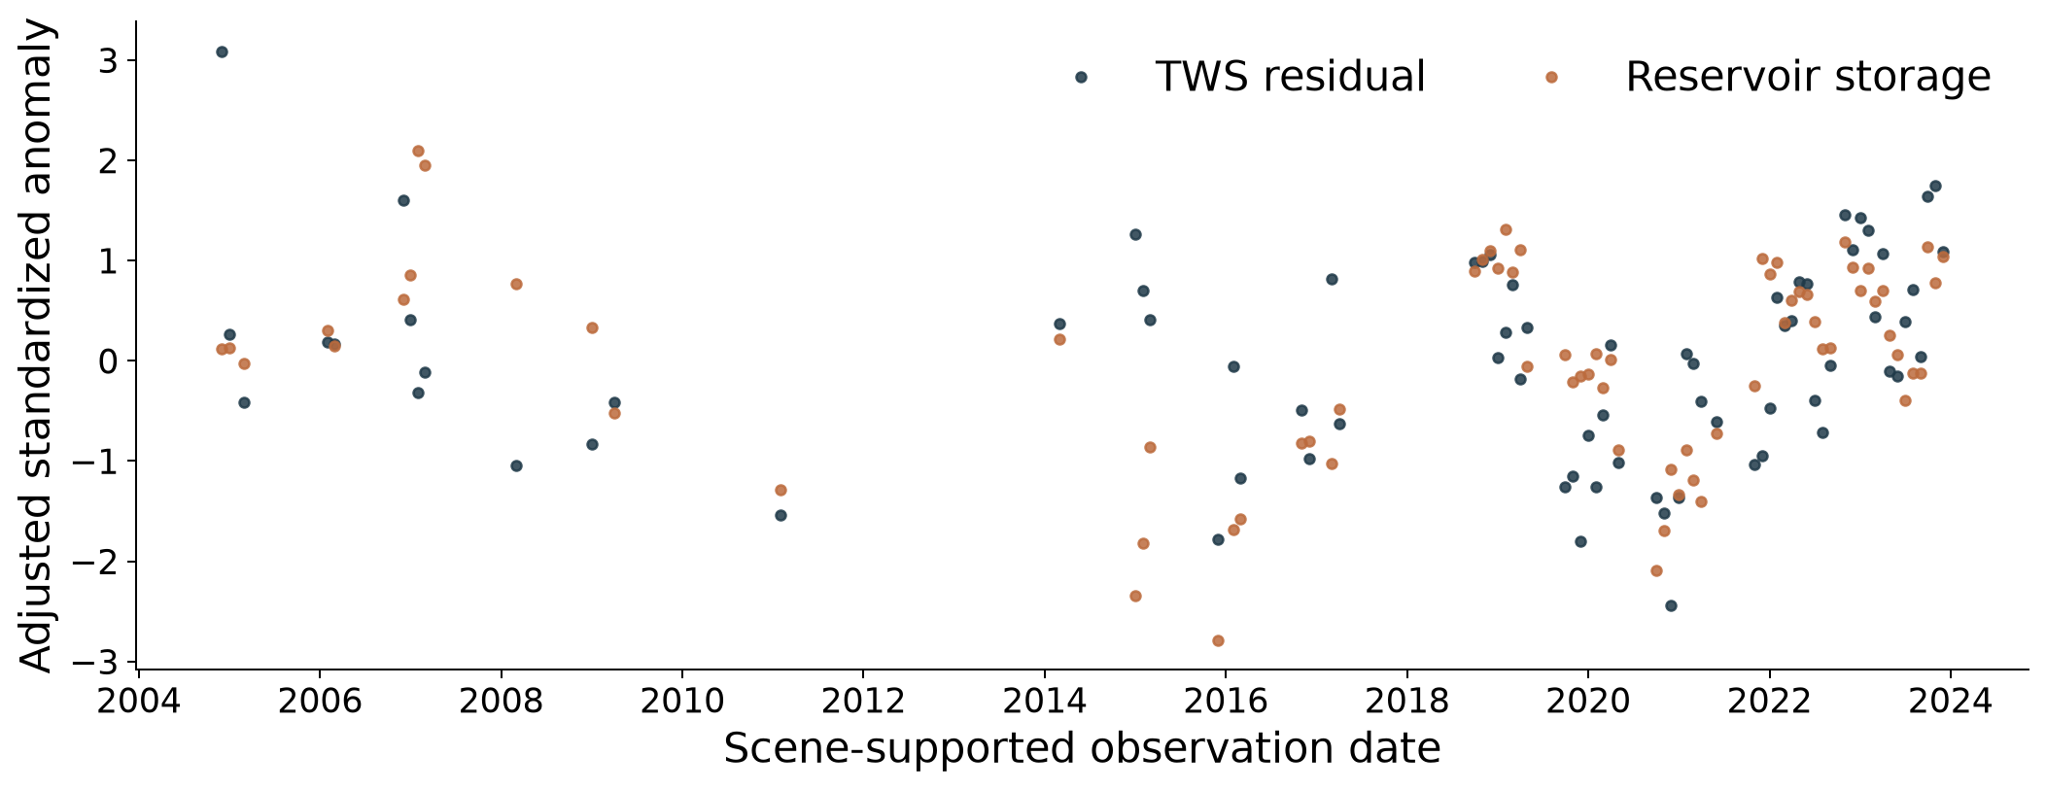
Independent reservoir evidence
26-reservoir fixed panel, 73 scene-supported months. Adjusted r = 0.439, year-cluster 95% interval 0.188–0.665. Both curves remove season and linear trend.
Evaluation
30 / 35
Notes:
26-reservoir fixed panel, 73 scene-supported months. Adjusted r = 0.439, year-cluster 95% interval 0.188–0.665. Both curves remove season and linear trend.
Source: verified Thailand extended study, report and basin/forcing appendix.
Main research presentation.

Slide 31
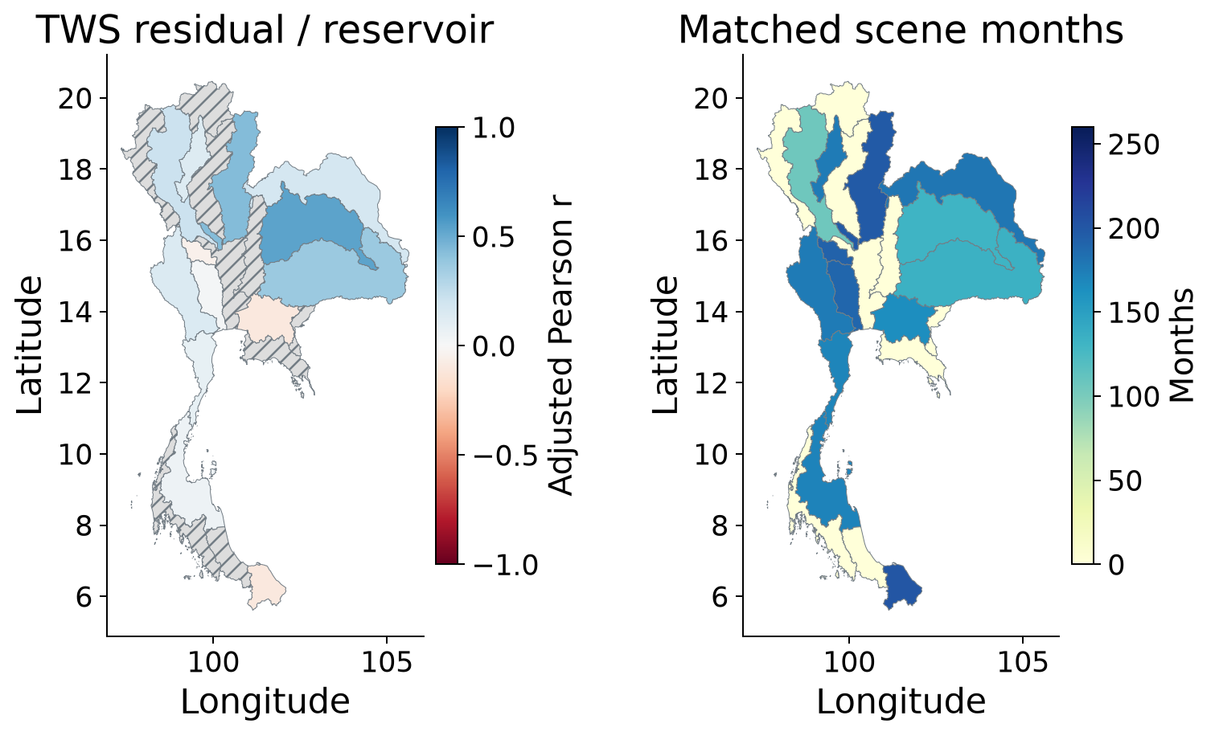
Reservoir agreement and observation support
Scene-screened MSEA-Res Level 1. Reservoir storage checks a surface-water component. Climate and operating decisions both affect reservoirs.
Evaluation
31 / 35
Notes:
Scene-screened MSEA-Res Level 1. Reservoir storage checks a surface-water component. Climate and operating decisions both affect reservoirs.
Source: verified Thailand extended study, report and basin/forcing appendix.
Main research presentation.

Slide 32
Sensitivity to the rainfall source
Test anomaly NSE in the frozen Ridge memory experiment
Storage | Native rainfall | CHIRPS replacement
TWSA | 0.890 | 0.688
GWSA | 0.723 | 0.562
PET and the native-forced parent target stay fixed. This tests forcing dependence, rather than which rainfall product is more accurate.
Evaluation
32 / 35
Notes:
PET and the native-forced parent target stay fixed. This tests forcing dependence, rather than which rainfall product is more accurate.
Source: verified Thailand extended study, report and basin/forcing appendix.
Main research presentation.

Slide 33
Decision support and reproducibility
Interactive storage histories, trend maps and observation support for all 22 basins
Downloadable basin performance tables and spatial/temporal forcing figures
Input subsets, pinned dependencies and executable scientific workflows
https://pratikkhanal16.github.io/thailand-water-storage-dss/extended/ • Source repository: pratikkhanal16/thailand-water-storage-dss
Objective 3
33 / 35
Notes:
https://pratikkhanal16.github.io/thailand-water-storage-dss/extended/ • Source repository: pratikkhanal16/thailand-water-storage-dss
Source: verified Thailand extended study, report and basin/forcing appendix.
Main research presentation.

Slide 34
Conclusions
The primary records show national TWSA and GWSA decline
Basin rankings and residual interpretation depend on products and observation support
Climate memory reconstructs the naturalized parent well, with weaker performance in some years
Wells and reservoirs provide complementary, limited evidence for residual interpretation
Contribution: a reproducible joint assessment of product sensitivity, climate memory, paired-model discrepancy and monitoring-network uncertainty.
Conclusions
34 / 35
Notes:
Contribution: a reproducible joint assessment of product sensitivity, climate memory, paired-model discrepancy and monitoring-network uncertainty.
Source: verified Thailand extended study, report and basin/forcing appendix.
Main research presentation.

Slide 35
Selected references
Save et al. (2016), CSR mascons. doi:10.1002/2016JB013007
Müller Schmied et al. (2024), WaterGAP. doi:10.5194/gmd-17-8817-2024
Sharifi et al. (2025), groundwater storage. doi:10.5194/hess-29-6985-2025
MSEA-Res (2025), reservoir storage. doi:10.5194/essd-17-2693-2025
GROW groundwater observations. doi:10.5281/zenodo.15149480
Full bibliography, source terms and basin results accompany the report. Theme: Metropolis by Matthias Vogelgesang and contributors, https://github.com/matze/mtheme.
References
35 / 35
Notes:
Full bibliography, source terms and basin results accompany the report. Theme: Metropolis by Matthias Vogelgesang and contributors, https://github.com/matze/mtheme.
Source: verified Thailand extended study, report and basin/forcing appendix.
Main research presentation.

Slide 36
Supporting results
Additional hydroclimatic context
Basin performance tables for questions
Observation support and interpretation
Supporting results
B1
Notes:
Source: verified Thailand extended study, report and basin/forcing appendix.
Backup slide for discussion.

Slide 37
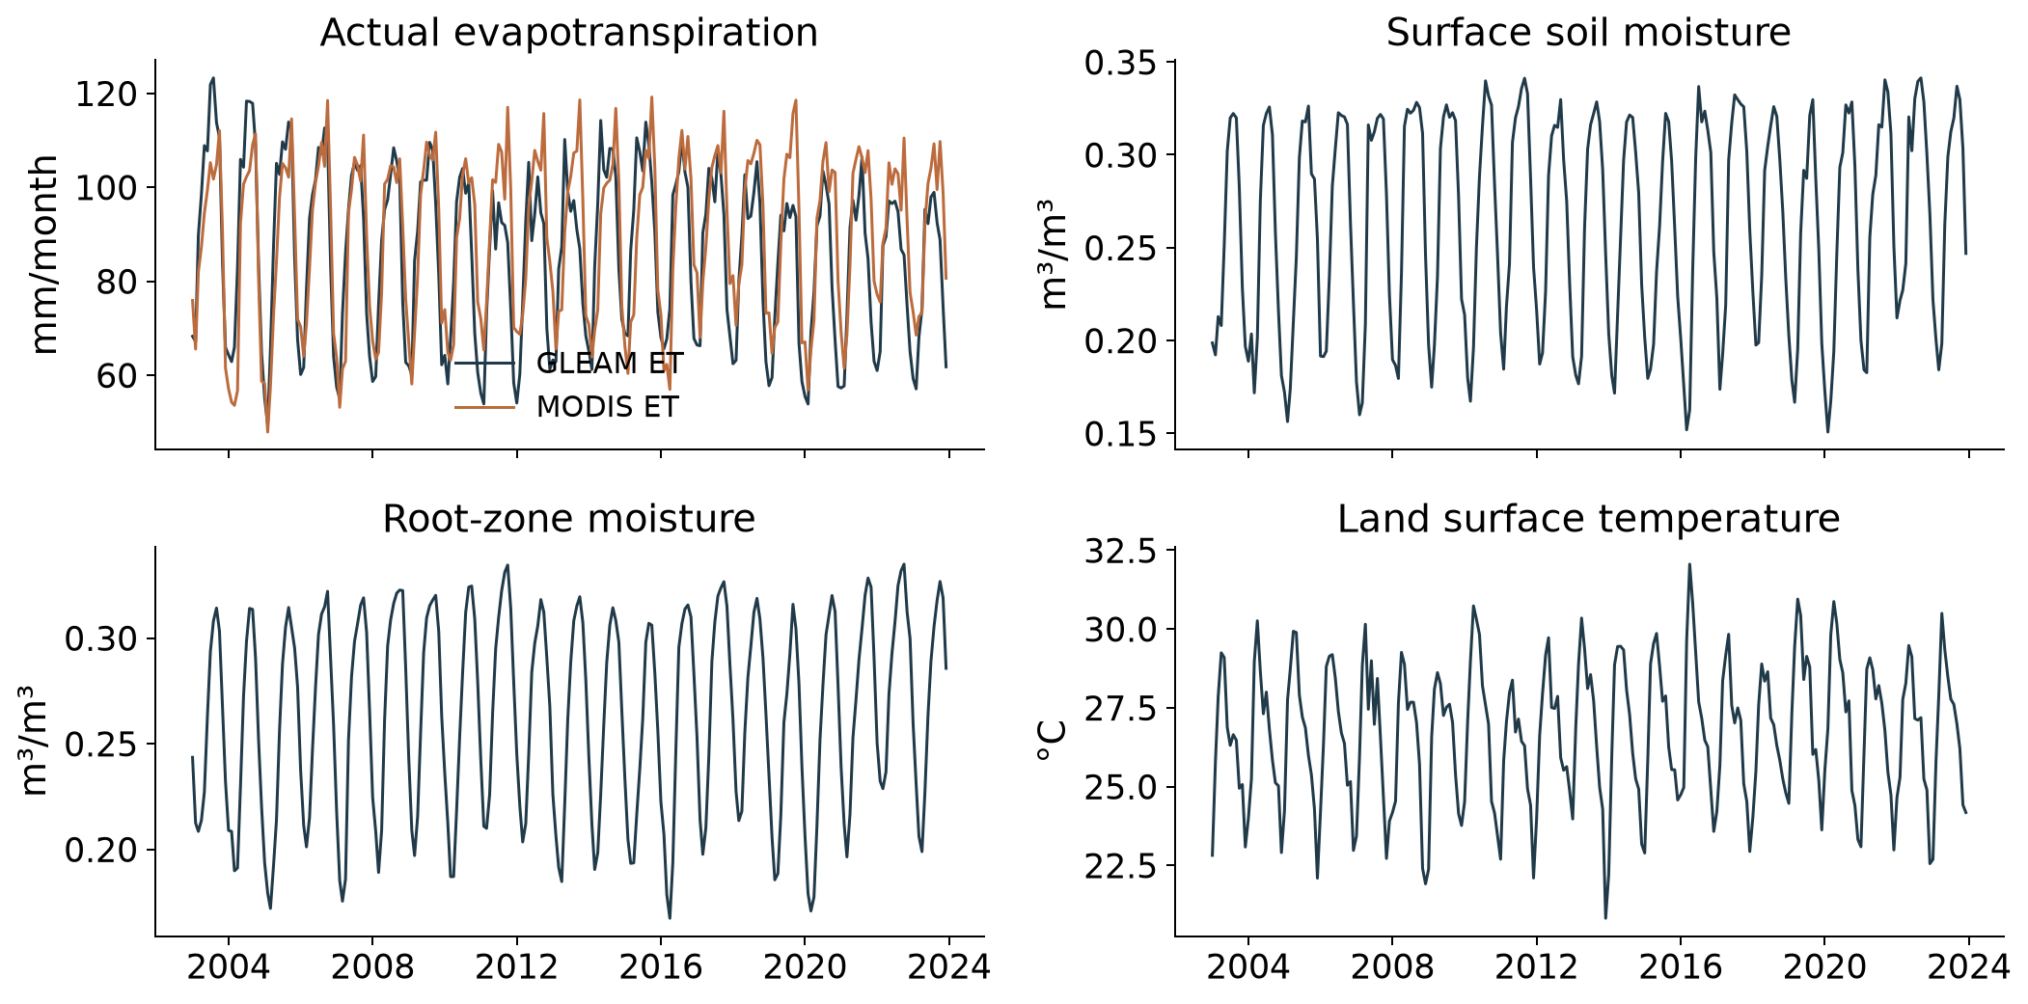
Supporting hydroclimatic histories
National monthly observations, 2003–2023. Actual ET, soil moisture and surface temperature provide context; they are not added primary predictors.
Supporting results
B2
Notes:
National monthly observations, 2003–2023. Actual ET, soil moisture and surface temperature provide context; they are not added primary predictors.
Source: verified Thailand extended study, report and basin/forcing appendix.
Backup slide for discussion.

Slide 38
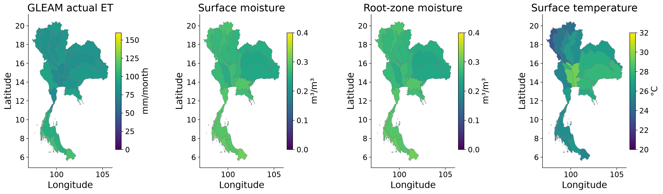
Spatial hydroclimatic context
Basin available-month means, 2003–2023. Product coverage differs. Volumetric moisture is distinct from storage in mm.
Supporting results
B3
Notes:
Basin available-month means, 2003–2023. Product coverage differs. Volumetric moisture is distinct from storage in mm.
Source: verified Thailand extended study, report and basin/forcing appendix.
Backup slide for discussion.

Slide 39
Spatial support and uncertainty
National aggregation touches 68 native CSR mascons
Inverse weight concentration is about 50.1 and does not count independent observations
Every principal basin is below the provider’s approximate 200,000 km² small-area caution
Conditional intervals do not include all gravity, compartment and hydrological-model errors
Supporting results
B4
Notes:
Source: verified Thailand extended study, report and basin/forcing appendix.
Backup slide for discussion.

Slide 40
Observed storage trends for every basin (01–11)
Basin | TWS slope | TWS q | n | GWS slope | GWS q | n
01 | -3.59 | <.001 | 237 | -2.88 | <.001 | 225
02 | -1.90 | 0.010 | 237 | -1.83 | 0.014 | 225
03 | -1.32 | 0.007 | 237 | -1.59 | <.001 | 225
04 | -3.65 | <.001 | 237 | -3.32 | <.001 | 225
05 | -4.42 | <.001 | 237 | -3.47 | <.001 | 225
06 | -3.71 | <.001 | 237 | -3.10 | <.001 | 225
07 | -3.21 | <.001 | 237 | -3.32 | <.001 | 225
08 | -3.79 | <.001 | 237 | -3.97 | <.001 | 225
09 | -3.74 | <.001 | 237 | -3.94 | <.001 | 225
10 | -7.36 | <.001 | 237 | -7.47 | <.001 | 225
11 | -5.50 | <.001 | 237 | -5.20 | <.001 | 225
Slopes are seasonal Sen estimates in mm/year. q is seasonal Mann–Kendall FDR across basins; n is observed months. Full intervals and original p-values remain in CSR_basin_trends.csv. Basin names are listed in Appendix A.
Supporting results
B5
Notes:
Slopes are seasonal Sen estimates in mm/year. q is seasonal Mann–Kendall FDR across basins; n is observed months. Full intervals and original p-values remain in CSR_basin_trends.csv. Basin names are listed in Appendix A.
Source: verified Thailand extended study, report and basin/forcing appendix.
Backup slide for discussion.

Slide 41
Observed storage trends for every basin (12–22)
Basin | TWS slope | TWS q | n | GWS slope | GWS q | n
12 | -7.06 | <.001 | 237 | -7.35 | <.001 | 225
13 | -6.89 | <.001 | 237 | -6.36 | <.001 | 225
14 | -5.25 | <.001 | 237 | -5.48 | <.001 | 225
15 | -8.64 | <.001 | 237 | -8.12 | <.001 | 225
16 | -7.68 | <.001 | 237 | -7.30 | <.001 | 225
17 | -7.51 | <.001 | 237 | -7.92 | <.001 | 225
18 | -5.85 | <.001 | 237 | -4.75 | <.001 | 225
19 | -34.37 | <.001 | 237 | -36.08 | <.001 | 225
20 | -6.25 | <.001 | 237 | -7.45 | <.001 | 225
21 | -1.62 | <.001 | 237 | -3.16 | <.001 | 225
22 | -21.48 | <.001 | 237 | -20.95 | <.001 | 225
Slopes are seasonal Sen estimates in mm/year. q is seasonal Mann–Kendall FDR across basins; n is observed months. Full intervals and original p-values remain in CSR_basin_trends.csv. Basin names are listed in Appendix A.
Supporting results
B6
Notes:
Slopes are seasonal Sen estimates in mm/year. q is seasonal Mann–Kendall FDR across basins; n is observed months. Full intervals and original p-values remain in CSR_basin_trends.csv. Basin names are listed in Appendix A.
Source: verified Thailand extended study, report and basin/forcing appendix.
Backup slide for discussion.

Slide 42
TWSA climate reconstruction performance (01–11)
Basin | n | r | NSE | Anom NSE | RMSE | MAE
01 | 96 | 0.991 | 0.981 | 0.807 | 22.08 | 16.90
02 | 96 | 0.990 | 0.979 | 0.904 | 17.32 | 13.88
03 | 96 | 0.990 | 0.973 | 0.812 | 27.37 | 19.39
04 | 96 | 0.981 | 0.961 | 0.821 | 15.61 | 11.58
05 | 96 | 0.974 | 0.946 | 0.732 | 21.43 | 15.40
06 | 96 | 0.991 | 0.981 | 0.876 | 15.90 | 12.00
07 | 96 | 0.987 | 0.974 | 0.868 | 15.24 | 11.08
08 | 96 | 0.987 | 0.972 | 0.873 | 15.38 | 11.43
09 | 96 | 0.992 | 0.983 | 0.901 | 14.14 | 10.83
10 | 96 | 0.967 | 0.928 | 0.792 | 42.23 | 30.13
11 | 96 | 0.990 | 0.980 | 0.875 | 15.34 | 12.27
Frozen ensemble, 2016–2023 test data. Target: naturalized WaterGAP, not GRACE. Errors are mm; anomaly NSE removes the training monthly climatology. Higher NSE and lower errors are better.
Supporting results
B7
Notes:
Frozen ensemble, 2016–2023 test data. Target: naturalized WaterGAP, not GRACE. Errors are mm; anomaly NSE removes the training monthly climatology. Higher NSE and lower errors are better.
Source: verified Thailand extended study, report and basin/forcing appendix.
Backup slide for discussion.

Slide 43
TWSA climate reconstruction performance (12–22)
Basin | n | r | NSE | Anom NSE | RMSE | MAE
12 | 96 | 0.987 | 0.974 | 0.864 | 11.22 | 8.35
13 | 96 | 0.974 | 0.942 | 0.778 | 32.00 | 23.99
14 | 96 | 0.991 | 0.981 | 0.856 | 18.49 | 14.13
15 | 96 | 0.975 | 0.942 | 0.764 | 28.65 | 22.72
16 | 96 | 0.979 | 0.957 | 0.705 | 14.60 | 11.45
17 | 96 | 0.987 | 0.972 | 0.742 | 16.75 | 13.62
18 | 96 | 0.979 | 0.957 | 0.827 | 14.38 | 10.97
19 | 96 | 0.982 | 0.965 | 0.911 | 17.38 | 13.55
20 | 96 | 0.982 | 0.963 | 0.903 | 22.54 | 18.01
21 | 96 | 0.977 | 0.951 | 0.887 | 25.44 | 18.76
22 | 96 | 0.985 | 0.970 | 0.903 | 17.36 | 13.16
Frozen ensemble, 2016–2023 test data. Target: naturalized WaterGAP, not GRACE. Errors are mm; anomaly NSE removes the training monthly climatology. Higher NSE and lower errors are better.
Supporting results
B8
Notes:
Frozen ensemble, 2016–2023 test data. Target: naturalized WaterGAP, not GRACE. Errors are mm; anomaly NSE removes the training monthly climatology. Higher NSE and lower errors are better.
Source: verified Thailand extended study, report and basin/forcing appendix.
Backup slide for discussion.

Slide 44
GWSA climate reconstruction performance (01–11)
Basin | n | r | NSE | Anom NSE | RMSE | MAE
01 | 96 | 0.982 | 0.963 | 0.830 | 5.74 | 4.47
02 | 96 | 0.986 | 0.956 | 0.901 | 4.98 | 4.08
03 | 96 | 0.982 | 0.953 | 0.781 | 10.59 | 7.70
04 | 96 | 0.969 | 0.933 | 0.755 | 7.04 | 5.33
05 | 96 | 0.963 | 0.927 | 0.678 | 8.87 | 6.32
06 | 96 | 0.980 | 0.958 | 0.842 | 3.94 | 2.92
07 | 96 | 0.977 | 0.948 | 0.824 | 4.83 | 3.96
08 | 96 | 0.984 | 0.963 | 0.865 | 5.52 | 4.22
09 | 96 | 0.982 | 0.958 | 0.832 | 6.04 | 4.78
10 | 96 | 0.968 | 0.935 | 0.661 | 4.90 | 4.09
11 | 96 | 0.958 | 0.914 | 0.627 | 7.09 | 5.40
Frozen ensemble, 2016–2023 test data. Target: naturalized WaterGAP, not GRACE. Errors are mm; anomaly NSE removes the training monthly climatology. Higher NSE and lower errors are better.
Supporting results
B9
Notes:
Frozen ensemble, 2016–2023 test data. Target: naturalized WaterGAP, not GRACE. Errors are mm; anomaly NSE removes the training monthly climatology. Higher NSE and lower errors are better.
Source: verified Thailand extended study, report and basin/forcing appendix.
Backup slide for discussion.

Slide 45
GWSA climate reconstruction performance (12–22)
Basin | n | r | NSE | Anom NSE | RMSE | MAE
12 | 96 | 0.981 | 0.962 | 0.812 | 4.62 | 3.61
13 | 96 | 0.959 | 0.920 | 0.703 | 5.50 | 4.45
14 | 96 | 0.985 | 0.970 | 0.812 | 4.39 | 3.12
15 | 96 | 0.963 | 0.902 | 0.360 | 10.51 | 8.46
16 | 96 | 0.970 | 0.933 | 0.564 | 10.88 | 8.87
17 | 96 | 0.980 | 0.952 | 0.589 | 11.67 | 9.60
18 | 96 | 0.958 | 0.907 | 0.711 | 6.84 | 5.11
19 | 96 | 0.968 | 0.926 | 0.823 | 10.40 | 8.46
20 | 96 | 0.946 | 0.892 | 0.668 | 11.69 | 9.70
21 | 96 | 0.953 | 0.904 | 0.808 | 9.19 | 7.33
22 | 96 | 0.967 | 0.922 | 0.780 | 11.32 | 8.94
Frozen ensemble, 2016–2023 test data. Target: naturalized WaterGAP, not GRACE. Errors are mm; anomaly NSE removes the training monthly climatology. Higher NSE and lower errors are better.
Supporting results
B10
Notes:
Frozen ensemble, 2016–2023 test data. Target: naturalized WaterGAP, not GRACE. Errors are mm; anomaly NSE removes the training monthly climatology. Higher NSE and lower errors are better.
Source: verified Thailand extended study, report and basin/forcing appendix.
Backup slide for discussion.

Slide 46
GLDAS matched land storage performance (01–11)
Basin | n | r | NSE | RMSE | MAE | Bias
01 | 261 | 0.949 | 0.850 | 55.42 | 46.06 | 4.24
02 | 261 | 0.955 | 0.877 | 38.82 | 31.16 | -3.20
03 | 261 | 0.957 | 0.670 | 62.72 | 55.91 | 3.44
04 | 261 | 0.940 | 0.702 | 56.19 | 48.08 | 11.12
05 | 261 | 0.931 | 0.620 | 65.72 | 57.34 | 12.09
06 | 261 | 0.961 | 0.901 | 37.15 | 30.56 | 3.75
07 | 261 | 0.962 | 0.874 | 36.09 | 29.37 | -2.62
08 | 261 | 0.926 | 0.712 | 59.38 | 51.34 | -2.20
09 | 261 | 0.956 | 0.825 | 48.01 | 41.12 | 1.04
10 | 261 | 0.871 | 0.390 | 77.84 | 69.70 | 7.74
11 | 261 | 0.900 | 0.756 | 59.88 | 49.64 | 3.91
Soil, canopy and snow only; naturalized WaterGAP compared with GLDAS Noah on matched months. Errors are mm; bias = WaterGAP minus GLDAS. This does not validate full TWS, GWS or human-only storage.
Supporting results
B11
Notes:
Soil, canopy and snow only; naturalized WaterGAP compared with GLDAS Noah on matched months. Errors are mm; bias = WaterGAP minus GLDAS. This does not validate full TWS, GWS or human-only storage.
Source: verified Thailand extended study, report and basin/forcing appendix.
Backup slide for discussion.

Slide 47
GLDAS matched land storage performance (12–22)
Basin | n | r | NSE | RMSE | MAE | Bias
12 | 261 | 0.848 | 0.465 | 75.38 | 66.62 | 7.09
13 | 261 | 0.814 | 0.317 | 95.06 | 85.91 | 13.97
14 | 261 | 0.955 | 0.788 | 62.51 | 53.84 | 4.43
15 | 261 | 0.934 | 0.621 | 60.08 | 51.92 | 5.74
16 | 261 | 0.860 | 0.453 | 78.69 | 68.66 | 9.02
17 | 261 | 0.891 | 0.559 | 71.30 | 62.24 | 3.90
18 | 261 | 0.858 | 0.514 | 80.68 | 71.40 | 13.50
19 | 261 | 0.866 | 0.690 | 49.28 | 39.89 | 0.01
20 | 261 | 0.844 | 0.544 | 53.29 | 41.99 | 10.73
21 | 261 | 0.678 | 0.403 | 62.21 | 51.62 | 9.14
22 | 261 | 0.887 | 0.686 | 49.60 | 40.29 | -6.04
Soil, canopy and snow only; naturalized WaterGAP compared with GLDAS Noah on matched months. Errors are mm; bias = WaterGAP minus GLDAS. This does not validate full TWS, GWS or human-only storage.
Supporting results
B12
Notes:
Soil, canopy and snow only; naturalized WaterGAP compared with GLDAS Noah on matched months. Errors are mm; bias = WaterGAP minus GLDAS. This does not validate full TWS, GWS or human-only storage.
Source: verified Thailand extended study, report and basin/forcing appendix.
Backup slide for discussion.

Slide 48
Residual agreement with annual groundwater head (01–11)
Basin | TWS r | TWS detr r | Years | GWS r | GWS detr r | Years
01 | 0.449 | 0.582 | 9 | -0.215 | 0.167 | 8
02 | 0.330 | 0.345 | 17 | 0.279 | 0.399 | 16
03 | -0.121 | -0.084 | 9 | 0.063 | -0.109 | 8
04 | -0.009 | -0.030 | 9 | -0.168 | -0.023 | 8
05 | 0.113 | 0.103 | 9 | -0.007 | 0.070 | 8
06 | 0.385 | 0.432 | 15 | 0.229 | 0.293 | 14
07 | -0.089 | -0.043 | 9 | -0.244 | 0.047 | 8
08 | 0.236 | 0.157 | 9 | 0.277 | -0.124 | 8
09 | 0.208 | 0.176 | 9 | 0.026 | -0.198 | 8
10 | 0.152 | 0.050 | 9 | 0.519 | 0.200 | 8
11 | — | — | 5 | — | — | 4
Longest-overlap retained-flags panel. Positive r means lower residual tends to occur with lower head. Detr r removes a linear trend. An em dash means unavailable evidence, not zero. Head is not converted into storage; no cross-unit NSE or RMSE is reported. Other station panels and conditional intervals remain in the complete CSV.
Supporting results
B13
Notes:
Longest-overlap retained-flags panel. Positive r means lower residual tends to occur with lower head. Detr r removes a linear trend. An em dash means unavailable evidence, not zero. Head is not converted into storage; no cross-unit NSE or RMSE is reported. Other station panels and conditional intervals remain in the complete CSV.
Source: verified Thailand extended study, report and basin/forcing appendix.
Backup slide for discussion.

Slide 49
Residual agreement with annual groundwater head (12–22)
Basin | TWS r | TWS detr r | Years | GWS r | GWS detr r | Years
12 | — | — | 5 | — | — | 4
13 | -0.044 | -0.212 | 17 | 0.027 | -0.147 | 16
14 | 0.094 | 0.074 | 17 | 0.093 | 0.116 | 16
15 | 0.001 | -0.041 | 9 | -0.082 | -0.187 | 8
16 | — | — | 3 | — | — | 2
17 | 0.041 | 0.136 | 9 | -0.420 | -0.215 | 8
18 | -0.335 | -0.394 | 9 | -0.289 | -0.115 | 8
19 | 0.227 | 0.096 | 9 | 0.033 | -0.147 | 8
20 | -0.197 | -0.656 | 18 | -0.375 | -0.722 | 17
21 | — | — | 0 | — | — | 0
22 | -0.080 | -0.143 | 15 | -0.389 | -0.450 | 14
Longest-overlap retained-flags panel. Positive r means lower residual tends to occur with lower head. Detr r removes a linear trend. An em dash means unavailable evidence, not zero. Head is not converted into storage; no cross-unit NSE or RMSE is reported. Other station panels and conditional intervals remain in the complete CSV.
Supporting results
B14
Notes:
Longest-overlap retained-flags panel. Positive r means lower residual tends to occur with lower head. Detr r removes a linear trend. An em dash means unavailable evidence, not zero. Head is not converted into storage; no cross-unit NSE or RMSE is reported. Other station panels and conditional intervals remain in the complete CSV.
Source: verified Thailand extended study, report and basin/forcing appendix.
Backup slide for discussion.

Slide 50
Complete basin results and source data
Report Appendix C: 11 tables for every basin
Report Appendix D: 10 spatial and temporal forcing figures
The website supplies full-precision CSVs, vector figures and runnable code
https://pratikkhanal16.github.io/thailand-water-storage-dss/extended/basin_forcing/
Supporting results
B15
Notes:
https://pratikkhanal16.github.io/thailand-water-storage-dss/extended/basin_forcing/
Source: verified Thailand extended study, report and basin/forcing appendix.
Backup slide for discussion.

