Slide 1
Water storage trends and attribution credibility
Farzeen Khan
MS in Water Engineering and Management
Asian Institute of Technology
Advisor: Dr. Natthachet Tangdamrongsub
Farzeen Khan · AIT · October 2026
1 / 42
Notes:
Source: extended CSR-based study; the thesis, manuscript, analysis scripts and LaTeX Beamer source accompany this deck.

Slide 2
Research objectives
Storage trends for all 22 principal basins and national context.
Climate-driven storage reconstruction, paired human effects and groundwater evidence.
Interactive decision support with reproducible code and data.
Farzeen Khan · AIT · October 2026
2 / 42
Notes:
Source: extended CSR-based study; the thesis, manuscript, analysis scripts and LaTeX Beamer source accompany this deck.

Slide 3
Proposed research contribution
Separate robust national decline from product-dependent basin rankings.
Test climate memory beyond seasonality and native forcing.
Audit human attribution through model discrepancy and well-network sensitivity.
Integrated empirical contribution; no claim of a first-ever algorithm or journal acceptance.
Farzeen Khan · AIT · October 2026
3 / 42
Notes:
Integrated empirical contribution; no claim of a first-ever algorithm or journal acceptance.
Source: extended CSR-based study; the thesis, manuscript, analysis scripts and LaTeX Beamer source accompany this deck.

Slide 4
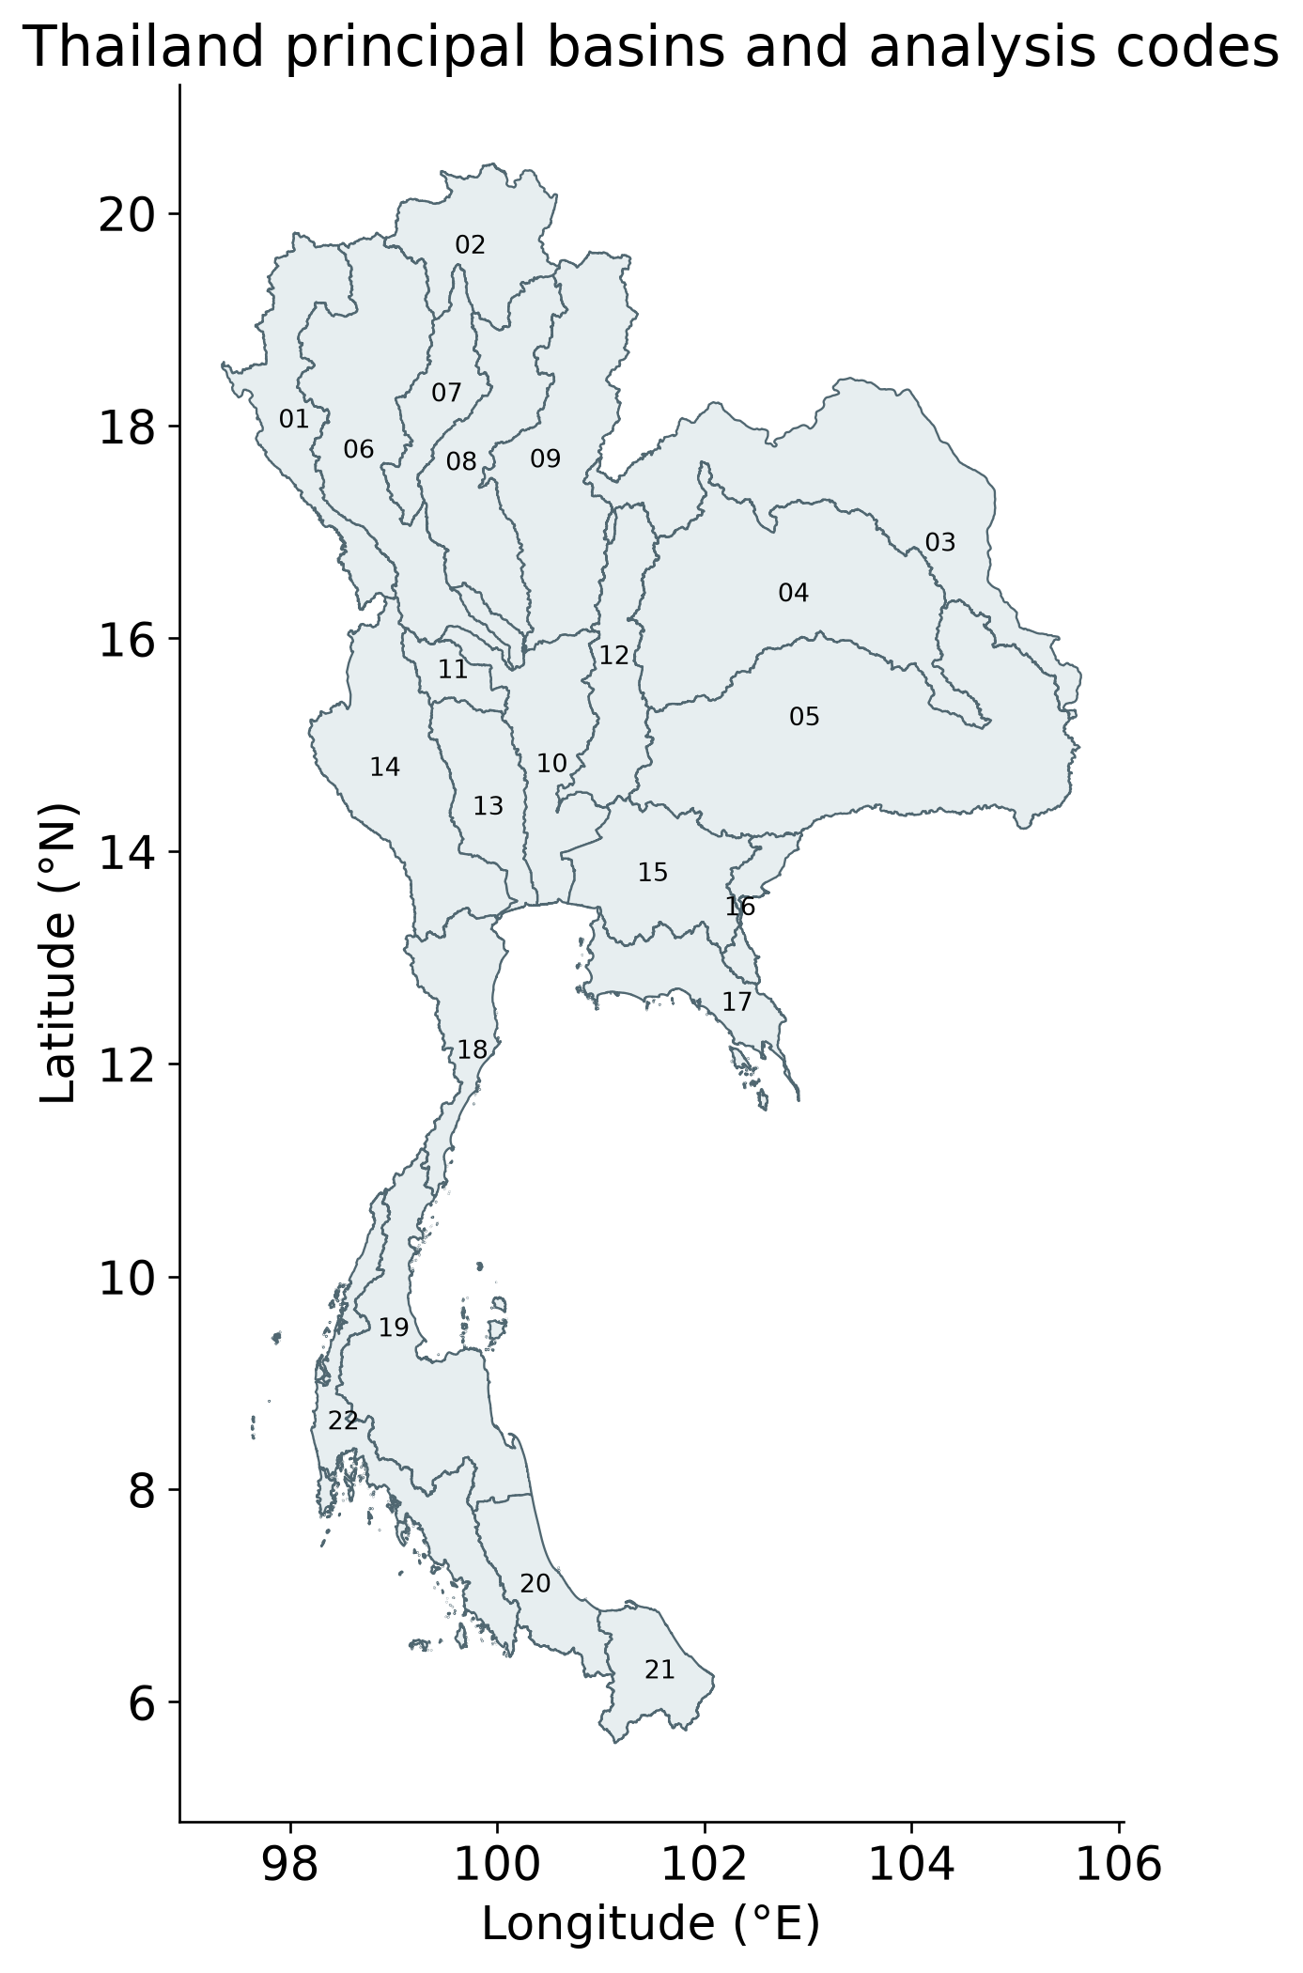
Study domain
ONWR principal-basin geometry. Basin codes and full names are retained in the thesis.
Farzeen Khan · AIT · October 2026
4 / 42
Notes:
ONWR principal-basin geometry. Basin codes and full names are retained in the thesis.
Source: extended CSR-based study; the thesis, manuscript, analysis scripts and LaTeX Beamer source accompany this deck.

Slide 5
Documented inputs and distinct scientific roles
Record | Period | Role
CSR RL06.3 | 2002–2024 | Observed TWSA
GLDAS + G3P | 2002–2023/24 | Storage compartments
WaterGAP pairing | 1981–2023 | Naturalized/historical experiment
CHIRPS and cube | 2003–2024 | Forcing and context
511 Thai wells | Mostly annual | Groundwater consistency
Full provenance, checksums and special-month audit accompany the data.
Farzeen Khan · AIT · October 2026
5 / 42
Notes:
Full provenance, checksums and special-month audit accompany the data.
Source: extended CSR-based study; the thesis, manuscript, analysis scripts and LaTeX Beamer source accompany this deck.

Slide 6
Groundwater storage balance
GWSA = TWSA − SMSA − SWSA − CWSA − SWEA
All compartments use mm water equivalent and a common reference.
Identical valid cells preserve the regional accounting identity.
Product depth and filtering differences remain structural uncertainty.
GLDAS Noah and G3P compartment data; Sharifi et al. (2025), doi:10.5194/hess-29-6985-2025.
Farzeen Khan · AIT · October 2026
6 / 42
Notes:
GLDAS Noah and G3P compartment data; Sharifi et al. (2025), doi:10.5194/hess-29-6985-2025.
Source: extended CSR-based study; the thesis, manuscript, analysis scripts and LaTeX Beamer source accompany this deck.

Slide 7
Three meanings of evaluation
Comparison | What it tests
Emulator / naturalized target | Reconstruction of a parent model
Matched land storage / GLDAS | Cross-model component consistency
Residual / groundwater heads | Groundwater pattern agreement
A strong score in one comparison does not validate the other two.
Farzeen Khan · AIT · October 2026
7 / 42
Notes:
A strong score in one comparison does not validate the other two.
Source: extended CSR-based study; the thesis, manuscript, analysis scripts and LaTeX Beamer source accompany this deck.

Slide 8
Chronological climate evaluation
Role | Years | Use
Warm-up | 1981–1990 | Antecedent weather memory
Train | 1991–2009 | Fit and internal tuning
Validation | 2010–2015 | Freeze ensemble choices
Test | 2016–2023 | Held-out performance
No GRACE lag, well-head feature or unrestricted year trend enters the primary emulator.
Farzeen Khan · AIT · October 2026
8 / 42
Notes:
No GRACE lag, well-head feature or unrestricted year trend enters the primary emulator.
Source: extended CSR-based study; the thesis, manuscript, analysis scripts and LaTeX Beamer source accompany this deck.

Slide 9
National CSR-based storage decline
Storage | Months | Sen mm/year | 95% interval
TWSA | 237 | −7.51 | −9.79 to −5.68
GWSA | 225 | −6.84 | −8.77 to −5.11
TWSA ends September 2024; GWSA ends September 2023. Intervals are conditional within-product estimates.
Farzeen Khan · AIT · October 2026
9 / 42
Notes:
TWSA ends September 2024; GWSA ends September 2023. Intervals are conditional within-product estimates.
Source: extended CSR-based study; the thesis, manuscript, analysis scripts and LaTeX Beamer source accompany this deck.

Slide 10
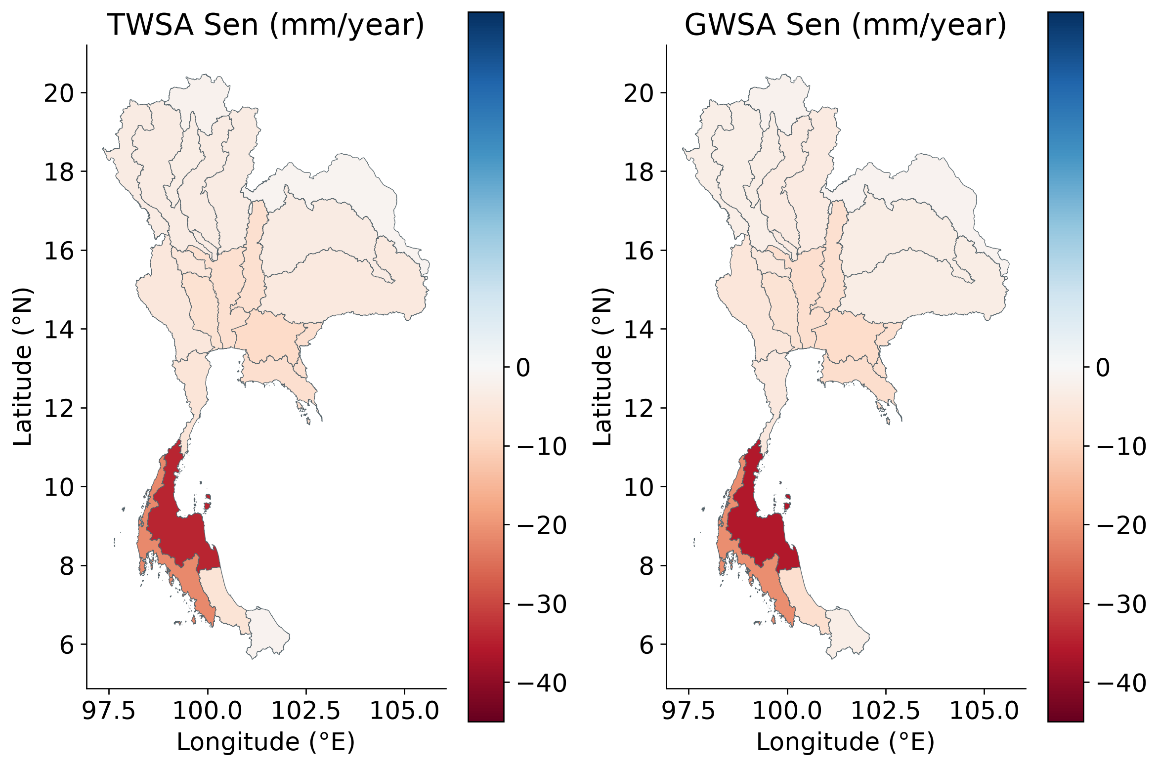
Basin storage trends
Basin-level screening, not single-grid-point CSR inference. All 22 basins retain the provider caution.
Farzeen Khan · AIT · October 2026
10 / 42
Notes:
Basin-level screening, not single-grid-point CSR inference. All 22 basins retain the provider caution.
Source: extended CSR-based study; the thesis, manuscript, analysis scripts and LaTeX Beamer source accompany this deck.

Slide 11
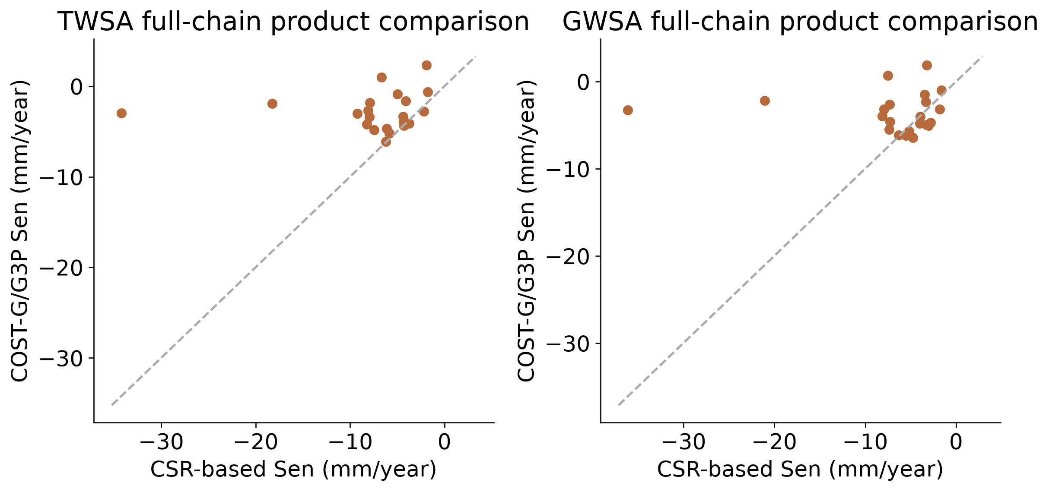
Product-dependent basin rankings
Spearman rank agreement: TWSA 0.138; GWSA 0.027. Common months and cells; GWS chains also differ in compartments.
Farzeen Khan · AIT · October 2026
11 / 42
Notes:
Spearman rank agreement: TWSA 0.138; GWSA 0.027. Common months and cells; GWS chains also differ in compartments.
Source: extended CSR-based study; the thesis, manuscript, analysis scripts and LaTeX Beamer source accompany this deck.

Slide 12
Spatial support is shared
National support touches 68 native mascons; inverse concentration is about 50.1.
All 22 principal basins are smaller than the provider’s approximate caution area.
Native concentration and overlap are diagnostics, not independent sample counts.
CSR RL06.3 native mapping and basin intersection weights; provider documentation.
Farzeen Khan · AIT · October 2026
12 / 42
Notes:
CSR RL06.3 native mapping and basin intersection weights; provider documentation.
Source: extended CSR-based study; the thesis, manuscript, analysis scripts and LaTeX Beamer source accompany this deck.

Slide 13
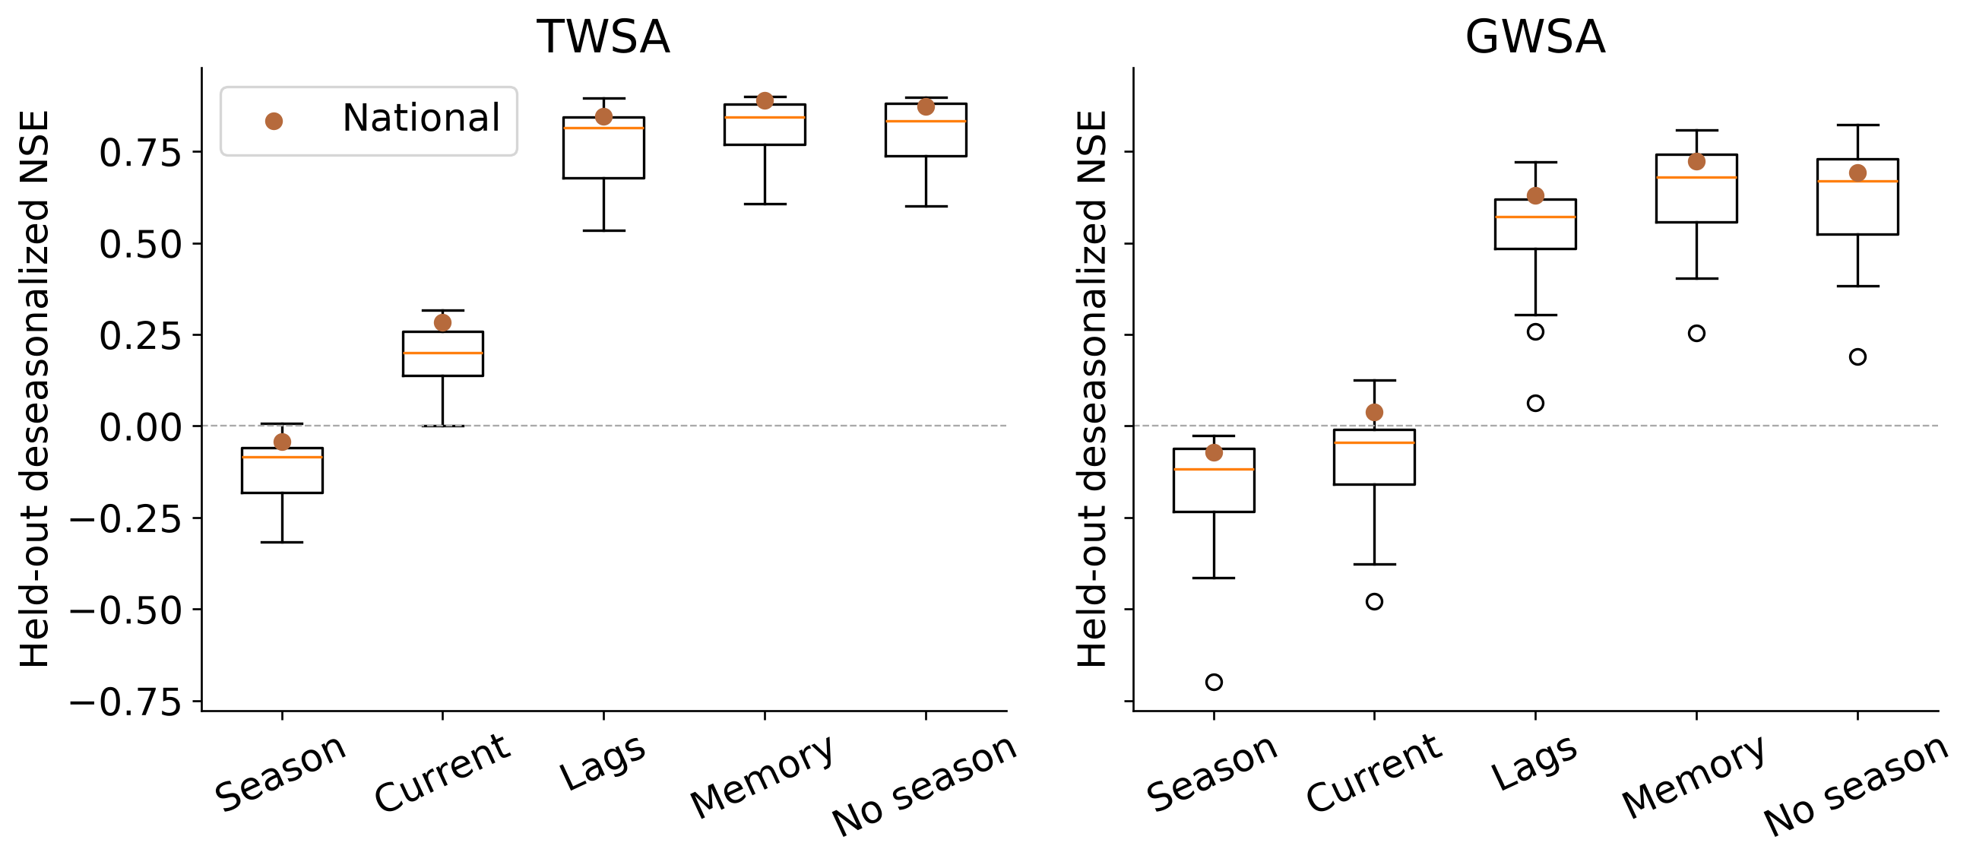
Climate memory improves anomaly reconstruction
National anomaly NSE: current → memory is 0.283 → 0.890 for TWSA and 0.039 → 0.723 for GWSA.
Farzeen Khan · AIT · October 2026
13 / 42
Notes:
National anomaly NSE: current → memory is 0.283 → 0.890 for TWSA and 0.039 → 0.723 for GWSA.
Source: extended CSR-based study; the thesis, manuscript, analysis scripts and LaTeX Beamer source accompany this deck.

Slide 14
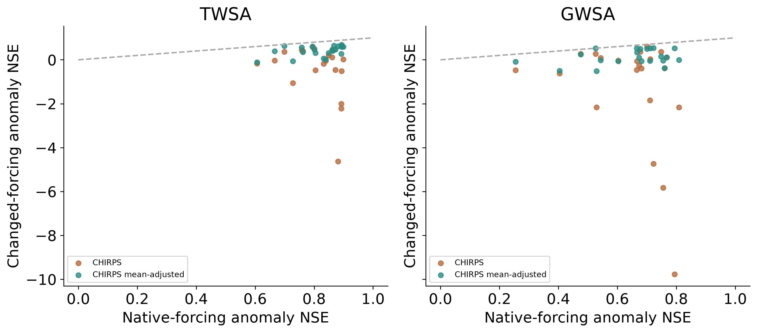
Independent precipitation changes model skill
CHIRPS replacement: anomaly NSE becomes 0.688 and 0.562. This is forcing sensitivity, not rainfall-accuracy validation.
Farzeen Khan · AIT · October 2026
14 / 42
Notes:
CHIRPS replacement: anomaly NSE becomes 0.688 and 0.562. This is forcing sensitivity, not rainfall-accuracy validation.
Source: extended CSR-based study; the thesis, manuscript, analysis scripts and LaTeX Beamer source accompany this deck.

Slide 15
Held-out observed rainfall response
Storage | P accumulation | Delay | Test r | Paired months
TWSA | 12 months | 1 month | 0.680 | 79
GWSA | 12 months | 2 months | 0.606 | 76
Selected in 2003–2015; tested in 2016–2023. Empirical delay is not aquifer residence time.
Farzeen Khan · AIT · October 2026
15 / 42
Notes:
Selected in 2003–2015; tested in 2016–2023. Empirical delay is not aquifer residence time.
Source: extended CSR-based study; the thesis, manuscript, analysis scripts and LaTeX Beamer source accompany this deck.

Slide 16
Attribution retains unexplained discrepancy
R = O − C = (A − C) + (O − A) = H + E
O: observed; C: naturalized; A: historical-human model.
H = A − C is the human perturbation represented by the model.
E = O − A remains unresolved observation–model discrepancy.
All terms share observed support and the 2004–2009 anomaly reference.
Farzeen Khan · AIT · October 2026
16 / 42
Notes:
All terms share observed support and the 2004–2009 anomaly reference.
Source: extended CSR-based study; the thesis, manuscript, analysis scripts and LaTeX Beamer source accompany this deck.

Slide 17
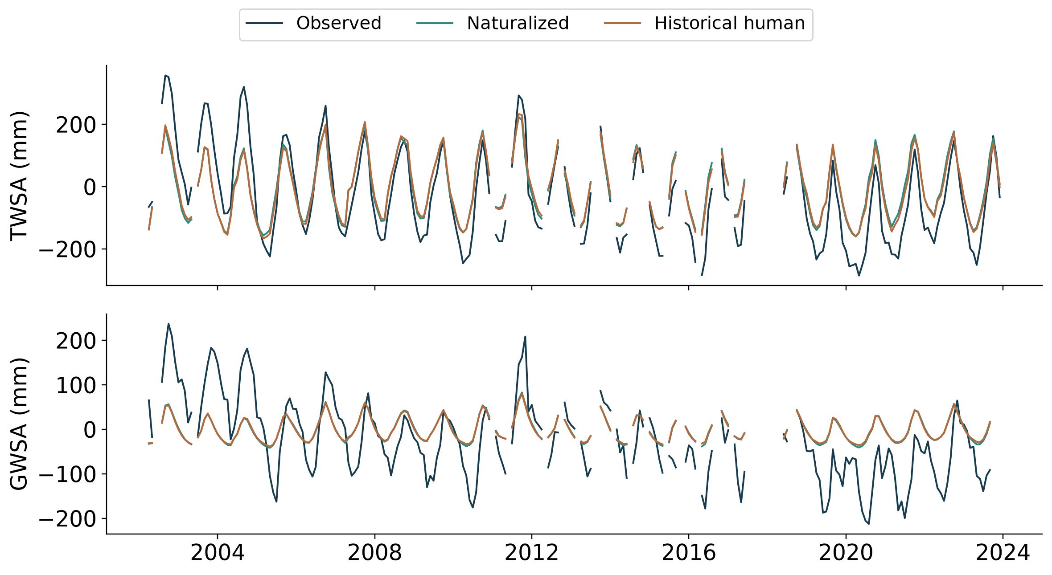
Observed and modeled storage
CSR observations and paired WaterGAP storage; no invented 2024 counterfactual.
Farzeen Khan · AIT · October 2026
17 / 42
Notes:
CSR observations and paired WaterGAP storage; no invented 2024 counterfactual.
Source: extended CSR-based study; the thesis, manuscript, analysis scripts and LaTeX Beamer source accompany this deck.

Slide 18
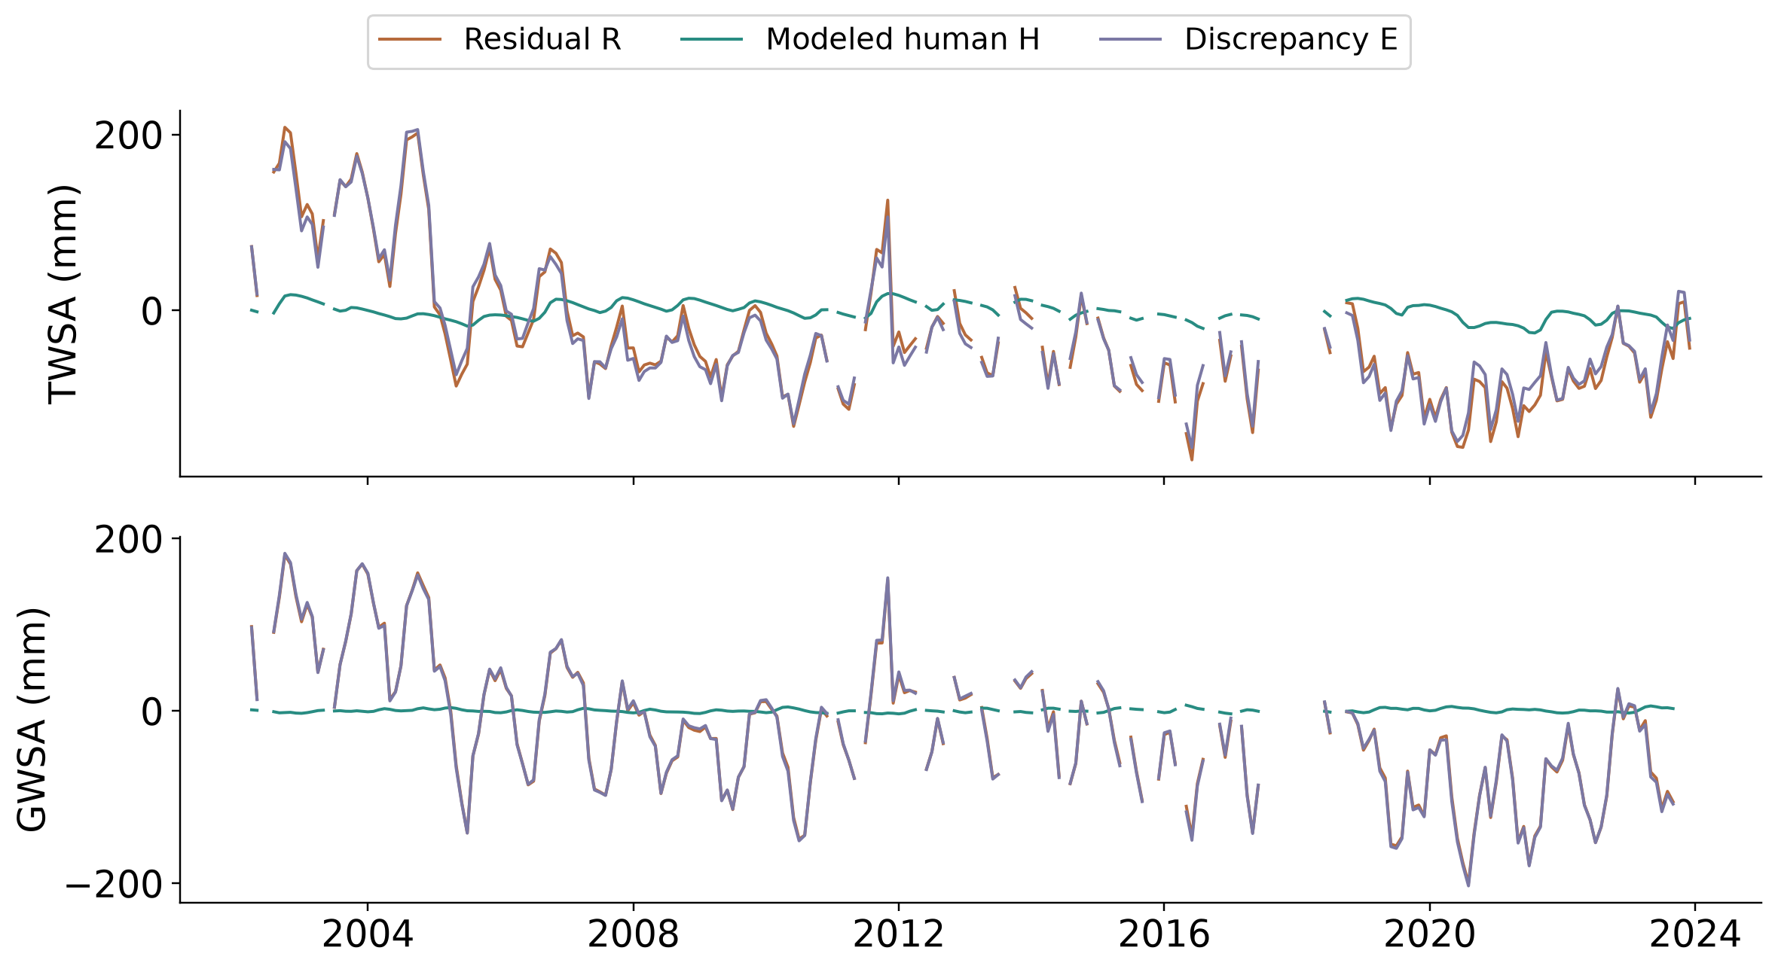
Residual and paired human effect differ
R = H + E exactly. The residual alone is not a measured pumping history.
Farzeen Khan · AIT · October 2026
18 / 42
Notes:
R = H + E exactly. The residual alone is not a measured pumping history.
Source: extended CSR-based study; the thesis, manuscript, analysis scripts and LaTeX Beamer source accompany this deck.

Slide 19
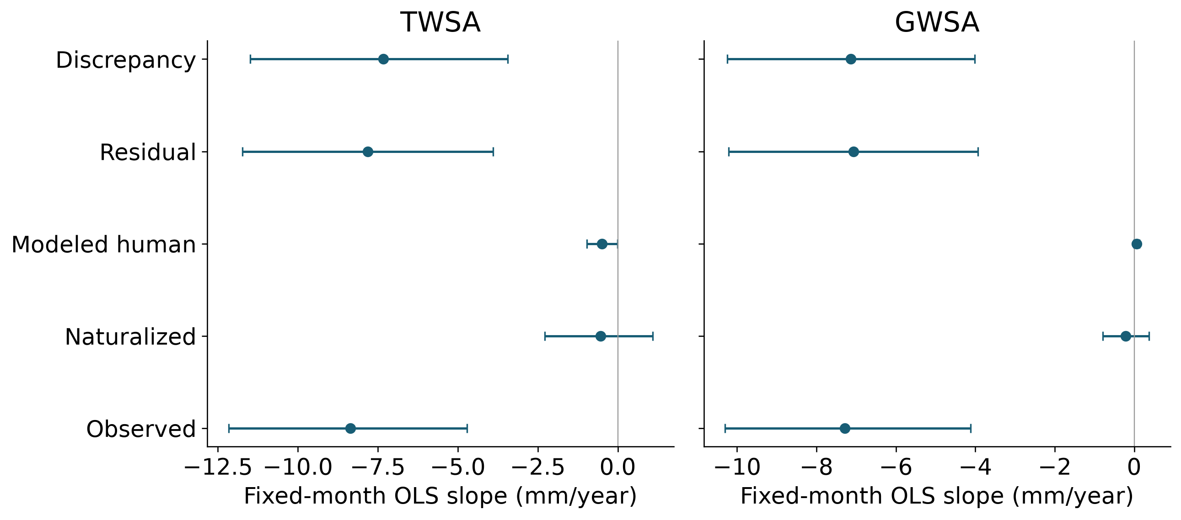
Additive national trend partition
OLS monthly fixed effects, identical dates and 999 shared two-year-block multipliers. Sen slopes are not additive.
Farzeen Khan · AIT · October 2026
19 / 42
Notes:
OLS monthly fixed effects, identical dates and 999 shared two-year-block multipliers. Sen slopes are not additive.
Source: extended CSR-based study; the thesis, manuscript, analysis scripts and LaTeX Beamer source accompany this deck.

Slide 20
Discrepancy magnitude diagnostic
Storage | D | Conditional interval
TWSA | 0.938 | 0.822–0.997
GWSA | 0.991 | 0.978–0.999
D = |βE| / (|βH| + |βE|). A descriptive magnitude index, not a causal human fraction.
Farzeen Khan · AIT · October 2026
20 / 42
Notes:
D = |βE| / (|βH| + |βE|). A descriptive magnitude index, not a causal human fraction.
Source: extended CSR-based study; the thesis, manuscript, analysis scripts and LaTeX Beamer source accompany this deck.

Slide 21
Groundwater observations
5,484 real aggregates from 511 wells; 506 annual wells and five monthly wells.
Co-located wells are grouped before regional averaging.
Heads remain in head units; aquifer storage coefficients are not invented.
GROW dataset, doi:10.5281/zenodo.15149480; source flags and original intervals retained.
Farzeen Khan · AIT · October 2026
21 / 42
Notes:
GROW dataset, doi:10.5281/zenodo.15149480; source flags and original intervals retained.
Source: extended CSR-based study; the thesis, manuscript, analysis scripts and LaTeX Beamer source accompany this deck.

Slide 22
Panel and period control change validation
Panel | TWS r | GWS r | GWS years
All overlap | 0.127 | 0.037 | 17
Fixed eligibility/wider history | 0.657 | 0.511 | 17
Common period | 0.325 | 0.029 | 8
Strict balanced | 0.305 | -0.000 | 8
2013–2022 common-period comparisons retain only eight usable storage years. No mission-gap interpolation.
Farzeen Khan · AIT · October 2026
22 / 42
Notes:
2013–2022 common-period comparisons retain only eight usable storage years. No mission-gap interpolation.
Source: extended CSR-based study; the thesis, manuscript, analysis scripts and LaTeX Beamer source accompany this deck.

Slide 23
Groundwater evidence remains limited
Strict balanced groundwater residual–head correlation is approximately zero.
382 eligible annual wells reduce to 225 coordinate-station trend trajectories.
54.2% decline in head, with a station-resampling interval of 47.1–60.0%.
Head-direction results do not estimate groundwater mass or validate total human TWSA.
Farzeen Khan · AIT · October 2026
23 / 42
Notes:
Head-direction results do not estimate groundwater mass or validate total human TWSA.
Source: extended CSR-based study; the thesis, manuscript, analysis scripts and LaTeX Beamer source accompany this deck.

Slide 24
Conclusions
Broad storage decline is more robust than local severity rankings.
Climate memory reconstructs a naturalized model well; attribution remains conditional.
Groundwater panel tests do not validate the whole residual as human-caused depletion.
Farzeen Khan · AIT · October 2026
24 / 42
Notes:
Source: extended CSR-based study; the thesis, manuscript, analysis scripts and LaTeX Beamer source accompany this deck.

Slide 25
Decision support and reproducibility
Inspect basin records, products, conditional uncertainty and observation support.
Download source-specific inputs, scientific tables and executable scripts.
github.com/pratikkhanal16/thailand-water-storage-dss
The extended CSR study is versioned separately from the earlier release.
Farzeen Khan · AIT · October 2026
25 / 42
Notes:
The extended CSR study is versioned separately from the earlier release.
Source: extended CSR-based study; the thesis, manuscript, analysis scripts and LaTeX Beamer source accompany this deck.

Slide 26
Research priorities
Aquifer-specific monthly heads, screened intervals and verified storage coefficients.
Independent pumping, recharge and reservoir-operation histories.
Additional naturalized models and physically harmonized compartment products.
Farzeen Khan · AIT · October 2026
26 / 42
Notes:
Source: extended CSR-based study; the thesis, manuscript, analysis scripts and LaTeX Beamer source accompany this deck.

Slide 27
Selected references
Save et al. (2016): doi:10.1002/2016JB013007
Müller Schmied et al. (2024): doi:10.5194/gmd-17-8817-2024
Sharifi et al. (2025): doi:10.5194/hess-29-6985-2025
Complete bibliography and primary source metadata are included in the thesis and manuscript.
Farzeen Khan · AIT · October 2026
27 / 42
Notes:
Complete bibliography and primary source metadata are included in the thesis and manuscript.
Source: extended CSR-based study; the thesis, manuscript, analysis scripts and LaTeX Beamer source accompany this deck.

Slide 28
Related Thai work and contribution
Abhishek et al. (2021): doi:10.1016/j.jhydrol.2021.126868
Sharma et al. (2025): doi:10.3390/rs17101731
Contribution: joint product, climate-memory, discrepancy and observation-network audit.
No claim that GRACE analysis, storage subtraction or groundwater validation is new to Thailand.
Farzeen Khan · AIT · October 2026
28 / 42
Notes:
No claim that GRACE analysis, storage subtraction or groundwater validation is new to Thailand.
Source: extended CSR-based study; the thesis, manuscript, analysis scripts and LaTeX Beamer source accompany this deck.

Slide 29
Validation beyond groundwater levels
Independent evidence | What it can test
Reservoir volume and operation | Surface-water contribution and management timing
Pumping and consumptive use | Withdrawal mechanism; returns and recharge still matter
InSAR / GNSS subsidence | Aquifer deformation; requires geomechanical context
No single proxy directly measures total human-only storage. Avoid using the same data in subtraction and validation.
Farzeen Khan · AIT · October 2026
29 / 42
Notes:
No single proxy directly measures total human-only storage. Avoid using the same data in subtraction and validation.
Source: extended CSR-based study; the thesis, manuscript, analysis scripts and LaTeX Beamer source accompany this deck.

Slide 30
New independent reservoir check
Product | Matched months | Adjusted TWS r
Scene-supported Level 1 | 73 | 0.439 [0.188, 0.665]
Provider-interpolated Level 2 | 228 | 0.381 [0.144, 0.552]
26 pre-2004 reservoirs; calendar-month and linear-trend effects removed on matched support. Conditional year-cluster intervals. MSEA-Res: doi:10.5194/essd-17-2693-2025.
Farzeen Khan · AIT · October 2026
30 / 42
Notes:
26 pre-2004 reservoirs; calendar-month and linear-trend effects removed on matched support. Conditional year-cluster intervals. MSEA-Res: doi:10.5194/essd-17-2693-2025.
Source: extended CSR-based study; the thesis, manuscript, analysis scripts and LaTeX Beamer source accompany this deck.

Slide 31
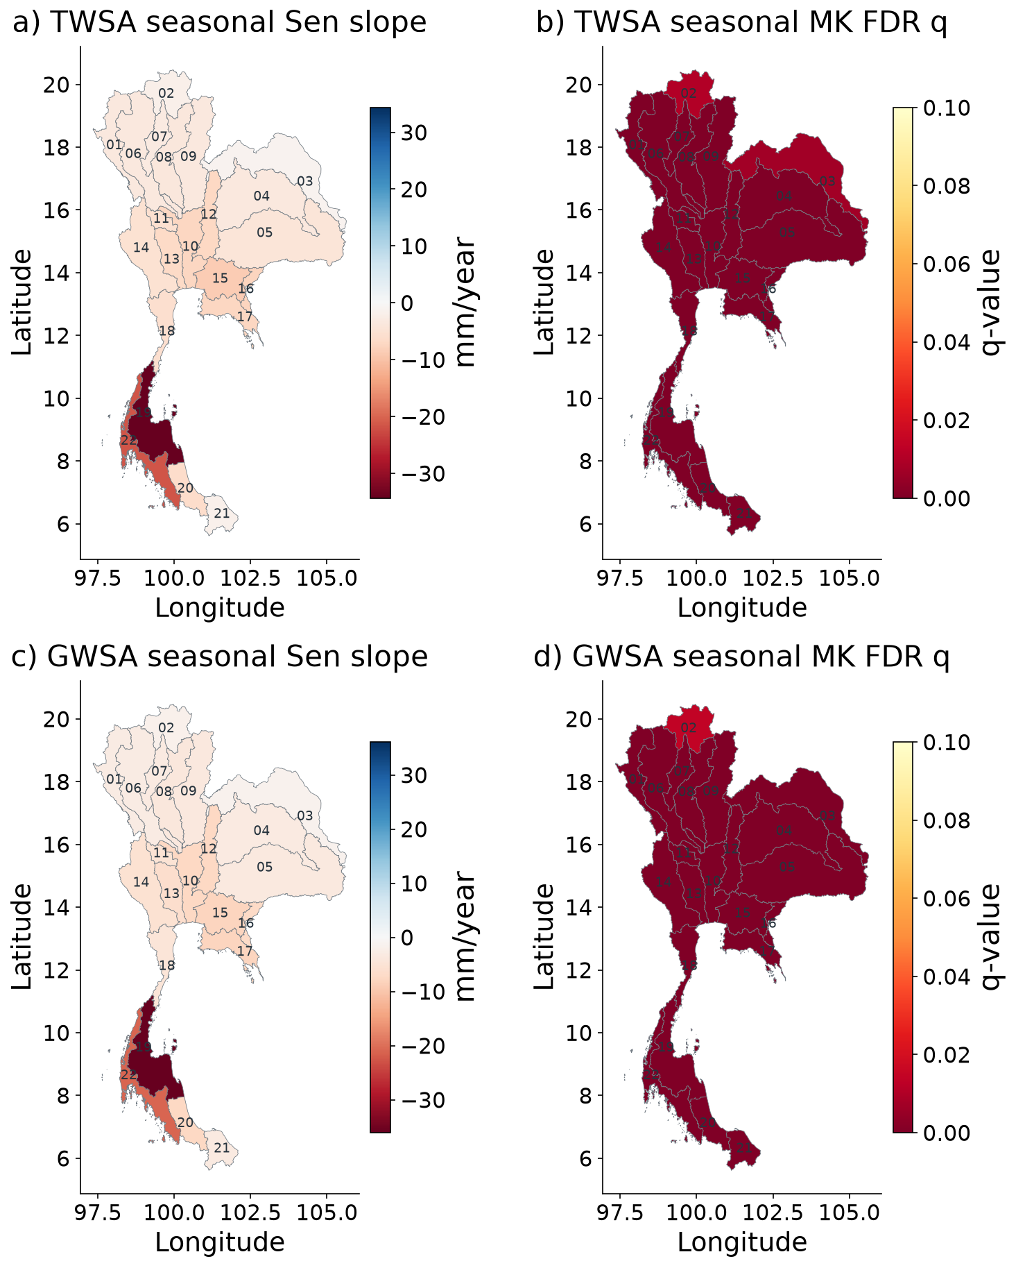
Spatial GRACE storage trends and Mann Kendall evidence
CSR basin-average trends; seasonal MK does not adjust serial dependence. All basins retain provider support cautions.
Farzeen Khan · AIT · October 2026
31 / 42
Notes:
CSR basin-average trends; seasonal MK does not adjust serial dependence. All basins retain provider support cautions.
Source: extended CSR-based study; the thesis, manuscript, analysis scripts and LaTeX Beamer source accompany this deck.

Slide 32
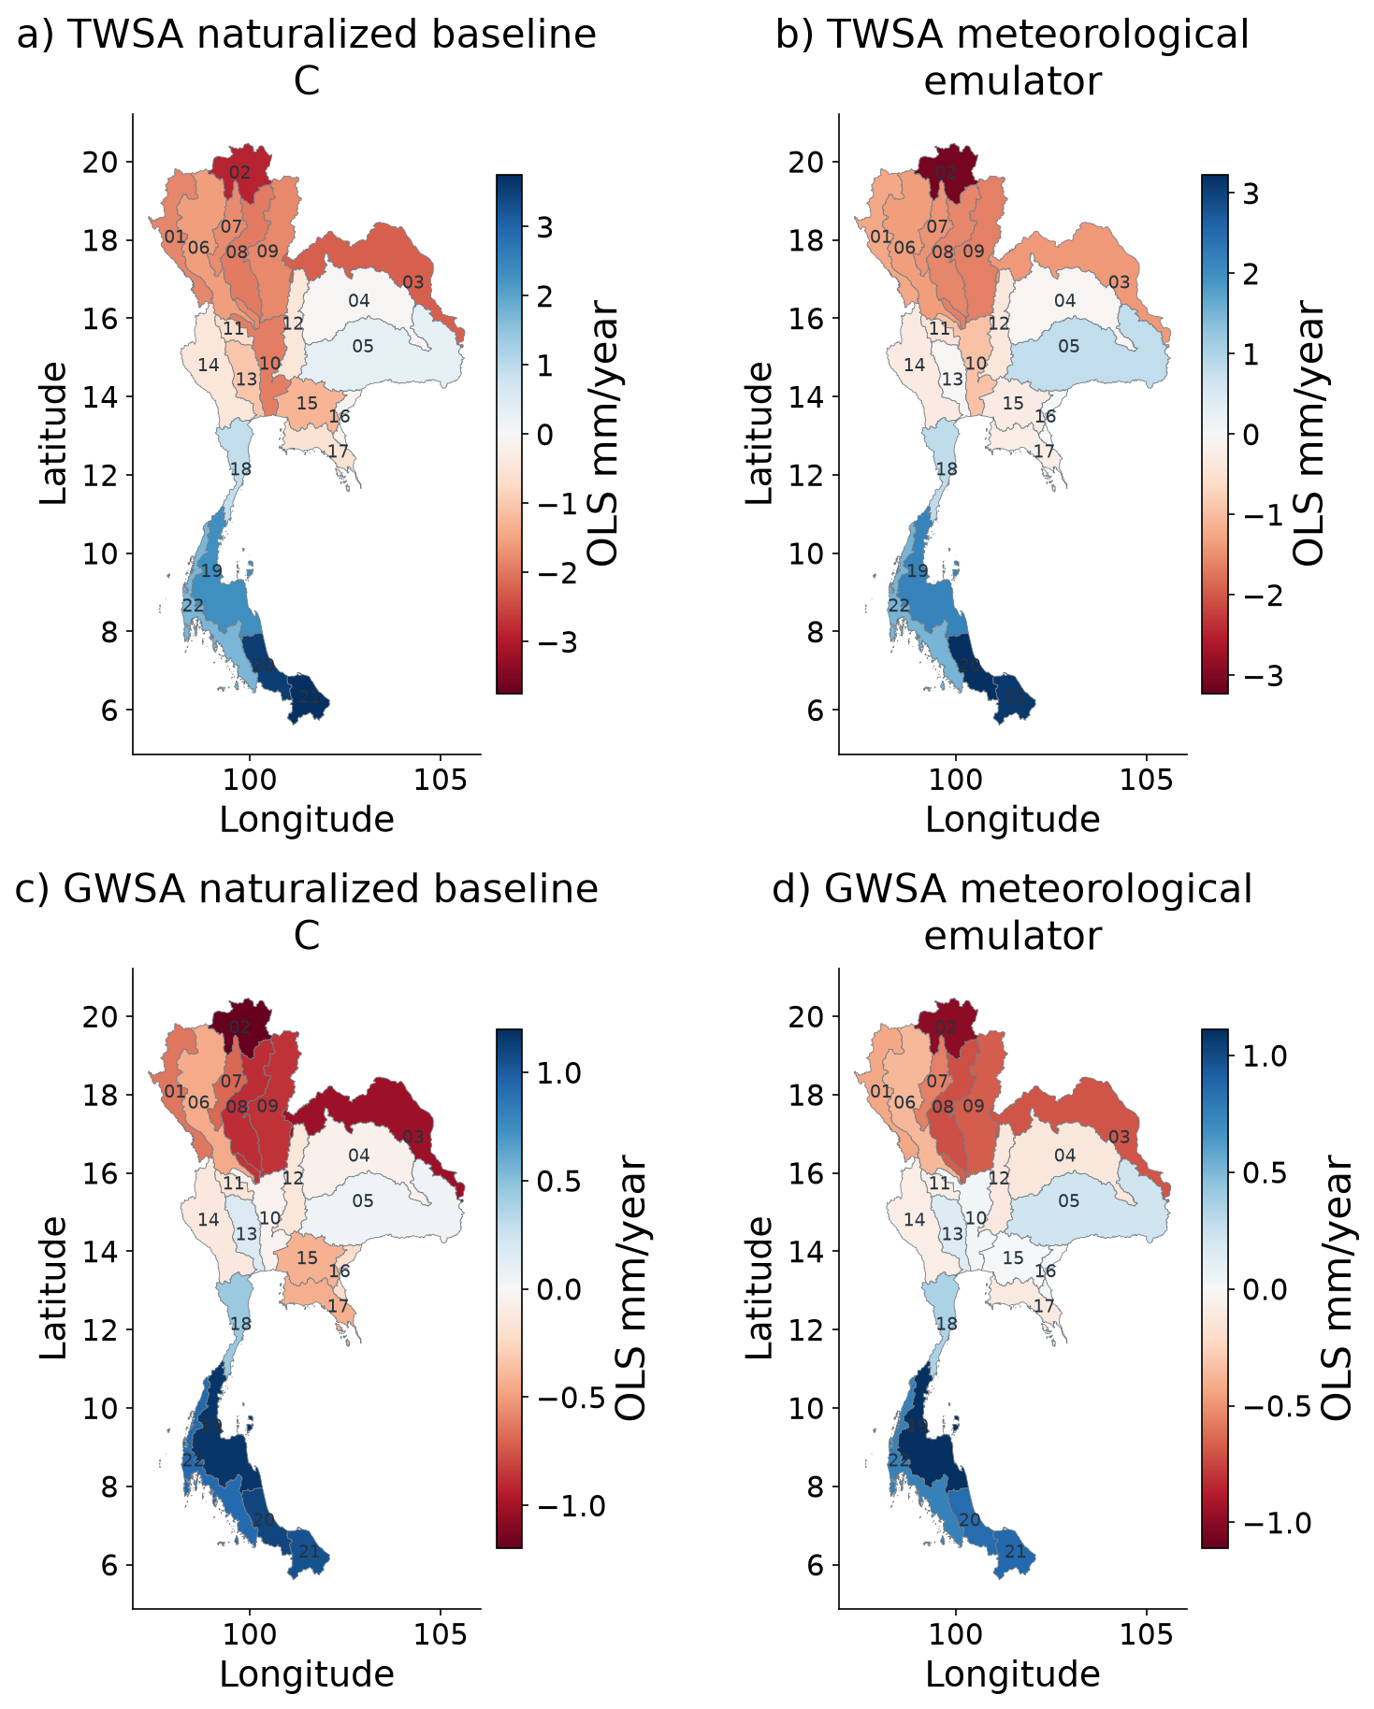
Spatial naturalized storage and climate reconstruction
Naturalized baseline C and statistical emulator are related model estimates; neither is an observed counterfactual.
Farzeen Khan · AIT · October 2026
32 / 42
Notes:
Naturalized baseline C and statistical emulator are related model estimates; neither is an observed counterfactual.
Source: extended CSR-based study; the thesis, manuscript, analysis scripts and LaTeX Beamer source accompany this deck.

Slide 33
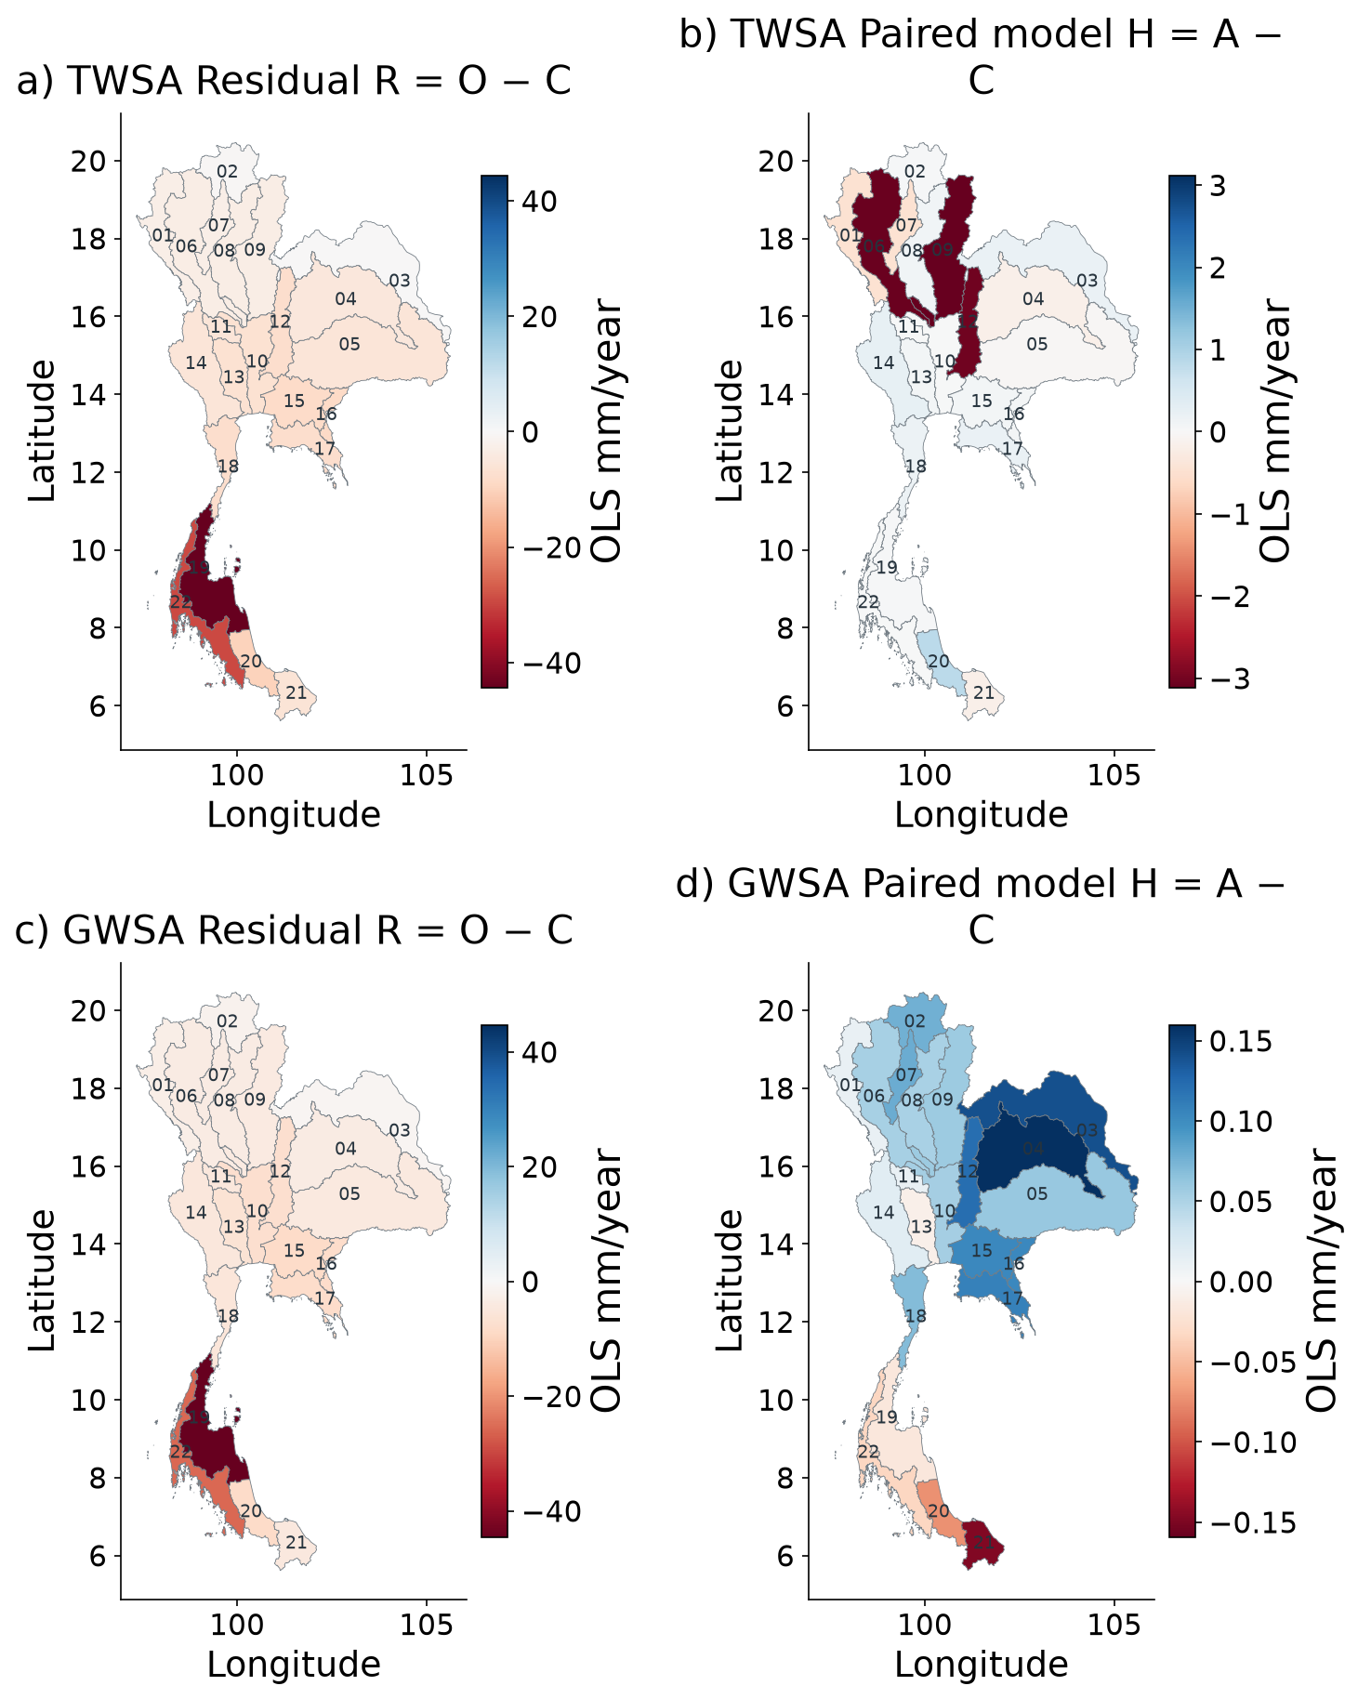
Spatial residual and modeled human perturbation
R = O − C = H + E; each panel has its own scale. H is the represented model perturbation, not pumping observations.
Farzeen Khan · AIT · October 2026
33 / 42
Notes:
R = O − C = H + E; each panel has its own scale. H is the represented model perturbation, not pumping observations.
Source: extended CSR-based study; the thesis, manuscript, analysis scripts and LaTeX Beamer source accompany this deck.

Slide 34
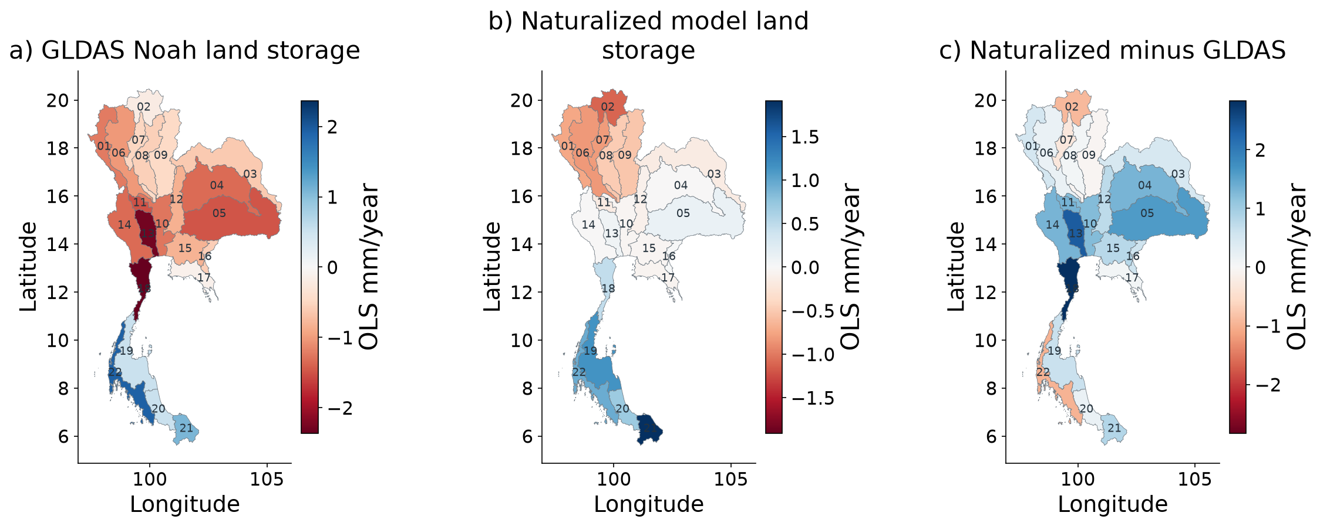
Spatial GLDAS matched compartment comparison
GLDAS and naturalized land storage both include soil, canopy and snow; no groundwater or surface water.
Farzeen Khan · AIT · October 2026
34 / 42
Notes:
GLDAS and naturalized land storage both include soil, canopy and snow; no groundwater or surface water.
Source: extended CSR-based study; the thesis, manuscript, analysis scripts and LaTeX Beamer source accompany this deck.

Slide 35
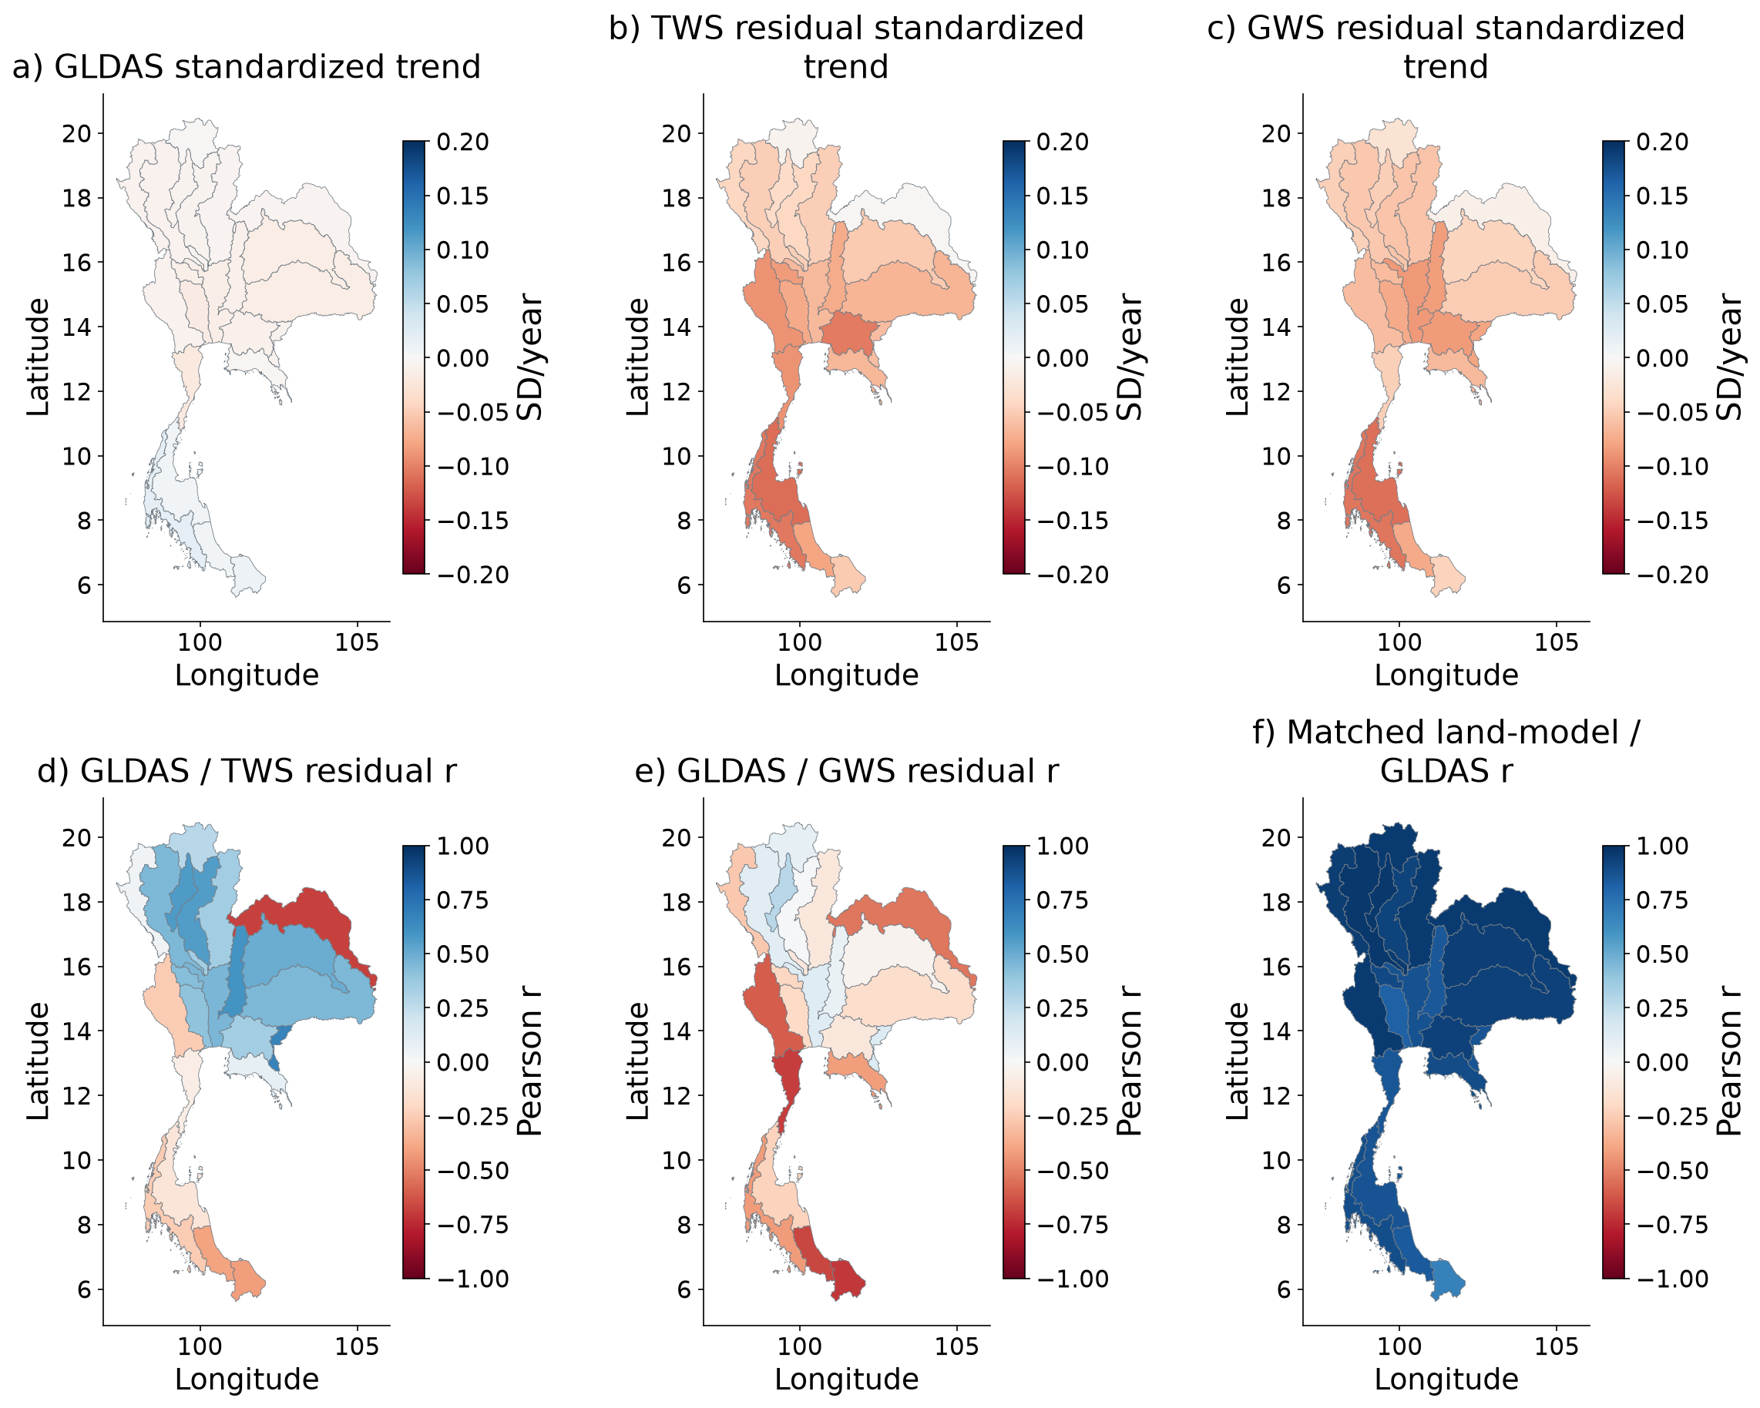
Spatial GLDAS and residual comparisons
Different compartments: standardized timing/shape comparisons, not a human-only validation target.
Farzeen Khan · AIT · October 2026
35 / 42
Notes:
Different compartments: standardized timing/shape comparisons, not a human-only validation target.
Source: extended CSR-based study; the thesis, manuscript, analysis scripts and LaTeX Beamer source accompany this deck.

Slide 36
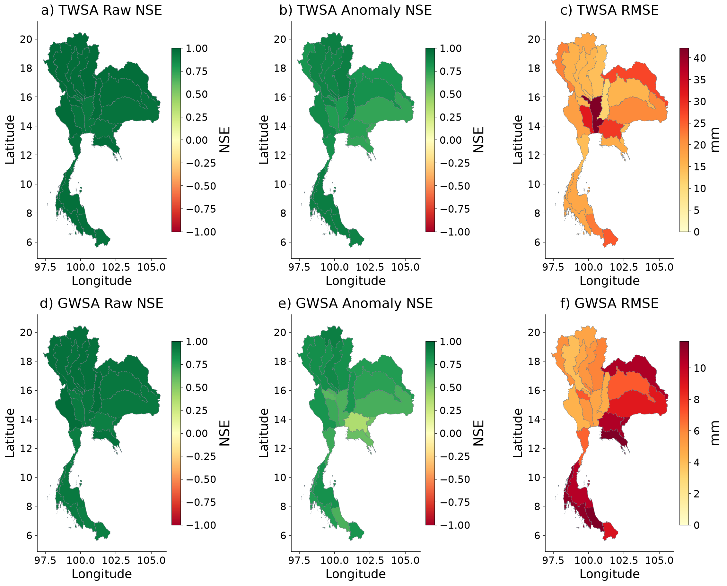
Spatial climate model evaluation
Frozen ensemble; 2016–2023 parent-model verification. NSE colours saturate below −1.
Farzeen Khan · AIT · October 2026
36 / 42
Notes:
Frozen ensemble; 2016–2023 parent-model verification. NSE colours saturate below −1.
Source: extended CSR-based study; the thesis, manuscript, analysis scripts and LaTeX Beamer source accompany this deck.

Slide 37
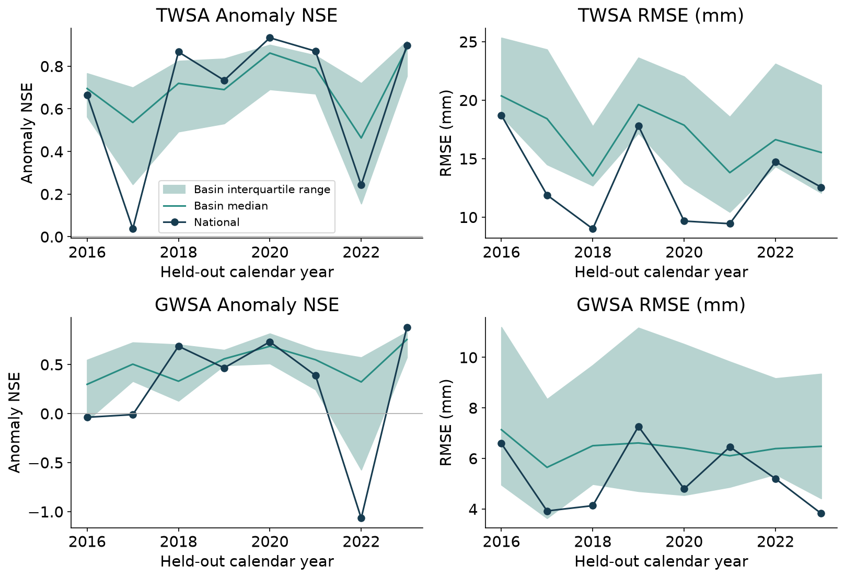
Climate model evaluation through time
Annual diagnostics use 12 modeled months; spatial IQR is not a confidence interval.
Farzeen Khan · AIT · October 2026
37 / 42
Notes:
Annual diagnostics use 12 modeled months; spatial IQR is not a confidence interval.
Source: extended CSR-based study; the thesis, manuscript, analysis scripts and LaTeX Beamer source accompany this deck.

Slide 38
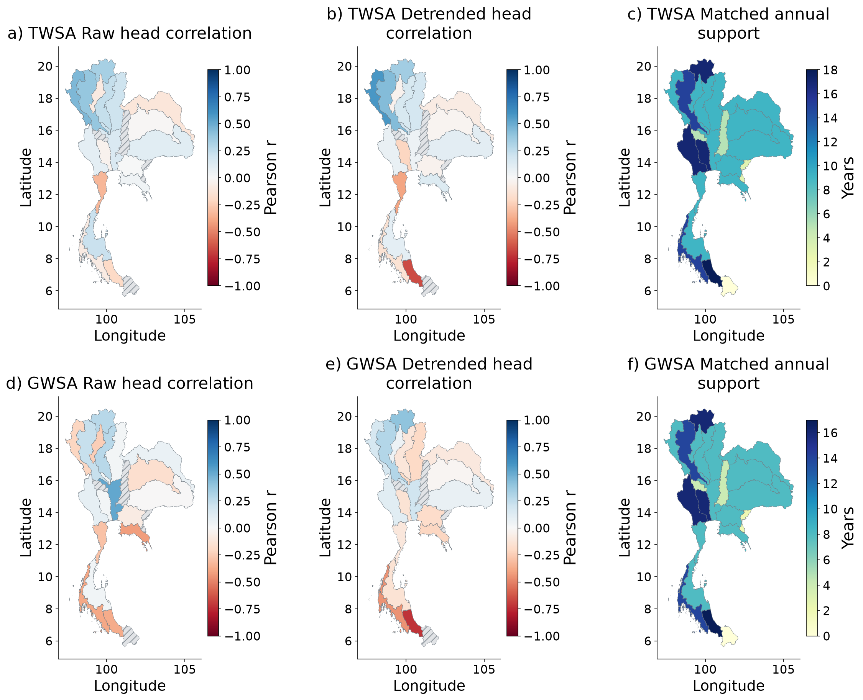
Spatial evaluation of residual agreement with groundwater
Head correlations and annual support; hatching means insufficient evidence, not zero effect.
Farzeen Khan · AIT · October 2026
38 / 42
Notes:
Head correlations and annual support; hatching means insufficient evidence, not zero effect.
Source: extended CSR-based study; the thesis, manuscript, analysis scripts and LaTeX Beamer source accompany this deck.

Slide 39
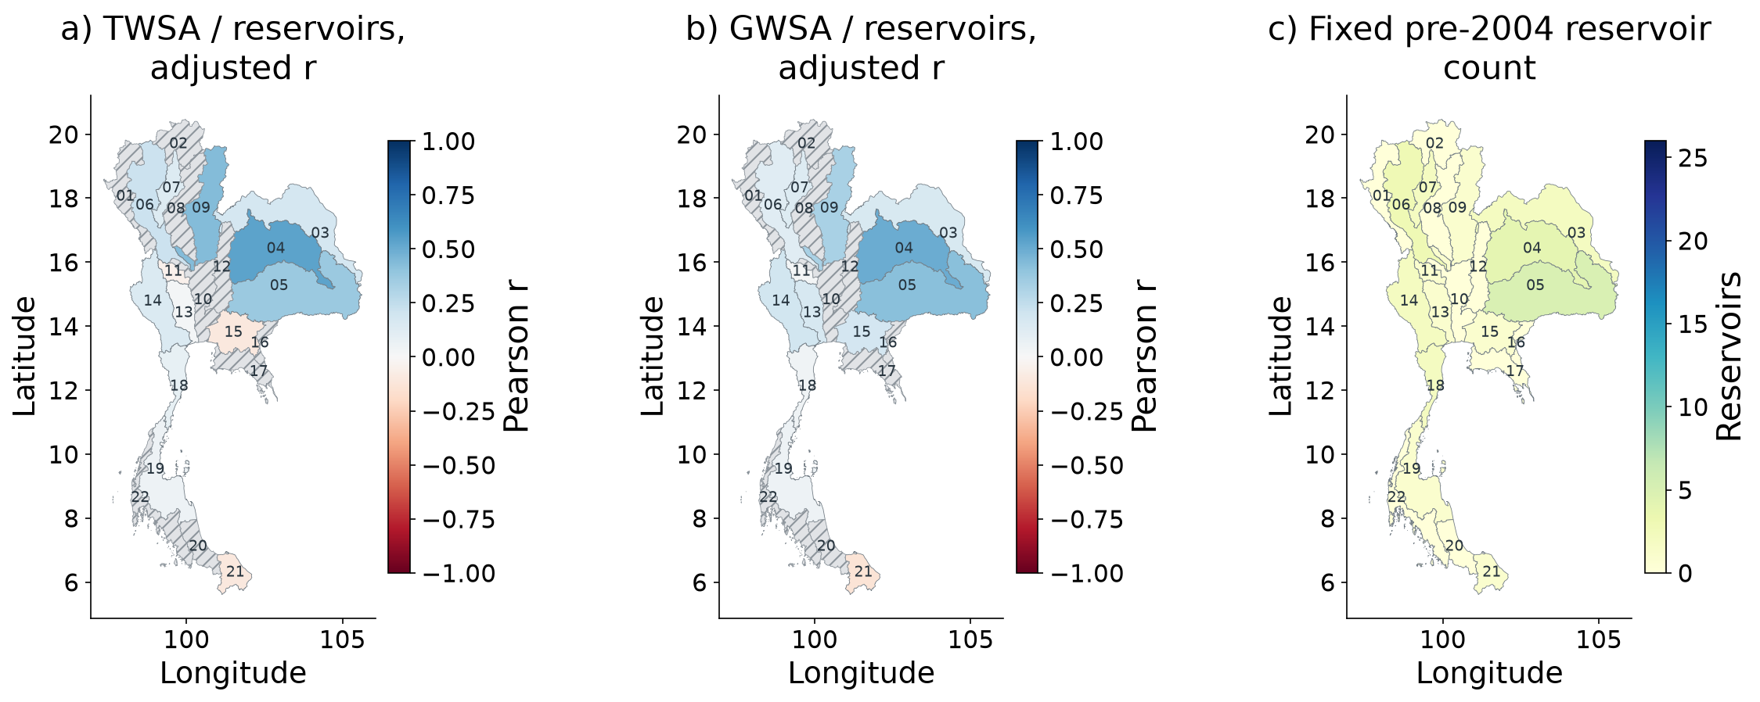
Spatial independent reservoir component evidence
Independent MSEA-Res scene estimates; reservoir changes respond to both climate and operations.
Farzeen Khan · AIT · October 2026
39 / 42
Notes:
Independent MSEA-Res scene estimates; reservoir changes respond to both climate and operations.
Source: extended CSR-based study; the thesis, manuscript, analysis scripts and LaTeX Beamer source accompany this deck.

Slide 40
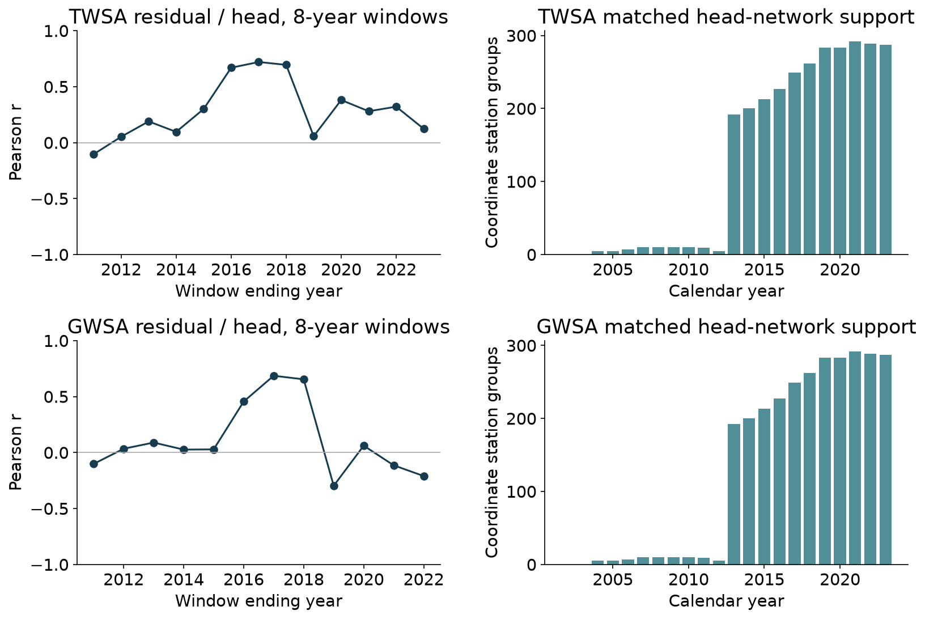
Residual validation metrics and network support through time
Overlapping 8-year windows require six annual pairs. Station counts are not temporal sample sizes.
Farzeen Khan · AIT · October 2026
40 / 42
Notes:
Overlapping 8-year windows require six annual pairs. Station counts are not temporal sample sizes.
Source: extended CSR-based study; the thesis, manuscript, analysis scripts and LaTeX Beamer source accompany this deck.

Slide 41
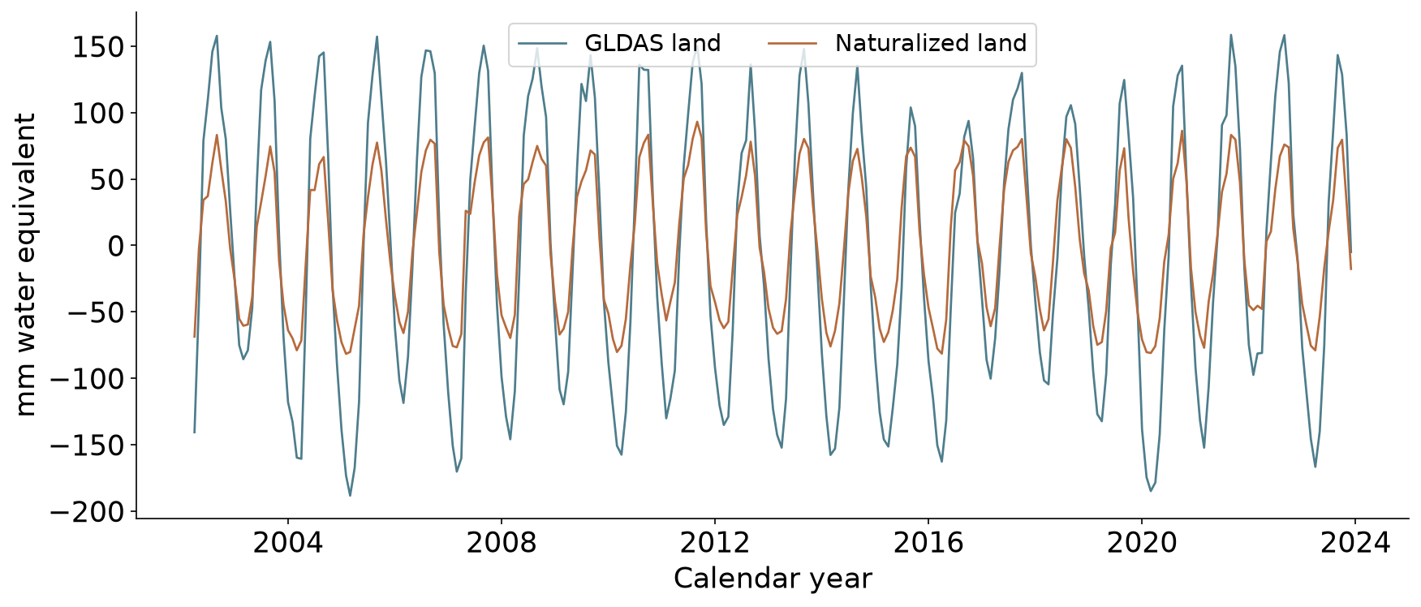
Matched GLDAS comparison through time
National soil + canopy + snow comparison. The revised report and manuscript include temporal subplots for all 22 basins.
Farzeen Khan · AIT · October 2026
41 / 42
Notes:
National soil + canopy + snow comparison. The revised report and manuscript include temporal subplots for all 22 basins.
Source: extended CSR-based study; the thesis, manuscript, analysis scripts and LaTeX Beamer source accompany this deck.

Slide 42
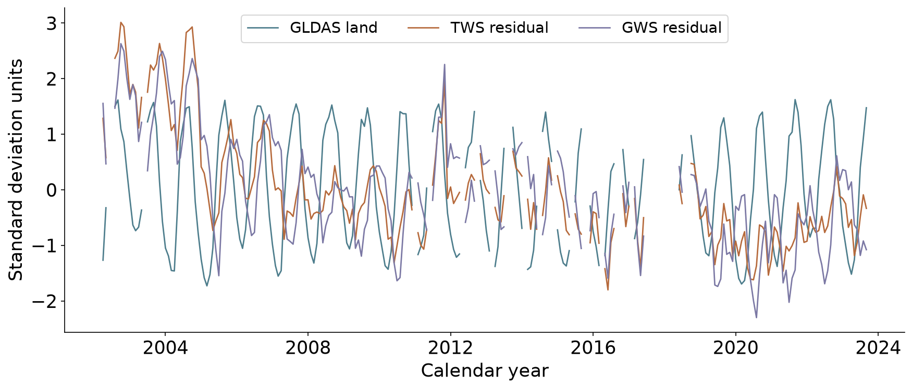
GLDAS and residual timing comparison
Separately standardized on joint observed months. GLDAS land storage does not represent human-only residual ground truth.
Farzeen Khan · AIT · October 2026
42 / 42
Notes:
Separately standardized on joint observed months. GLDAS land storage does not represent human-only residual ground truth.
Source: extended CSR-based study; the thesis, manuscript, analysis scripts and LaTeX Beamer source accompany this deck.

