Slide 1
Water storage change across Thailand
A basin assessment of climate variability and the remaining residual
Farzeen Khan
MS in Water Engineering and Management
Asian Institute of Technology
Advisor: Dr. Natthachet Tangdamrongsub

Slide 2
Why water storage matters
Rainfall tells us how much water arrives. Storage tells us how much remains.
Total water storage includes soil, rivers, reservoirs and groundwater.
This study examines monthly changes across all 22 principal basins.
Introduction
2 / 32

Slide 3
The problem is identifying the cause
Storage can fall during drought, increased water use, or both.
GRACE observes total water mass; it does not observe pumping separately.
A model residual needs additional evidence before it can be called a human effect.
Background and problem
3 / 32

Slide 4
Three research objectives
Objective | Output
1 Storage change | Basin trends and monthly TWSA / GWSA
2 Climate and residual | Evaluated reconstruction and component checks
3 Decision support | Interactive basin website and runnable code
Objectives
4 / 32

Slide 5
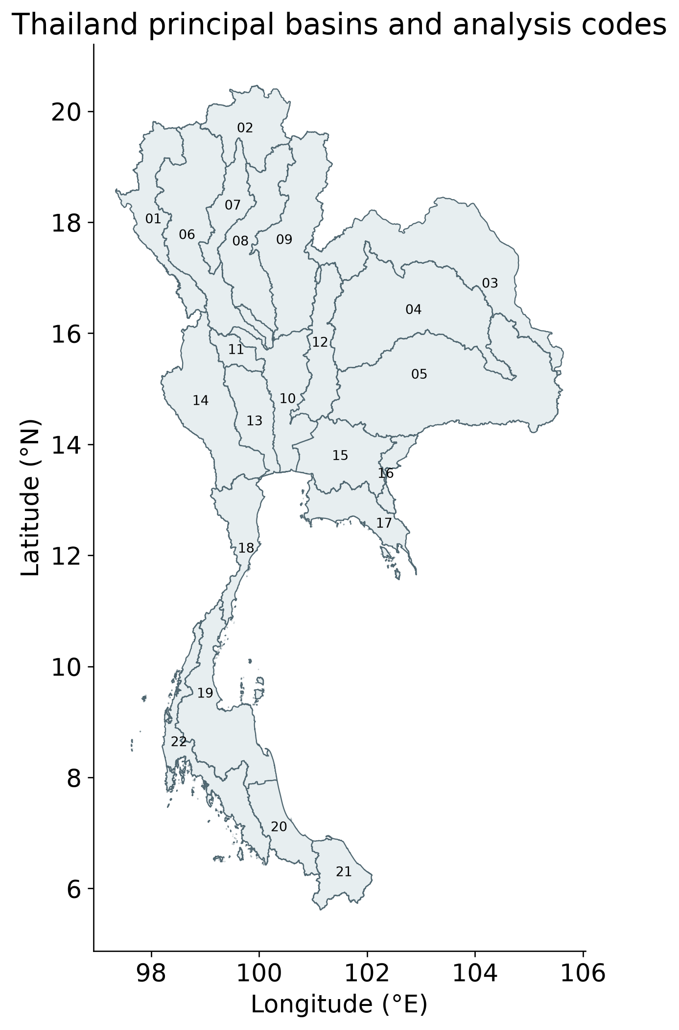
Thailand’s 22 principal basins
Interpretation
Every basin is included in the maps and tables.
The polygons report basin averages; they do not create independent GRACE resolution.
See the report for dates, sample counts and uncertainty.
Study area
5 / 32
Notes:
Every basin is included in the maps and tables.
The polygons report basin averages; they do not create independent GRACE resolution.

Slide 6
What each dataset contributes
Data | Question it addresses
GRACE and storage components | How is total / groundwater storage changing?
Naturalized model and weather | Can climate-related storage be reconstructed?
GLDAS matching land storage | Do soil, canopy and snow estimates agree?
Wells and reservoir scenes | What independent component evidence exists?
Data collection
6 / 32

Slide 7
Method 1 calculate storage and trends
Groundwater = total − soil − surface − canopy − snow storage.
Use common units, the 2004–2009 reference and valid spatial support.
Seasonal Sen slopes describe the rate of change; Mann–Kendall tests assess ordered change.
A negative anomaly is storage below the reference, not a negative absolute water volume.
Methodology
7 / 32
Notes:
A negative anomaly is storage below the reference, not a negative absolute water volume.

Slide 8
Method 2 test the climate reconstruction
Stage | Period | Purpose
Warm-up | 1981–1990 | Initialize weather memory
Training | 1991–2009 | Fit weather-storage relationships
Validation | 2010–2015 | Select models and weights
Testing | 2016–2023 | Evaluate unseen years
NSE: 1 perfect; 0 mean benchmark; negative worse. Anomaly NSE removes the training seasonal cycle.
Methodology
8 / 32
Notes:
NSE: 1 perfect; 0 mean benchmark; negative worse. Anomaly NSE removes the training seasonal cycle.

Slide 9
Method 3 interpret the residual
Residual = observed storage − naturalized climate baseline.
It contains the model’s human effect plus an unexplained observation-model gap.
Check matching GLDAS compartments, groundwater levels and reservoirs separately.
The weather emulator reconstructs the naturalized parent. It does not independently observe the true climate-only counterfactual.
Methodology
9 / 32
Notes:
The weather emulator reconstructs the naturalized parent. It does not independently observe the true climate-only counterfactual.

Slide 10
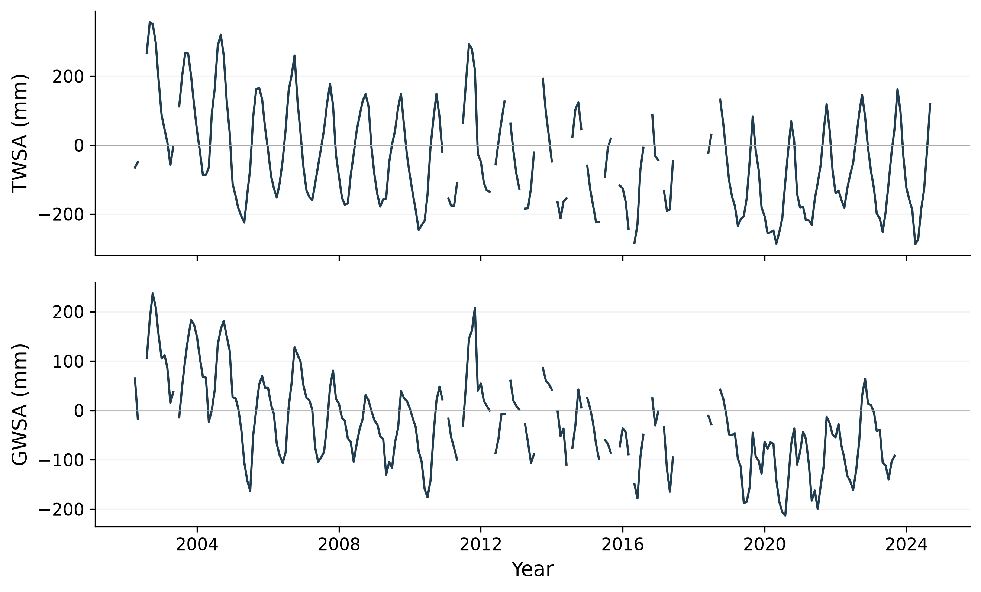
National storage declines
Interpretation
Total storage: −7.51 mm/year.
Derived groundwater: −6.84 mm/year.
Wet-year recovery can occur within a longer decline.
See the report for dates, sample counts and uncertainty.
Results
10 / 32
Notes:
TWSA uses the primary CSR record through September 2024; derived GWSA ends September 2023. Missing satellite months remain gaps. Negative anomalies mean storage below the 2004–2009 reference, not a negative absolute water volume.
Total storage: −7.51 mm/year.
Derived groundwater: −6.84 mm/year.
Wet-year recovery can occur within a longer decline.

Slide 11
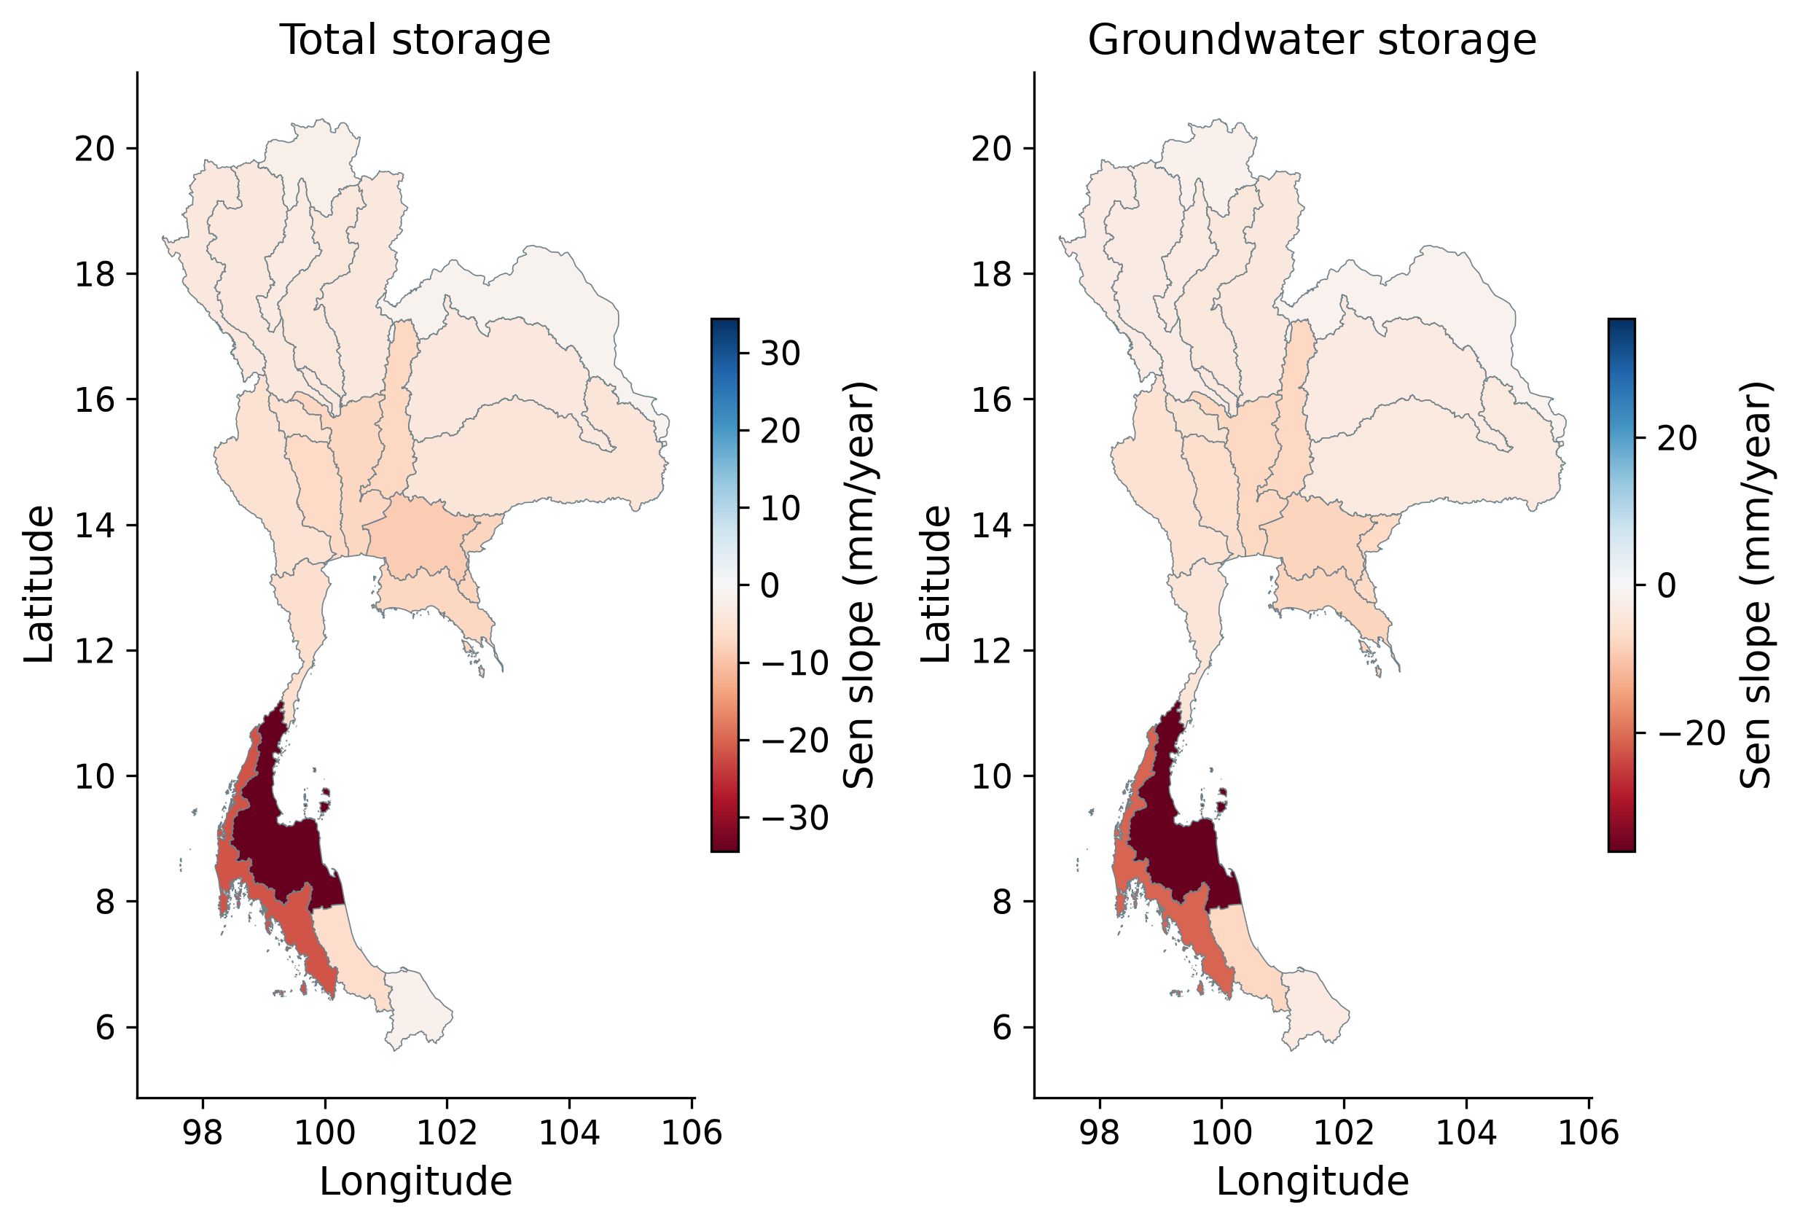
Trend magnitude varies across basins
Interpretation
Negative colours indicate declining storage.
Use the map for regional screening; neighbouring basins share gravity support.
See the report for dates, sample counts and uncertainty.
Results
11 / 32
Notes:
Seasonal Sen slopes for all 22 basins. Negative rates indicate decline. Basin significance, intervals and sample counts are reported separately. All basins share broad GRACE support.
Negative colours indicate declining storage.
Use the map for regional screening; neighbouring basins share gravity support.

Slide 12
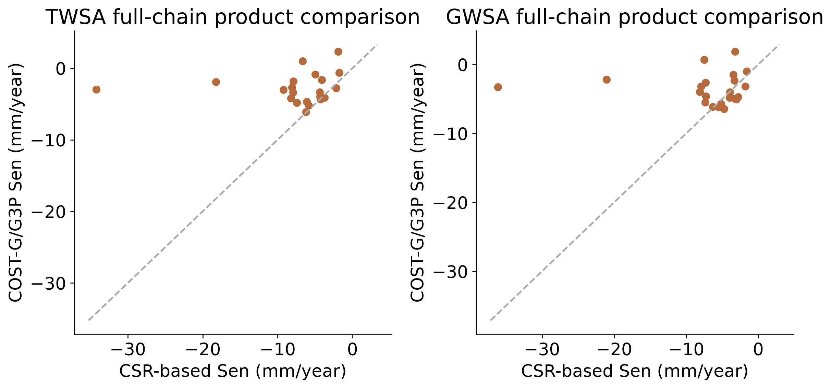
Basin rankings depend on the processing chain
Interpretation
National decline persists in both chains.
Basin rank agreement is weak: 0.138 for total and 0.027 for groundwater.
See the report for dates, sample counts and uncertainty.
Results
12 / 32
Notes:
Common-date basin trends differ across CSR and COST-G/G3P. Rank correlations are 0.138 for TWSA and 0.027 for GWSA; both gravity and compartment processing differ.
National decline persists in both chains.
Basin rank agreement is weak: 0.138 for total and 0.027 for groundwater.

Slide 13
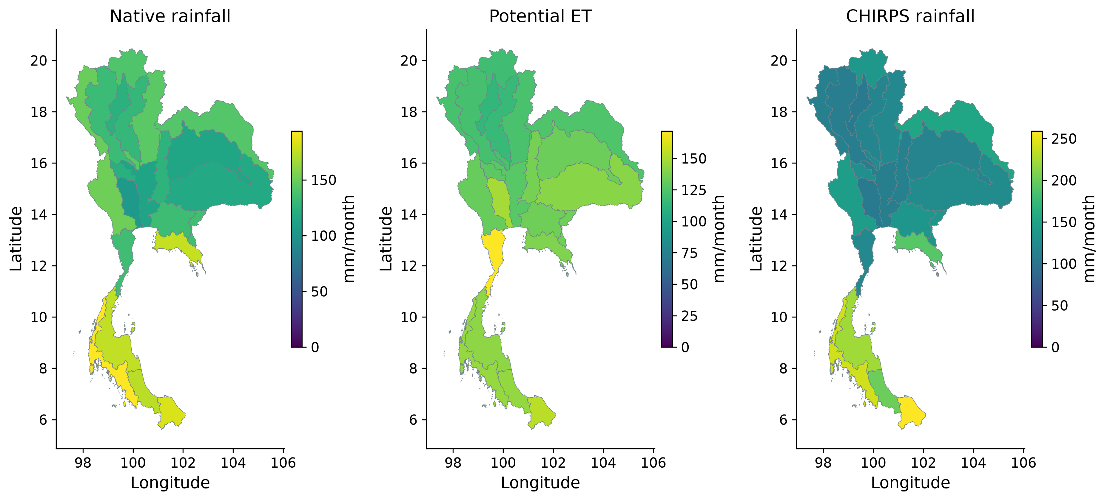
Rainfall and atmospheric demand vary in space
Interpretation
Rainfall and potential ET are the model inputs.
These are monthly fluxes; they are not stored water.
See the report for dates, sample counts and uncertainty.
Results
13 / 32
Notes:
Available-month means, 2003–2023. Native rainfall and PET drive the reconstruction; CHIRPS supplies alternative rainfall. Monthly fluxes are distinct from storage anomalies.
Rainfall and potential ET are the model inputs.
These are monthly fluxes; they are not stored water.

Slide 14
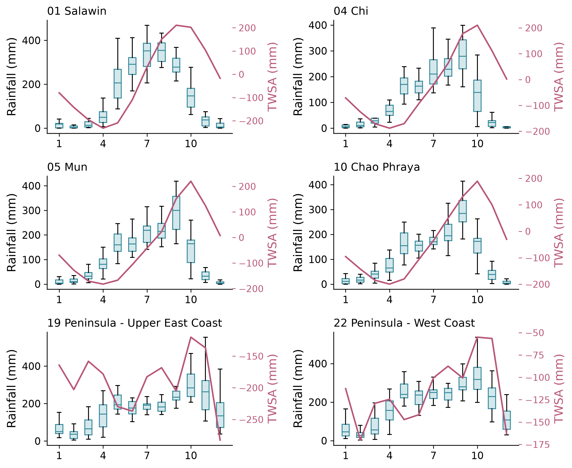
Storage responds to the seasonal water balance
Interpretation
Blue boxes show rainfall by month. Pink shows mean storage on the right axis.
Storage integrates preceding rainfall and losses. Six geographical examples are shown.
See the report for dates, sample counts and uncertainty.
Results
14 / 32
Notes:
Six geographically distributed illustrative basins; all 22 remain in the numerical release. Boxes show interannual native rainfall by month (quartiles and 1.5-IQR whiskers; outliers suppressed); pink line is mean observed TWSA on its own right-hand axis. Distribution spread is not a confidence interval.
Blue boxes show rainfall by month. Pink shows mean storage on the right axis.
Storage integrates preceding rainfall and losses. Six geographical examples are shown.

Slide 15
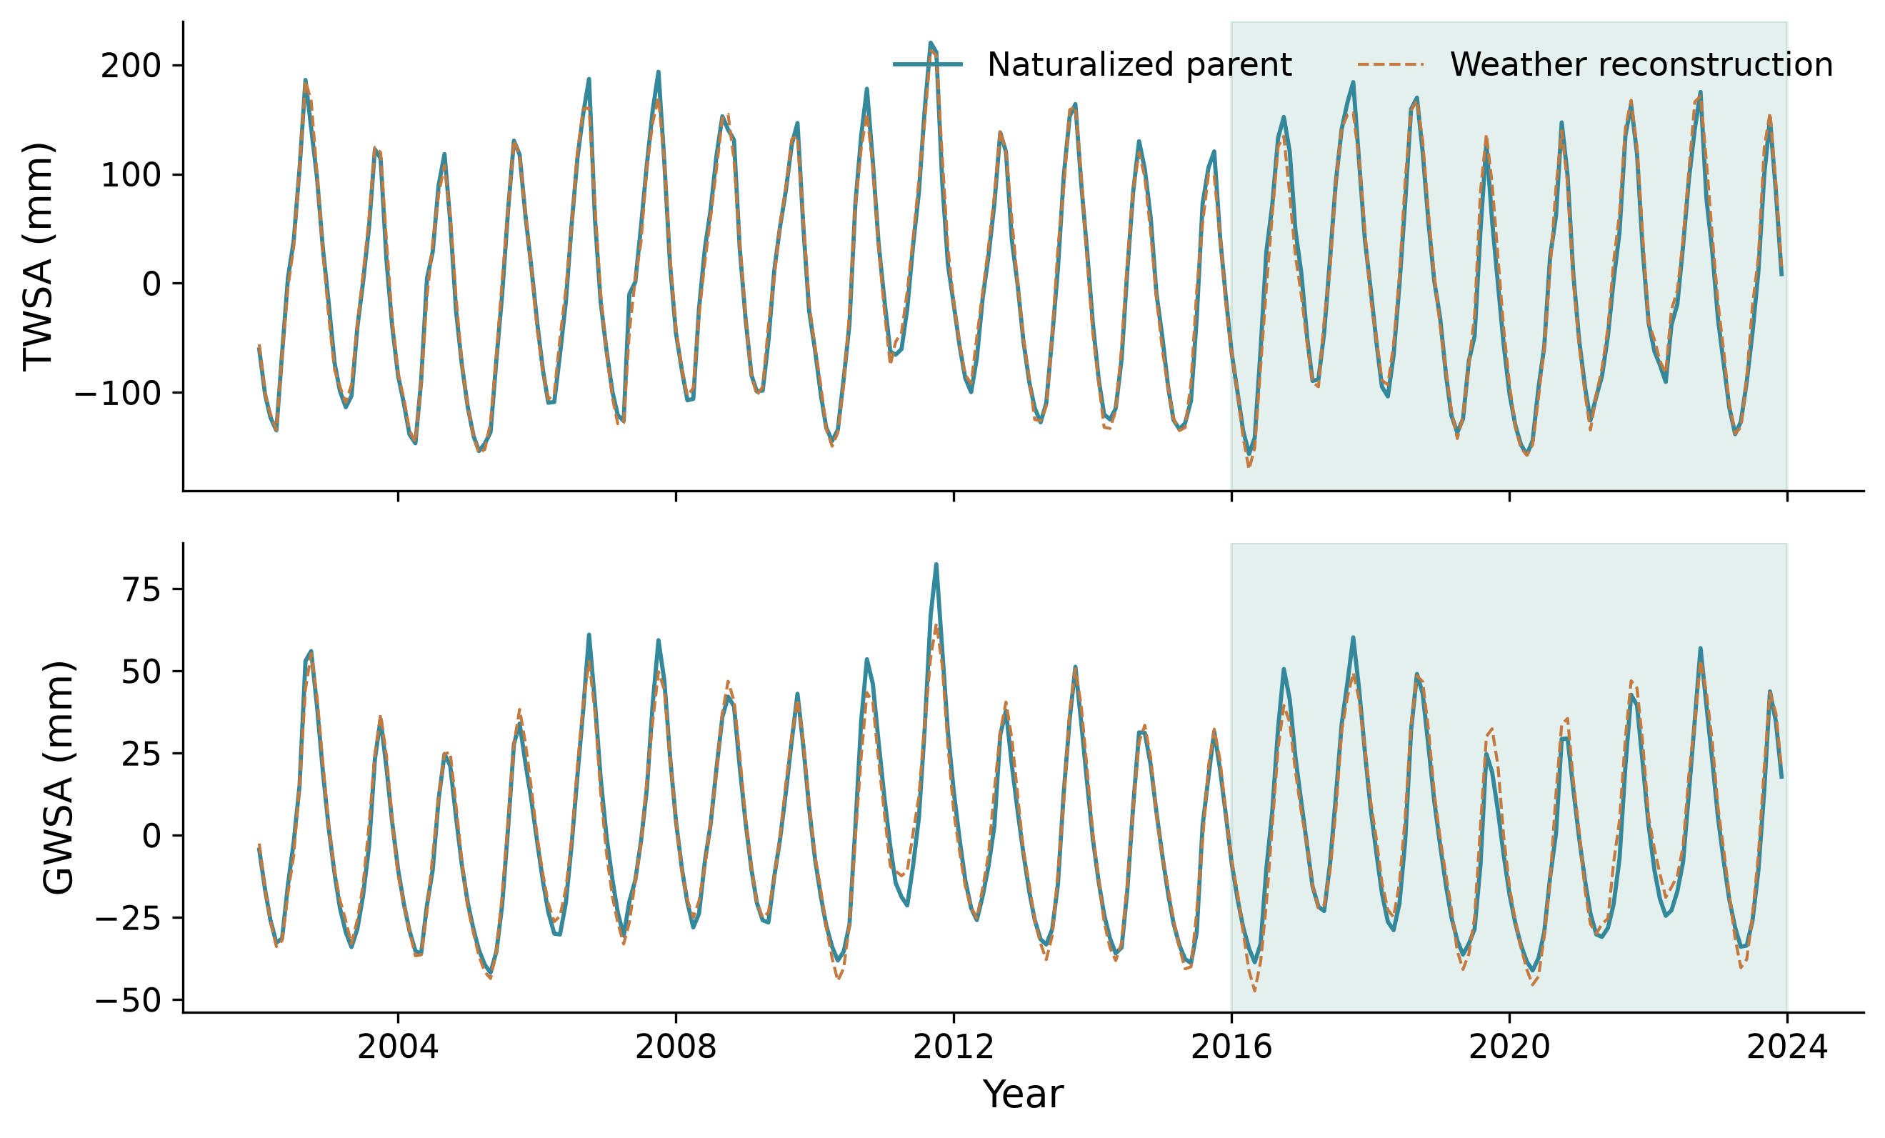
Weather reconstructs the naturalized parent
Interpretation
Shaded years are unseen test data.
High agreement evaluates the parent model; it does not prove climate-only observational accuracy.
See the report for dates, sample counts and uncertainty.
Results
15 / 32
Notes:
The shaded years 2016–2023 were excluded from training and model selection. Close curves show reconstruction of the parent model; they do not independently establish the true natural climate counterfactual.
Shaded years are unseen test data.
High agreement evaluates the parent model; it does not prove climate-only observational accuracy.

Slide 16
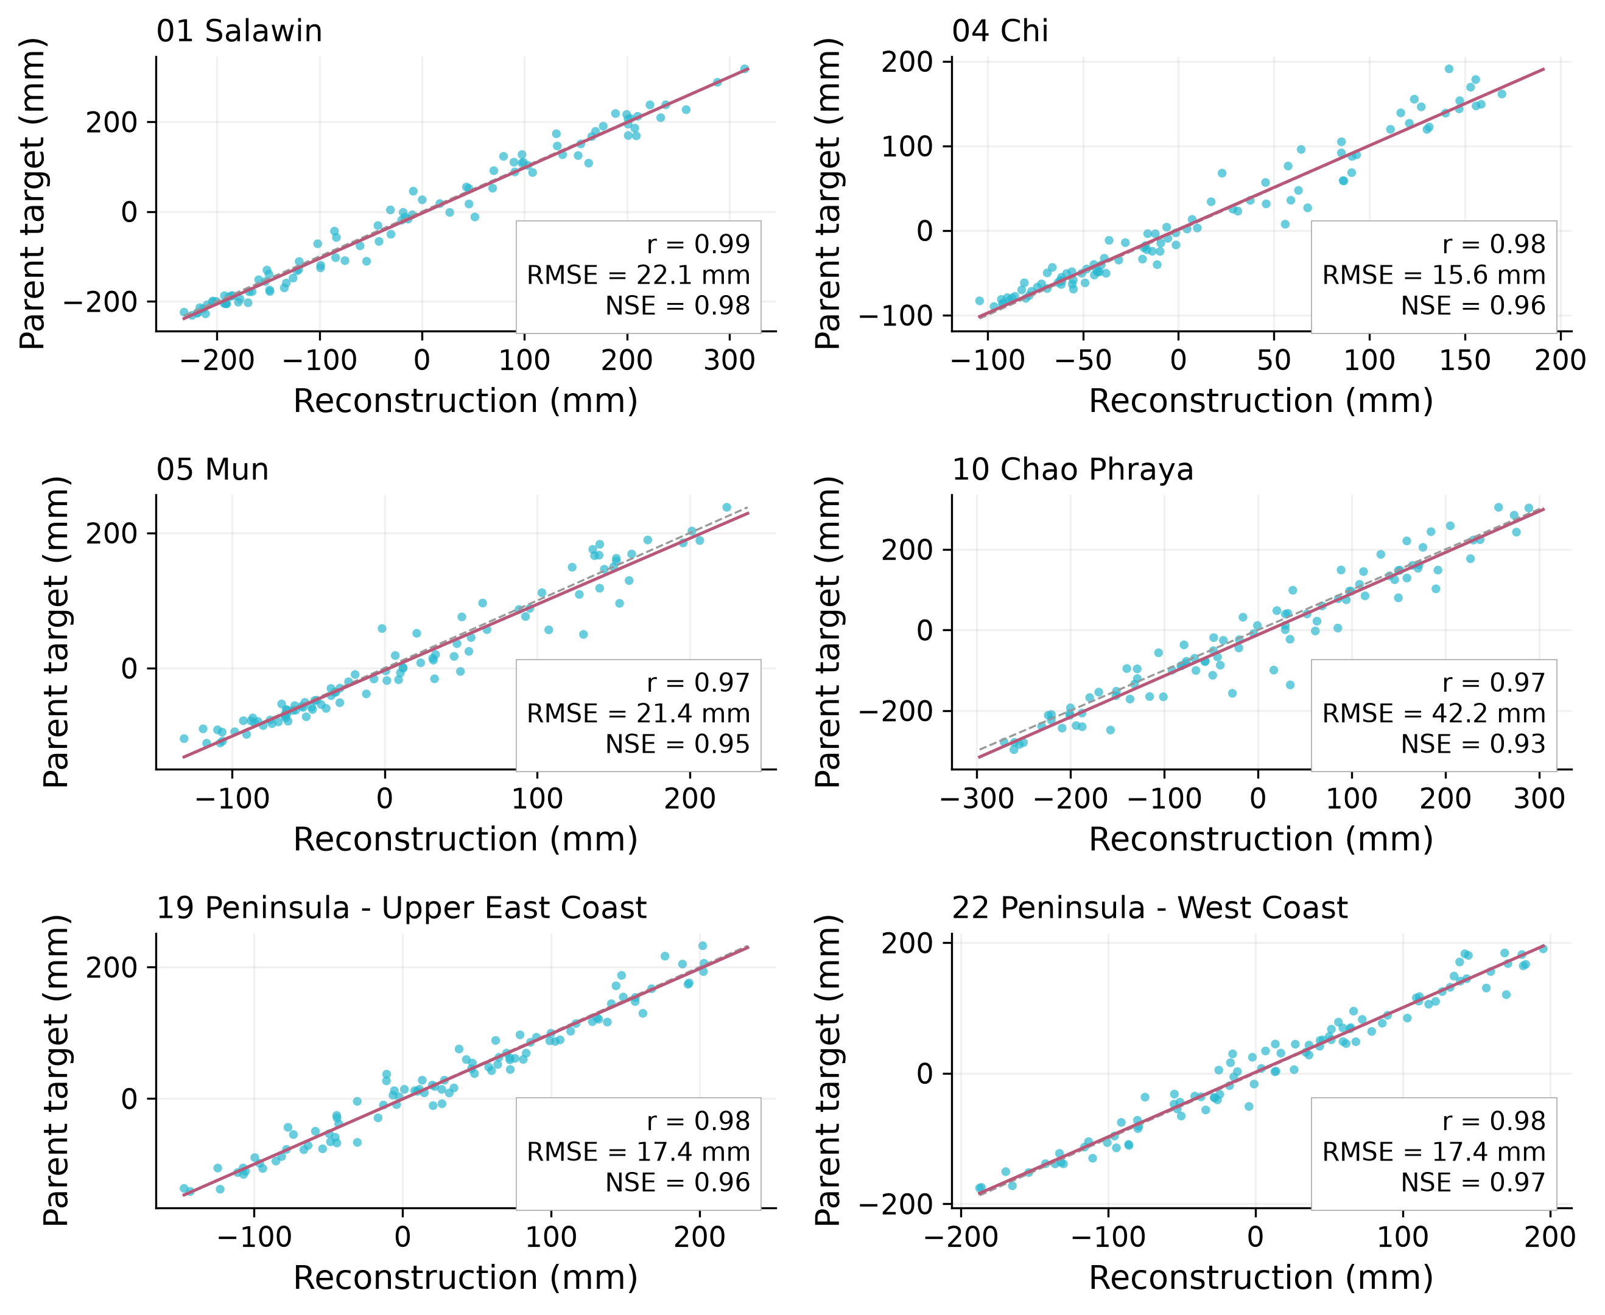
Held-out predictions are close to their target
Interpretation
The grey line is perfect agreement.
RMSE is error in mm; NSE compares error with a mean benchmark. All 22 basin scores are reported.
See the report for dates, sample counts and uncertainty.
Results
16 / 32
Notes:
2016–2023 test months, six geographical examples. Grey is identity; pink is a descriptive fit. Metrics compare predictions directly with the parent target. Basin selection is geographic, not based on model performance; all 22 basin metrics are provided.
The grey line is perfect agreement.
RMSE is error in mm; NSE compares error with a mean benchmark. All 22 basin scores are reported.

Slide 17
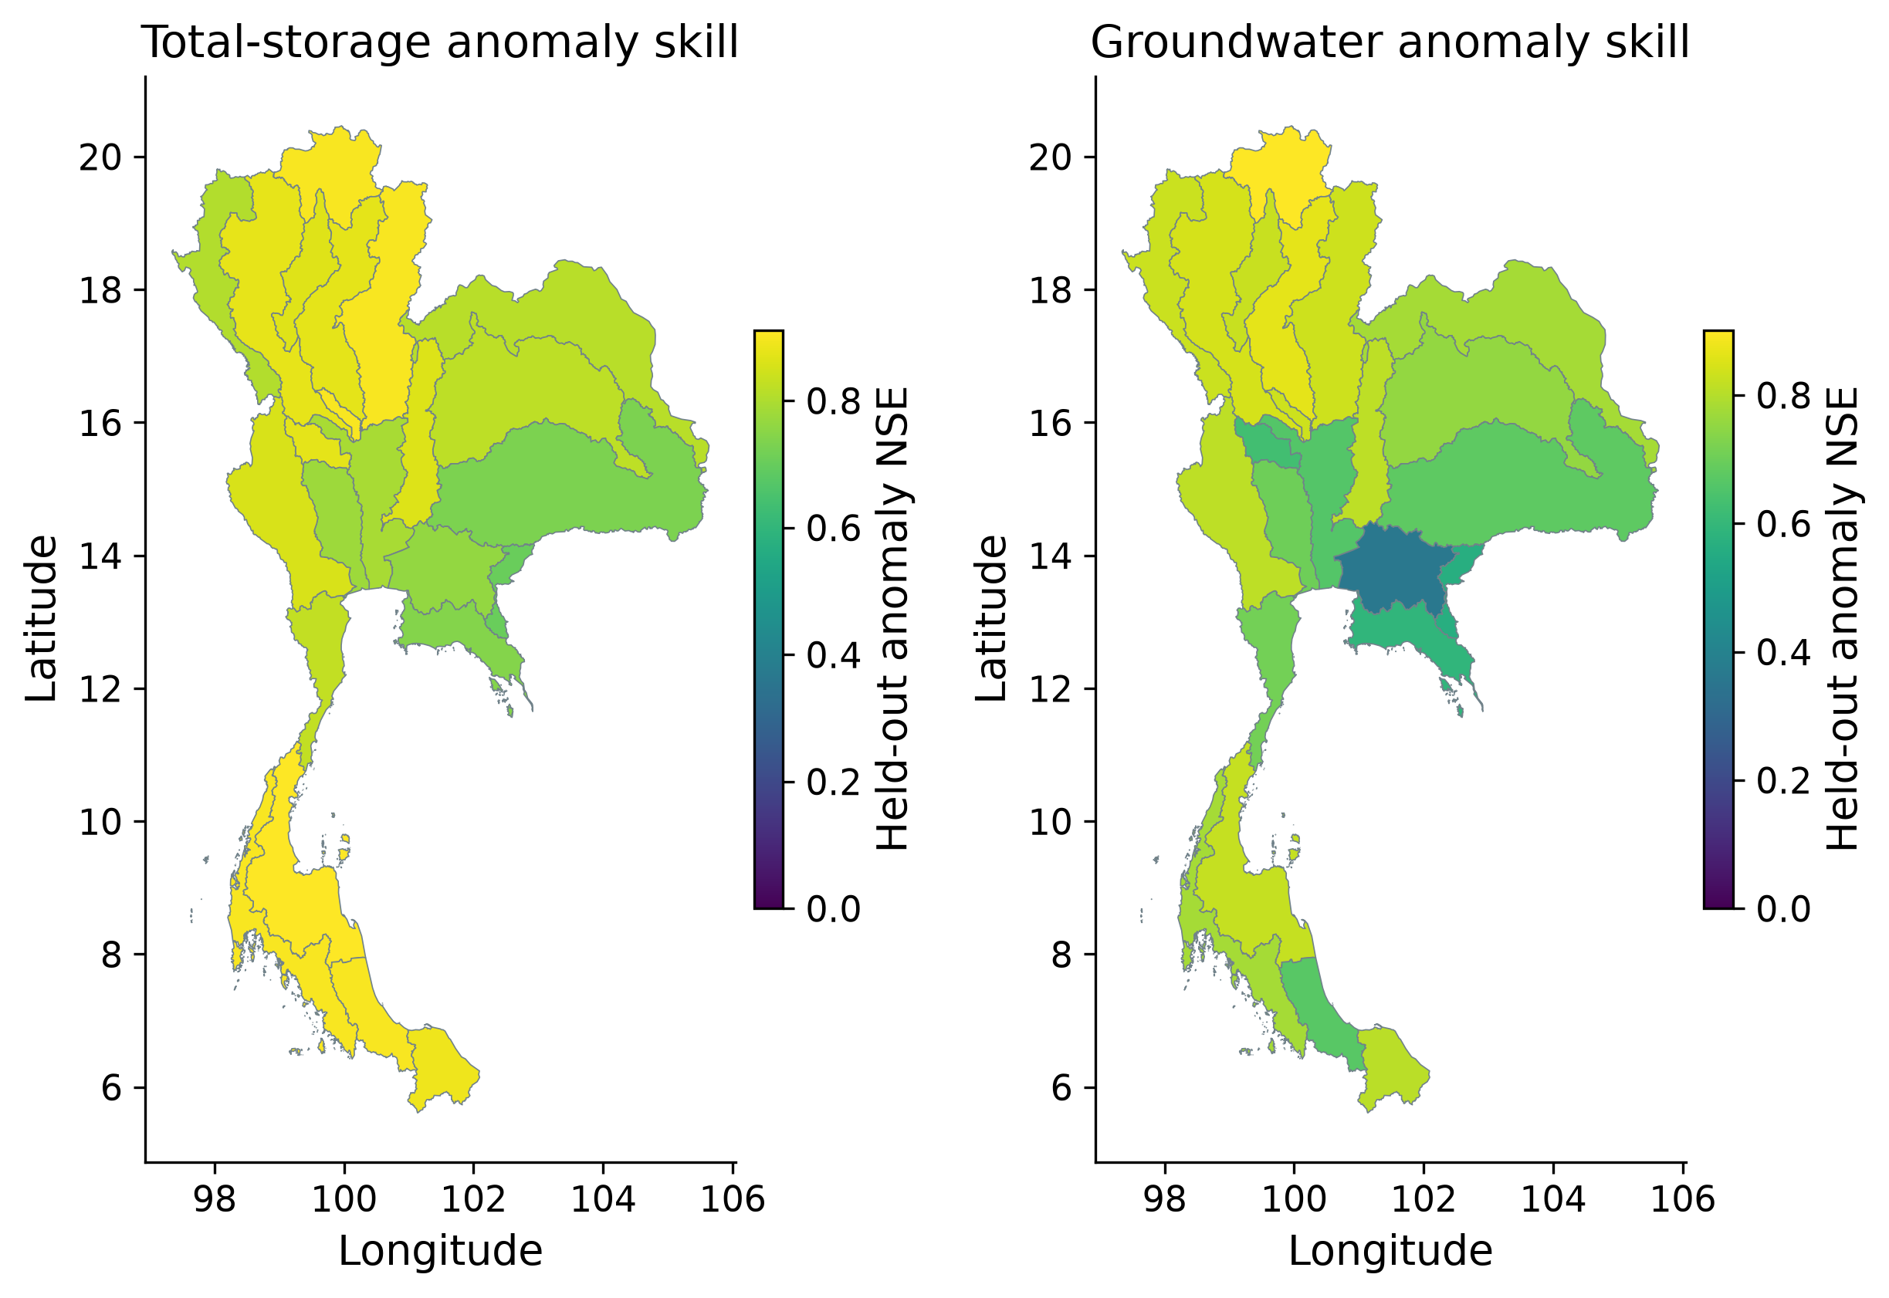
Anomaly skill is not spatially uniform
Interpretation
Higher NSE means better reconstruction.
Anomaly skill removes the usual seasonal cycle, giving a stricter test.
See the report for dates, sample counts and uncertainty.
Results
17 / 32
Notes:
NSE compares squared error with the target-mean benchmark; 1 is perfect, 0 equals that benchmark and negative is worse. Monthly climatology comes only from training. The target is naturalized WaterGAP.
Higher NSE means better reconstruction.
Anomaly skill removes the usual seasonal cycle, giving a stricter test.

Slide 18
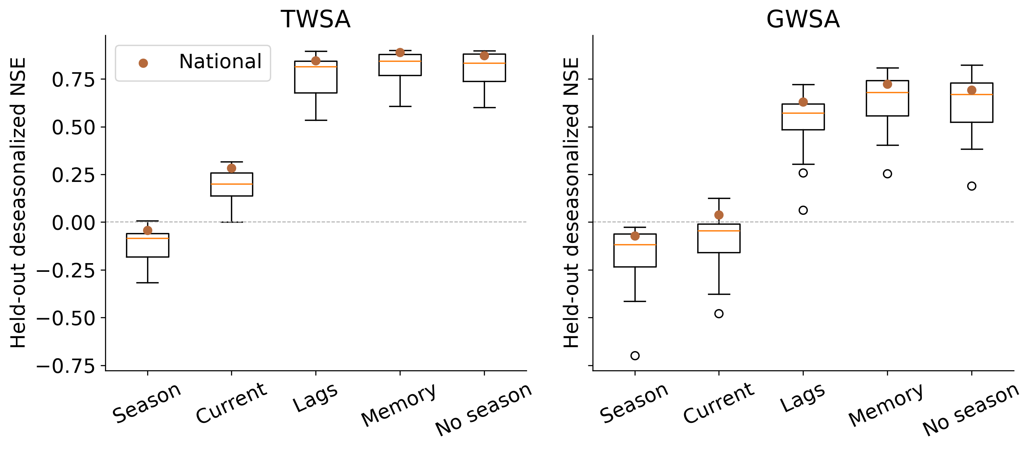
Climate memory improves reconstruction
Interpretation
Past weather adds information beyond current rainfall and PET.
National anomaly NSE rises from 0.283 to 0.890 for total storage.
See the report for dates, sample counts and uncertainty.
Results
18 / 32
Notes:
Controlled Ridge comparison; boxplots describe basin variation, not confidence intervals. National test anomaly NSE improves from 0.283 to 0.890 for TWSA and 0.039 to 0.723 for GWSA.
Past weather adds information beyond current rainfall and PET.
National anomaly NSE rises from 0.283 to 0.890 for total storage.

Slide 19
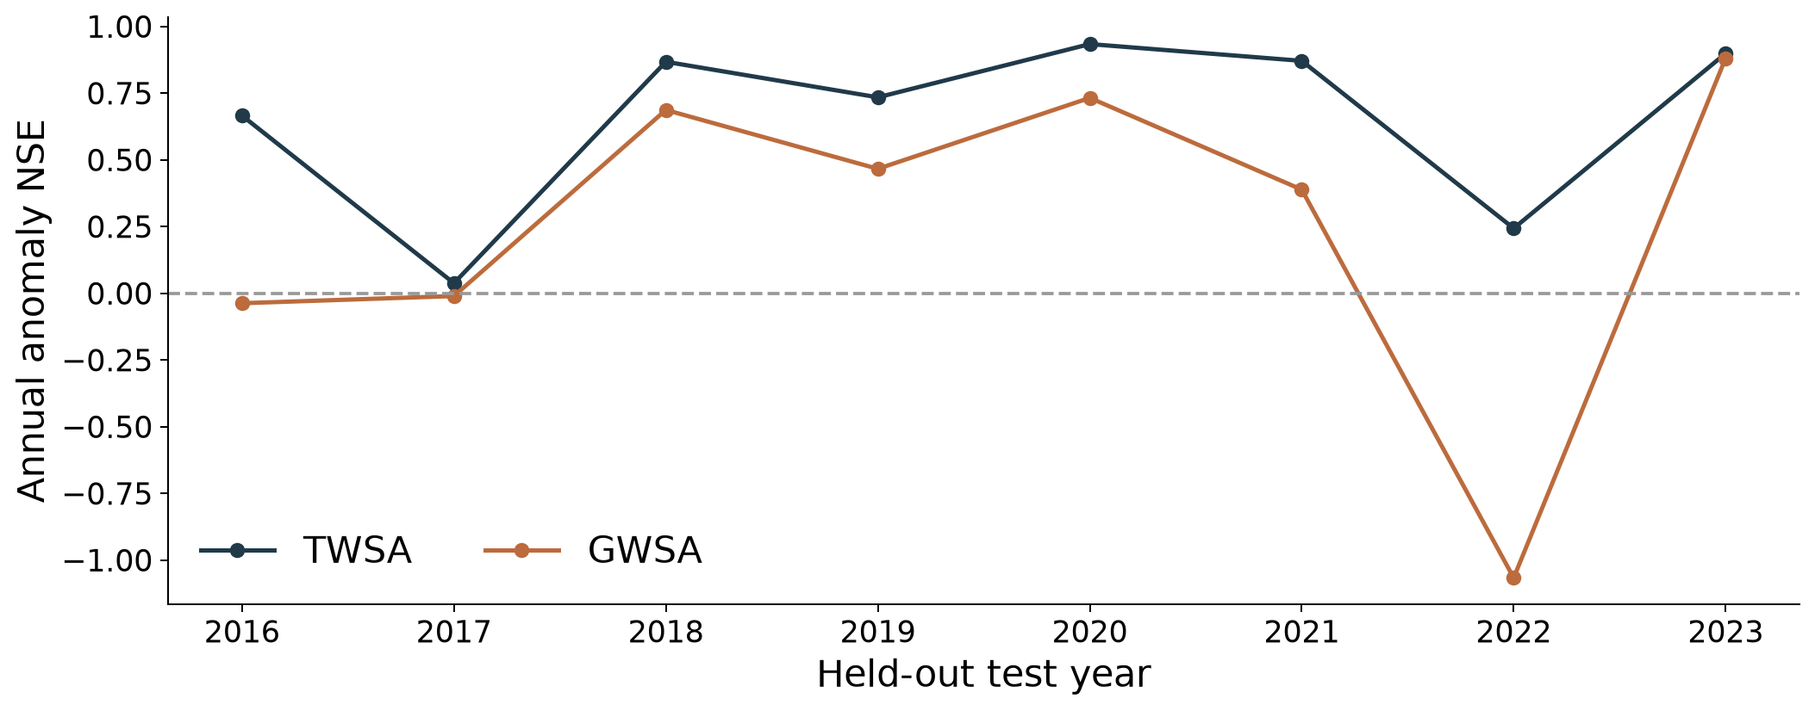
A pooled score can hide a weak year
Interpretation
Groundwater anomaly NSE is −1.067 in 2022.
The model performs worse than the mean benchmark in that year; the failure is retained.
See the report for dates, sample counts and uncertainty.
Results
19 / 32
Notes:
National annual anomaly NSE against the naturalized parent. The 2022 groundwater score is −1.067 and is retained; pooled scores hide this failure.
Groundwater anomaly NSE is −1.067 in 2022.
The model performs worse than the mean benchmark in that year; the failure is retained.

Slide 20
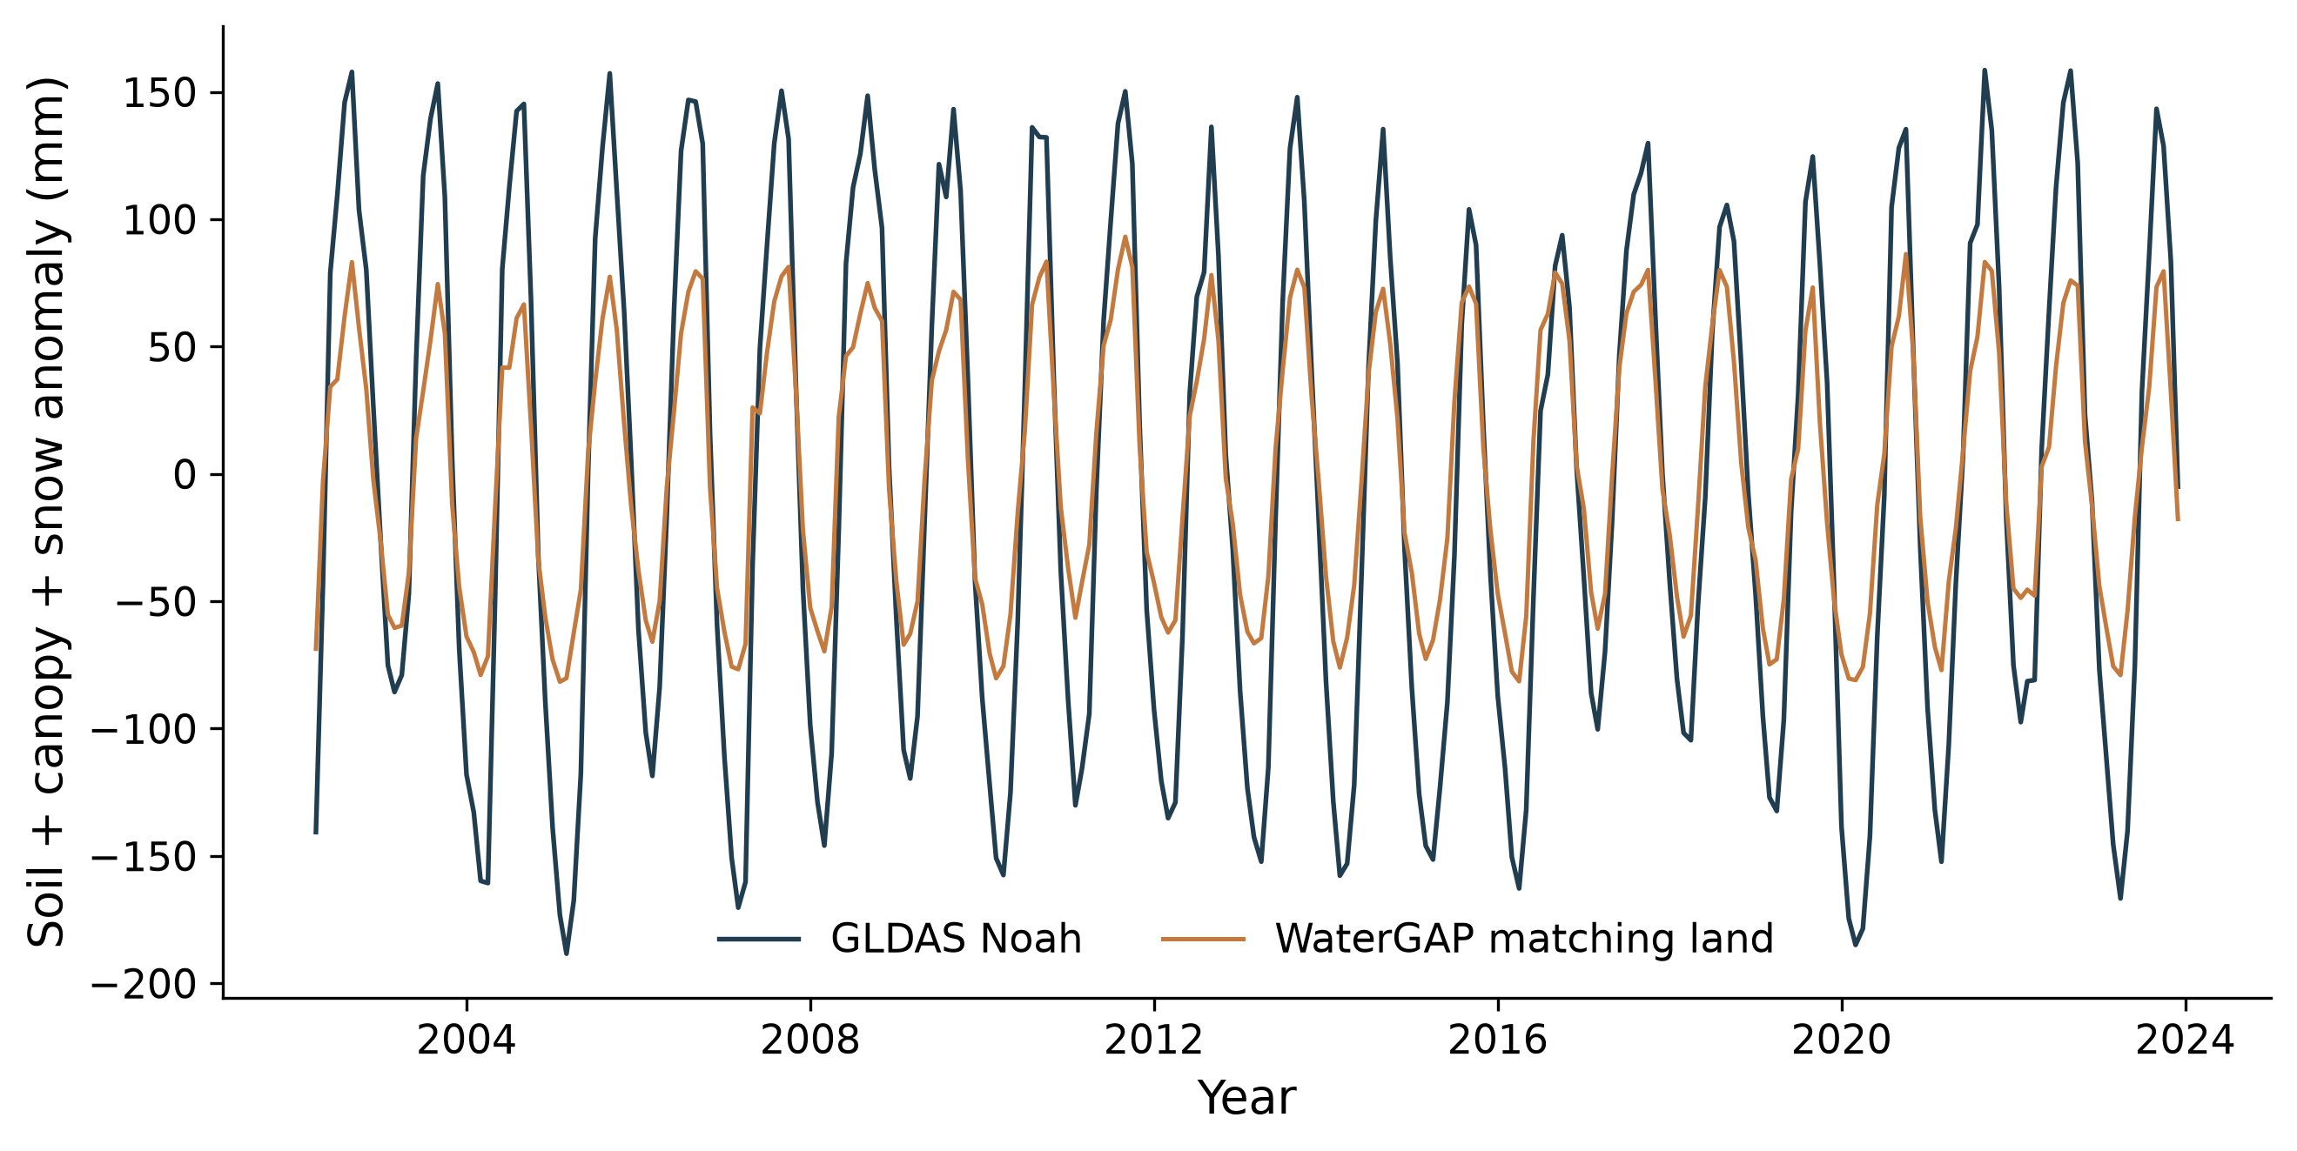
GLDAS checks matching land storage
Interpretation
National r = 0.969; RMSE = 52.49 mm.
The comparison covers soil, canopy and snow only. It does not validate groundwater or human effects.
See the report for dates, sample counts and uncertainty.
Results
20 / 32
Notes:
This comparison excludes groundwater and open surface water. GLDAS is a cross-model benchmark, not an observed total-storage or human-only validation dataset.
National r = 0.969; RMSE = 52.49 mm.
The comparison covers soil, canopy and snow only. It does not validate groundwater or human effects.

Slide 21
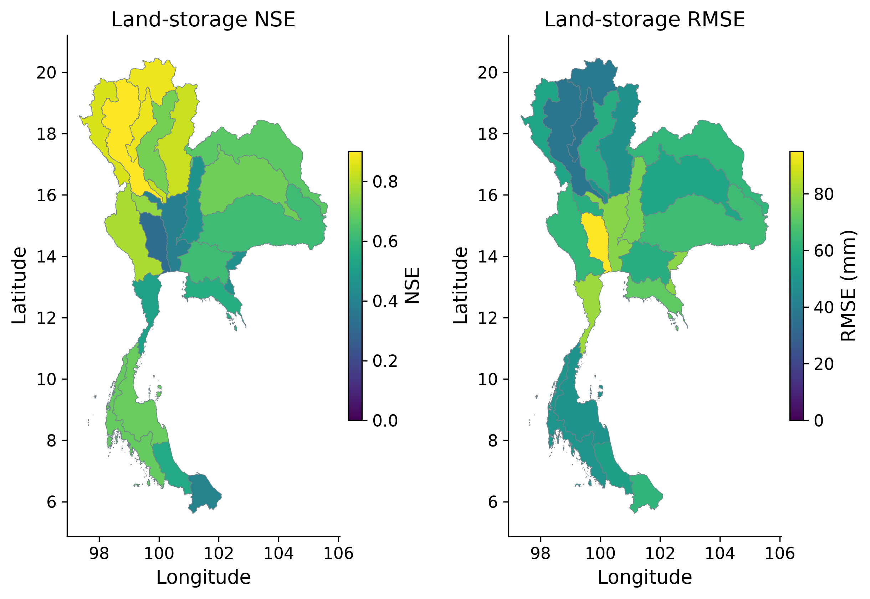
GLDAS agreement differs among basins
Interpretation
Higher NSE and lower RMSE mean closer agreement for the same land-storage target.
Shared climate and component dependence limit independence.
See the report for dates, sample counts and uncertainty.
Results
21 / 32
Notes:
Matching soil, canopy and snow compartments on paired dates. Higher NSE and lower RMSE mean closer model agreement for this same target. They do not validate the residual.
Higher NSE and lower RMSE mean closer agreement for the same land-storage target.
Shared climate and component dependence limit independence.

Slide 22
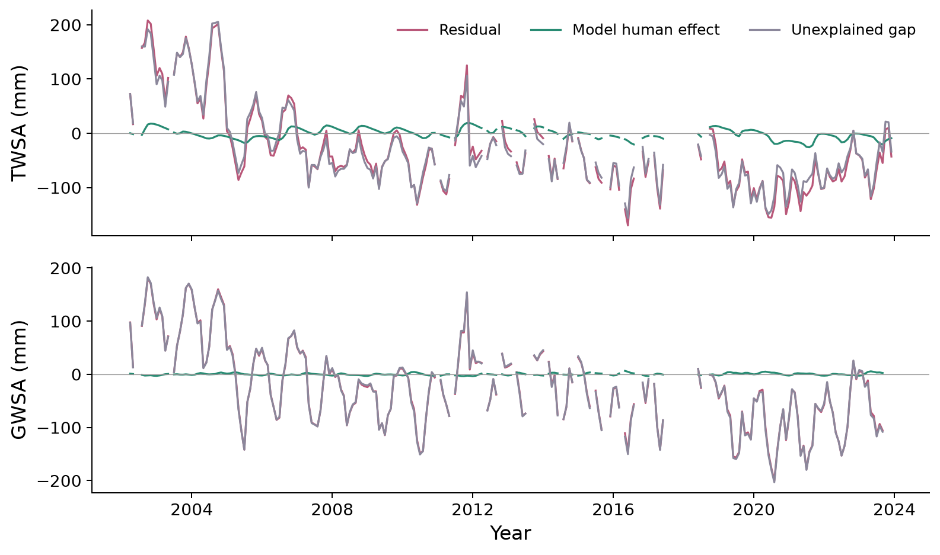
The residual is larger than the modeled human effect
Interpretation
The residual closely follows the unexplained gap.
The entire residual cannot be treated as measured human depletion.
See the report for dates, sample counts and uncertainty.
Results
22 / 32
Notes:
Residual = observed − naturalized. Modeled human effect = historical − naturalized. Unexplained gap = observed − historical. Thus residual = modeled human effect + unexplained gap. A negative residual is not measured pumping.
The residual closely follows the unexplained gap.
The entire residual cannot be treated as measured human depletion.

Slide 23
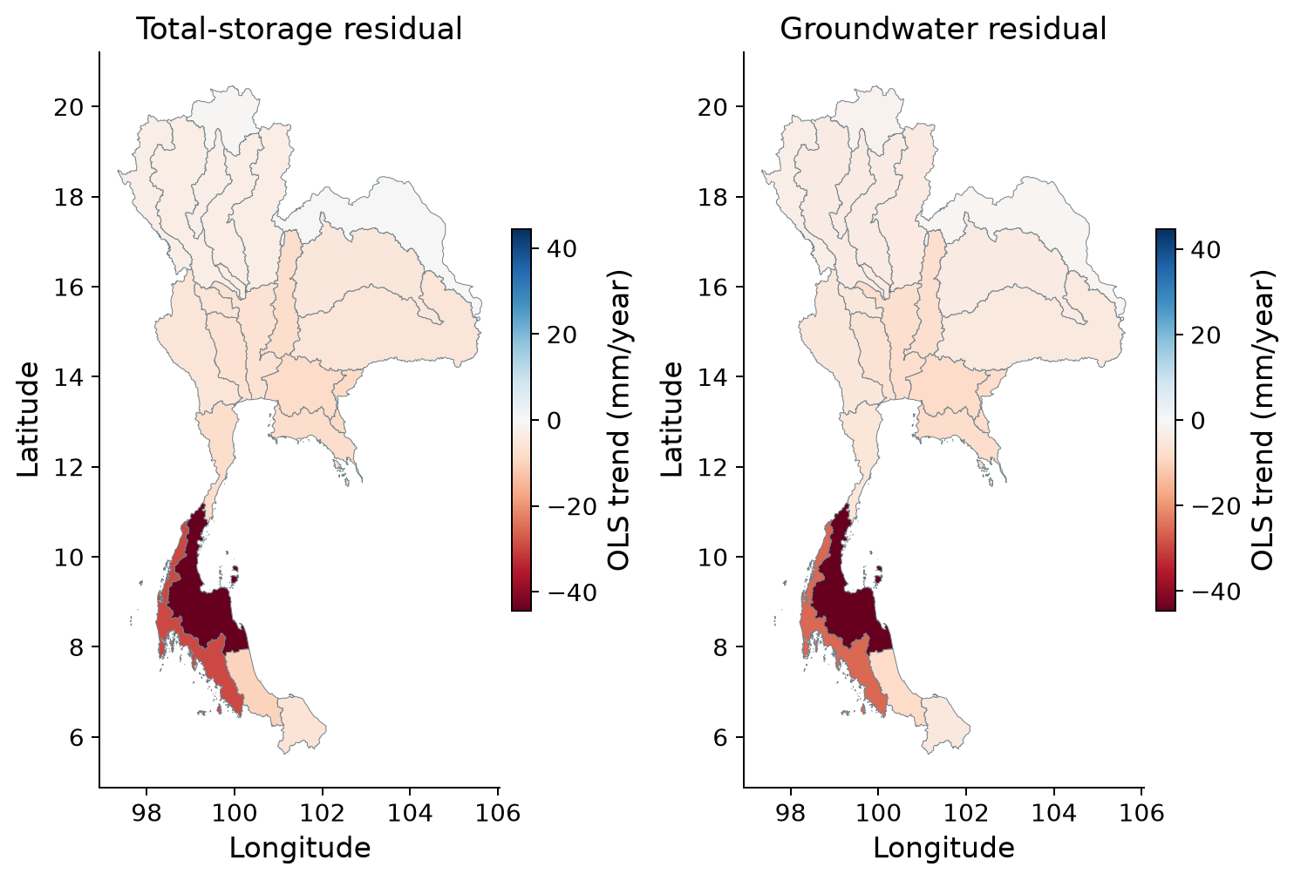
Residual trends identify where to investigate
Interpretation
Negative rates mean observations decline relative to the naturalized baseline.
Human influence and model or measurement errors can both contribute.
See the report for dates, sample counts and uncertainty.
Results
23 / 32
Notes:
Calendar-month fixed-effect OLS on common available dates. These additive rates differ from the primary seasonal Sen estimates. Residuals include human effects and observation/model discrepancy.
Negative rates mean observations decline relative to the naturalized baseline.
Human influence and model or measurement errors can both contribute.

Slide 24
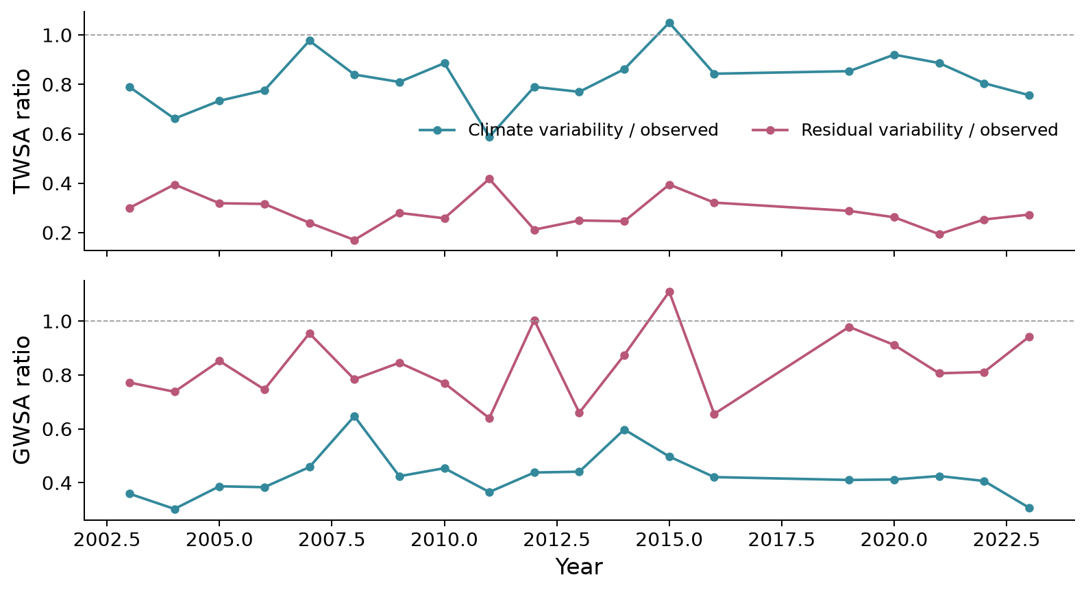
Variability changes through time
Interpretation
Climate and residual variability differ from year to year.
These ratios need not add to one. They are not human-versus-climate percentages.
See the report for dates, sample counts and uncertainty.
Results
24 / 32
Notes:
Annual mean absolute deviations on the same available months (minimum eight). Ratios need not sum to one and may exceed one because components covary. These are not climate/human percentages.
Climate and residual variability differ from year to year.
These ratios need not add to one. They are not human-versus-climate percentages.

Slide 25
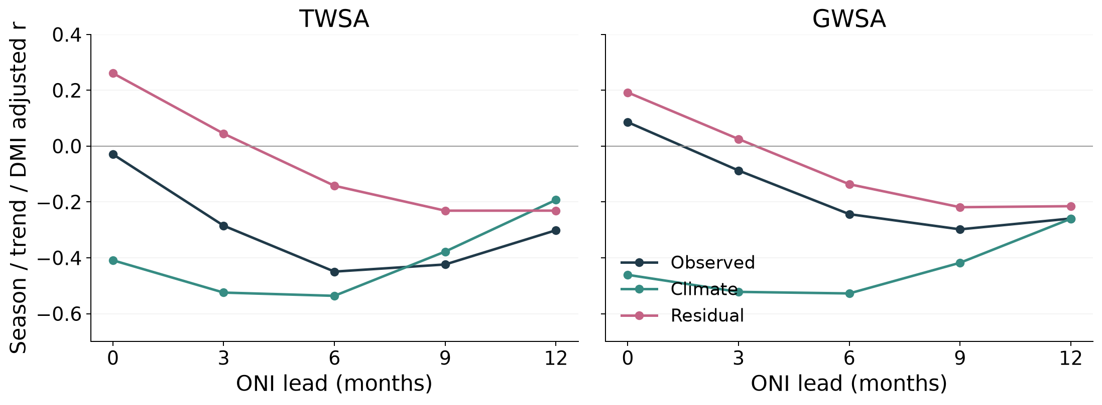
ENSO is clearer in the climate baseline
Interpretation
At six months, baseline r is about −0.53; residual r is about −0.14.
No basin test passes the conservative FDR screen. This does not prove no remaining climate effect.
See the report for dates, sample counts and uncertainty.
Results
25 / 32
Notes:
National partial correlations remove season, trend and contemporaneous DMI, 2003–2023. All five selected ENSO leads are shown. The residual has a weaker six-month association, but this does not prove complete climate removal.
At six months, baseline r is about −0.53; residual r is about −0.14.
No basin test passes the conservative FDR screen. This does not prove no remaining climate effect.

Slide 26
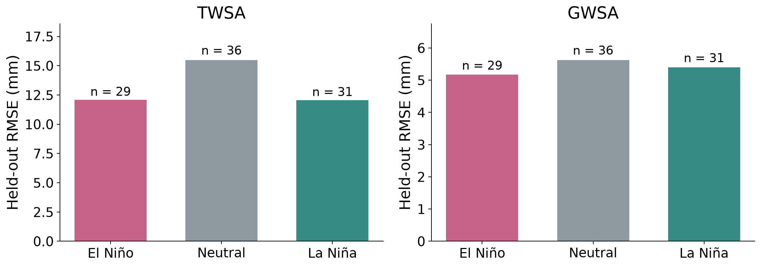
ENSO phase scores remain conditional
Interpretation
The model is frozen across all ENSO phases.
Months share episodes, so these are reconstruction comparisons rather than independent event forecasts.
See the report for dates, sample counts and uncertainty.
Results
26 / 32
Notes:
Held-out parent reconstruction, with 29 El Niño, 36 neutral and 31 La Niña months. Months share events; this is not independent event prediction.
The model is frozen across all ENSO phases.
Months share episodes, so these are reconstruction comparisons rather than independent event forecasts.

Slide 27
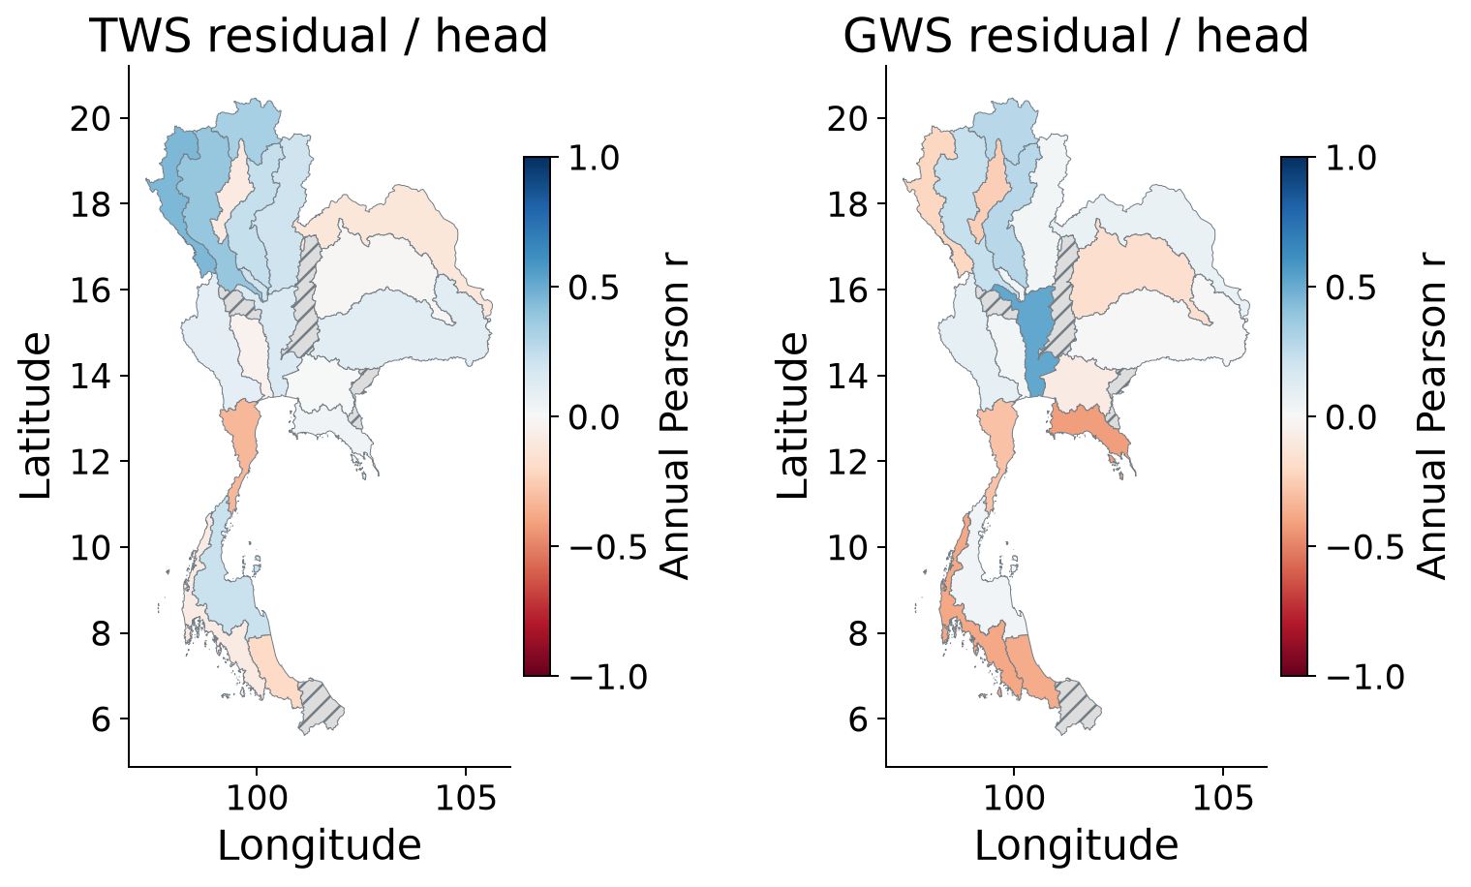
Groundwater support is weak and uneven
Interpretation
National groundwater-residual / head r is only 0.037.
Head is a local water level, not regional water volume. The balanced-panel result is near zero.
See the report for dates, sample counts and uncertainty.
Results
27 / 32
Notes:
Annual residual–head correlations. Hatching indicates inadequate support. Head and basin storage have different units and observation scales; no storage-volume validation is implied.
National groundwater-residual / head r is only 0.037.
Head is a local water level, not regional water volume. The balanced-panel result is near zero.

Slide 28
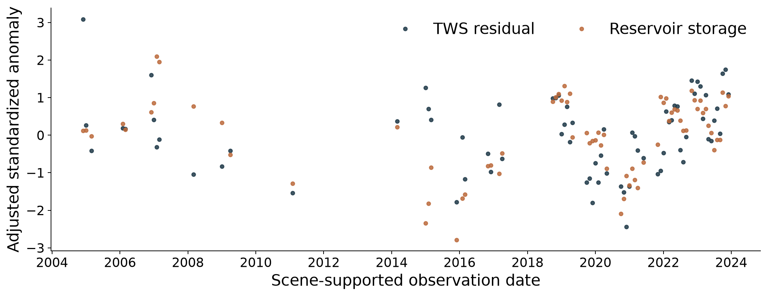
Reservoirs support a surface-water component
Interpretation
Adjusted r = 0.439 across 73 scene-supported months.
Reservoirs respond to climate and operations together; this cannot validate the total human residual.
See the report for dates, sample counts and uncertainty.
Results
28 / 32
Notes:
Scene-supported values, with season and trend removed, then standardized. Points preserve observation gaps. Adjusted national r = 0.439 across 73 months; year-cluster 95% interval 0.188–0.665.
Adjusted r = 0.439 across 73 scene-supported months.
Reservoirs respond to climate and operations together; this cannot validate the total human residual.

Slide 29
Conclusion what the study establishes
The primary national records show declining total and groundwater storage.
Weather memory reconstructs the naturalized model well, with identifiable weak years.
The residual remains human influence plus unresolved discrepancy; independent evidence is limited.
Conclusion
29 / 32

Slide 30
Discussion how to use these results
Storage detection is stronger than precise human attribution.
Product choice and monitoring coverage change local interpretation.
Use basin results to prioritize investigation and monitoring, supported by the downloadable evidence.
Discussion
30 / 32

Slide 31
Further work that would strengthen the study
Obtain consistent monthly wells, aquifer properties and pumping records.
Improve surface-water observations and matched GRACE spatial response.
Test alternative naturalized models and longer climate-event records.
Further work
31 / 32

Slide 32
References and reproducible research
Ji et al. (2025), climate reconstruction: doi:10.1080/17538947.2025.2557516
Müller Schmied et al. (2024), WaterGAP: doi:10.5194/gmd-17-8817-2024
Chueasa et al. (2024), Thai rainfall and ENSO: doi:10.1016/j.mex.2024.102954
Sharifi et al. (2025), spatial response: doi:10.5194/hess-29-6985-2025
Mahto et al. (2025), reservoirs: doi:10.5194/essd-17-2693-2025
Code and full bibliography: github.com/pratikkhanal16/thailand-water-storage-dss. Metropolis theme: matze/mtheme.
References
32 / 32
Notes:
Code and full bibliography: github.com/pratikkhanal16/thailand-water-storage-dss. Metropolis theme: matze/mtheme.

