Slide 1
Water storage trends and climate attribution
Farzeen Khan
MS in Water Engineering and Management • Asian Institute of Technology
Advisor: Dr. Natthachet Tangdamrongsub
Farzeen Khan • AIT • 24 October 2026
01
Notes:
Three-objective research release. Source report and manuscript accompany this deck.

Slide 2
Three objectives are implemented for all 22 basins
Storage trends: TWSA/GWSA, seasonal Sen, Mann–Kendall and uncertainty.
Climate attribution: naturalized hydrology, emulators, GLDAS and actual well checks.
Decision support: interactive maps, time series and downloadable evidence.
Farzeen Khan • AIT • 24 October 2026
02
Notes:
Objective 1 full TWSA ends September 2024; GWSA ends September 2023. Revised WaterGAP climate baseline ends December 2023.

Slide 3
The groundwater balance includes all compartments
GWSA = TWSA − soil − surface water − canopy − snow
All terms use mm water equivalent and a common 2004–2009 reference.
Common valid cells preserve the basin water balance; filtering mismatch remains.
Farzeen Khan • AIT • 24 October 2026
03
Notes:
Sources: local GRACE, GLDAS Noah, G3P/LISFLOOD. Observations and model fields use common support for attribution. No zero surface-water assumption.

Slide 4
The revised climate baseline is explicitly naturalized
WaterGAP naturalized run: direct water use and artificial reservoirs switched off.
Historical-human run: same model and meteorological forcing, with direct human impacts.
Climate emulators learn naturalized storage; GRACE is excluded from fitting.
Farzeen Khan • AIT • 24 October 2026
04
Notes:
Müller Schmied et al. 2024 https://doi.org/10.5194/gmd-17-8817-2024 . Naturalized DOI10.25716/GUDE.1TWP-GNQP, historical DOI10.25716/GUDE.14B4-KQ6R.

Slide 5
Residuals include modeled human effects and error
Residual R = observed O − naturalized C
Modeled human H = historical-human A − naturalized C
R = H + E, where discrepancy E = observed O − historical-human A
Farzeen Khan • AIT • 24 October 2026
05
Notes:
All anomalies use 2004–2009. H is change in modeled human influence relative to the reference, not total pre-GRACE depletion. The exact identity is checked numerically.

Slide 6
Climate testing separates seasonality from anomalies
Predictors: precipitation, potential ET, causal lags and climate-memory indices.
Warm-up 1981–1990; train 1991–2009; validate 2010–2015; test 2016–2023.
Ridge, ElasticNet, splines and Random Forest; validation selects frozen ensembles.
Farzeen Khan • AIT • 24 October 2026
06
Notes:
Scaling and tuning are within chronological training folds. No unrestricted year trend, observed storage lag or groundwater head predictor enters the primary emulator.

Slide 7
Emulators reproduce the naturalized parent model
Target | Test NSE | Anomaly NSE | RMSE mm
TWSA | 0.981 | 0.888 | 13.45
GWSA | 0.961 | 0.781 | 5.42
Farzeen Khan • AIT • 24 October 2026
07
Notes:
Test has96 months per national target. These are model-emulation scores, not independent validation of actual groundwater depletion.

Slide 8
High emulator skill does not imply observed accuracy
Comparison | TWSA NSE | GWSA NSE
Naturalized / observed | 0.652 | 0.110
Historical-human / observed | 0.673 | 0.093
Farzeen Khan • AIT • 24 October 2026
08
Notes:
The historical-human WaterGAP model is compared against observed storage on common support. GWS agreement remains weak despite strong emulation.

Slide 9
GLDAS benchmarks matching land compartments
Naturalized WaterGAP soil + canopy + snow versus GLDAS Noah land storage.
National benchmark NSE = 0.738 and r = 0.969.
Noah has no groundwater compartment; it cannot independently validate GWSA.
Farzeen Khan • AIT • 24 October 2026
09
Notes:
Noah and WaterGAP soil columns differ. This is a cross-model benchmark with related climatic drivers, not independent observations. Source NASA GLDAS dataset specifications.

Slide 10
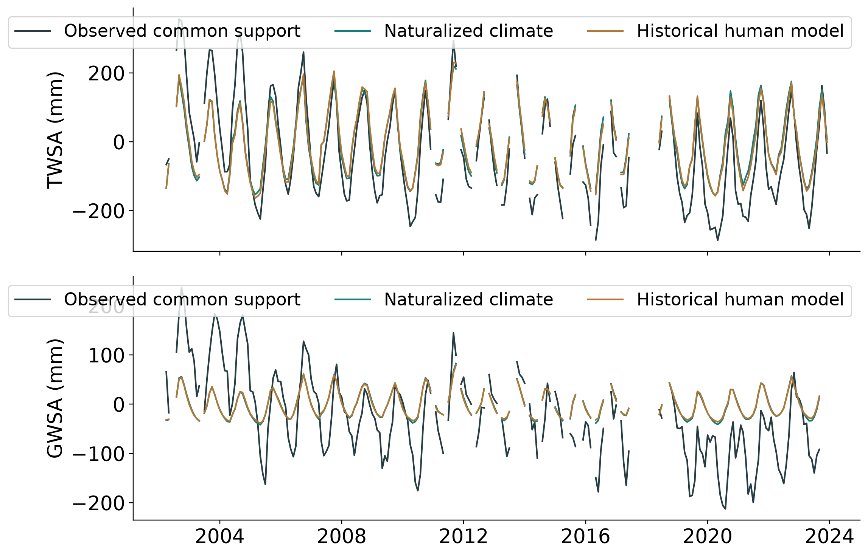
Observed storage and modeled climate differ
Farzeen Khan • AIT • 24 October 2026
10
Notes:
National common-support series. Source simulations end December 2023; missing observations remain gaps.

Slide 11
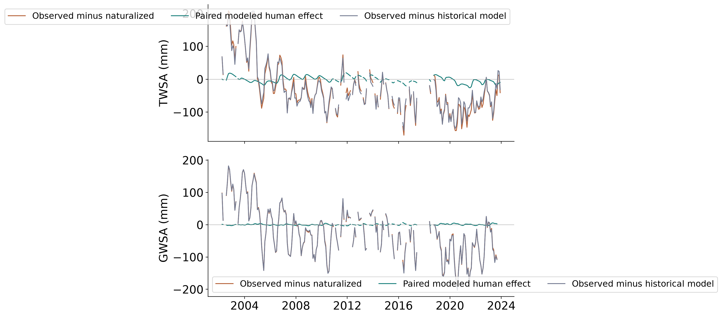
Large discrepancy remains after modeled human effects
Farzeen Khan • AIT • 24 October 2026
11
Notes:
The paired modeled human effect is much smaller than the observed residual. Do not allocate all discrepancy to abstraction.

Slide 12
National trends require cautious attribution
Component | TWSA | GWSA
Observed full record | −7.46 | −6.82
Naturalized common record | −0.25 | −0.05
Observed residual | −6.61 | −6.55
Paired modeled human | −0.52 | +0.04
Farzeen Khan • AIT • 24 October 2026
12
Notes:
Seasonal Sen slopes in mm/year are not additive. The separate OLS monthly-fixed-effect table supplies an additive point partition.

Slide 13
Well heads cannot validate total human TWSA
A well measures local groundwater head; TWSA also includes rivers, reservoirs and soil.
Heads contain both climate and human effects. Raw residual correlation can be misleading.
Use groundwater consistency checks; pumping/storage validation requires aquifer and management data.
Farzeen Khan • AIT • 24 October 2026
13
Notes:
Unconfined storage conversion would require ΔSgw(mm)=1000 Sy Δh(m). No specific yield or storativity is invented. Total human TWSA needs evidence about other compartments as well.

Slide 14
Actual well observations give weak residual agreement
Residual | Annual years | Raw r | Climate-controlled r
TWSA | 18 | 0.142 | 0.131
GWSA | 17 | 0.054 | 0.029
Farzeen Khan • AIT • 24 October 2026
14
Notes:
GROW:5484 observed aggregates,511 Thai wells,506 annual and5 monthly. Partial correlations control naturalized climate descriptively, not causally.

Slide 15
The decision-support system exposes uncertainty
All 22 basins: observed trends, naturalized climate and residual comparison.
Separate panels identify model verification, GLDAS benchmarking and groundwater evidence.
pratikkhanal16.github.io/thailand-water-storage-dss/
Farzeen Khan • AIT • 24 October 2026
15
Notes:
GitHub Pages application. Source and full report include metadata, missing-date policy, source licenses and downloadable tables.

Slide 16
Human attribution remains uncertain
Observed decline is conditional on supplied GRACE data; product provenance needs confirmation.
Climate emulation is strong, but independent groundwater consistency is weak.
The residual remains candidate human influence plus model and observation error.
Farzeen Khan • AIT • 24 October 2026
16
Notes:
The supplied GRACE file lacks processing-centre/release/leakage metadata. Different groundwater products give different slope magnitudes. Further aquifer-specific monthly heads, pumping and reservoir histories are needed for stronger attribution.

