Slide 1



Information Systems
Department of Natural Sciences and Computer Technology
Development of an Offline Mobile Application Prototype for Tourism Navigation in Shohimardon Region
Bachelor Paper
Shoirova Farzona
Supervisor
Dr.sc,ing., Profesor, Jelena Caiko
May 2026

Slide 2


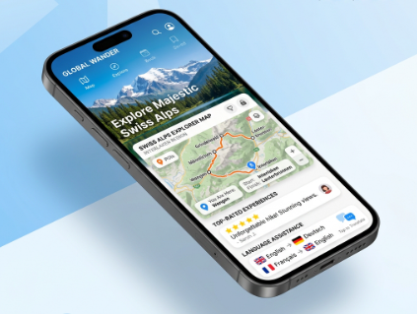
Problem
Problem Statement:
Shohimardon is one of the most beautiful mountain resort areas in the Fergana Valley of Uzbekistan, attracting thousands of domestic and international tourists annually. However, the region faces significant challenges in the digital tourism sphere:
Lack of a dedicated digital platform — There is no centralized mobile application that provides tourists with comprehensive information about Shohimardon's attractions, shrines, hotels, restaurants, and recreation zones.
Language barrier — Foreign tourists face difficulty navigating the region due to the absence of multilingual information resources (Uzbek, Russian, English).
Offline accessibility — Most tourist areas in Shohimardon have limited or unstable internet connectivity, making cloud-only applications unreliable.
Navigation difficulties — Tourists struggle to locate specific points of interest without a visual, interactive map with route-building capabilities.
No review/rating system — There is no mechanism for tourists to rate and review places, which limits the ability of future visitors to make informed decisions.

Slide 3
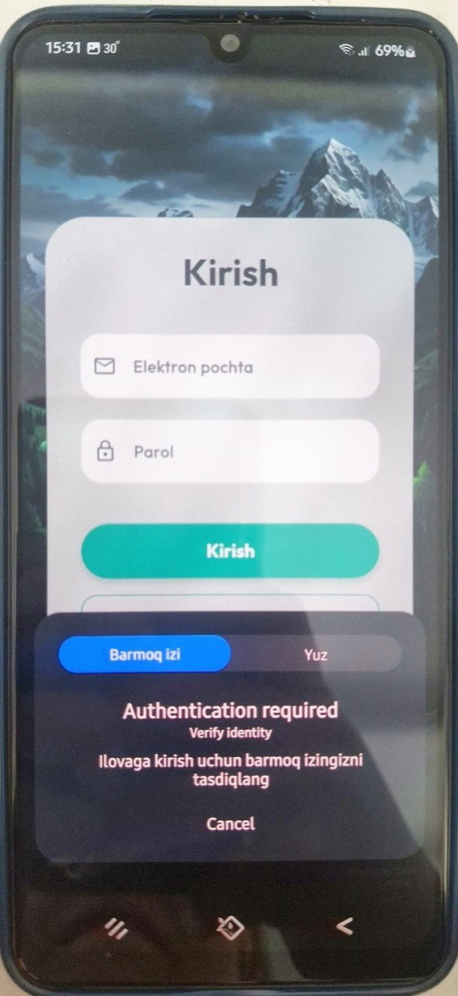
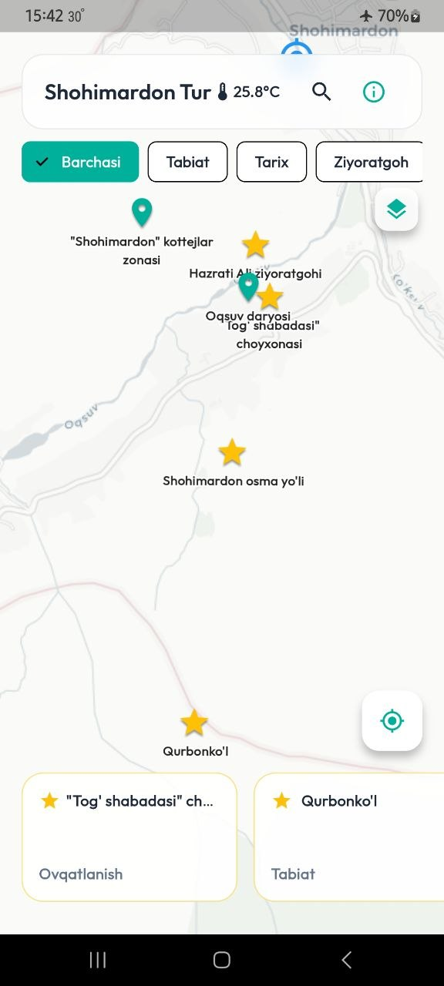
Defended Thesis
Thesis 1 — Has been offered: "A multi-level testing approach has been offered to ensure the high reliability of the application's core functions (authentication, synchronization, and maps)."
Thesis 2 — Has been modified: "The traditional architecture has been modified into an offline-first model using Firebase and SQLite, guaranteeing an uninterrupted user experience even without an internet connection."
Thesis 3 — Has been suggested: "An Agile development methodology has been suggested, enabling rapid prototyping, continuous updates, and quick integration of user feedback."

Slide 4
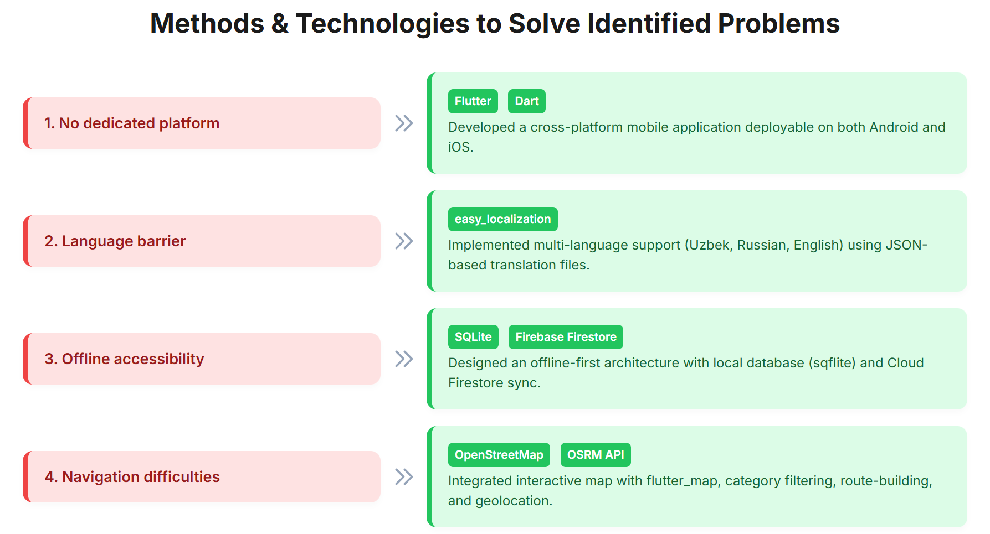
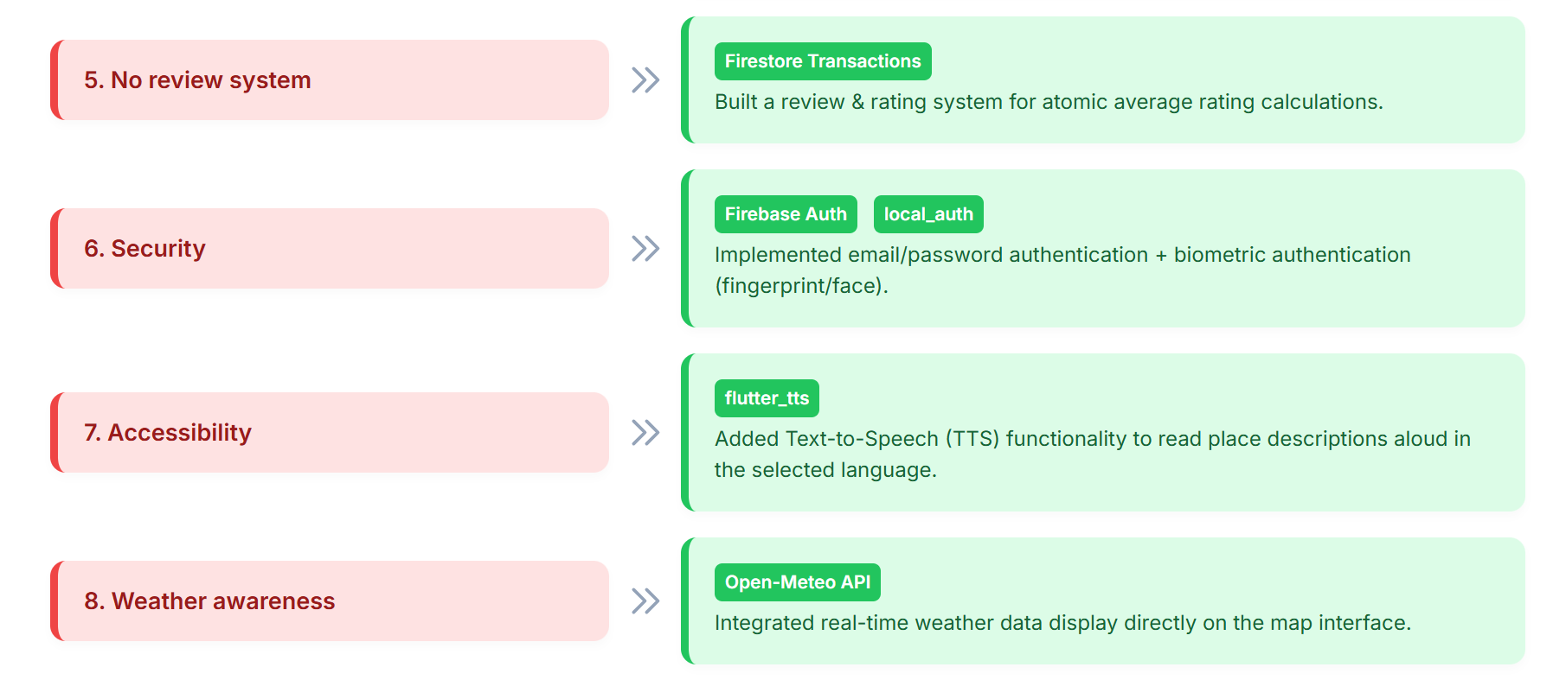
Methods/ways/decisions to solve this problem
The following established methods and technaologies were used to solve the identified problems:

Slide 5
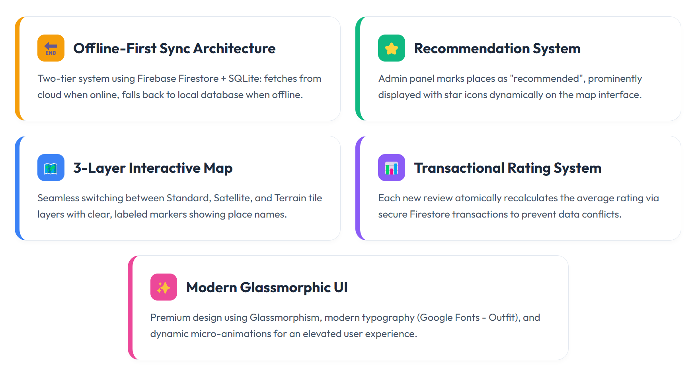
My own method/way/decision to overcame this problem

Slide 6
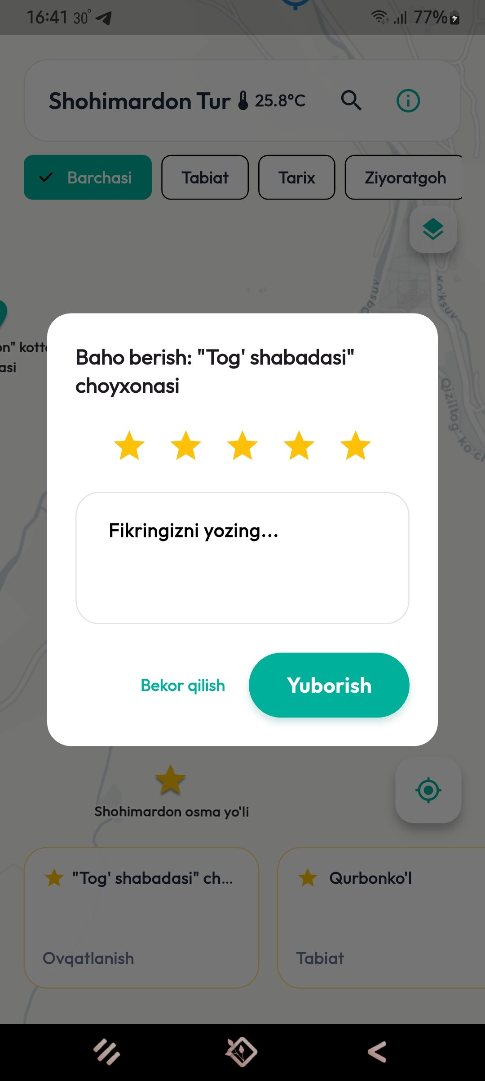
Levels of Testing (Slide to explain the first Defended Thesis)
Unit Testing — Testing individual functions: TouristObject.fromMap(), getLocalizedName(), AuthProvider.login()
Integration Testing — Testing module interactions: Firebase → SQLite sync, review submission → rating update
System Testing — Testing the full app flow: Language Selection → Login → Map → Place Details → Directions → Review
Acceptance Testing — Validating the app with end-users and the diploma committee

Slide 7
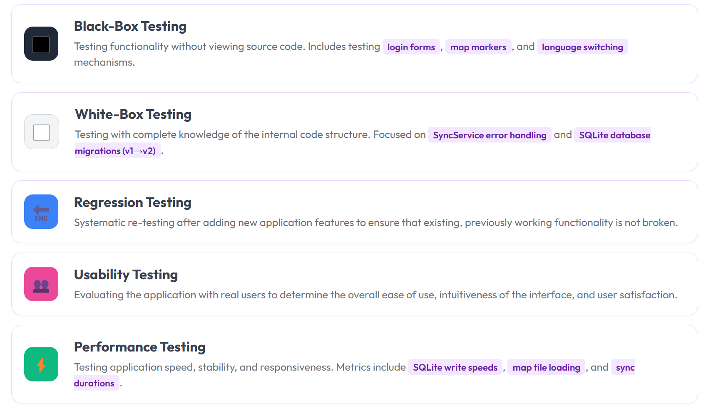
Software testing methods (Slide to explain the first Defended Thesis)

Slide 8
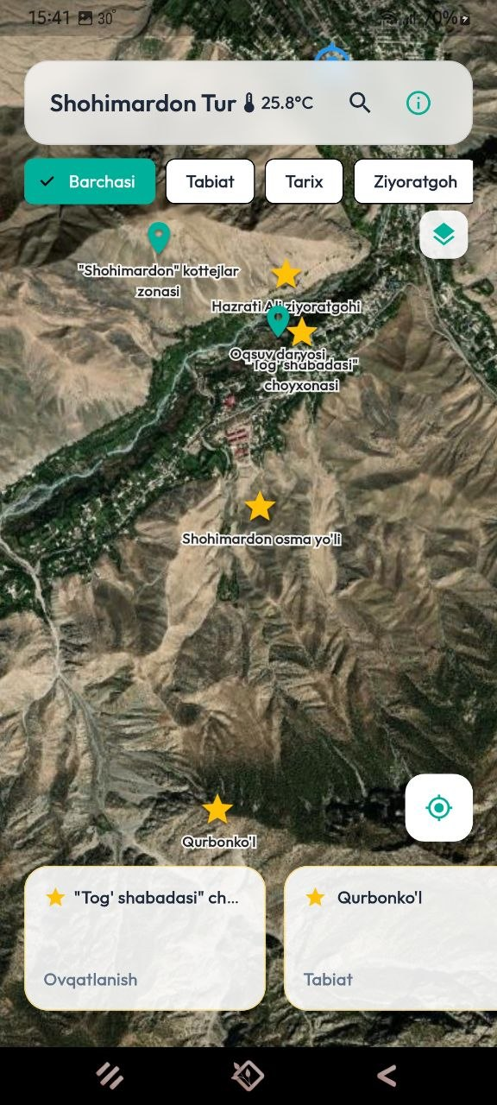
The Different Software Development Methodologies (Slide to explain the third Defended Thesis)
Methodology | Description | Pros | Cons
Waterfall | Sequential phases | Clear structure | Inflexible to changes
Agile | Iterative, incremental | Flexible, fast results | Scope creep risk
Scrum | Sprint-based (2-4 weeks) | Organized process | Overhead for small teams
Spiral | Risk-driven | Risk management | Complex, costly
Why Agile was chosen:
The project was developed in 5 iterations: Architecture → Data Layer → UI/UX → Advanced Features → Final Polish
Requirements changed during development (offline mode, weather, border guide) — Agile adapted seamlessly
Lightweight process ideal for a solo developer

Slide 9
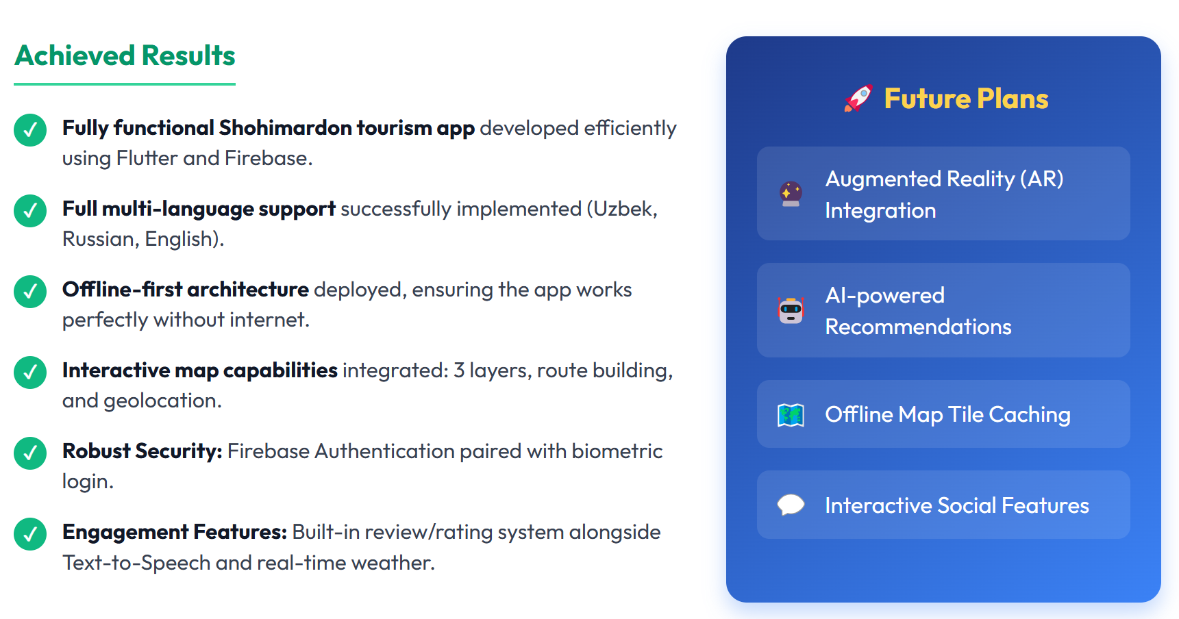
General Conclusion

Slide 10
Thank you!

