Slide 1
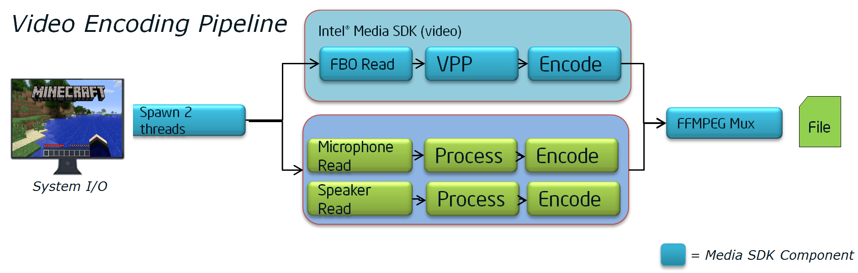
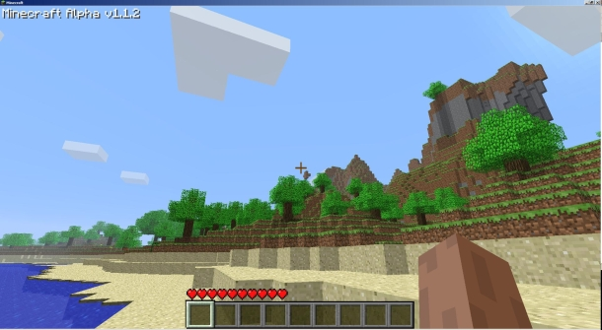
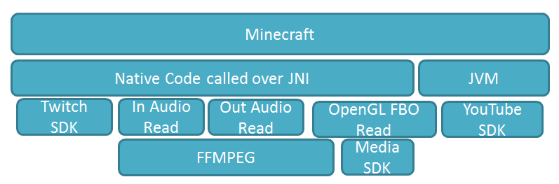
Minecraft + Intel® Media SDK HW Accelerated Video Game Streaming
Farzon Lotfi & Shardul Golwalkar
Visual Computing Products (VCP)
Take a game with +20M downloads and +81M YouTube videos and show developers ease of integrating Intel Media SDK and unleashing the full power of Intel hardware!
Without QSV, real-time streaming is limited in quality and uses 100% CPU performance . With QSV, real-time streaming uses 15% CPU.
Asynchronously grab audio and video frames and encode to an H.264 compatible video container (.mp4)
Software uses a layered and pipeline architecture. The layered approach allows for abstraction of individual components . The pipeline approach takes advantage of instruction level parallelism.
4.2x higher FPS with Hardware encoding vs. Software
Game play
Software Architecture

