Slide 1
PerfectStore Solution Showcase
Agentic AI for Perfect Store Execution — India Market
Commercial Strategy × Multi-Agent AI × Field-Ready Execution
India Market
Snacks Portfolio
6-Agent Pipeline
10,000-Outlet Run Validated

Slide 2
Agenda
1
Overview
What Perfect Store is and what this AI solution automates
2
Components / Architecture
The 6-agent pipeline, knowledge layer, and LLM backend
3
Demo
Live run — data in, executive outputs out
4
Roadmap (optional)
Where the agentic architecture goes next
5
Q&A
Open discussion

Slide 3
Overview — What Is Perfect Store?
A CPG commercial execution framework that turns strategy into store-level action — defining, measuring, and improving what “good” looks like across channels and formats.
Perfect Store answers 3 questions
What this solution adds
Which stores matter most?
› Automates the full lifecycle — segmentation → MSL → space allocation → reporting
Segmentation
What should happen there?
› Grounds every output in CPG commercial logic, not generic AI text
MSL, Price-Pack, Visibility
Are we executing well — and does it pay off?
› Runs unattended — watches inbox/, processes new data end-to-end, no manual steps
Scorecards & Value Realization
› Replaces intuition with scalable, data-backed, auditable standards
Objective: differentiated execution standards by store segment, activated through GTM routines, with measurable NSV / margin impact.
PerfectStore Solution Showcase
3

Slide 4
Components — The 6-Agent Pipeline
1
Data Quality Agent
Sequential, context-compounding
Null / outlier checks + LLM-verdict DQ report
▼
Each agent's output becomes the next agent's context — DQ verdict feeds prioritization, priority tier feeds segmentation, segments feed MSL.
2
Prioritization Agent
A/B/C/D tiers via quantile regression, opportunity gap
▼
3
Segmentation Agent
Config-driven: features, thresholds, cluster count all live in config.json — no code change to retune.
KMeans on 25+ features, LLM-authored segment labels
▼
4
MSL Generator Agent
Hero vs. Strategic SKU list per segment
Graceful degradation: rule-based fallback at every step if the LLM call fails.
▼
5
Output Agent
Executive PDF, Excel workbooks, segment CSVs
▼
6
Space Allocation Agent
Rack-ready facings, shelf zones, days-of-supply
PerfectStore Solution Showcase
4

Slide 5
Components — Knowledge Layer & LLM Backend
Commercial context as code
LLM backend — swappable, resilient
ContextLoader injects curated markdown (context/project.md + per-agent files) as system prompts — grounding every LLM call in Perfect Store logic. Deterministic, version-controlled RAG with zero retrieval-relevance risk.
› Unified call_llm() client
One interface abstracts Gemini, Vertex AI, Claude & local Ollama
Geography
Metro → Tier-1 → Tier-2/3 → Rural
› Automatic fallback chain
2.5-pro → 2.5-flash → 2.0-flash for resilience
Portfolio
Lays, Kurkure, Doritos + India PPG (₹5/10/20/30...)
› Context caching
Server-side, 1-hr TTL — ~75% input-token cost reduction measured
Channels
GT, MT, AfH, EC trade definitions
Metrics
VPO, BI, SEC, opportunity gap glossary
› Structured parsing
JSON-first with regex fallback if the model drifts off-schema
Multi-market ready: swap /context/project.md to onboard a new market — zero code changes.
PerfectStore Solution Showcase
5

Slide 6
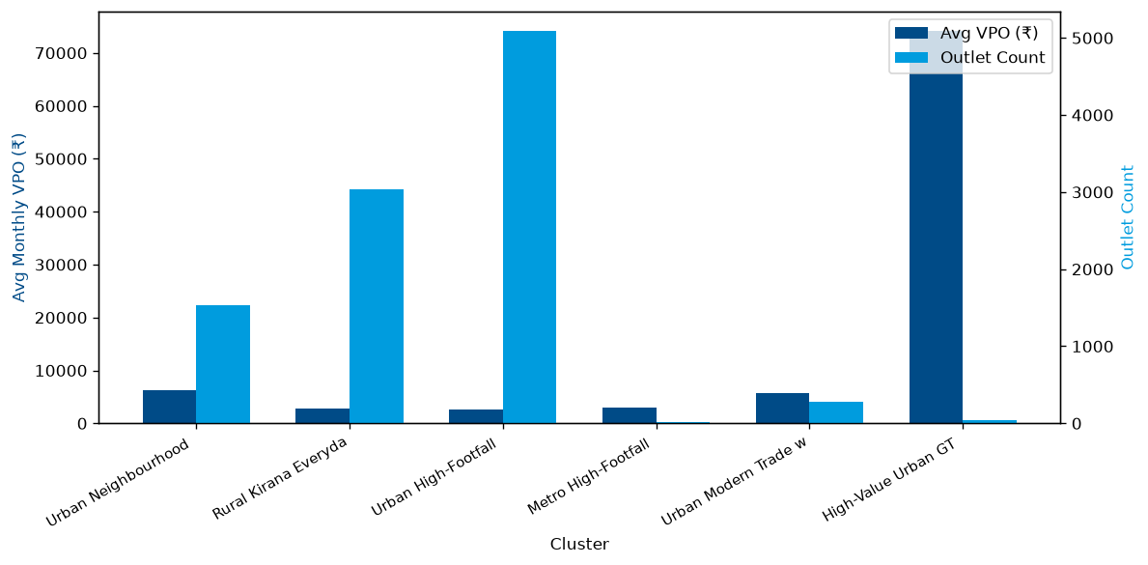
Demo — Data In, Executive Outputs Out
What we'll run live
1
Drop a raw outlet/SKU file into inbox/ (or python main.py run <file>)
2
Watcher auto-detects format, pipeline runs all 6 agents end-to-end
3
Walk through the generated DQ report, priority tiers, and segment labels
4
Open the MSL workbook, Space Allocation workbook, and executive PDF
Reference run — 10,000 outlets
Actual chart output — segment_report workbook
• 6 segments — largest: 5,088 outlets (Urban High-Footfall Impulse GT)
• 8 priority tiers — A+ (644) down to D (180 outlets)
• 4 output workbooks + 1 executive PDF per run, fully unattended
PerfectStore Solution Showcase
6

Slide 7
Roadmap (Optional)
1
Supervisor Agent
Meta-orchestrator that monitors agent outputs and triggers re-runs on quality failures
2
Inter-Agent Feedback Loops
Agents negotiate instead of passing static text — e.g. MSL flags priority misalignment back to Segmentation
3
Natural Language Query Agent
Conversational layer over pipeline outputs — “Which B+ stores in Maharashtra have the highest gap for Kurkure?”
4
Scenario Simulation Agent
“What if we add 3 SKUs to Bucket C?” — re-runs downstream and shows comparative impact
PerfectStore Solution Showcase
7

Slide 8
Questions & Discussion
PerfectStore Solution Showcase

