Slide 1
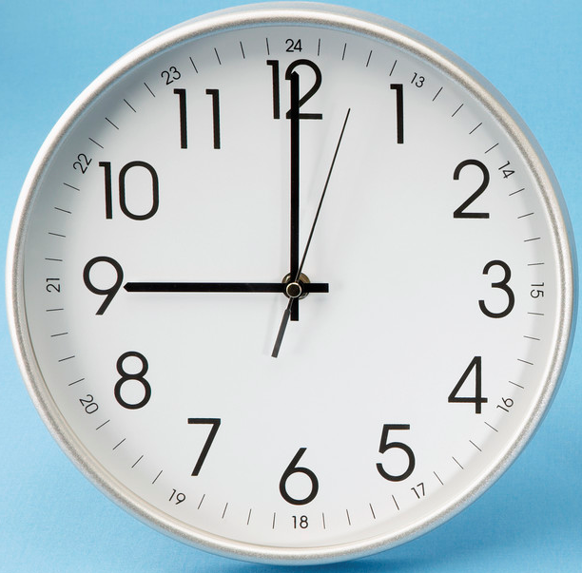
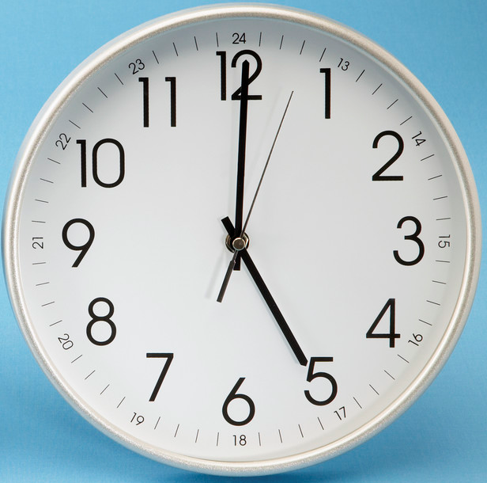
A man with a watch knows what time it is. A man with two watches is never sure.
Segal’s Law

Slide 2
A Decentralized Frame Synchronization of a TDMA-based Wireless Sensor Network
Fasika Assegei
Advisors: Frits van der Wateren
dr.ir. Peter Smulders

Slide 3
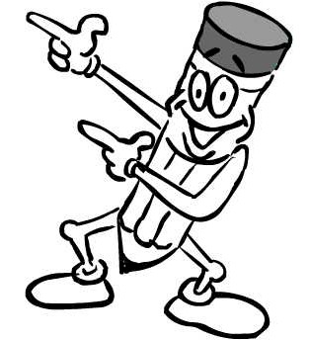
What is synchronization ?
Having the same time of reference
Either global (UTC) or local (relative)
Rhythmical
What a synchronized time !!!!

Slide 4
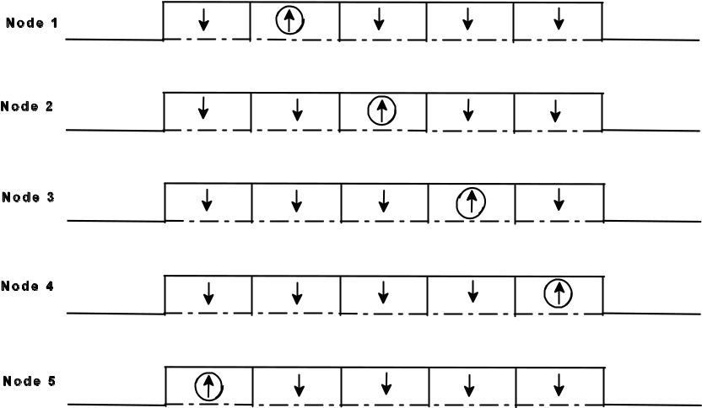

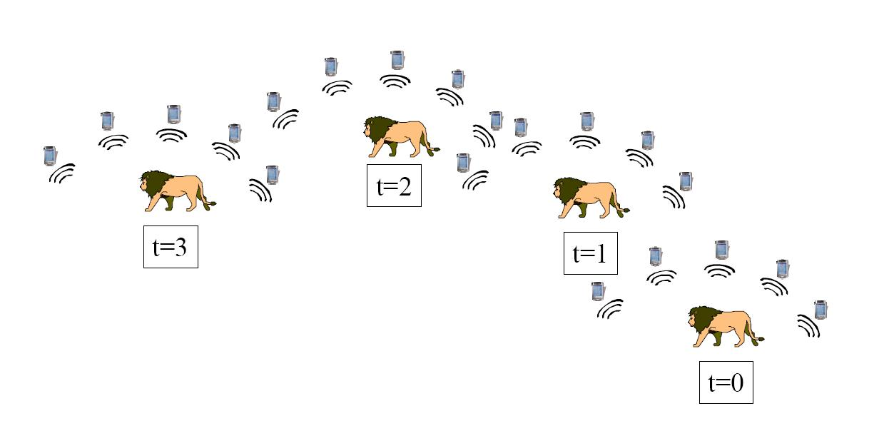
Why synchronization ?
Time is God's way of keeping everything from happening at once.

Slide 5
Isn’t this a solved problem by now ???
  NTP, MACs with sync built in (802.11), time broadcasts (GPS, WWVB), high-stability oscillators (Rubidium, Cesium)
If this isn’t the Internet:
  Important assumptions no longer hold
    (fewer resources -- such as energy, good connectivity, infrastructure, size, and cost -- are available)
  Sensor apps have stronger requirements
    (…but we have to do better than the Internet anyway)

Slide 6
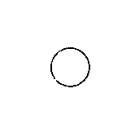
Wireless Sensor Networks
Wireless network of low cost sensors
Nodes communicate by broadcasting
Multi-hop communication needed in order to reach far-away destinations.

Slide 7
Wireless Sensor Networks: Why different ?
Energy limitation
  Each node has a limited battery life
Dynamic nature of the network
  Mobility and interference
Diverse applications
  Relative and absolute reference
Cost of node
  Cheap and costless node

Slide 8
Synchronization Methods- Previously
Centralized synchronization
  Central reference time
  Global or Relative
Receiver-Receiver
  RBS broadcast synchronization
    [Elson, Girod and Estrin, 2002]
    Time stamping
Decentralized synchronization
  Estimation of the other’s clock time
  Not fully explored

Slide 9
What is NEW here ?
Decentralized synchronization
  Relative time references
No timestamping
  Low message overhead and no sync message
Primarily using estimation (biased and unbiased)
Energy efficient
  Able to use as low energy as possible

Slide 10
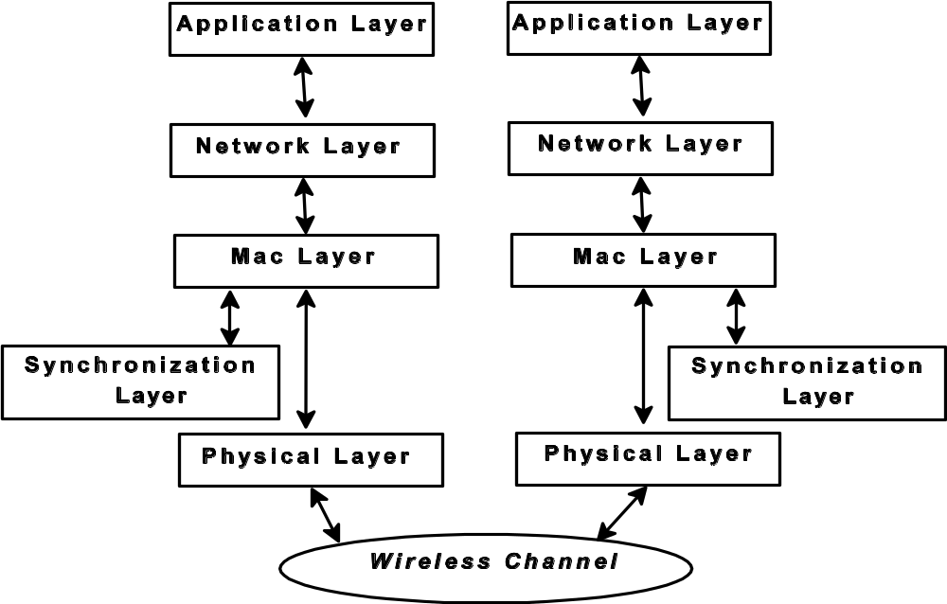

Slide 11
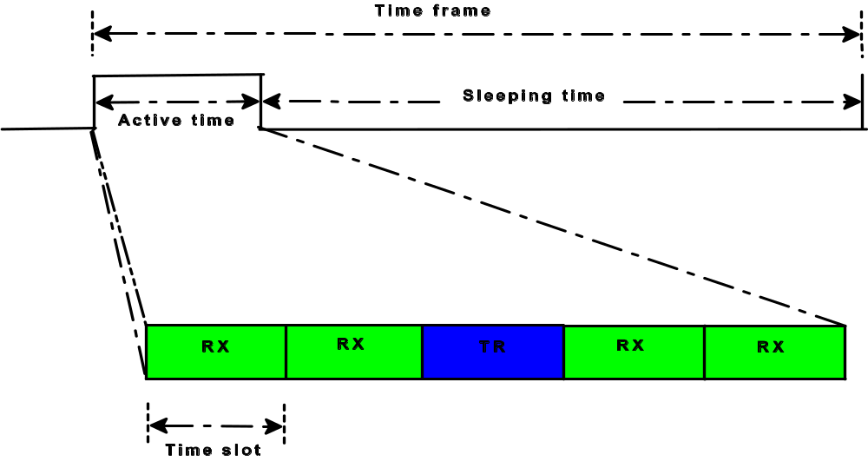
TDMA scheduling

Slide 12
Definitions
Phase error
  Time difference between the clocks
Frequency error
  The difference in the rates of the clocks
Clock skew
  How far apart are the clocks in the real time?
Clock cycle (clk)
  The time between adjacent pulses of the oscillator

Slide 13
Sources of Error
Oscillator characteristics:
  Accuracy: Difference between ideal frequency and actual frequency of the oscillator.
  Stability: Tendency of the oscillator to stay at the same frequency over time.
Network and System Parameters
  Receive and Transmit Delay: Time duration between message generation and network injection.
  Propagation Delay: Time to travel from sender to receiver.
  Access Delay: Time to access the channel.

Slide 14
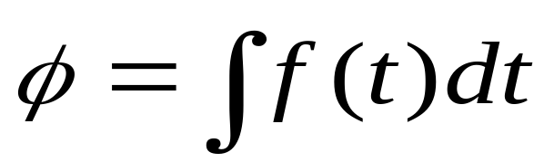
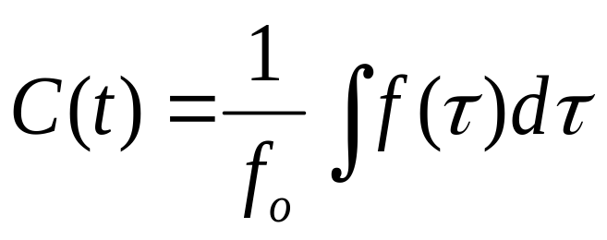
Clock Drift
From the relation of frequency and phase
The clock time will be:
where fo is the nominal frequency of the clock

Slide 15
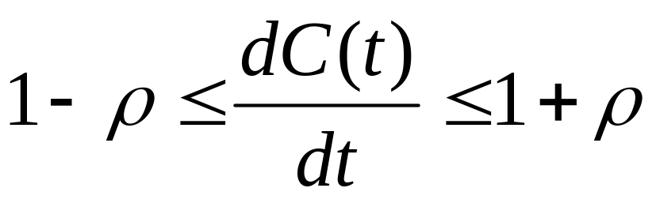
Clock drift contd.
The nodes clock time is thus bounded as :
Where ρ is the maximum clock drift.

Slide 16

Clock Synchronization: More Formally
C(t) = C(t) +-
e
The clock skew is ρ i.e. 1- ρ < <1+ρ
  for every time t after the algorithm completes
Transmissions delays on link e
Symmetric links: same delay, same uncertainty

Slide 17
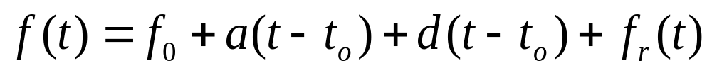
Frequency and its variation
The frequency of the clock is given as :
Where :
A is the aging factor
D is the environmental factor
f_{r} is the noise instability
f_{o} is the nominal frequency

Slide 18
Synchronization frequency

Slide 19
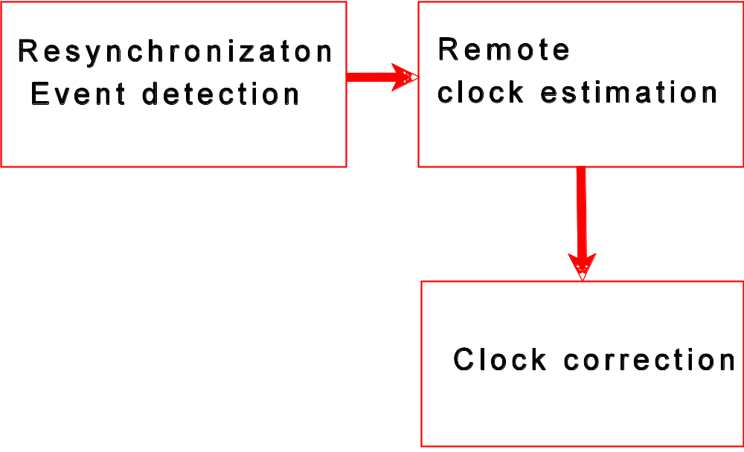
Synchronization algorithms

Slide 20
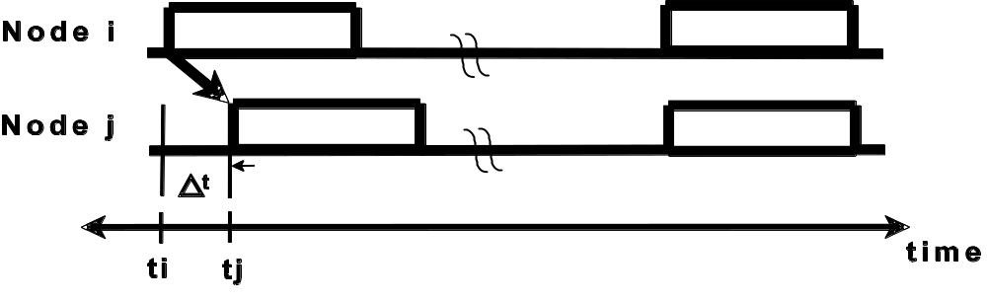
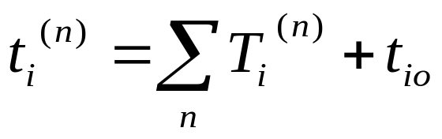
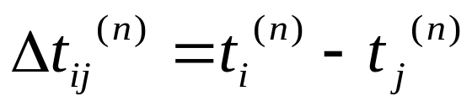
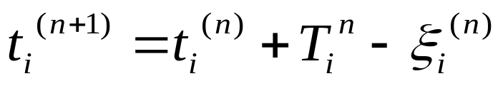
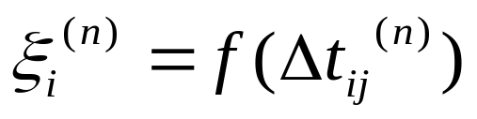
Mathematical Model
What is f ???

Slide 21
Median as a method for synchronization
Nodes broadcast packets.
Each receiver records the time that the packet is received .
Each receiver i computes its phase offset to any other node j in the neighborhood
Receivers compute the median of the offsets
Receivers adjust their wakeup time by the computed offset value.

Slide 22
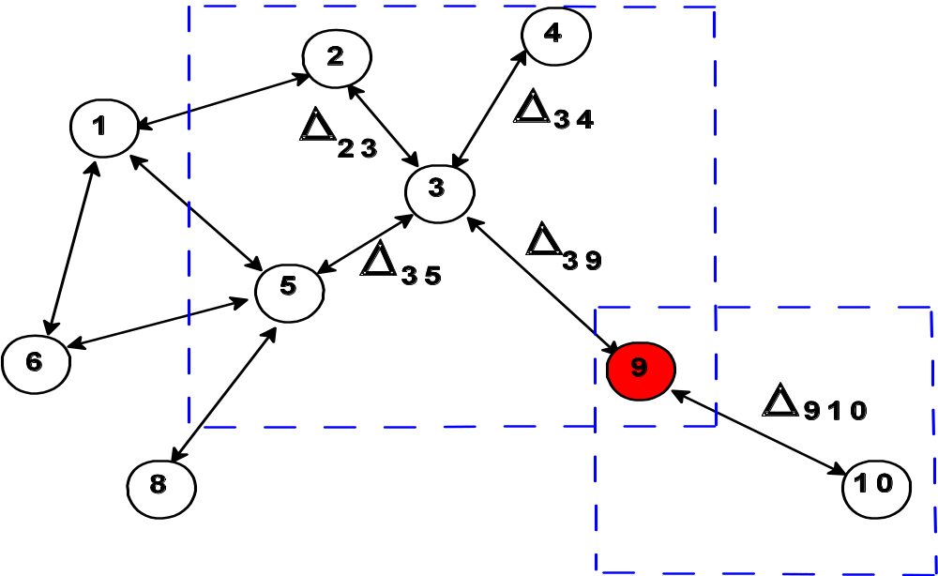
A WSN scenario for Median
Calculating offset
Got message from Node 3
Got message from Node 10

Slide 23
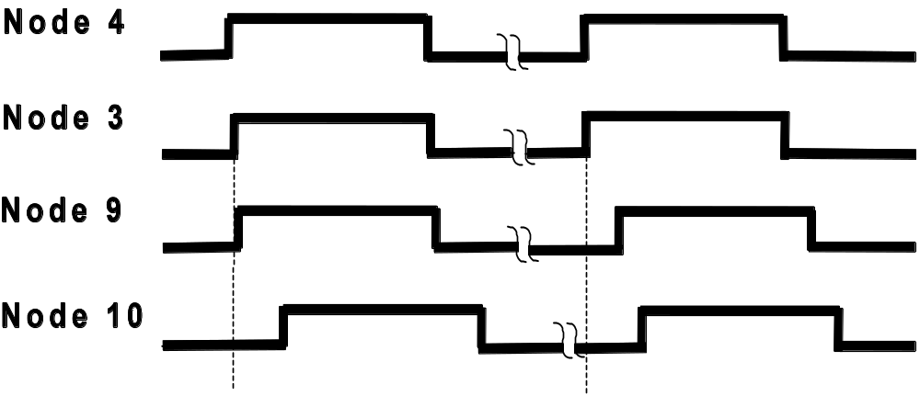
Node 9 drifted from its neighbors

Slide 24
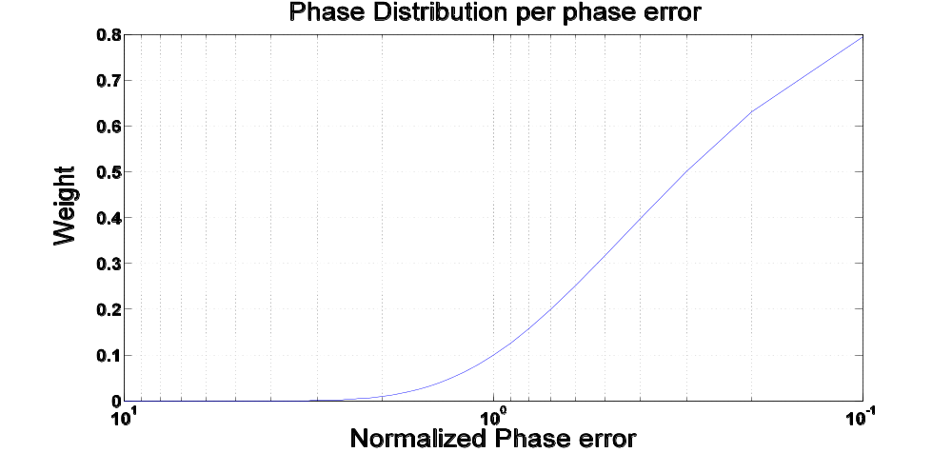

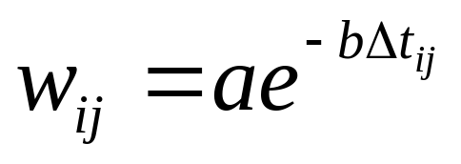
Weighted Measurements

Slide 25
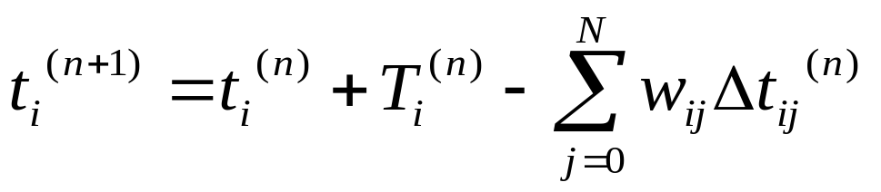
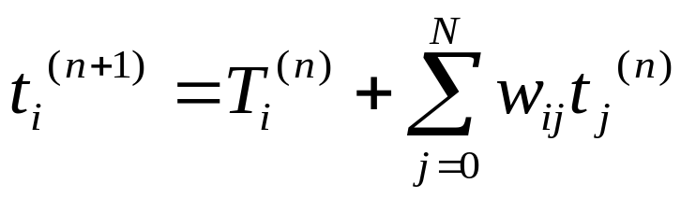
Weighted measurements Contd.

Slide 26
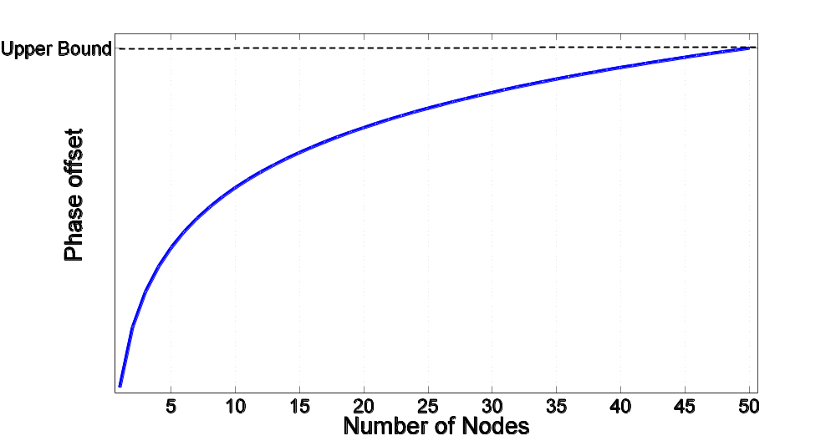
Non Linear Curve Fitting

Slide 27


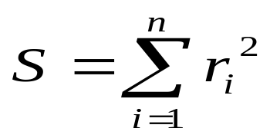

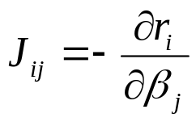
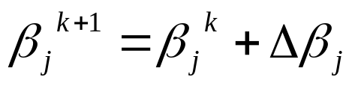
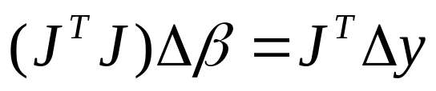
Non Linear Curve fitting Contd.

Slide 28
Discrete time Kalman Filter
Estimator
Predict equations
Update equations

Slide 29
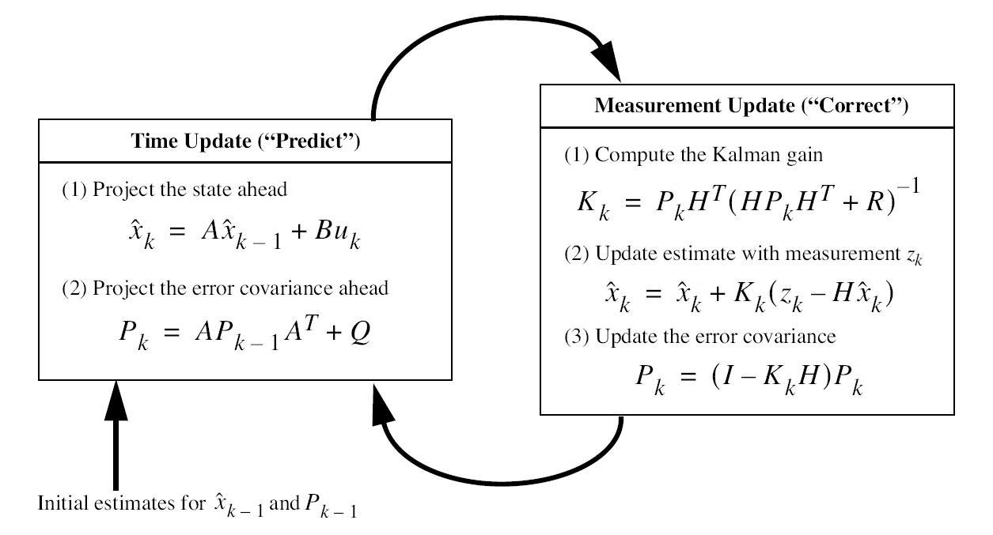
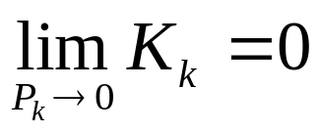
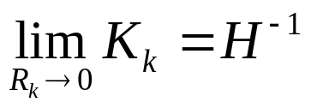
Kalman Filter Contd.

Slide 30
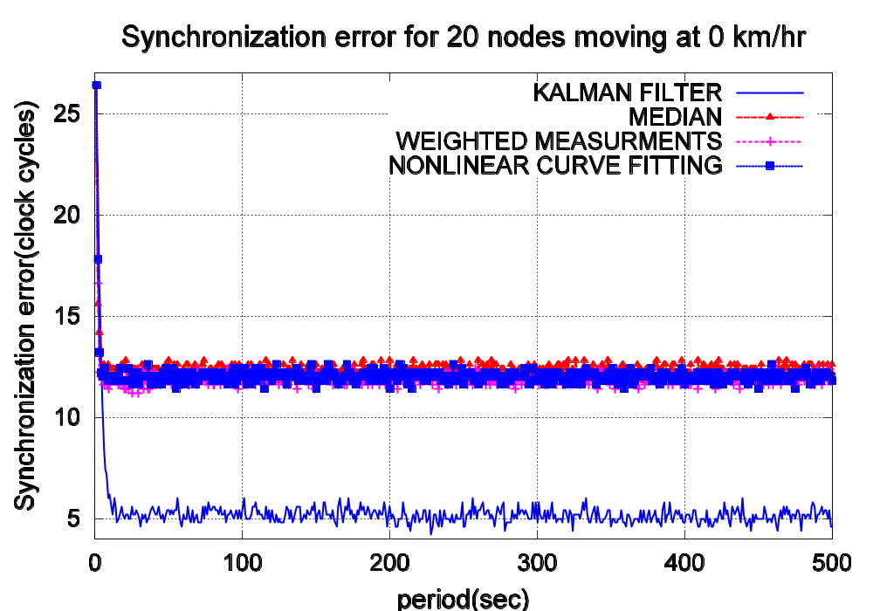
Simulation Results

Slide 31
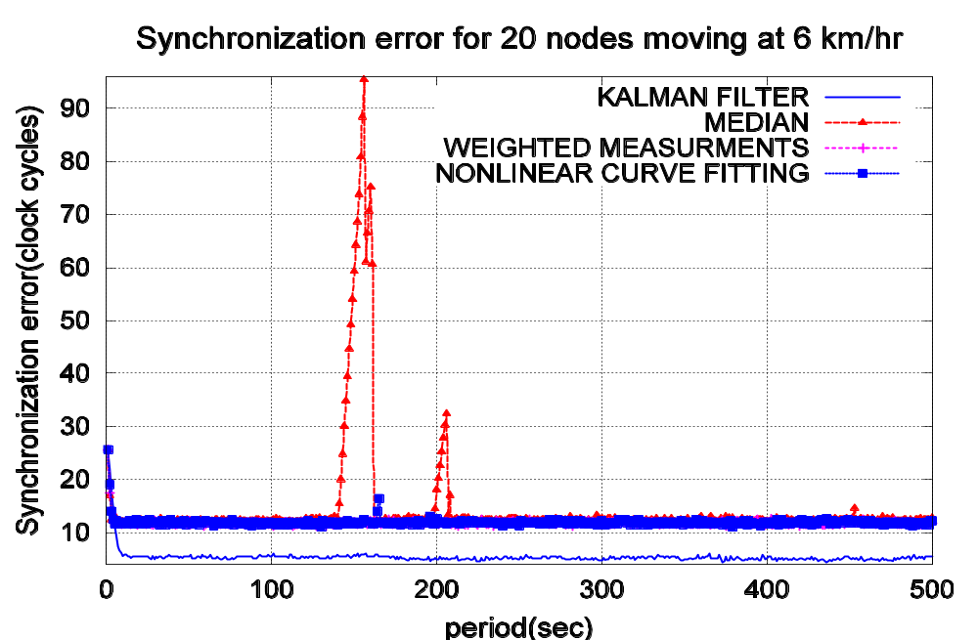
Simulation results Contd.

Slide 32
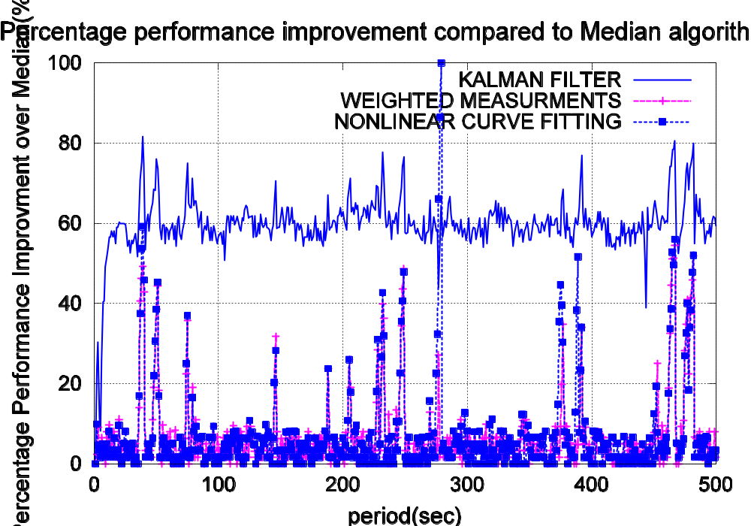
Simulation results Contd.

Slide 33
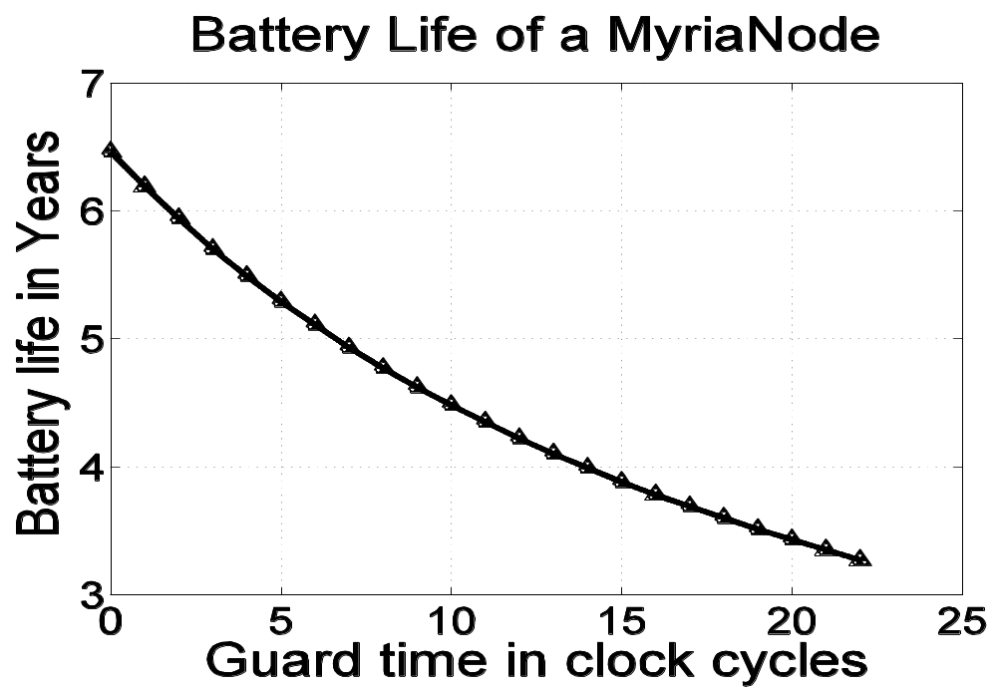
Energy Consumption
Communication is more expensive than computing.

Slide 34
Conclusion
KF performs the best in all cases.
Median is still the choice in static environment, when considered in all aspects.
Reducing the communication cost and increasing cost of computing is worthy to try.

Slide 35
Recommendation
Software power minimization techniques.
SDR for further investigation.
Additional tools for frequency error minimization.

Slide 36

Thank you!

