Slide 1
TinyOS – Communication and computation at the extremes
Jason Hill
http://tinyos.millennium.berkeley.edu
U.C. Berkeley
1/10/2001

Slide 2
Computing in a cubic millimeter:
Combine sensing, communication and computation into a complete architecture
  Advances in low power wireless communication technology and micro-electromechanical sensors (MEMS) transducers make this possible
The Smallest Possible Ninja Unit
Event based programming model plus a set of System components that provide applications efficient communication and sensing primitives
Notes:
Evy so oft tech changes lead to the enabling of completely new

Slide 3
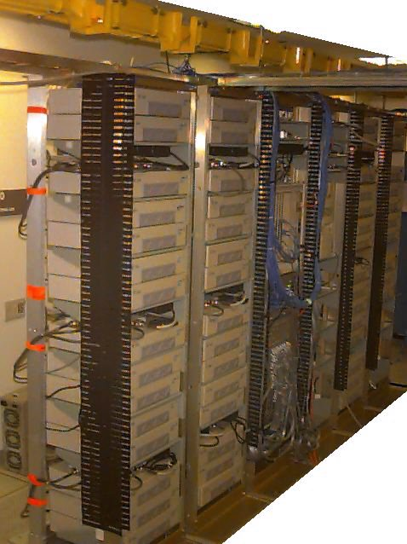
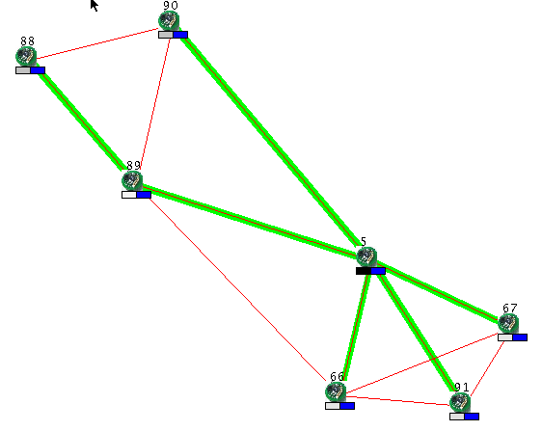
Ad hoc sensing
Autonomous nodes self
assembling into a network
of sensors
Sensor information propagated
to central collection point
Intermediate nodes assist distant
nodes to reach the base station
Connectivity and error rates used
to infer distance
Base Station
Routing Tree Link
Connectivity

Slide 4
TinyOS with Ninja
TinyOS devices are individual Ninja Units that sense and actuate physical world
Routes and identities of base stations automatically discovered
Active proxies interact with base stations and forward data from units into the Ninja Base
Sensor readings stored in DDS for later querying and evaluation
Ninja Bases used to distribute data to end users

Slide 5
Organization
The Big Picture
Hardware Advances
Software Advances
Planned Deployments

Slide 6
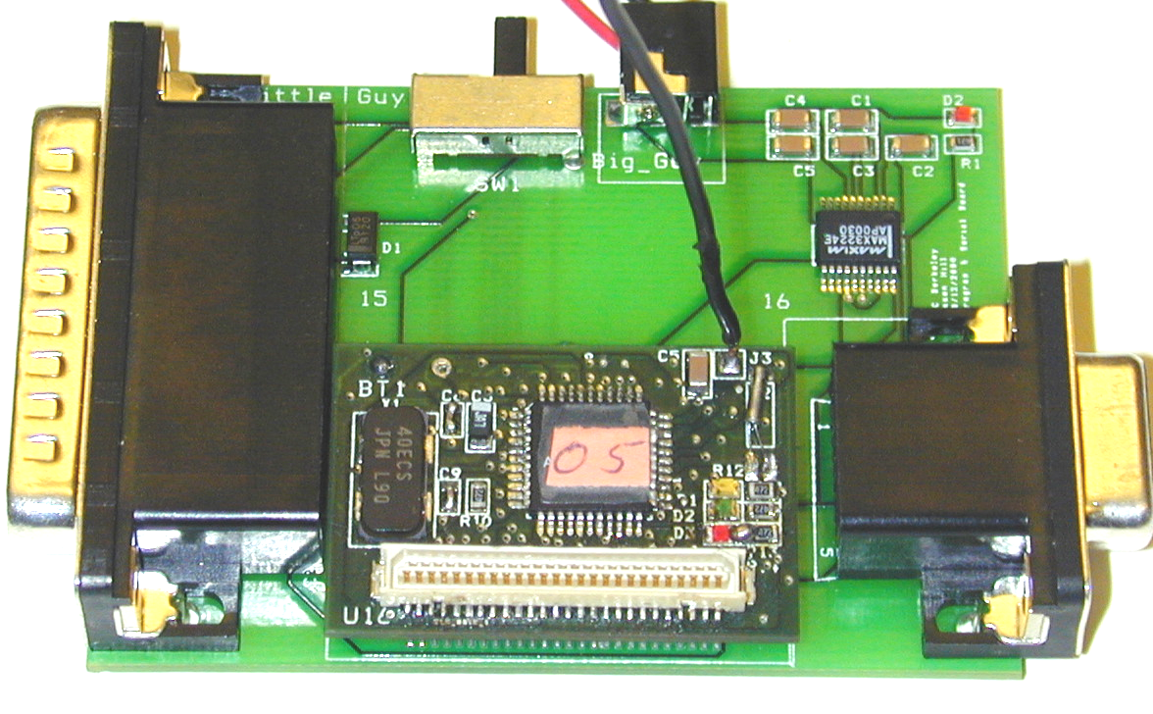
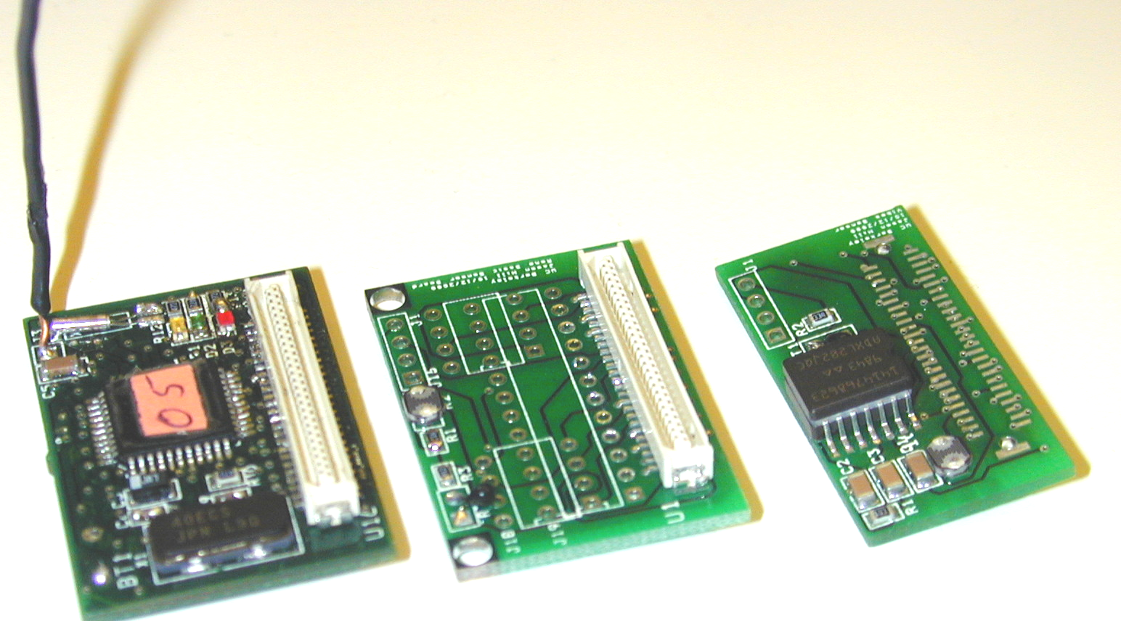
Hardware Kits
Two Board Sandwich
  Main CPU board
  with Radio Communication
  Secondary Sensor Board
Allows for expansion and
customization
Current sensors include:
Acceleration, Magnetic Field,
Temperature, Pressure,
Humidity, Light, and RF Signal Strength
Can control RF transmission strength & Sense Reception Strength
Improved transmission distances (30-100ft)‏
Notes:
While our original design was a great starting point. We quickly realized that in order to explore the diverse set of applications for this devices, we needed to add the ability to customize the hardware. To accomplish this, we separated the computation and communication portion from the sensor array. We were left with a deign where sensor packs can be attached to the computation/communication core. This allows deployment application specific sensor hardware.

Slide 7
Getting Others Involved:
Others using our devices:
  UCLA, UIUC, Intel Research (Portland)‏
  5 different Berkeley class projects last semester
Early February, Mote Boot Camp
  Intensive training session for people
Crossbow – Manufacturing and selling hardware
Marathon – Building high power sensor boards
Development tools for Windows and Linux

Slide 8
Software Directions
Location Detection
Secure Messaging
Power Conservation
Byte Code Interpreter

Slide 9
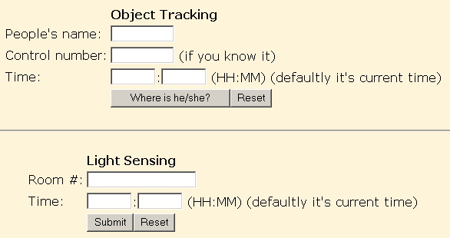
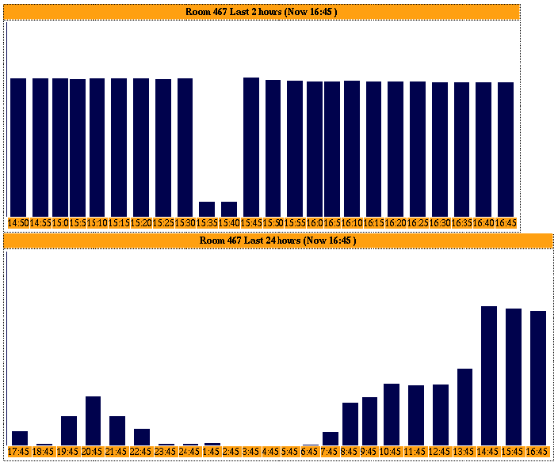
Location service
16 motes deployed on 4th floor Soda Hall
  10 round motes as office landmarks
  2 base stations around corners of the building
  4 Rene motes as active badges for location tracking
  AA batteries (3 weeks)‏
Tracking precision +/- one office
http://nighthawk.cs.berkeley.edu:8080/tracking

Slide 10
Position Estimation
Klemmer, Waterson, Whitehouse study
Empirical Analysis of RF Strength vs. Distance
Signal strength sensing
  Circuit works, falls off cleanly in good environment
  Incredibly sensitive to obstructions!
Infrastructure based services convert raw readings into real world distances
Error rates a useful proximity metric
  Bit errors vs. packet errors
signal strength + Kalman filter provides good position detection

Slide 11
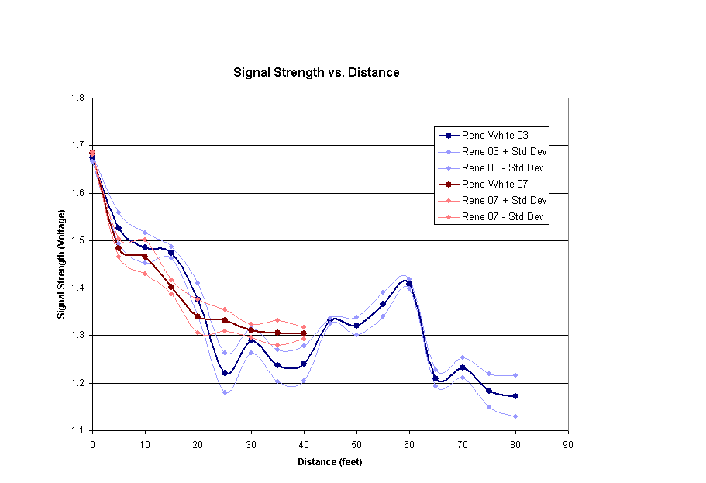

Slide 12
Signal strength limitations
Exponential fall off of RF signal causes exponential fall off of position accuracy
  Linear measuring techniques such as delay and phase shifts can be more consistent
Obstacles cause drastic variations in signal strength readings

Slide 13
Secure Messaging
Enables trusted communication to “Bases”
Use RC5 Cryptography to secure data transmissions
  Shared secret keys between base and each device
Secure, authenticated device to base station messages
Authenticated base station broadcasts
Activity
Time
Key Setup
4 ms
Authentication
300 µs
Encryption
60 µs

Slide 14
Energy Optmization
It turns out energy is your most valuable resource
  Traditional notions of resources – memory, CPU, I/O become expenses, not resources
All components must support low power modes
What can software do to conserve energy
Notes:
In hand held devices do you really choose weather or not to have the display active or communication take place. A user dictates the requirements and the system’s only choice is how to meet those demands with the available resources.

Slide 15
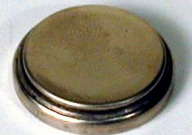
Power Breakdown…
Active
Idle
Sleep
CPU
5 mA
2 mA
5 μA
Radio
7 mA (TX)‏
4.5 mA (RX)‏
5 μA
EE-Prom
3 mA
0
0
Panasonic CR2354
560 mAh
LED’s
4 mA
0
0
Photo Diode
200 μA
0
0
Temperature
200 μA
0
0
But what does this mean?
  Lithium Battery runs for 35 hours at peak load and years at minimum load!
    That’s three orders of magnitude difference!
  A one byte transmission uses the same energy as approx 11000 cycles of computation.
Notes:
The ratio between Active and Idle is interesting…. This has bearing on the decision to include multiple controllers in the I/O hierarchy. It is better to have a single CPU 80% active that two CPU’s

Slide 16
Low-Power Listening
Great way to save power is to turn radio off when there is nothing to hear
Can turn radio on/of in about 1/3 bit
  Can detect transmission at cost of ~5 bit times
Small sub-msg recv sampling
Application-level synchronization rendezvous to determine when to sample
µs time scale
sleep
preamble
message
Xmit:
Recv:
b
ms time scale
sleep
Active
sleep
Active

Slide 17
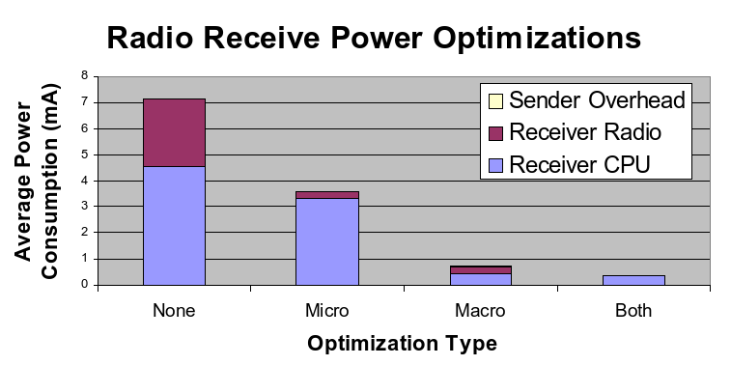
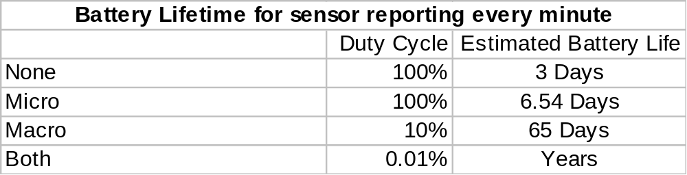
Sample tradeoffs
Panasonic CR2354
560 mAh

Slide 18
Application-Specific Virtual Machine
Small byte-code interpreter component
  Code, static data, stack
Accepts clock-event capsules
  Other events too
Hides split-phase operations below interpreter
HW + collection of components defines space of applications
  Allows very efficient coding within this space
Capsules define specific query / logic

Slide 19
Bringing it all together
A field experiment…

Slide 20
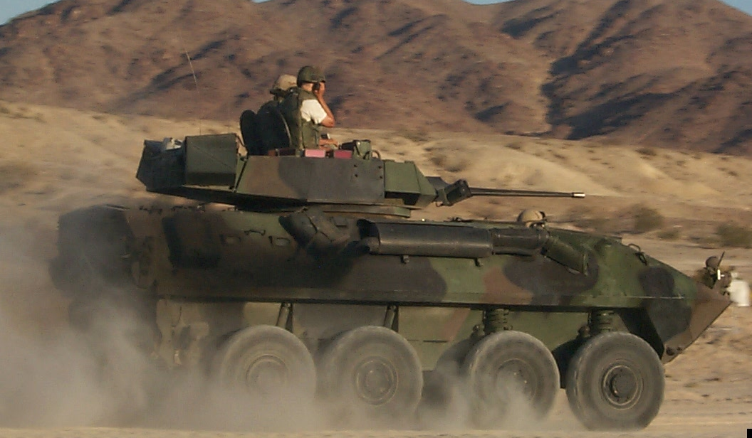
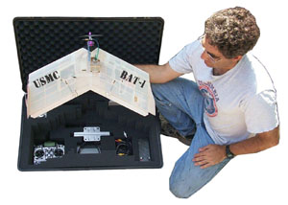
Planned Data Collection Experiment
March, 2001 (60 days from now)‏
UAV mote deployment
Vehicle detection and tracking
“Pick-up” data from network at a later date

Slide 21

Test Scenario
delivery of motes
network discovery
position estimation
time base synchronization
vehicle tracking
reporting to UAV

Slide 22
How to follow our progress:
http://tinyos.millennium.berkeley.edu

