Slide 1

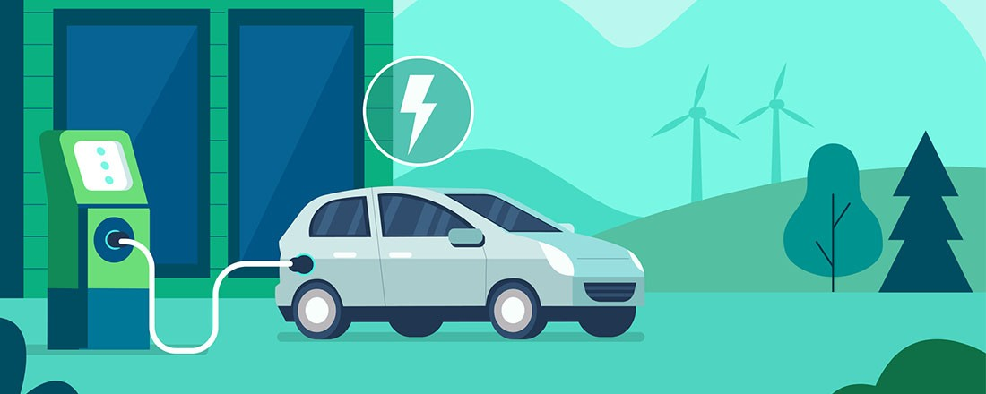
ATLIQ
MOTORS
ELECTRIC VEHICLES IN INDIA
MARKET ANALYSIS REPORT
Reporting by
Fasal Mohammed
Market Analyst

Slide 2
INTRODUCTION
ATLIQ MOTORS, the automotive company based in USA, is looking forward to extend their best selling EV lines into the Indian Market.
This market analysis study is done with the objective of helping ATLIQ MOTORS make a data driven decision before making that huge leap.
The Data analysis and dashboarding was done using Power BI.
The dataset used for the analysis is from the period of 2022-2024 (3 years), and is taken from a Government of India source.

Slide 3
AGENDA
MAKER PERFORMANCE ANALYSIS REPORT
2-WHEELER MAKER PERFORMANCE ANALYSIS
4 – WHEELER MAKER PERFORMANCE ANALYSIS
QUATERLY PERFORMANCE ANALYSIS
STATE-WISE PERFORMANCE ANALYSIS REPORT
FACTORS OF EV GROWTH
IMPACT OF SUBSIDIES
MANUFACTURING PLANT LOCATION
BRAND AMBASSADOR FOR ATLIQ MOTORS IN INDIA
TOP 3 RECOMMENDATIONS

Slide 4
1. MAKER ANALYSIS
Conducted a macro level analysis and Top and Bottom Performers are being presented.
Benchmark the best practices of top performers.
Avoid the practices/pitfalls of Bottom performers
Understand Market dynamics and Consumer preferences
Understand relative market position and refine our positioning to meet the demands of the Indian market
Look for potential partners or mergers/acquisition targets among weaker competitors

Slide 5
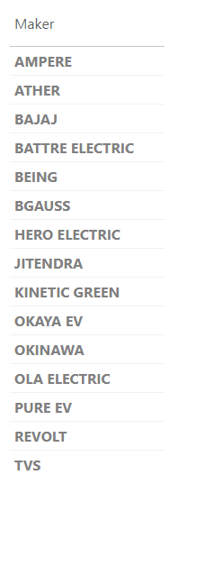
1.1.1 DIFFERENT COMPANIES OPERATING IN INDIAN 2W EV MARKET
As of March 2024, there are around 15 players in the Indian 2W EV Market.
Prominent companies being OLA ELECTRIC, ATHER, TVS, BAJAJ etc.

Slide 6
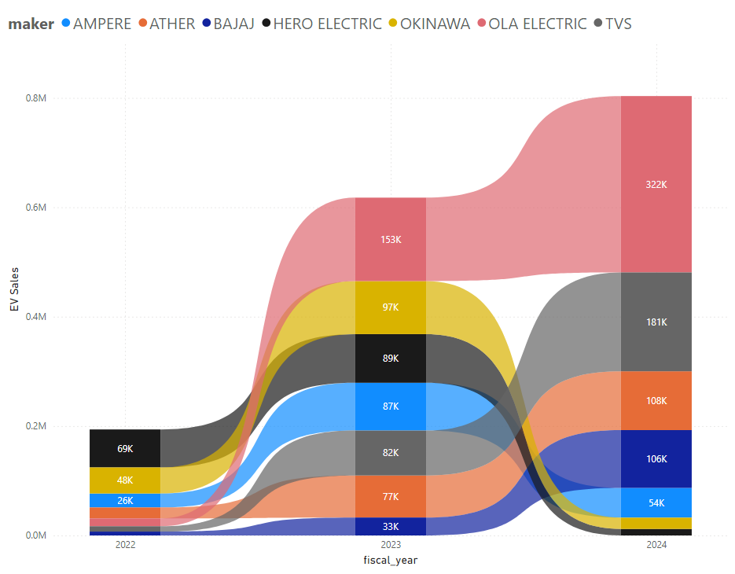
1.1.2 RISE AND FALL OF EV 2W LEADERSHIP
FALL of HERO ELECTRIC AND OKINAWA
Hero electric has fallen from being the Market leader (2022) to
3rd (2023) and to 7th (2024) – a massive decline of 59% CAGR in sales.
OKINAWA maintained its 2nd position from (2022) to (2023),
but fell to 7th (2024) – significant decline of 34% CAGR in sales
RISE OF OLA ELECTRIC , TVS AND BAJAJ
From 5th position (2022) ,OLA rose to Market Leadership (2023) &
maintained the position in (2024) – a whopping growth of
373% CAGR in sale
From 6th (2022), TVS rose to 5th (2023) and to 2nd (2024) – growth
of a substantial 330% CAGR in sales
Another significant growth is of Bajaj, rising from 7th
(2022 & 2023) to 4th (2024), with a significant increase of
285% CAGR in sales

Slide 7
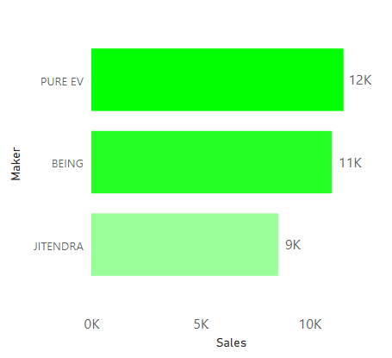
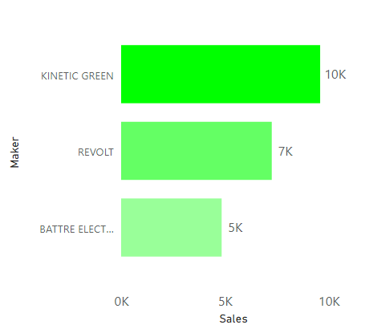
1.1.3 BOTTOM PERFROMERS IN EV 2W MARKET
BOTTOM MAKERS OF EV 2W SALES IN THE FISCAL YEAR 2022-2024
2W Bottom Makers 2023
2W Bottom Makers 2024

Slide 8
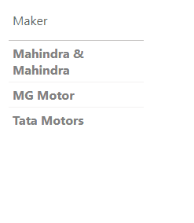
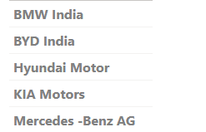
1.2.1 DIFFERENT COMPANIES OPERATING IN INDIAN 4-WHEELER EV MARKET
Grouped by segments
Makers belonging to a group have major share of their models in those particular segments.
Group 1 - Budget EVs (Price Range: Under Rs 10 lakh ) & Mid-Range EVs (Price Range: Between Rs 10-25 lakh )
Group 2 - Premium EVs (Price Range: 25 -50 lakhs) and Luxury EVs (Price Range: More than 50 lakhs)
Volvo Auto India

Slide 9
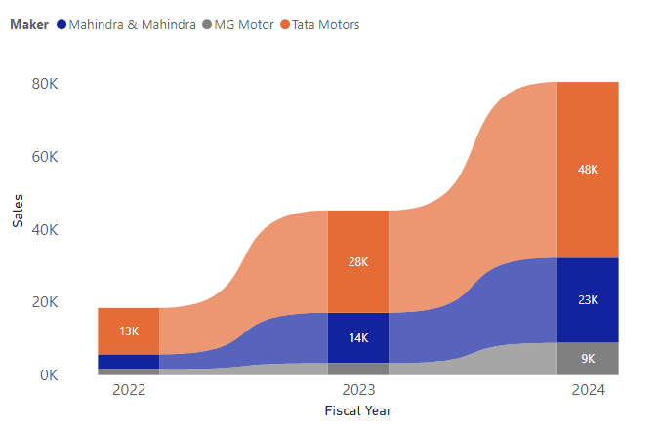
1.2.2 DOMINANCE OF TATA EV AMONG EV 4W BUDGET AND MID-RANGE SEGMENTS
1. TOP 3 MAKERS FOR THE FISCAL YEARS 2022, 2023 and 2024 IN EV BUDGET AND MID RANGE 4-WHEELER SALES.
Tata Motors has maintained the market leadership
with a CAGR of 95% through out the period.
Mahindra has maintained the 2nd position and is
Growing at an impressive CAGR of 140%.
MG Motors is another growing company with
CAGR of 132%.
4W Bottom Makers 2024

Slide 10
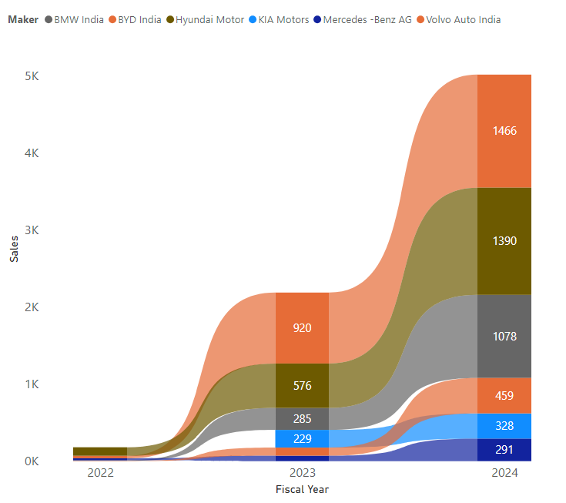
1.2.3 EV SALE TRENDS IN EV 4W PREMIUM AND LUXURY SEGMENTS
List the top 3 and bottom 3 makers for the fiscal years 2023 and 2024 in terms of the number of 4 wheelers sold
Hyundai was the market leader in 2022, but fell to 2nd
in 2023 , which it maintained in 2024- grew at an impressive
255% CAGR in sales
BYD India rose from 2nd (2022) to become market leader (2023)
and has maintained the leadership in 2024 – grew with a
significant 567% CAGR.
BMW India has jumped from 4th position in 2022 to 3rd position
in 2023 and has maintained it in 2024- grew at a
whopping 1140 % CAGR.
Volvo Auto India is another company which has made a
Massive growth with a CAGR of 972% in sales.

Slide 11
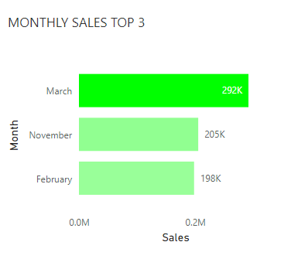
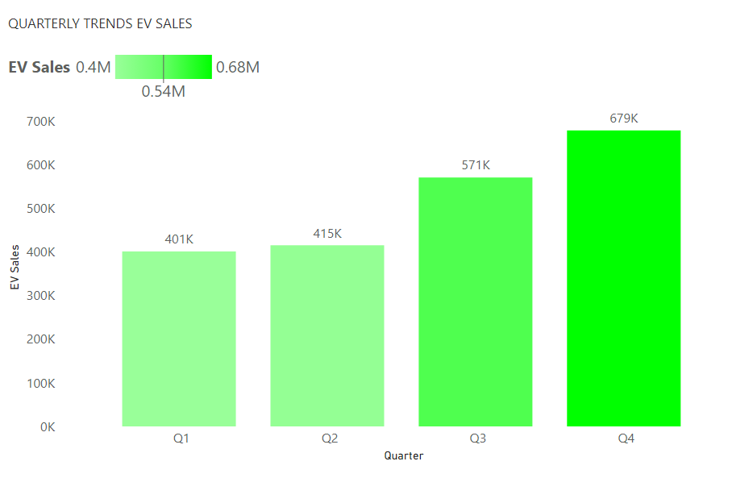
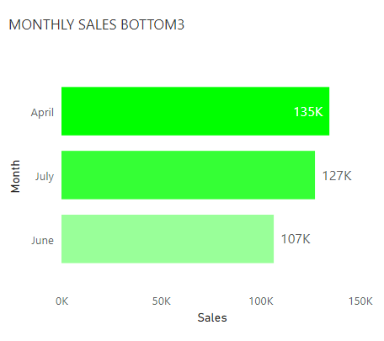
1.3 QUARTERLY DYNAMICS OF INDIAN MARKET
In India, Fiscal Year begins in April of a year and ends in march of next year
Quarterly Market Dynamics
Q4 (January – March)
Financial year end
Most sales in general
Significant Promotion and Discounts to meet sales targets.
Tax planning - Purchasing to avail tax deductions
Q1 (April-June)
Beginning of the fiscal year
Low sales in general
Cutting back on expenditure after heavy spending in Q4
Launch of new models with no discounts
Q2 (July-September)
Low to moderate sales in general
Most part is Monsoon season
Beginning of festive seasons – leading to increase in sales
Q3 (October - December)
Festive seasons boom – Diwali, Christmas etc
high sales in general
It is essential to understand this seasonal market dynamics and effectively apply them on our strategies to gain sales.

Slide 12
2. STATE PERFORMANCE ANALYSIS
India is divided into 28 states and 8 Union Territories
Different states have their own specific EV ecosystems, geographical terrains, consumer preferences etc.
Conducted a macro level analysis and Top and Bottom Performing states are pointed out.
Understand which states that have a supporting EV ecosystem and there by make our strategic decisions.

Slide 13
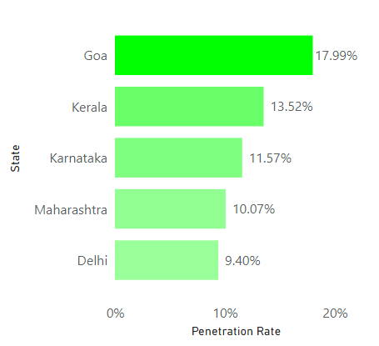
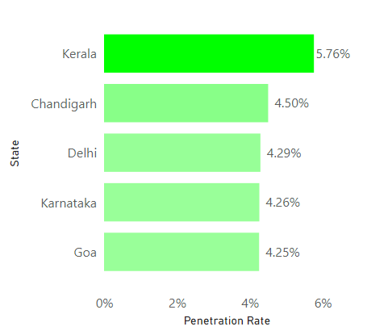
2.1 TOP STATES IN EV ADOPTION – FISCAL YEAR 2024
Top 5 – 2W- Penetration Rate
Top 5 – 4W - Penetration Rate

Slide 14
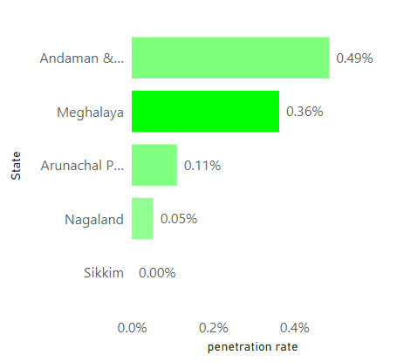
2.2 BOTTOM STATES IN EV ADOPTION - FISCAL YEAR 2024
2. Identify the top 5 states with the highest penetration rate in 2-wheeler and 4-wheeler EV sales in FY 2024.
Hilly areas in general have low penetration rate.
Challenging terrain and topography
Limited availability of charging stations
Thus increasing range anxiety
Bottom 5 – Penetration rate – FY 2024

Slide 15
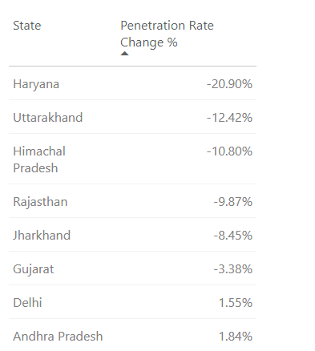
2.3 STATES HAVING A DECLINING ADOPTION OF EV
3. List the states with negative penetration (decline) in EV sales from 2022 to 2024?
No state recorded a decline in Penetration Rate from
2022 to 2024
But 8 States recorded a decline in from 2023 to 2024
States with PR decline 2023-2024

Slide 16
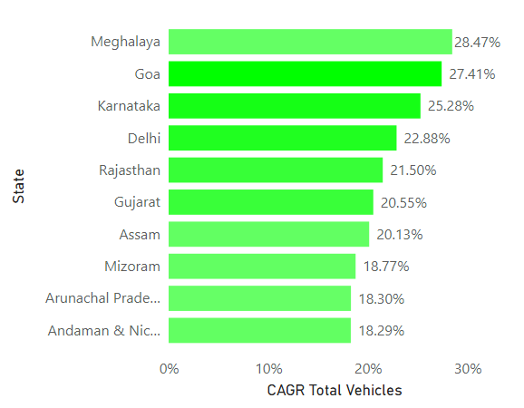
2.4 STATES WITH THE MOST DEMAND FOR VEHICLES
TOP 10 – CAGR Total Vehicles- 2022-2024

Slide 17
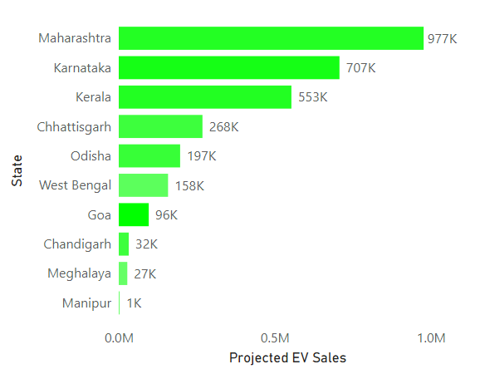
2.5 THE STATES EXPECTED TO HAVE MOST EV VEHICLES IN 2030
EV Sales Projection 2030 - Top 10 States by PR

Slide 18
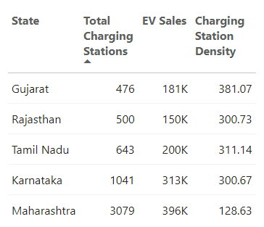
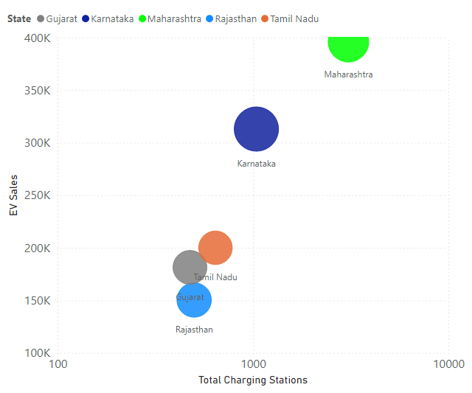
2.6 RELATIONSHIP BETWEEN AVAILABILITY OF CHARGING STATIONS AND EV SALES
Even though EV Sales declined marginally from Gujrat to Rajasthan where Charging stations increased, it consistently and significantly increased thereafter along with the increase in Charging stations.
In general , EV sales increases with increase in the availability of charging stations - showing a high and positive correlation.

Slide 19
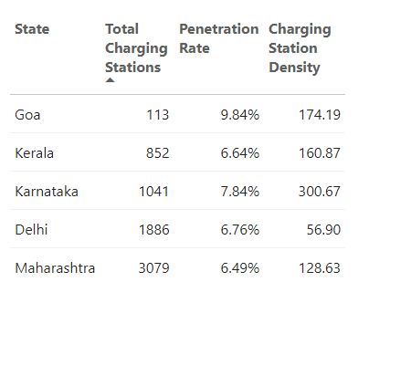
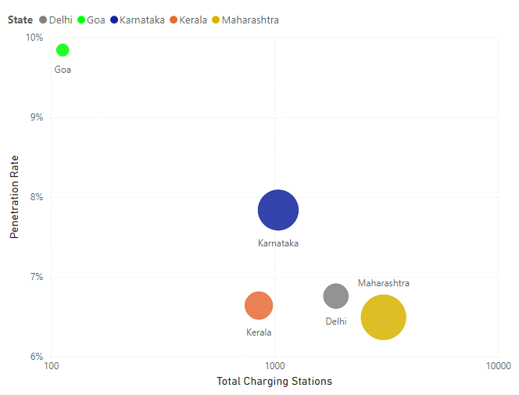
2.7 RELATIONSHIP BETWEEN AVAILABILITY OF CHARGING STATIONS AND PENETRATION RATE
It was found that the states that have high adoption rates have more than twice the charging station availability than the national average (720), thus indicating a positive correlation.
The exception of Goa owes to the small size of the state thus requiring less charging stations for high adoption.

Slide 20
3. PRIMARY FACTORS RESPONSIBLE FOR EV GROWTH IN 2023 & 2024
WHY CHOOSE EV?
Advantages of Electric Vehicles over Traditional ICE vehicles
Lower operating costs such as reduced fuel expenses and maintenance cost
Factors responsible for sales growth in 2023 and 2024
Increased consumer awareness of the environmental, economic and performance benefits.
Increase in the utilization of Government subsidies - reducing upfront costs.
Increase in the availability of charging Stations – Reducing range anxiety

Slide 21
4. IMPACT OF SUBSIDIES ON EV ADOPTION
Despite the lower operating costs (Fuel and maintenance cost ), the high upfront cost of EV than its ICE counterparts – makes it challenging to buy EV
Subsidies play an important role in EV adoption by reducing this upfront cost and making EV affordable.
CRITERION
Depend on the model and battery capacity of the vehicle
Limited to a specified number of vehicles or specified validity of time encouraging early adopters.
CENTRAL GOVERNEMT SUBSIDIES
FAME Scheme (Faster Adoption and Manufacturing of electric vehicles)
India’s flagship e-mobility promotion scheme
Subsidies for 2W,3W and 4W
STATE GOVERNMENT SUBSIDIES
Over and above FAME scheme
Monetary incentives. Road Tax and Registration fees exemptions etc.
Not all states provide subsidies
The States that provided the most subsidies are :
Maharashtra → 4W - Up to Rs. 2.5 lakh, 2W - Up to Rs. 25,000, 100% Road Tax Exemption
Gujrat → 4W - Up to Rs. 1.5 lakh, 2W - Up to Rs. 20,000, 50% Road Tax Exemption
Goa → 4W - Up to Rs. 1 lakh, 2W - Up to Rs. 15,000, 100% Road Tax Exemption
Impact well reflected in the EV sales and Adoption rates of these respective states.

Slide 22
5. IDEAL MANUFACTURING PLANT LOCATION
TAMIL NADU, MAHARASHTRA , GUJRAT
These states have the following advantages in common:
1. Presence of already existing EV manufacturing plants- Easier to integrate into existing supply chains, easier availability of labor force etc.
TAMIL NADU– OLA , ATHER, TVS, AMPERE
MAHARASTRA – Mahindra , Bajaj
GUJRAT – TATA EV
2. Friendly and Welcoming EV Policy – Capital subsidies, tax exemptions etc.
3. Infrastructure - excellent port facilities, robust road and rail connectivity, and reliable power supply.
4. High rankings in Ease of Doing Business report by Govt. of India.
5. Access to large Markets in southern and central India – cost effective and speedy distribution.

Slide 23
6. BRAND AMABASSADOR
Shubman Gill, the rising star in Indian cricket who is known for his impressive batting skills, is an excellent choice.
Boosts brand visibility and increase Brand awareness
In India, Cricket and Cinema are the events that receive the most public attention.
Gill being 24 years of age, will help attract the primary EV customers who are in the age group of 18-45
15 million Instagram followers
Brand Image Fit
Sportspersons are known for their technical proficiency, Performance, healthy lifestyle etc.
ATLIQ MOTORS can associate with these values to build an appealing brand image.

Slide 24
7. TOP 3 RECOMMENDATIONS
Market Positioning:
Focus on Affordable and Mid-Range EV Models (in the case of 4W) to accelerate the expansion as the Indian mass market is price-sensitive.
Market Gap - Minimal players like TATA EV, Mahindra and Mahindra and MG Motors in the segment.
Vehicle Design Features:
Affordability - Qualify for government subsidies
Reliability- Robust enough to Endure diverse terrains and climate conditions of India.
Distribution Network
Improve Distribution network in states having high adoptions rates like Goa, Maharashtra, Karnataka , Kerala etc.
Avoid hilly regions/states - low in Adoption rates - until sufficient charging infra is developed.

Slide 25
THANK YOU FOR WATCHING

