Slide 1
F11. RGB mosaicing via multi-graph synchronization
Azzoni Francesco
Fasana Corrado
Pasini Samuele

Slide 2
Summary
Introduction
Alignment
Pair-wise Homography Representation
Our focus: Global Homography Estimation
Basic Approach
Simple-Graph
Edge-Averaging
Multi-Graph
Multi-Patch
Edge-Averaging Patch
Compositing
Evaluation
Real data evaluation
Synthetic data evaluation
Qualitative Outcomes
Synthetic Data Generation
Quantitative Outcomes

Slide 3
Introduction
Image mosaicing refers to the problem of aligning/registering multiple images in a bigger one leveraging on homographic transformation.
Two steps are required:
• Alignment: estimate the homographic transformation between pairs of images
• Compositing: selecting a final compositing surface and decide how to optimally blend image-pixels to minimize visible seams, blur, and ghosting.

Slide 4
Alignment
Feature Extraction (SIFT)
Feature Matching (FLANN-based)
Robust pair-wise Homography Estimation (RANSAC)
Global Homography Estimation

Slide 5
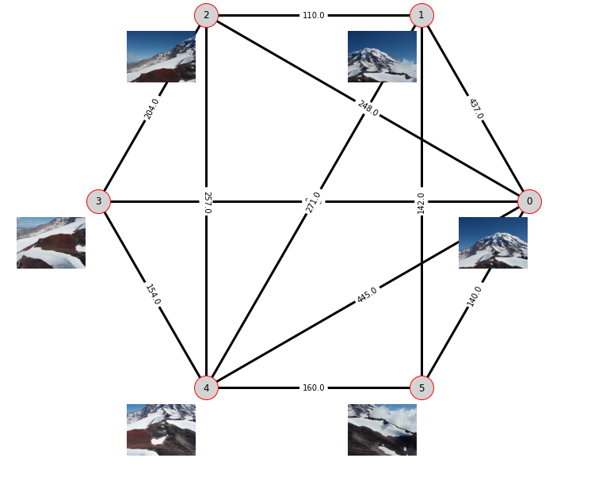
Pair-wise Homography Representation
Graph-Representation

Slide 6
Our focus: Global Homography Estimation
Several techniques:
Basic
Simple-Graph
Edge-Averaging
Multi-Graph
Multi-Patch
Edge-Averaging Patch
Notes:
We focused our research on the alignment step, comparing different methods.

Slide 7
Basic Approach
Mechanism
Given a graph-representation of pair-wise homographies, and a reference image (Ir), the idea is to estimate the homography between an image Ij and Ir by combining the pair-wise homographies.
Pro
Simple
Fast
Intuitive
Works even with acyclic graphs
Cons
Error cumulation

Slide 8
Simple-Graph
Mechanism
Given a graph-representation of pair-wise homographies, and a reference image (Ir), the idea is to solve a graph synchronization problem where the nodes of the graph are the states, and the edges are the pair-wise homographies.
Pro
Error distribution
Closed-form solution
The more the cycles the better it works
Cons
Works only with cyclic graphs
Slower than Basic Stitching
Notes:
Explain what is synchronization

Slide 9
Edge-Averaging
Mechanism
Given a graph-representation of pair-wise homographies with multiple edges, and a reference image (Ir), the idea is to reduce the problem to a Simple-Graph synchronization by averaging together the multi-edges having the same source and destination nodes.
Pro
Same as Simple-Graph
Intuitive
Cons
Same as Simple-Graph
No theoretical guarantees

Slide 10
Multi-Graph
Mechanism
Given a graph-representation of pair-wise homographies with multiple edges, and a reference image (Ir), the idea is to solve a multi-graph synchronization problem where the nodes of the graph are the states, and the edges are the pair-wise homographies.
Pro
Same as Simple-Graph
The more the multi-edges the better it works
Cons
Synchronization over the expanded graph is computationally expensive
Notes:
Same as Simple-Graph but applied to the expanded graph

Slide 11
Multi-Patch
Mechanism
Given a graph-representation of pair-wise homographies, and a reference image (Ir), the idea is to solve a partioned synchronization problem. The graph is first partitioned in several clusters and simple-graph synchronization is applied to each cluster independently. Then, each cluster is condensed into a node to build a multi-edge graph (patch graph) where the edges are the inter-cluster homographies. Finally, multi-graph synchronization is applied.
Pro
Reduce complexity with lots of images
Cons
Projecting the inter-cluster homographies can introduces numerical errors

Slide 12
Edge-Averaging Patch
Mechanism
Given a graph-representation of pair-wise homographies, and a reference image (Ir), the idea is the same as Multi-Patch synchronization with the only difference that edge-averaging is applied instead of multi-graph synchronization on the patch graph.
Pro
Same as Multi-Patch
Cons
Same as Multi-Patch
No theoretical guarantees

Slide 13
Compositing
Having defined a reference image, all the other images are transformed in the reference frame according to the computed global homographies and fused into a single image using the maximum operator.

Slide 14
Results evaluation
Real data evaluation
Qualitative
Quantitative
Synthetic data evaluation
Qualitative
Quantitative

Slide 15
Real data evaluation
Qualitative – All the presented methods are evaluated visually observing the quality of the stitched image using some benchmark datasets.
Quantitative – Given the absence of a ground truth it is not possible to evaluate the results quantitatively.

Slide 16
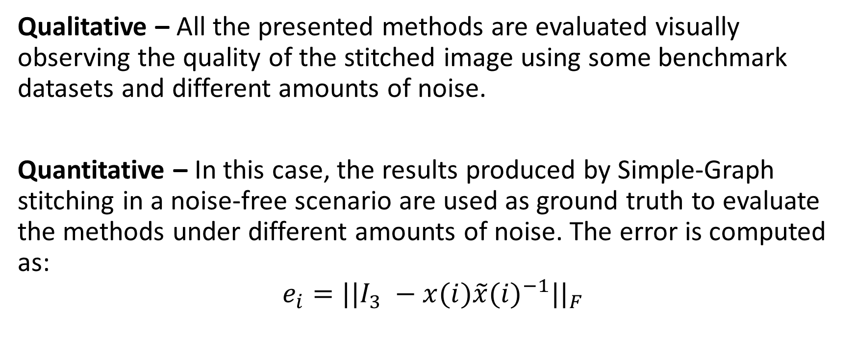
Synthetic data evaluation
Qualitative – All the presented methods are evaluated visually observing the quality of the stitched image using some benchmark datasets and different amounts of noise.
Quantitative – In this case, the results produced by Simple-Graph stitching in a noise-free scenario are used as ground truth to evaluate the methods under different amounts of noise. The error is computed as:
$$e_{i}={||I_{3} −x(i)\tilde{x}{(i)}^{−1}||}_{F}$$

Slide 17
Qualitative Outcomes
Method | Real Data - Qualitative | Synthetic Data - Qualitative
Basic | Worse than the others in some cases | Depends on the dataset
Simple-Graph | Good | Depends on the dataset
Edge-Averaging | Good | Best
Multi-Graph | Good | Best
Multi-Patch | Worse than the others in some cases | Worst
Edge-Averaging Patch | Good | Depends on the dataset

Slide 18
Synthetic Data Generation
Given that it is difficult to assess which method is better using only qualitative evaluation on the original datasets due to the fact that the results are quite similar, we decided to generate synthetic data adding different levels of noise to real data.
In particular, we added a Gaussian noise to the points identified by SIFT.

Slide 19
Qualitative Outcomes
Method | Real Data - Qualitative | Synthetic Data - Qualitative
Basic | Worse than the others in some cases | Depends on the dataset
Simple-Graph | Good | Depends on the dataset
Edge-Averaging | Good | Best
Multi-Graph | Good | Best
Multi-Patch | Worse than the others in some cases | Worst
Edge-Averaging Patch | Good | Depends on the dataset

Slide 20
Quantitative Outcomes with Synthetic data
Method | Sun | Snow | Pognana | Mountain
Basic | Ok (slightly better than Edge-Averaging Patch) | Worst | Worst | Ok (slightly better than Edge-Averaging Patch)
Simple-Graph | Bad (slightly better than Multi-Patch) | Ok | Ok | Worst
Edge-Averaging | Best | Best | Best | Best
Multi-Graph | Best | Best | Best | Best
Multi-Patch | Worst | Ok (slightly better than Simple Graph) | Ok (slightly better than Simple Graph) | Ok
Edge-Averaging Patch | Ok | Ok (same as Multi-Patch) | Ok (same as Multi-Patch) | Ok (slightly better than Multi-Patch)

