Slide 1
F11. RGB mosaicing via multi-graph synchronization
Azzoni Francesco
Fasana Corrado
Pasini Samuele

Slide 2
Summary
Introduction
Our focus: Alignment

Slide 3
Introduction
Image mosaicing refers to the problem of aligning/registering multiple images in a bigger one leveraging on homographic transformation.
Two steps are required:
• Alignment: estimate the homographic transformation between pairs of images
• Compositing: selecting a final compositing surface and decide how to optimally blend image-pixels to minimize visible seams, blur, and ghosting.

Slide 4
Alignment
Feature Extraction (SIFT)
Feature Matching (FLANN-based)
Robust pair-wise Homography Estimation (RANSAC)
Global Homography Estimation

Slide 5
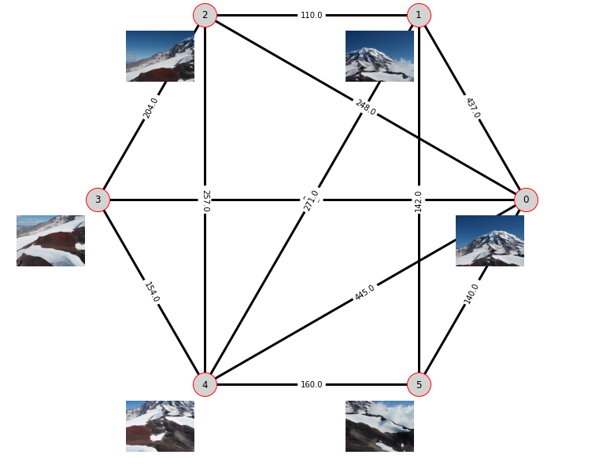
Pair-wise Homography Representation
Graph-Representation

Slide 6
Our focus: Global Homography Estimation
Several techniques:
Basic
Simple-Graph
Edge-Averaging
Multi-Graph
Multi-Patch
Edge-Averaging Patch
Notes:
We focused our research on the alignment step, comparing different methods.

Slide 7
Basic Approach
Mechanism
Given a graph-representation of pair-wise homographies, and a reference image (Ir), the idea is to estimate the homography between an image Ij and Ir by combining the pair-wise homographies.
Pro
Simple
Fast
Intuitive
Works even with acyclic graphs
Cons
Error cumulation

Slide 8
Simple-Graph
Mechanism
Given a graph-representation of pair-wise homographies, and a reference image (Ir), the idea is to solve a graph synchronization problem where the nodes of the graph are the states, and the edges are the pair-wise homographies.
Pro
Error distribution
Closed-form solution
The more the cycles the better it works
Cons
Works only with cyclic graphs
Slower than Basic Stitching
Notes:
Explain what is synchronization

Slide 9
Edge-Averaging
Mechanism
Given a graph-representation of pair-wise homographies with multiple edges, and a reference image (Ir), the idea is to reduce the problem to a Simple-Graph synchronization by averaging together the multi-edges having the same source and destination nodes.
Pro
Same as Simple-Graph
Intuitive
Cons
Same as Simple-Graph
No theoretical guarantees

Slide 10
Multi-Graph
Mechanism
Given a graph-representation of pair-wise homographies with multiple edges, and a reference image (Ir), the idea is to solve a multi-graph synchronization problem where the nodes of the graph are the states, and the edges are the pair-wise homographies.
Pro
Same as Simple-Graph
The more the multi-edges the better it works
Cons
Synchronization over the expanded graph is computationally expensive
Notes:
Same as Simple-Graph but applied to the expanded graph

Slide 11
Multi-Patch
Mechanism
Given a graph-representation of pair-wise homographies, and a reference image (Ir), the idea is to solve a partioned synchronization problem. The graph is first partitioned in several clusters and simple-graph synchronization is applied in each cluster independently. Then, each cluster is condensed into a node to build a multi-edge graph (patch graph) where the edges are the inter-cluster homographies. Finally, multi-graph synchronization is applied.
Pro
Reduce complexity with lots of images
Cons
Projecting the inter-cluster homographies can introduces numerical errors

Slide 12
Edge-Averaging Patch
Mechanism
Given a graph-representation of pair-wise homographies, and a reference image (Ir), the idea is the same as Multi-Patch synchronization with the only difference that edge-averaging is applied instead of multi-graph synchronization on the patch graph.
Pro
Same as Multi-Patch
Cons
Same as Multi-Patch
No theoretical guarantees

Slide 13
Composing
Having defined a reference image, all the other images are transformed in the reference frame according to the computed global homographies and fused into a single image using the maximum operator.

Slide 14
Results evaluation
Real data evaluation
Qualitative
Quantitative
Synthetic data evaluation
Qualitative
Quantitative

Slide 15
Real data evaluation
Qualitative – All the presented methods are evaluated visually observing the quality of the stitched image using some benchmark datasets.
Quantitative – Given the absence of a ground truth it is not possible to evaluate the results quantitatively.

Slide 16
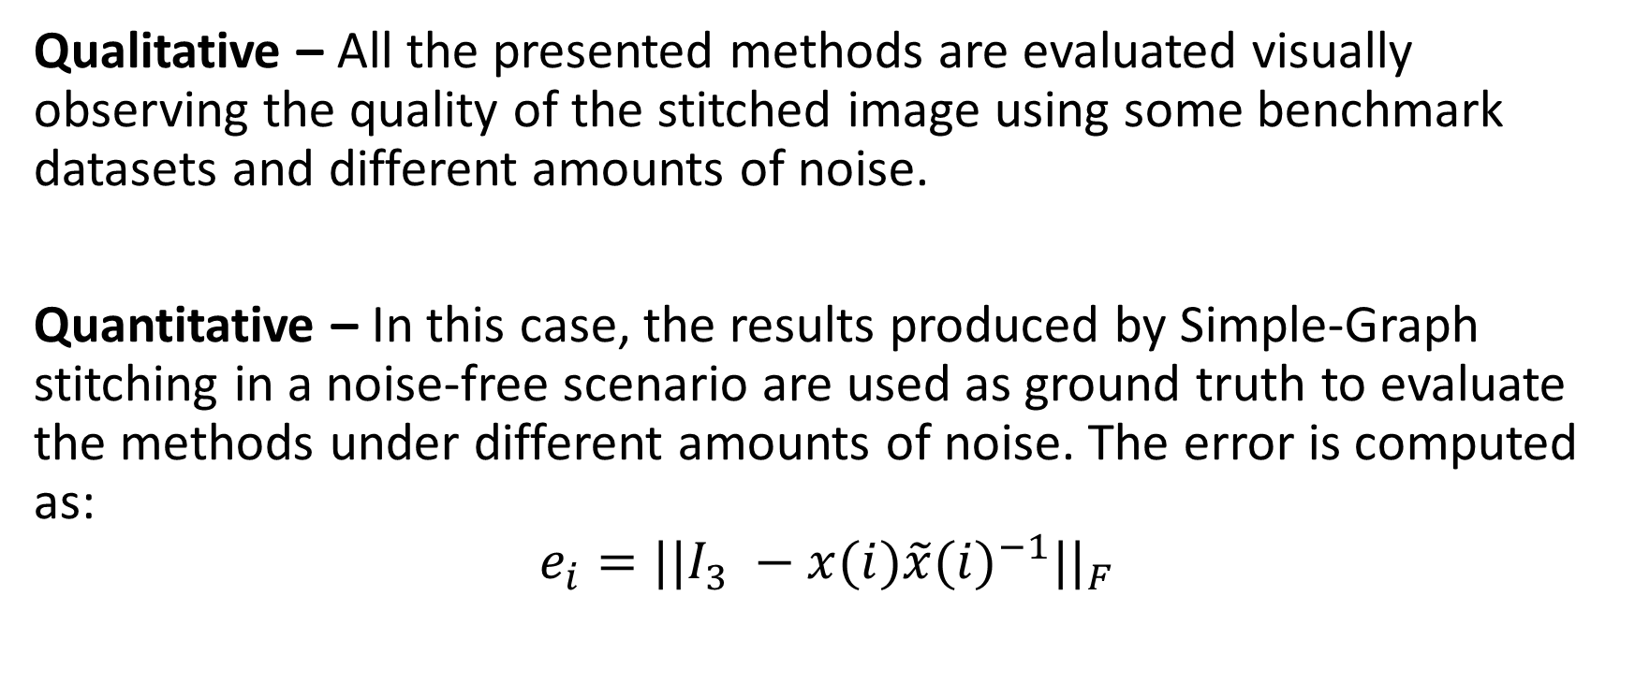
Synthetic data evaluation
Qualitative – All the presented methods are evaluated visually observing the quality of the stitched image using some benchmark datasets and different amounts of noise.
Quantitative – In this case, the results produced by Simple-Graph stitching in a noise-free scenario are used as ground truth to evaluate the methods under different amounts of noise. The error is computed as:
$$e_{i}={||I_{3} −x(i)\tilde{x}{(i)}^{−1}||}_{F}$$

Slide 17
Outcomes
Method | Real Data - Qualitative | Synthetic Data - Qualitative
Basic | Worse than the others in some cases
Simple-Graph | Good
Edge-Averaging | Good | Best
Multi-Graph | Good | Best
Multi-Patch | Worse than the others in some cases | Worst
Edge-Averaging Patch | Good

Slide 18
Thanks for the attention!

