Slide 1
User intent Classification
Francesca Sapien, DAT SF 19

Slide 2
Project Background
Open-ended exploration of keyword portfolio
Already considered:
Segmenting by Theme/Topic: Health, Famous People, Vehicles
Segmenting by Popularity: Clicks, time on page, etc.
Not considered:
User Intent : What is the user trying to obtain or accomplish when they type in a given keyword?

Slide 3
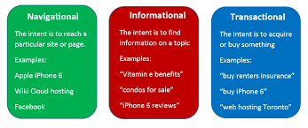
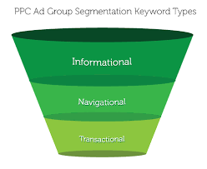
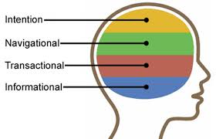
What is User Intent?
Popular Papers: Jansen & Booth, 2007

Slide 4
What is User Intent?
Informational
User is trying to obtain information about a topic, and it’s appropriate to respond with text.
Resource
User is trying to obtain a specific resource that can either be accessed online or downloaded.
Navigational
User is trying to navigate to a website or resource hosted on a specific website.
Transactional
User is trying to purchase an item.

Slide 5
User Intent Classes
Informational Classes
Generic
Direct Answer
Guide
Navigational
Resource
Transactional

Slide 6
User Intent Classes
Generic
Implied request: "Show/Tell me anything about my topic”
Direct Answer
Implied request: “Show/tell me X about my topic”
Guide
Next steps to accomplish task or project
Navigational
Navigate to website. Includes biz names & gov agencies, without context
Resource
Navigate to resource.
Transactional
Explicit and implicit transactional intent. Includes product names.

Slide 7
Exploratory Data Labeling
Labeling Samples:
Top performing keywords (cross-categorical)
Random keywords (cross-categorical)
Samples of top-performing subject categories

Slide 8
Exploratory Data Analysis
Labeling Samples:
Top performing keywords (cross-categorical)
Random keywords (cross-categorical)
Samples of top-performing subject categories
Key Takeaways:
Subject categories often have an overall “theme” and feature one or two major intent classes:
Intent classes can have very different structure across subject categories:

Slide 9
Exploratory Data Analysis

Slide 10
Data Set Selection
Sample of Top KW in the Health Subject Category
Why Health?
Strong definition and thematically consistent
Unambiguous keywords
High user engagement

Slide 11
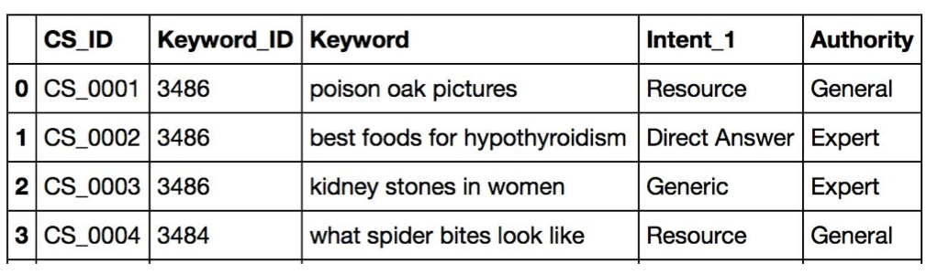
Data Set Selection
~100k Health keywords
Sent to CrowdSource and labeled for User Intent
Additional parameters: Authority, Temporal, Location Dependent

Slide 12
Labeled Data Exploration

Slide 13
Labeled Data Exploration

Slide 14
Building a Model
CountVectorizer
TFIDFTransformer
SGDClassifier for GEN/DA Model
LinearSVM for Multiclass Model

Slide 15
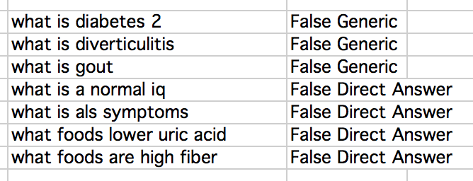
Challenges: Labeler Error
Generic/DA mistakes: ~450 contained the token “what”
…WTF?

Slide 16
Challenges: Unbalanced Classes
Guide and Resource were overrepresented in the data for the multiclass classifier
Oversample or undersample?
Guide | Resource
how to increase hormones | diet for kidney failure
facet arthropathy treatment | nummular dermatitis pictures
intertrigo treatment | sea lice bites pictures
treatment for eye | pics of bone cancer
home remedies for nasal drip | pictures of chronic urticaria
stomach bloating treatment | nmfc freight codes
hysteroscopy procedure | treatment plan forms
magnilife sciatica relief | eye exam charts
tooth pain relief | piles symptoms pictures
tooth abscess cure | tums dosage chart

Slide 17
Challenges: Definition Complexity
Definition Complexity: Why does NAV look so bad?

Slide 18
Results

Slide 19
Next Steps

