Slide 1
User intent Classification
Francesca Sapien, DAT SF 19

Slide 2
Project Background
Open-ended exploration of keyword portfolio
Already considered:
Segmenting by Topic: Health, Famous People, Vehicles
Segmenting by Popularity: Clicks, time on page, etc.
Not considered:
User Intent : What is the user trying to obtain or accomplish when they type in a given keyword?

Slide 3
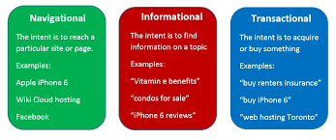
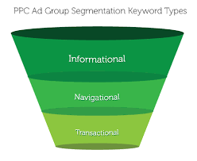

What is User Intent?
Popular Papers: Jansen & Booth, 2007

Slide 4
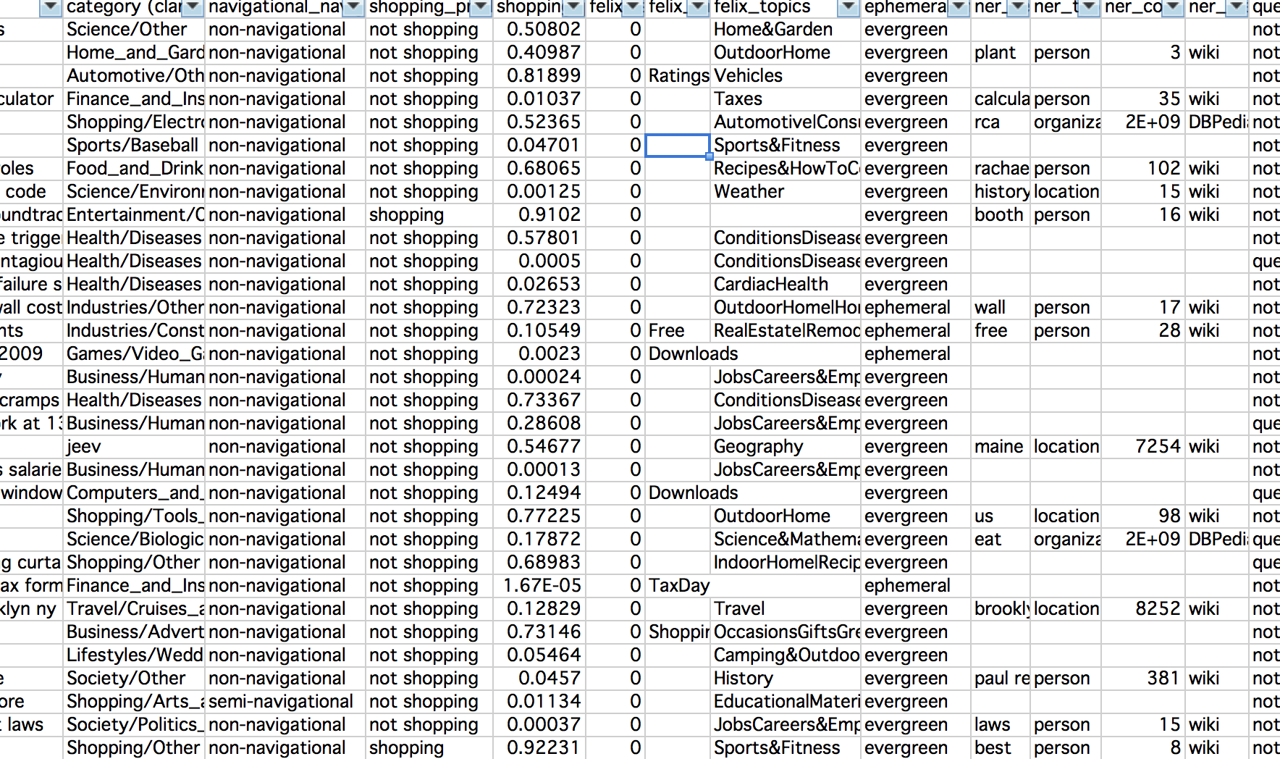
Creating Intent Classes

Slide 5
User Intent Classes
Informational
User is trying to obtain information about a topic (generally appropriate to surface text)
Resource
User is trying to obtain a specific resource that can either be accessed online or downloaded.
Navigational
User is trying to navigate to a website or resource hosted on a specific website.
Transactional
User is trying to purchase an item.

Slide 6
User Intent Classes
Informational Classes
Generic: "Show/tell me anything about my topic”
Direct Answer: “Show/tell me X about my topic”
Guide: How-to, instructions, recipes
Navigational Class
Includes biz names & gov agencies, without context
Resource Class
Includes streamable or downloadable resources
Transactional
Explicit and implicit transactional intent. Includes product names.

Slide 7
Exploratory Data Analysis
Initial Labeling
Top performing keywords (cross-categorical)
Random keywords (cross-categorical)
Samples of top-performing subject categories: Health, Vehicles, Home&Garden, Travel
Key Takeaways
Intent classes can have very different structure across subject categories:
Resource KW in Health: charts, graphs
Resource KW in Vehicles: diagram, manuals
Subject categories often have an overall “theme” and feature one or two major intent classes:
Vehicles: Transactional/Resource
Health: Informational
Notes:
- For some intents, patterns tend to be more important than tokens

Slide 8
Exploratory Data Analysis

Slide 9
Large-Scale Labeling: Data Set Selection
Top-performing KW in the Health subject category
Why Health?
Strong definition and thematically consistent
Unambiguous keywords
High user engagement
Notes:
- Home&Garden has everything from getting rid of moles to values of antique furniture

Slide 10
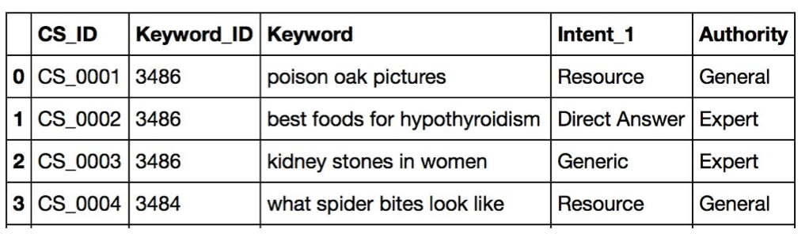
Labeled Data Set
~100k Health keywords
Sent to CrowdSource and labeled for User Intent
Additional parameters: Authority, Temporal, Location Dependent

Slide 11
Labeled Data Exploration
Generic 42953
Dir. Answer 36731
Guide 9008
Resource 7064
Navigational 1226
Transaction 1158

Slide 12

Labeled Data Exploration
Notes:
TF-IDF most frequent terms, most frequent bigrams etc.
Helped me make choices about whether or not to use certain methods on the data– conventional stopword lists not a good idea, for example

Slide 13
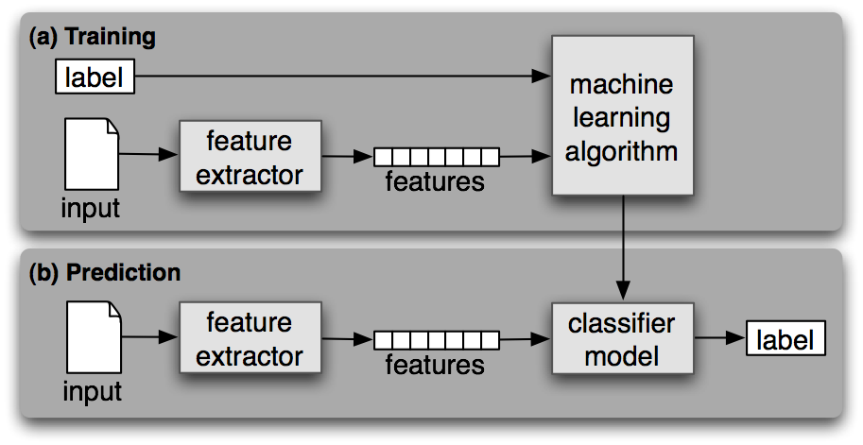
Building a Text Classification Model
Image from nltk.org

Slide 14
Model Selection: Experiments
Text Pre-Processing
Remove stop words?
Remove numerals and characters?
Stem/Lemmatize?
Feature Extraction
CountVectorizer
TFIDFTransformer
Models
Naïve Bayes
LinearSVM
SGDClassifier (linear SVM with some additional training)

Slide 15
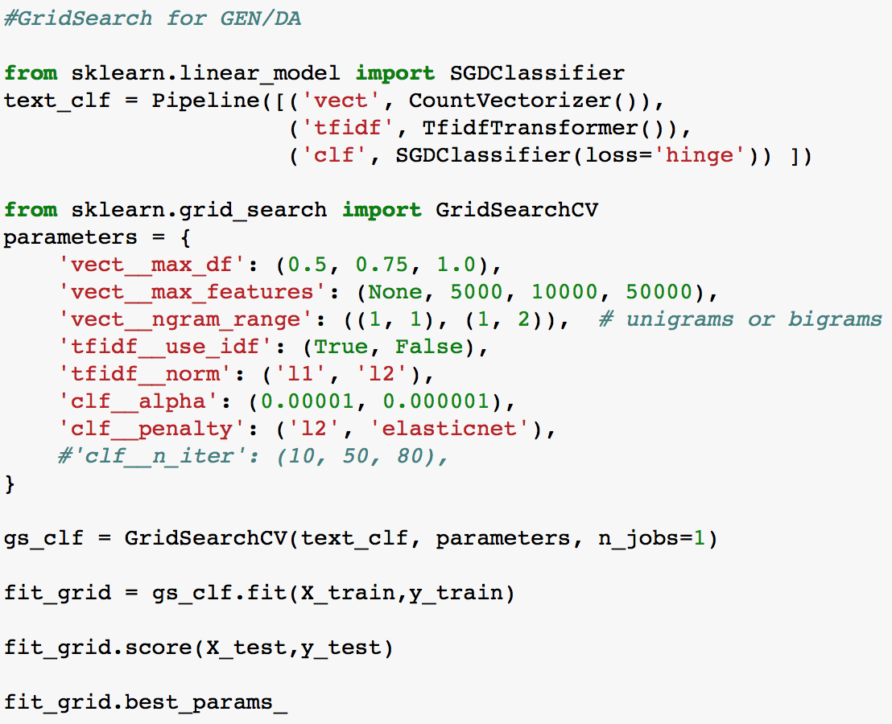
Model Selection: GridSearch!

Slide 16
Finally!
Text Pre-Processing
Stopword list: Constrained, manually created.
Remove numerals and misc characters: Yes.
Stem/Lemmatize: Nope.
Feature Extraction
CountVectorizer: Parameters via GridSearch
TFIDFTransformer: Parameters via GridSearch
Model
Binary SGDClassifier for Generic/Direct Answer
Multiclass SGDClassifier for smaller user intent classes

Slide 17
Results
Generic/Direct Answer Model (Binary)
Confusion Matrix
Class Name | Precision | Recall | F1-Score | Support
Generic | 0.8 | 0.92 | 0.86 | 10764
Direct Answer | 0.88 | 0.74 | 0.8 | 9157
Avg/Total | 0.84 | 0.83 | 0.83 | 19921
 | Actual Generic | Actual Direct Answer
Pred. Generic | 9848 | 916
Pred. Direct Answer | 2430 | 6727
Notes:
AUC Score: 0.824765384492
Cross Validated Accuracy: 0.828346165856

Slide 18
Results
Other Intents Model (Multiclass)
Confusion Matrix
Class Name | Precision | Recall | F1-Score | Support
Guide | 0.98 | 0.98 | 0.98 | 2197
Navigational | 0.82 | 0.94 | 0.88 | 299
Resource | 0.98 | 0.96 | 0.97 | 1800
Transactional | 0.97 | 0.94 | 0.95 | 318
Avg/Total | 0.97 | 0.97 | 0.97 | 4614
 | Actual HOW | Actual NAV | Actual RES | Actual BUY
Pred. HOW | 2166 | 9 | 20 | 2
Pred. NAV | 2 | 281 | 12 | 4
Pred. RES | 33 | 43 | 1722 | 2
Pred. BUY | 3 | 13 | 4 | 298
Notes:
Cross Validated Accuracy: 0.96266718674

Slide 19
Challenges:
Labeler Error: Generic/DA mistakes: ~450 contained the token “what”
Unbalanced Classes
Definition Complexity
Notes:
Unbalanced classes: class_weight

Slide 20
Next Steps
User Intent Classes
Experiment with clustering
Improve Feature Extraction/Feature Engineering
Named Entity recognition
Stemming/Lemmatization
Word2Vec/Gensim
Model Improvements
Implement “confidence score” (decision_function)
Remake with final user intent classes
Attempt with cross-categorical data

