Slide 1
Black Holes as the Fundamental Force of the Universe
Francisco Gonçalves

Slide 2
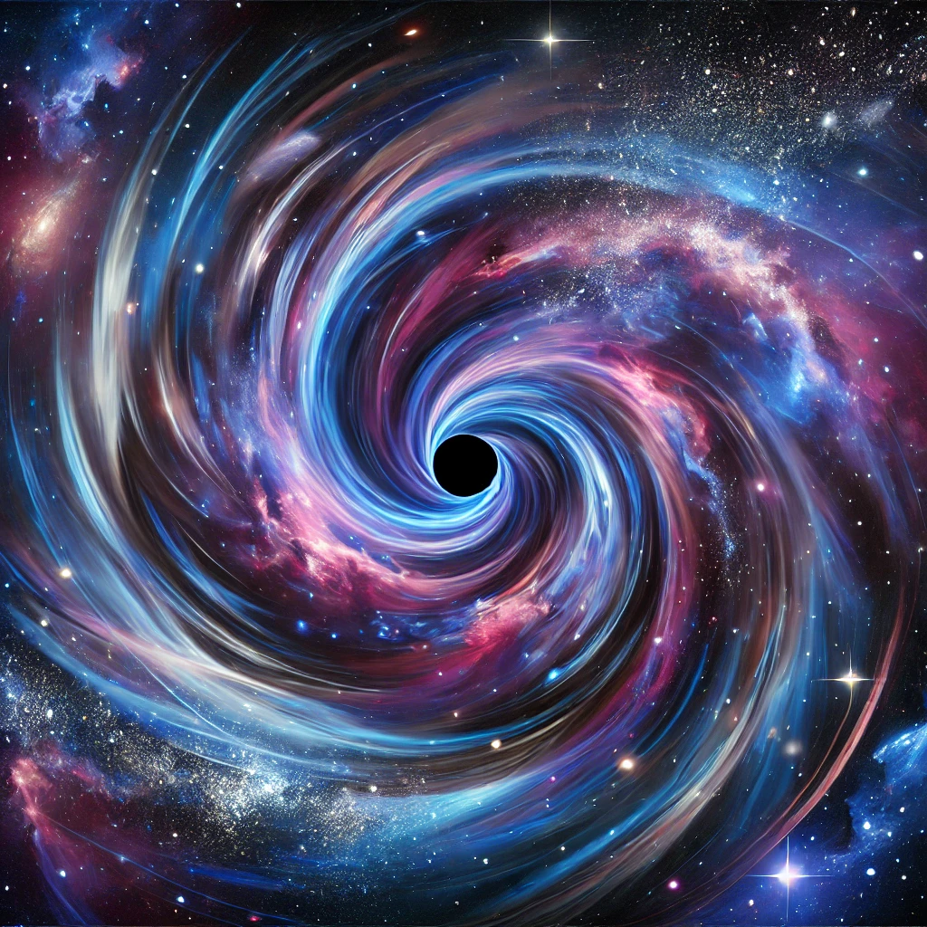
Introduction
The problem of dark matter and dark energy. Limitations of the Lambda-CDM model.

Slide 3
Theory Origin
Primordial and formed black holes as gravitational engines of the universe.

Slide 4
Core Proposal
Black holes as dominant force, replacing dark matter.

Slide 5
Universe Expansion
Hawking radiation may explain cosmic acceleration. Dark energy as a dynamic effect.

Slide 6
Big Crunch vs Big Freeze
Potential cosmic collapse: expansion and contraction cycles.

Slide 7
Recent DESI Data
Dark energy's force may be weakening. Scientists suggest a paradigm shift.

Slide 8
Theory Alignment
DESI data supports the hypothesis of black holes as fundamental force.

Slide 9
Testing the Hypothesis
CMB, LIGO, JWST may help validate the theory.

Slide 10
Conclusion
A new way to understand the cosmos. Speculative theory with growing empirical support.

Slide 11
References
DESI data, LIGO studies, cosmological literature.

Slide 12
Thank You!
Francisco Gonçalves
Email: francis.goncalves@gmail.com
Open to discussion and collaboration.

